Slide 1
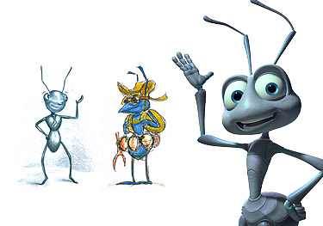
Swarm Intelligence

Slide 2
Outline
Background
  What is a Swarm Intelligence (SI)?
  Examples from nature
  Origins and Inspirations of SI
Ant Colony Optimization

Slide 3
What is a Swarm?
A loosely structured collection of interacting agents
  Agents:
    Individuals that belong to a group (but are not necessarily identical)
    They contribute to and benefit from the group
    They can recognize, communicate, and/or interact with each other
The instinctive perception of swarms is a group of agents in motion – but that does not always have to be the case.
A swarm is better understood if thought of as agents exhibiting a collective behavior

Slide 4
Swarm Intelligence (SI)
An artificial intelligence (AI) technique based on the collective behavior in decentralized, self-organized systems
Generally made up of agents who interact with each other and the environment
No centralized control structures
Based on group behavior found in nature

Slide 5
Examples of Swarms in Nature:
Classic Example: Swarm of Bees
Can be extended to other similar systems:
  Ant colony
    Agents: ants
  Flock of birds
    Agents: birds
  Traffic
    Agents: cars
  Crowd
    Agents: humans
  Immune system
    Agents: cells and molecules

Slide 6
Two Common SI Algorithms
Inspiration from swarm intelligence has led to some highly successful optimisation algorithms.
  Ant Colony (-based) Optimisation – a way to solve optimisation problems based on the way that ants indirectly communicate directions to each other.
  Particle Swarm Optimisation — a different way to solve optimisation problems, based on the swarming behaviour of several kinds of organisms.

Slide 7
Biologically Inspired Computation
Ant Colony Optimisation

Slide 8
Ant Colony Optimization (ACO)
The study of artificial systems modeled after the behavior of real ant colonies and are useful in solving discrete optimization problems
Introduced in 1992 by Marco Dorigo
  Originally called it the Ant System (AS)
  Has been applied to
    Traveling Salesman Problem (and other shortest path problems)
    Several NP-hard Problems
It is a population-based metaheuristic used to find approximate solutions to difficult optimization problems

Slide 9
Overview
“Ant Colony Optimization (ACO) studies artificial systems that take inspiration from the behavior of real ant colonies and which are used to solve discrete optimization problems.”
-Source: ACO website, http://iridia.ulb.ac.be/~mdorigo/ACO/about.html

Slide 10
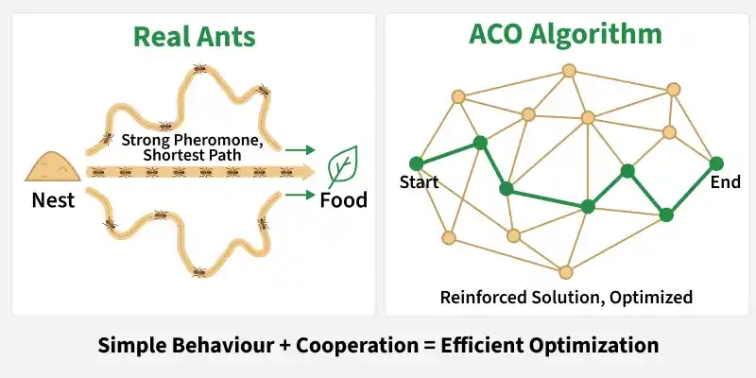
Ant Colony Optimization (ACO) is a nature-inspired algorithm that learns from how real ants collectively find the shortest path to food without any central control. Instead of fixed rules, it improves solutions over time through simple behaviour and cooperation making it effective for complex optimization problems. In nature, ants follow a simple process like:
They move randomly and leave a pheromone trail
Shorter paths gather pheromones faster
More ants follow stronger trails
Over time, the shortest path becomes dominant

Slide 11
Artificial Ants
A set of software agents
Stochastic
Based on the pheromone model
  Pheromones are used by real ants to mark paths. Ants follow these paths (i.e., trail-following behaviors)
Incrementally build solutions by moving on a graph
Constraints of the problem are built into the heuristics of the ants

Slide 12
A key concept: Stigmergy
Stigmergy is:
indirect communication via interaction with the environment.
    A problem gets solved bit by bit ..
    Individuals communicate with each other in the above way, affecting what each other does on the task.
    Individuals leave markers or messages – these don’t solve the problem in themselves, but they affect other individuals in a way that helps them solve the problem …

Slide 13
Key Components
Ant Colony Optimization is built on a few core components that work together to guide the search toward optimal solutions.
Ants: Simple agents that explore the problem space and construct solutions step by step.
Pheromone trails: Numerical values that store past experience and indicate which paths are more promising.
Heuristic information: Problem specific knowledge such as distance, cost or time that helps ants make informed decisions.
Probability based movement: Ants choose paths using probabilities influenced by pheromones and heuristic values, rather than fixed rules.
Pheromone evaporation: Pheromone levels gradually decrease over time, preventing premature convergence and encouraging continued exploration.

Slide 14

Naturally Observed Ant Behavior
All is well in the world of the ant.
Notes:
Was first introduced in Marco Dorigo’s Ph.D. thesis.
As we have seen, the TSP provides an excellent test environment…
In problems like the quadratic assignment problem and the sequential ordering problem these ACO algorithms outperform all known algorithms on vast classes of benchmark problems.

Slide 15
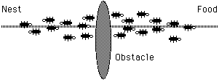
Naturally Observed Ant Behavior
Oh no! An obstacle has blocked our path!
Notes:
Was first introduced in Marco Dorigo’s Ph.D. thesis.
As we have seen, the TSP provides an excellent test environment…
In problems like the quadratic assignment problem and the sequential ordering problem these ACO algorithms outperform all known algorithms on vast classes of benchmark problems.

Slide 16
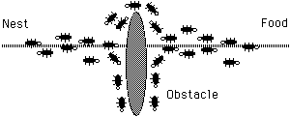
Naturally Observed Ant Behavior
Where do we go? Everybody, flip a coin.
Notes:
Was first introduced in Marco Dorigo’s Ph.D. thesis.
As we have seen, the TSP provides an excellent test environment…
In problems like the quadratic assignment problem and the sequential ordering problem these ACO algorithms outperform all known algorithms on vast classes of benchmark problems.

Slide 17
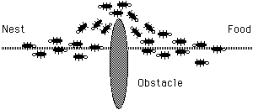
Naturally Observed Ant Behavior
Shorter path reinforced.
Notes:
Was first introduced in Marco Dorigo’s Ph.D. thesis.
As we have seen, the TSP provides an excellent test environment…
In problems like the quadratic assignment problem and the sequential ordering problem these ACO algorithms outperform all known algorithms on vast classes of benchmark problems.

Slide 18
Stigmergy in Ants
Ants are behaviorally unsophisticated, but collectively they can perform complex tasks.
Ants have highly developed sophisticated sign-based stigmergy
  They communicate using pheromones;
  They lay trails of pheromone that can be followed by other ants.
If an ant has a choice of two pheromone trails to follow, one to the NW, one to the NE, but the NW one is stronger – which one will it follow?

Slide 19
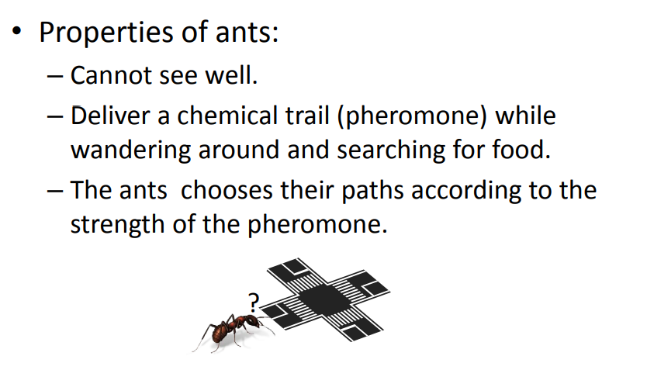

Slide 20
Pheromone Trails
Individual ants lay pheromone trails while travelling from the nest, to the food or possibly in both directions.
The pheromone trail gradually evaporates over time.
But pheromone trail strength accumulate with multiple ants using path.
_{Nest}
_{Food source}

Slide 21
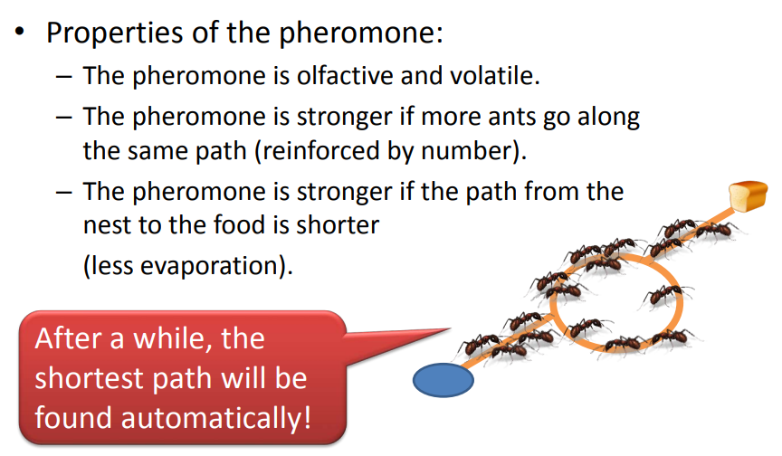

Slide 22
Pheromone Trails continued
Initial state:
no ants
τ = 15
τ = 30
τ = 15
τ = 30

Slide 23
Ant Colony Optimisation Algorithms: Basic Ideas
Ants are agents that:
Move along between nodes in a graph.
They choose where to go based on pheromone strength.
An ant’s path represents a specific candidate solution.
When an ant has finished a solution, pheromone is laid on its path, according to quality of solution.
This pheromone trail affects behaviour of other ants by `stigmergy’ …

Slide 24
Using ACO
The optimization problem must be written in the form of a path finding problem with a weighted graph
The artificial ants search for “good” solutions by moving on the graph
  Ants can also build infeasible solutions – which could be helpful in solving some optimization problems
The metaheuristic is constructed using three procedures:
  ConstructAntsSolutions
  UpdatePheromones
  DaemonActions

Slide 25
Construct Ants Solutions
Manages the colony of ants
Ants move to neighboring nodes of the graph
Moves are determined by stochastic local decision policies based on pheromone trails and heuristic information
Evaluates the current partial solution to determine the quantity of pheromones the ants should deposit at a given node

Slide 26
Update Pheromones
Process for modifying the pheromone trails
Modified by
  Increase
    Ants deposit pheromones on the nodes (or the edges)
  Decrease
    Ants don’t replace the pheromones and they evaporate
Increasing the pheromones increases the probability of paths being used (i.e., building the solution)
Decreasing the pheromones decreases the probability of the paths being used (i.e., forgetting)

Slide 27
Daemon Actions
Used to implement larger actions that require more than one ant
Examples:
  Perform a local search
  Collection of global information

Slide 28
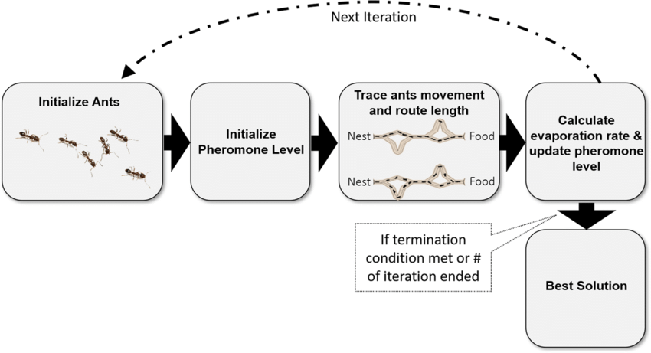
ACO Steps

Slide 29
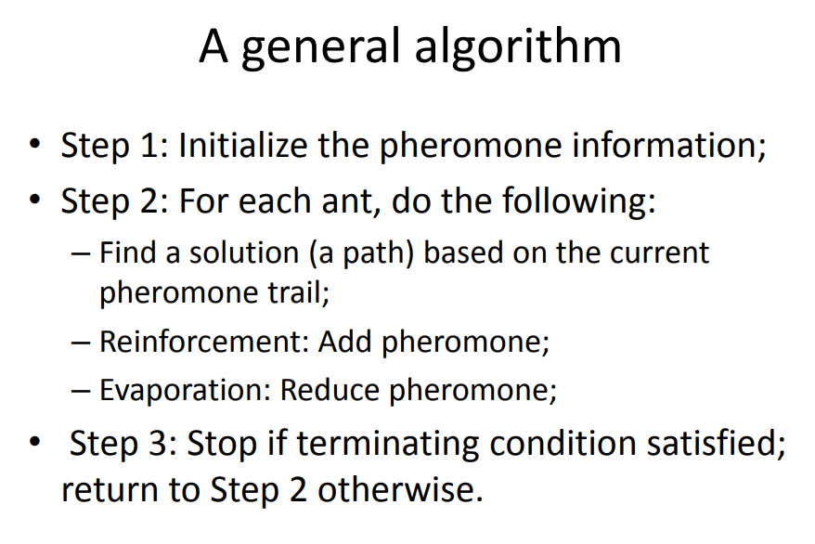

Slide 30
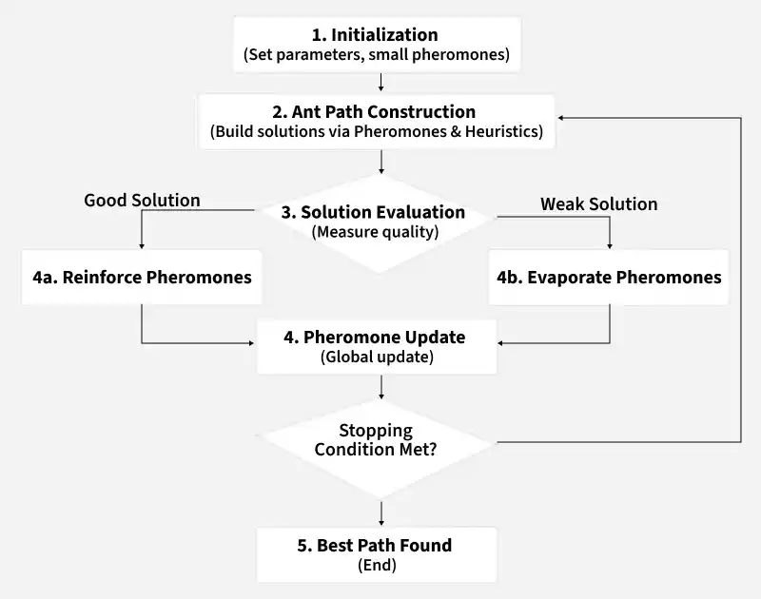
How it Works
Ant Colony Optimization operates through an iterative loop that progressively refines solutions based on collective learning.

Slide 31
Initialization: Set initial parameters and assign small pheromone values to all paths.
Ant path construction: Each ant builds a solution by moving through the problem space based on pheromones and heuristic information.
Solution evaluation: The quality of each solution is measured using a fitness or cost function.
Pheromone update: Good solutions receive more pheromone reinforcement, while pheromones on other paths evaporate.
Iteration until best path is found: The process repeats until a stopping condition is met or the best path is discovered.

Slide 32
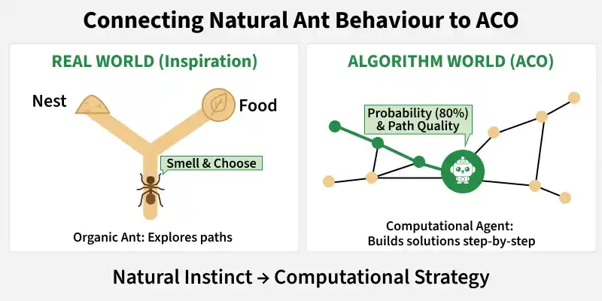
Turning Ant Behaviour into a Problem Solving Strategy
Ant Colony Optimization converts the natural behaviour of ants into a computational problem solving framework, where simple agents collectively build high quality solutions.
Ants as agents: In ACO, each ant is a simple computational agent that constructs a solution step by step, similar to how real ants explore routes.
Pheromones as memory: Pheromones are numerical values assigned to paths, representing how effective those paths were in previous solutions.
Nodes and paths: Nodes represent possible states or locations, while paths represent transitions between them, similar to routes between a nest and food.
Decision making: Ants select paths probabilistically, considering both pheromone strength and path quality instead of following fixed rules.

Slide 33
Applications Of ACO
Vehicle routing with time window constraints
Network routing problems
Assembly line balancing
Heating oil distribution
Data mining

Slide 34
E.g. A 4-city TSP
Initially, random levels of pheromone are scattered on the edges
A
B
D
Pheromone
C
AB: 10, AC: 10, AD, 30, BC, 40, CD 20
Ant

Slide 35
E.g. A 4-city TSP
An ant is placed at a random node
A
B
D
Pheromone
C
AB: 10, AC: 10, AD, 30, BC, 40, CD 20
Ant

Slide 36
E.g. A 4-city TSP
The ant decides where to go from that node,
based on probabilities
calculated from:
- pheromone strengths,
- next-hop distances.
Suppose this one chooses BC
A
B
D
Pheromone
C
AB: 10, AC: 10, AD, 30, BC, 40, CD 20
Ant

Slide 37
E.g. A 4-city TSP
The ant is now at C, and has a `tour memory’ = {B, C} – so he cannot
visit B or C again.
Again, he decides next hop
(from those allowed) based
on pheromone strength
and distance;
suppose he chooses
CD
A
B
D
Pheromone
C
AB: 10, AC: 10, AD, 30, BC, 40, CD 20
Ant

Slide 38
E.g. A 4-city TSP
The ant is now at D, and has a `tour memory’ = {B, C, D}
There is only one place he can go now:
A
B
D
Pheromone
C
AB: 10, AC: 10, AD, 30, BC, 40, CD 20
Ant

Slide 39
E.g. A 4-city TSP
So, he has nearly finished his tour, having gone over the links:
BC, CD, and DA.
A
B
D
Pheromone
C
AB: 10, AC: 10, AD, 30, BC, 40, CD 20
Ant

Slide 40
E.g. A 4-city TSP
So, he has nearly finished his tour, having gone over the links:
BC, CD, and DA. AB is added to complete the round trip.
A
B
Now, pheromone on the tour
is increased, in line with the
fitness of that tour.
D
Pheromone
C
AB: 10, AC: 10, AD, 30, BC, 40, CD 20
Ant

Slide 41
E.g. A 4-city TSP
A
B
Next, pheromone everywhere
is decreased a little, to model
decay of trail strength over
time
D
Pheromone
C
AB: 10, AC: 10, AD, 30, BC, 40, CD 20
Ant

Slide 42
E.g. A 4-city TSP
We start again, with another ant in a random position.
A
B
Where will he go?
Next , the actual algorithm
and variants.
D
Pheromone
C
AB: 10, AC: 10, AD, 30, BC, 40, CD 20
Ant

Slide 43
The ACO algorithm for the TSP
We have a TSP, with n cities.
1. We place some ants at each city. Each ant then does this:
    It makes a complete tour of the cities, coming back to its starting city, using a transition rule to decide which links to follow. By this rule, it chooses each next-city at random, but based partly by the pheromone levels existing at each path, and based partly by heuristic information.
2. When all ants have completed their tours.
Global Pheromone Updating occurs.
    The current pheromone levels on all links are reduced (I.e. pheromone levels decay over time).
    Pheromone is laid (belatedly) by each ant as follows: it places pheromone on all links of its tour, with strength depending on how good the tour was.

Slide 44
The ACO algorithm for the TSP
[a simplified version with all essential details]
We have a TSP, with n cities.
1. We place some ants at each city. Each ant then does this:
    It makes a complete tour of the cities, coming back to its starting city, using a transition rule to decide which links to follow. By this rule, it chooses each next-city at random, but biased partly by the pheromone levels existing at each path, and biased partly by heuristic information.
2. When all ants have completed their tours.
Global Pheromone Updating occurs.
    The current pheromone levels on all links are reduced (I.e. pheromone levels decay over time).
    Pheromone is lain (belatedly) by each ant as follows: it places pheromone on all links of its tour, with strength depending on how good the tour was.
Then we go back to 1 and repeat the whole process many times, until we reach a termination criterion.

Slide 45

  ACO Algorithm
  Set all parameters and initialize the pheromone trails
  Loop
  Sub-Loop
      Construct solutions based on the state transition rule
      Apply the online pheromone update rule
      Continue until all ants have been generated
    Apply Local Search
    Evaluate all solutions and record the best solution so far
    Apply the offline pheromone update rule
  Continue until the stopping criterion is reached

Slide 46
ACO System, cont.
Often applied to TSP (Travelling Salesman Problem): shortest path between n nodes
Algorithm in Pseudocode:
  Initialize Trail
  Do While (Stopping Criteria Not Satisfied) – Cycle Loop
    Do Until (Each Ant Completes a Tour) – Tour Loop
    Local Trail Update
    End Do
    Analyze Tours
    Global Trail Update
  End Do

Slide 47
Ant Systems Algorithm for TSP
Initialize
Place each ant in a randomly chosen city
For Each Ant
Choose NextCity(For Each Ant)
yes
more cities
to visit
No
Return to the initial cities
Update pheromone level using the tour cost for each ant
No
Stopping
criteria
yes
Print Best tour

Slide 54
Ant Colony Optimization
Characteristics of the algorithm
• An ant is a solution.
• Solutions (ants) are at different places in the solution space.
• How they change is based on the probability of changing to a different schedule.
• An ant completes its tour after selection a choice for each stand.
• Utilities (objective function values) of each tour are calculated.
• Pheromone levels are updated after all of the ants have completed all of
their tours.

Slide 55
Ant Colony Optimization
Characteristics of the algorithm
The probability of moving from Point A to Point B
depends on the attractiveness of the move and the
trail level.
Attractiveness - an a priori desirability (typically
based on the inverse distance) of the move.
Trail level - an a posteriori, computed attractiveness.
This is computed after an ant completes a solution,
increasing or decreasing the desirabilities of
components of a solution.
A
?
C
B

Slide 56
Ant Colony Optimization
Characteristics of the algorithm
Amounts of pheromones are updated after
a solution has been generated.
(1-p) prior pheromone + Δpheromone
Where:
p = a coefficient related to the evaporation rate.
if A→B path is used, pheromone levels increase
Δpheromone = Q / L_{k}
Where:
Q = a constant
L_{k} = solution length (quality)
Else pheromone levels decrease, since in this case
Δpheromone = 0
A
?
C
B

Slide 57
Ant Colony Optimization
Advantages:
• It is intuitive to biologically-minded people, mimicking nature.
• The system is built on positive feedback (pheromone attraction)
and negative attractiveness (pheromone evaporation).
• Pheromone evaporation helps avoid convergence to a local optima.
Disadvantages:
• For routing problems it may make more sense, but for harvest
scheduling problems, it requires a conceptual leap of faith.
• Fine-tuning the sensitive parameters may require significant effort.

Slide 58
Ant Colony Optimization
Necessary parameters
1) The initial population of ants (an ant cycle).
2) The total number of tours.
3) The evaporation rate.
4) The amount of pheromone applied to a section of a cycle or solution.
5) The constant Q.

Slide 59
Methodology
Parameters of ACO Algorithm
      : Pheromone trail of combination (i,j)
      : Local heuristic of combination (i,j)
      : Transition probability of combination (i,j)
      : Relative importance of pheromone trail
      : Relative importance of local heuristic
      : Determines the relative importance of exploitation versus exploration
      : Trail persistence (pheromone decay rate)

Slide 60
The transition rule
is the amount of pheromone currently on the path that goes
directly from city i to city j.
is the heuristic value of this link – in the classic TSP
application, this is chosen to be 1/distance(i,j) -- i.e. the shorter
the distance, the higher the heuristic value.
is the probability that ant k will choose the link that goes
from i to j
State Transition Probability:
Where our ant is at city i, and j is a city as yet unvisited on its
tour, and the summation is over all of k’s unvisited cities

Slide 61

Global pheromone update
is amount of pheromone added to the (i, j) link by ant k.
NA is the number of ants
is a parameter called the pheromone decay rate.
L_{k} is the length of the tour completed by ant k
at the next iteration becomes:
Pheromone evaporation
Where

Slide 62
Generate initial ants
Ant Colony Optimization
For all ants,
develop an ant tour
Basic Process
Assess the quality of the
ant tours
Change probabilities of
pieces of each
potential tour
Update pheromone levels
Has the
best solution
been improved?
Yes
Save best solution
No
Have we
reached the
stopping
criteria?
No
Yes
Stop and report
the best solution
found during search

Slide 63
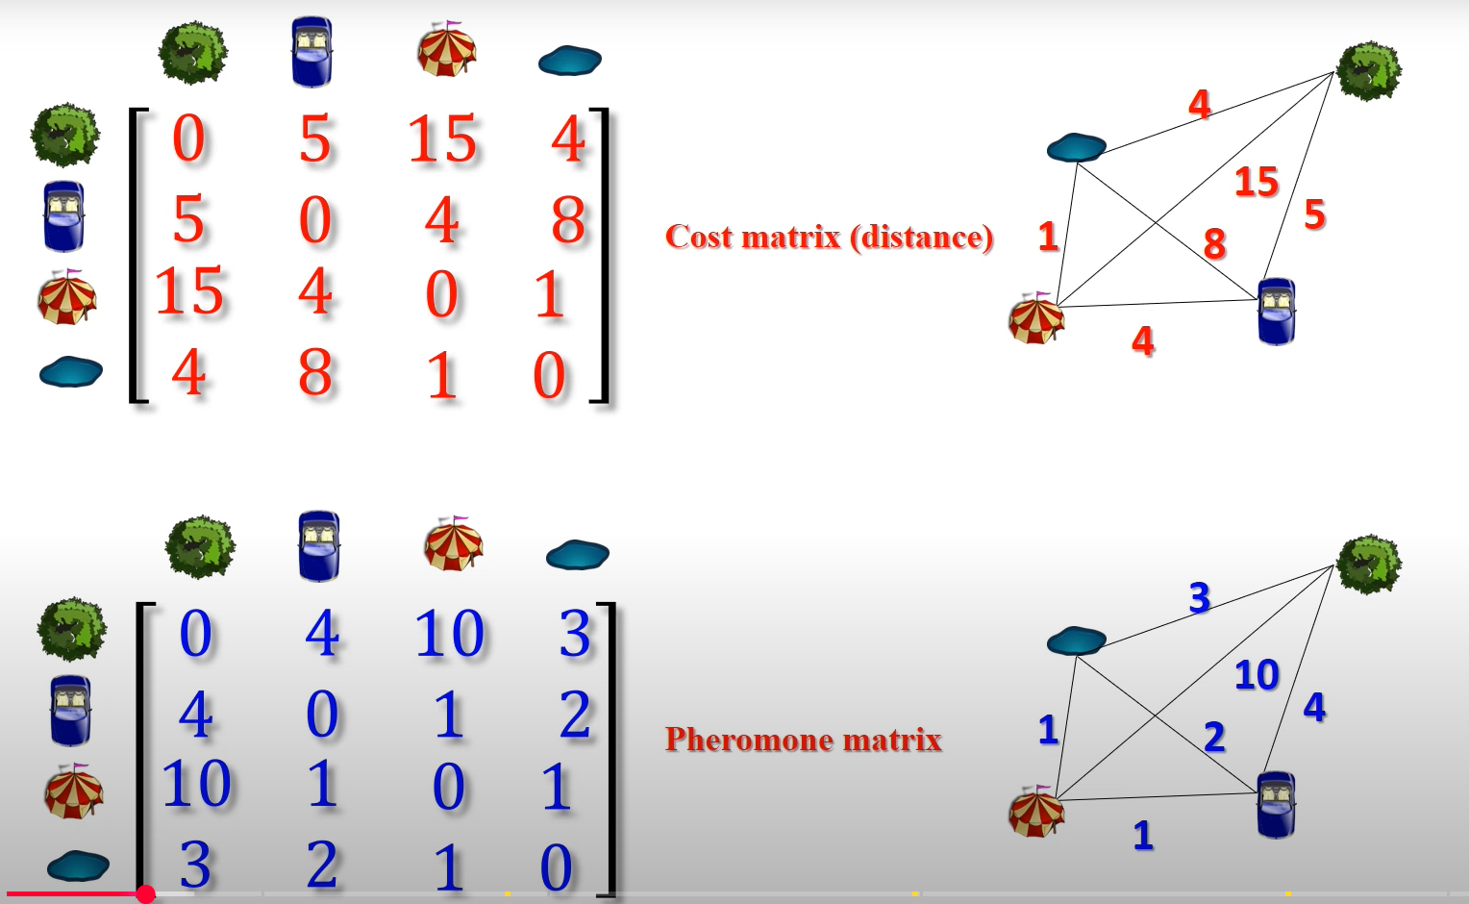
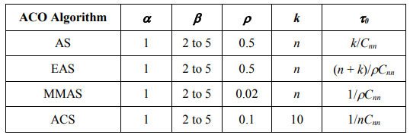
A simple TSP example

Slide 64
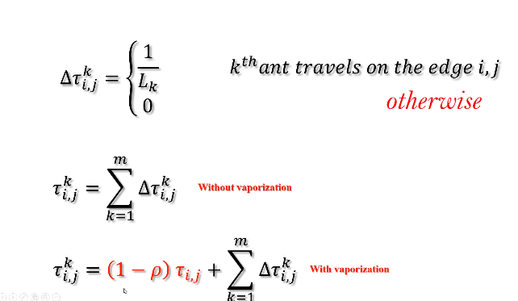
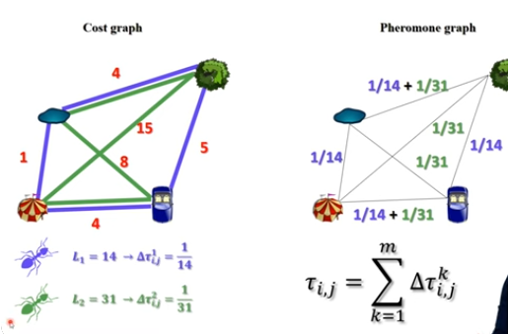
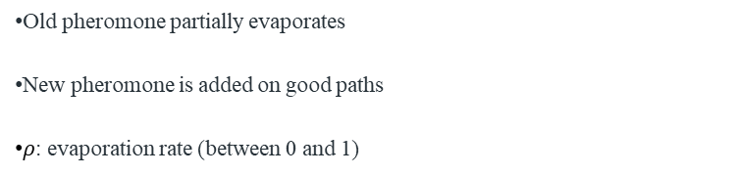
Pheromone Added by an Ant
Each ant adds pheromone based on path quality:
Pheromone Update Rule
After all ants complete their paths, pheromones are updated:
Old pheromone partially evaporates
New pheromone is added on good paths
$ρ$: evaporation rate (between 0 and 1)

Slide 65
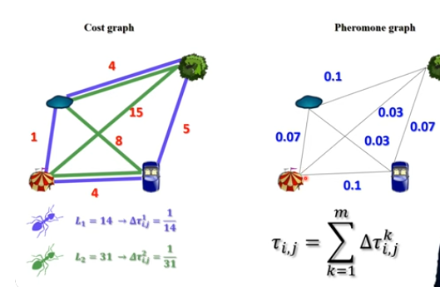

Slide 66
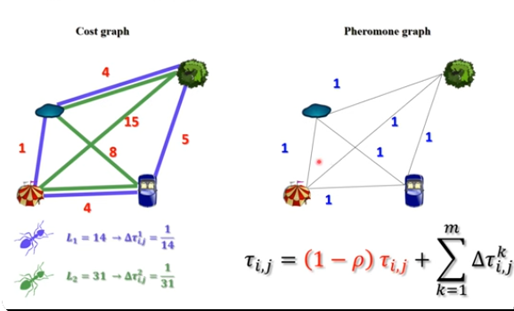

Slide 67
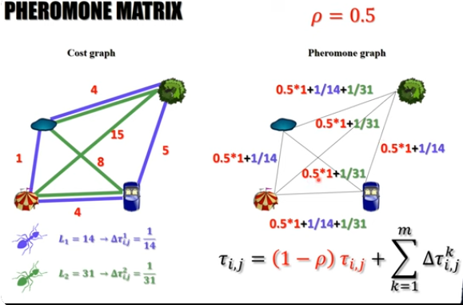

Slide 68
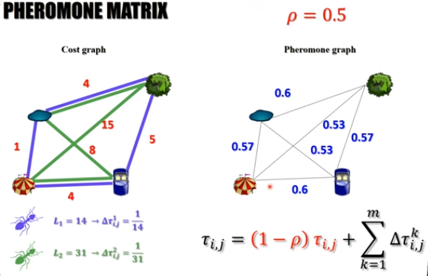

Slide 69
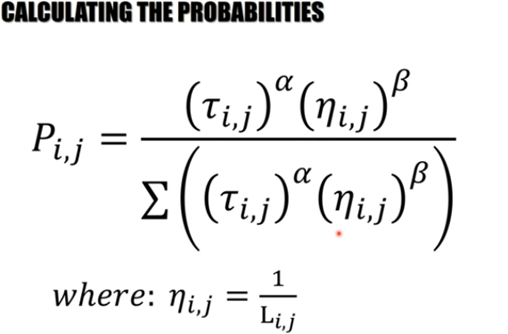

Slide 70
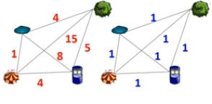
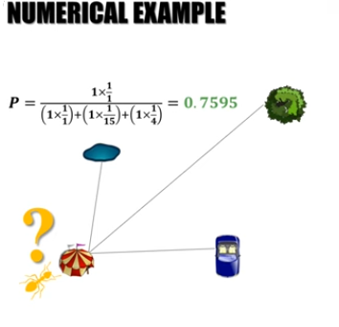
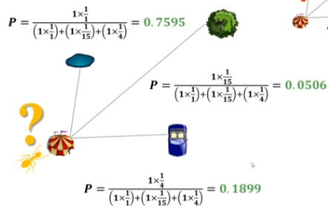
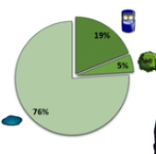

Slide 71
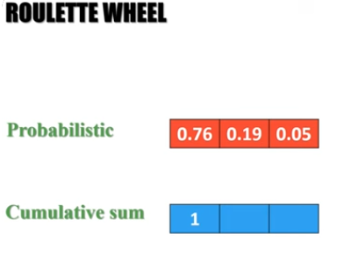
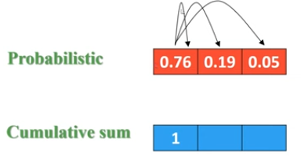
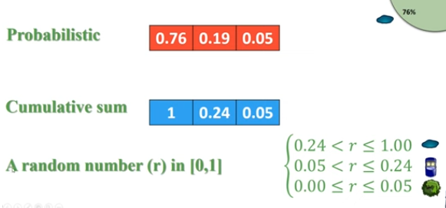
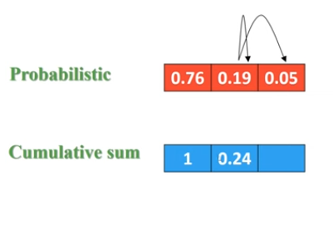
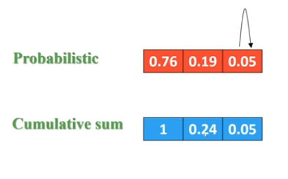

Slide 72

A simple TSP example
[]
1
[]
A
B
2
[]
C
3
[]
4
D
E
[]
d_{AB} =100;d_{BC} = 60…;d_{DE} =150
5

Slide 73
Iteration 1
[A]
[B]
1
A
2
B
[C]
3
C
[D]
[E]
D
5
4
E

Slide 74
How to build next sub-solution?
[A]
1
A
B
[A]
1
[A]
C
1
[A,D]
[A]
1
1
D
E

Slide 75
Iteration 2
[E,A]
[C,B]
5
A
3
B
[B,C]
2
C
[A,D]
[D,E]
1
D
4
E

Slide 76
Iteration 3
[D,E,A]
[E,A,B]
4
5
A
B
[A,D,C]
1
C
[B,C,D]
[C,B,E]
2
D
3
E

Slide 77
Iteration 4
[B,C,D,A]
[D,E,A,B]
2
A
4
B
[E,A,B,C]
5
C
[C,B,E,D]
[A,DCE]
D
3
1
E

Slide 78
Iteration 5
[C,B,E,D,A]
[A,D,C,E,B]
3
1
A
B
[D,E,A,B,C]
4
C
[E,A,B,C,D]
[B,C,D,A,E]
D
5
E
2

Slide 79
Path and Pheromone Evaluation
[A,D,C,E,B]
L₁ =300
1
[B,C,D,A,E]
L₂ =450
2
[C,B,E,D,A]
L₃ =260
3
[D,E,A,B,C]
L₄ =280
4
[E,A,B,C,D]
L₅ =420
5

Slide 80
End of First Run
Save Best Tour (Sequence and length)
All ants die
New ants are born

Slide 81
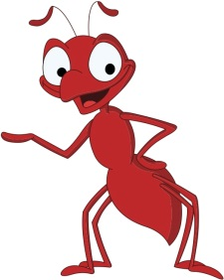
ACO algorithms for TSP
Ant System
Elitist Ant System
Rank-based Ant System
Ant Colony System
MAX-MIN Ant System

Slide 82
Ant System: Pheromone initialization
Pheromone initialization
Τ_{ij} = m / C^{nn},
where:
  m – number of ants
  C^{nn} – path length of nearest-neighbor algorithm

Slide 83
Ant System: Tour construction
Ant k is located in city i
is the neighborhood of city i
Probability to go to city :

Slide 84
Tour construction: comprehension
α = 0 – greedy algorithm
β = 0 – only pheromone is at work
  quickly leads to stagnation

Slide 85
Ant System: update pheromone trails – evaporation
Evaporation for all connections∀(i, j) ∈ L:
τ_{ij} ← (1 – ρ) τ_{ij},
ρ ∈[0, 1] – evaporation rate
Prevents convergence to suboptimal solutions

Slide 86
Ant System: update pheromone trails – deposit
T^{k} – path of ant k
C^{k} – length of path T^{k}
Ants deposit pheromone on visited arcs:

Slide 87
Elitist Ant System
Best-so-far ant deposits pheromone on each iteration:

Slide 88

Rank-based Ant System
Another improvement over AS.
Each ant deposits an amount of pheromone that decreases with its rank.
In each iteration, only the best (w-1) ranked ants and the best-so-far ant are allowed to deposit pheromone.

Slide 89
MAX-MIN Ant System
Only iteration-best or best-so-far ant deposits pheromone
Pheromone trails are limited to the interval [τ_{min,} τ_{max}]

Slide 90
Ant Colony System
Differs from Ant System in three points:
  More aggressive tour construction rule
  Only best ant evaporates and deposits pheromone
  Local pheromone update

Slide 91
Ant Colony System
Tour Construction
Local pheromone update:
τ_{ij} ← (1 – ξ)τ_{ij} + ξτ₀,

Slide 92
Ant-Q & Ant Colony System (ACS)
Local Updating
(Online Updating)
Global Updating
(Offline Updating)
Exploitation
Exploration

Slide 93
Not just for TSP of course
ACO is naturally applicable to any sequencing problem, or indeed any problem
All you need is some way to represent solutions to the problem as paths in a network.

Slide 94
E.g.
Single machine scheduling with due-dates
These jobs have to be done; their length represents the time they will take.
A
B
C
D
E

Slide 95
E.g.
Single machine scheduling with due-dates
These jobs have to be done; their length represents the time they will take.
Each has a `due date’, when it needs to be finished
A
3pm
3:30pm
5pm
4pm
4:30pm
B
C
D
E

Slide 96
E.g.
Single machine scheduling with due-dates
These jobs have to be done; their length represents the time they will take.
Each has a `due date’, when it needs to be finished
A
3pm
3:30pm
5pm
4pm
4:30pm
Only one `machine’ is available to process these jobs, so can do just one at a time.
[e.g. machine might be
human tailor, photocopier,
Etc …]
B
C
D
E

Slide 97
An example schedule
2 pm
3 pm
4 pm
5 pm
6 pm
A due 3pm
B – 3:30
C - 5pm
D – 4pm
E -4:30
A is 10min late Fitness might be average lateness;
B is 40min late in this case 46min
C is 20min early (lateness = 0)
D is 90min late or fitness could be Max lateness,
E is 90min late in this case 90min

Slide 98
Another schedule
2 pm
3 pm
4 pm
5 pm
6 pm
B – 3:30
A due 3pm
D – 4pm
E -4:30
C - 5pm
A is 70min late Fitness might be average lateness;
B is 30min early (0 lateness) in this case again 46min
C is 60min late
D is 50min late or fitness could be Max lateness,
E is 50min late in this case 70min

Slide 99
Applying ACO to this problem
Just like with the TSP, each ant finds paths in a network, where, in this case, each job is a node. Also, no need to return to start node – path is complete when every node is visited.

Slide 100
Initially, random levels of pheromone are scattered on the edges,
an ant starts at a Start node (so the first link it chooses defines
the first task to schedule on the machine); as before it uses a
transition rule to take one step at a time, biased by pheromone levels,
and also a heuristic score, each time choosing the next machine
to schedule.
A
B
E
Start
C
D

Slide 101
See here if you’re very interested in ACO:
http://iridia.ulb.ac.be/dorigo/ACO/ACO.html
ACO is a thriving and maturing research area – it has its own
conferences. It gets very good results on some difficult problems.
Following the above link will help you find examples.
ACO research and practice tends to concentrate on:
    hybridisation with other methods; e.g. it is common to
    improve an individual ant’s solution by local search, and then
    lay pheromone.
    New and adaptive ways to control the relative influence of
    heuristics, pheromone strength and pheromone decay.

Slide 102
Resources
Ant Colony Optimization by Marco Dorigo and Thomas Stϋtzle, The MIT Press, 2004
Swarm Intelligence by James Kennedy and Russell Eberhart with Yuhui Shi, Morgan Kauffmann Publishers, 2001
Advances in Applied Artificial Intelligence edited by John Fulcher, IGI Publishing, 2006
Data Mining: A Heuristic Approach by Hussein Abbass, Ruhul Sarker, and Charles Newton, IGI Publishing, 2002
“Ant Colony Optimization” Curatored by Marco Dorigo, http://www.scholarpedia.org/article/Ant_Colony_Optimization
“Ant Colony Optimization” by Marco Dorigo, http://iridia.ulb.ac.be/~mdorigo/ACO/ACO.htm;
“Particle Swarm Optimization” http://www.swarmintelligence.org
“Swarm Intelligence” http://en.wikipedia.org/wiki/Swarm_intelligence
Picture of Flik, http://www.pixar.com

