Slide 1
Informed Search Algorithms
Ahmet Ünveren

Slide 2
What is Search in Artificial Intelligence?
Search is the process of finding a sequence of actions that leads from an initial state to a goal state.
Examples:
Finding a route on Google Maps
Solving a maze
Playing games like chess
Robot path planning

Slide 3
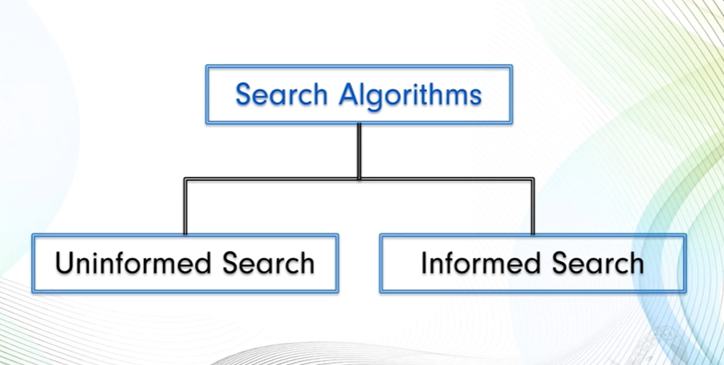
Classification of Search Algorithms
Uninformed (Blind) Search
No additional knowledge about the problem
Explore blindly
Examples:
  Depth First Search (DFS)
  Breadth First Search (BFS)
  Uniform Cost Search (UCS)
Informed (Heuristic) Search
Uses additional knowledge (heuristics)
Guides the search towards the goal
More efficient than uninformed search

Slide 4
What are Informed Search Algorithms?
Informed Search Algorithms use a heuristic function to estimate how close a current state is to the goal.
Instead of exploring blindly, informed search makes intelligent decisions about which node to expand next.

Slide 5
Heuristic Function (h(n))
Definition:
A heuristic function, denoted as h(n), estimates the cost from node n to the goal.
Characteristics:
Problem-specific
Computed quickly
Guides the search
Example:
In route finding:
h(n) = straight-line distance from city n to destination

Slide 6

Why Use Informed Search?
Uninformed search suffers from:
Large search space
High time complexity
Unnecessary node expansions
Informed search:
Reduces search space
Improves efficiency
Finds solutions faster

Slide 7
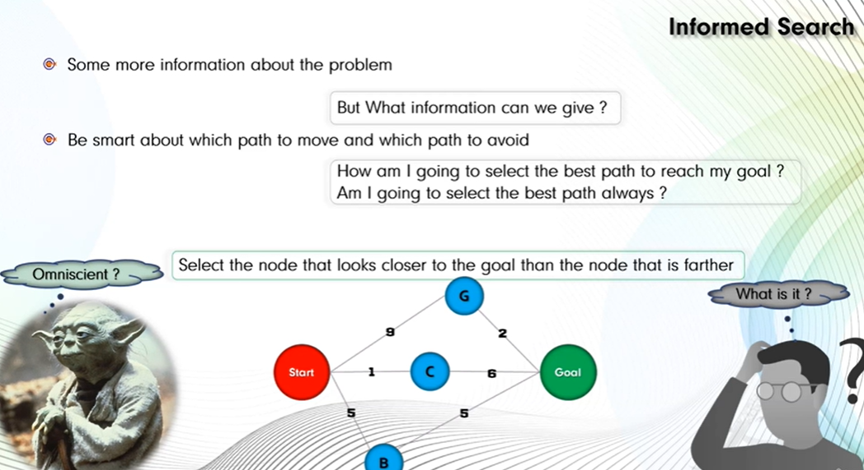

Slide 8
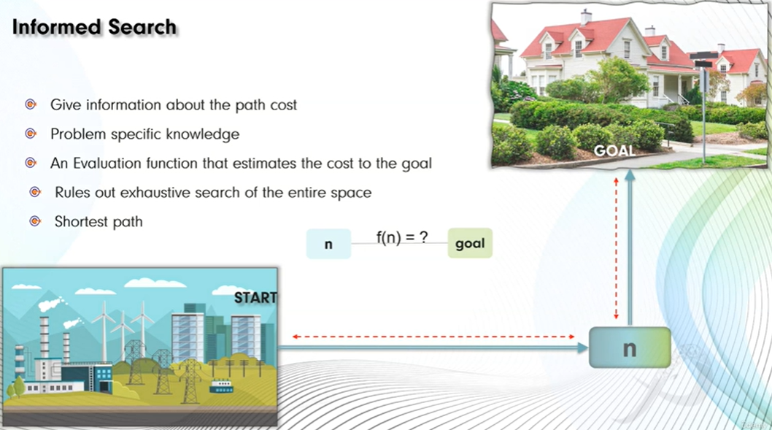
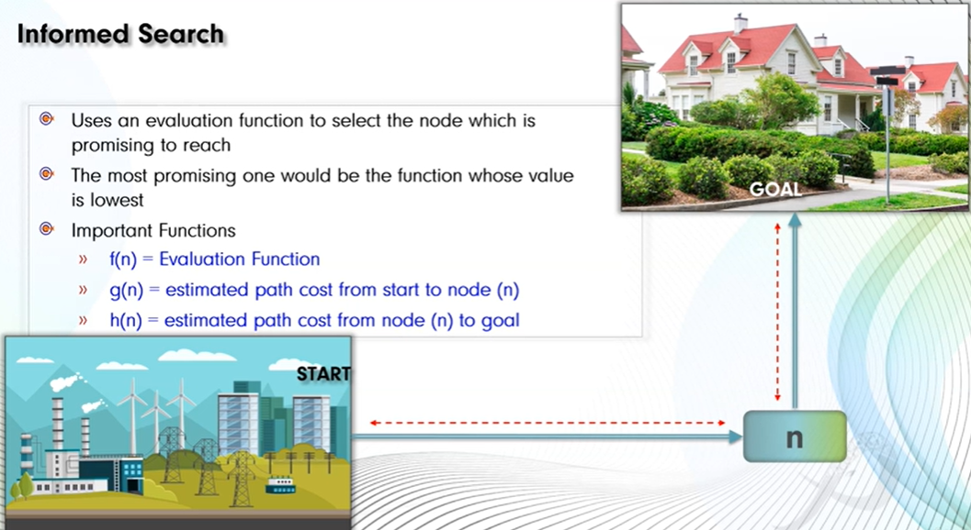
General Working of Informed Search
Start from the initial state
Generate successors
Use heuristic value to evaluate nodes
Expand the most promising node
Continue until goal is reached
Evaluation Function
Informed search algorithms use an evaluation function f(n).
Common forms:
Greedy Best-First Search:
f(n) = h(n)
A* Search:
f(n) = g(n) + h(n)
Where:
g(n) = cost from start to node n
h(n) = estimated cost from n to goal

Slide 9
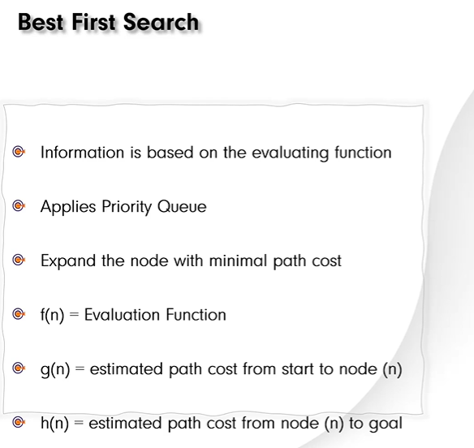
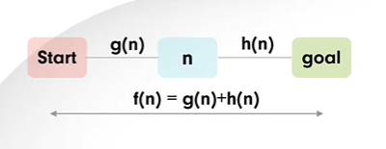
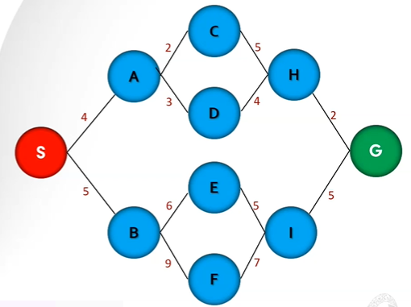

Slide 10


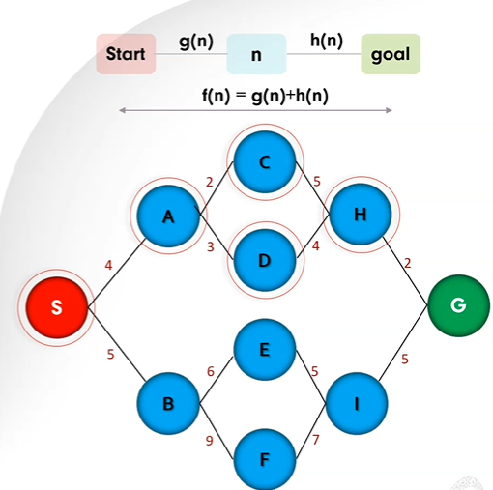

Slide 11
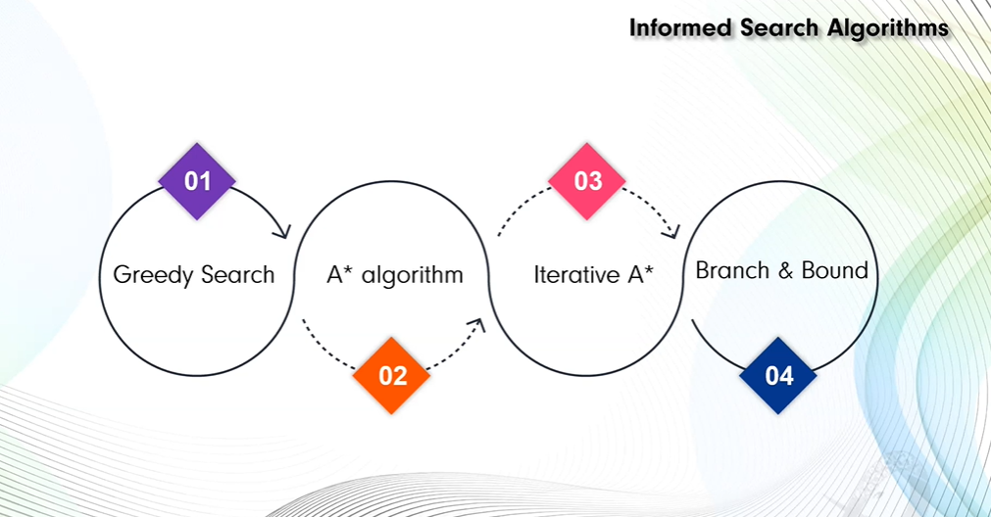

Slide 12
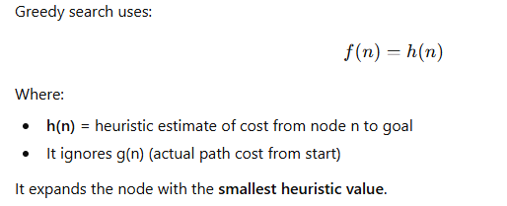
Greedy Best-First Search (GBFS)
Greedy Best-First Search (GBFS) is an informed search algorithm that selects the next node to expand based solely on a heuristic estimate of how close the node is to the goal.
It is called “greedy” because it always chooses the node that appears to be closest to the goal, without considering the cost already spent.
It favors those nodes that look like they are closest to the goal, but it does not always guarantee an optimal solution. It is useful when a good heuristic is found, meaning that we do not always have to solve the problem from scratch.

Slide 13
Working Principle
Start from initial node.
Insert it into a priority queue.
Always expand the node with the lowest h(n).
Stop when goal is reached.
Uses:
Priority Queue (Min-Heap)

Slide 14
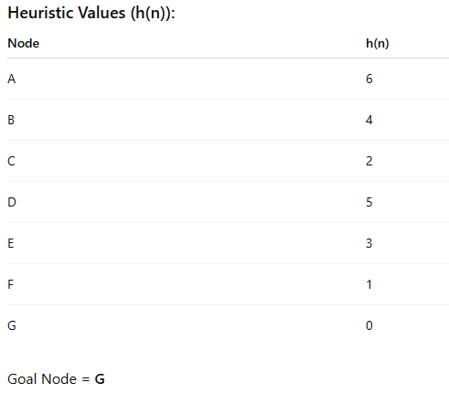
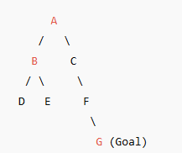
Example Graph

Slide 15
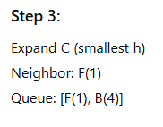
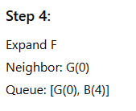

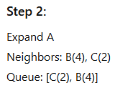

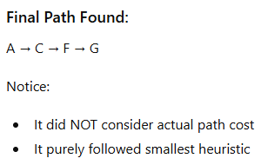
Greedy Best First Search Solution

Slide 16
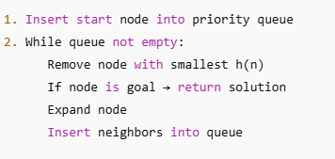
Algorithm (Pseudocode)
import heapq
graph = {
'A': ['B', 'C'],
'B': ['D', 'E'],
'C': ['F'],
'D': [],
'E': [],
'F': ['G'],
'G': []
}
heuristic = {
'A': 6,
'B': 4,
'C': 2,
'D': 5,
'E': 3,
'F': 1,
'G': 0
}

Slide 17

Python Code
def greedy_best_first_search(Tcost,graph, heuristic, start, goal):
priority_queue = []
heapq.heappush(priority_queue, (heuristic[start], start, [start]))
visited = set()
while priority_queue:
h_value, node, path = heapq.heappop(priority_queue)
Tcost=Tcost+h_value
if node == goal:
return path, Tcost
if node not in visited:
visited.add(node)
for neighbor in graph[node]:
heapq.heappush(
priority_queue,
(heuristic[neighbor], neighbor, path + [neighbor])
)
return None
import heapq
graph = {
'A': ['B', 'C'],
'B': ['D', 'E'],
'C': ['F'],
'D': [],
'E': [],
'F': ['G'],
'G': []
}
heuristic = {
'A': 6,
'B': 4,
'C': 2,
'D': 5,
'E': 3,
'F': 1,
'G': 0
}

Slide 18
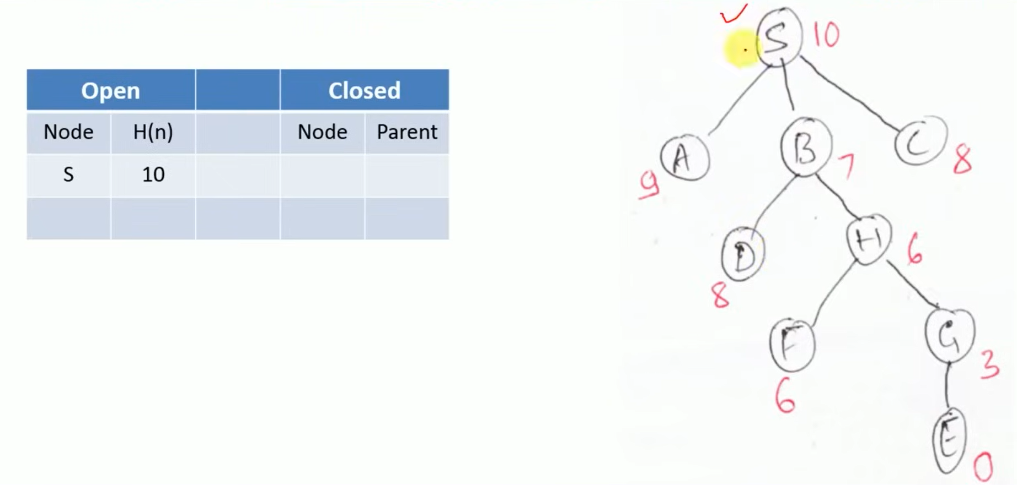
Example

Slide 19
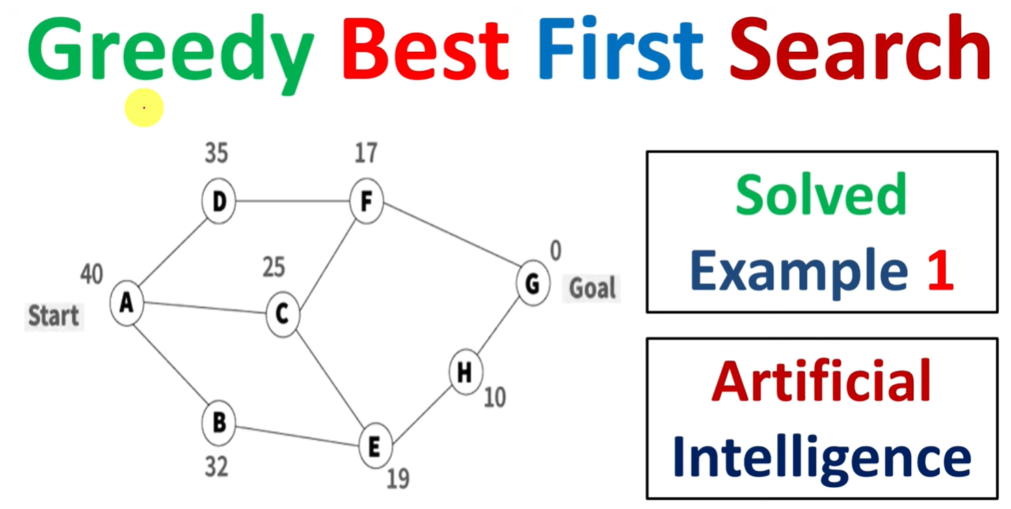

Slide 20
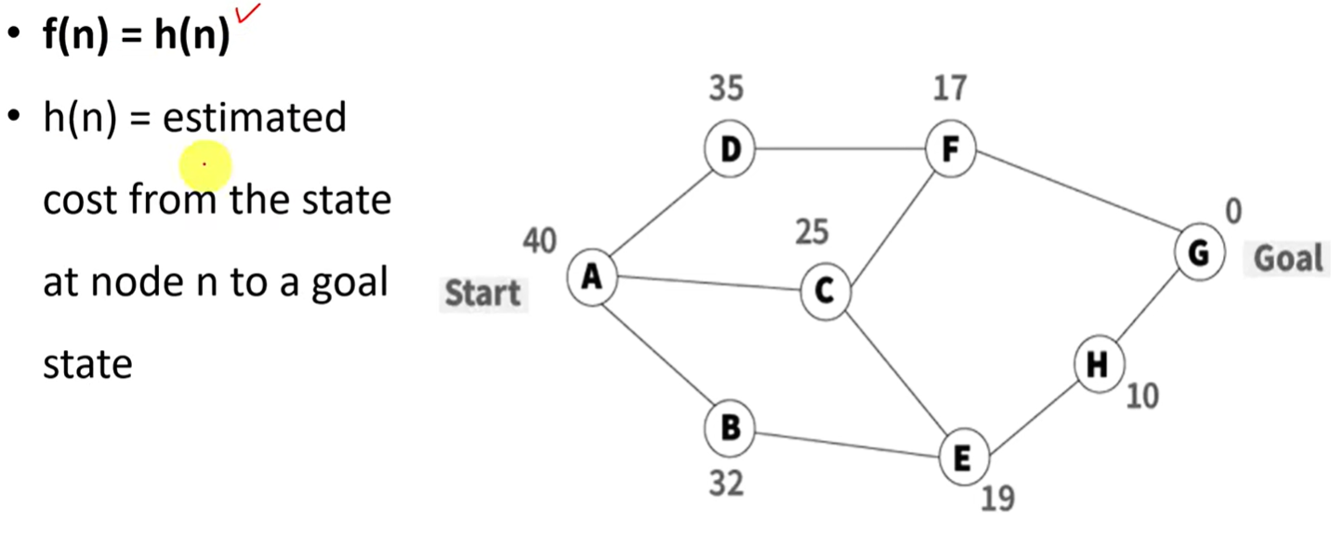

Slide 21
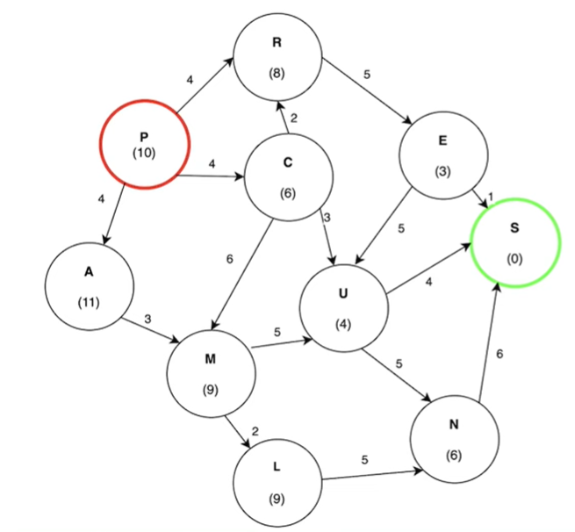
Example 2

Slide 22
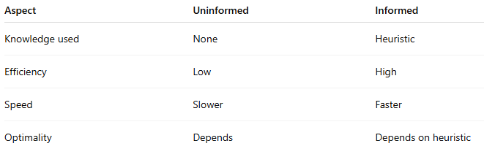
Comparison: Uninformed vs Informed Search

Slide 23
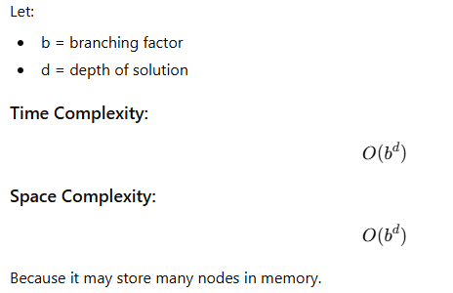
Time and Space Complexity

Slide 24
Greedy Best-First Search for Maze
Maze Problem
We use:
S → Start
E → Goal
0 → Free path
1 → Wall
S
 |  |  | E
maze = [
['S', 0, 0, 0],
[1, 1, 0, 1],
[0, 0, 0, 1],
[0, 1, 0, 'E']
]

Slide 25
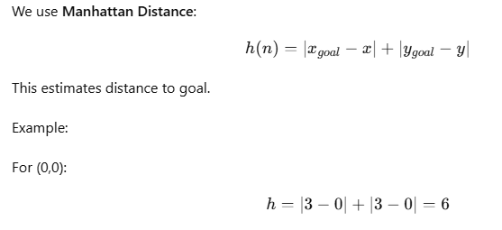
Heuristic Function

Slide 26
Step-by-Step Priority Queue Trace
Step 1
Start at (0,0)
Queue: [(6, (0,0))]
Step 2
Expand (0,0)
Valid neighbor:
(0,1) → h = 5
Queue: [(5, (0,1))]
Step 3
Expand (0,1)
Valid neighbor:
(0,2) → h = 4
Queue: [(4, (0,2))]
Step 4
Expand (0,2)
Valid neighbors:
(0,3) → h = 3
(1,2) → h = 3
Queue: [(3, (0,3)), (3, (1,2))]
Step 5
Expand (0,3)
No useful new moves.
Queue: [(3, (1,2))]
Step 6
Expand (1,2)
Add:
(2,2) → h = 2
Queue: [(2, (2,2))]
Step 7
Expand (2,2)
Add:
(3,2) → h = 1
Queue:[(1, (3,2))]
S
 |  |  | E
Step 8
Expand (3,2)
Add:
(3,3) → h = 0
Queue:[(0, (3,3))]
Step 9
Expand (3,3) → GOAL
Final Path Found (0,0) (0,1) (0,2) (1,2) (2,2) (3,2) (3,3)

Slide 27
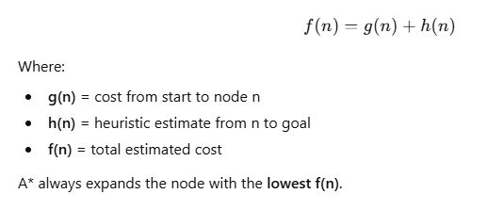
A* (A-Star) Algorithm
A* is an informed search algorithm that finds the shortest path from a start node to a goal node using both:
Actual cost from start → g(n)
Estimated cost to goal → h(n)
It combines the strengths of:
Uniform Cost Search (optimal)
Greedy Best-First Search (fast)

Slide 28
The Algorithm
The A* algorithm is implemented in a similar way to Dijkstra’s algorithm. Given a weighted graph with non-negative edge weights, to find the lowest-cost path from a start node S to a goal node G, two lists are used:
  An open list, implemented as a priority queue, which stores the next nodes to be explored. Because this is a priority queue, the most promising candidate node (the one with the lowest value from the evaluation function) is always at the top. Initially, the only node in this list is the start node S.
  A closed list which stores the nodes that have already been evaluated. When a node is in the closed list, it means that the lowest-cost path to that node has been found.
To find the lowest cost path, a search tree is constructed in the following way:
Initialize a tree with the root node being the start node S.
Remove the top node from the open list for exploration.
Add the current node to the closed list.
Add all nodes that have an incoming edge from the current node as child nodes in the tree.
Update the lowest cost to reach the child node.
Compute the evaluation function for every child node and add them to the open list.

Slide 29
Just like in Dijkstra’s algorithm, the lowest cost is updated as the algorithm progresses in the following way:
current_lowest_cost = min(current_lowest_cost, parent_node_cost + edge_weight)
All nodes except for the start node start with a lowest cost of infinity. The start node has an initial lowest cost of 0.
The algorithm concludes when the goal node G is removed from the open list and explored, indicating that a shortest path has been found. The shortest path is the path from the start node S to the goal node G in the tree.
Note: The algorithm ends when the goal node G has been explored, NOT when it is added to the open list.

Slide 30
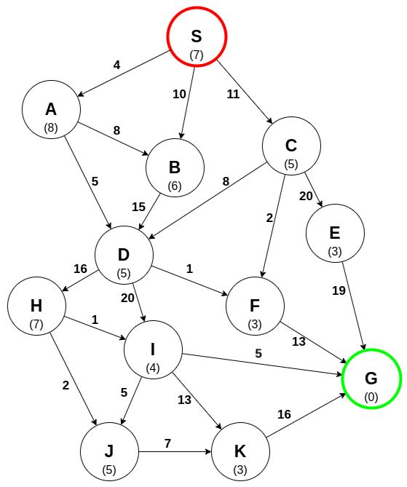
Example

Slide 31
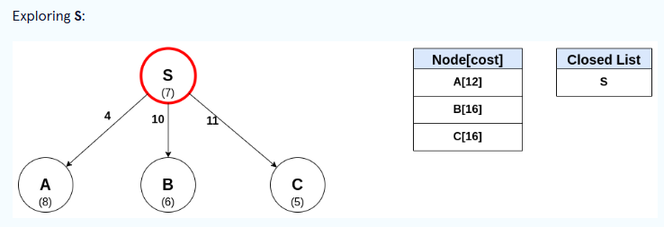
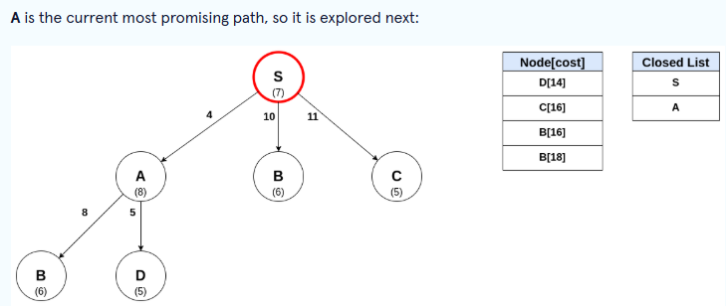
Each edge has an associated weight, and each node has a heuristic cost (in parentheses).
An open list is maintained in which the node S is the only node in the list. The search tree can now be constructed.

Slide 32
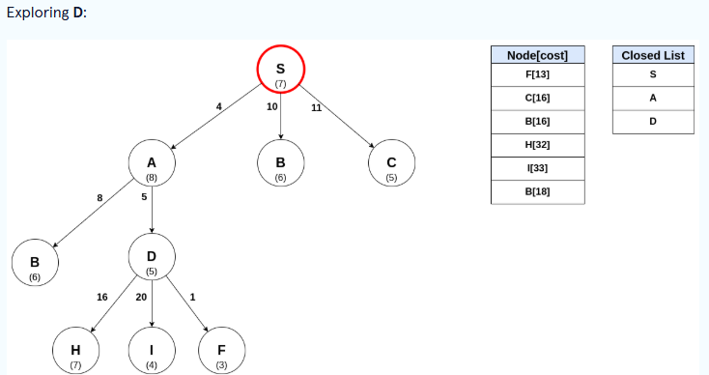

Slide 33
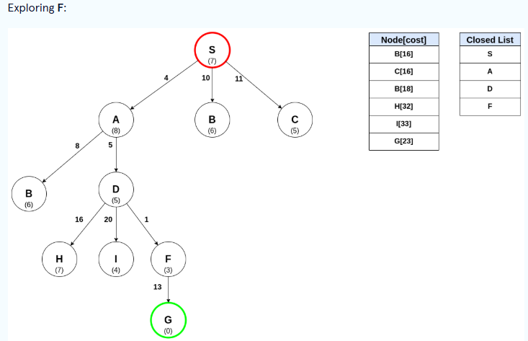

Slide 34
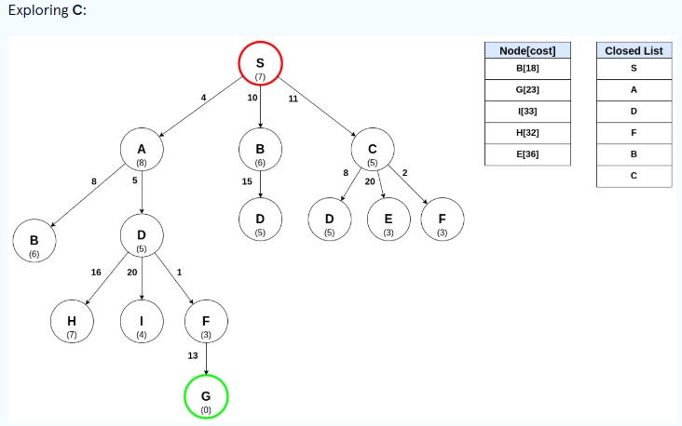

Slide 35
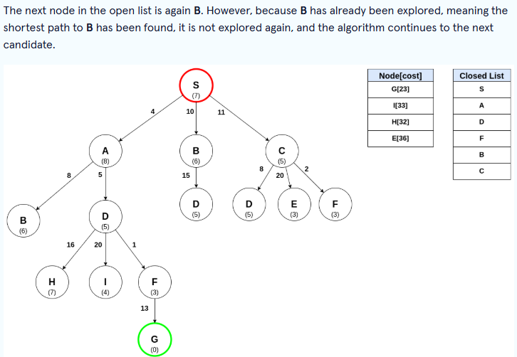

Slide 36
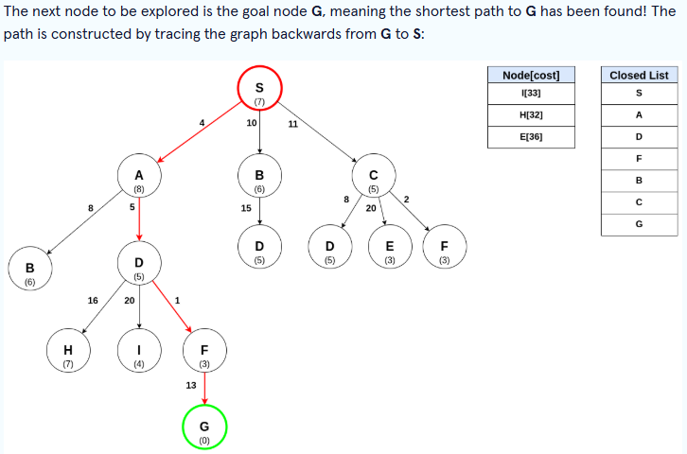
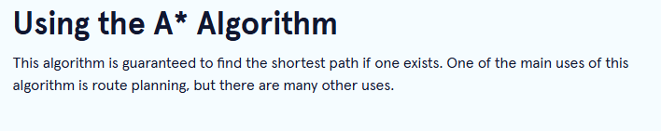

Slide 37
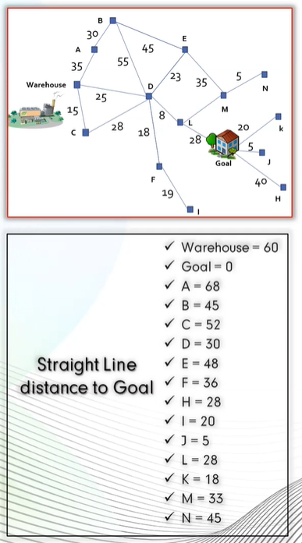
Example

Slide 38
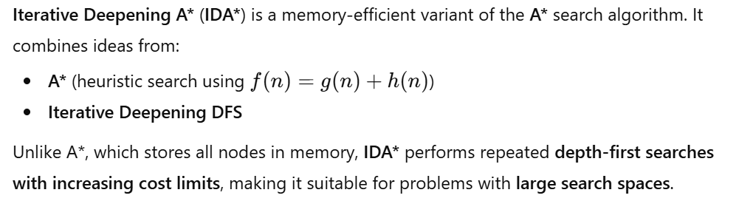
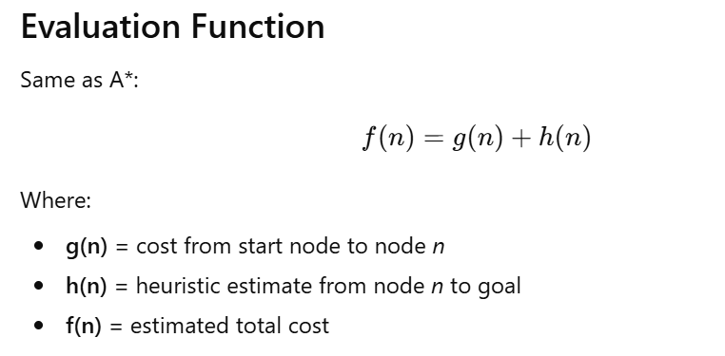
Iterative Deepening A* (IDA*) Algorithm

Slide 39
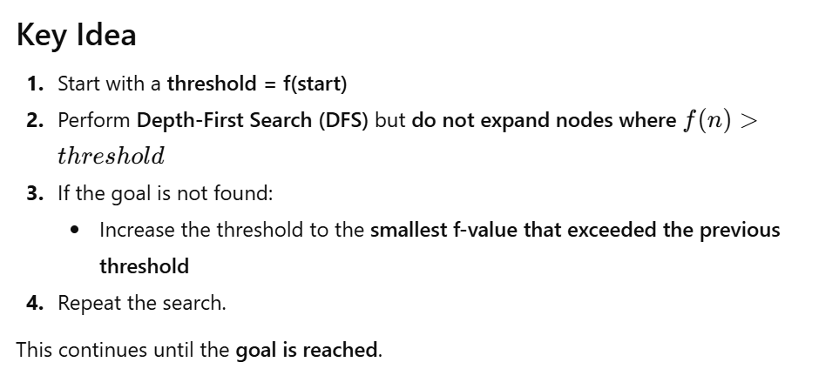

Slide 40
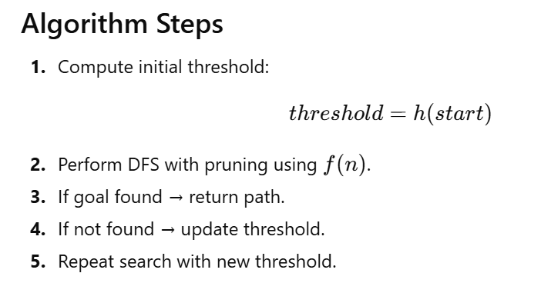

Slide 41
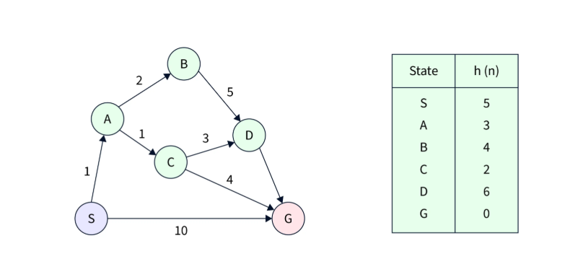
Example:
2

