Slide 1
Informed Search Algorithms
Ahmet Ünveren

Slide 2
What is Search in Artificial Intelligence?
Search is the process of finding a sequence of actions that leads from an initial state to a goal state.
Examples:
Finding a route on Google Maps
Solving a maze
Playing games like chess
Robot path planning

Slide 3
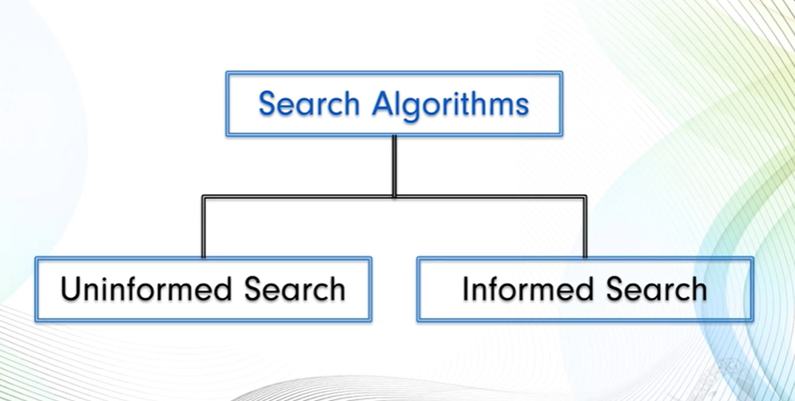
Classification of Search Algorithms
Uninformed (Blind) Search
No additional knowledge about the problem
Explore blindly
Examples:
  Depth First Search (DFS)
  Breadth First Search (BFS)
  Uniform Cost Search (UCS)
Informed (Heuristic) Search
Uses additional knowledge (heuristics)
Guides the search towards the goal
More efficient than uninformed search

Slide 4
What are Informed Search Algorithms?
Informed Search Algorithms use a heuristic function to estimate how close a current state is to the goal.
Instead of exploring blindly, informed search makes intelligent decisions about which node to expand next.

Slide 5
Heuristic Function (h(n))
Definition:
A heuristic function, denoted as h(n), estimates the cost from node n to the goal.
Characteristics:
Problem-specific
Computed quickly
Guides the search
Example:
In route finding:
h(n) = straight-line distance from city n to destination

Slide 6

Why Use Informed Search?
Uninformed search suffers from:
Large search space
High time complexity
Unnecessary node expansions
Informed search:
Reduces search space
Improves efficiency
Finds solutions faster

Slide 7
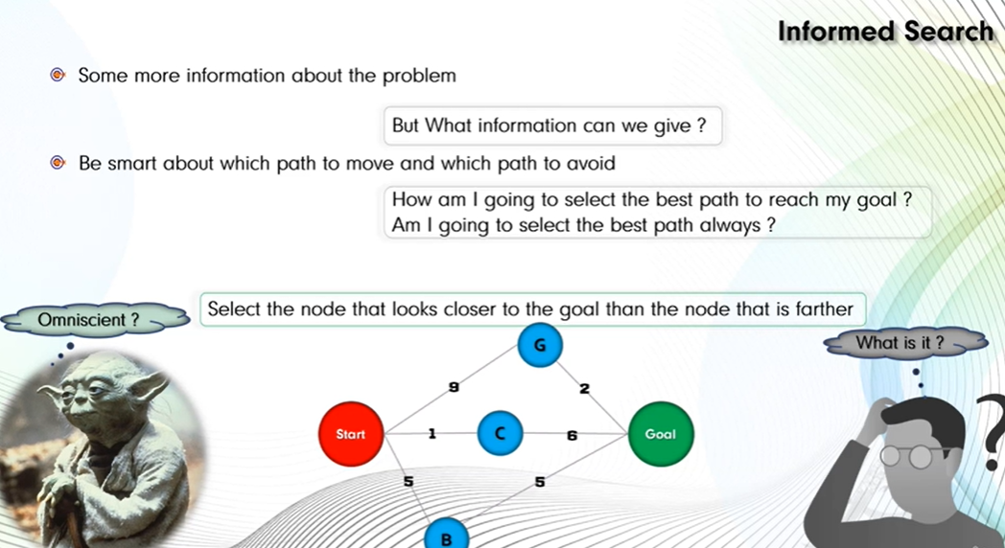

Slide 8
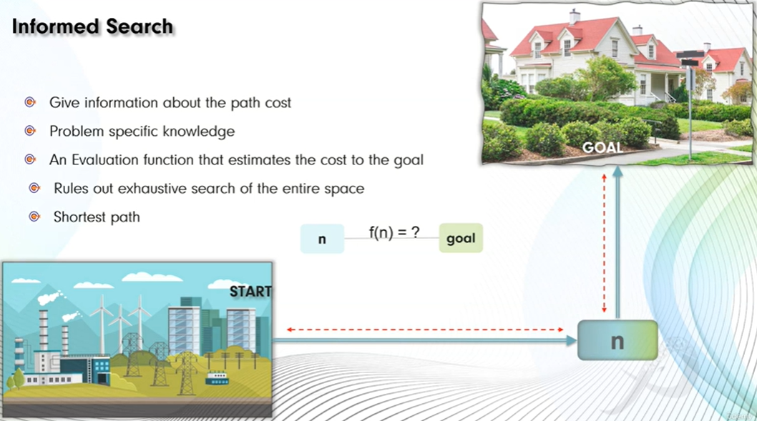
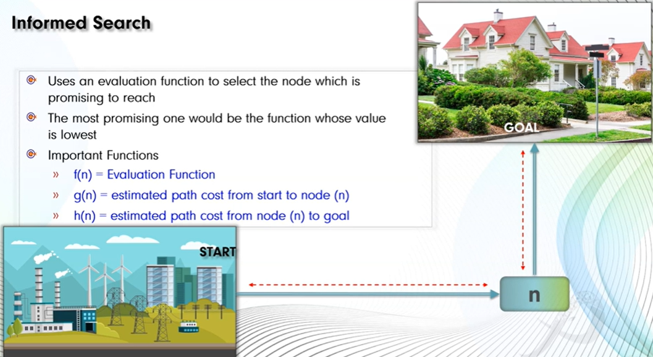
General Working of Informed Search
Start from the initial state
Generate successors
Use heuristic value to evaluate nodes
Expand the most promising node
Continue until goal is reached
Evaluation Function
Informed search algorithms use an evaluation function f(n).
Common forms:
Greedy Best-First Search:
f(n) = h(n)
A* Search:
f(n) = g(n) + h(n)
Where:
g(n) = cost from start to node n
h(n) = estimated cost from n to goal

Slide 9
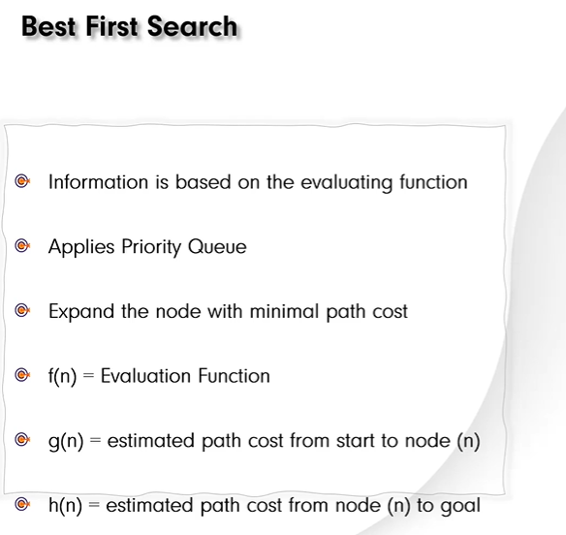
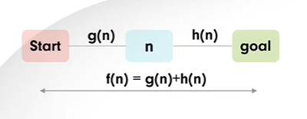
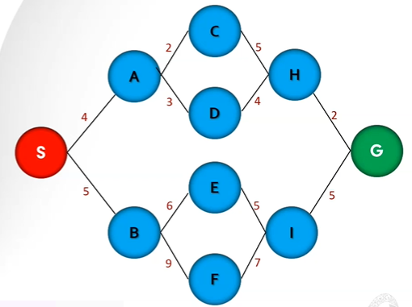

Slide 10


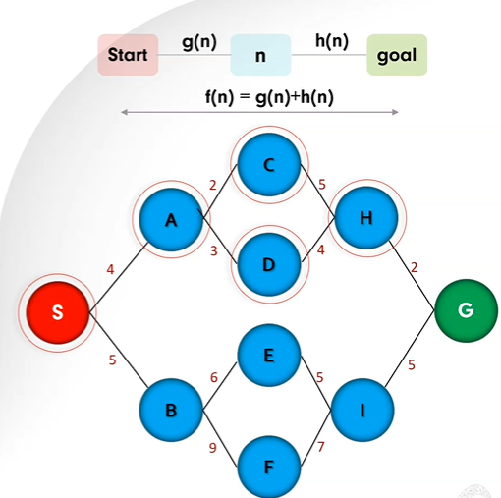

Slide 11
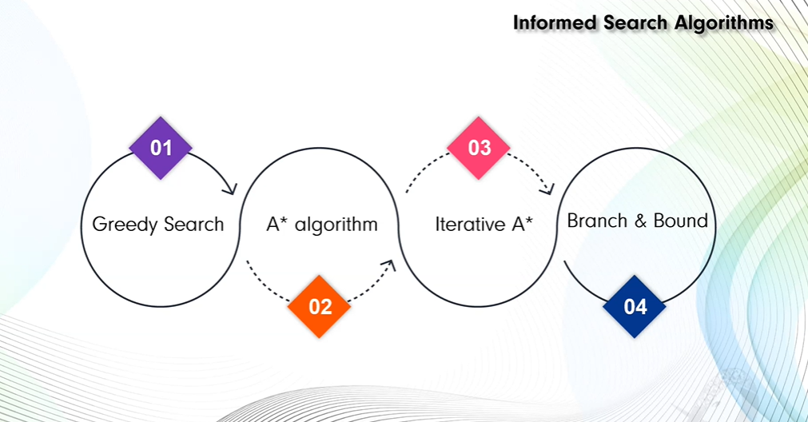

Slide 12
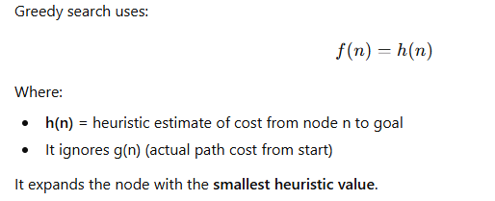
Greedy Best-First Search (GBFS)
Greedy Best-First Search (GBFS) is an informed search algorithm that selects the next node to expand based solely on a heuristic estimate of how close the node is to the goal.
It is called “greedy” because it always chooses the node that appears to be closest to the goal, without considering the cost already spent.
It favors those nodes that look like they are closest to the goal, but it does not always guarantee an optimal solution. It is useful when a good heuristic is found, meaning that we do not always have to solve the problem from scratch.

Slide 13
Working Principle
Start from initial node.
Insert it into a priority queue.
Always expand the node with the lowest h(n).
Stop when goal is reached.
Uses:
Priority Queue (Min-Heap)

Slide 14
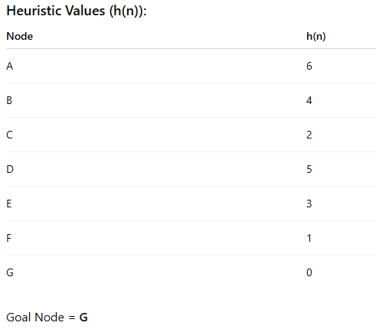
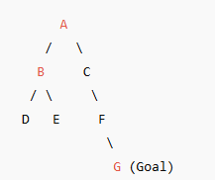
Example Graph

Slide 15
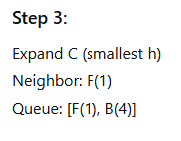
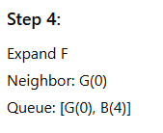

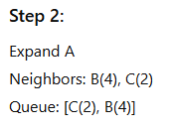

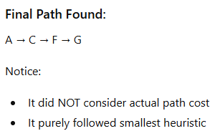
Greedy Best First Search Solution

Slide 16
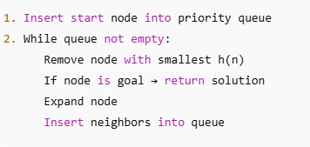
Algorithm (Pseudocode)
import heapq
graph = {
'A': ['B', 'C'],
'B': ['D', 'E'],
'C': ['F'],
'D': [],
'E': [],
'F': ['G'],
'G': []
}
heuristic = {
'A': 6,
'B': 4,
'C': 2,
'D': 5,
'E': 3,
'F': 1,
'G': 0
}

Slide 17

Python Code
def greedy_best_first_search(Tcost,graph, heuristic, start, goal):
priority_queue = []
heapq.heappush(priority_queue, (heuristic[start], start, [start]))
visited = set()
while priority_queue:
h_value, node, path = heapq.heappop(priority_queue)
Tcost=Tcost+h_value
if node == goal:
return path, Tcost
if node not in visited:
visited.add(node)
for neighbor in graph[node]:
heapq.heappush(
priority_queue,
(heuristic[neighbor], neighbor, path + [neighbor])
)
return None
import heapq
graph = {
'A': ['B', 'C'],
'B': ['D', 'E'],
'C': ['F'],
'D': [],
'E': [],
'F': ['G'],
'G': []
}
heuristic = {
'A': 6,
'B': 4,
'C': 2,
'D': 5,
'E': 3,
'F': 1,
'G': 0
}

Slide 18
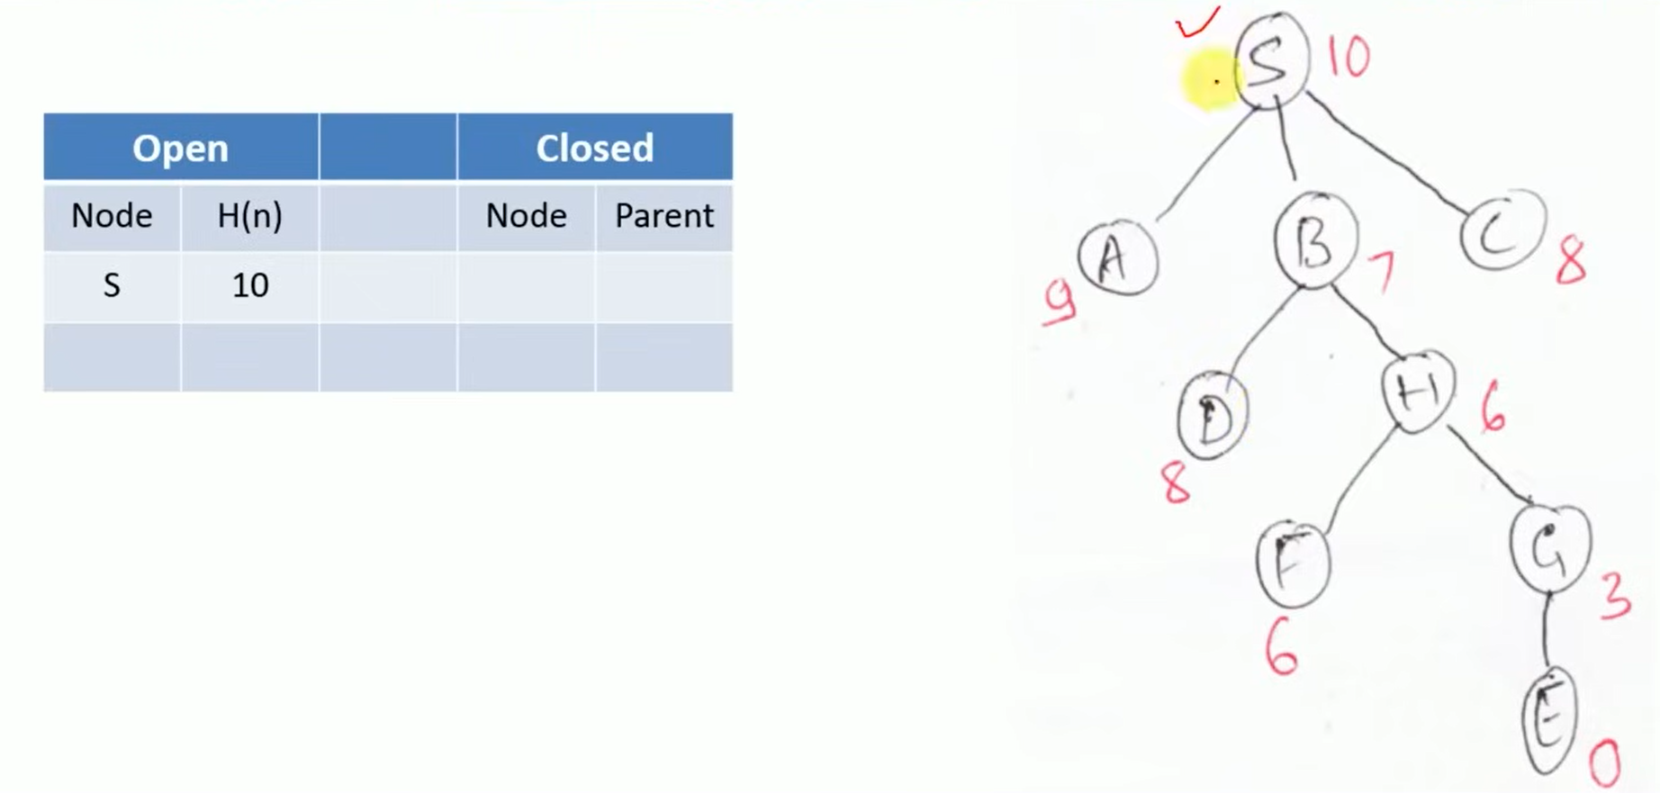
Example

Slide 19
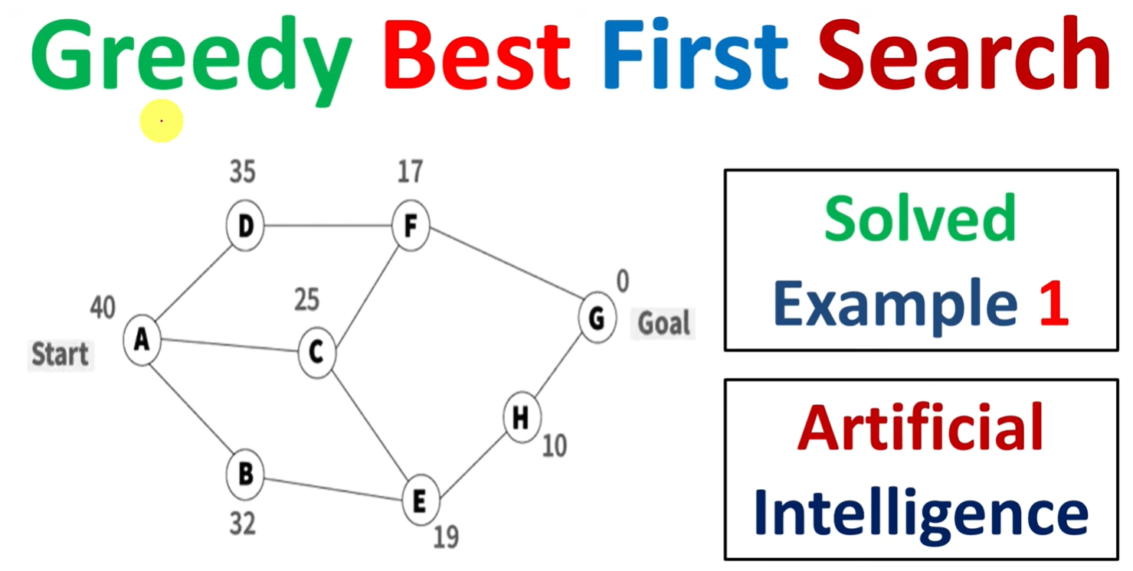

Slide 20
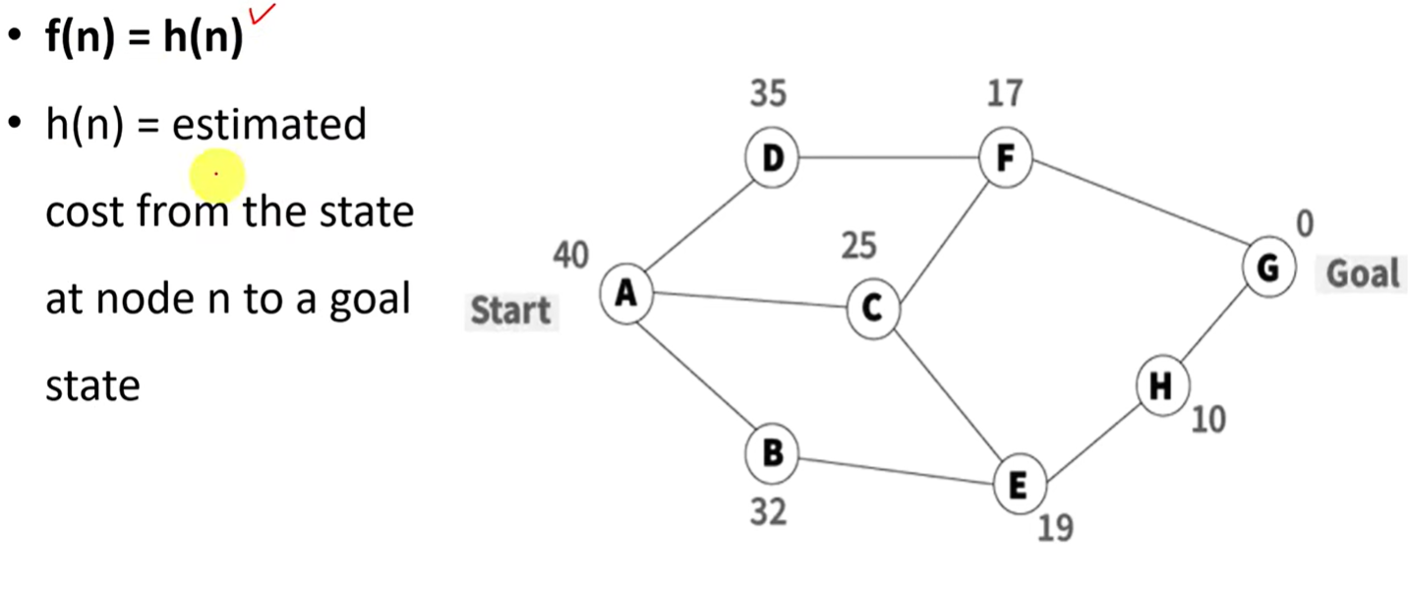

Slide 21
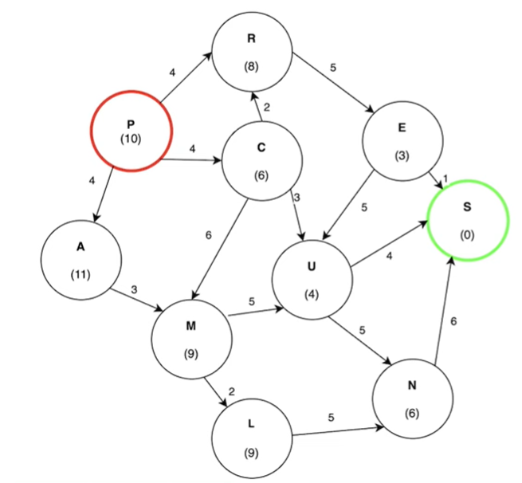
Example 2

Slide 22
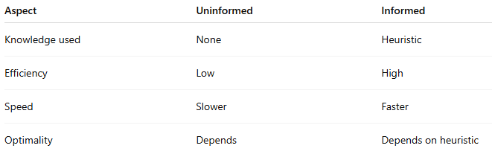
Comparison: Uninformed vs Informed Search

Slide 23
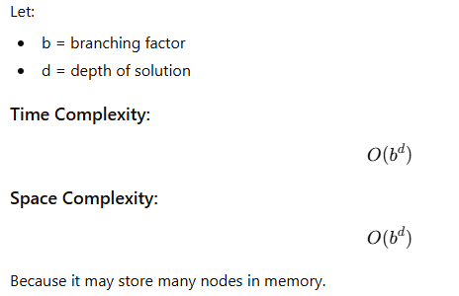
Time and Space Complexity

Slide 24
Greedy Best-First Search for Maze
Maze Problem
We use:
S → Start
E → Goal
0 → Free path
1 → Wall
S
 |  |  | E
maze = [
['S', 0, 0, 0],
[1, 1, 0, 1],
[0, 0, 0, 1],
[0, 1, 0, 'E']
]

Slide 25
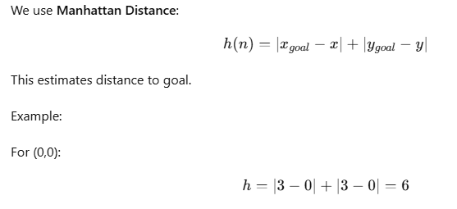
Heuristic Function

Slide 26
Step-by-Step Priority Queue Trace
Step 1
Start at (0,0)
Queue: [(6, (0,0))]
Step 2
Expand (0,0)
Valid neighbor:
(0,1) → h = 5
Queue: [(5, (0,1))]
Step 3
Expand (0,1)
Valid neighbor:
(0,2) → h = 4
Queue: [(4, (0,2))]
Step 4
Expand (0,2)
Valid neighbors:
(0,3) → h = 3
(1,2) → h = 3
Queue: [(3, (0,3)), (3, (1,2))]
Step 5
Expand (0,3)
No useful new moves.
Queue: [(3, (1,2))]
Step 6
Expand (1,2)
Add:
(2,2) → h = 2
Queue: [(2, (2,2))]
Step 7
Expand (2,2)
Add:
(3,2) → h = 1
Queue:[(1, (3,2))]
S
 |  |  | E
Step 8
Expand (3,2)
Add:
(3,3) → h = 0
Queue:[(0, (3,3))]
Step 9
Expand (3,3) → GOAL
Final Path Found (0,0) (0,1) (0,2) (1,2) (2,2) (3,2) (3,3)

Slide 27
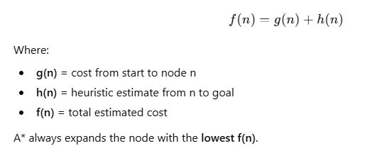
A* (A-Star) Algorithm
A* is an informed search algorithm that finds the shortest path from a start node to a goal node using both:
Actual cost from start → g(n)
Estimated cost to goal → h(n)
It combines the strengths of:
Uniform Cost Search (optimal)
Greedy Best-First Search (fast)

Slide 28
The Algorithm
The A* algorithm is implemented in a similar way to Dijkstra’s algorithm. Given a weighted graph with non-negative edge weights, to find the lowest-cost path from a start node S to a goal node G, two lists are used:
  An open list, implemented as a priority queue, which stores the next nodes to be explored. Because this is a priority queue, the most promising candidate node (the one with the lowest value from the evaluation function) is always at the top. Initially, the only node in this list is the start node S.
  A closed list which stores the nodes that have already been evaluated. When a node is in the closed list, it means that the lowest-cost path to that node has been found.
To find the lowest cost path, a search tree is constructed in the following way:
Initialize a tree with the root node being the start node S.
Remove the top node from the open list for exploration.
Add the current node to the closed list.
Add all nodes that have an incoming edge from the current node as child nodes in the tree.
Update the lowest cost to reach the child node.
Compute the evaluation function for every child node and add them to the open list.

Slide 29
Just like in Dijkstra’s algorithm, the lowest cost is updated as the algorithm progresses in the following way:
current_lowest_cost = min(current_lowest_cost, parent_node_cost + edge_weight)
All nodes except for the start node start with a lowest cost of infinity. The start node has an initial lowest cost of 0.
The algorithm concludes when the goal node G is removed from the open list and explored, indicating that a shortest path has been found. The shortest path is the path from the start node S to the goal node G in the tree.
Note: The algorithm ends when the goal node G has been explored, NOT when it is added to the open list.

Slide 30
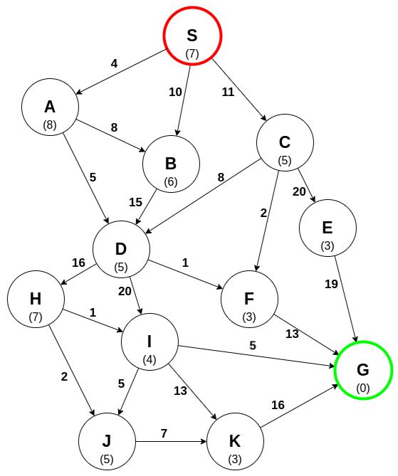
Example

Slide 31
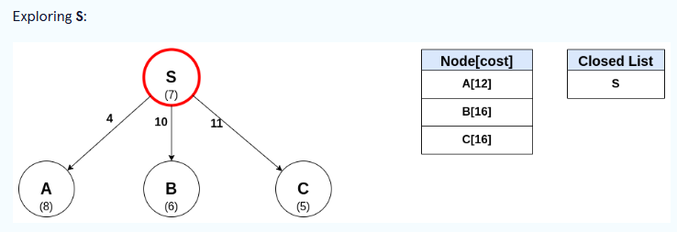
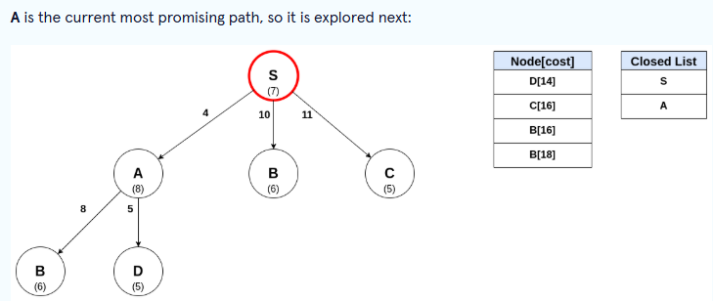
Each edge has an associated weight, and each node has a heuristic cost (in parentheses).
An open list is maintained in which the node S is the only node in the list. The search tree can now be constructed.

Slide 32
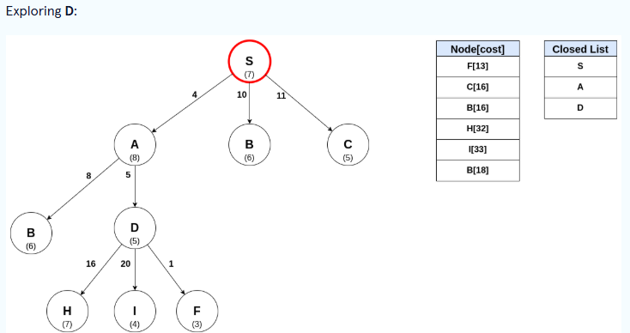

Slide 33
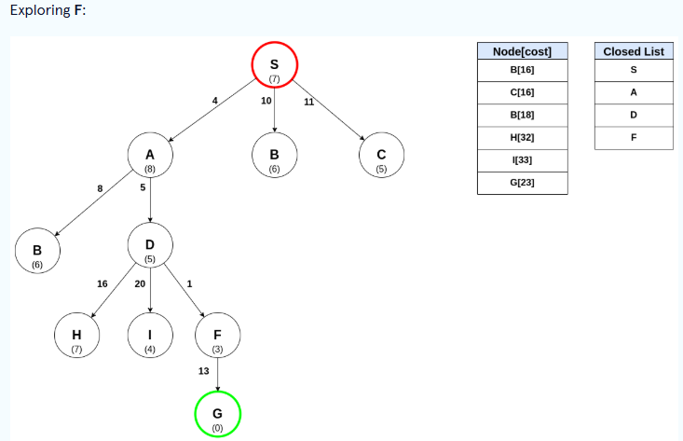

Slide 34
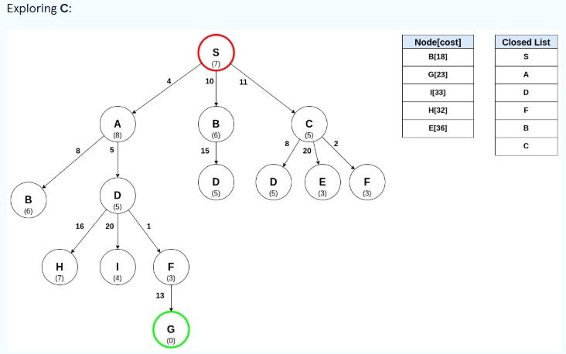

Slide 35
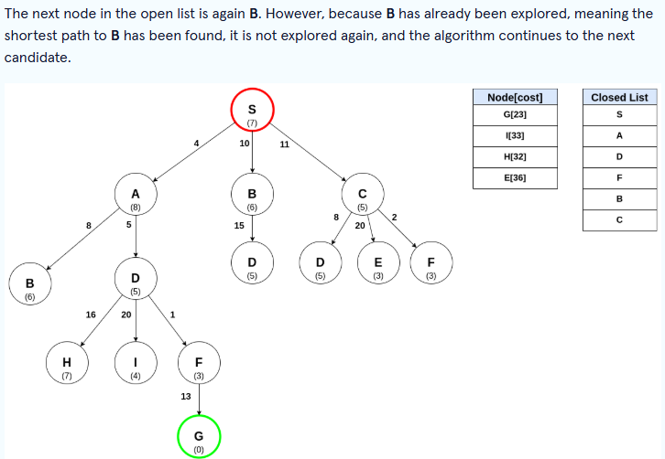

Slide 36
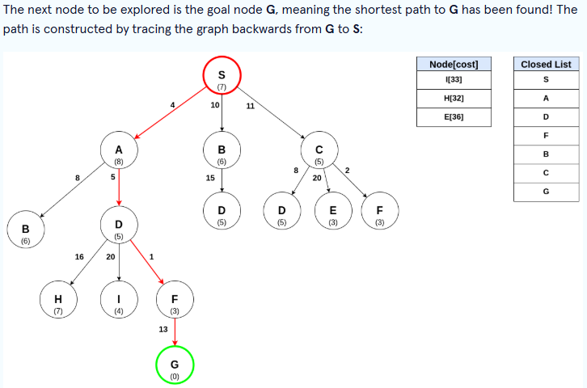
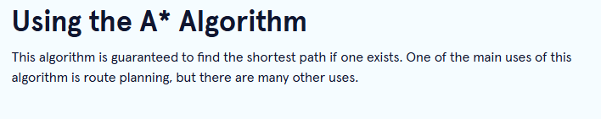

Slide 37
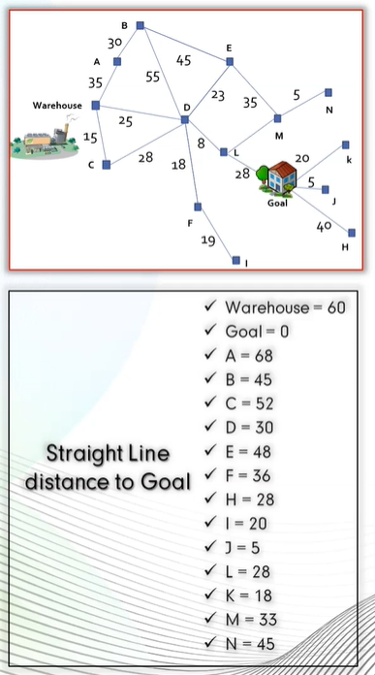
Home Work

Slide 38
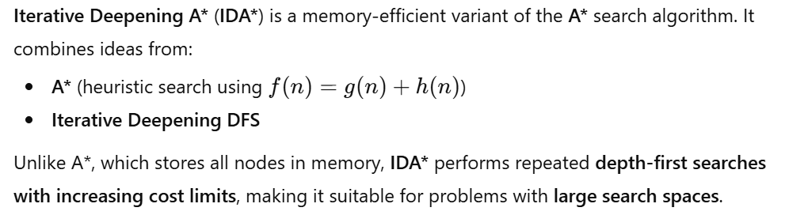
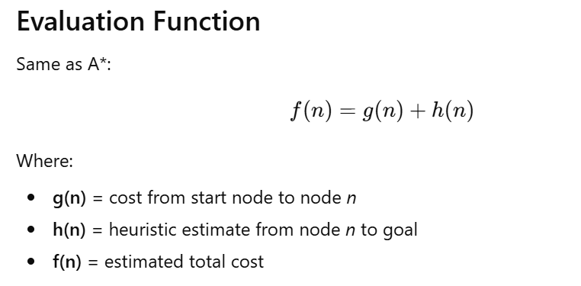
Iterative Deepening A* (IDA*) Algorithm

Slide 39
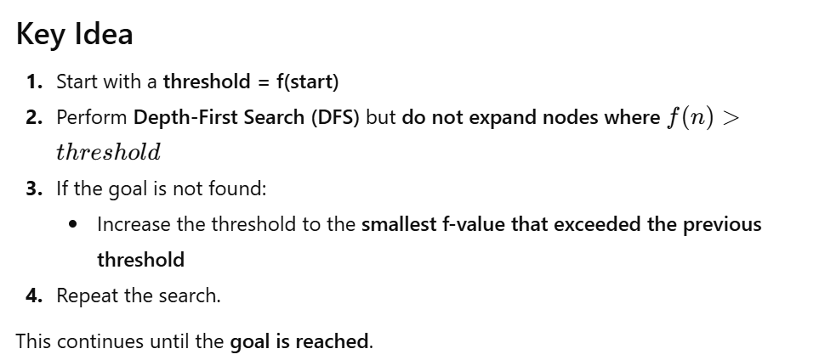

Slide 40
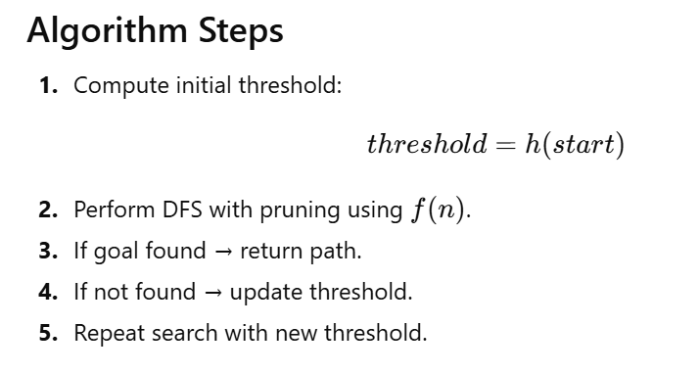

Slide 41
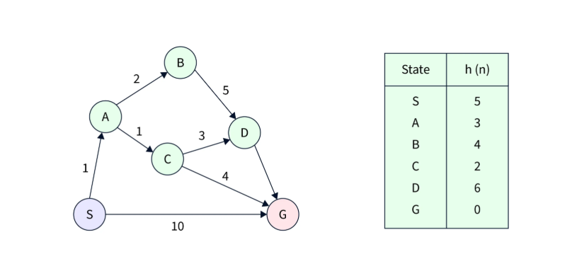
Example:
2

Slide 42
Example 2

Slide 43
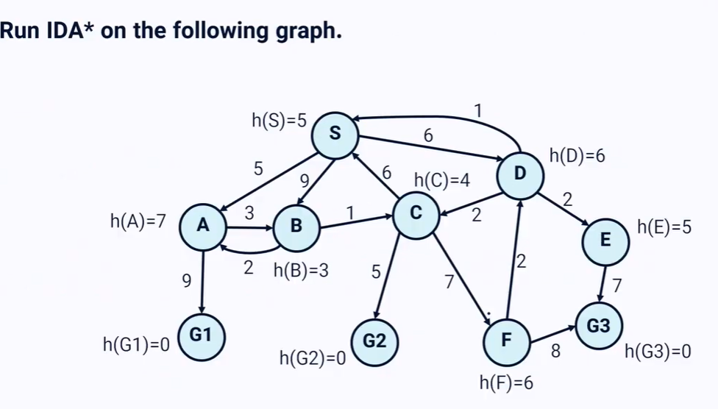

Slide 44
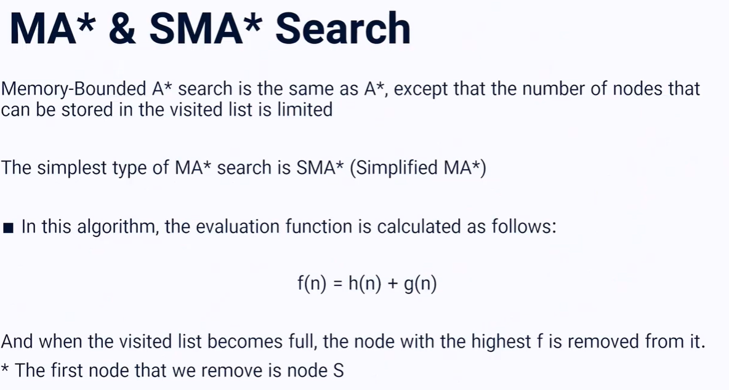

Slide 45
SMA* Search is an informed search algorithm for traversing a graph. SMA* evaluates and explores nodes by combining the cost to reach the node (g) and the cost to get from the node to the goal (h). The algorithm selects the node with the lowest f = g + h value to explore next. We typically use a priority queue (frontier) to select the node with the lowest f value for expansion. A* search runs out of space quickly because it keeps all generated nodes in memory. SMA* is a memory-bounded version of A* search that limits the number of nodes stored in memory. When the memory limit is reached, SMA* removes the node with the highest f value from memory and continues the search. This process ensures that the algorithm remains within the memory constraints while still finding the optimal path. It is a fundamental algorithm used in various applications such as pathfinding, robotics, route planning, and optimization problems.

Slide 46
Algorithm
The SMA* Search algorithm is a pathfinding algorithm used to find the shortest path from a start node to a goal node in a graph, taking into account both the actual cost from the start node and an estimated cost to the goal node. The heuristic function h estimates the cost to reach the goal from node n as h(n). The cost function g(n) gives the actual cost to reach node n from the start node. The priority queue is ordered by the total cost f(n) which is the sum of g(n) and h(n).
STEP 1: Initialize the frontier (priority queue) with the start node 'start' and set g and f values to 0 and h(start) respectively.
STEP 2: While the frontier is not empty, select the deepest lowest f cost node.
STEP 3: If the selected node is the goal node, reconstruct and return the path from the start node to the goal node.
STEP 4: Generate the successors of the node. For every successor s of the selected node n, do the following:
  If successor is not a goal state and its depth equals max_depth, set f[s] to infinity.
  Otherwise, set f cost to max(f[n], g[s] + h[s]).
STEP 5:
  If n has no more successors, update the f cost of the node and its ancestors if necessary.
  If all successors of n have been generated, remove n from the frontier.
STEP 6:
  If memory is full, identify the shallowest high cost leaf node.
  Remove it from its parent's successor's list.
  If necessary, re-insert the parent into the frontier.
STEP 7: Insert the successor s of node n into the frontier.
STEP 8: Repeat steps 2-7 until the goal node is reached or the frontier is empty.

Slide 47
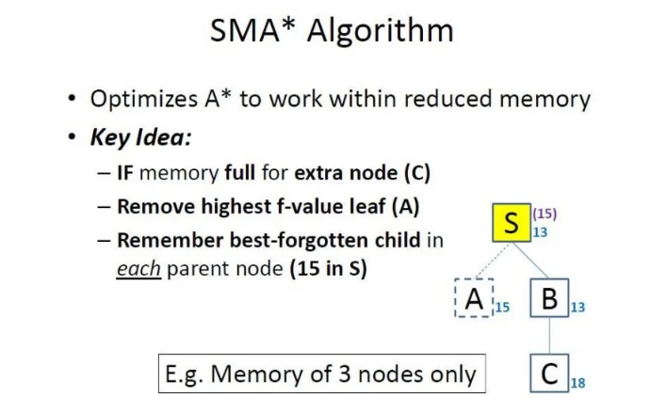

Slide 48
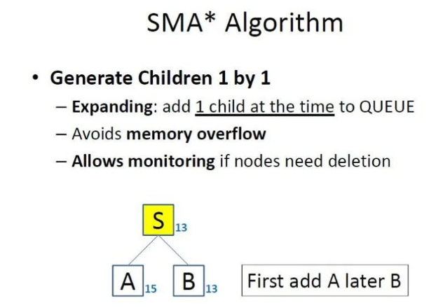

Slide 49
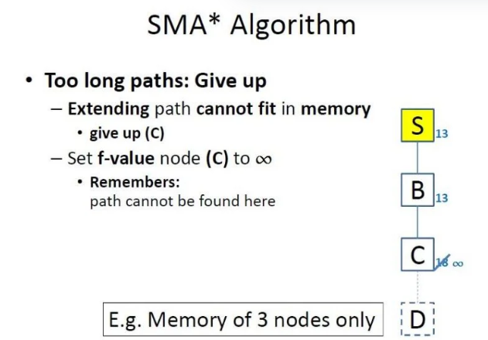

Slide 50
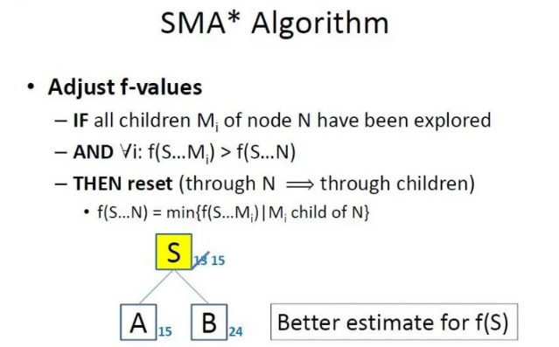

Slide 51
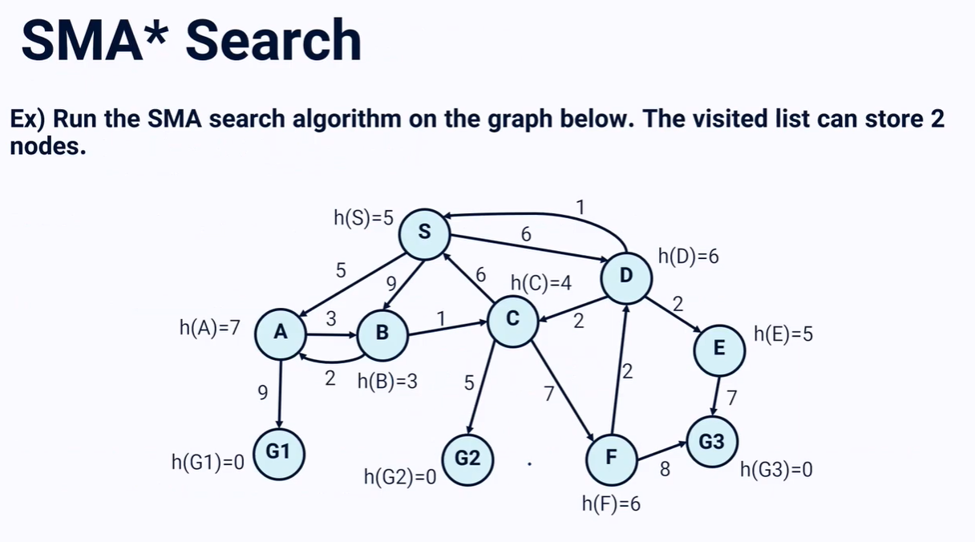

Slide 52
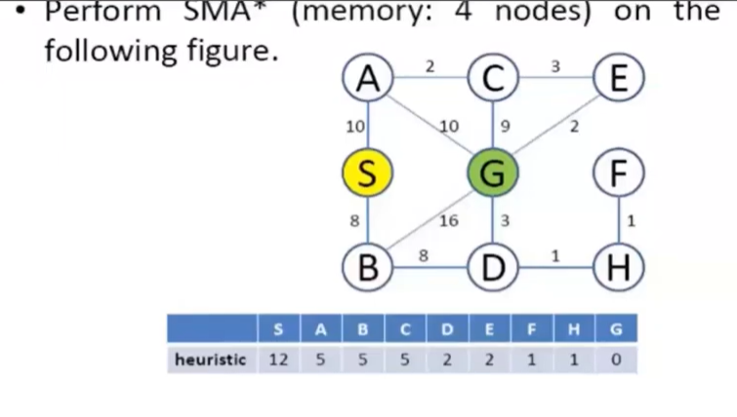

Slide 53
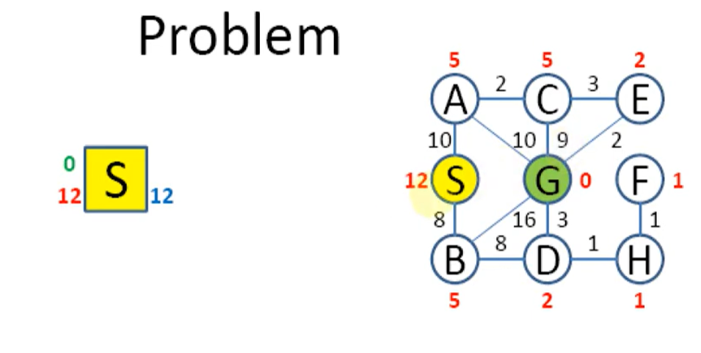

Slide 54
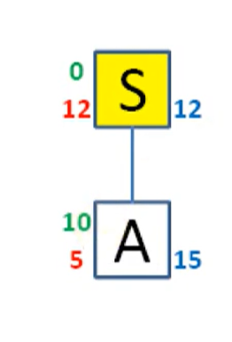






Slide 55







Slide 56









Slide 57




Slide 58


Slide 59
Problem Solving using the Simplified Memory-Bound A* Algorithm
Let's examine a problem-solving scenario using the SMA* algorithm. Suppose we have a search tree with various nodes and corresponding costs. The goal is to find the optimal path from the root node to the goal node, considering the memory constraint of storing only a limited number of nodes.
Examining the Memory Constraint in a Problem
In our problem scenario, we have a memory constraint that allows storing only a specific number of nodes. Any new node exceeding this limit needs to be dropped from the memory. We will explore how the SMA* algorithm handles this constraint and maintains consistency in the search process.
Step-by-Step Solution using the Algorithm
To solve the problem using the SMA* algorithm, we start with the root node. We add nodes to the tree Based on their costs, utilizing the available memory efficiently. If the memory limit is exceeded, we remove nodes while maintaining the lowest cost path.
  Introduction of the root node, its value, and initial memory utilization.
  Addition of left and right subtree nodes based on their costs, updating the root node's value accordingly.
  Memory constraint management when the memory limit is reached and a node needs to be dropped.
  Exploration of child nodes and drop down of irrelevant or less promising nodes to maintain memory consistency.
  Re-generation of previously dropped nodes when needed for future processing.
  Identification of the shallowest path and the lowest F cost path to the goal node.
  Conclusion of the algorithm execution with the optimal solution found.

Slide 60
Advantages
Completeness: SMA* is complete if the available memory is sufficient to store the shallowest solution path.
Optimality: SMA* is optimal if enough memory is available to store the shallowest optimal solution path. Otherwise, it returns the best solution that can be reached with the available memory.
Optimal Efficiency: When enough memory is available for the entire search tree, the search is optimally efficient.
Disadvantages
Optimality Sacrifice: SMA* sacrifices optimality for memory efficiency. When memory becomes full, SMA* discards nodes with the highest f-cost, potentially leading to suboptimal solutions. This can result in the algorithm finding paths that are longer or less optimal than the shortest path.
Heuristic Dependence: The performance of SMA* Search heavily depends on the quality of the heuristic function used. If the heuristic is not admissible (i.e., it overestimates the true cost), SMA* may not find the optimal solution. Additionally, designing an effective heuristic for certain problem domains can be challenging.
Complexity: SMA* introduces additional complexity compared to traditional A* algorithms due to the need to manage memory constraints and handle the removal of nodes when memory is full. Tuning parameters such as the maximum depth or the criteria for removing nodes can be challenging and may require careful experimentation to achieve good performance across different problem domains.

