Slide 1

Comparing Two Metaheuristic Algorithms Using Statistical Analysis

Slide 2
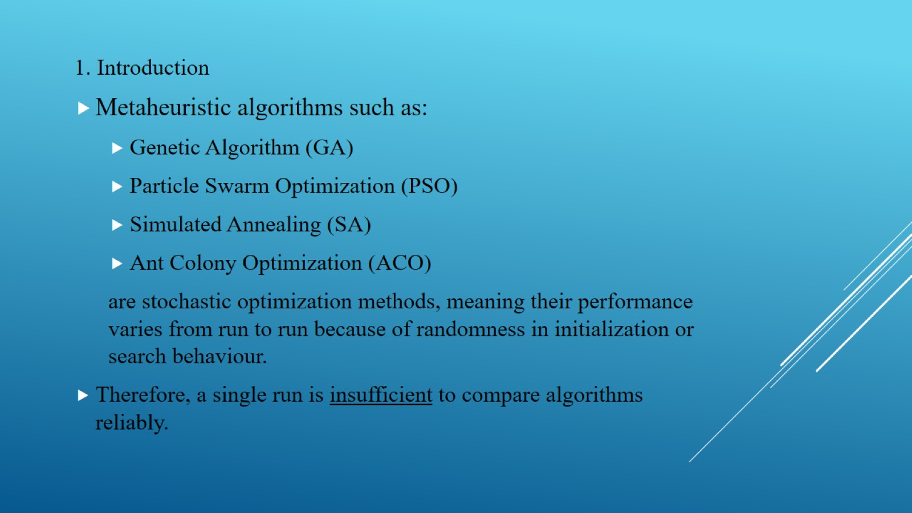

Slide 3

The standard practice is to:
Run each algorithm multiple times (typically 30–50 independent runs)
Record the best solution from each run
Compute descriptive statistics
Perform statistical significance tests
Draw conclusions based on robustness and consistency

Slide 4
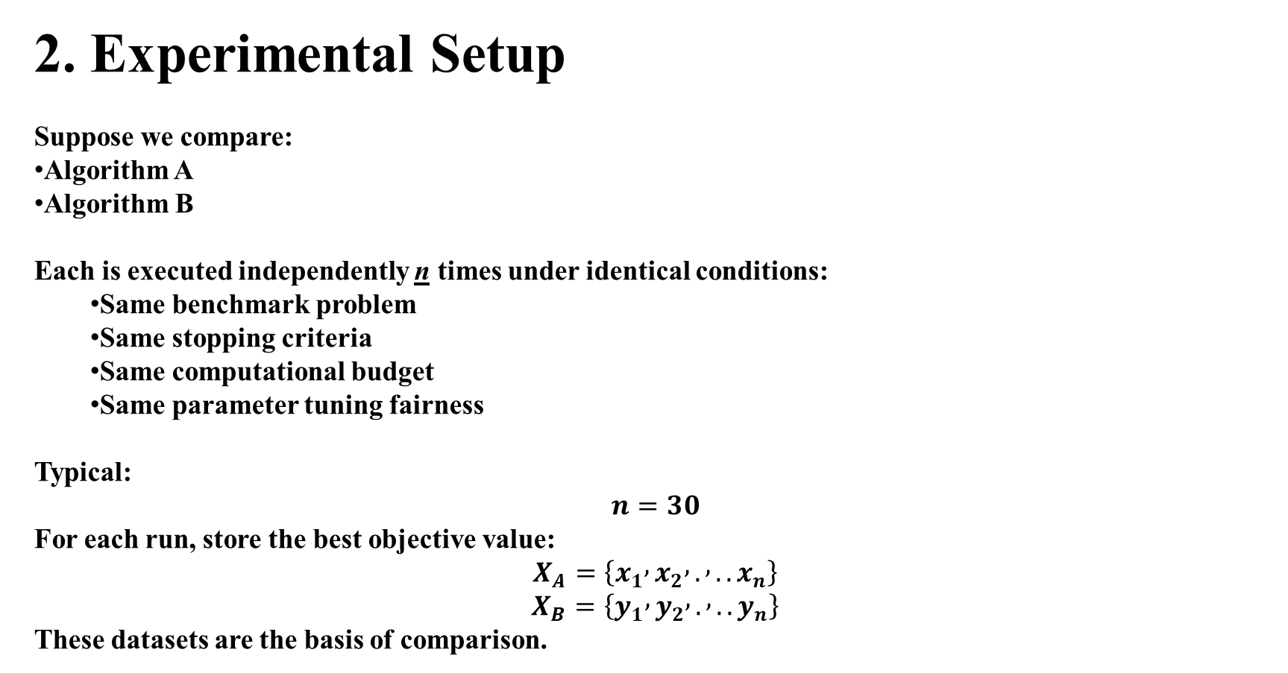
2. Experimental Setup
Suppose we compare:
Algorithm A
Algorithm B
Each is executed independently n times under identical conditions:
  Same benchmark problem
  Same stopping criteria
  Same computational budget
  Same parameter tuning fairness
Typical:
$$n=30$$
For each run, store the best objective value:
$$X_{A}=\left\{x_{1} , x_{2} , . , ..x_{n}\right\}$$
$$X_{B}=\left\{y_{1} , y_{2} , . , ..y_{n}\right\}$$
These datasets are the basis of comparison.

Slide 5
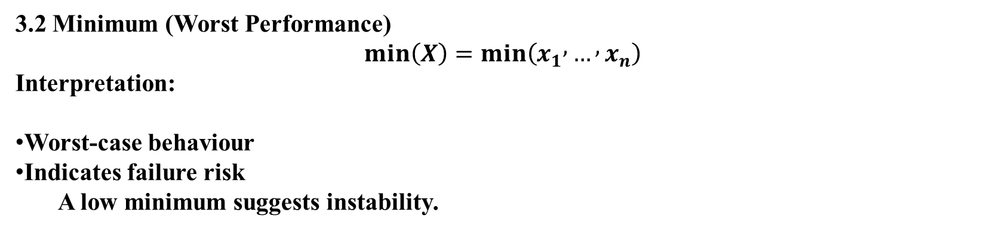
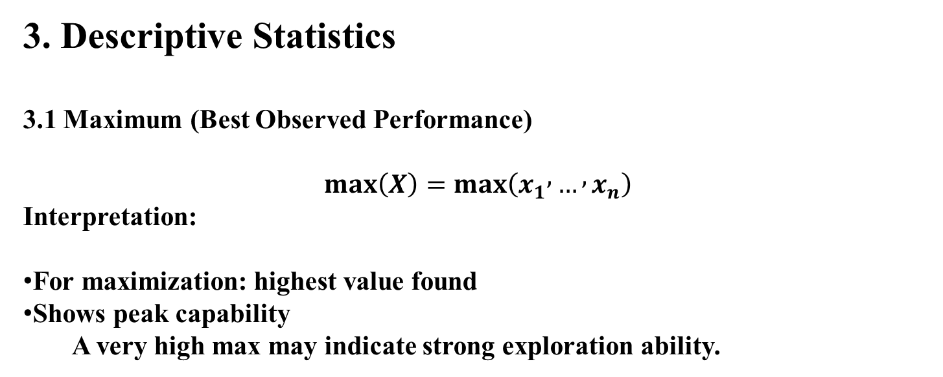
3. Descriptive Statistics
3.1 Maximum (Best Observed Performance)
$$max⁡\left(X\right)=max⁡\left(x_{1} , … , x_{n}\right)$$
Interpretation:
For maximization: highest value found
Shows peak capability
A very high max may indicate strong exploration ability.
3.2 Minimum (Worst Performance)
$$min⁡\left(X\right)=min⁡\left(x_{1} , … , x_{n}\right)$$
Interpretation:
Worst-case behaviour
Indicates failure risk
A low minimum suggests instability.

Slide 6
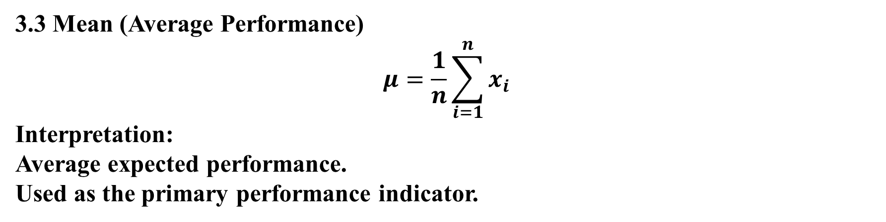
3.3 Mean (Average Performance)
$$μ=\frac{1}{n}\sum_{i=1}^{n}{x_{i}}$$
Interpretation:
Average expected performance.
Used as the primary performance indicator.

Slide 7
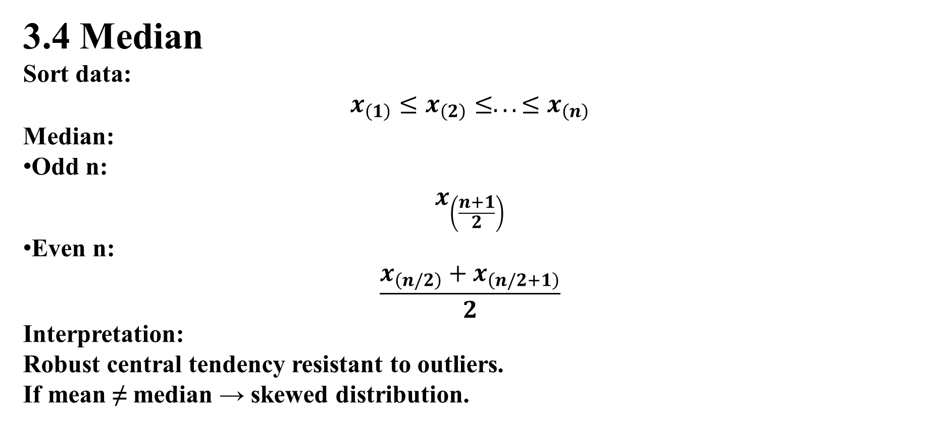
3.4 Median
Sort data:
$$x_{\left(1\right)}≤x_{\left(2\right)}≤...≤x_{\left(n\right)}$$
Median:
Odd n:
$$x_{\left(\frac{n+1}{2}\right)}$$
Even n:
$$\frac{x_{\left(n/2\right)}+x_{\left(n/2+1\right)}}{2}$$
Interpretation:
Robust central tendency resistant to outliers.
If mean ≠ median → skewed distribution.

Slide 8
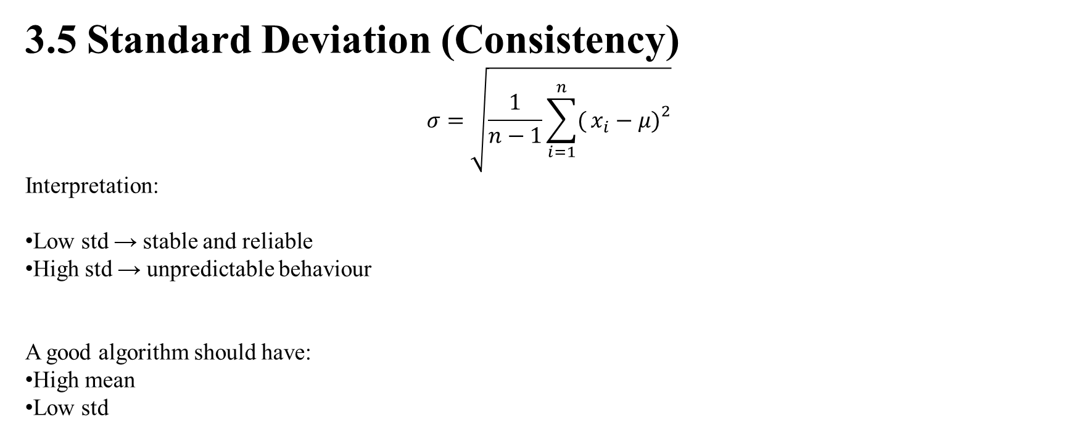
3.5 Standard Deviation (Consistency)
$$σ=\sqrt{\frac{1}{n−1}\sum_{i=1}^{n}{(}\left.x_{i}−μ{\left.)\right.}^{2}\right.}$$
Interpretation:
Low std → stable and reliable
High std → unpredictable behaviour
A good algorithm should have:
High mean
Low std

Slide 9
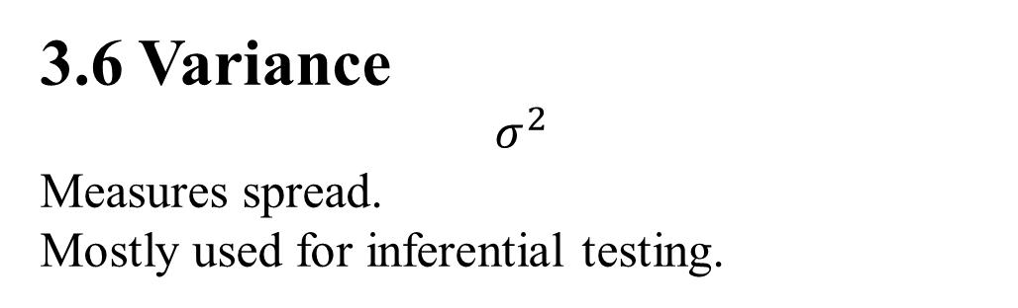
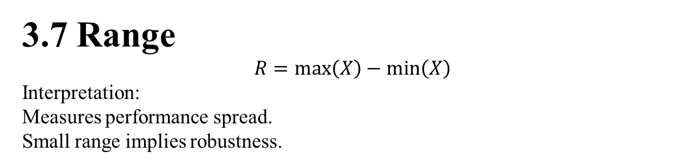
3.6 Variance
$$σ^{2}$$
Measures spread.
Mostly used for inferential testing.
3.7 Range
$$R=max⁡\left(X\right)−min⁡\left(X\right)$$
Interpretation:
Measures performance spread.
Small range implies robustness.

Slide 10
Wilcoxon Signed-Rank Test
The Wilcoxon Signed-Rank Test is a non-parametric statistical test used to compare two paired samples.
It is widely used in metaheuristic optimization because algorithm results are often:
non-normal,
noisy,
stochastic.
It is the non-parametric alternative to the paired t-test.

Slide 11
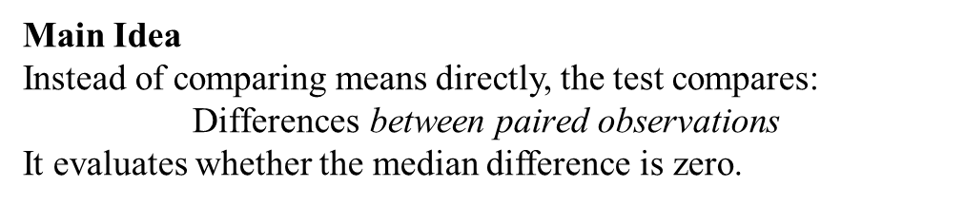
When Do We Use It?
Use the Wilcoxon Signed-Rank Test when:
Conditions
Two algorithms are compared
Example:
PSO vs GA
Results are paired
Meaning:
Both algorithms are tested under the same conditions.
Examples:
Same benchmark instances
Same random seeds
Same datasets
Main Idea
Instead of comparing means directly, the test compares:
$$\text{Differences} \text{between} \text{paired} \text{observations}$$
It evaluates whether the median difference is zero.

Slide 12
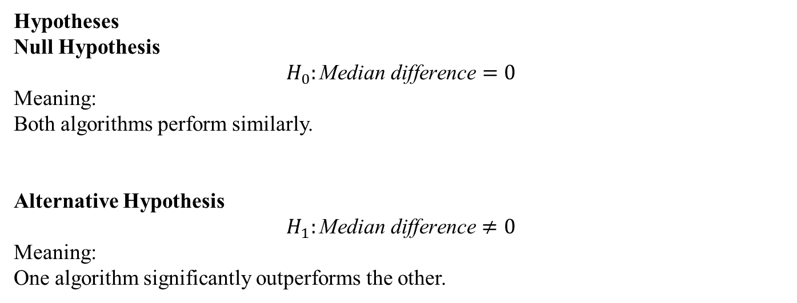
Hypotheses
Null Hypothesis
$$H_{0}:\text{Median} \text{difference}=0$$
Meaning:
Both algorithms perform similarly.
Alternative Hypothesis
$$H_{1}:\text{Median} \text{difference}≠0$$
Meaning:
One algorithm significantly outperforms the other.

Slide 13
Step-by-Step Example
Suppose we run two algorithms 10 times.
Assume higher values are better.
Run | Algorithm A | Algorithm B
1 | 95 | 90
2 | 93 | 91
3 | 96 | 92
4 | 92 | 93
5 | 97 | 95
6 | 94 | 90
7 | 98 | 94
8 | 95 | 91
9 | 96 | 92
10 | 97 | 93

Slide 14
Step 1: Compute Differences
Run | Difference
1 | 5
2 | 2
3 | 4
4 | -1
5 | 2
6 | 4
7 | 4
8 | 4
9 | 4
10 | 4
di​=Ai​−Bi​

Slide 15

Step 2: Remove Zero Differences
None are zero here.
Compute Absolute Differences
| Run | Difference | $∣d_{i}∣$|
|---|---|---|
|1|5|5|
|2|2|2|
|3|4|4|
|4|-1|1|
|5|2|2|
|6|4|4|
|7|4|4|
|8|4|4|
|9|4|4|
|10|4|4|

Slide 16
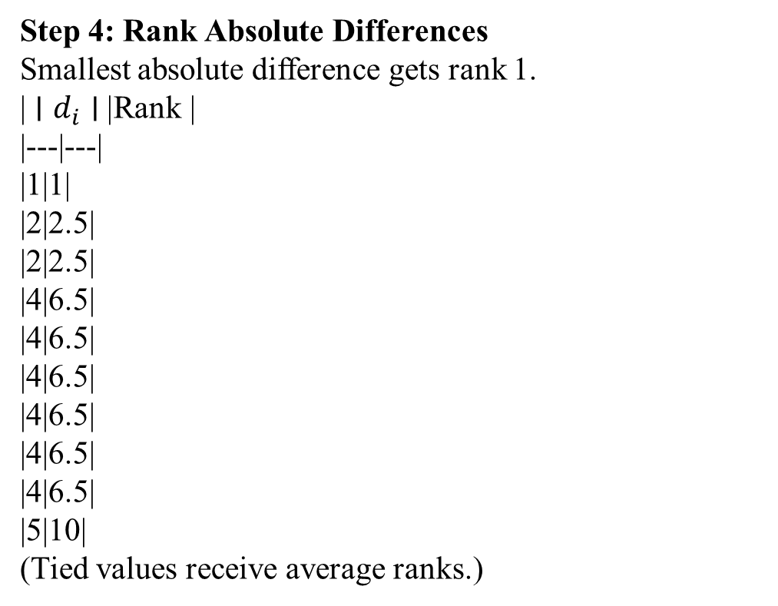
Step 4: Rank Absolute Differences
Smallest absolute difference gets rank 1.
| $∣d_{i}∣$| Rank |
|---|---|
|1|1|
|2|2.5|
|2|2.5|
|4|6.5|
|4|6.5|
|4|6.5|
|4|6.5|
|4|6.5|
|4|6.5|
|5|10|
(Tied values receive average ranks.)

Slide 17
Step 5: Restore Signs
Difference | Rank | Signed Rank
5 | 10 | +10
2 | 2.5 | +2.5
4 | 6.5 | +6.5
-1 | 1 | -1
2 | 2.5 | +2.5
4 | 6.5 | +6.5
4 | 6.5 | +6.5
4 | 6.5 | +6.5
4 | 6.5 | +6.5
4 | 6.5 | +6.5

Slide 18
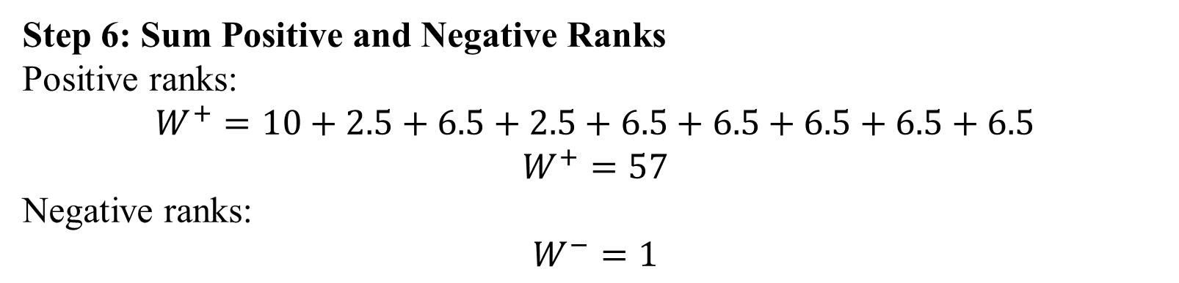
Step 6: Sum Positive and Negative Ranks
Positive ranks:
$$W^{+}=10+2.5+6.5+2.5+6.5+6.5+6.5+6.5+6.5$$
$$W^{+}=57$$
Negative ranks:
$$W^{−}=1$$

Slide 19
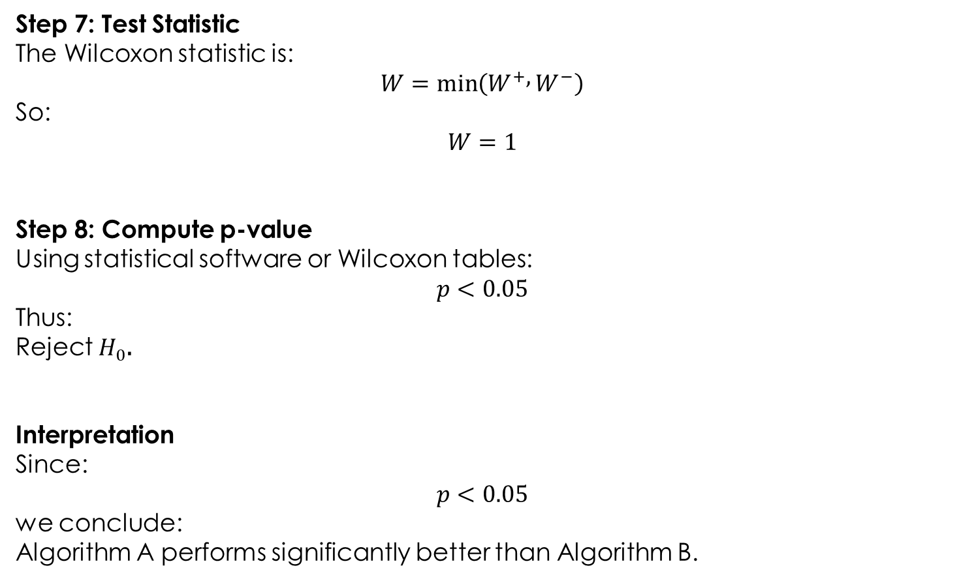
Step 7: Test Statistic
The Wilcoxon statistic is:
$$W=min⁡\left(W^{+} , W^{−}\right)$$
So:
$$W=1$$
Step 8: Compute p-value
Using statistical software or Wilcoxon tables:
$$p<0.05$$
Thus:
Reject $H_{0}$.
Interpretation
Since:
$$p<0.05$$
we conclude:
Algorithm A performs significantly better than Algorithm B.

Slide 20
Reporting Results in Research Papers
Typical reporting format:
The Wilcoxon Signed-Rank Test was conducted at a 5% significance level to compare Algorithm A and Algorithm B. The obtained p-value (0.003) indicates that Algorithm A significantly outperformed Algorithm B.

Slide 21
Example in Python
from scipy.stats import wilcoxon
A = [95,93,96,92,97,94,98,95,96,97]
B = [90,91,92,93,95,90,94,91,92,93]
stat, p = wilcoxon(A, B)
print("Statistic:", stat)
print("p-value:", p)

Slide 22
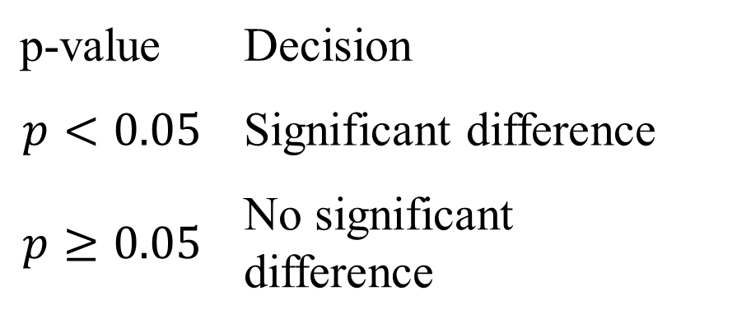
Decision Rule Summary
p-value | Decision
$$p<0.05$$ | Significant difference
$$p≥0.05$$ | No significant difference

