Slide 1
Lecture
Simulated Annealing
Tabu Search
Genetic algorithms
Ant Colony optimization

Slide 2
Basic Idea
Tabu search
Tabu search is a metaheuristic algorithm that can be used for solving combinatorial optimization problems, such as the traveling salesman problem
Tabu search uses a local or neighborhood search procedure to iteratively move from a solution x to a solution x' in the neighborhood of x, until some stopping criterion has been satisfied.
To explore regions of the search space that would be left unexplored by the local search procedure (see local optimality), tabu search modifies the neighborhood structure of each solution as the search progresses.
Allow non-improving moves, but prevent cycling back to recently visited solutions.

Slide 3
Tabu
The word tabu (or taboo) comes from Tongan
a language of Polynesia
used by the aborigines of Tonga island to indicate things that cannot be touched because they are sacred
”Loaded with a dangerous, unnatural force”
”Banned due to moral, taste or risk”

Slide 4
Tabu Search
Tabu Search:
Cut off the search from parts of the search space (temporarily)
Guide the search towards other parts of the search by using penalties and bonuses
Uses principles for intelligent problem solving
Uses structures that are exploring the search history, without remembering everything
A*: have complete memory
Simulated Annealing: have no memory

Slide 5
Origin of Tabu Search
Fred Glover 1986: ”Future paths for integer programming and links to artificial intelligence”
Pierre Hansen 1986: ”The Steepest Ascent/Mildest Descent Heuristic for Combinatorial Optimization”
Tabu coined by Glover

Slide 6
Main Ideas of Tabu Search
Based on Local Search – LS
Allows non-improving moves
can exit local optima
Uses extra memory to avoid looping, and to diversify the search
General strategy for controlling a LS, or other “inner” heuristic
Meta-Heuristic (Glover)

Slide 7
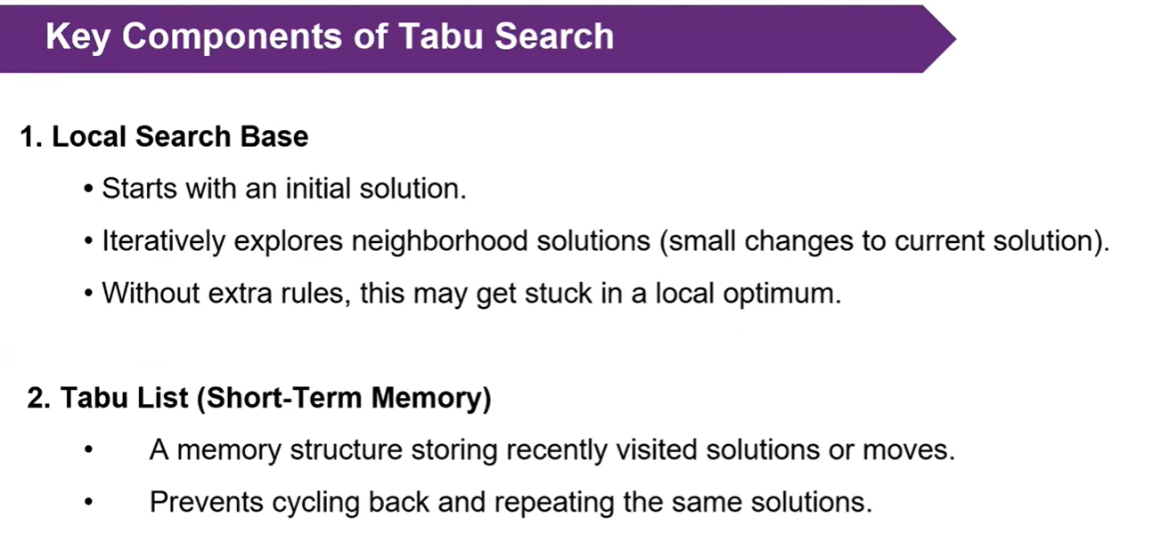
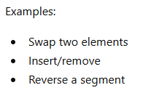

Slide 8
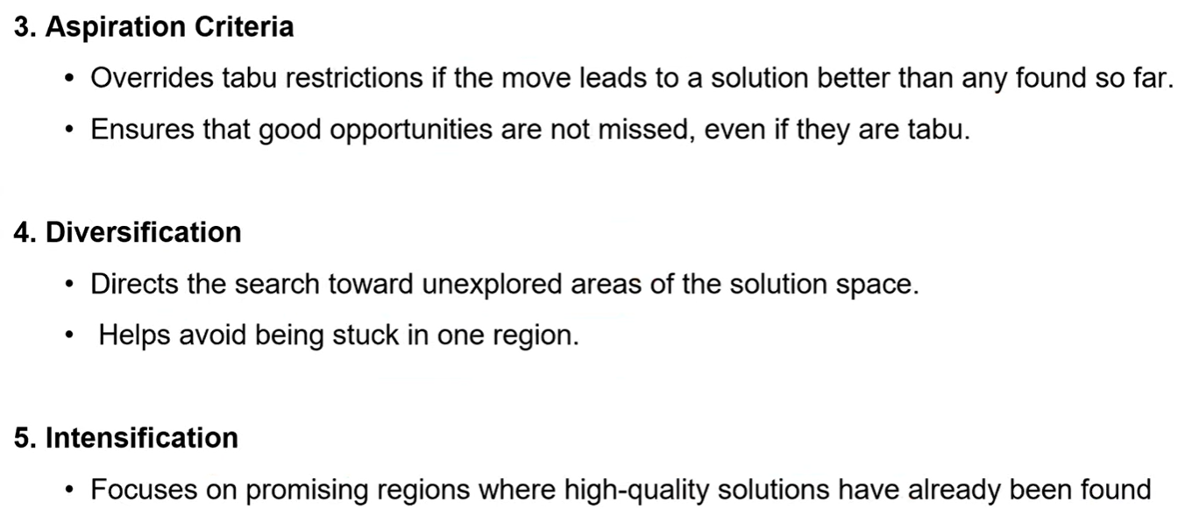

Slide 9
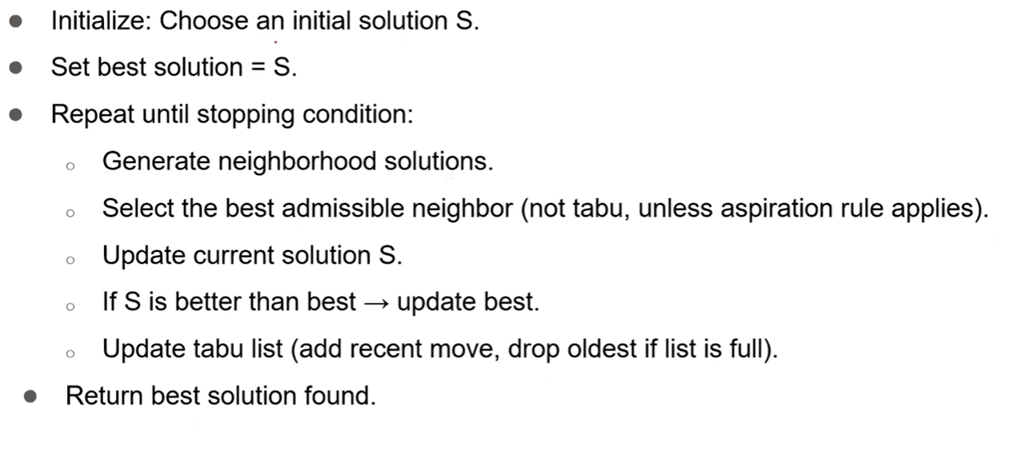
General Formulation

Slide 10
Some Critical Choices
Choice of neighborhood, N
Definition of the tabu memory
How to select the candidate list
The definition of the evaluation function
Improvement in solution values
Tabu criteria
Aspiration criteria
Long term strategies
Diversification, intensification, …

Slide 11
Basic Tabu Search
Local Search with “Best Improvement” strategy
Always select the best move
But: Some neighbors are tabu, and cannot be selected
Defined by the tabu criterion
Tabu neighbors might be selected anyway if they are deemed to be good enough
Aspiration criterion
Memory – tabu list

Slide 12
The Tabu Criterion (1)
In Tabu Search, we allow moving to a worse solution
Since we (in basic TS) always select the ”Best Improvement”, how can we avoid cycling between solutions?
The answer is the tabu criterion:
We are not allowed to move to solutions that we have visited before
They are tabu!

Slide 13
The Tabu Criterion (2)
The basic job of the tabu criterion is thus to avoid visiting the same solution more than once
How to accomplish this?
Store all the solutions visited during the search, and check that the new solution is not among those previously visited
Too time consuming!
Find some way of (approximately) represent those solutions that we have seen most recently, and avoid returning immediately to those (or similar) solutions

Slide 14
Tabu Attribute Selection
Attribute
A property of a solution or a move
Can be based on any aspect of the solution that are changed by a move
Attributes are the basis for tabu restrictions
We use them to represent the solutions visited recently
A move can change more than one attribute

Slide 15
TS – Tabu Criterion
The tabu criterion is defined on selected attributes of a move, (or the resulting solution if the move is selected)
It is very often a component of the solution
The attribute is tabu for a certain amount of time (i.e. iterations)
This is called the Tabu Tenure (TT)
The tabu criterion usually avoids the immediate move reversal (or repetition)
It also avoids the other (later) moves containing the tabu attribute. This cuts off a much larger part of the search space

Slide 16
TS – Attributes and Tabu Criteria
Can have several tabu criteria on different attributes, each with its own tabu tenure
These can be disjunct
If a move is to exchange a component (e.g. edge) in the solution with a component not in the solution, we can have the following tabu attributes and criteria
Edge added
Edge dropped
Edge added or edge dropped
Edge added and edge dropped

Slide 17
Use of Attributes in Tabu Restrictions
Assume that the move from s_{k} → s_{k+1} involves the attribute A
The usual tabu restriction:
Do not allow moves that reverse the status for A
The TSP example:
Move: exchange cities 2 and 5: x_{2,5}
The tabu criterion could disallow:
Moves involving 2 and 5
Moves involving 2 or 5
Moves involving 2
Moves involving 5

Slide 18
Tabu Tenure (1)
The tabu criterion will disallow moves that change back the value of some attribute(s)
For how long do we need to enforce this rule?
For ever: the search stops because no changes are allowed
For too long: the search might become too limited (too much of the search space is cut off due to the tabu criterion)
For too short: the search will still cycle, but the length of the cycle can be more than 2
The number of iterations for which the value of the attribute remains tabu is called the Tabu Tenure

Slide 19
Tabu Tenure (2)
Earlier: The magical number 7, plus or minus 2
Sometimes: in relation to problem size: n^{1/2}
Static (fixed) tabu tenure is not recommended
The search gets more easily stuck in loops
Dynamic tabu tenure is highly recommended
Change the tabu tenure at certain intervals
Can use uniform random selection in [tt₁, tt₂]
This is usually called dynamic, even though it is not
Reactive Tabu Search
Detect stagnation → increase TT
When escaped → reduce TT

Slide 20
Tabu Tenure (3)
Dependent on the tabu attributes
Example: TSP – n cities – 2-opt
Use edges-added and edges-dropped as tabu attributes
|n²| edges in the problem instance
|n| edges in the solution
Many more edges outside the solution than in the solution
Using the same TT would be unbalanced

Slide 21
Aspiration Criterion (1)
The tabu criterion is usually not exact
Some solutions that are not visited are nevertheless tabu for some time
Possible problem: one of the neighbors is very good, but we cannot go there because some attribute is tabu
Solution: if we somehow know that the solution is not visited before, we can allow ourselves to move there anyway
i.e., the solution is a new best solution: obviously we have not visited it before!

Slide 22
Aspiration Criterion (2)
Simplest: Allow new best solutions, otherwise keep tabu status
Criteria based on
Degree of feasibility
Degree of change
Feasibility level vs. Objective function value
Objective function value vs. Feasibility level
Distance between solutions
E.g. hamming distance
Influence of a move
The level of structural change in a solution
If all moves are tabu:
Choose the best move, or choose randomly (in the candidate list)

Slide 23
TS - Diversification
Basic Tabu Search often gets stuck in one area of the search space
Diversification is trying to get to somewhere else
Historically random restarts have been very popular
Frequency-based diversification tries to be more clever
penalize elements of the solution that have appeared in many other solutions visited

Slide 24
TS - Intensification
To aggressively prioritize good solution attributes in a new solution
Usually based on frequency
Can be based on elite solutions, or part of them (vocabularies)

Slide 25
Flowchart of a Standard Tabu Search Algorithm
Initial solution
(i in S)
Create a candidate
list of solutions
Evaluate solutions
Stopping conditions
satisfied ?
Update Tabu &
Aspiration
Conditions
No
Choose the best
admissible solution
Yes
Final solution

Slide 26
Basic Concepts
Tabu-lists contains moves which have been made in the recent past but are forbidden for a certain number of iterations.
Algorithm
Step 1.
k=1
Select an initial schedule S₁ using some heuristic and set S_{best} = S₁
Step 2.
Select S_{c}∈N(S_{k})
If the move S_{k} → S_{c} is prohibited by a move on the tabu-list
then go to Step 2
If the move S_{k} → S_{c} is not prohibited by a move on the tabu-list
then S_{k+1} = S_{c}
Enter reverse move at the top of the tabu-list
Push all other entries in the tabu-list one position down
Delete the entry at the bottom of the tabu-list
If F(S_{c}) < F(S_{best}) then S_{best} = S_{c}
Go to Step 3.
Step 3.
k = k+1 ;
If stopping condition = true then STOP
else go to Step 2
Notes:
Modern Heuristic Search Methods, (Eds.) V.J. Rayward-Smith, I.H.Osman, C.R. Reeves, G.D. Smith, John Wiley & Sons Ltd. 1996

Slide 27
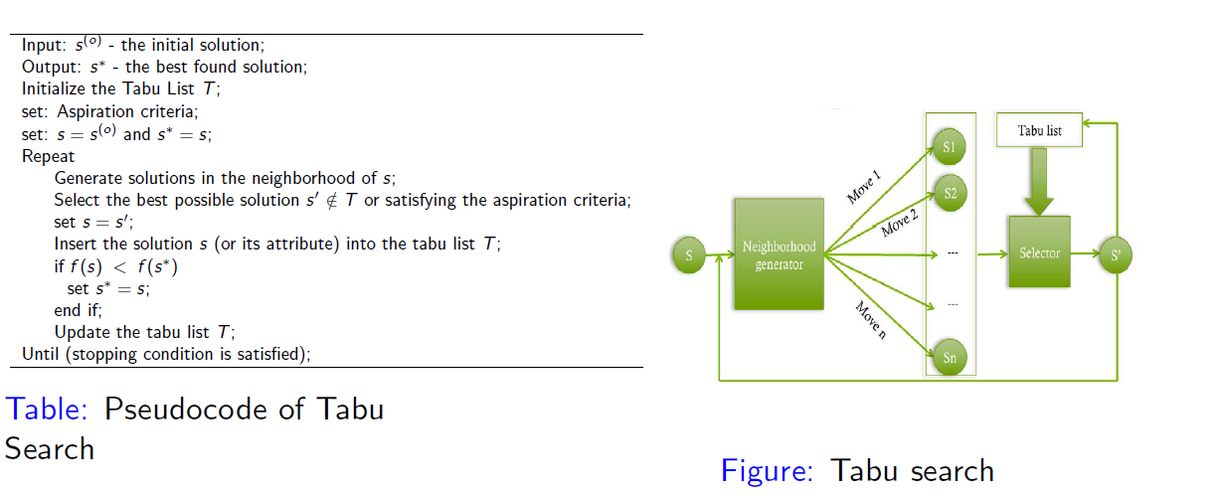

Slide 28
TS Example: TSP
Representation: permutation vector
Move: pairwise exchange
5
2
3
7
1
6
4

Slide 29
Move: Exchange in permutation vector
5
2
3
7
1
6
4
Move: Exchange(5,6)
5
2
3
7
1
6
4

Slide 30
TSP Example
Number of neighbors:
For every neighbor: Move value
Choice of tabu criterion
Attribute: cities involved in a move
Moves involving the same cities are tabu
Tabu tenure = 3 (fixed)
Aspiration criterion
new best solution

Slide 31
TSP Example: Data structure
Data structure: triangular table, storing the number of iterations until moves are legal
Updated for every move

Slide 32
TSP Example: Tabu Criteria/Attributes
Illegal to operate on given cities
Illegal to change the city in position k in the vector
Criteria on edges
Links often present in good solutions
Length of links w.r.t. the average
For permutation problems
Attributes related to previous/next often work well
5
2
3
7
1
6
4

Slide 33
TSP Example: Iteration 0
Starting solution: Value = 234
Tabu list:

Slide 34
TSP Example: Iteration 1
Current solution: Value = 234
Candidate list:
After move: Value = 200
Tabu list:

Slide 35
TSP Example: Iteration 2
Current solution: Value = 200
Candidate list:
Choose move (3,1)
Tabu list:

Slide 36
TSP Example: Iteration 2
Current solution: Value = 200
Candidate list:
Choose move (3,1)
Update tabu list
Tabu list:

Slide 37
TSP Example: Iteration 3
Current solution: Value = 198
Candidate list:
Tabu!
Choose move (2,4)
NB: Worsening move!
Tabu list:

Slide 38
TSP Example: Iteration 3
Current solution: Value = 198
Candidate list:
Tabu!
Choose move (2,4)
NB: Worsening move!
Tabu list:
Update
tabu list

Slide 39
TSP Example: Iteration 4
Current solution: Value = 202
Candidate list:
Tabu!
Choose move (4,5)
Aspiration!
Tabu list:

Slide 40
Observations
In the example 3 out of 21 moves are prohibited
More restrictive tabu effect can be achieved by
Increasing the tabu tenure
Using stronger tabu-restrictions
Using OR instead of AND for the 2 cities in a move

Slide 41
TSP Example: Frequency Based Long Term Memory
Typically used to diversify the search
Can be activated after a period with no improvement
Often penalize attributes of moves that have been selected often
Tabu-status (closeness in time)
Frequency of moves

Slide 42
