Slide 1
CMPE/CMSE371
Analysis of Algorithms
Exercises & Solutions – PART II

Slide 3
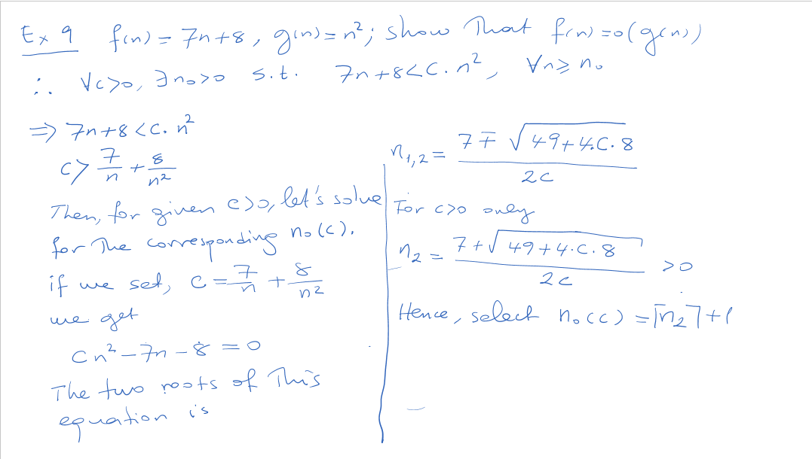

Slide 4
