Slide 1
Line
1. for i ←0 to 3
2. printf("\n i = %d" , i);
3. printf("\n i = %d" , i);
i ← | i < 4 | printing
0 | true | i = 0
1 | true | i = 1
2 | true | i = 2
3 | true | i = 3
4 | false

Slide 2
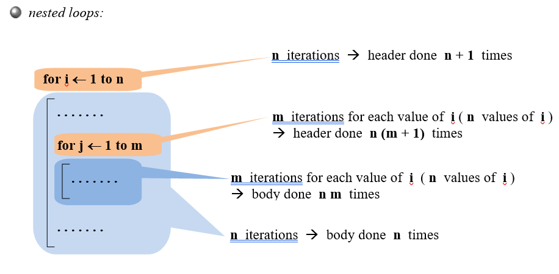

Slide 3
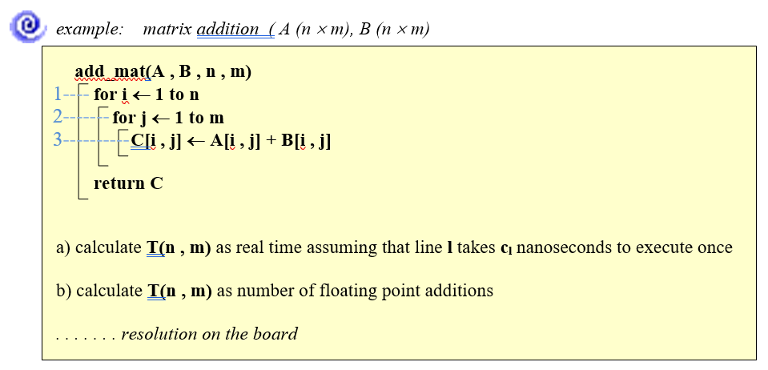

Slide 4
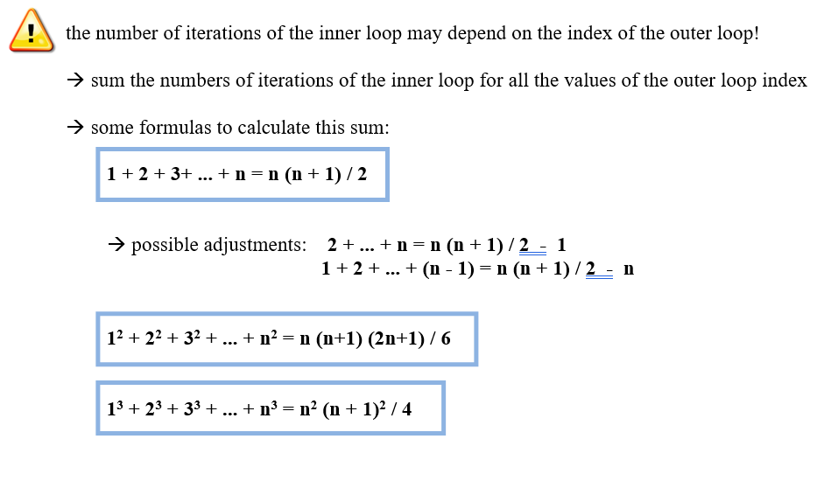

Slide 15
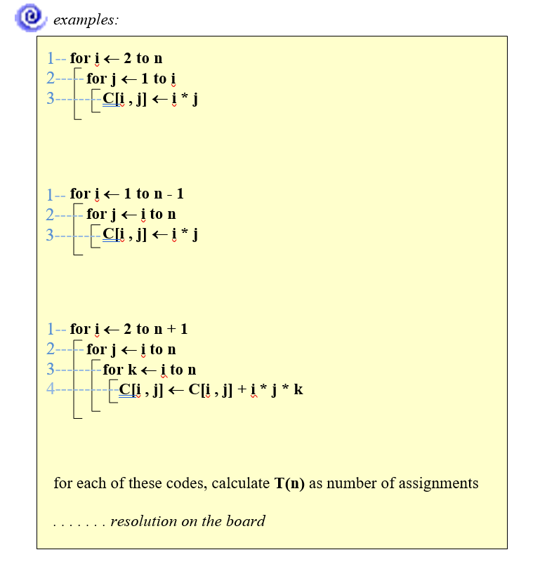

Slide 18
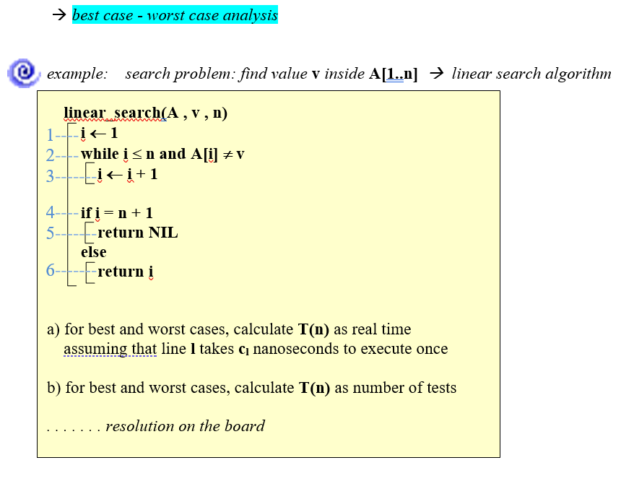

Slide 20
Example:
Algorithm LinearSearch(A, key)
1 i ← 1
2 while i ≤ n and A[i] != key
3 do i++
if i ≤ n
then return true
else return false

Slide 21
INPUT: a sequence of n numbers, key to search for.
OUTPUT: true if key occurs in the sequence, false otherwise.
LinearSearch(A, key) cost times
1 i ← 1 c₁ 1
2 while i ≤ n and A[i] != key c₂ x
3 do i++ c₃ x-1
if i ≤ n c₄ 1
then return true c₅ 1
else return false c₆ 1
x ranges between 1 and n+1.
So, the running time ranges between
c₁+ c₂+ c₄ + c₅ – best case
and
c₁+ c₂(n+1)+ c₃n + c₄ + c₆ – worst case

Slide 22
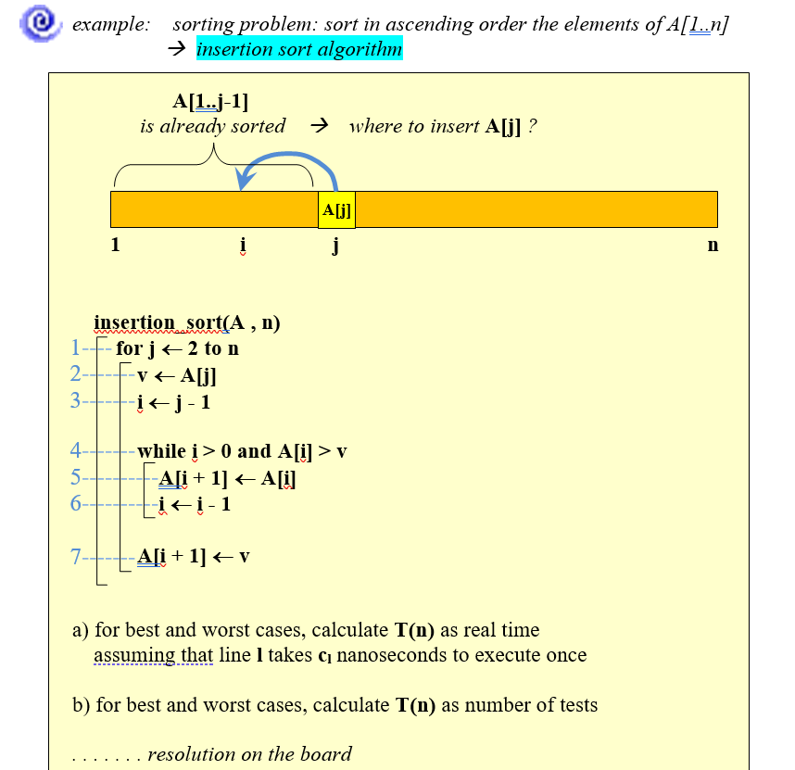

Slide 23
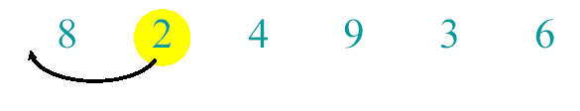
Example of Insertion Sort

Slide 24

Example of Insertion Sort

Slide 25
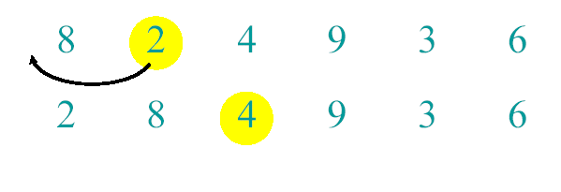
Example of Insertion Sort

Slide 26
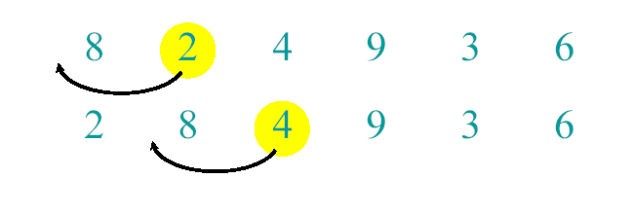
Example of Insertion Sort

Slide 27
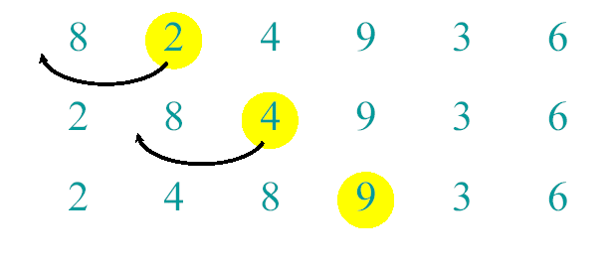
Example of Insertion Sort

Slide 28
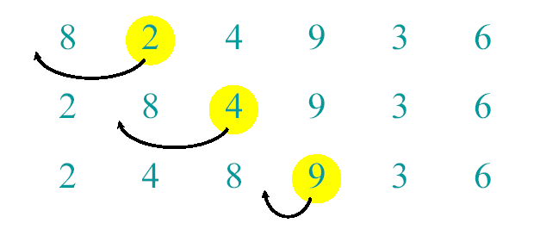
Example of Insertion Sort

Slide 29
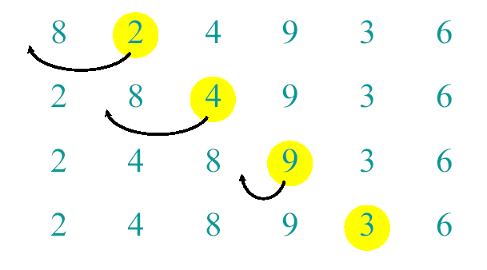
Example of Insertion Sort

Slide 30
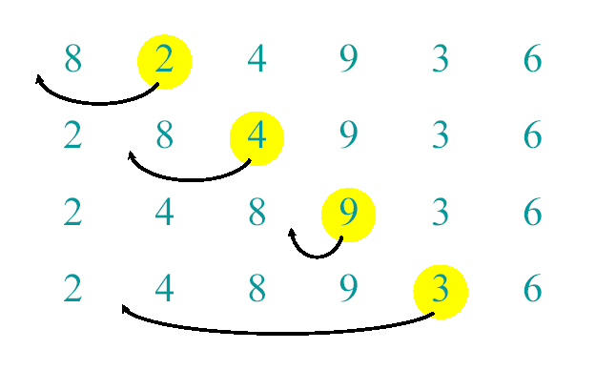
Example of Insertion Sort

Slide 31
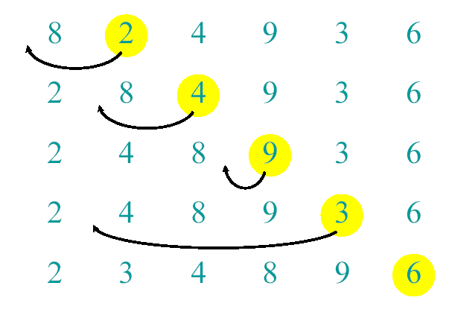
Example of Insertion Sort

Slide 32
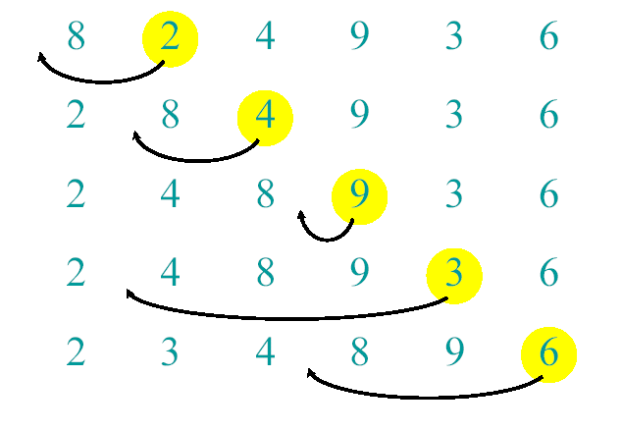
Example of Insertion Sort

Slide 33
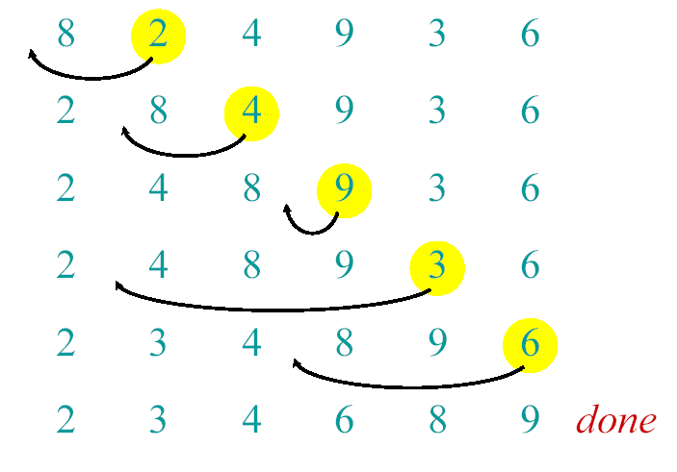
Example of Insertion Sort

Slide 34
Analysis of INSERTION-SORT(contd.)

Slide 35
Analysis of INSERTION-SORT(contd.)
The total running time is

Slide 36
Analysis of INSERTION-SORT(contd.)
The best case: The array is already sorted.
(t_{j} =1 for j=2,3, ...,n)

Slide 37
Analysis of INSERTION-SORT(contd.)
The worst case: The array is reverse sorted
(t_{j} =j for j=2,3, ...,n).

