Slide 1
CMPE371 Analysis of Algorithms Exersises Before Midterm Exam

Slide 17
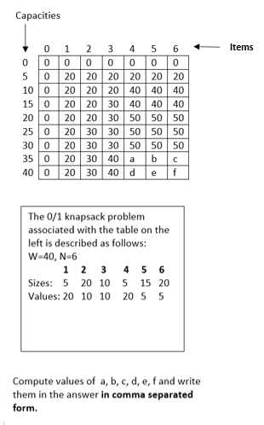
Question 4

Slide 18
Q.5. Considering the 0/1 knapsack question, what is the optimum value stored in the knapsack?

Slide 22
Rod Cutting not included in Midterm II.

Slide 25
What are the optimal piece lengths for the rod-cutting problem. Write own your answer in comma separated form.

Slide 26
Given T(n) = 3*T(n-3)+2, solve for T(n) and write down the solution in answer area using an appropriate asymptotic relation. In case that you cannot write the expression algebraically, you can write in word, like
BigOh(n square) or BigOh(n^2).

