Slide 1
CMPE371
Analysis of Algorithms
FALL 2022-2023
Lecture 1

Slide 2
Lecture 1
Programming Techniques
Brute force approach
Divide and conquer
Greedy algorithms:
activity selection problem
fractional knapsack problem
Dynamic programming:
matrix chain multiplication problem
longest common subsequence problem
Graph Algorithms
Running Time Analysis of Algorithms
Introduction
Pseudo-code representation of an algorithm
Analyzing algorithms
Measuring the running time and memory size of an algorithm
Calculating the running time and memory size of an iterative algorithm
Order of growth of a function, asymptotic notations
Calculating the algorithmic complexity of an iterative algorithm:
practical rules
Calculating the algorithmic complexity of a recursive algorithm:
recursion tree method

Slide 3
Introduction
what is a computer program?
a set of instructions written in a specific programming language
that is complete enough for a computer to execute it automatically
what is an algorithm?
fundamental structure of a computer program
set of instructions written in an abstract form, pseudo-code or flowchart,
independently from any specific computer or programming language
→ explains clearly to a human brain the general procedure to solve a problem

Slide 4
Example: sorting
  input: A sequence of numbers.
  output: An ordered permutation of the input.
  issues: correctness, efficiency, storage, etc.
Input
Algorithm
Output

Slide 5
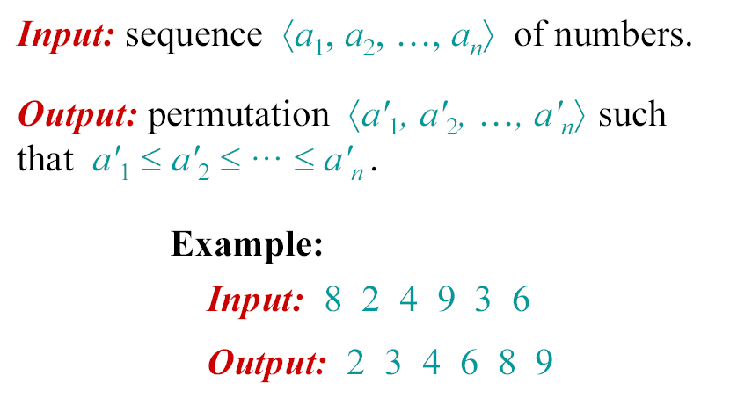
The problem of sorting

Slide 6
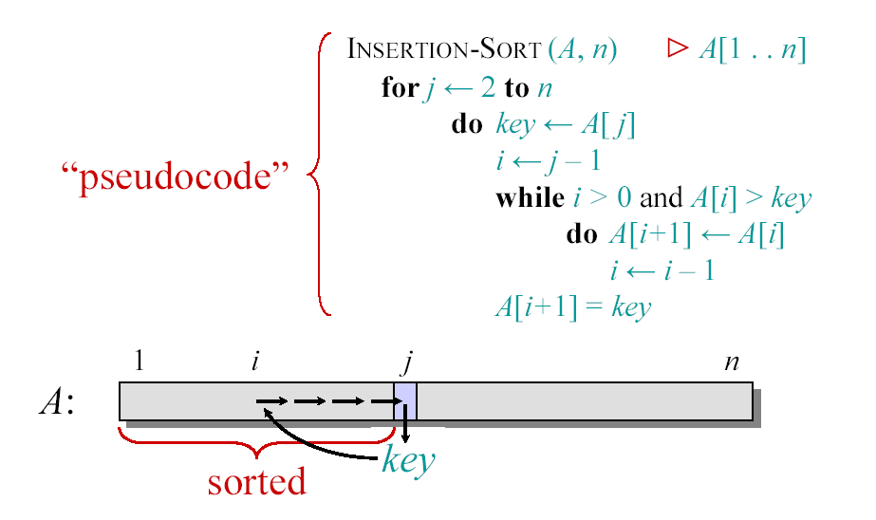
Insertion Sort

Slide 7

what are the costs of running a computer program on a computer?
→ some time and some memory...
→ cost analysis: we must have an idea of the running time and memory size
required to solve a problem of a certain size
maybe resolution becomes intractable when problem size increases...
(would require a PC to run for even longer than the age of the universe, 13 billion years)
intractable: possible in theory but impossible in practice...
no need to write a program if we realize that it will not be usable...
→ we should analyze the algorithm to know in advance the costs of running it

Slide 8
Algorithm Analysis
Determining performance characteristics.
(Predicting the resource requirements.)
  Time, memory, communication bandwidth etc.
  Computation time (running time) is of primary concern.
Why analyze algorithms?
  Choose the most efficient of several possible algorithms for the same problem.
  Is the best possible running time for a problem reasonably finite for practical purposes?
  Is the algorithm optimal (best in some sense)? – Is something better possible?

Slide 9
Analysis of algorithms
The theoretical study of computer-program
performance and resource usage.
What’s more important than performance?
• modularity
• correctness
• maintainability
• functionality
• robustness
• user-friendliness
• programmer time
• simplicity
• extensibility
• reliability

Slide 11
Running Time – Definition
Call each simple instruction and access to a word of memory a “primitive operation” or “step.”
Running time of an algorithm for a given input is
  The number of steps executed by the algorithm on that input.
Often referred to as the complexity of the algorithm.

Slide 12
Complexity and Input
Complexity of an algorithm generally depends on
  Size of input.
    Input size depends on the problem.
      Examples: Number of items to be sorted.
      Number of vertices and edges in a graph.
  Other characteristics of the input data.
    Are the items already sorted?
    Are there cycles in the graph?

Slide 13
Worst, Average, and Best-case Complexity
Worst-case Complexity
  Maximum steps the algorithm takes for any possible input.
  Most tractable measure.
Average-case Complexity
  Average of the running times of all possible inputs.
  Demands a definition of probability of each input, which is usually difficult to provide and to analyze.
Best-case Complexity
  Minimum number of steps for any possible input.
  Not a useful measure. Why?

Slide 14

Pseudo-code representation of an algorithm
to analyze easily an algorithm, we need to represent it in a way that is:
♦ clear and straightforward (the brain must easily comprehend its structure)
♦ without any detail of implementation (unnecessary for analysis)
♦ independent from any programming language (meant for the brain, not for a computer)
flowchart representation of an algorithm is mostly outdated and not suitable for analysis

Slide 15
pseudo-code conventions:
→ based on the principles of structured programming
(sequential structure, conditional structure, iterative structure)
→ based on data abstraction:
♦ no variable declarations, no types
♦ we do not specify any memory allocation
♦ no pointers, no pointer arithmetic

Slide 17
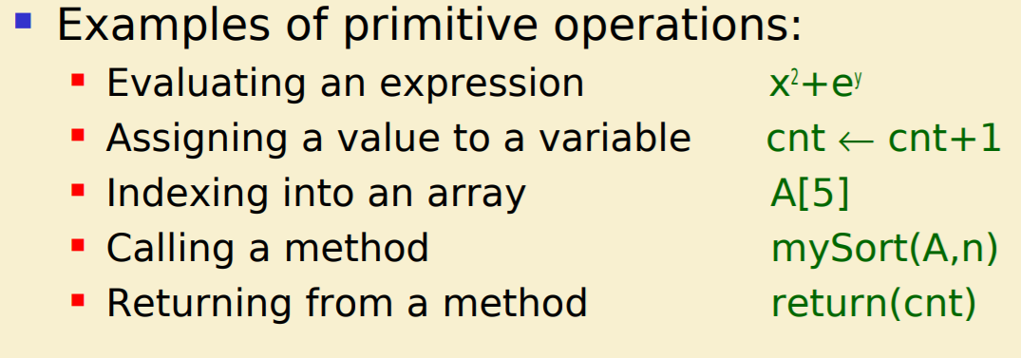

Slide 18
no input - output operations
assignment: variable ← value
if-then-else construct
while construct
block of code represented with indentation and vertically stretched square bracket
1D array: A[1..n] with 1..n range of the index → element: A[i]
2D array: A[1..n , 1..m] with 1..n and 1..m ranges of indices → element: A[i , j]
function call: similar to C → arguments are passed by value
except for arrays that are passed by reference

Slide 21
Analyzing algorithms
we must analyze an algorithm in order to predict the costs of executing it on a computer:
♦ running time necessary to execute the code → T(n), n: input size
♦ size of memory necessary for the data structures of the code

Slide 22
why we should know the costs of an algorithm before coding it:
better to know in advance if the algorithm can be executed with affordable costs:
♦ running time of at most a few months...
♦ memory size inferior to the RAM (or virtual memory) of our computer.
find the bottlenecks, i.e. the parts of the program that will take the most time
compare the efficiencies of two (or more) algorithms

Slide 23
we assume a generic model of computer:
only one CPU
instructions are executed one after the other
→ no parallelism, no concurrency

Slide 24
quantifying problem size and costs:

Slide 25
Insertion Sort

Slide 26
running time as a function:

Slide 27
best case - average case - worst case:
for a given n, T(n) varies between
its best case value (when the code runs in the shortest possible time)
and
its worst case value (when the code runs in the longest possible time)
most of the time, T(n) is around its average case value

Slide 28
best case - worst case analysis:
find in the code the test(s) over the data
→ choose for these test(s) the values that minimize - maximize T(n)
→ lower bound - upper bound for T(n)
worst case is the most significant case :
♦ we know things cannot be worse than that!
♦ very often, the average case happens to be nearly as bad as the worst case

Slide 29
Measuring the running time and memory size of an algorithm (T(n)):
problem: to measure T(n) and the memory size, we must first write the code and run it !
measure the running time:
direct measure of physical time
→ use function clock() in C language
#include <time.h>
. . . . . . .
clock_t t0 = clock();
for (i = 1 ; i <= n ; i++)
for (j = i + 1 ; j <= n ; j++)
if (a[i][j] < 0)
a[i][j] = a[i][j] * a[i][j];
printf("\n running time = %f" , (double)(clock() - t0) / CLOCKS_PER_SEC);
. . . . . . .

Slide 30
int counter = 0;
for (i = 1 ; i <= n ; i++)
for (j = i + 1 ; j <= n ; j++)
if (a[i][j] < 0)
{ a[i][j] = a[i][j] * a[i][j];
counter++; }
printf("\n running time = %d" , counter);

