Slide 1
CMPE371
Analysis of Algorithms
FALL 2022-2023
Lecture 3

Slide 2
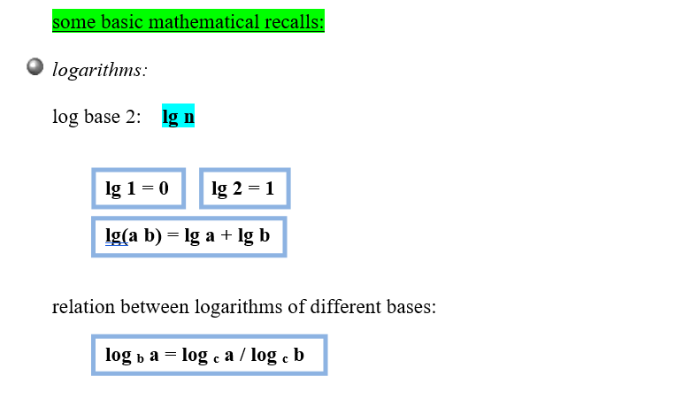
Order of growth of a function, asymptotic notations

Slide 3
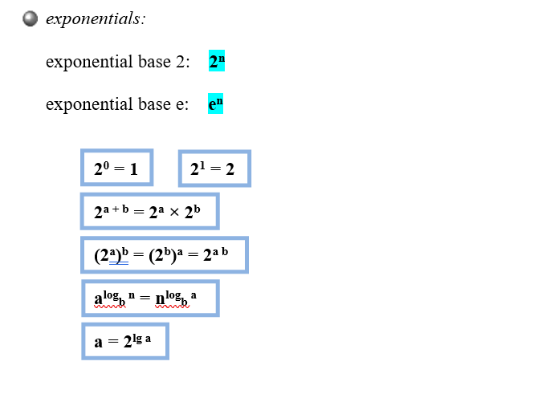

Slide 4
Order of growth
Principal interest is to determine
  how running time grows with input size – Order of growth.
  the running time for large inputs – Asymptotic complexity.
In determining the above,
  Lower-order terms and coefficient of the highest-order term are insignificant.
  Ex: In 7n⁵+6n³+n+10, which term dominates the running time for very large n?
Complexity of an algorithm is denoted by the highest-order term in the expression for running time.
  Ex: Ο(n), Θ(1), Ω(n²), etc.
  Constant complexity when running time is independent of the input size – denoted Ο(1).
  Linear Search: Best case Θ(1), Worst and Average cases: Θ(n).

Slide 5
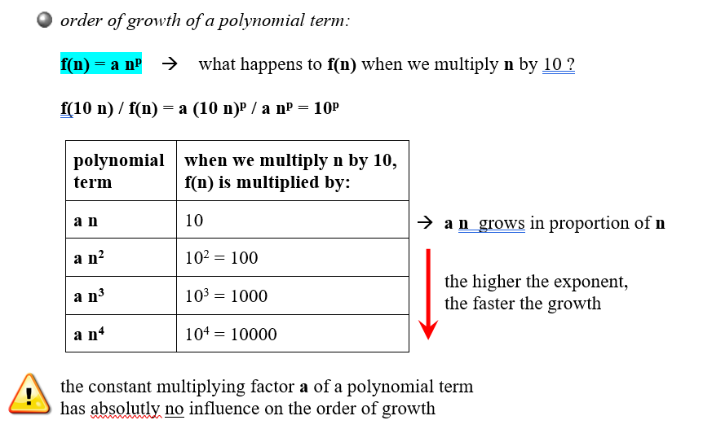

Slide 6
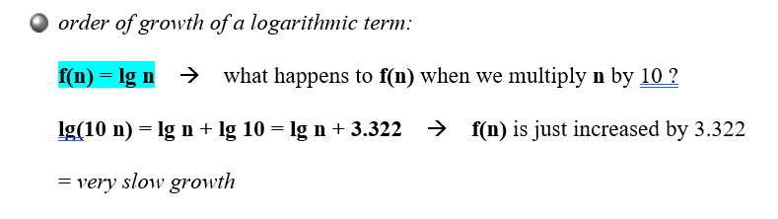
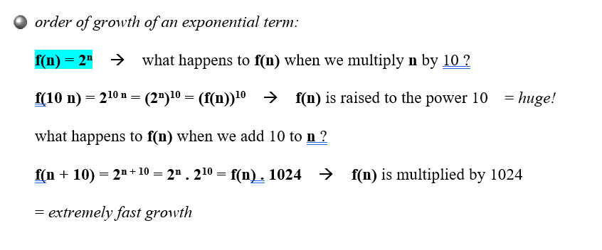

Slide 7
Comparison of Algorithms
Complexity function can be used to compare the performance of algorithms.
Algorithm A is more efficient than Algorithm B for solving a problem, if the complexity function of A is of lower order than that of B.
Examples:
  Linear Search – Θ(n) vs. Binary Search – Θ(lg n)
  Insertion Sort – Θ(n²) vs. Quick Sort – Θ(n lg n)

Slide 8
Asymptotic Notation,

Slide 9
Asymptotic Complexity
Running time of an algorithm as a function of input size n for large n.
Expressed using only the highest-order term in the expression for the exact running time.
  Instead of exact running time, say Θ(n²).
Describes behavior of function in the limit.
Written using Asymptotic Notation.

Slide 10
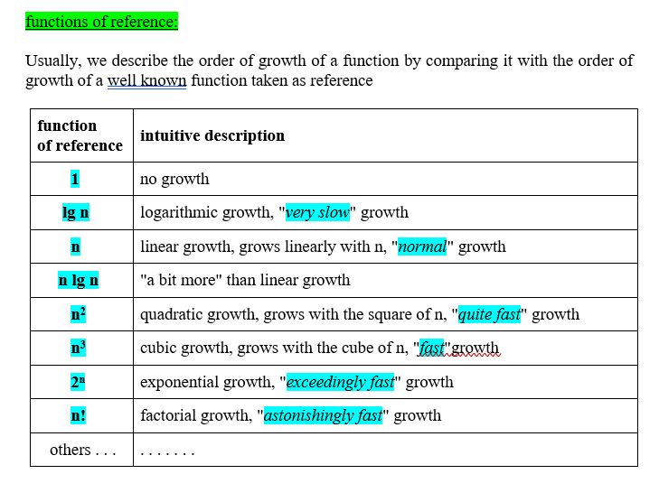

Slide 11
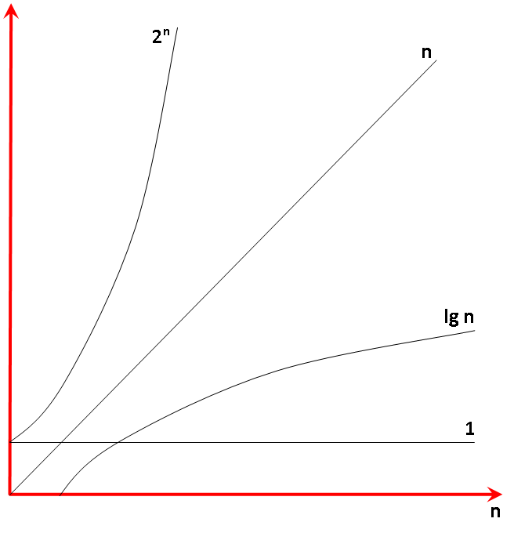

Slide 12
Asymptotic Notation
Θ, O, Ω, o, ω
Defined for functions over the natural numbers.
  Ex: f(n) = Θ(n²).
  Describes how f(n) grows in comparison to n².
Define a set of functions; in practice used to compare two function sizes.
The notations describe different rate-of-growth relations between the defining function and the defined set of functions.

Slide 13
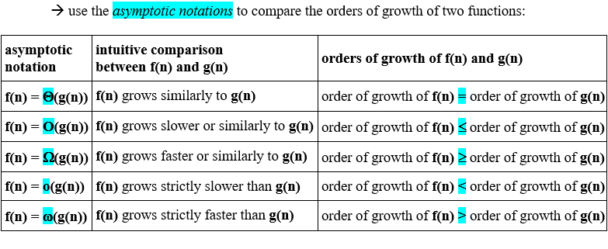

Slide 14
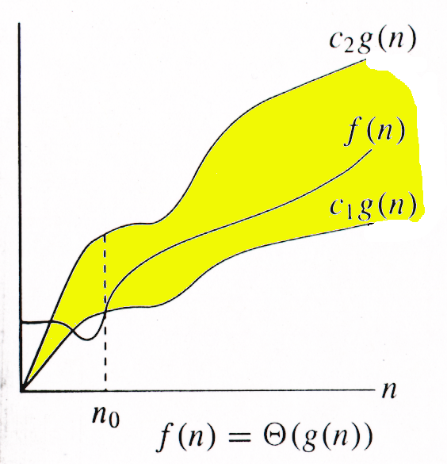
Θ-notation
For function g(n), we define Θ(g(n)), big-Theta of n, as the set:
Θ(g(n)) = {f(n) :
∃ positive constants c₁, c₂, and n_{0,} such that ∀n ≥ n₀,
we have 0 ≤ c₁g(n) ≤ f(n) ≤ c₂g(n)
}
Intuitively: Set of all functions that
have the same rate of growth as g(n).
g(n) is an asymptotically tight bound for f(n).

Slide 15
Example
Θ(g(n)) = {f(n) : ∃ positive constants c₁, c₂, and n₀, such that ∀n ≥ n₀, 0 ≤ c₁g(n) ≤ f(n) ≤ c₂g(n)}
10n² - 3n = Θ(n²)
What constants for n₀, c₁, and c₂ will work?
Make c₁ a little smaller than the leading coefficient, and c₂ a little bigger.
To compare orders of growth, look at the leading term.
Exercise: Prove that (n²/2)-3n= Θ(n²)

Slide 16
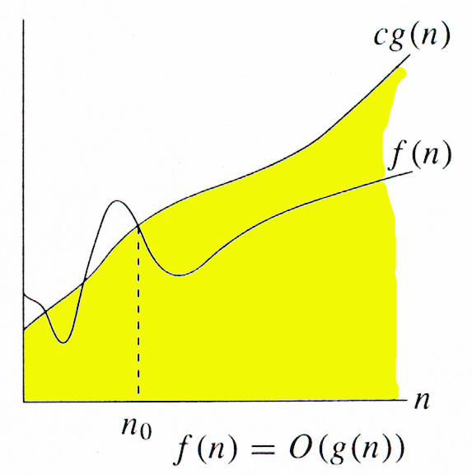
O-notation
For function g(n), we define O(g(n)), big-O of n, as the set:
O(g(n)) = {f(n) :
∃ positive constants c and n_{0,} such that ∀n ≥ n₀,
we have 0 ≤ f(n) ≤ cg(n) }
Intuitively: Set of all functions whose rate of growth is the same as or lower than that of g(n).
g(n) is an asymptotic upper bound for f(n).
f(n) = Θ(g(n)) ⇒ f(n) = O(g(n)).
Θ(g(n)) ⊂ O(g(n)).

Slide 17
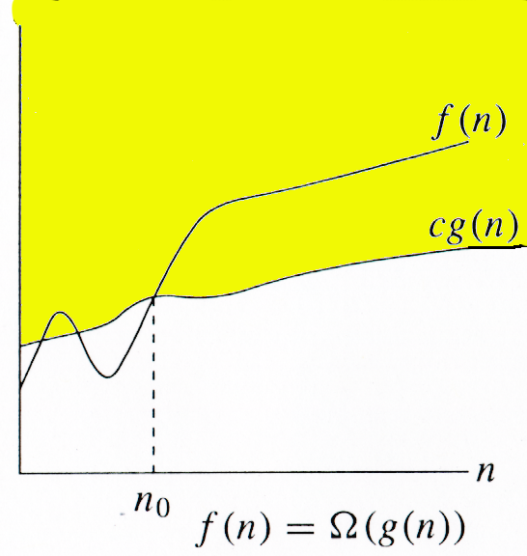
Ω -notation
For function g(n), we define Ω(g(n)), big-Omega of n, as the set:
Ω(g(n)) = {f(n) :
∃ positive constants c and n_{0,} such that ∀n ≥ n₀,
we have 0 ≤ cg(n) ≤ f(n)}
Intuitively: Set of all functions whose rate of growth is the same as or higher than that of g(n).
g(n) is an asymptotic lower bound for f(n).
f(n) = Θ(g(n)) ⇒ f(n) = Ω(g(n)).
Θ(g(n)) ⊂ Ω(g(n)).

Slide 18
Relations Between Θ, O, Ω
limn→∞ f(n)/g(n) ≠0,∞ ⇒ f = Θ(g)
limn→∞ f(n)/g(n) ≠ ∞ ⇒ f = O(g)
limn→∞ f(n)/g(n) ≠ 0 ⇒ f = Ω(g)

Slide 19
o-notation
For a given function g(n), the set little-o:
o(g(n)) = {f(n): ∀ c > 0, ∃ n₀ > 0 such that
∀ n ≥ n₀, we have 0 ≤ f(n) < cg(n)}.
f(n) becomes insignificant relative to g(n) as n approaches infinity:
lim [f(n) / g(n)] = 0
^{n→∞}
g(n) is an upper bound for f(n) that is not asymptotically tight.
Observe the difference in this definition from previous ones.

Slide 20
ω -notation
For a given function g(n), the set little-omega:
ω(g(n)) = {f(n): ∀ c > 0, ∃ n₀ > 0 such that
∀ n ≥ n₀, we have 0 ≤ cg(n) < f(n)}.
f(n) becomes arbitrarily large relative to g(n) as n approaches infinity:
lim [f(n) / g(n)] = ∞.
^{n→∞}
g(n) is a lower bound for f(n) that is not asymptotically tight.

Slide 22
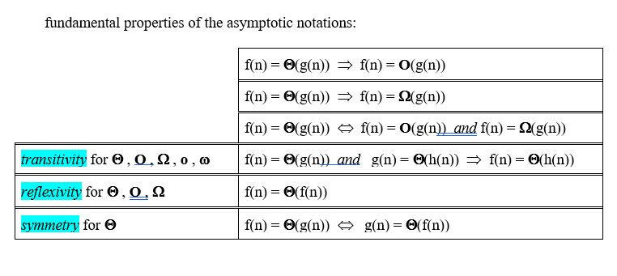

Slide 23
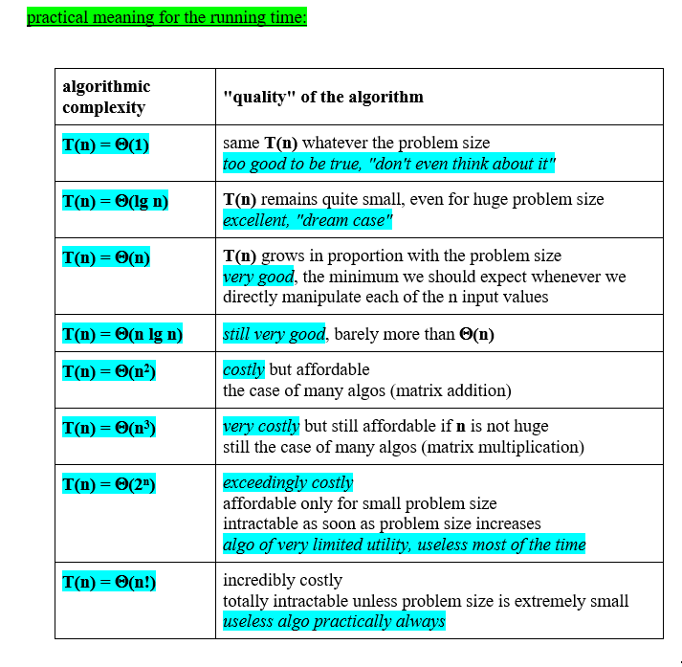

Slide 24
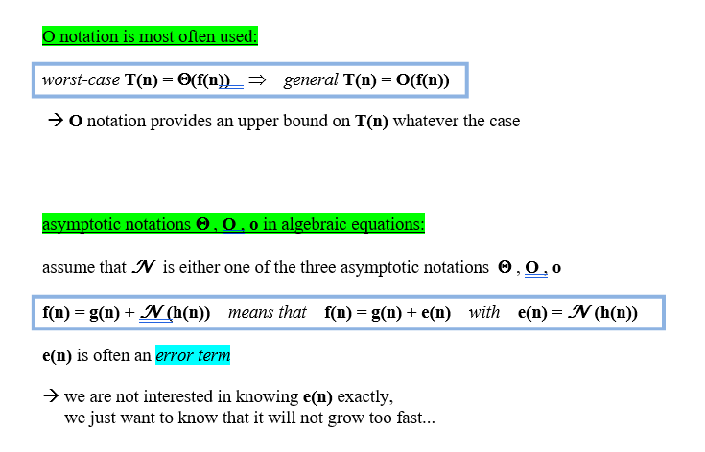

Slide 25
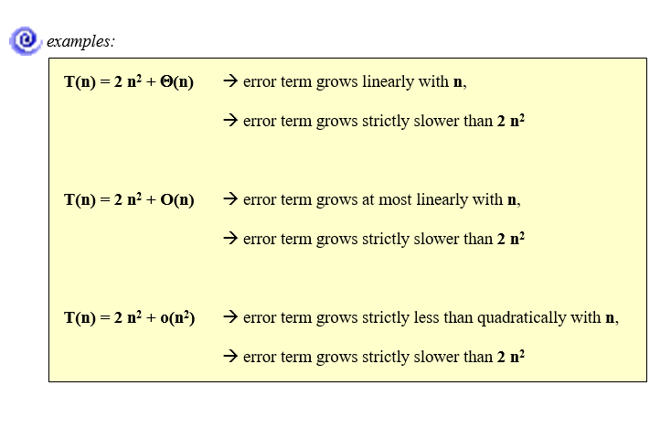

Slide 26
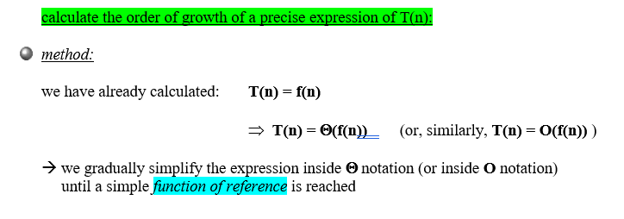
Calculating the algorithmic complexity of an iterative algorithm: practical rules

Slide 27
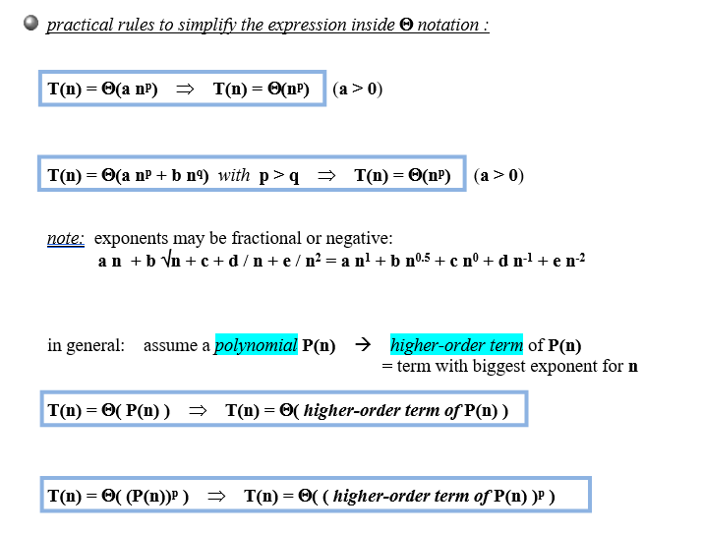

Slide 28
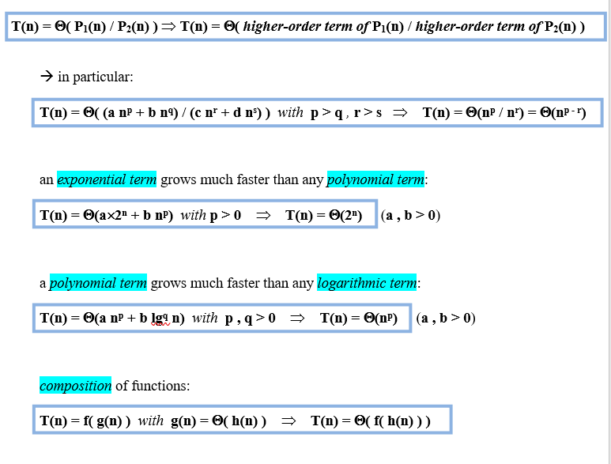

Slide 29
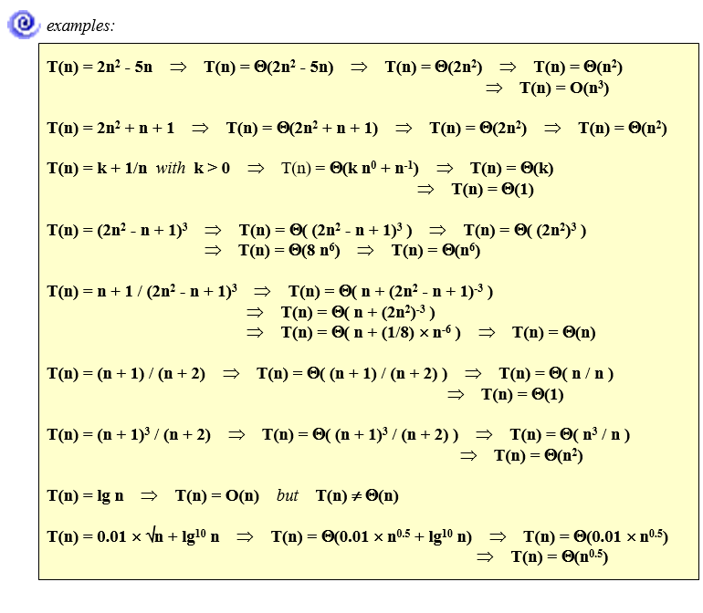

Slide 30
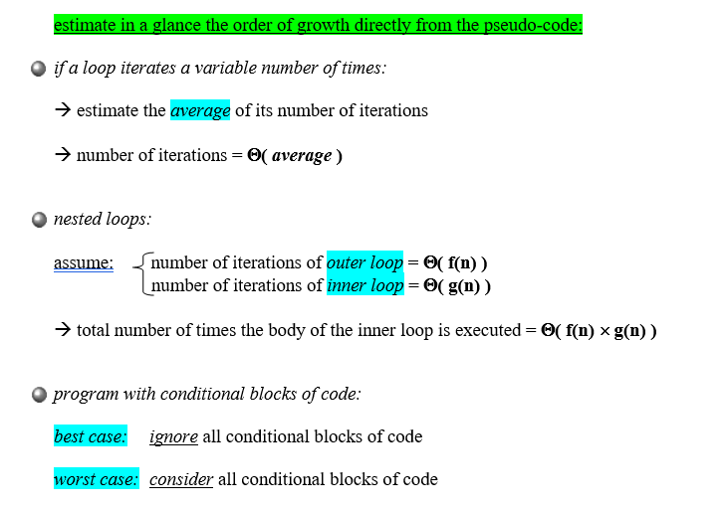

Slide 31
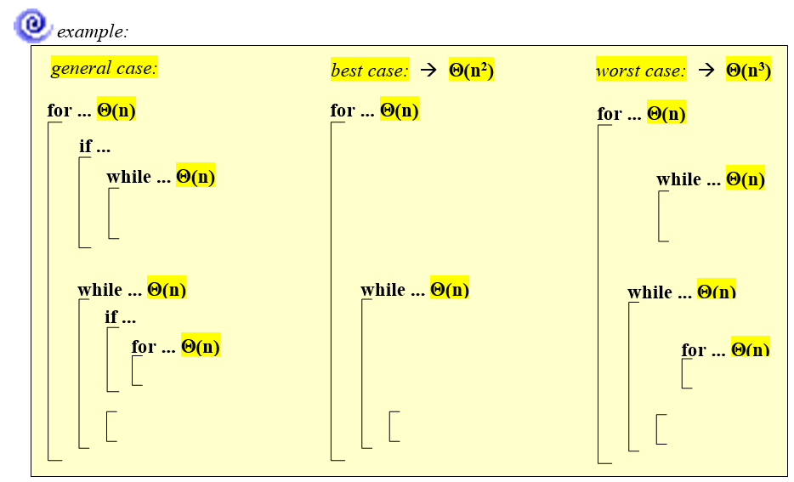

Slide 32
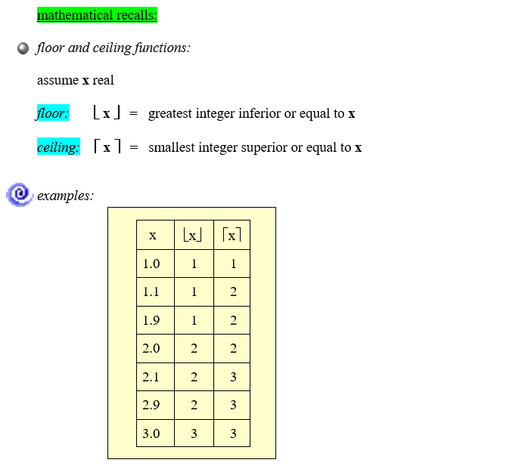
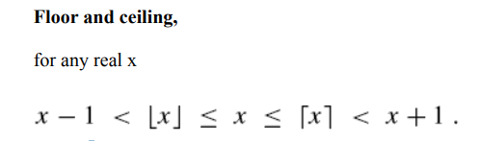

Slide 33
S(N) = 1 + 2 + 3 + 4 + … N =
Sum of Squares:
Geometric Series:
                A > 1
A < 1

Slide 34
Linear Geometric Series:
Harmonic Series:

Slide 35
Logarithms:

Slide 36
Summations with general bounds:
Linearity of Summations:

