Slide 1
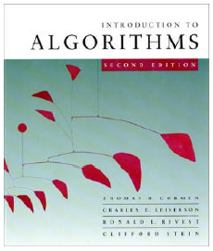
CMPE371 Analysis of Algorithms FALL 2022-2023 Lecture 6

Slide 2
Analysis of Algorithms
Part II: Algorithm Design Techniques
Programming paradigms
Brute force approach
Divide and conquer
Dynamic programming:
matrix chain multiplication problem
longest common subsequence problem
rod cuting problem
Greedy algorithms:
activity selection problem
fractional knapsack problem

Slide 3
Dynamic Programming
Dynamic Programming is a general algorithm design technique
for solving problems defined by or formulated as recurrences with overlapping subinstances
Invented by American mathematician Richard Bellman in the 1950s to solve optimization problems and later assimilated by CS
“Programming” here means “planning”
Main idea:
set up a recurrence relating a solution to a larger instance to solutions of some smaller instances
- solve smaller instances once
record solutions in a table
extract solution to the initial instance from that table

Slide 4
Example: Fibonacci numbers
Recall definition of Fibonacci numbers:
F(n) = F(n-1) + F(n-2)
F(0) = 0
F(1) = 1
Computing the n^{th} Fibonacci number recursively (top-down):
F(n)
F(n-1) + F(n-2)
F(n-2) + F(n-3) F(n-3) + F(n-4)
...

Slide 5
Example: Fibonacci numbers (cont.)
Computing the n^{th} Fibonacci number using bottom-up iteration and recording results:
F(0) = 0
F(1) = 1
F(2) = 1+0 = 1
…
F(n-2) =
F(n-1) =
F(n) = F(n-1) + F(n-2)
Efficiency:
- time
- space
What if we solve it recursively?
n
n

Slide 6
Matrix-chain Multiplication
Suppose we have a sequence or chain A₁, A₂, …, A_{n} of n matrices to be multiplied
That is, we want to compute the product A₁A₂…A_{n}
There are many possible ways (parenthesizations) to compute the product

Slide 7
Matrix-chain Multiplication …contd
Example: consider the chain A₁, A₂, A₃, A₄ of 4 matrices
Let us compute the product A₁A₂A₃A₄
There are 5 possible ways:
(A₁(A₂(A₃A₄)))
(A₁((A₂A₃)A₄))
((A₁A₂)(A₃A₄))
((A₁(A₂A₃))A₄)
(((A₁A₂)A₃)A₄)

Slide 8
Matrix-chain Multiplication …contd
To compute the number of scalar multiplications necessary, we must know:
Algorithm to multiply two matrices
Matrix dimensions
Can you write the algorithm to multiply two matrices?

Slide 9
Algorithm to Multiply 2 Matrices
Input: Matrices A_{p×q} and B_{q×r} (with dimensions p×q and q×r)
Result: Matrix C_{p×r} resulting from the product A·B
MATRIX-MULTIPLY(A_{p×q} , B_{q×r})
1. for i ← 1 to p
2. for j ← 1 to r
3. C[i, j] ← 0
4. for k ← 1 to q
5. C[i, j] ← C[i, j] + A[i, k] · B[k, j]
6. return C
Scalar multiplication in line 5 dominates time to compute C Number of scalar multiplications = pqr

Slide 10
Matrix-chain Multiplication …contd
Example: Consider three matrices
A_{10×100}, B_{100×5}, and C_{5×50}
There are 2 ways to parenthesize
((AB)C) = D_{10×5} · C_{5×50}
AB ⇒ 10·100·5=5,000 scalar multiplications
DC ⇒ 10·5·50 =2,500 scalar multiplications
(A(BC)) = A_{10×100} · E_{100×50}
BC ⇒ 100·5·50=25,000 scalar multiplications
AE ⇒ 10·100·50 =50,000 scalar multiplications
Total: 7,500
Total: 75,000

Slide 11
Matrix-chain Multiplication …contd
Matrix-chain multiplication problem
Given a chain A₁, A₂, …, A_{n} of n matrices, where
for i=1, 2, …, n, matrix A_{i} has dimension p_{i-1}×p_{i}
Parenthesize the product A₁A₂…A_{n} such that the total number of scalar multiplications is minimized
Brute force method of exhaustive search takes time exponential in n

Slide 12
Dynamic Programming Approach
The structure of an optimal solution
Let us use the notation A_{i..j} for the matrix that results from the product A_{i} A_{i+1} … A_{j}
An optimal parenthesization of the product A₁A₂…A_{n} splits the product between A_{k} and A_{k+1} for some integer k where1 ≤ k < n
First compute matrices A_{1..k} and A_{k+1..n} ; then multiply them to get the final matrix A_{1..n}

Slide 13
Dynamic Programming Approach …contd
Key observation: parenthesizations of the subchains A₁A₂…A_{k} and A_{k+1}A_{k+2}…A_{n} must also be optimal if the parenthesization of the chain A₁A₂…A_{n} is optimal (why?)
That is, the optimal solution to the problem contains within it the optimal solution to subproblems

Slide 14
Dynamic Programming Approach …contd
Recursive definition of the value of an optimal solution
Let m[i, j] be the minimum number of scalar multiplications
necessary to compute A_{i..j}
Minimum cost to compute A_{1..n} is m[1, n]
Suppose the optimal parenthesization of A_{i..j} splits the product between A_{k} and A_{k+1} for some integer k where i ≤ k < j

Slide 15
Dynamic Programming Approach …contd
A_{i..j} = (A_{i} A_{i+1}…A_{k})·(A_{k+1}A_{k+2}…A_{j})= A_{i..k} · A_{k+1..j}
Cost of computing A_{i..j} = cost of computing A_{i..k} + cost of computing A_{k+1..j} + cost of multiplying A_{i..k} and A_{k+1..j}
Cost of multiplying A_{i..k} and A_{k+1..j} is p_{i-1}p_{k} p_{j}
m[i, j ] = m[i, k] + m[k+1, j ] + p_{i-1}p_{k} p_{j} for i ≤ k < j
m[i, i ] = 0 for i=1,2,…,n

Slide 16
Dynamic Programming Approach …contd
But… optimal parenthesization occurs at one value of k among all possible i ≤ k < j
Check all these and select the best one
0 if i=j
m[i, j ] =
min {m[i, k] + m[k+1, j ] + p_{i-1}p_{k} p_{j} } if i<j
i ≤ k< j

Slide 17
Dynamic Programming Approach …contd
To keep track of how to construct an optimal solution, we use a table s
s[i, j ] = value of k at which A_{i} A_{i+1} … A_{j} is split for optimal parenthesization
Algorithm: next slide
First computes costs for chains of length l=1
Then for chains of length l=2,3, … and so on
Computes the optimal cost bottom-up

Slide 18
Algorithm to Compute Optimal Cost
Input: Array p[0…n] containing matrix dimensions and n
Result: Minimum-cost table m and split table s
MATRIX-CHAIN-ORDER(p[ ], n)
for i ← 1 to n
m[i, i] ← 0
for l ← 2 to n
for i ← 1 to n-l+1
j ← i+l-1
m[i, j] ← ∞
for k ← i to j-1
q ← m[i, k] + m[k+1, j] + p[i-1] p[k] p[j]
if q < m[i, j]
m[i, j] ← q
s[i, j] ← k
return m and s
Takes O(n³) time
Requires O(n²) space

Slide 19
Constructing Optimal Solution
Our algorithm computes the minimum-cost table m and the split table s
The optimal solution can be constructed from the split table s
Each entry s[i, j ]=k shows where to split the product A_{i} A_{i+1} … A_{j} for the minimum cost

Slide 20
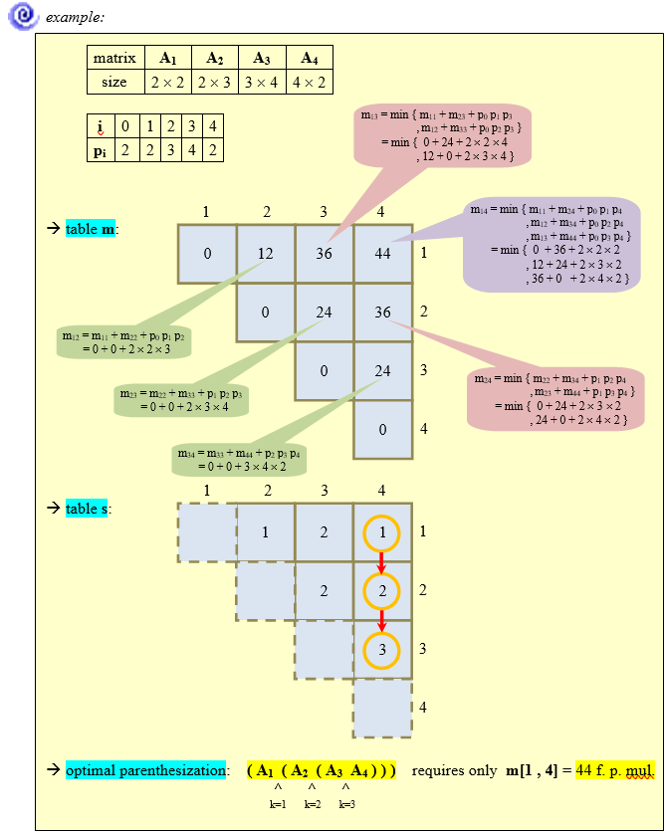

Slide 21
Example
The algorithm takes O(n³) time and requires O(n²) space.
Example:
Consider the following six matrix problem.
The problem therefore can be phrased as one of filling in the following table representing the values m.
Matrix | A₁ | A₂ | A₃ | A₄ | A₅ | A₆
Dimensions | 10x20 | 20x5 | 5x15 | 15x50 | 50x10 | 10x15
i\j | 1 2 3 4 5 6
1 2 3 4 5 6
0
0
0
0
0
0

Slide 22
Example (Contd.)
Chains of length 2 are easy, as there is no minimization required, so
m[i, i+1] = p_{i-1}p_{i}p_{i+1}
m[1, 2] = 10x20x5 = 1000
m[2, 3] = 20x5x15 = 1500
m[3, 4] = 5x15x50 = 3750
m[4, 5] = 15x50x10 = 7500
m[5, 6] = 50x10x15 = 7500
i\j | 1 2 3 4 5 6
1 2 3 4 5 6
0
1000
0
1500
0
3750
0
7500
0
7500
0

Slide 23
Example (Contd.)
Chains of length 3 require some minimization – but only one each.
m[1,3]=min{(m[1,1]+m[2,3]+p₀p₁p₃),(m[1,2]+m[3,3]+p₀p₂p₃)}
= min{(0+1500+10x20x15), (1000+0+10x5x15)}
= min { 4500, 1750 } = 1750
m[2,4]=min{(m[2,2]+m[3,4]+p₁p₂p₄),(m[2,3]+m[4,4]+p₁p₃p₄)}
= min{(0+3750+20x5x50), (1500+0+20x15x50)}
= min { 8750, 16500 } = 8750
m[3,5]=min{(m[3,3]+m[4,5]+p₂p₃p₅),(m[3,4]+m[5,5]+p₂p₄p₅)}
= min{(0+7500+5x15x10), (3750+0+5x50x10)}
= min { 8250, 6250 } = 6250
m[4,6]=min{(m[4,4]+m[5,6]+p₃p₄p₆),(m[4,5]+m[6,6]+p₃p₅p₆)}
= min{(0+7500+15x50x15), (7500+0+15x10x15)}
= min { 18750, 9750 } = 9750
i\j | 1 2 3 4 5 6
1 2 3 4 5 6
0
1000
1750
0
1500
8750
0
3750
6250
0
7500
9750
0
7500
0

Slide 24
Example (Contd.)
m[1,4]=min{(m[1,1]+m[2,4]+p₀p₁p₄),(m[1,2]+m[3,4]+p₀p₂p₄),
(m[1,3]+m[4,4]+p₀p₃p₄)}
= min{(0+8750+10x20x50), (1000+3750+10x5x50),
(1750+0+10x15x50)}
= min { 18750, 7250, 9250 } = 7250
m[2,5]=min{(m[2,2]+m[3,5]+p₁p₂p₅),(m[2,3]+m[4,5]+p₁p₃p₅),
(m[2,4]+m[5,5]+p₁p₄p₅)}
= min{(0+6250+20x5x10), (1500+7500+20x15x10),
(8750+0+20x50x10)}
= min { 7250, 12000, 18750 } = 7250
m[3,6]=min{(m[3,3]+m[4,6]+p₂p₃p₆),(m[3,4]+m[5,6]+p₂p₄p₆),
(m[3,5]+m[6,6]+p₂p₅p₆)}
= min{(0+9750+5x15x15), (3750+7500+5x50x15),
(6250+0+5x10x15)}
= min { 10875, 15000, 7000 } = 7000
i\j | 1 2 3 4 5 6
1 2 3 4 5 6
0
1000
1750
7250
0
1500
8750
7250
0
3750
6250
7000
0
7500
9750
0
7500
0

Slide 25
Example (Contd.)
m[1,5]=min{(m[1,1]+m[2,5]+p₀p₁p₅),(m[1,2]+m[3,5]+p₀p₂p₅),
(m[1,3]+m[4,5]+p₀p₃p₅),(m[1,4]+m[5,5]+p₀p₄p₅)}
= min{(0+7250+10x20x10), (1000+6250+10x5x10),
(1750+7500+10x15x10), (7250+0+10x50x10)}
= min { 9250, 7750, 10750, 12250 } = 7750
m[2,6]=min{(m[2,2]+m[3,6]+p₁p₂p₆),(m[2,3]+m[4,6]+p₁p₃p₆),
(m[2,4]+m[5,6]+p₁p₄p₆),(m[2,5]+m[6,6]+p₁p₅p₆)}
= min{(0+7000+20x5x15), (1500+9750+20x15x15),
(8750+7500+20x50x15), (7250+0+20x10x15)}
= min { 8500, 15750, 31,250, 10250 } = 8500
m[1,6]=min{(m[1,1]+m[2,6]+p₀p₁p₆),(m[1,2]+m[3,6]+p₀p₂p₆),
(m[1,3]+m[4,6]+p₀p₃p₆),(m[1,4]+m[5,6]+p₀p₄p₆), (m[1,5]+m[6,6]+p₀p₅p₆)}
= min{(11500, 8750, 13750, 22250, 9250 } = 8750
i\j | 1 2 3 4 5 6
1 2 3 4 5 6
0
1000
1750
7250
7750
8750
0
8750
7250
1500
8500
0
3750
6250
7000
0
7500
9750
0
7500
0

Slide 26
Dynamic Programming Approach (Contd.)
The algorithm takes O(n³) time and requires O(n²) space.
Step 4: Constructing an optimal solution
Our algorithm computes the minimum-cost table m and the split table s.
The optimal solution can be constructed from the split table s.
Each entry s[i, j ]=k shows where to split the product A_{i} A_{i+1} … A_{j} for the minimum cost.
The following recursive procedure prints an optimal parenthesization.
Algorithm PrintOptimalPerens(s, i, j)
{ if (i=j) then
Print “A”_{i};
else
{ Print “(“;
PrintOptimalPerens(s, i, s[i,j]);
PrintOptimalPerens(s, s[i,j]+1, j);
Print “)”;
}
}

Slide 27
Example (Contd.)
So far we have decided that the best way to parenthesize the expression results in 8750 multiplication.
But we have not addressed how we should actually DO the multiplication to achieve the value.
However, look at the last computation we did – the minimum value came from computing
A = (A₁A₂)(A₃A₄A₅A₆)
Therefore in an auxiliary array, we store value s[1,6]=2.
In general, as we proceed with the algorithm, if we find that the best way to compute A_{i..j} is as
A_{i..j} = A_{i..k}A_{(k+1)..j}
then we set
s[i, j] = k.
Then from the values of k we can reconstruct the optimal way to parenthesize the expression.

Slide 28
Example (Contd.)
If we do this then we find that the s array looks like this:
i\j | 1 2 3 4 5 6
1 2 3 4 5 6 | 1 1 2 2 2 2 2 2 2 2 2 3 3 4 5 4 4 5 5 5 6
We already know that we must compute A_{1..2} and A_{3..6}.
By looking at s[3,6] = 5, we discover that we should compute A_{3..6} as A_{3..5}A_{6..6} and then by seeing that s[3,5] = 4, we get the final parenthesization
A = ((A₁A₂)(((A₃A₄)A₅)A₆)).
And quick check reveals that this indeed takes the required 8750 multiplications.

Slide 29
Example
Show how to multiply this matrix chain optimally
Solution on the board
Minimum cost 15,125
Optimal parenthesization ((A₁(A₂A₃))((A₄ A₅)A₆))
Matrix | Dimension
A₁ | 30×35
A₂ | 35×15
A₃ | 15×5
A₄ | 5×10
A₅ | 10×20
A₆ | 20×25

Slide 30
Longest Common Subsequence (LCS)
Application: comparison of two DNA strings
Ex: X= {A B C B D A B }, Y= {B D C A B A}
Longest Common Subsequence:
X = A B C B D A B
Y = B D C A B A
Brute force algorithm would compare each subsequence of X with the symbols in Y

Slide 31
LCS Algorithm
if |X| = m, |Y| = n, then there are 2^{m} subsequences of X; we must compare each with Y (n comparisons)
So the running time of the brute-force algorithm is O(n 2^{m})
Notice that the LCS problem has optimal substructure: solutions of subproblems are parts of the final solution.
Subproblems: “find LCS of pairs of prefixes of X and Y”
Notes:
Illustration:
From previous slide:
X = A B C B D A B
Y = B D C A B A
X_3, a prefix of X: ABC
Y_4, a prefix of Y: BDCA
Optimal solution for these is: BC

Slide 32
LCS Algorithm
First we’ll find the length of LCS. Later we’ll modify the algorithm to find LCS itself.
Define X_{i}, Y_{j} to be the prefixes of X and Y of length i and j respectively
Define c[i,j] to be the length of LCS of X_{i} and Y_{j}
Then the length of LCS of X and Y will be c[m,n]

Slide 33
LCS recursive solution
We start with i = j = 0 (empty substrings of x and y)
Since X₀ and Y₀ are empty strings, their LCS is always empty (i.e. c[0,0] = 0)
LCS of empty string and any other string is empty, so for every i and j: c[0, j] = c[i,0] = 0

Slide 34
LCS recursive solution
When we calculate c[i,j], we consider two cases:
First case: x[i]=y[j]: one more symbol in strings X and Y matches, so the length of LCS X_{i} and Y_{j} equals to the length of LCS of smaller strings X_{i-1} and Y_{j-1} , plus 1

Slide 35
LCS recursive solution
Second case: x[i] != y[j]
As symbols don’t match, our solution is not improved, and the length of LCS(X_{i} , Y_{j}) is the same as before (i.e. maximum of LCS(X_{i}, Y_{j-1}) and LCS(X_{i-1},Y_{j})
Why not just take the length of LCS(X_{i-1}, Y_{j-1}) ?

Slide 36
LCS Length Algorithm
LCS-Length(X, Y)
1. m = length(X) // get the # of symbols in X
2. n = length(Y) // get the # of symbols in Y
3. for i = 1 to m c[i,0] = 0 // special case: Y₀
4. for j = 1 to n c[0,j] = 0 // special case: X₀
5. for i = 1 to m // for all X_{i}
6. for j = 1 to n // for all Y_{j}
7. if ( X_{i} == Y_{j} )
8. c[i,j] = c[i-1,j-1] + 1
9. else c[i,j] = max( c[i-1,j], c[i,j-1] )
10. return c[m,n] // return LCS length for X and Y

Slide 37
LCS Example
We’ll see how LCS algorithm works on the following example:
X = ABCB
Y = BDCAB
What is the Longest Common Subsequence
of X and Y?
LCS(X, Y) = BCB
X = A B C B
Y = B D C A B

Slide 38
LCS Example (0)
ABCB
BDCAB
j 0 1 2 3 4 5
i
Yj
B
D
C
A
B
0
Xi
A
1
2
B
3
C
4
B
X = ABCB; m = |X| = 4
Y = BDCAB; n = |Y| = 5
Allocate array c[4,5]

Slide 39
LCS Example (1)
ABCB
BDCAB
j 0 1 2 3 4 5
i
Yj
B
D
C
A
B
0
Xi
0
0
0
0
0
0
A
1
0
2
B
0
3
C
0
4
B
0
for i = 1 to m c[i,0] = 0
for j = 1 to n c[0,j] = 0

Slide 40
LCS Example (2)
ABCB
BDCAB
j 0 1 2 3 4 5
i
Yj
B
D
C
A
B
0
Xi
0
0
0
0
0
0
A
1
0
0
2
B
0
3
C
0
4
B
0
if ( X_{i} == Y_{j} )
c[i,j] = c[i-1,j-1] + 1
else c[i,j] = max( c[i-1,j], c[i,j-1] )

Slide 41
LCS Example (3)
ABCB
BDCAB
j 0 1 2 3 4 5
i
Yj
B
D
C
A
B
0
Xi
0
0
0
0
0
0
A
1
0
0
0
0
2
B
0
3
C
0
4
B
0
if ( X_{i} == Y_{j} )
c[i,j] = c[i-1,j-1] + 1
else c[i,j] = max( c[i-1,j], c[i,j-1] )

Slide 42
LCS Example (4)
ABCB
BDCAB
j 0 1 2 3 4 5
i
Yj
B
D
C
A
B
0
Xi
0
0
0
0
0
0
A
1
0
0
0
0
1
2
B
0
3
C
0
4
B
0
if ( X_{i} == Y_{j} )
c[i,j] = c[i-1,j-1] + 1
else c[i,j] = max( c[i-1,j], c[i,j-1] )

Slide 43
LCS Example (5)
ABCB
BDCAB
j 0 1 2 3 4 5
i
Yj
B
D
C
A
B
0
Xi
0
0
0
0
0
0
A
1
0
0
0
0
1
1
2
B
0
3
C
0
4
B
0
if ( X_{i} == Y_{j} )
c[i,j] = c[i-1,j-1] + 1
else c[i,j] = max( c[i-1,j], c[i,j-1] )

Slide 44
LCS Example (6)
ABCB
BDCAB
j 0 1 2 3 4 5
i
Yj
B
D
C
A
B
0
Xi
0
0
0
0
0
0
A
1
0
0
0
0
1
1
2
B
0
1
3
C
0
4
B
0
if ( X_{i} == Y_{j} )
c[i,j] = c[i-1,j-1] + 1
else c[i,j] = max( c[i-1,j], c[i,j-1] )

Slide 45
LCS Example (7)
ABCB
BDCAB
j 0 1 2 3 4 5
i
Yj
B
D
C
A
B
0
Xi
0
0
0
0
0
0
A
1
0
0
0
0
1
1
2
B
0
1
1
1
1
3
C
0
4
B
0
if ( X_{i} == Y_{j} )
c[i,j] = c[i-1,j-1] + 1
else c[i,j] = max( c[i-1,j], c[i,j-1] )

Slide 46
LCS Example (8)
ABCB
BDCAB
j 0 1 2 3 4 5
i
Yj
B
D
C
A
B
0
Xi
0
0
0
0
0
0
A
1
0
0
0
0
1
1
2
B
0
1
1
1
1
2
3
C
0
4
B
0
if ( X_{i} == Y_{j} )
c[i,j] = c[i-1,j-1] + 1
else c[i,j] = max( c[i-1,j], c[i,j-1] )

Slide 47
LCS Example (10)
ABCB
BDCAB
j 0 1 2 3 4 5
i
Yj
B
D
C
A
B
0
Xi
0
0
0
0
0
0
A
1
0
0
0
0
1
1
2
B
0
1
1
1
1
2
3
C
0
1
1
4
B
0
if ( X_{i} == Y_{j} )
c[i,j] = c[i-1,j-1] + 1
else c[i,j] = max( c[i-1,j], c[i,j-1] )

Slide 48
LCS Example (11)
ABCB
BDCAB
j 0 1 2 3 4 5
i
Yj
B
D
C
A
B
0
Xi
0
0
0
0
0
0
A
1
0
0
0
0
1
1
2
B
0
1
1
1
1
2
3
C
0
1
1
2
4
B
0
if ( X_{i} == Y_{j} )
c[i,j] = c[i-1,j-1] + 1
else c[i,j] = max( c[i-1,j], c[i,j-1] )

Slide 49
LCS Example (12)
ABCB
BDCAB
j 0 1 2 3 4 5
i
Yj
B
D
C
A
B
0
Xi
0
0
0
0
0
0
A
1
0
0
0
0
1
1
2
B
0
1
1
1
1
2
3
C
0
1
1
2
2
2
4
B
0
if ( X_{i} == Y_{j} )
c[i,j] = c[i-1,j-1] + 1
else c[i,j] = max( c[i-1,j], c[i,j-1] )

Slide 50
LCS Example (13)
ABCB
BDCAB
j 0 1 2 3 4 5
i
Yj
B
D
C
A
B
0
Xi
0
0
0
0
0
0
A
1
0
0
0
0
1
1
2
B
0
1
1
1
1
2
3
C
0
1
1
2
2
2
4
B
0
1
if ( X_{i} == Y_{j} )
c[i,j] = c[i-1,j-1] + 1
else c[i,j] = max( c[i-1,j], c[i,j-1] )

Slide 51
LCS Example (14)
ABCB
BDCAB
j 0 1 2 3 4 5
i
Yj
B
D
C
A
B
0
Xi
0
0
0
0
0
0
A
1
0
0
0
0
1
1
2
B
0
1
1
1
1
2
3
C
0
1
1
2
2
2
4
B
0
1
1
2
2
if ( X_{i} == Y_{j} )
c[i,j] = c[i-1,j-1] + 1
else c[i,j] = max( c[i-1,j], c[i,j-1] )

Slide 52
LCS Example (15)
ABCB
BDCAB
j 0 1 2 3 4 5
i
Yj
B
D
C
A
B
0
Xi
0
0
0
0
0
0
A
1
0
0
0
0
1
1
2
B
0
1
1
1
1
2
3
C
0
1
1
2
2
2
4
B
3
0
1
1
2
2
if ( X_{i} == Y_{j} )
c[i,j] = c[i-1,j-1] + 1
else c[i,j] = max( c[i-1,j], c[i,j-1] )

Slide 53
LCS Algorithm Running Time
LCS algorithm calculates the values of each entry of the array c[m,n]
So what is the running time?
O(m*n)
since each c[i,j] is calculated in constant time, and there are m*n elements in the array

Slide 54
How to find actual LCS
So far, we have just found the length of LCS, but not LCS itself.
We want to modify this algorithm to make it output Longest Common Subsequence of X and Y
Each c[i,j] depends on c[i-1,j] and c[i,j-1]
or c[i-1, j-1]
For each c[i,j] we can say how it was acquired:
For example, here
c[i,j] = c[i-1,j-1] +1 = 2+1=3
2
2
2
3

Slide 55
How to find actual LCS - continued
Remember that
So we can start from c[m,n] and go backwards
Look first to see if 2nd case above was true
If not, then c[i,j] = c[i-1, j-1]+1, so remember x[i] (because x[i] is a part of LCS)
When i=0 or j=0 (i.e. we reached the beginning), output remembered letters in reverse order

Slide 56
Algorithm to find actual LCS
Here’s a recursive algorithm to do this: LCS_print(x, m, n, c) { if (c[m][n] == c[m-1][n]) // go up? LCS_print(x, m-1, n, c); else if (c[m][n] == c[m][n-1] // go left? LCS_print(x, m, n-1, c); else { // it was a match! LCS_print(x, m-1, n-1, c); print(x[m]); // print after recursive call } }

Slide 57
Finding LCS
j 0 1 2 3 4 5
i
Yj
B
D
C
A
B
0
Xi
0
0
0
0
0
0
A
1
0
0
0
0
1
1
2
B
0
1
1
1
1
2
3
C
0
1
1
2
2
2
4
B
3
0
1
1
2
2

Slide 58
Finding LCS (2)
j 0 1 2 3 4 5
i
Yj
B
D
C
A
B
0
Xi
0
0
0
0
0
0
A
1
0
0
0
0
1
1
2
B
0
1
1
1
1
2
3
C
0
1
1
2
2
2
4
B
3
0
1
1
2
2
LCS (reversed order):
B
C
B
B C B
(this string turned out to be a palindrome)
LCS (straight order):

Slide 59
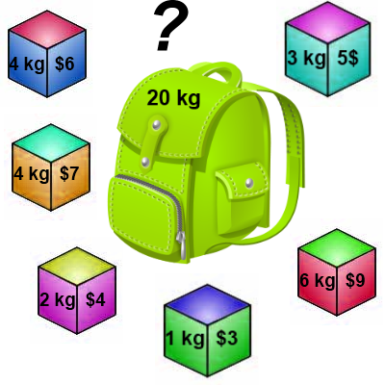
Knapsack 0-1 Problem
The goal is to maximize the value of a knapsack that can hold at most W units (i.e. lbs or kg) worth of goods from a list of items I₀, I₁, … I_{n-1}.
Each item has 2 attributes:
Value – let this be v_{i} for item I_{i}
Weight – let this be w_{i} for item I_{i}

Slide 60
Knapsack 0-1 Problem
The difference between this problem and the fractional knapsack one is that you CANNOT take a fraction of an item.
You can either take it or not.
Hence the name Knapsack 0-1 problem.

Slide 61
Knapsack 0-1 Problem
Brute Force
The naïve way to solve this problem is to cycle through all 2^{n} subsets of the n items and pick the subset with a legal weight that maximizes the value of the knapsack.
We can come up with a dynamic programming algorithm that will USUALLY do better than this brute force technique.

Slide 62
Knapsack 0-1 Problem
As we did before we are going to solve the problem in terms of sub-problems.
So let’s try to do that…
Our first attempt might be to characterize a sub-problem as follows:
Let S_{k} be the optimal subset of elements from {I₀, I₁, …, I_{k}}.
What we find is that the optimal subset from the elements {I₀, I₁, …, I_{k+1}} may not correspond to the optimal subset of elements from {I₀, I₁, …, I_{k}} in any regular pattern.
Basically, the solution to the optimization problem for S_{k+1} might NOT contain the optimal solution from problem S_{k}.

Slide 63
Knapsack 0-1 Problem
Let’s illustrate that point with an example:
Item Weight Value(benefit)
I₀ 3 10
I₁ 8 4
I₂ 9 9
I₃ 8 11
The maximum weight the knapsack can hold is 20.
The best set of items from {I₀, I₁, I₂} is {I₀, I₁, I₂}
BUT the best set of items from {I₀, I₁, I₂, I₃} is {I₀, I₂, I₃}.
In this example, note that this optimal solution, {I₀, I₂, I₃}, does NOT build upon the previous optimal solution, {I₀, I₁, I₂}.
(Instead it build's upon the solution, {I₀, I₂}, which is really the optimal subset of {I₀, I₁, I₂} with weight 12 or less.)

Slide 64
Knapsack 0-1 problem
So now we must re-work the way we build upon previous sub-problems…
Let B[k, w] represent the maximum total value of a subset S_{k} with weight w.
Our goal is to find B[n, W], where n is the total number of items and W is the maximal weight the knapsack can carry.
So our recursive formula for subproblems:
B[k, w] = B[k - 1,w], if w_{k} > w
= max { B[k - 1,w], B[k - 1,w - w_{k}] + b_{k}}, otherwise
In English, this means that the best subset of S_{k} that has total weight w is:
The best subset of S_{k-1} that has total weight w, or
The best subset of S_{k-1} that has total weight w-w_{k} plus the item k

Slide 65
Knapsack 0-1 Problem –Recursive Formula
The best subset of S_{k} that has the total weight w, either contains item k or not.
First case: w_{k} > w
Item k can’t be part of the solution! If it was the total weight would be > w, which is unacceptable.
Second case: w_{k} ≤ w
Then the item k can be in the solution, and we choose the case with greater value.

Slide 66
Knapsack 0-1 Algorithm
for w = 0 to W { // Initialize 1st row to 0’s
B[0,w] = 0
}
for i = 1 to n { // Initialize 1st column to 0’s
B[i,0] = 0
}
for i = 1 to n {
for w = 0 to W {
if w_{i} <= w { //item i can be in the solution
if v_{i} + B[i-1,w-w_{i}] > B[i-1,w]
B[i,w] = v_{i} + B[i-1,w- w_{i}]
else
B[i,w] = B[i-1,w]
}
else B[i,w] = B[i-1,w] // w_{i} > w
}
}

Slide 67
Knapsack 0-1 Problem
Let’s run our algorithm on the following data:
n = 4 (# of elements)
W = 5 (max weight)
Elements (weight, value):
(2,3), (3,4), (4,5), (5,6)

Slide 68
Knapsack 0-1 Example
i / w | 0 | 1 | 2 | 3 | 4 | 5
0 | 0 | 0 | 0 | 0 | 0 | 0
1 | 0
2 | 0
3 | 0
4 | 0
// Initialize the base cases
for w = 0 to W
B[0,w] = 0
for i = 1 to n
B[i,0] = 0

Slide 69
Knapsack 0-1 Example
Items:
1: (2,3)
2: (3,4)
3: (4,5)
4: (5,6)
i / w | 0 | 1 | 2 | 3 | 4 | 5
0 | 0 | 0 | 0 | 0 | 0 | 0
1 | 0
2 | 0
3 | 0
4 | 0
i / w | 0 | 1 | 2 | 3 | 4 | 5
0 | 0 | 0 | 0 | 0 | 0 | 0
1 | 0 | 0
2 | 0
3 | 0
4 | 0
i = 1
v_{i} = 3
w_{i} = 2
w = 1
w-w_{i} = -1
if w_{i} <= w //item i can be in the solution
if v_{i} + B[i-1,w-w_{i}] > B[i-1,w]
B[i,w] = v_{i} + B[i-1,w- w_{i}]
else
B[i,w] = B[i-1,w]
else B[i,w] = B[i-1,w] // w_{i} > w

Slide 70
Knapsack 0-1 Example
Items:
1: (2,3)
2: (3,4)
3: (4,5)
4: (5,6)
i / w | 0 | 1 | 2 | 3 | 4 | 5
0 | 0 | 0 | 0 | 0 | 0 | 0
1 | 0 | 0
2 | 0
3 | 0
4 | 0
i / w | 0 | 1 | 2 | 3 | 4 | 5
0 | 0 | 0 | 0 | 0 | 0 | 0
1 | 0 | 0 | 3
2 | 0
3 | 0
4 | 0
i = 1
v_{i} = 3
w_{i} = 2
w = 2
w-w_{i} = 0
if w_{i} <= w //item i can be in the solution
if v_{i} + B[i-1,w-w_{i}] > B[i-1,w]
B[i,w] = v_{i} + B[i-1,w- w_{i}]
else
B[i,w] = B[i-1,w]
else B[i,w] = B[i-1,w] // w_{i} > w
if w_{i} <= w //item i can be in the solution
if v_{i} + B[i-1,w-w_{i}] > B[i-1,w]
B[i,w] = v_{i} + B[i-1,w- w_{i}]
else
B[i,w] = B[i-1,w]
else B[i,w] = B[i-1,w] // w_{i} > w

Slide 71
Knapsack 0-1 Example
Items:
1: (2,3)
2: (3,4)
3: (4,5)
4: (5,6)
i / w | 0 | 1 | 2 | 3 | 4 | 5
0 | 0 | 0 | 0 | 0 | 0 | 0
1 | 0 | 0 | 3
2 | 0
3 | 0
4 | 0
i / w | 0 | 1 | 2 | 3 | 4 | 5
0 | 0 | 0 | 0 | 0 | 0 | 0
1 | 0 | 0 | 3 | 3
2 | 0
3 | 0
4 | 0
i = 1
v_{i} = 3
w_{i} = 2
w = 3
w-w_{i} = 1
if w_{i} <= w //item i can be in the solution
if v_{i} + B[i-1,w-w_{i}] > B[i-1,w]
B[i,w] = v_{i} + B[i-1,w- w_{i}]
else
B[i,w] = B[i-1,w]
else B[i,w] = B[i-1,w] // w_{i} > w

Slide 72
Knapsack 0-1 Example
Items:
1: (2,3)
2: (3,4)
3: (4,5)
4: (5,6)
i / w | 0 | 1 | 2 | 3 | 4 | 5
0 | 0 | 0 | 0 | 0 | 0 | 0
1 | 0 | 0 | 3 | 3
2 | 0
3 | 0
4 | 0
i / w | 0 | 1 | 2 | 3 | 4 | 5
0 | 0 | 0 | 0 | 0 | 0 | 0
1 | 0 | 0 | 3 | 3 | 3
2 | 0
3 | 0
4 | 0
i = 1
v_{i} = 3
w_{i} = 2
w = 4
w-w_{i} = 2
if w_{i} <= w //item i can be in the solution
if v_{i} + B[i-1,w-w_{i}] > B[i-1,w]
B[i,w] = v_{i} + B[i-1,w- w_{i}]
else
B[i,w] = B[i-1,w]
else B[i,w] = B[i-1,w] // w_{i} > w

Slide 73
Knapsack 0-1 Example
Items:
1: (2,3)
2: (3,4)
3: (4,5)
4: (5,6)
i / w | 0 | 1 | 2 | 3 | 4 | 5
0 | 0 | 0 | 0 | 0 | 0 | 0
1 | 0 | 0 | 3 | 3 | 3
2 | 0
3 | 0
4 | 0
i / w | 0 | 1 | 2 | 3 | 4 | 5
0 | 0 | 0 | 0 | 0 | 0 | 0
1 | 0 | 0 | 3 | 3 | 3 | 3
2 | 0
3 | 0
4 | 0
i = 1
v_{i} = 3
w_{i} = 2
w = 5
w-w_{i} = 3
if w_{i} <= w //item i can be in the solution
if v_{i} + B[i-1,w-w_{i}] > B[i-1,w]
B[i,w] = v_{i} + B[i-1,w- w_{i}]
else
B[i,w] = B[i-1,w]
else B[i,w] = B[i-1,w] // w_{i} > w

Slide 74
Knapsack 0-1 Example
Items:
1: (2,3)
2: (3,4)
3: (4,5)
4: (5,6)
i / w | 0 | 1 | 2 | 3 | 4 | 5
0 | 0 | 0 | 0 | 0 | 0 | 0
1 | 0 | 0 | 3 | 3 | 3 | 3
2 | 0
3 | 0
4 | 0
i / w | 0 | 1 | 2 | 3 | 4 | 5
0 | 0 | 0 | 0 | 0 | 0 | 0
1 | 0 | 0 | 3 | 3 | 3 | 3
2 | 0 | 0
3 | 0
4 | 0
i = 2
v_{i} = 4
w_{i} = 3
w = 1
w-w_{i} = -2
if w_{i} <= w //item i can be in the solution
if v_{i} + B[i-1,w-w_{i}] > B[i-1,w]
B[i,w] = v_{i} + B[i-1,w- w_{i}]
else
B[i,w] = B[i-1,w]
else B[i,w] = B[i-1,w] // w_{i} > w
if w_{i} <= w //item i can be in the solution
if v_{i} + B[i-1,w-w_{i}] > B[i-1,w]
B[i,w] = v_{i} + B[i-1,w- w_{i}]
else
B[i,w] = B[i-1,w]
else B[i,w] = B[i-1,w] // w_{i} > w

Slide 75
Knapsack 0-1 Example
Items:
1: (2,3)
2: (3,4)
3: (4,5)
4: (5,6)
i / w | 0 | 1 | 2 | 3 | 4 | 5
0 | 0 | 0 | 0 | 0 | 0 | 0
1 | 0 | 0 | 3 | 3 | 3 | 3
2 | 0 | 0
3 | 0
4 | 0
i / w | 0 | 1 | 2 | 3 | 4 | 5
0 | 0 | 0 | 0 | 0 | 0 | 0
1 | 0 | 0 | 3 | 3 | 3 | 3
2 | 0 | 0 | 3
3 | 0
4 | 0
i = 2
v_{i} = 4
w_{i} = 3
w = 2
w-w_{i} = -1
if w_{i} <= w //item i can be in the solution
if v_{i} + B[i-1,w-w_{i}] > B[i-1,w]
B[i,w] = v_{i} + B[i-1,w- w_{i}]
else
B[i,w] = B[i-1,w]
else B[i,w] = B[i-1,w] // w_{i} > w

Slide 76
Knapsack 0-1 Example
Items:
1: (2,3)
2: (3,4)
3: (4,5)
4: (5,6)
i / w | 0 | 1 | 2 | 3 | 4 | 5
0 | 0 | 0 | 0 | 0 | 0 | 0
1 | 0 | 0 | 3 | 3 | 3 | 3
2 | 0 | 0 | 3
3 | 0
4 | 0
i / w | 0 | 1 | 2 | 3 | 4 | 5
0 | 0 | 0 | 0 | 0 | 0 | 0
1 | 0 | 0 | 3 | 3 | 3 | 3
2 | 0 | 0 | 3 | 4
3 | 0
4 | 0
i = 2
v_{i} = 4
w_{i} = 3
w = 3
w-w_{i} = 0
if w_{i} <= w //item i can be in the solution
if v_{i} + B[i-1,w-w_{i}] > B[i-1,w]
B[i,w] = v_{i} + B[i-1,w- w_{i}]
else
B[i,w] = B[i-1,w]
else B[i,w] = B[i-1,w] // w_{i} > w
if w_{i} <= w //item i can be in the solution
if v_{i} + B[i-1,w-w_{i}] > B[i-1,w]
B[i,w] = v_{i} + B[i-1,w- w_{i}]
else
B[i,w] = B[i-1,w]
else B[i,w] = B[i-1,w] // w_{i} > w

Slide 77
Knapsack 0-1 Example
Items:
1: (2,3)
2: (3,4)
3: (4,5)
4: (5,6)
i / w | 0 | 1 | 2 | 3 | 4 | 5
0 | 0 | 0 | 0 | 0 | 0 | 0
1 | 0 | 0 | 3 | 3 | 3 | 3
2 | 0 | 0 | 3 | 4
3 | 0
4 | 0
i / w | 0 | 1 | 2 | 3 | 4 | 5
0 | 0 | 0 | 0 | 0 | 0 | 0
1 | 0 | 0 | 3 | 3 | 3 | 3
2 | 0 | 0 | 3 | 4 | 4
3 | 0
4 | 0
i = 2
v_{i} = 4
w_{i} = 3
w = 4
w-w_{i} = 1
if w_{i} <= w //item i can be in the solution
if v_{i} + B[i-1,w-w_{i}] > B[i-1,w]
B[i,w] = v_{i} + B[i-1,w- w_{i}]
else
B[i,w] = B[i-1,w]
else B[i,w] = B[i-1,w] // w_{i} > w

Slide 78
Knapsack 0-1 Example
Items:
1: (2,3)
2: (3,4)
3: (4,5)
4: (5,6)
i / w | 0 | 1 | 2 | 3 | 4 | 5
0 | 0 | 0 | 0 | 0 | 0 | 0
1 | 0 | 0 | 3 | 3 | 3 | 3
2 | 0 | 0 | 3 | 4 | 4
3 | 0
4 | 0
i / w | 0 | 1 | 2 | 3 | 4 | 5
0 | 0 | 0 | 0 | 0 | 0 | 0
1 | 0 | 0 | 3 | 3 | 3 | 3
2 | 0 | 0 | 3 | 4 | 4 | 7
3 | 0
4 | 0
i = 2
v_{i} = 4
w_{i} = 3
w = 5
w-w_{i} = 2
if w_{i} <= w //item i can be in the solution
if v_{i} + B[i-1,w-w_{i}] > B[i-1,w]
B[i,w] = v_{i} + B[i-1,w- w_{i}]
else
B[i,w] = B[i-1,w]
else B[i,w] = B[i-1,w] // w_{i} > w

Slide 79
Knapsack 0-1 Example
Items:
1: (2,3)
2: (3,4)
3: (4,5)
4: (5,6)
i / w | 0 | 1 | 2 | 3 | 4 | 5
0 | 0 | 0 | 0 | 0 | 0 | 0
1 | 0 | 0 | 3 | 3 | 3 | 3
2 | 0 | 0 | 3 | 4 | 4 | 7
3 | 0
4 | 0
i / w | 0 | 1 | 2 | 3 | 4 | 5
0 | 0 | 0 | 0 | 0 | 0 | 0
1 | 0 | 0 | 3 | 3 | 3 | 3
2 | 0 | 0 | 3 | 4 | 4 | 7
3 | 0 | 0 | 3 | 4
4 | 0
i = 3
v_{i} = 5
w_{i} = 4
w = 1..3
w-w_{i} = -3..-1
if w_{i} <= w //item i can be in the solution
if v_{i} + B[i-1,w-w_{i}] > B[i-1,w]
B[i,w] = v_{i} + B[i-1,w- w_{i}]
else
B[i,w] = B[i-1,w]
else B[i,w] = B[i-1,w] // w_{i} > w
if w_{i} <= w //item i can be in the solution
if v_{i} + B[i-1,w-w_{i}] > B[i-1,w]
B[i,w] = v_{i} + B[i-1,w- w_{i}]
else
B[i,w] = B[i-1,w]
else B[i,w] = B[i-1,w] // w_{i} > w

Slide 80
Knapsack 0-1 Example
Items:
1: (2,3)
2: (3,4)
3: (4,5)
4: (5,6)
i / w | 0 | 1 | 2 | 3 | 4 | 5
0 | 0 | 0 | 0 | 0 | 0 | 0
1 | 0 | 0 | 3 | 3 | 3 | 3
2 | 0 | 0 | 3 | 4 | 4 | 7
3 | 0 | 0 | 3 | 4
4 | 0
i / w | 0 | 1 | 2 | 3 | 4 | 5
0 | 0 | 0 | 0 | 0 | 0 | 0
1 | 0 | 0 | 3 | 3 | 3 | 3
2 | 0 | 0 | 3 | 4 | 4 | 7
3 | 0 | 0 | 3 | 4 | 5
4 | 0
i = 3
v_{i} = 5
w_{i} = 4
w = 4
w-w_{i} = 0
if w_{i} <= w //item i can be in the solution
if v_{i} + B[i-1,w-w_{i}] > B[i-1,w]
B[i,w] = v_{i} + B[i-1,w- w_{i}]
else
B[i,w] = B[i-1,w]
else B[i,w] = B[i-1,w] // w_{i} > w
if w_{i} <= w //item i can be in the solution
if v_{i} + B[i-1,w-w_{i}] > B[i-1,w]
B[i,w] = v_{i} + B[i-1,w- w_{i}]
else
B[i,w] = B[i-1,w]
else B[i,w] = B[i-1,w] // w_{i} > w

Slide 81
Knapsack 0-1 Example
Items:
1: (2,3)
2: (3,4)
3: (4,5)
4: (5,6)
i / w | 0 | 1 | 2 | 3 | 4 | 5
0 | 0 | 0 | 0 | 0 | 0 | 0
1 | 0 | 0 | 3 | 3 | 3 | 3
2 | 0 | 0 | 3 | 4 | 4 | 7
3 | 0 | 0 | 3 | 4 | 5
4 | 0
i / w | 0 | 1 | 2 | 3 | 4 | 5
0 | 0 | 0 | 0 | 0 | 0 | 0
1 | 0 | 0 | 3 | 3 | 3 | 3
2 | 0 | 0 | 3 | 4 | 4 | 7
3 | 0 | 0 | 3 | 4 | 5 | 7
4 | 0
i = 3
v_{i} = 5
w_{i} = 4
w = 5
w-w_{i} = 1
if w_{i} <= w //item i can be in the solution
if v_{i} + B[i-1,w-w_{i}] > B[i-1,w]
B[i,w] = v_{i} + B[i-1,w- w_{i}]
else
B[i,w] = B[i-1,w]
else B[i,w] = B[i-1,w] // w_{i} > w
if w_{i} <= w //item i can be in the solution
if v_{i} + B[i-1,w-w_{i}] > B[i-1,w]
B[i,w] = v_{i} + B[i-1,w- w_{i}]
else
B[i,w] = B[i-1,w]
else B[i,w] = B[i-1,w] // w_{i} > w

Slide 82
Knapsack 0-1 Example
Items:
1: (2,3)
2: (3,4)
3: (4,5)
4: (5,6)
i / w | 0 | 1 | 2 | 3 | 4 | 5
0 | 0 | 0 | 0 | 0 | 0 | 0
1 | 0 | 0 | 3 | 3 | 3 | 3
2 | 0 | 0 | 3 | 4 | 4 | 7
3 | 0 | 0 | 3 | 4 | 5 | 7
4 | 0
i / w | 0 | 1 | 2 | 3 | 4 | 5
0 | 0 | 0 | 0 | 0 | 0 | 0
1 | 0 | 0 | 3 | 3 | 3 | 3
2 | 0 | 0 | 3 | 4 | 4 | 7
3 | 0 | 0 | 3 | 4 | 5 | 7
4 | 0 | 0 | 3 | 4 | 5
i = 4
v_{i} = 6
w_{i} = 5
w = 1..4
w-w_{i} = -4..-1
if w_{i} <= w //item i can be in the solution
if v_{i} + B[i-1,w-w_{i}] > B[i-1,w]
B[i,w] = v_{i} + B[i-1,w- w_{i}]
else
B[i,w] = B[i-1,w]
else B[i,w] = B[i-1,w] // w_{i} > w
if w_{i} <= w //item i can be in the solution
if v_{i} + B[i-1,w-w_{i}] > B[i-1,w]
B[i,w] = v_{i} + B[i-1,w- w_{i}]
else
B[i,w] = B[i-1,w]
else B[i,w] = B[i-1,w] // w_{i} > w

Slide 83
Knapsack 0-1 Example
Items:
1: (2,3)
2: (3,4)
3: (4,5)
4: (5,6)
i / w | 0 | 1 | 2 | 3 | 4 | 5
0 | 0 | 0 | 0 | 0 | 0 | 0
1 | 0 | 0 | 3 | 3 | 3 | 3
2 | 0 | 0 | 3 | 4 | 4 | 7
3 | 0 | 0 | 3 | 4 | 5 | 7
4 | 0 | 0 | 3 | 4 | 5
i / w | 0 | 1 | 2 | 3 | 4 | 5
0 | 0 | 0 | 0 | 0 | 0 | 0
1 | 0 | 0 | 3 | 3 | 3 | 3
2 | 0 | 0 | 3 | 4 | 4 | 7
3 | 0 | 0 | 3 | 4 | 5 | 7
4 | 0 | 0 | 3 | 4 | 5 | 7
i = 4
v_{i} = 6
w_{i} = 5
w = 5
w-w_{i} = 0
if w_{i} <= w //item i can be in the solution
if v_{i} + B[i-1,w-w_{i}] > B[i-1,w]
B[i,w] = v_{i} + B[i-1,w- w_{i}]
else
B[i,w] = B[i-1,w]
else B[i,w] = B[i-1,w] // w_{i} > w
if w_{i} <= w //item i can be in the solution
if v_{i} + B[i-1,w-w_{i}] > B[i-1,w]
B[i,w] = v_{i} + B[i-1,w- w_{i}]
else
B[i,w] = B[i-1,w]
else B[i,w] = B[i-1,w] // w_{i} > w

Slide 84
Knapsack 0-1 Example
Items:
1: (2,3)
2: (3,4)
3: (4,5)
4: (5,6)
i / w | 0 | 1 | 2 | 3 | 4 | 5
0 | 0 | 0 | 0 | 0 | 0 | 0
1 | 0 | 0 | 3 | 3 | 3 | 3
2 | 0 | 0 | 3 | 4 | 4 | 7
3 | 0 | 0 | 3 | 4 | 5 | 7
4 | 0 | 0 | 3 | 4 | 5 | 7
We’re DONE!!
The max possible value that can be carried in this knapsack is $7

Slide 85
Knapsack 0-1 Algorithm
This algorithm only finds the max possible value that can be carried in the knapsack
The value in B[n,W]
To know the items that make this maximum value, we need to trace back through the table.

Slide 86
Knapsack 0-1 Algorithm Finding the Items
Let i = n and k = W
if B[i, k] ≠ B[i-1, k] then
mark the i^{th} item as in the knapsack
i = i-1, k = k-w_{i}
else
i = i-1 // Assume the i^{th} item is not in the knapsack
// Could it be in the optimally packed knapsack?

Slide 87
Knapsack 0-1 Algorithm Finding the Items
Items:
1: (2,3)
2: (3,4)
3: (4,5)
4: (5,6)
Knapsack:
i / w | 0 | 1 | 2 | 3 | 4 | 5
0 | 0 | 0 | 0 | 0 | 0 | 0
1 | 0 | 0 | 3 | 3 | 3 | 3
2 | 0 | 0 | 3 | 4 | 4 | 7
3 | 0 | 0 | 3 | 4 | 5 | 7
4 | 0 | 0 | 3 | 4 | 5 | 7
i = 4
k = 5
v_{i} = 6
w_{i} = 5
B[i,k] = 7
B[i-1,k] = 7
i = n , k = W
while i, k > 0
if B[i, k] ≠ B[i-1, k] then
mark the i^{th} item as in the knapsack
i = i-1, k = k-w_{i}
else
i = i-1

Slide 88
Knapsack 0-1 Algorithm Finding the Items
Items:
1: (2,3)
2: (3,4)
3: (4,5)
4: (5,6)
Knapsack:
i / w | 0 | 1 | 2 | 3 | 4 | 5
0 | 0 | 0 | 0 | 0 | 0 | 0
1 | 0 | 0 | 3 | 3 | 3 | 3
2 | 0 | 0 | 3 | 4 | 4 | 7
3 | 0 | 0 | 3 | 4 | 5 | 7
4 | 0 | 0 | 3 | 4 | 5 | 7
i = 3
k = 5
v_{i} = 5
w_{i} = 4
B[i,k] = 7
B[i-1,k] = 7
i = n , k = W
while i, k > 0
if B[i, k] ≠ B[i-1, k] then
mark the i^{th} item as in the knapsack
i = i-1, k = k-w_{i}
else
i = i-1

Slide 89
Knapsack 0-1 Algorithm Finding the Items
Items:
1: (2,3)
2: (3,4)
3: (4,5)
4: (5,6)
Knapsack:
Item 2
i / w | 0 | 1 | 2 | 3 | 4 | 5
0 | 0 | 0 | 0 | 0 | 0 | 0
1 | 0 | 0 | 3 | 3 | 3 | 3
2 | 0 | 0 | 3 | 4 | 4 | 7
3 | 0 | 0 | 3 | 4 | 5 | 7
4 | 0 | 0 | 3 | 4 | 5 | 7
i = 2
k = 5
v_{i} = 4
w_{i} = 3
B[i,k] = 7
B[i-1,k] = 3
k – w_{i} = 2
i = n , k = W
while i, k > 0
if B[i, k] ≠ B[i-1, k] then
mark the i^{th} item as in the knapsack
i = i-1, k = k-w_{i}
else
i = i-1

Slide 90
Knapsack 0-1 Algorithm Finding the Items
Items:
1: (2,3)
2: (3,4)
3: (4,5)
4: (5,6)
Knapsack:
Item 2
Item 1
i / w | 0 | 1 | 2 | 3 | 4 | 5
0 | 0 | 0 | 0 | 0 | 0 | 0
1 | 0 | 0 | 3 | 3 | 3 | 3
2 | 0 | 0 | 3 | 4 | 4 | 7
3 | 0 | 0 | 3 | 4 | 5 | 7
4 | 0 | 0 | 3 | 4 | 5 | 7
i = 1
k = 2
v_{i} = 3
w_{i} = 2
B[i,k] = 3
B[i-1,k] = 0
k – w_{i} = 0
i = n , k = W
while i, k > 0
if B[i, k] ≠ B[i-1, k] then
mark the i^{th} item as in the knapsack
i = i-1, k = k-w_{i}
else
i = i-1

Slide 91
Knapsack 0-1 Algorithm Finding the Items
Items:
1: (2,3)
2: (3,4)
3: (4,5)
4: (5,6)
Knapsack:
Item 2
Item 1
i / w | 0 | 1 | 2 | 3 | 4 | 5
0 | 0 | 0 | 0 | 0 | 0 | 0
1 | 0 | 0 | 3 | 3 | 3 | 3
2 | 0 | 0 | 3 | 4 | 4 | 7
3 | 0 | 0 | 3 | 4 | 5 | 7
4 | 0 | 0 | 3 | 4 | 5 | 7
i = 1
k = 2
v_{i} = 3
w_{i} = 2
B[i,k] = 3
B[i-1,k] = 0
k – w_{i} = 0
k = 0, so we’re DONE!
The optimal knapsack should contain:
Item 1 and Item 2

Slide 92
Knapsack 0-1 Problem – Run Time
for w = 0 to W
B[0,w] = 0
for i = 1 to n
B[i,0] = 0
for i = 1 to n
for w = 0 to W
< the rest of the code >
What is the running time of this algorithm?
O(n*W)
Remember that the brute-force algorithm takes: O(2^{n})
O(W)
O(n)
Repeat n times
O(W)

Slide 93
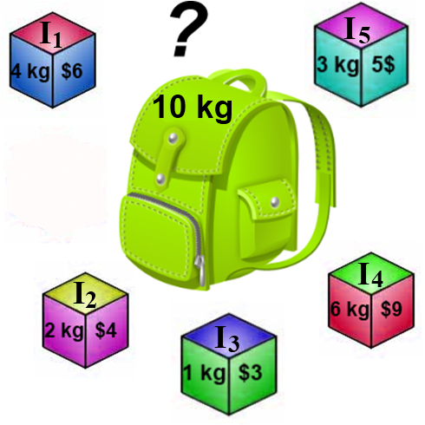
Knapsack Problem
Fill out the dynamic programming table for the knapsack problem to the right.
Trace back through the table to find the items in the knapsack.

Slide 94
Rod cutting Problem
Suppose you have a rod of length n, and you want to cut up the rod and sell the pieces in
a way that maximizes the total amount of money you get. A piece of length i is worth pi
dollars.

Slide 95
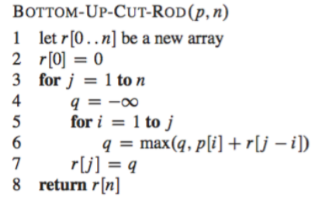
For example, if you have a rod of length 4, there are eight different ways to cut it, and the
best strategy is cutting it into two pieces of length 2, which gives you 10 dollars.
Exercise: How many ways are there to cut up a rod of length n?
Answer: 2 ^n−1 , because there are n − 1 places where we can choose to make cuts, and at
each place, we either make a cut or we do not make a cut.
Despite the exponentially large possibility space, we can use dynamic programming to write
an algorithm that runs in Θ(n^2).

Slide 96
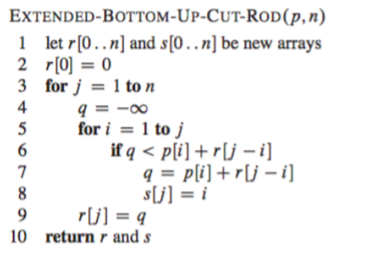

Slide 98
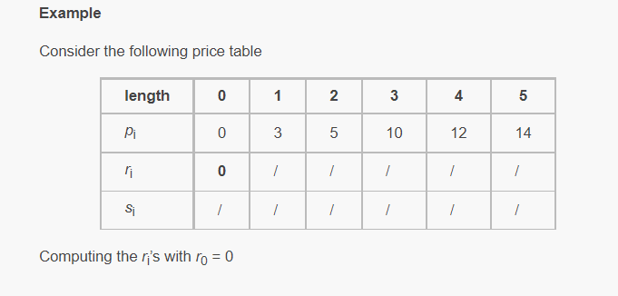

Slide 99
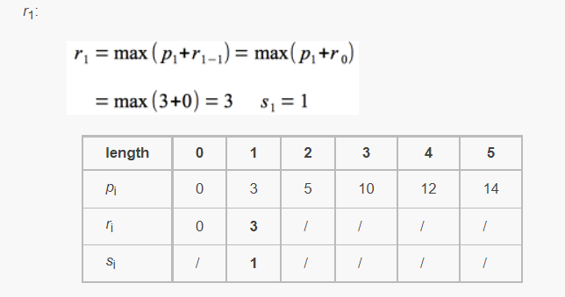

Slide 100
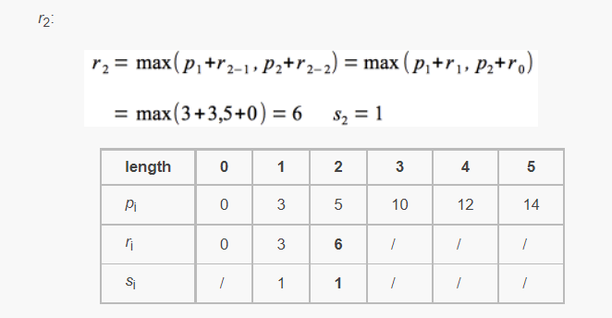

Slide 101
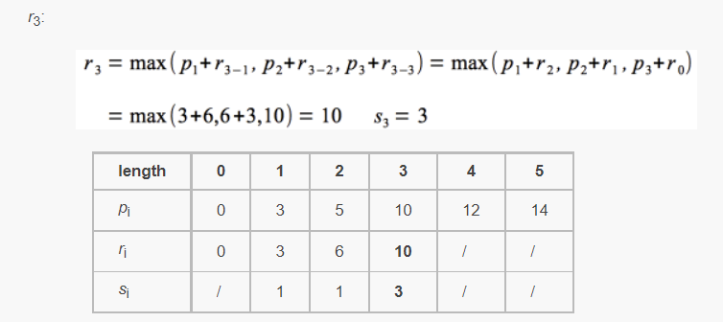

Slide 102
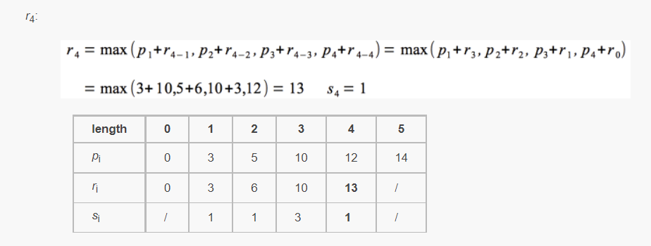

Slide 104
