Slide 1
CMPE371
Analysis of Algorithms
FALL 2026-2027
Lecture 1

Slide 2
Lecture 1
Programming Techniques
Brute force approach
Divide and conquer
Greedy algorithms:
activity selection problem
fractional knapsack problem
Dynamic programming:
matrix chain multiplication problem
longest common subsequence problem
Graph Algorithms
Running Time Analysis of Algorithms
Introduction
Pseudo-code representation of an algorithm
Analyzing algorithms
Measuring the running time and memory size of an algorithm
Calculating the running time and memory size of an iterative algorithm
Order of growth of a function, asymptotic notations
Calculating the algorithmic complexity of an iterative algorithm:
practical rules
Calculating the algorithmic complexity of a recursive algorithm:
recursion tree method

Slide 3
Introduction
what is a computer program?
a set of instructions written in a specific programming language
that is complete enough for a computer to execute it automatically
what is an algorithm?
fundamental structure of a computer program
set of instructions written in an abstract form, pseudo-code or flowchart,
independently from any specific computer or programming language

Slide 4
A Valid Algorithm is:
A sequence of unambiguous instructions for solving a problem, i.e. for obtaining the required output for any legitimate input in
a finite amount of time.
Important Points are:
Non-ambiguity
Range of inputs
The same algorithm can be represented in different ways
Several algorithms for solving the same problem

Slide 5
Example: computing greatest commom divisor, gcd(m,n)
  input: Two integer numbers.
  output: The greatest integer that divides both m and n evenly.
  issues: correctness, efficiency, storage, etc.
Input(s)
Algorithm
Output(s)

Slide 6
Algorithm gcd(m,n)
while n ≠0 do
r ← m mod n
m ← n
n ← r
return m
t ← min (m ,n)
if m % t = 0 goto 3,
else goto 4
3. if n % t = 0 return t,
else goto 4
4. t ← t - 1
5. goto 2

Slide 7
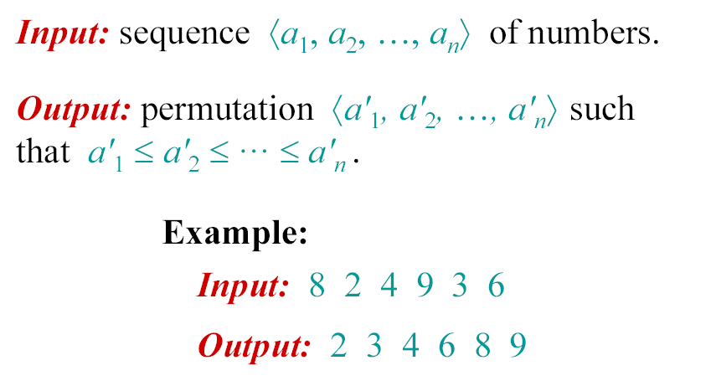
Example: The problem of sorting

Slide 8
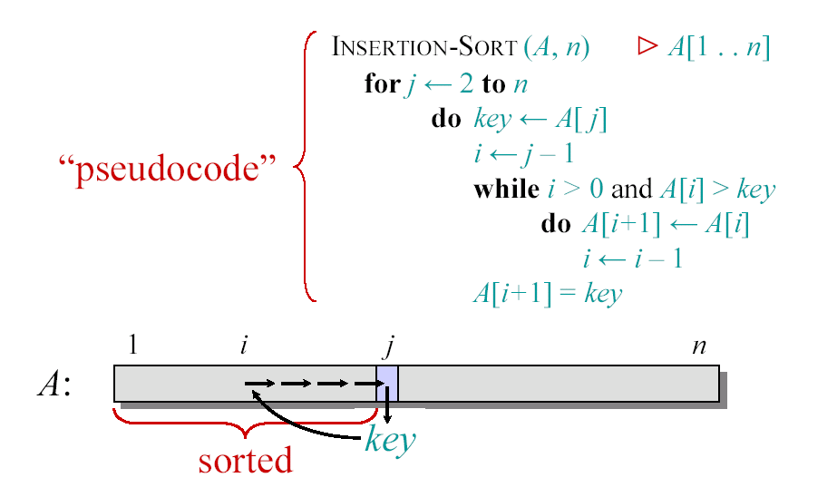
Insertion Sort

Slide 9
Issues and Approaches for Algorithm Analysis
Issues
  Correctness
  Time efficiency
  Space efficiency
  Optimality
Approaches
  Theoretical analysis
  Empirical analysis

Slide 10
what are the costs of running a computer program on a computer?
→ Computation time and Storage space required.
→ cost analysis: we must have an idea of the running time and memory size
required to solve a problem of a certain size
An intractable problem: possible in theory but impossible in practice.
Usually some problem types become intractable when problem size increases.
→ we should analyze the algorithm to know in advance the computational costs of running it

Slide 11
Algorithm Analysis
Determining performance characteristics.
(Predicting the resource requirements.)
  Usually running time and memory requirements
  Computation time (running time) is of primary concern.
Why analyze algorithms?
  Choose the most efficient of several possible algorithms for the same problem.
  Is the best possible running time for a problem reasonably finite for practical purposes?
  Is the algorithm optimal (best in some sense)? – Is something better possible?

Slide 12
Running Time – Definition
Call each simple instruction and access to a word of memory a “primitive operation” or “step.”
Time efficiency : the number of repetitions of the basic operation as a function of input size.
Running time of an algorithm for a given input is
  The number of steps executed by the algorithm on that input.
Often referred to as the complexity of the algorithm.
Units of measuring running time: Identify and count the basic operation(s) in the algorithm.

Slide 13
Complexity and Input
Complexity of an algorithm generally depends on input size.
  Input size is influenced by
  the data representation, e.g. matrix
  the operations of the algorithm, e.g. spell-checker
  the properties of the objects in the problem, e.g. checking if a given integer is a prime number.

Slide 14
Examples
Problem | Size of input
Find x in an array | The number of the elements in the array
Multiply two matrices | The dimensions of the matrices
Sort an array | The number of elements in the array
Traverse a binary tree | The number of nodes
Solve a system of linear equations | The number of equations, or the number of the unknowns, or both

Slide 15
Examples of Basic Operations
Problem | Basic Operation
Find x in an array | Comparison of x with an entry in the array
Multiplying two matrices with real entries | Multiplication of two real numbers
Sort an array of numbers | Comparison of two array entries plus moving elements in the array
Traverse a tree | Traverse an edge

Slide 16
Work done by an algorithm
Let
T(n): running time
c_{op} : execution time for basic operation
C(n) : number of times basic operation is executed
Then we have: T(n) ≈ c_{op} C(n)

Slide 17
Worst, Average, and Best-case Complexity
Worst-case Complexity
  Maximum number steps the algorithm takes for any possible input.
  Most tractable measure.
Average-case Complexity
  Average of the running times of all possible inputs.
  Demands a definition of probability of each input, which is usually difficult to provide and to analyze.
Best-case Complexity
  Minimum number of steps for any possible input.
  Not always a useful measure. Why?

Slide 18

Pseudo-code representation of an algorithm
to analyze an algorithm easily, we need to represent it in a way that is:
♦ clear and straightforward (the brain must easily comprehend its structure)
♦ without any detail of implementation (unnecessary for analysis)
♦ independent from any programming language
flowchart representation of an algorithm is mostly outdated and not suitable for analysis

Slide 19
Pseudo-code conventions:
→ based on the principles of structured programming
(sequential structure, conditional structure, iterative structure)
→ based on data abstraction:
♦ no variable declarations, no types
♦ we do not specify any memory allocation
♦ no pointers, no pointer arithmetic

Slide 20
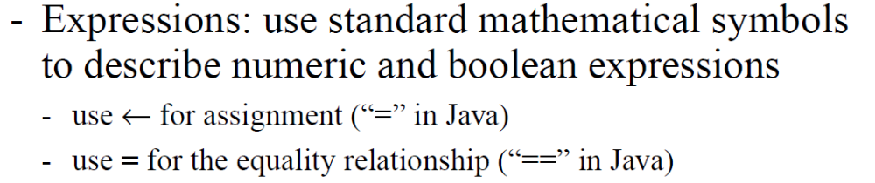
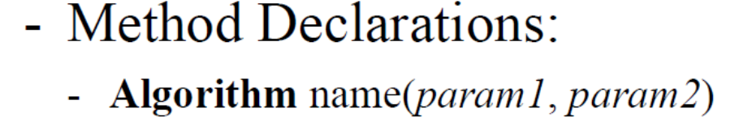
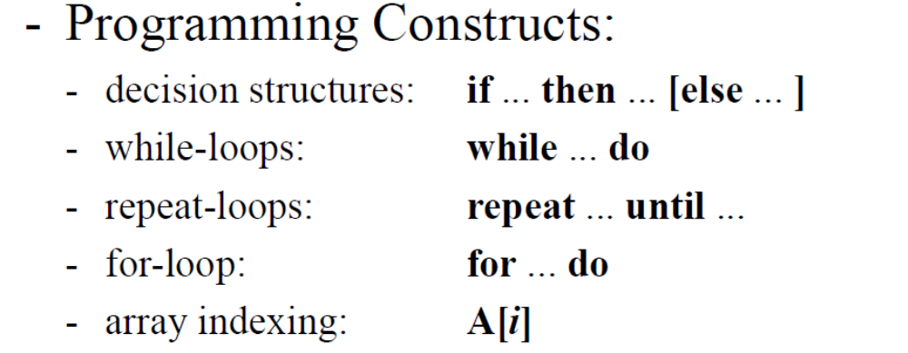

Slide 21
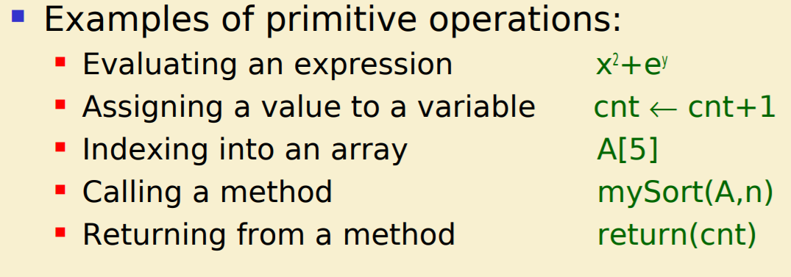

Slide 22
no input - output operations
assignment: variable ← value
if-then-else construct
while construct
block of code represented with indentation and vertically stretched square bracket
1D array: A[1..n] with 1..n range of the index → element: A[i]
2D array: A[1..n , 1..m] with 1..n and 1..m ranges of indices → element: A[i , j]
function call: similar to C → arguments are passed by value
except for arrays that are passed by reference

Slide 23
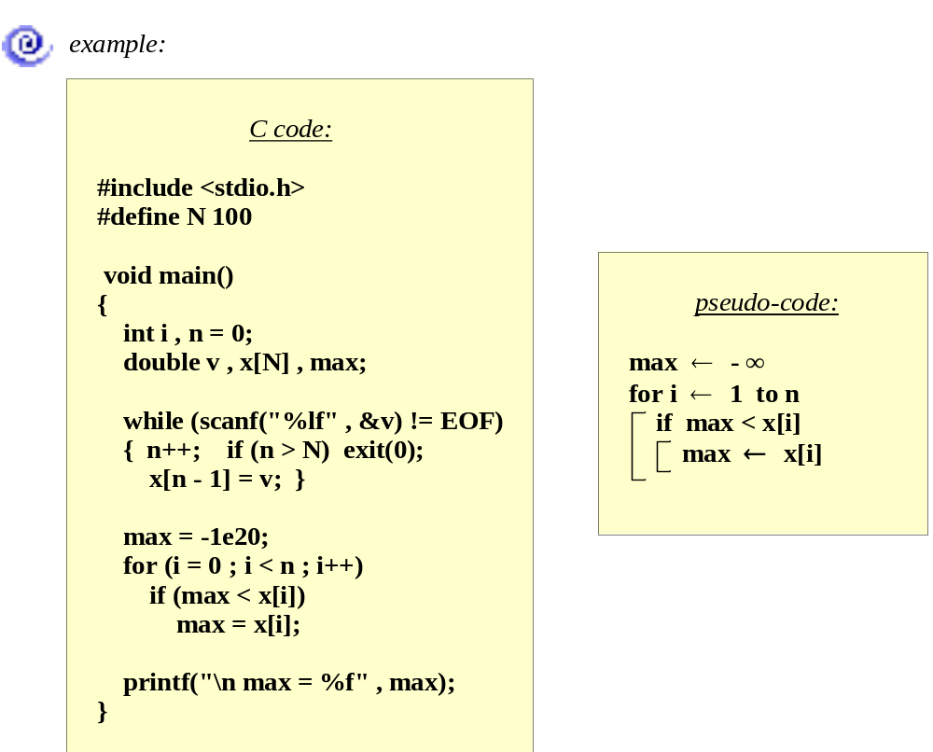

Slide 24
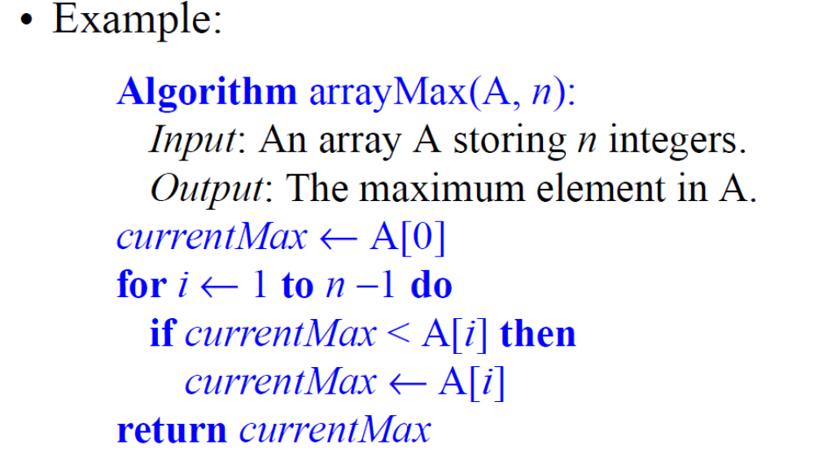

Slide 25
Analyzing algorithms
we must analyze an algorithm in order to predict the costs of executing it on a computer:
♦ running time necessary to execute the code → T(n), n: input size
♦ size of memory necessary for the data structures of the code

Slide 26
why we should know the costs of an algorithm before coding it:
better to know in advance if the algorithm can be executed with affordable costs:
♦ running time of at most a few months...
♦ memory size inferior to the RAM (or virtual memory) of our computer.
find the bottlenecks, i.e. the parts of the program that will take the most time
compare the efficiencies of two (or more) algorithms

Slide 27
We assume a generic model of computer:
only one CPU
instructions are executed one after the other
→ no parallelism, no concurrency

Slide 28
Types of formulas for basic operation count
Exact formula
e.g., T(n) = n(n-1)/2
Formula indicating order of growth with specific multiplicative constant
e.g., T(n) ≈ 0.5 n²
Formula indicating order of growth with unknown multiplicative constant
e.g., T(n) ≈ c.n²

Slide 29
Example
Let T(n) = 3n(n-1) ≈ 3n²
Suppose we double the input size.
How much longer the program will run?

Slide 30
For a given n, T(n) varies between
its best case value (when the code runs in the shortest possible time)
and
its worst case value (when the code runs in the longest possible time)
most of the time, T(n) is around its average case value

