Slide 1
CMPE371
Analysis of Algorithms
FALL 2026-2027
Lecture 2

Slide 2
Calculating the running time and memory size of an iterative algorithm
running time:
an iterative algorithm is made of loops (eventually nested) and of tests over the data
we must count the total number of iterations and express it as an algebraic expression
loops:
header line of loop executed one more time than the number of iterations:
  assignment and test on index executed one more time → exit from the loop

Slide 3
Line
1. for i ←0 to 3
2. printf("\n i = %d" , i);
3. printf("\n i = %d" , i);
i ← | i < 4 | printing
0 | true | i = 0
1 | true | i = 1
2 | true | i = 2
3 | true | i = 3
4 | false

Slide 4
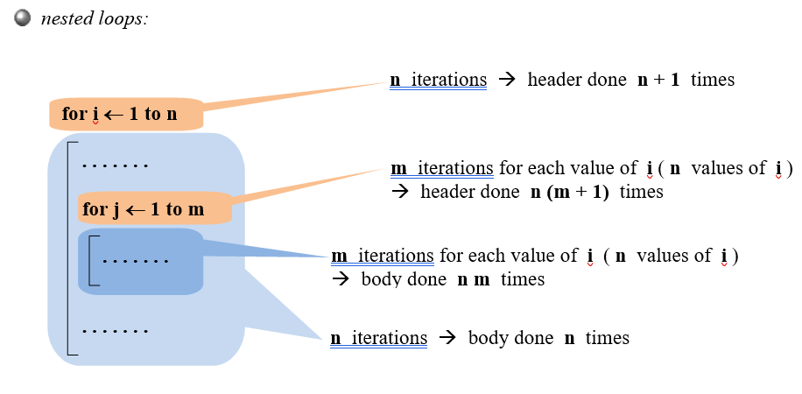

Slide 5
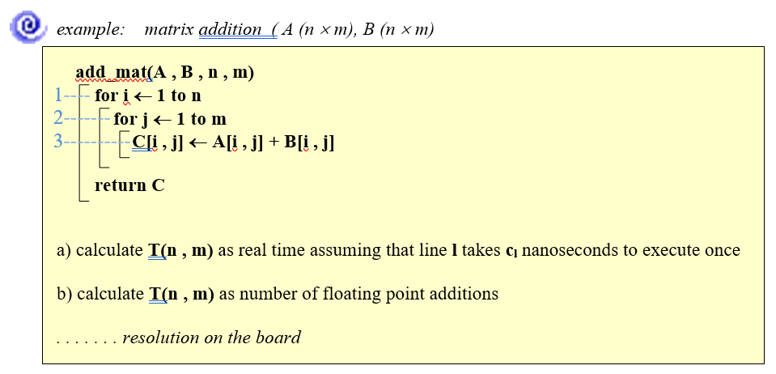

Slide 6
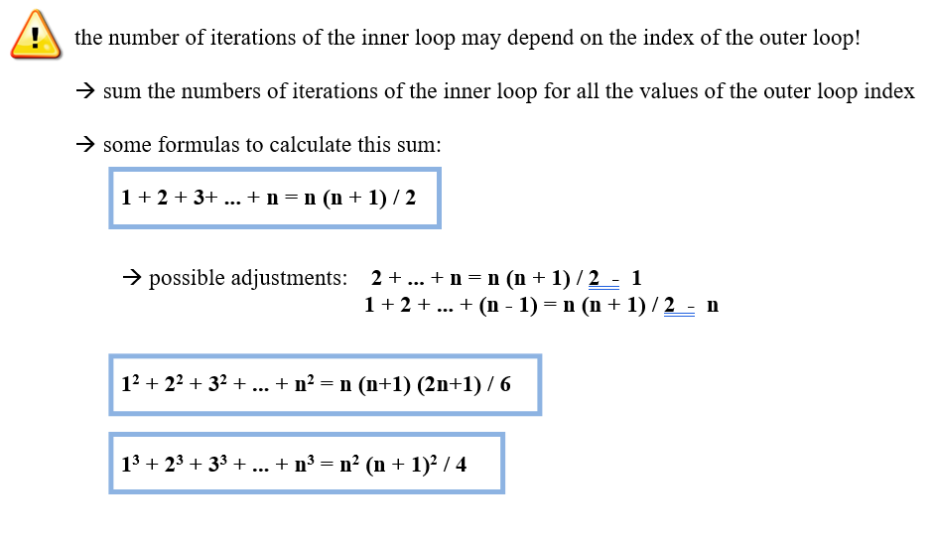

Slide 17
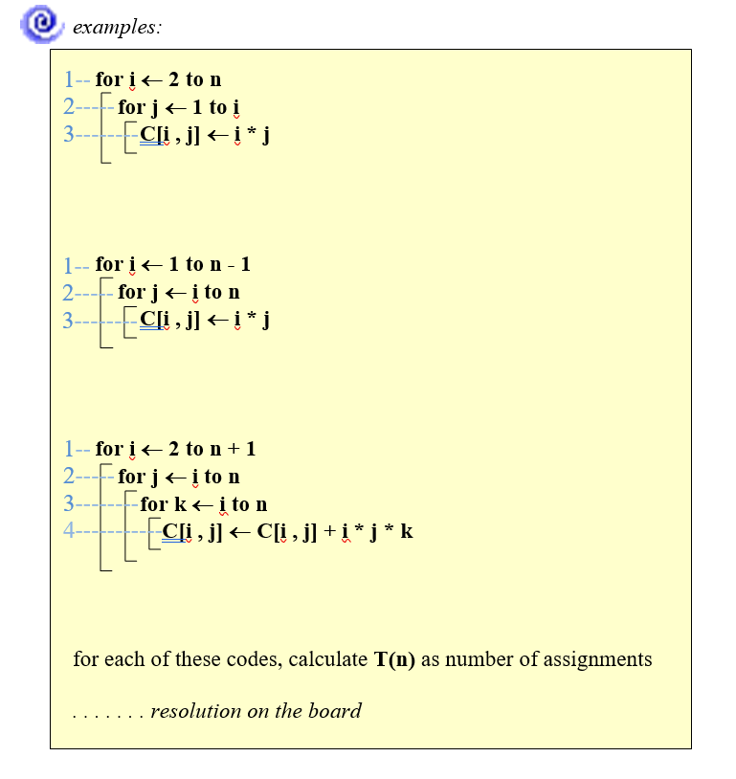

Slide 20
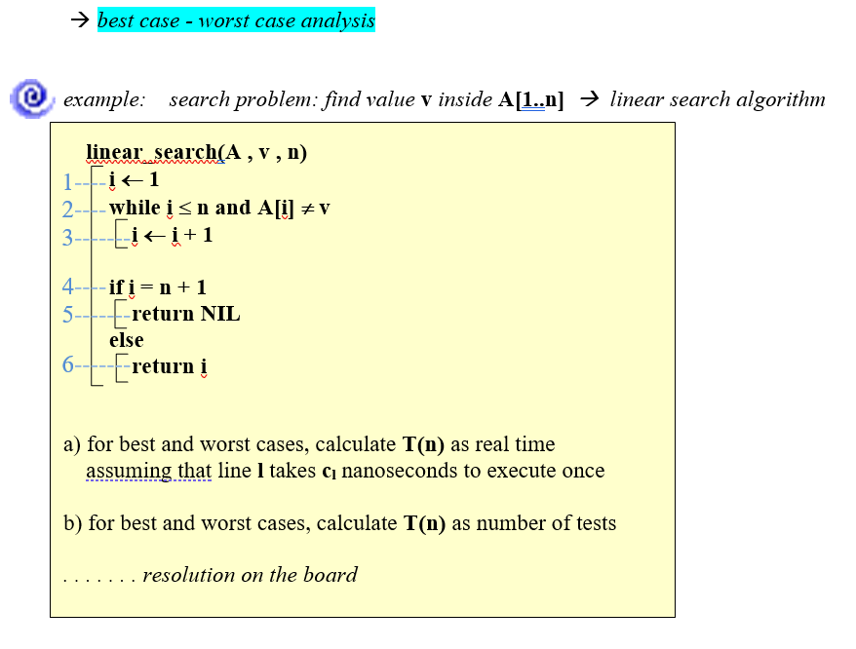

Slide 22
Example:
Algorithm LinearSearch(A, key)
1 i ← 1
2 while i ≤ n and A[i] != key
3 do i++
if i ≤ n
then return true
else return false

Slide 23
INPUT: a sequence of n numbers, key to search for.
OUTPUT: true if key occurs in the sequence, false otherwise.
LinearSearch(A, key) cost times
1 i ← 1 c₁ 1
2 while i ≤ n and A[i] != key c₂ x
3 do i++ c₃ x-1
if i ≤ n c₄ 1
then return true c₅ 1
else return false c₆ 1
x ranges between 1 and n+1.
So, the running time ranges between
c₁+ c₂+ c₄ + c₅ – best case
and
c₁+ c₂(n+1)+ c₃n + c₄ + c₆ – worst case

Slide 24
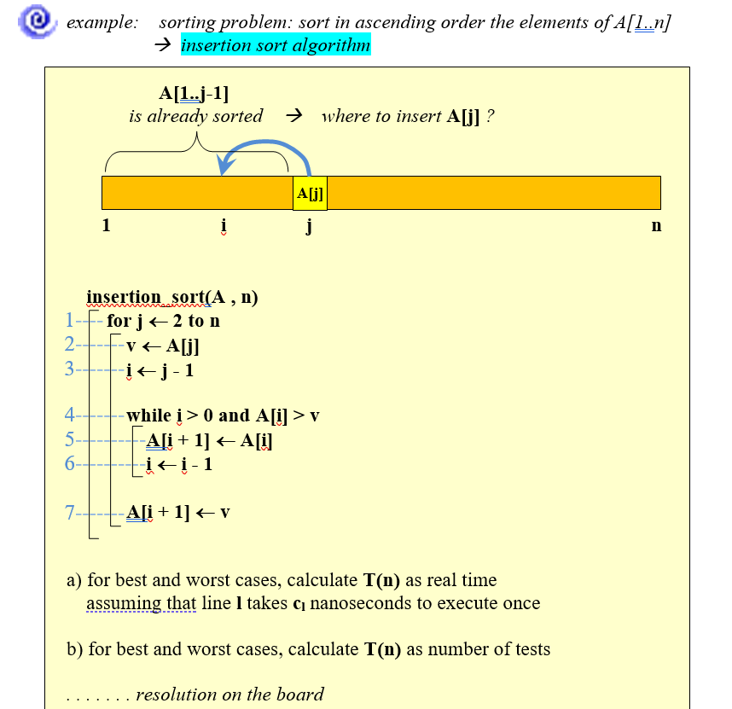

Slide 25

Example of Insertion Sort

Slide 26

Example of Insertion Sort

Slide 27
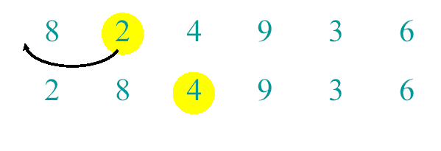
Example of Insertion Sort

Slide 28
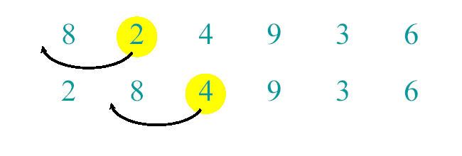
Example of Insertion Sort

Slide 29
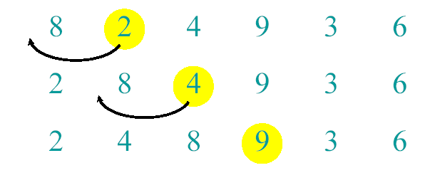
Example of Insertion Sort

Slide 30
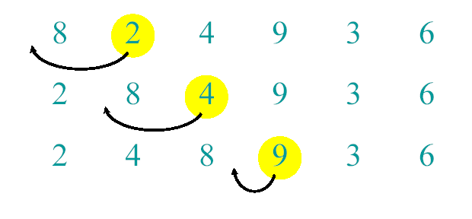
Example of Insertion Sort

Slide 31
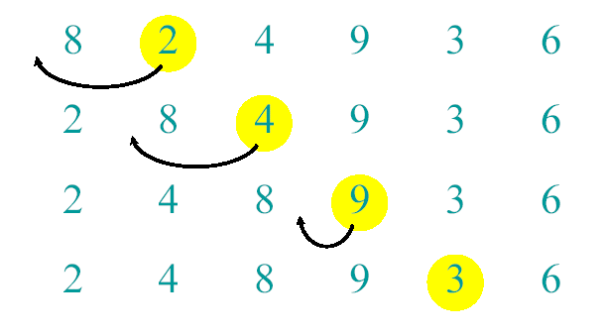
Example of Insertion Sort

Slide 32
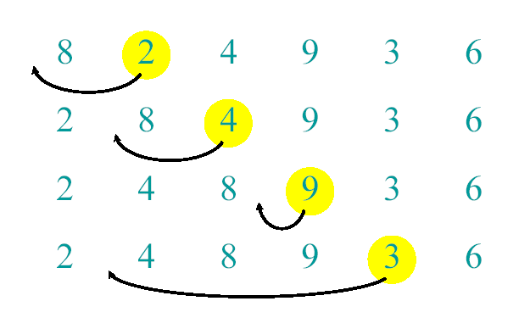
Example of Insertion Sort

Slide 33
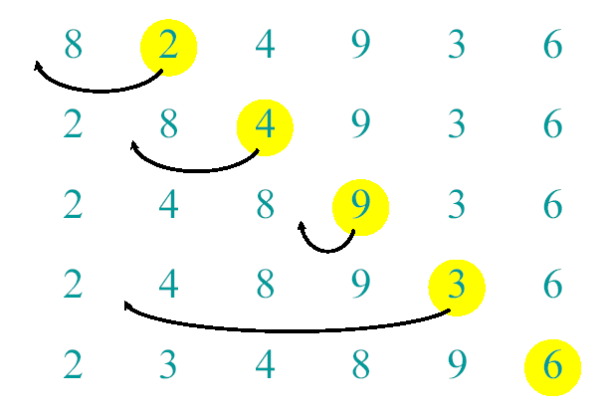
Example of Insertion Sort

Slide 34
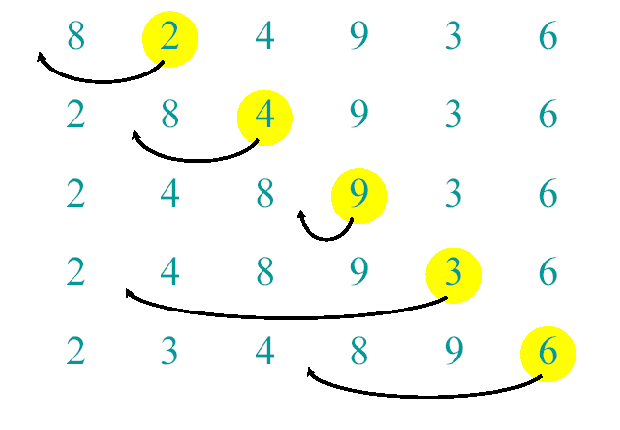
Example of Insertion Sort

Slide 35
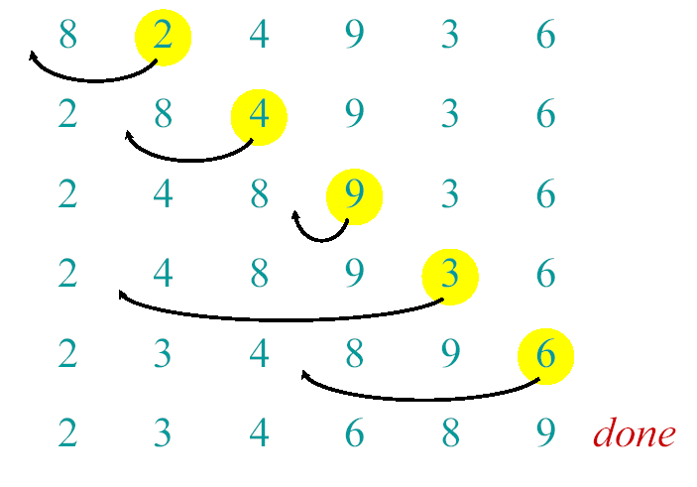
Example of Insertion Sort

Slide 36
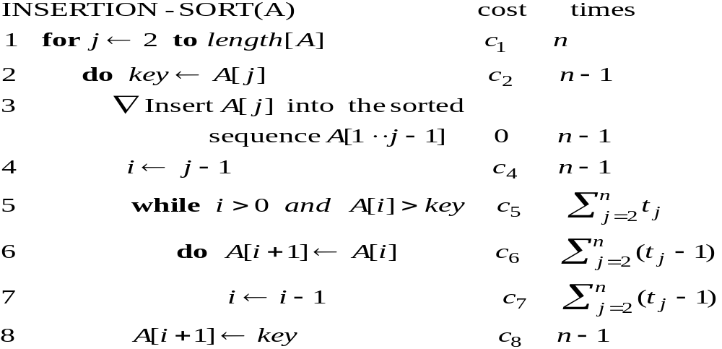
Analysis of INSERTION-SORT(contd.)

Slide 37
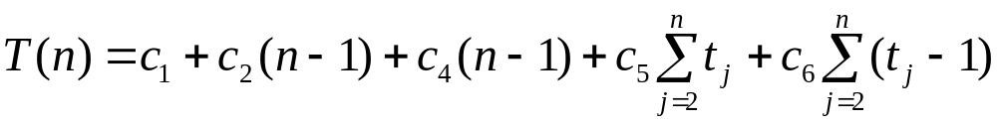
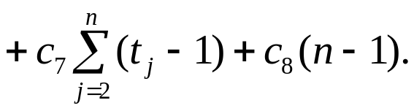
Analysis of INSERTION-SORT(contd.)
The total running time is

Slide 38
Analysis of INSERTION-SORT(contd.)
The best case: The array is already sorted.
(t_{j} =1 for j=2,3, ...,n)

Slide 39
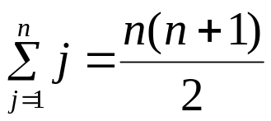

Analysis of INSERTION-SORT(contd.)
The worst case: The array is reverse sorted
(t_{j} =j for j=2,3, ...,n).

