Slide 1
CMPE371
Analysis of Algorithms
FALL 2026-2027
Lecture 3

Slide 2
Asymptotic Notations

Slide 3
Asymptotic Complexity
Running time of an algorithm as a function of input size n for large n.
Expressed using only the highest-order term in the expression for the exact running time.
  Instead of exact running time.
Describes behavior of function in the limit.
Written using Asymptotic Notation.

Slide 4
Asymptotic Notation
Θ, O, Ω, o, ω
Defined for functions over the natural numbers.
  Ex: f(n) = Θ(n²).
  Describes how f(n) grows in comparison to n².
Define a set of functions; in practice used to compare two function sizes.
The notations describe different rate-of-growth relations between the defining function and the defined set of functions.

Slide 5
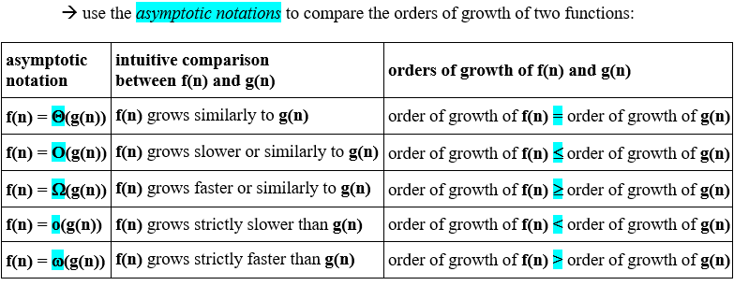

Slide 6
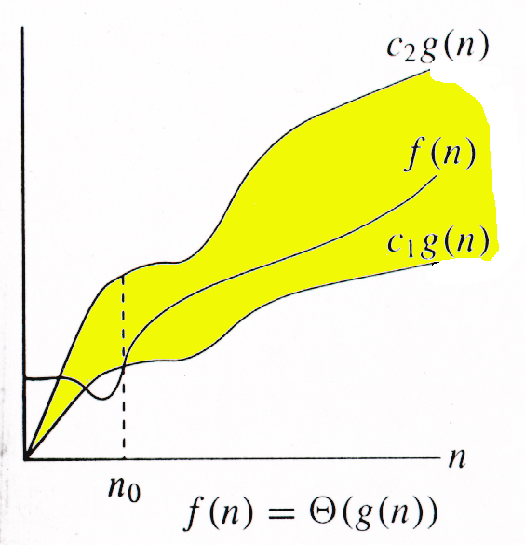
Θ-notation
For function g(n), we define Θ(g(n)), big-Theta of n, as the set:
Θ(g(n)) = {f(n) :
∃ positive constants c₁, c₂, and n_{0,} such that ∀n ≥ n₀,
we have 0 < c₁g(n) ≤ f(n) ≤ c₂g(n)
}
Intuitively: Set of all functions that
have the same rate of growth as g(n).
g(n) is an asymptotically tight bound for f(n).

Slide 7
Example
Θ(g(n)) = {f(n) : ∃ positive constants c₁, c₂, and n₀, such that ∀n ≥ n₀, 0 < c₁g(n) ≤ f(n) ≤ c₂g(n)}
10n² - 3n = Θ(n²)
What constants for n₀, c₁, and c₂ will work?
Make c₁ a little smaller than the leading coefficient, and c₂ a little bigger.
To compare orders of growth, look at the leading term.
Exercise: Prove that (n²/2)-3n= Θ(n²)

Slide 8
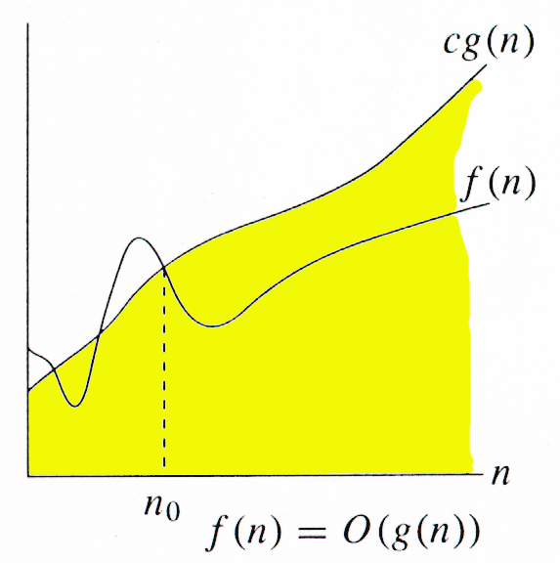
O-notation
For function g(n), we define O(g(n)), big-O of n, as the set:
O(g(n)) = {f(n) :
∃ positive constants c and n_{0,} such that ∀n ≥ n₀,
we have 0 < f(n) ≤ cg(n) }
Intuitively: Set of all functions whose rate of growth is the same as or lower than that of g(n).
g(n) is an asymptotic upper bound for f(n).
f(n) = Θ(g(n)) ⇒ f(n) = O(g(n)).
Θ(g(n)) ⊂ O(g(n)).

Slide 9
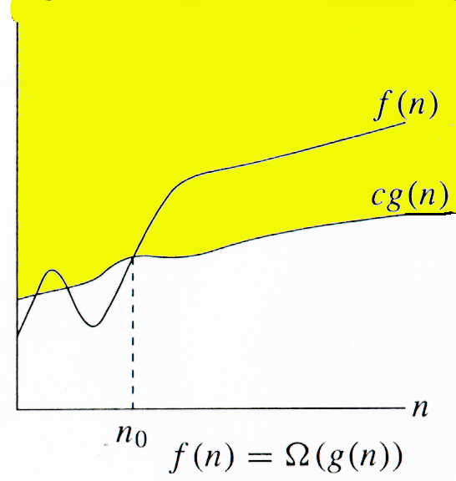
Ω -notation
For function g(n), we define Ω(g(n)), big-Omega of n, as the set:
Ω(g(n)) = {f(n) :
∃ positive constants c and n_{0,} such that ∀n ≥ n₀,
we have 0 < cg(n) ≤ f(n)}
Intuitively: Set of all functions whose rate of growth is the same as or higher than that of g(n).
g(n) is an asymptotic lower bound for f(n).
f(n) = Θ(g(n)) ⇒ f(n) = Ω(g(n)).
Θ(g(n)) ⊂ Ω(g(n)).

Slide 10
Relations Between Θ, O, Ω
limn→∞ f(n)/g(n) = c; =c >0 and c< ∞ ⇒ f = Θ(g)
limn→∞ f(n)/g(n) = c; c < ∞ ⇒ f = O(g)
limn→∞ f(n)/g(n) =c; c > 0 ⇒ f = Ω(g)

Slide 11
o-notation
For a given function g(n), the set little-o:
o(g(n)) = {f(n): ∀ c > 0, ∃ n₀ > 0 such that
∀ n ≥ n₀, we have 0 < f(n) < cg(n)}.
f(n) becomes insignificant relative to g(n) as n approaches infinity:
lim [f(n) / g(n)] = 0
^{n→∞}
g(n) is an upper bound for f(n) that is not asymptotically tight.
Observe the difference in this definition from previous ones.

Slide 12
ω -notation
For a given function g(n), the set little-omega:
ω(g(n)) = {f(n): ∀ c > 0, ∃ n₀ > 0 such that
∀ n ≥ n₀, we have 0 < cg(n) < f(n)}.
f(n) becomes arbitrarily large relative to g(n) as n approaches infinity:
lim [f(n) / g(n)] = ∞.
^{n→∞}
g(n) is a lower bound for f(n) that is not asymptotically tight.

Slide 14
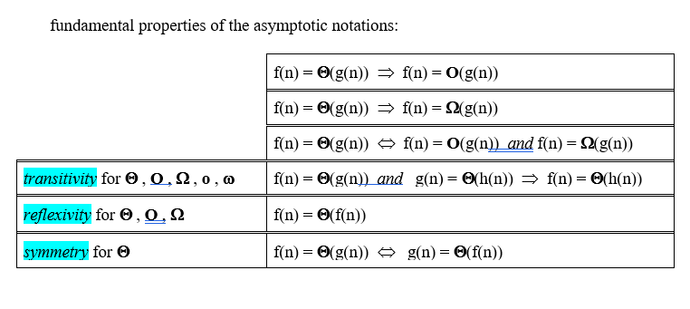

Slide 15
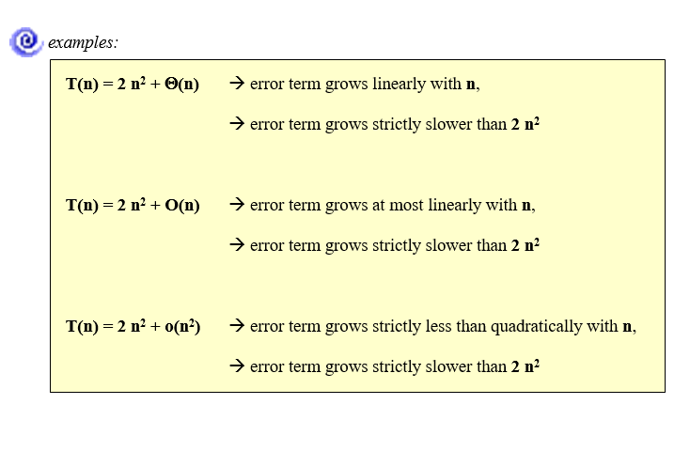

Slide 16
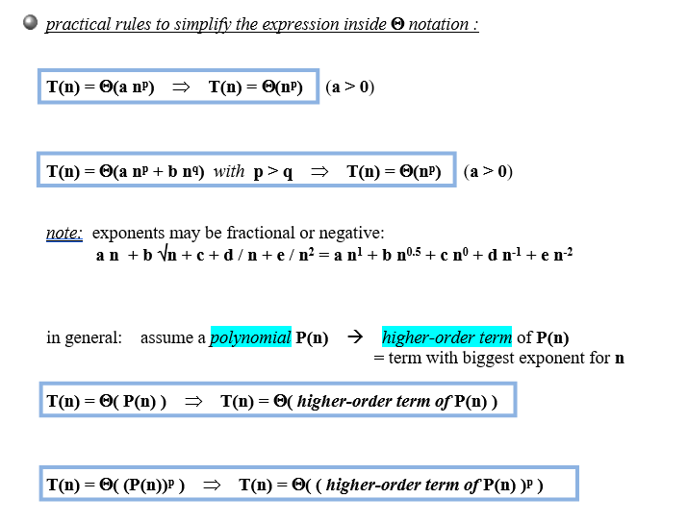

Slide 17
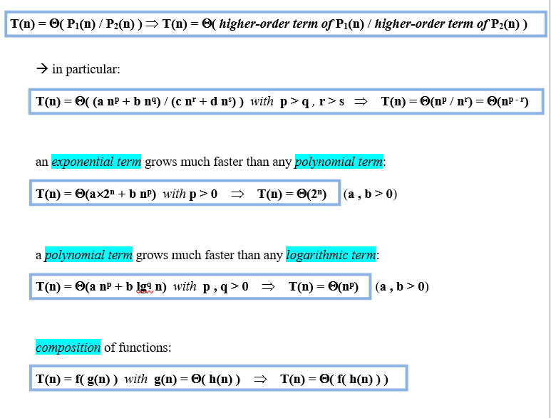

Slide 18
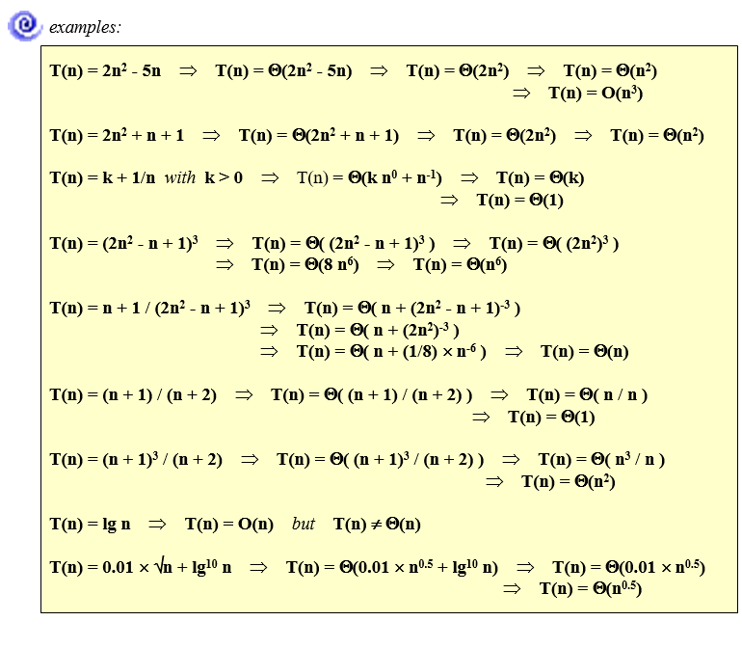

Slide 19
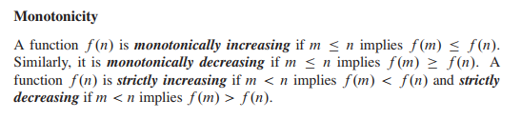
STANDART NOTATIONS AND COMMON FUNTIONS

Slide 20
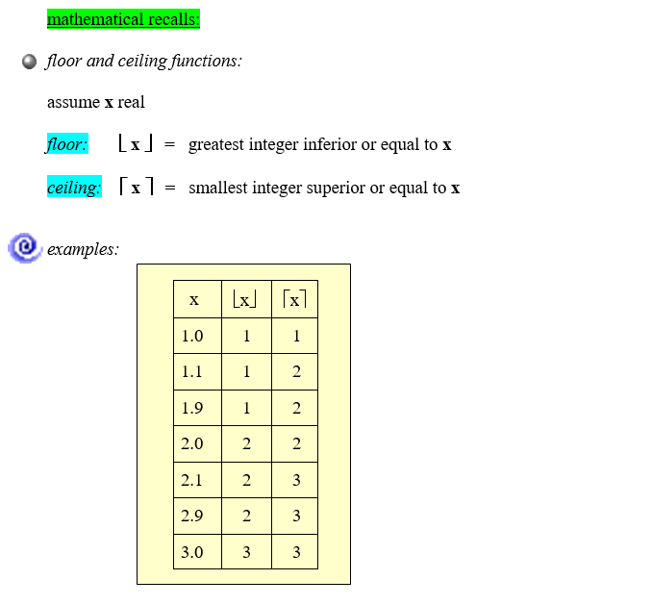
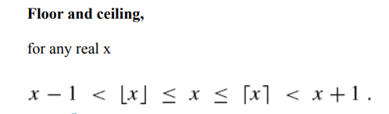

Slide 21
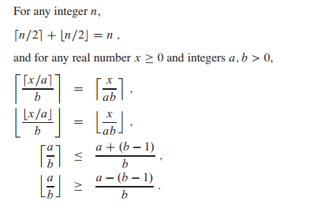
Floor and ceiling functions are monotonically increasing functions.

Slide 22
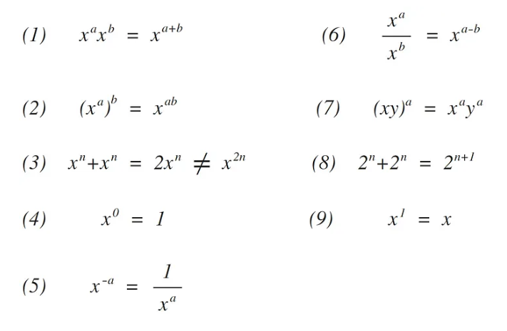
EXPONENTIALS

Slide 23
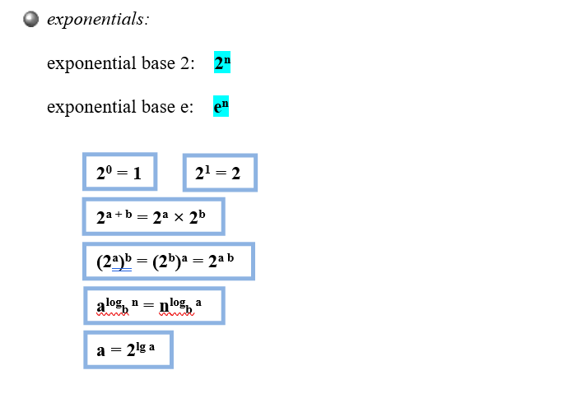

Slide 24



Slide 25


Slide 26


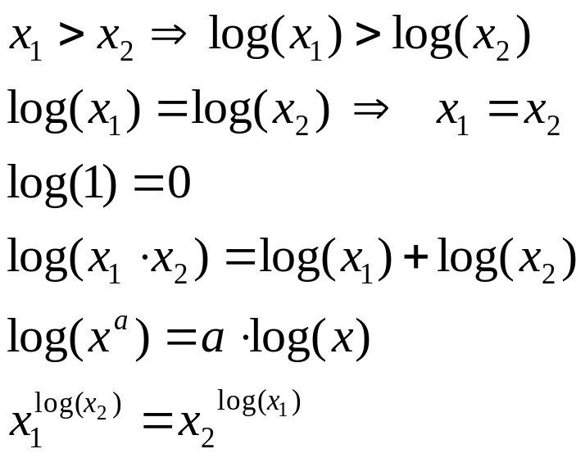
Logarithms
Definition:
Properties:

Slide 27
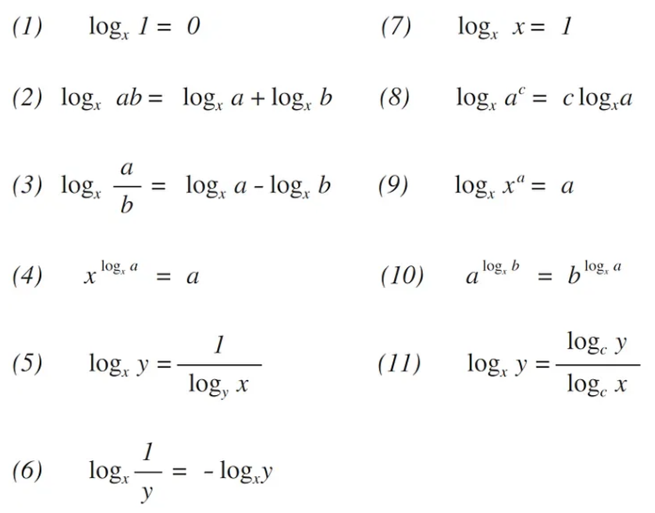

Slide 28
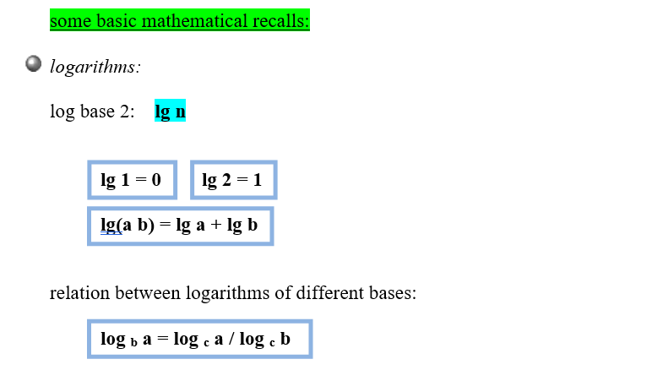
Order of growth of a function

Slide 29
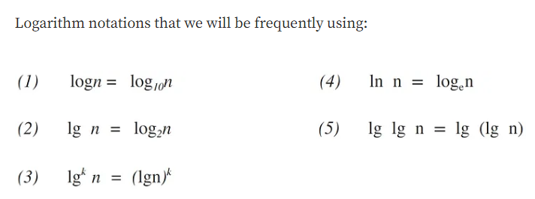

Slide 30
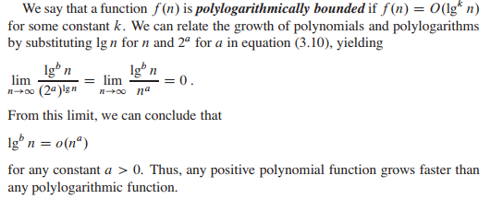
Changing the base of a logarithm from one constant to another changes the value of the logarithm by only a constant factor, and so we shall often use the notation “lg n” when we don’t care about constant factors.

Slide 31
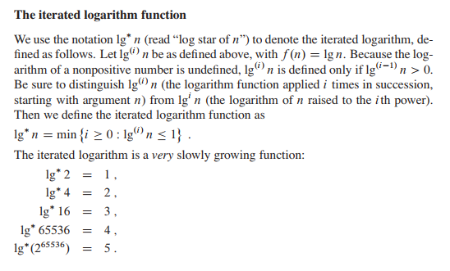

Slide 32
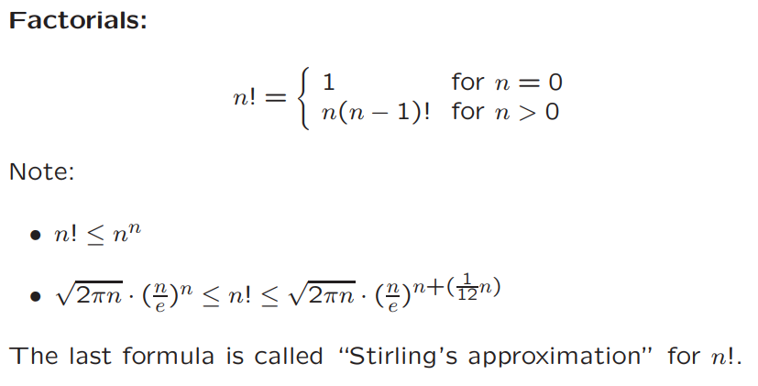

Also note that:

Slide 33
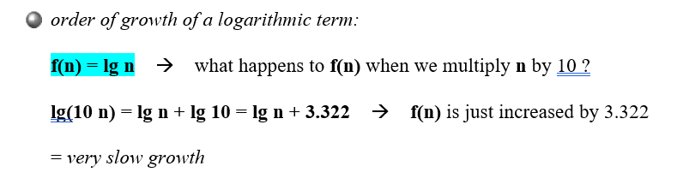
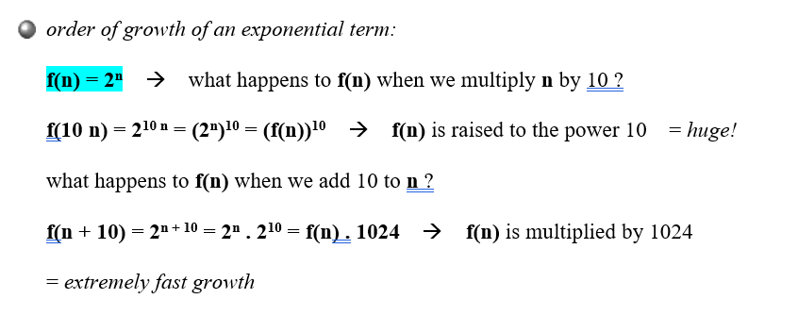

Slide 34
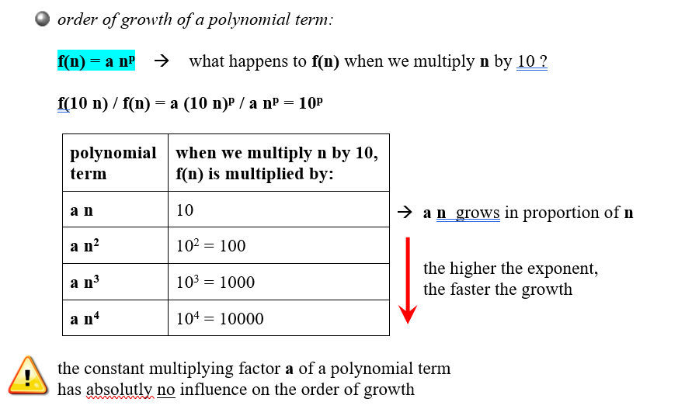

Slide 35
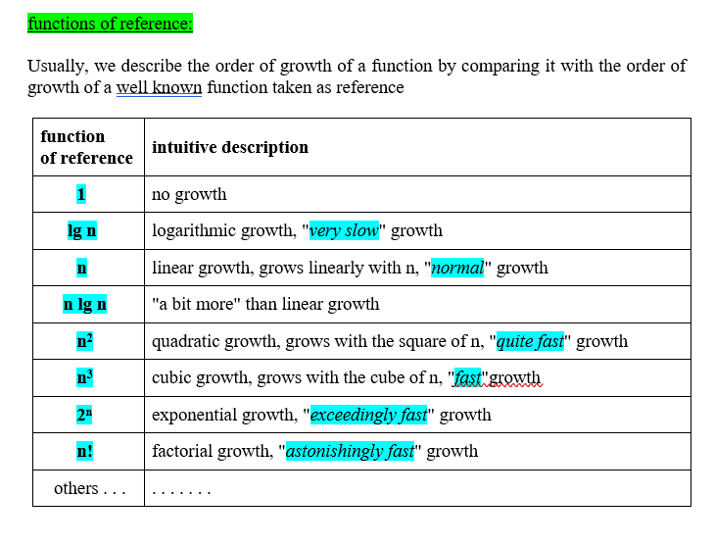

Slide 36
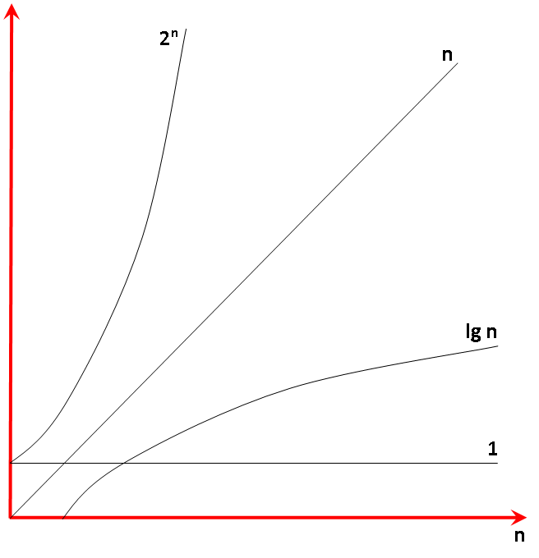

Slide 37
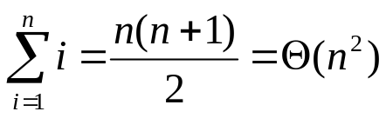
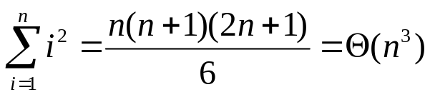
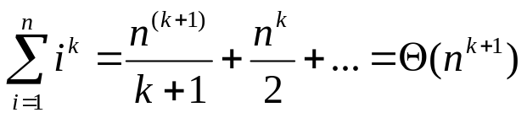
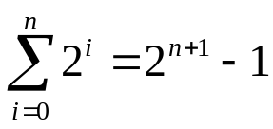
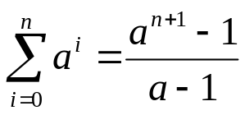
Summations

Slide 38
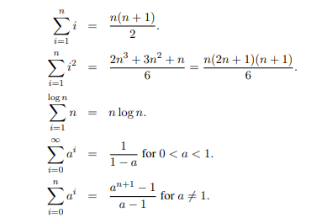

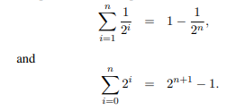

Slide 39
Order of growth
Principal interest is to determine
  how running time grows with input size – Order of growth.
  the running time for large inputs – Asymptotic complexity.
In determining the above,
  Lower-order terms and coefficient of the highest-order term are insignificant.
  Ex: In 7n⁵+6n³+n+10, which term dominates the running time for very large n?
Complexity of an algorithm is denoted by the highest-order term in the expression for running time.
  Constant complexity when running time is independent of the input size – denoted.

