Slide 1
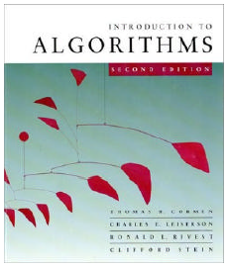
CMPE371
Analysis of Algorithms
FALL 2026-2027
Lecture 4 Part I

Slide 2
Mathematical Analysis of Non-recursive Algorithms
Remember that steps in mathematical analysis of non-recursive algorithms are:
Decide on parameter n indicating input size
Identify algorithm’s basic operation
Determine worst anf best case for input of size n
Set up summation for C(n) reflecting algorithm’s loop structure
Simplify summation using standard formulas.

Slide 3
Divide and Conquer: Recursive Algorithms
Main Idea:
Divide the given problem to sub-problems
Solve the sub-problems independent of each other.
Conquer the solutions
By recursion!

Slide 4
Simple Example
SimpleExample(N)
IF N=0 THEN 1
RETURN
    ELSE
    FOR i←1 TO N DO N+1
    PRINT(‘x’) N
    SimpleExample(N-1) T(N-1)
T(N) = O(1) if N=0
= (N+1)+N+T(N-1) = T(N-1)+θ(N), Otherwise

Slide 5
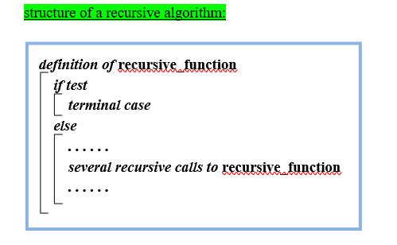
Calculating the algorithmic complexity of a recursive algorithm

Slide 6
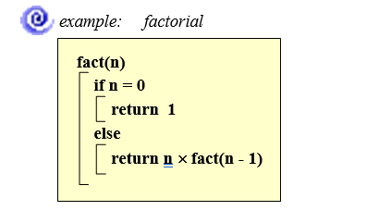
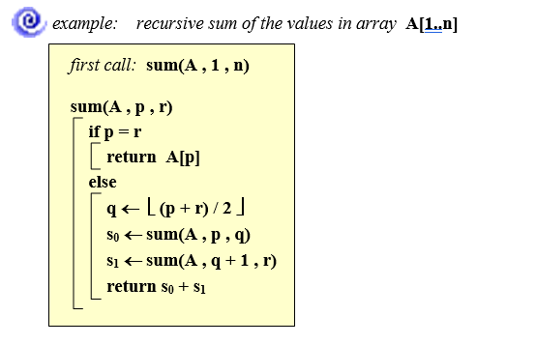

Slide 7
Mathematical Analysis of Recursive Algorithms
Steps in mathematical analysis of recursive algorithms
Decide on parameter n indicating input size
Identify algorithm’s basic operation
Determine worst and best case for input of size n; depending on the conditional operations in algorithm.
Set up a recurrence relation and initial condition(s)
Solve the recurrence to obtain a closed form or estimate the order of growth of the solution.

Slide 8
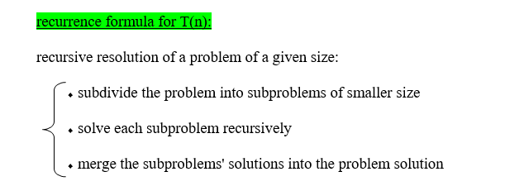
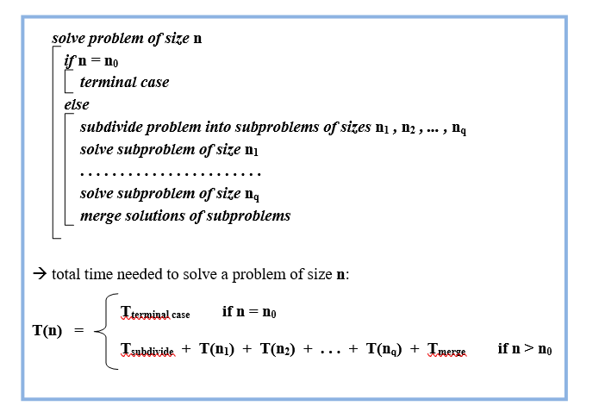

Slide 9
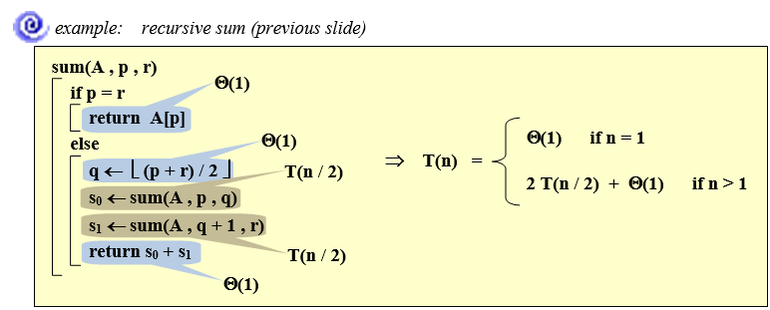

Slide 10
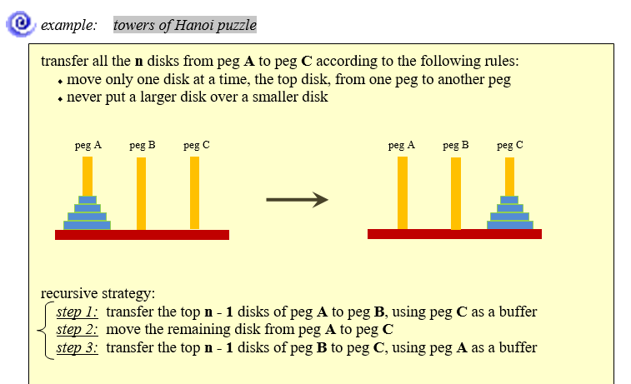

Slide 11
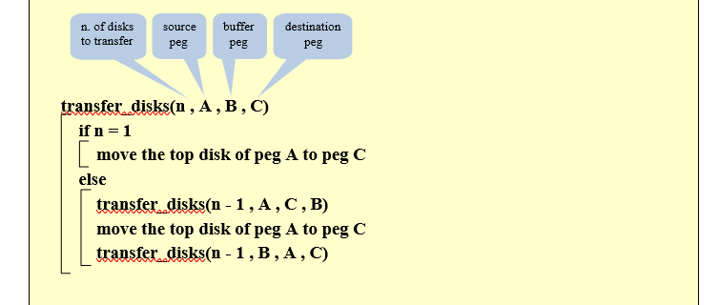
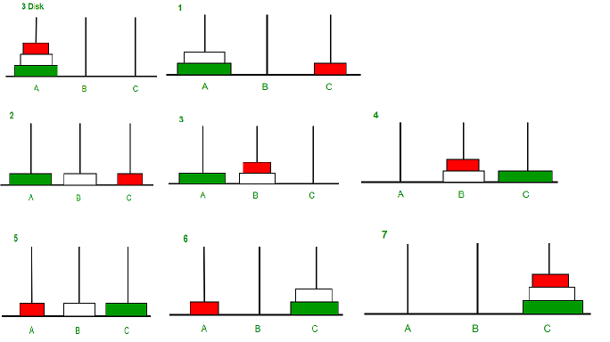

Slide 12
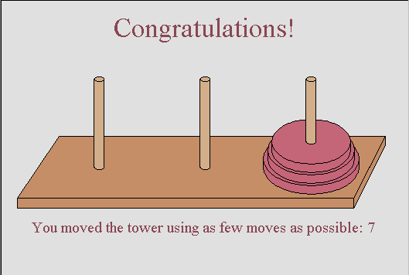
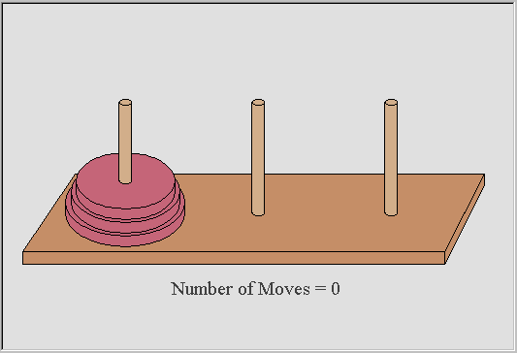
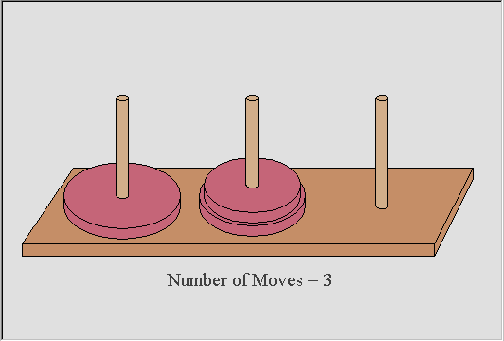
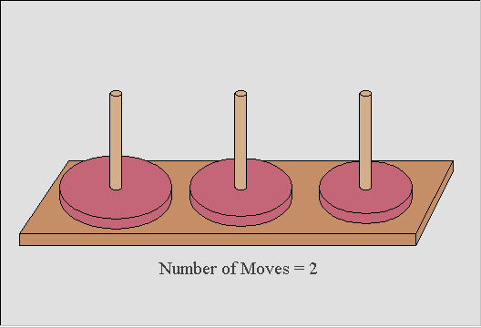
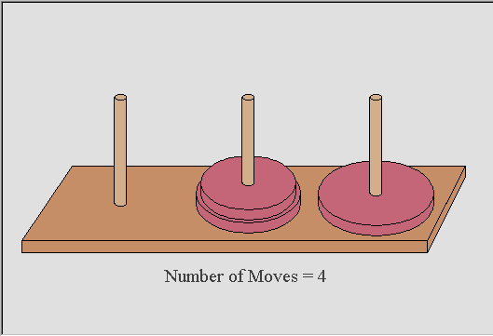
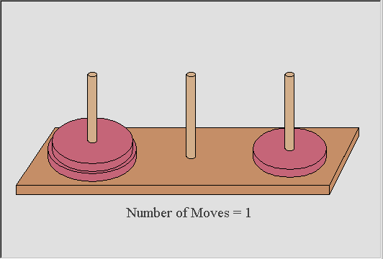
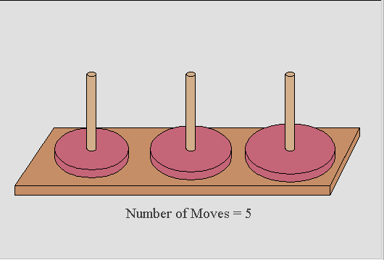
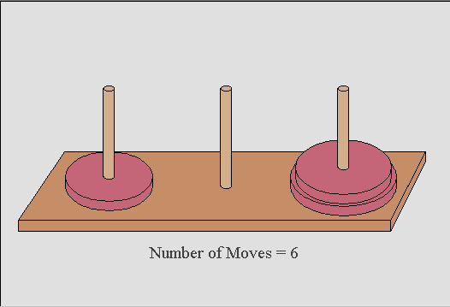
How many moves does it take?
Did you know you should be able to complete the puzzle in (2^{n} -1) moves where n is the number of disks.
For 3 disks 2^{n} -1= (2³ – 1) = (8-1) =7 moves
Notes:
This slide shows how to complete the Tower of Hanoi puzzle for 3 disks using as few moves as possible.

Slide 14
Merge Sort Approach
To sort an array A[p . . r]:
Divide
  Divide the n-element sequence to be sorted into two subsequences of n/2 elements each
Conquer
  Sort the subsequences recursively using merge sort
  When the size of the sequences is 1 there is nothing more to do
Merge
  Merge the two sorted subsequences

Slide 15
Merge Sort
p
q
r
1
2
3
4
5
6
7
8
Alg.: MERGE-SORT(A, p, r)
if p < r Check for base case
then q ← ⎣(p + r)/2⎦ Divide
MERGE-SORT(A, p, q) Conquer
MERGE-SORT(A, q + 1, r) Conquer
MERGE(A, p, q, r) Combine
Initial call: MERGE-SORT(A, 1, n)
5
2
4
7
1
3
2
6

Slide 16
Example – n Power of 2
Divide
1
2
3
4
5
6
7
8
5
2
4
7
1
3
2
6
q = 4
1
2
3
4
5
6
7
8
5
2
4
7
1
3
2
6
1
2
3
4
5
6
7
8
5
2
4
7
1
3
2
6
1
2
3
4
5
6
7
8
5
2
4
7
1
3
2
6

Slide 17
Example – n Power of 2
Conquer
and
Merge
1
2
3
4
5
6
7
8
1
2
2
3
4
5
6
7
1
2
3
4
5
6
7
8
2
4
5
7
1
2
3
6
1
2
3
4
5
6
7
8
2
5
4
7
1
3
2
6
1
2
3
4
5
6
7
8
5
2
4
7
1
3
2
6

Slide 18
Example – n Not a Power of 2
1
2
3
4
5
6
7
8
9
10
11
Divide
4
7
2
6
1
4
7
3
5
2
6
q = 6
1
2
3
4
5
6
7
8
9
10
11
q = 3
4
7
2
6
1
4
7
3
5
2
6
q = 9
1
2
3
4
5
6
7
8
9
10
11
4
7
2
6
1
4
7
3
5
2
6
1
2
3
4
5
6
7
8
9
10
11
4
7
2
6
1
4
7
3
5
2
6
1
2
4
5
7
8
4
7
6
1
7
3

Slide 19
Example – n Not a Power of 2
Conquer
and
Merge
1
2
3
4
5
6
7
8
9
10
11
1
2
2
3
4
4
5
6
6
7
7
1
2
3
4
5
6
7
8
9
10
11
1
2
4
4
6
7
2
3
5
6
7
1
2
3
4
5
6
7
8
9
10
11
2
4
7
1
4
6
3
5
7
2
6
1
2
3
4
5
6
7
8
9
10
11
4
7
2
1
6
4
3
7
5
2
6
1
2
4
5
7
8
4
7
6
1
7
3

Slide 20
Merging
p
q
r
1
2
3
4
5
6
7
8
2
4
5
7
1
2
3
6
Input: Array A and indices p, q, r such that p ≤ q < r
  Subarrays A[p . . q] and A[q + 1 . . r] are sorted
Output: One single sorted subarray A[p . . r]

Slide 21
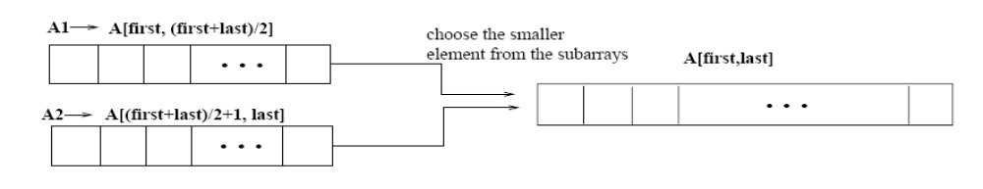
Merging
p
q
r
1
2
3
4
5
6
7
8
2
4
5
7
1
2
3
6
Idea for merging:
  Two piles of sorted cards
    Choose the smaller of the two top cards
    Remove it and place it in the output pile
  Repeat the process until one pile is empty
  Take the remaining input pile and place it face-down onto the output pile
A1← A[p, q]
A[p, r]
A2← A[q+1, r]

Slide 22
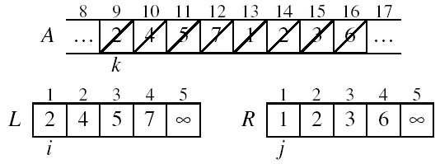
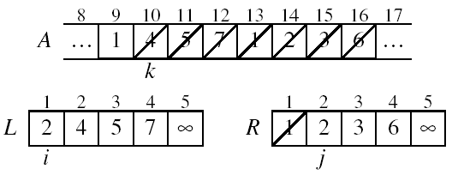
Example: MERGE(A, 9, 12, 16)
p
q
r

Slide 23
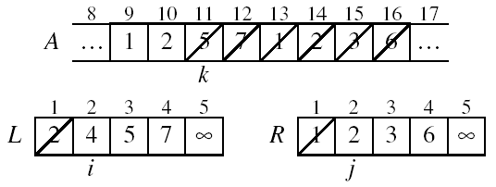
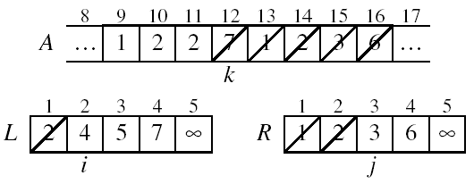
Example: MERGE(A, 9, 12, 16)

Slide 24
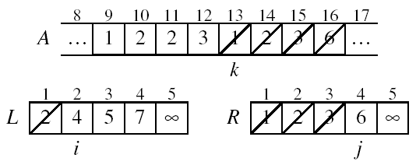
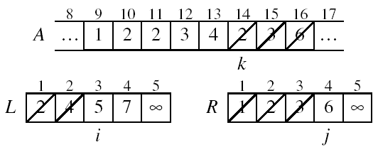
Example (cont.)

Slide 25
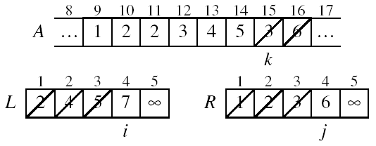
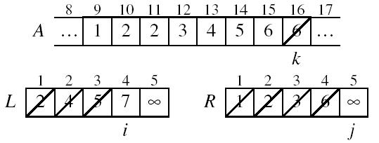
Example (cont.)

Slide 26
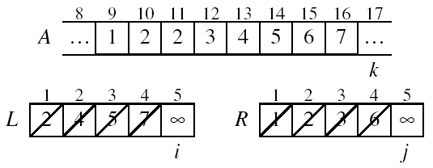
Example (cont.)
Done!

Slide 27
Merge - Pseudocode
p
q
r
Alg.: MERGE(A, p, q, r)
Compute n₁ and n₂
Copy the first n₁ elements into L[1 . . n₁ + 1] and the next n₂ elements into R[1 . . n₂ + 1]
L[n₁ + 1] ← ∞; R[n₂ + 1] ← ∞
i ← 1; j ← 1
for k ← p to r
do if L[ i ] ≤ R[ j ]
then A[k] ← L[ i ]
i ←i + 1
else A[k] ← R[ j ]
j ← j + 1
1
2
3
4
5
6
7
8
2
4
5
7
1
2
3
6
n₁
n₂
p
q
L
2
4
5
7
∞
q + 1
r
R
1
2
3
6
∞

Slide 28
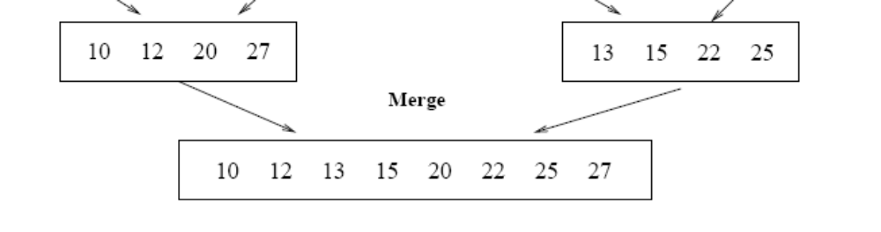
Running Time of Merge (assume last for loop)
Initialization (copying into temporary arrays):
  Θ(n₁ + n₂) = Θ(n)
Adding the elements to the final array:
  - n iterations, each taking constant time ⇒ Θ(n)
Total time for Merge:
  Θ(n)

Slide 29
Analyzing Divide-and Conquer Algorithms
The recurrence is based on the three steps of the paradigm:
  T(n) – running time on a problem of size n
  Divide the problem into a subproblems, each of size n/b: takes D(n)
  Conquer (solve) the subproblems aT(n/b)
  Combine the solutions C(n)
Θ(1) if n ≤ c
T(n) = aT(n/b) + D(n) + C(n) otherwise

Slide 30
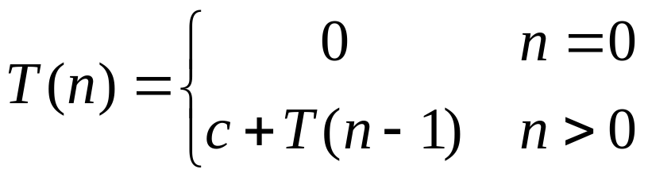
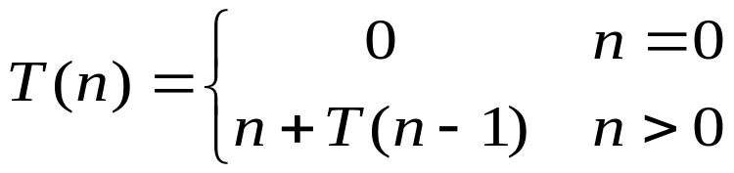
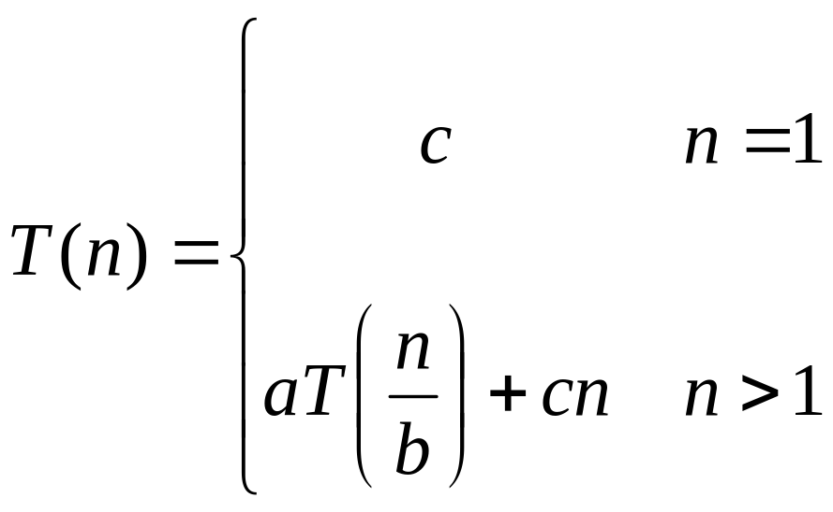
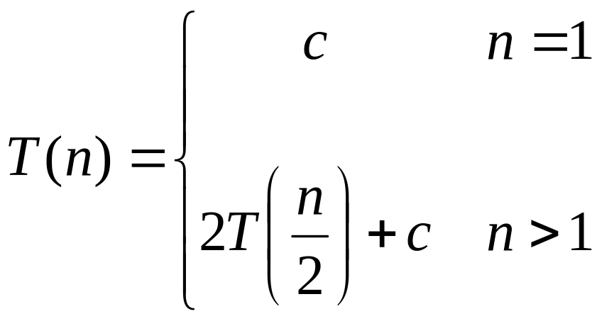
Recurrence Examples

Slide 31
Methods for Solving Recurrences
Substitution method
Iteration method
Recursion tree method
Master method

