Slide 1
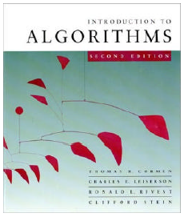
CMPE371
Analysis of Algorithms
FALL 2026-2027
Lecture 4 Part III

Slide 2
Methods for Solving Recurrences
Substitution method
Iteration method
Recursion tree method
Master method

Slide 3
The Iteration Method
Convert the recurrence into a summation and try to bound it using known series
  Iterate the recurrence until the initial condition is reached.
  Use back-substitution to express the recurrence in terms of n and the initial (boundary) condition.
Iteration method:
  Expand the recurrence k times
  Work some algebra to express as a summation
  Evaluate the summation

Slide 4
The Iteration Method
T(n) = c + T(n/2)
T(n) = c + T(n/2)
= c + c + T(n/4)
= c + c + c + T(n/8)
Assume n = 2^{k}
T(n) = c + c + … + c + T(1)
= clgn + T(1)
= Θ(lgn)
T(n/2) = c + T(n/4)
T(n/4) = c + T(n/8)
k times

Slide 5
Iteration Method – Example
T(n) = n + 2T(n/2)
T(n) = n + 2T(n/2)
= n + 2(n/2 + 2T(n/4))
= n + n + 4T(n/4)
= n + n + 4(n/4 + 2T(n/8))
= n + n + n + 8T(n/8)
… = kn + 2^{k}T(n/2^{k})
= kn + 2^{k}T(1)
= nlgn + nT(1) = Θ(nlgn)
Assume: n = 2^{k}
T(n/2) = n/2 + 2T(n/4)

Slide 6
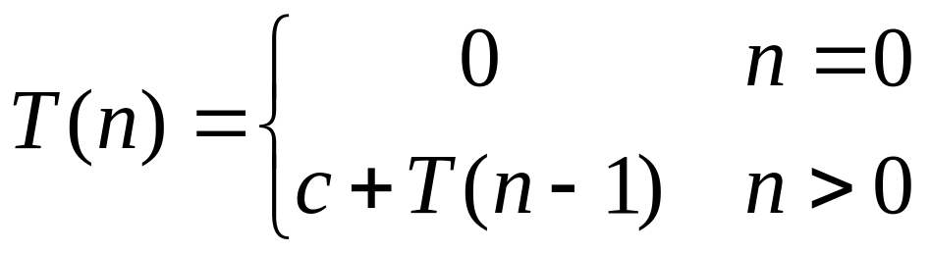
T(n) = c + T(n-1) = c + c + T(n-2)
= 2c + T(n-2) = 2c + c + T(n-3)
= 3c + T(n-3) … kc + T(n-k)
= ck + T(n-k)
So far for n ≥ k we have
  T(n) = ck + T(n-k)
To stop the recursion, we should have
  n - k = 0 ➔ k = n
  T(n) = cn + T(0) = cn
Thus in general T(n) = O(n)

Slide 7
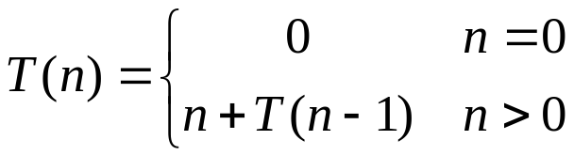
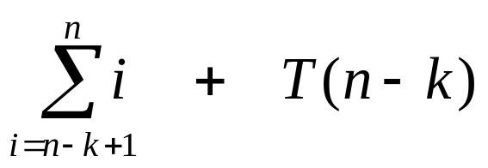
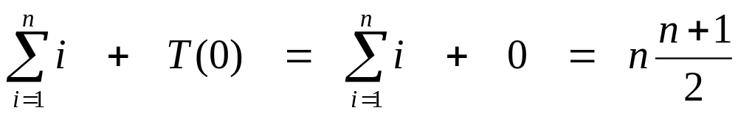
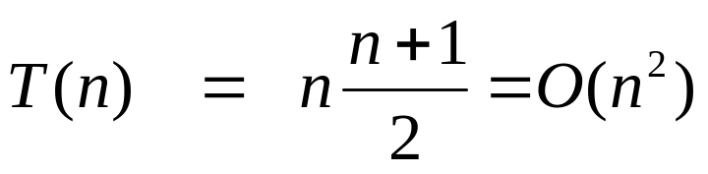
T(n) = n + T(n-1)
= n + n-1 + T(n-2)
= n + n-1 + n-2 + T(n-3)
= n + n-1 + n-2 + n-3 + T(n-4)
= …
= n + n-1 + n-2 + n-3 + … + (n-k+1) + T(n-k)
= for n ≥ k
To stop the recursion, we should have n - k = 0 ➔ k = n

Slide 8
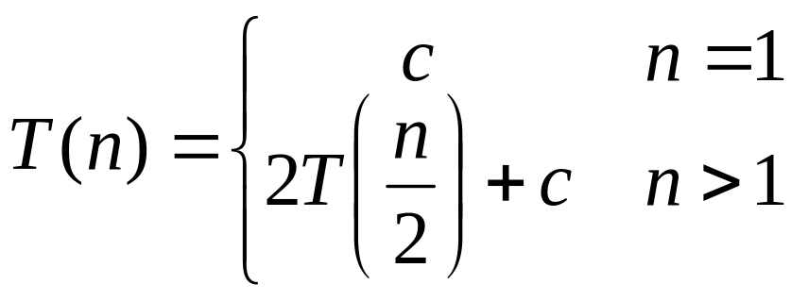
T(n) = 2 T(n/2) + c 1
= 2(2 T(n/2/2) + c) + c 2
= 2² T(n/2²) + 2c + c
= 2²(2 T(n/2²/2) + c) + (2²-1)c 3
= 2³ T(n/2³) + 4c + 3c
= 2³ T(n/2³) + (2³-1)c
= 2³(2 T(n/2³/2) + c) + 7c 4
= 2⁴ T(n/2⁴) + (2⁴-1)c
= …
= 2^{k} T(n/2^{k}) + (2^{k} - 1)c k

Slide 9
So far for n ≥ k we have
  T(n) = 2^{k} T(n/2^{k}) + (2^{k} - 1)c
To stop the recursion, we should have
  n/2^{k} = 1 ➔ n = 2^{k} ➔ k = lg n
  T(n) = n T(n/n) + (n - 1)c
  = n T(1) + (n-1)c
  = nc + (n-1)c
  = nc + nc – c = 2cn – c
  T(n) = 2cn – c = O(n)

Slide 10
The recursion-tree method
Convert the recurrence into a tree:
  Each node represents the cost incurred at various levels of recursion
  Sum up the costs of all levels
recursion tree method:
step1: draw the recursion tree, find its number of levels
step2: sum all the local times of the nodes, first over each level, then over all levels
Used to “guess” a solution for the recurrence

Slide 11
Step-01:
Draw a recursion tree based on the given recurrence relation.
Step-02:
Determine-
Cost of each level
Total number of levels in the recursion tree
Number of nodes in the last level
Cost of the last level
Step-03:
Add cost of all the levels of the recursion tree and simplify the expression so obtained in terms of asymptotic notation.

Slide 12

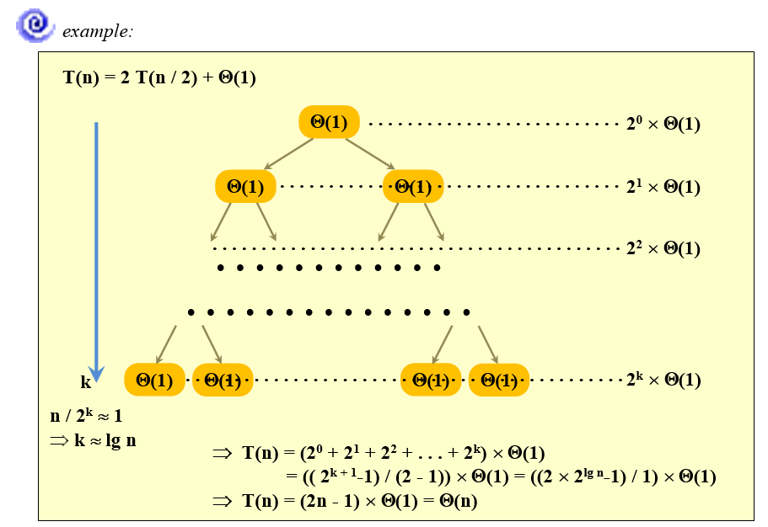

Slide 13
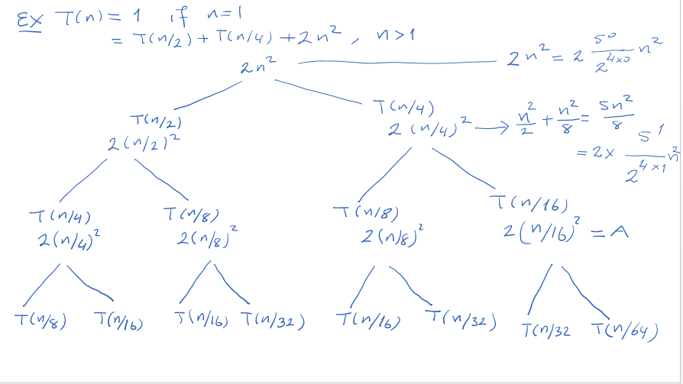

Slide 14
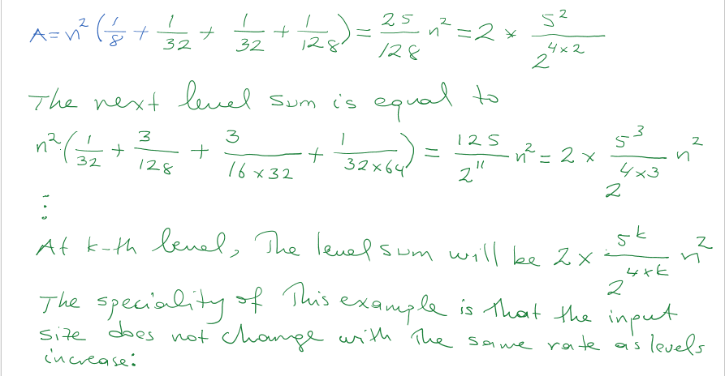

Slide 18
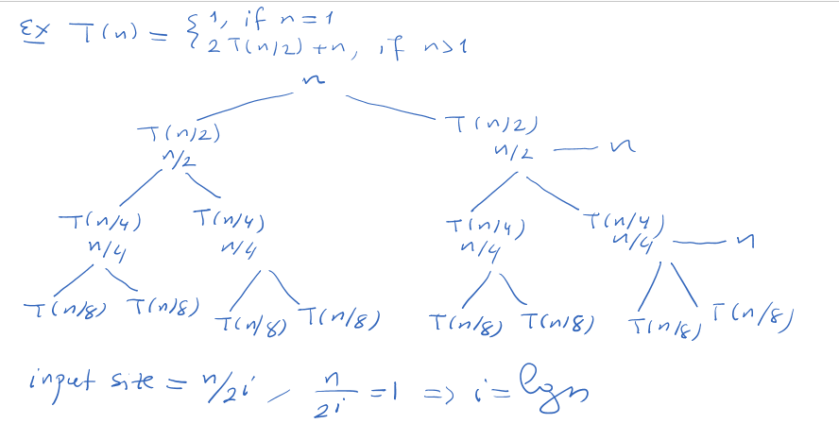

Slide 19
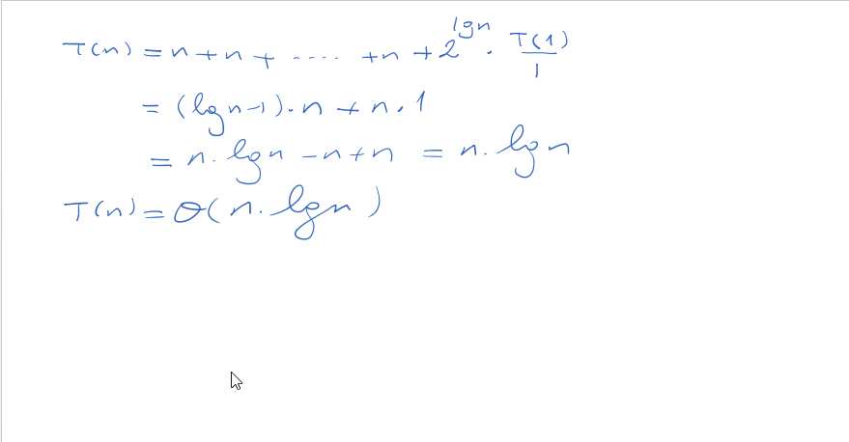

Slide 20
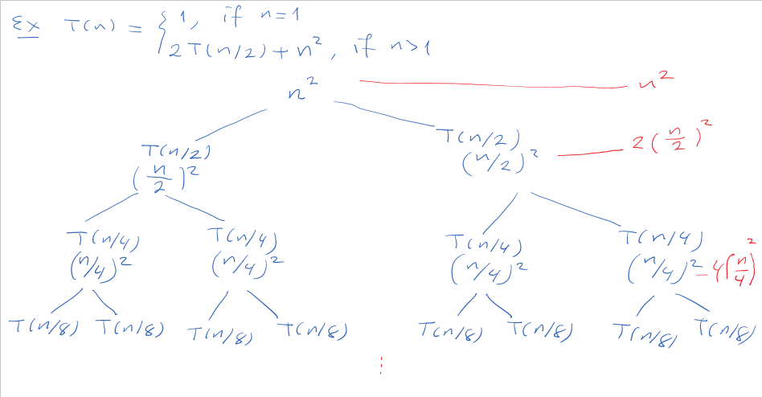

Slide 21
