Slide 1

CMPE371
Analysis of Algorithms
FALL 2025-2026
Lecture 4 Part IV

Slide 2
Methods for Solving Recurrences
Substitution method
Iteration method
Recursion tree method
Master method

Slide 3
Example of recursion tree
Solve T(n) = T(n/4) + T(n/2) + n²:
T(n)

Slide 4
Example of recursion tree
Solve T(n) = T(n/4) + T(n/2) + n²:
n²
T(n/4)
T(n/2)

Slide 5
Example of recursion tree
Solve T(n) = T(n/4) + T(n/2) + n²:
n²
(n/4)²
(n/2)²
T(n/16)
T(n/8)
T(n/8)
T(n/4)

Slide 6
Example of recursion tree
Solve T(n) = T(n/4) + T(n/2) + n²:
n²
(n/4)²
(n/2)²
(n/16)²
(n/8)²
(n/8)²
(n/4)²
…
Θ(1)

Slide 7

Example of recursion tree
Solve T(n) = T(n/4) + T(n/2) + n²:
n²
(n/4)²
(n/2)²
(n/16)²
(n/8)²
(n/8)²
(n/4)²
…
Θ(1)

Slide 8
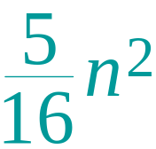
Example of recursion tree
Solve T(n) = T(n/4) + T(n/2) + n²:
n²
(n/4)²
(n/2)²
(n/16)²
(n/8)²
(n/8)²
(n/4)²
…
Θ(1)

Slide 9
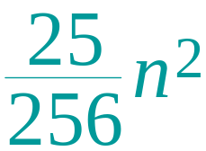
Example of recursion tree
Solve T(n) = T(n/4) + T(n/2) + n²:
n²
(n/4)²
(n/2)²
(n/16)²
(n/8)²
(n/8)²
(n/4)²
…
…
Θ(1)

Slide 10
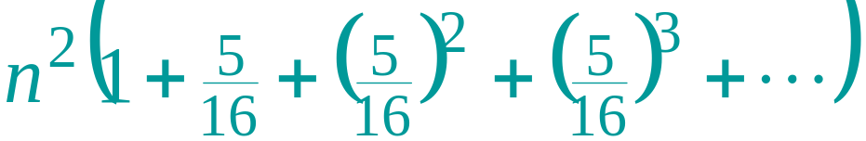
Example of recursion tree
Solve T(n) = T(n/4) + T(n/2) + n²:
n²
(n/4)²
(n/2)²
(n/16)²
(n/8)²
(n/8)²
(n/4)²
…
…
Θ(1)
Total =
= Θ(n²)
geometric series

Slide 11
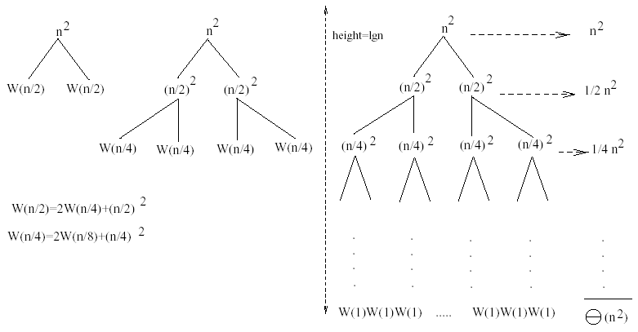
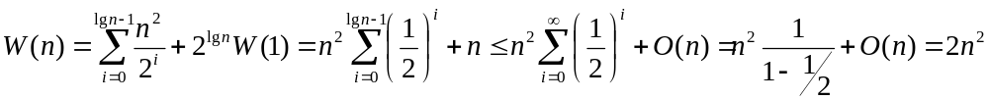
Example
W(n) = 2W(n/2) + n²
Subproblem size at level i is: n/2^{i}
Subproblem size hits 1 when 1 = n/2^{i} ⇒ i = lgn
Cost of the problem at level i = (n/2^{i})² No. of nodes at level i = 2^{i}
Total cost:
⇒ W(n) = O(n²)

Slide 12
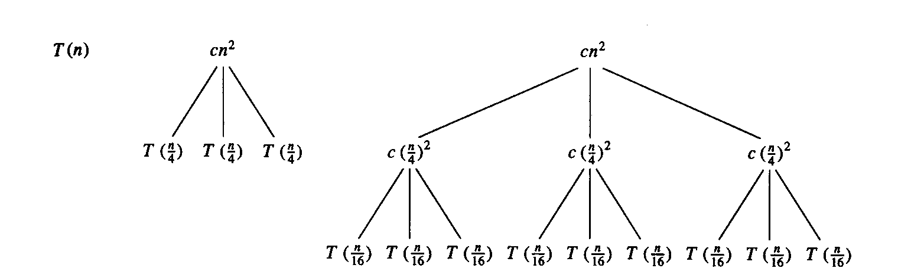
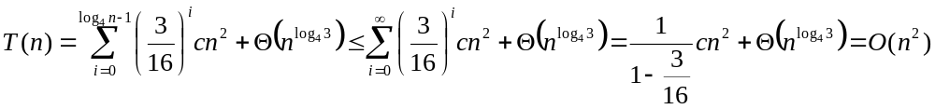
Example
E.g.: T(n) = 3T(n/4) + cn²
Subproblem size at level i is: n/4^{i}
Subproblem size hits 1 when 1 = n/4^{i} ⇒ i = log₄n
Cost of a node at level i = c(n/4^{i})²
Number of nodes at level i = 3^{i} ⇒ last level has 3^{log}₄^{n} = n^{log}₄³ nodes
Total cost:
⇒ T(n) = O(n²)

Slide 13
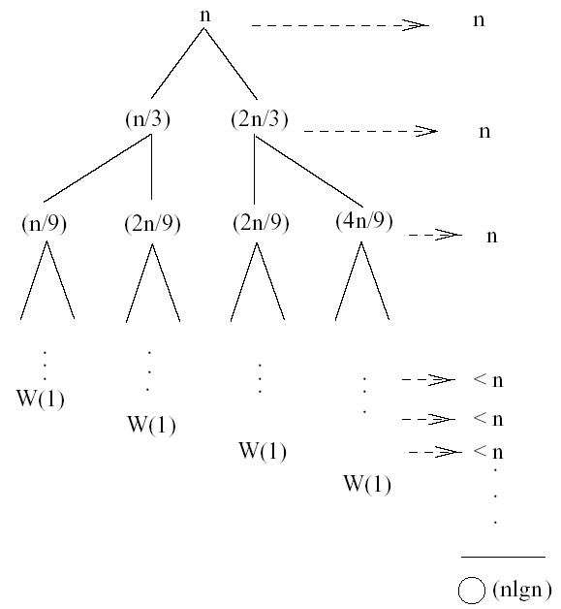
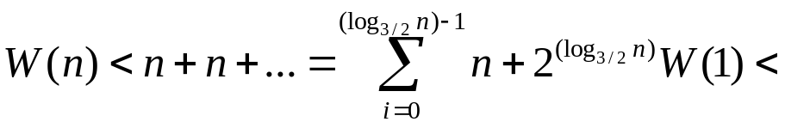
Example
W(n) = W(n/3) + W(2n/3) + n
The longest path from the root to a leaf is: n → (2/3)n → (2/3)² n → … → 1
Subproblem size hits 1 when 1 = (2/3)^{i}n ⇔ i=log_{3/2}n
Cost of the problem at level i = n
Total cost:
⇒ W(n) = O(nlgn)

Slide 14
The master method
The master method applies to recurrences of the form
T(n) = a T(n/b) + f (n) ,
where a ≥ 1, b > 1, and f is asymptotically positive.

Slide 15
Three common cases
Compare f (n) with n^{logba}:
f (n) = O(n^{logba – ε}) for some constant ε > 0.
  f (n) grows polynomially slower than n^{logba} (by an n^{ε} factor).
Solution: T(n) = Θ(n^{logba}) .

Slide 16
Three common cases
Compare f (n) with n^{logba}:
f (n) = Θ(n^{logba} lg^{k}n) for some constant k ≥ 0.
  f (n) and n^{logba} grow at similar rates.
  Solution: T(n) = Θ(n^{logba} lg^{k+1}n) .

Slide 17
Three common cases (cont.)
Compare f (n) with n^{logba}:
f (n) = Ω(n^{logba + ε}) for some constant ε > 0.
  f (n) grows polynomially faster than n^{logba} (by an n^{ε} factor),
and f (n) satisfies the regularity condition that a f (n/b) ≤ c f (n) for some constant c < 1.
Solution: T(n) = Θ( f (n) ) .

Slide 18
Examples
Ex. T(n) = 4T(n/2) + n
a = 4, b = 2 ⇒ n^{logba} = n²; f (n) = n.
CASE 1: f (n) = O(n^{2 – ε}) for 0< ε < 1.
∴ T(n) = Θ(n²).
Ex. T(n) = 4T(n/2) + n²
a = 4, b = 2 ⇒ n^{logba} = n²; f (n) = n².
CASE 2: f (n) = Θ(n²lg⁰n), that is, k = 0.
∴ T(n) = Θ(n²lg n).

Slide 19
Examples
Ex. T(n) = 4T(n/2) + n³
a = 4, b = 2 ⇒ n^{logba} = n²; f (n) = n³.
CASE 3: f (n) = Ω(n^{2 + ε}) for 0<ε < 1
and 4(n/2)³ ≤ cn³ (reg. cond.) for ½ <= c <1
∴ T(n) = Θ(n³).

