Slide 1

CMPE371
Analysis of Algorithms
FALL 2021-2022
Lecture 4

Slide 2
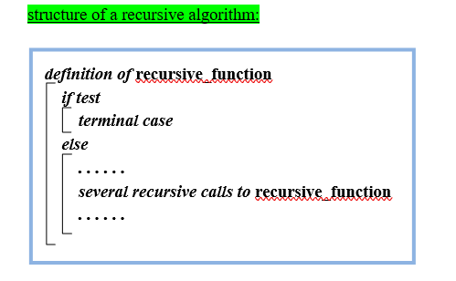
Calculating the algorithmic complexity of a recursive algorithm:

Slide 3
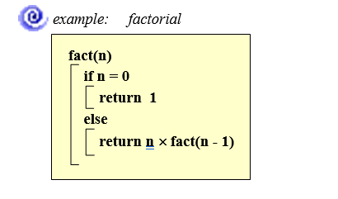
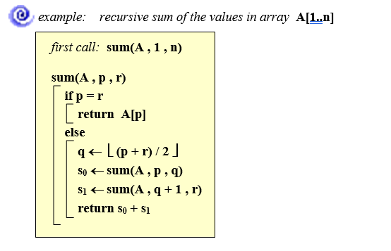

Slide 9
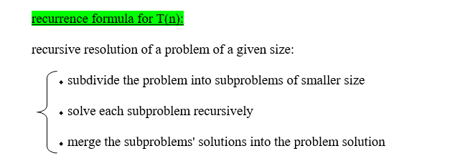
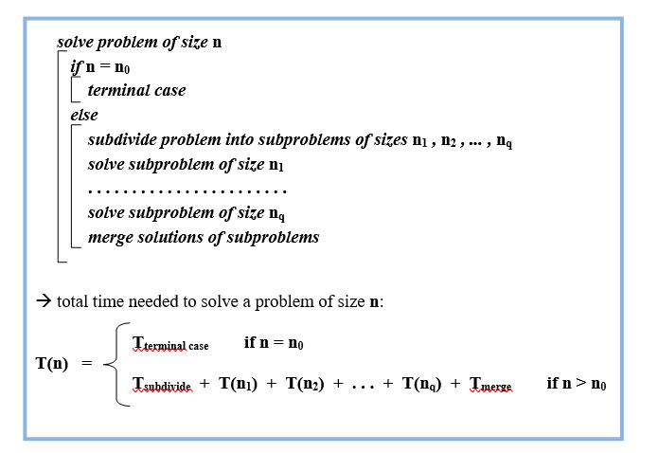

Slide 10
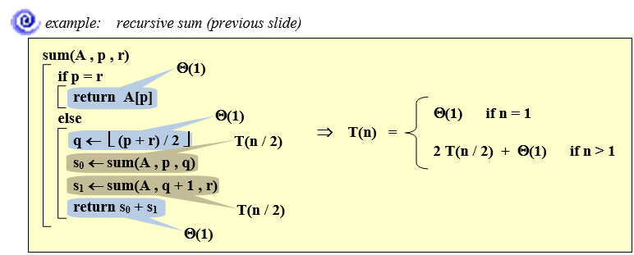

Slide 11
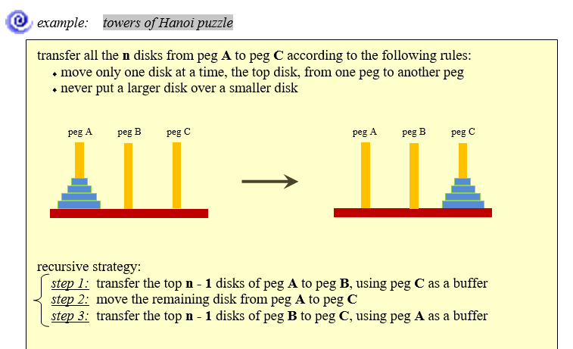

Slide 12
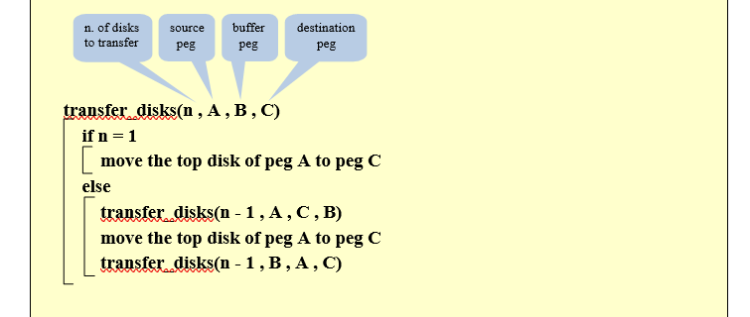

Slide 13
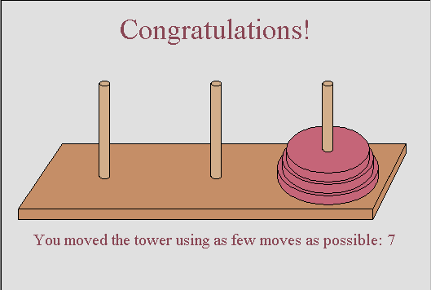
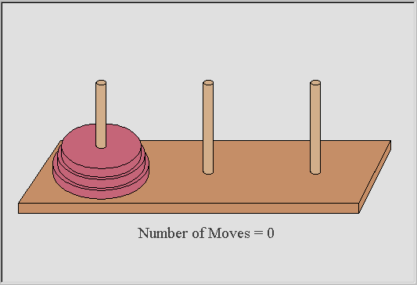
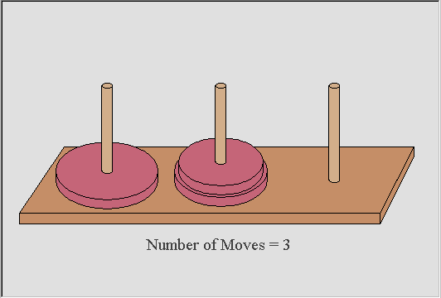
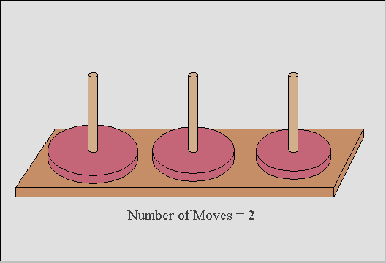
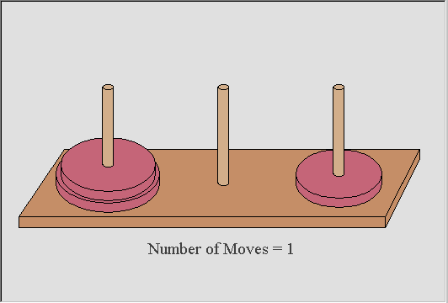
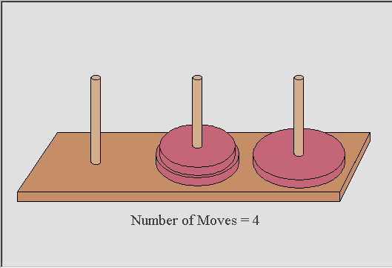
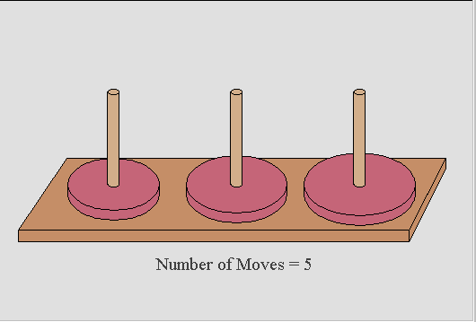
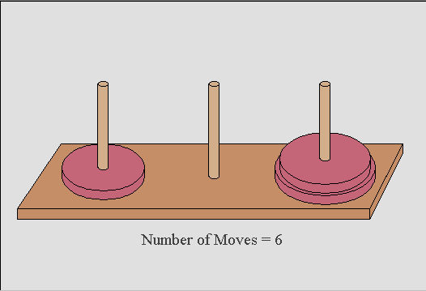
How many moves does it take?
Did you know you should be able to complete the puzzle in (2^{n} -1) moves where n is the number of disks.
For 3 disks 2^{n} -1= (2³ – 1) = (8-1) =7 moves
Notes:
This slide shows how to complete the Tower of Hanoi puzzle for 3 disks using as few moves as possible.

Slide 15
An Example: Merge Sort
Sorting Problem: Sort a sequence of n elements into non-decreasing order.
Divide: Divide the n-element sequence to be sorted into two subsequences of n/2 elements each
Conquer: Sort the two subsequences recursively using merge sort.
Combine: Merge the two sorted subsequences to produce the sorted answer.

Slide 16
Merge Sort – Example
18
26
32
6
43
15
9
1
22
26
19
55
37
43
99
2
18
26
32
6
43
15
9
1
22
26
19
55
37
43
99
2
18
26
32
6
43
15
9
1
22
26
19
55
37
43
99
2
18
26
32
6
43
15
9
1
22
26
19
55
37
43
99
2
18
26
32
6
43
15
9
1
22
26
19
55
37
43
99
2

Slide 17
Merge Sort – Example
Original Sequence
Sorted Sequence
18
26
32
6
43
15
9
1
18
26
32
6
43
15
9
1
1
6
9
15
18
26
32
43
18
26
32
6
43
15
9
1
18
26
32
6
43
15
9
1
6
26
32
6
18
26
32
18
1
9
15
43
1
9
15
43
18
26
43
15
9
1
18
26
32
6
43
15
9
1
32
6
18
26
6
32
15
43
18
26
6
32
15
43
1
9
1
9
18
26
32
15
1
15
18
26
32
6
43
15
9
1
26
6
15
1
6
43
9
26
32
43
9
18
32
6
9
1
18
43
18
26
32
6
43
15
9
1
18
26
32
6
43
15
9
1

Slide 18
Merge-Sort (A, p, r)
INPUT: a sequence of n numbers stored in array A
OUTPUT: an ordered sequence of n numbers
MergeSort (A, p, r) // sort A[p..r] by divide & conquer
if p < r
then q ← ⎣(p+r)/2⎦
MergeSort (A, p, q)
MergeSort (A, q+1, r)
Merge (A, p, q, r) // merges A[p..q] with A[q+1..r]
Initial Call: MergeSort(A, 1, n)

Slide 19
Procedure Merge
Merge(A, p, q, r)
1 n₁ ← q – p + 1
2 n₂ ← r – q
for i ← 1 to n₁
do L[i] ← A[p + i – 1]
for j ← 1 to n₂
do R[j] ← A[q + j]
L[n₁+1] ← ∞
R[n₂+1] ← ∞
i ← 1
j ← 1
for k ←p to r
do if L[i] ≤ R[j]
then A[k] ← L[i]
i ← i + 1
else A[k] ← R[j]
j ← j + 1
Input: Array containing sorted subarrays A[p..q] and A[q+1..r].
Output: Merged sorted subarray in A[p..r].
Sentinels, to avoid having to
check if either subarray is
fully copied at each step.

Slide 20
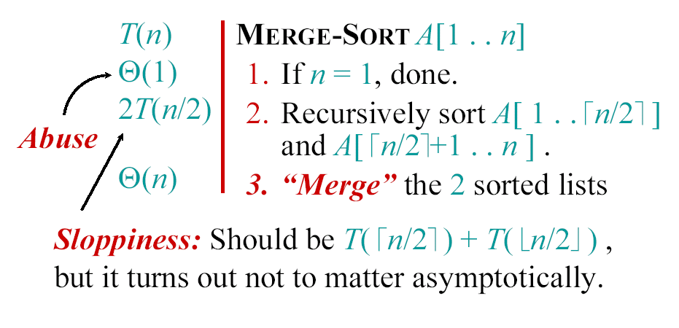
Analyzing merge sort

Slide 21
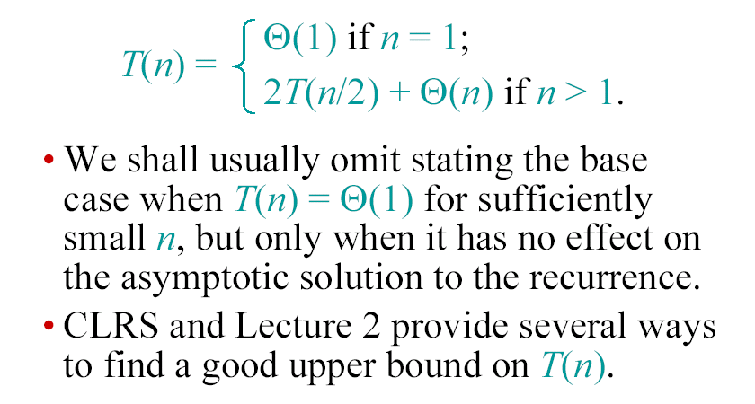
Recurrence for merge sort

Slide 22
Recurrence Examples

Slide 23
Methods for Solving Recurrences
Substitution method
Iteration method
Recursion tree method
Master method

Slide 24
Substitution method
The most general method:
Guess the form of the solution.
Verify by induction.
Solve for constants.
Example: T(n) = 4T(n/2) + 100n
[Assume that T(1) = Θ(1).]
Guess O(n³) . (Prove O and Ω separately.)
Assume that T(k) ≤ ck³ for k < n .
Prove T(n) ≤ cn³ by induction.

Slide 27
Example of substitution
T
(
n
)
=
4
T
(
n
/
2
)
+
100n
≤
4
c
(
n
/
2
)
3
+
100n
=
(
c
/
2
)
n
3
+
100n
=
cn
3
−
((
c
/
2
)
n
3
−
100n
)
desired – residual
≤
cn
3
desired
whenever (c/2)n³ – 100n ≥ 0, for example, if c ≥ 200 and n ≥ 1.
residual

Slide 28
Example (continued)
We must also handle the initial conditions, that is, ground the induction with base cases.
Base: T(n) = Θ(1) for all n < n₀, where n₀ is a suitable constant.
For 1 ≤ n < n₀, we have “Θ(1)” ≤ cn³, if we pick c big enough.
This bound is not tight!

Slide 29
A tighter upper bound?
We shall prove that T(n) = O(n²).
Assume that T(k) ≤ ck² for k < n:
T
(
n
)
=
4
T
(
n
/
2
)
+
100n
≤
cn
2
+
100n
≤
cn
2
for no choice of c > 0. Lose!

Slide 30
A tighter upper bound!
IDEA: Strengthen the inductive hypothesis.
Subtract a low-order term.
Inductive hypothesis: T(k) ≤ c₁k² – c₂k for k < n.
T
(
n
)
=
4
T
(
n
/
2
)
+
100n
≤
4
(
c
(
n
/
2
)
2
−
c
(
n
/
2
))
+
100n
1
2
=
c
n
2
−
2
c
n
+
100n
1
2
=
c
n
2
−
c
n
−
(
c
n
−
)
1
2
100n
2
≤
c
n
2
−
c
n
if c₂ > 100.
1
2
Pick c₁ big enough to handle the initial conditions.

Slide 36
Example
T(n) = T(n-1) + n
Guess: T(n) = O(n²)
  Induction goal: T(n) ≤ c n², for some c and n ≥ n₀
  Induction hypothesis: T(n-1) ≤ c(n-1)² for all k < n
Proof of induction goal:
T(n) = T(n-1) + n ≤ c (n-1)² + n
= cn² – (2cn – c - n) ≤ cn²
if: 2cn – c – n ≥ 0 ⇔ c ≥ n/(2n-1) ⇔ c ≥ 1/(2 – 1/n)
  For n ≥ 1 ⇒ 2 – 1/n ≥ 1 ⇒ any c ≥ 1 will work

Slide 37
Example
T(n) = 2T(n/2) + n
Guess: T(n) = O(nlgn)
  Induction goal: T(n) ≤ cn lgn, for some c and n ≥ n₀
  Induction hypothesis: T(n/2) ≤ cn/2 lg(n/2)
Proof of induction goal:
T(n) = 2T(n/2) + n ≤ 2c (n/2)lg(n/2) + n
= cn lgn – cn + n ≤ cn lgn
if: - cn + n ≤ 0 ⇒ c ≥ 1
Base case?

Slide 38
Changing variables
T(n) = 2T( ) + lgn
  Rename: m = lgn ⇒ n = 2^{m}
  T (2^{m}) = 2T(2^{m/2}) + m
  Rename: S(m) = T(2^{m})
  S(m) = 2S(m/2) + m ⇒ S(m) = O(mlgm) (demonstrated before)
  T(n) = T(2^{m}) = S(m) = O(mlgm)=O(lgnlglgn)
  Idea: transform the recurrence to one that you have seen before

Slide 39
The Iteration Method
Convert the recurrence into a summation and try to bound it using known series
  Iterate the recurrence until the initial condition is reached.
  Use back-substitution to express the recurrence in terms of n and the initial (boundary) condition.
Iteration method:
  Expand the recurrence k times
  Work some algebra to express as a summation
  Evaluate the summation

Slide 40
The Iteration Method
T(n) = c + T(n/2)
T(n) = c + T(n/2)
= c + c + T(n/4)
= c + c + c + T(n/8)
Assume n = 2^{k}
T(n) = c + c + … + c + T(1)
= clgn + T(1)
= Θ(lgn)
T(n/2) = c + T(n/4)
T(n/4) = c + T(n/8)
k times

Slide 43
Iteration Method – Example
T(n) = n + 2T(n/2)
T(n) = n + 2T(n/2)
= n + 2(n/2 + 2T(n/4))
= n + n + 4T(n/4)
= n + n + 4(n/4 + 2T(n/8))
= n + n + n + 8T(n/8)
… = in + 2^{i}T(n/2^{i})
= kn + 2^{k}T(1)
= nlgn + nT(1) = Θ(nlgn)
Assume: n = 2^{k}
T(n/2) = n/2 + 2T(n/4)

Slide 46
T(n) = c + T(n-1) = c + c + T(n-2)
= 2c + T(n-2) = 2c + c + T(n-3)
= 3c + T(n-3) … kc + T(n-k)
= ck + T(n-k)
So far for n ≥ k we have
  T(n) = ck + T(n-k)
To stop the recursion, we should have
  n - k = 0 ➔ k = n
  T(n) = cn + T(0) = cn
Thus in general T(n) = O(n)

Slide 47
T(n) = n + T(n-1)
= n + n-1 + T(n-2)
= n + n-1 + n-2 + T(n-3)
= n + n-1 + n-2 + n-3 + T(n-4)
= …
= n + n-1 + n-2 + n-3 + … + (n-k+1) + T(n-k)
= for n ≥ k
To stop the recursion, we should have n - k = 0 ➔ k = n

Slide 49
T(n) = 2 T(n/2) + c 1
= 2(2 T(n/2/2) + c) + c 2
= 2² T(n/2²) + 2c + c
= 2²(2 T(n/2²/2) + c) + (2²-1)c 3
= 2³ T(n/2³) + 4c + 3c
= 2³ T(n/2³) + (2³-1)c
= 2³(2 T(n/2³/2) + c) + 7c 4
= 2⁴ T(n/2⁴) + (2⁴-1)c
= …
= 2^{k} T(n/2^{k}) + (2^{k} - 1)c k

Slide 50
So far for n ≥ k we have
  T(n) = 2^{k} T(n/2^{k}) + (2^{k} - 1)c
To stop the recursion, we should have
  n/2^{k} = 1 ➔ n = 2^{k} ➔ k = lg n
  T(n) = n T(n/n) + (n - 1)c
  = n T(1) + (n-1)c
  = nc + (n-1)c
  = nc + nc – c = 2cn – c
  T(n) = 2cn – c = O(n)

Slide 51
The recursion-tree method
Convert the recurrence into a tree:
  Each node represents the cost incurred at various levels of recursion
  Sum up the costs of all levels
recursion tree method:
step1: draw the recursion tree, find its number of levels
step2: sum all the local times of the nodes, first over each level, then over all levels
Used to “guess” a solution for the recurrence

Slide 52
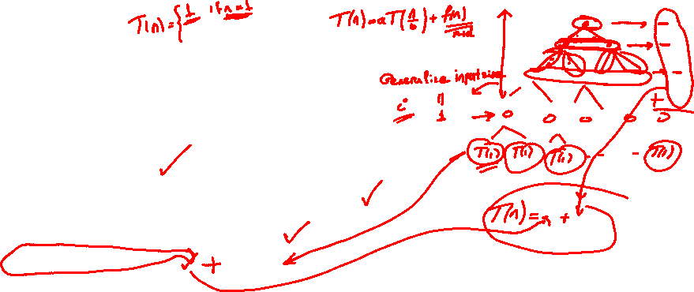
Step-01:
Draw a recursion tree based on the given recurrence relation.
Step-02:
Determine-
Cost of each level
Total number of levels in the recursion tree
Number of nodes in the last level
Cost of the last level
Step-03:
Add cost of all the levels of the recursion tree and simplify the expression so obtained in terms of asymptotic notation.

Slide 53

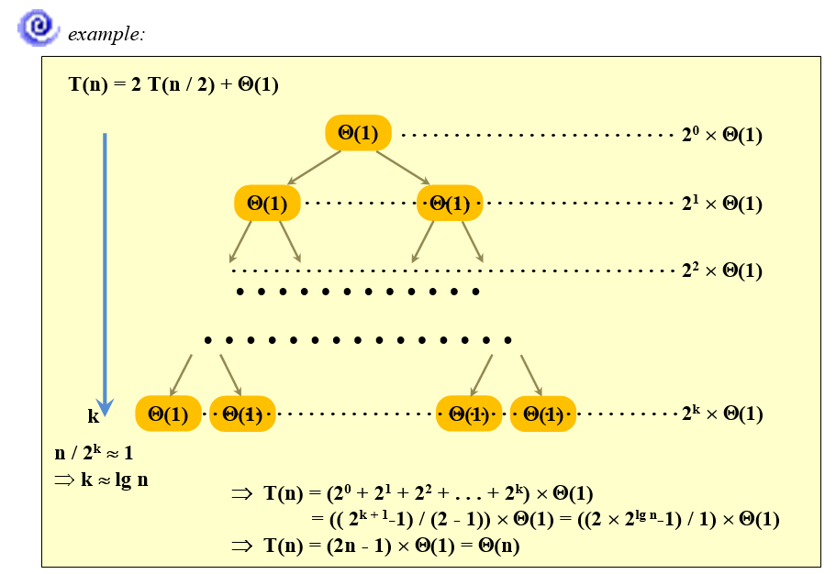

Slide 54
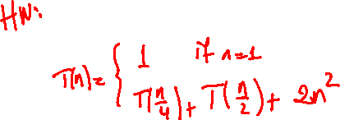

Slide 55
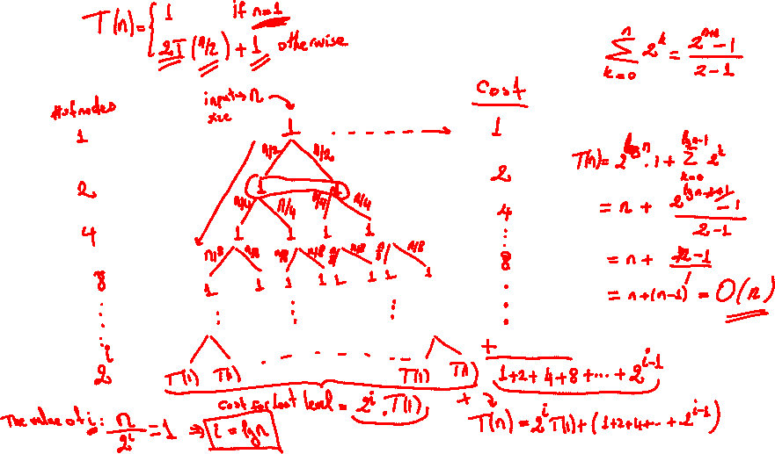

Slide 56
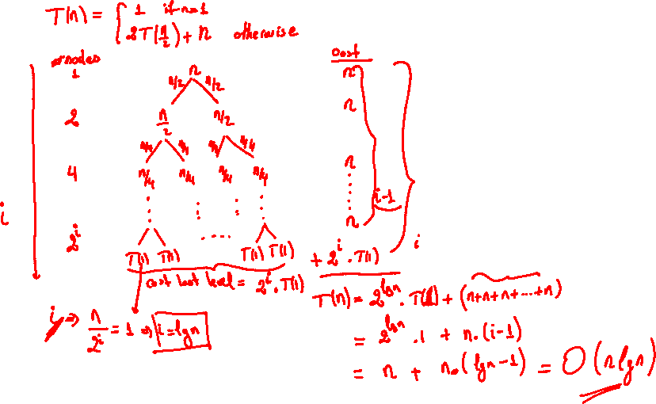

Slide 57
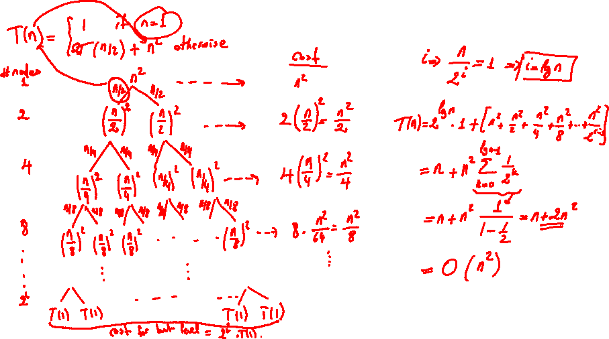

Slide 58
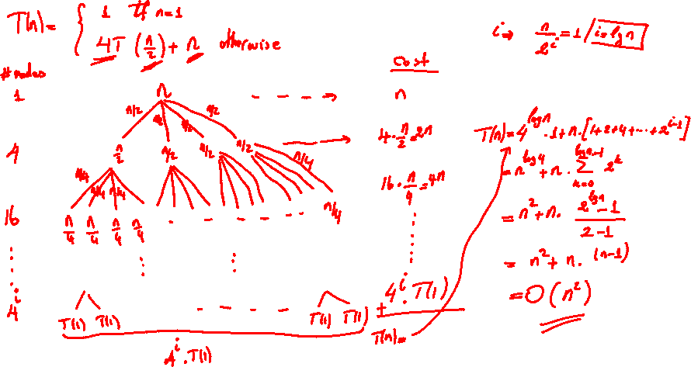

Slide 59
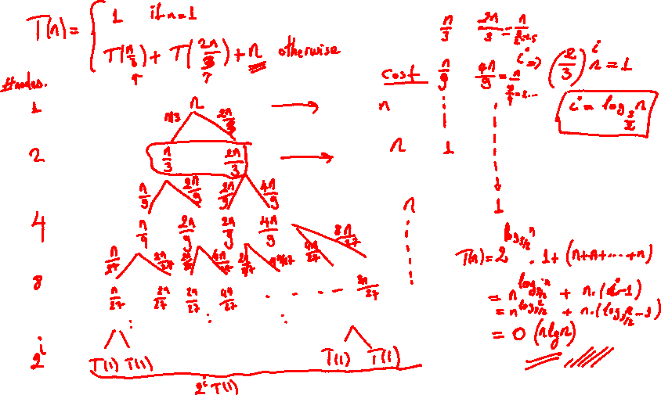

Slide 60
T(n) = 2 T(n / 2) + n²
T(n) = T(n / 3) + T(2 n / 3) + n
. . . . . . . resolution on the board

Slide 61
Example of recursion tree
Solve T(n) = T(n/4) + T(n/2) + n²:

Slide 62
Example of recursion tree
Solve T(n) = T(n/4) + T(n/2) + n²:
T(n)

Slide 63
Example of recursion tree
Solve T(n) = T(n/4) + T(n/2) + n²:
n²
T(n/4)
T(n/2)

Slide 64
Example of recursion tree
Solve T(n) = T(n/4) + T(n/2) + n²:
n²
(n/4)²
(n/2)²
T(n/16)
T(n/8)
T(n/8)
T(n/4)

Slide 65
Example of recursion tree
Solve T(n) = T(n/4) + T(n/2) + n²:
n²
(n/4)²
(n/2)²
(n/16)²
(n/8)²
(n/8)²
(n/4)²
…
Θ(1)

Slide 66
Example of recursion tree
Solve T(n) = T(n/4) + T(n/2) + n²:
n²
(n/4)²
(n/2)²
(n/16)²
(n/8)²
(n/8)²
(n/4)²
…
Θ(1)

Slide 67
Example of recursion tree
Solve T(n) = T(n/4) + T(n/2) + n²:
n²
(n/4)²
(n/2)²
(n/16)²
(n/8)²
(n/8)²
(n/4)²
…
Θ(1)

Slide 68
Example of recursion tree
Solve T(n) = T(n/4) + T(n/2) + n²:
n²
(n/4)²
(n/2)²
(n/16)²
(n/8)²
(n/8)²
(n/4)²
…
…
Θ(1)

Slide 69
Example of recursion tree
Solve T(n) = T(n/4) + T(n/2) + n²:
n²
(n/4)²
(n/2)²
(n/16)²
(n/8)²
(n/8)²
(n/4)²
…
…
Θ(1)
Total =
= Θ(n²)
geometric series

Slide 70
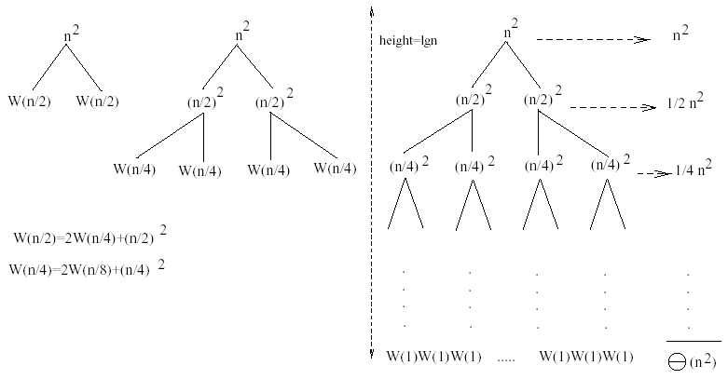
Example
W(n) = 2W(n/2) + n²
Subproblem size at level i is: n/2^{i}
Subproblem size hits 1 when 1 = n/2^{i} ⇒ i = lgn
Cost of the problem at level i = (n/2^{i})² No. of nodes at level i = 2^{i}
Total cost:
⇒ W(n) = O(n²)

Slide 71
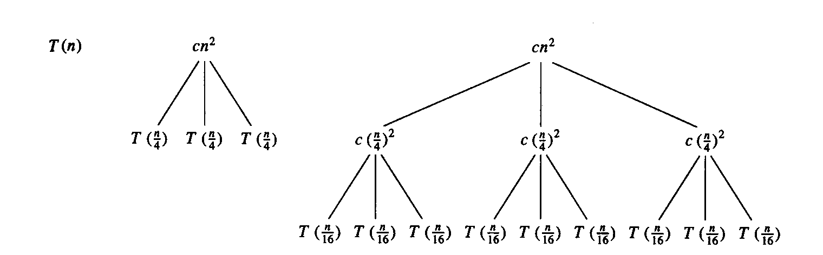
Example
E.g.: T(n) = 3T(n/4) + cn²
Subproblem size at level i is: n/4^{i}
Subproblem size hits 1 when 1 = n/4^{i} ⇒ i = log₄n
Cost of a node at level i = c(n/4^{i})²
Number of nodes at level i = 3^{i} ⇒ last level has 3^{log}₄^{n} = n^{log}₄³ nodes
Total cost:
⇒ T(n) = O(n²)

Slide 72
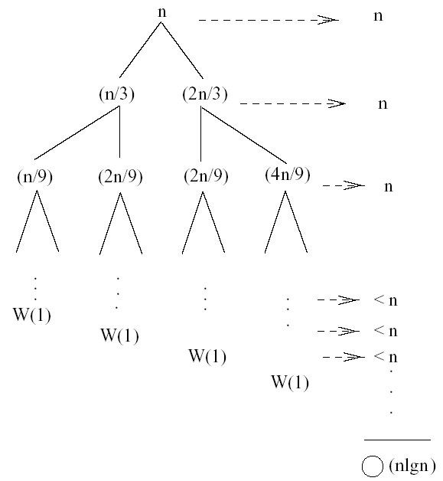
Example
W(n) = W(n/3) + W(2n/3) + n
The longest path from the root to a leaf is: n → (2/3)n → (2/3)² n → … → 1
Subproblem size hits 1 when 1 = (2/3)^{i}n ⇔ i=log_{3/2}n
Cost of the problem at level i = n
Total cost:
⇒ W(n) = O(nlgn)

Slide 73
The master method
The master method applies to recurrences of the form
T(n) = a T(n/b) + f (n) ,
where a ≥ 1, b > 1, and f is asymptotically positive.

Slide 74
Three common cases
Compare f (n) with n^{logba}:
f (n) = O(n^{logba – ε}) for some constant ε > 0.
  f (n) grows polynomially slower than n^{logba} (by an n^{ε} factor).
Solution: T(n) = Θ(n^{logba}) .

Slide 75
Three common cases
Compare f (n) with n^{logba}:
f (n) = Θ(n^{logba} lg^{k}n) for some constant k ≥ 0.
  f (n) and n^{logba} grow at similar rates.
  Solution: T(n) = Θ(n^{logba} lg^{k+1}n) .

Slide 76
Three common cases (cont.)
Compare f (n) with n^{logba}:
f (n) = Ω(n^{logba + ε}) for some constant ε > 0.
  f (n) grows polynomially faster than n^{logba} (by an n^{ε} factor),
and f (n) satisfies the regularity condition that a f (n/b) ≤ c f (n) for some constant c < 1.
Solution: T(n) = Θ( f (n) ) .

Slide 77
Examples
Ex. T(n) = 4T(n/2) + n
a = 4, b = 2 ⇒ n^{logba} = n²; f (n) = n.
CASE 1: f (n) = O(n^{2 – ε}) for ε = 1.
∴ T(n) = Θ(n²).
Ex. T(n) = 4T(n/2) + n²
a = 4, b = 2 ⇒ n^{logba} = n²; f (n) = n².
CASE 2: f (n) = Θ(n²lg⁰n), that is, k = 0.
∴ T(n) = Θ(n²lg n).

Slide 78
Examples
Ex. T(n) = 4T(n/2) + n³
a = 4, b = 2 ⇒ n^{logba} = n²; f (n) = n³.
CASE 3: f (n) = Ω(n^{2 + ε}) for ε = 1
and 4(cn/2)³ ≤ cn³ (reg. cond.) for c = 1/2.
∴ T(n) = Θ(n³).
Ex. T(n) = 4T(n/2) + n²/lg n
a = 4, b = 2 ⇒ n^{logba} = n²; f (n) = n²/lg n.
Master method does not apply. In particular, for every constant ε > 0, we have n^{ε} = ω(lg n).

Slide 83
Appendix: geometric series
for x ≠ 1
for |x| < 1

