Slide 1
Packing and Signing of the Application

Slide 2
If you think that the Android app you wrote is ready to run on Google Play after testing on the device or on the virtual machine, the next two steps will require you to create and then sign your application's executable package.
Android App Pack (.apk)
The .apk files are called Android Application Package File and allow the application code to be packaged and runable. The application packages are actually different for each operating system and are also available in names: .msi on Windows , .dmg on Mac OS , .rpm , .deb etc. on Linux .

Slide 3
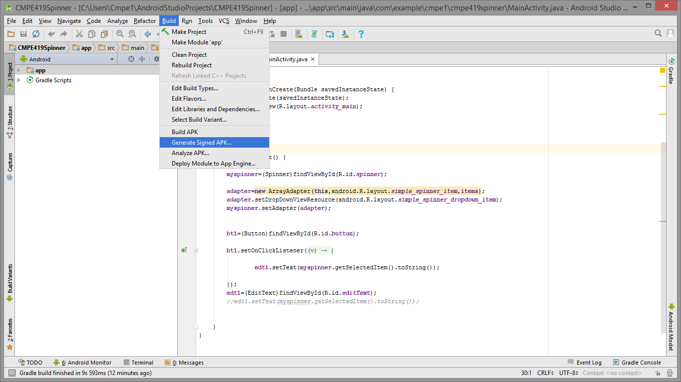
We can use Android Studio to sign our project on Android. From the top Build menu, we click on the Generate Signed APK button.

Slide 4
Here we need to specify the folder where our application's key will be held. If we are going to create this folder for the first time, Create New , you should use Use Existing Keystore option if we are updating our current application . The most important thing to note here is our new password. Return may not be possible if we do not lose this benefit which will be useful to us in the future.

Slide 5
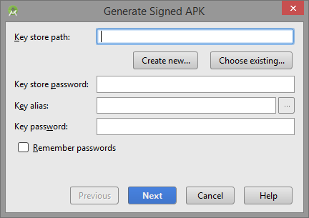

Slide 6
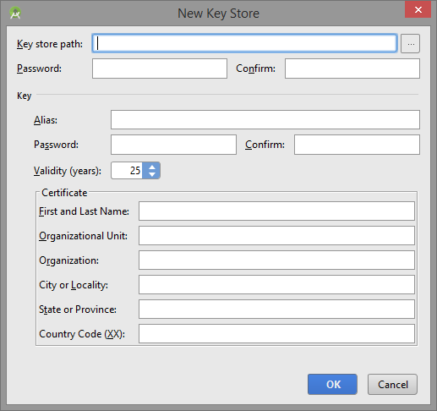

Slide 7
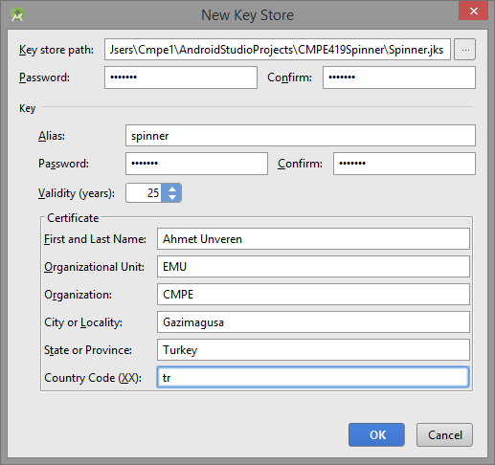
Once you fill in the required pages from the opening page, we confirm our entries and create a key.

Slide 8
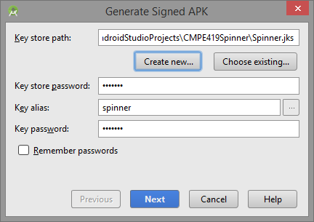

Slide 9
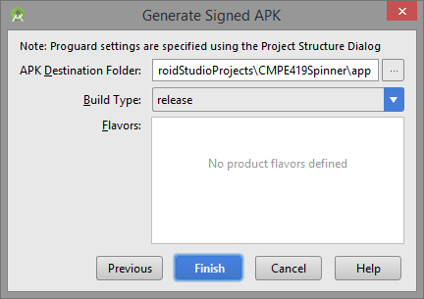

Slide 10
