Slide 1
CMPE419 Mobile Application Development
Asst.Prof.Dr.Ahmet Ünveren
2017-2018 SPRING
Computer Engineering Department

Slide 2
Layouts
1) LinearLayout
2) FrameLayout
3) RelativeLayout
4) TableLayout
Views
Android ListView example
Android GridView example

Slide 3
Layouts
An Android layout is a class that handles arranging the way its children appear on the screen. Anything that is a View (or inherits from View) can be a child of a layout. All of the layouts inherit from ViewGroup (which inherits from View) so you can nest layouts. You could also create your own custom layout by making a class that inherits from ViewGroup.

Slide 4
1) LinearLayout
LinearLayout organizes elements along a single line.
You specify whether that line is verticle or horizontal
using android:orientation.
Here is a sample Layout XML using LinearLayout.

Slide 5
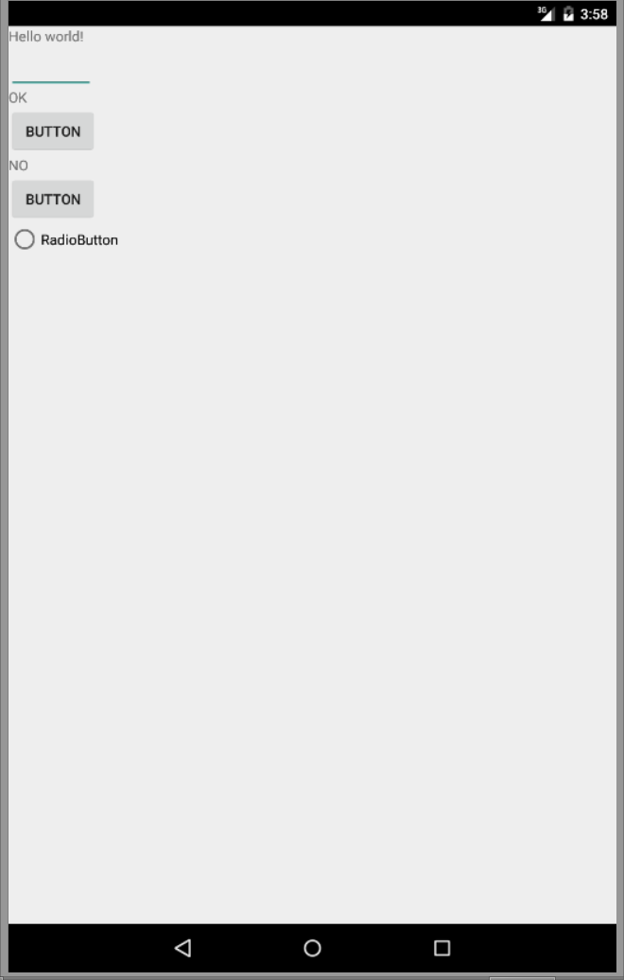
<LinearLayout xmlns:android="http://schemas.android.com/apk/res/android"
xmlns:tools="http://schemas.android.com/tools"
android:id="@+id/LinearLayout1"
android:layout_width="match_parent"
android:layout_height="match_parent"
android:orientation="vertical"
tools:context="${relativePackage}.${activityClass}" >
<TextView
android:id="@+id/textView1"
android:layout_width="wrap_content"
android:layout_height="wrap_content"
android:text="@string/hello_world" />
<EditText
android:id="@+id/editText1"
android:layout_width="wrap_content"
android:layout_height="wrap_content"
android:ems="4" />
<TextView
android:id="@+id/textView2"
android:layout_width="wrap_content"
android:layout_height="wrap_content"
android:text="OK" />
<Button
android:id="@+id/button1"
android:layout_width="wrap_content"
android:layout_height="wrap_content"
android:text="Button" />
<TextView
android:id="@+id/textView3"
android:layout_width="wrap_content"
android:layout_height="wrap_content"
android:text="NO" />
<Button
android:id="@+id/button2"
android:layout_width="wrap_content"
android:layout_height="wrap_content"
android:text="Button" />
<RadioButton
android:id="@+id/radioButton1"
android:layout_width="wrap_content"
android:layout_height="wrap_content"
android:text="RadioButton" />
</LinearLayout>

Slide 6
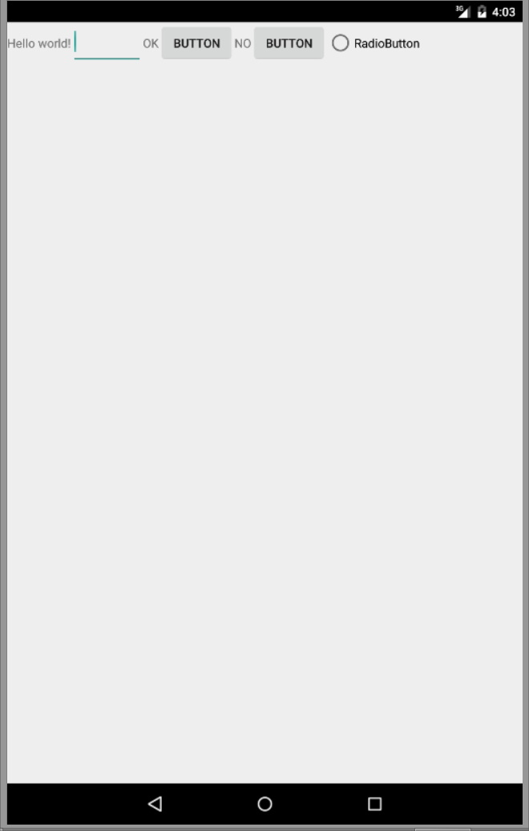
<LinearLayout xmlns:android="http://schemas.android.com/apk/res/android"
xmlns:tools="http://schemas.android.com/tools"
android:id="@+id/LinearLayout1"
android:layout_width="match_parent"
android:layout_height="match_parent"
android:orientation="horizontal"
tools:context="${relativePackage}.${activityClass}" >
<TextView
android:id="@+id/textView1"
android:layout_width="wrap_content"
android:layout_height="wrap_content"
android:text="@string/hello_world" />
<EditText
android:id="@+id/editText1"
android:layout_width="wrap_content"
android:layout_height="wrap_content"
android:ems="4" />
<TextView
android:id="@+id/textView2"
android:layout_width="wrap_content"
android:layout_height="wrap_content"
android:text="OK" />
<Button
android:id="@+id/button1"
android:layout_width="wrap_content"
android:layout_height="wrap_content"
android:text="Button" />
<TextView
android:id="@+id/textView3"
android:layout_width="wrap_content"
android:layout_height="wrap_content"
android:text="NO" />
<Button
android:id="@+id/button2"
android:layout_width="wrap_content"
android:layout_height="wrap_content"
android:text="Button" />
<RadioButton
android:id="@+id/radioButton1"
android:layout_width="wrap_content"
android:layout_height="wrap_content"
android:text="RadioButton" />
</LinearLayout>

Slide 7
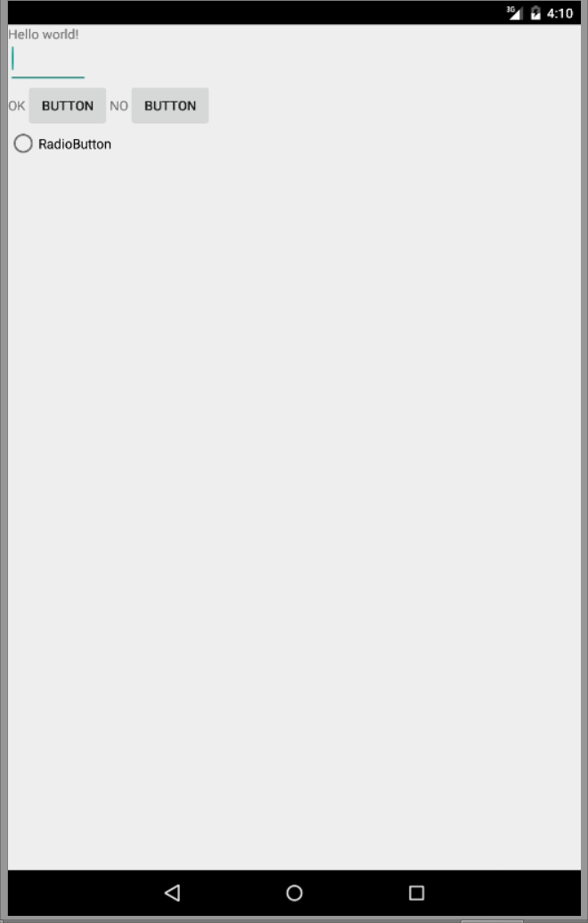
Nested LinearLeyout:
<LinearLayout
android:layout_width="match_parent"
android:layout_height="wrap_content" >
<TextView
android:id="@+id/textView2"
android:layout_width="wrap_content"
android:layout_height="wrap_content"
android:text="OK" />
<Button
android:id="@+id/button1"
android:layout_width="wrap_content"
android:layout_height="wrap_content"
android:text="Button" />
<TextView
android:id="@+id/textView3"
android:layout_width="wrap_content"
android:layout_height="wrap_content"
android:text="NO" />
<Button
android:id="@+id/button2"
android:layout_width="wrap_content"
android:layout_height="wrap_content"
android:text="Button" />
</LinearLayout>

Slide 8
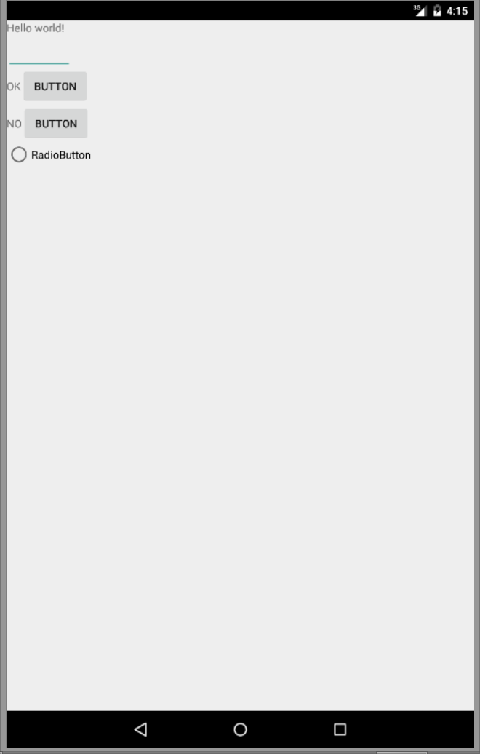
<LinearLayout
android:layout_width="match_parent"
android:layout_height="wrap_content" >
<TextView
android:id="@+id/textView2"
android:layout_width="wrap_content"
android:layout_height="wrap_content"
android:text="OK" />
<Button
android:id="@+id/button1"
android:layout_width="wrap_content"
android:layout_height="wrap_content"
android:text="Button" />
</LinearLayout>
<LinearLayout
android:layout_width="match_parent"
android:layout_height="wrap_content" >
<TextView
android:id="@+id/textView3"
android:layout_width="wrap_content"
android:layout_height="wrap_content"
android:text="NO" />
<Button
android:id="@+id/button2"
android:layout_width="wrap_content"
android:layout_height="wrap_content"
android:text="Button" />
</LinearLayout>

Slide 9
2) FrameLayout
FrameLayout is designed to display a single item at a time.
You can have multiple elements within a FrameLayout but each element will be positioned based on the top left of the screen.
Elements that overlap will be displayed overlapping.
I have created a simple XML layout using FrameLayout that shows how this works.

Slide 10
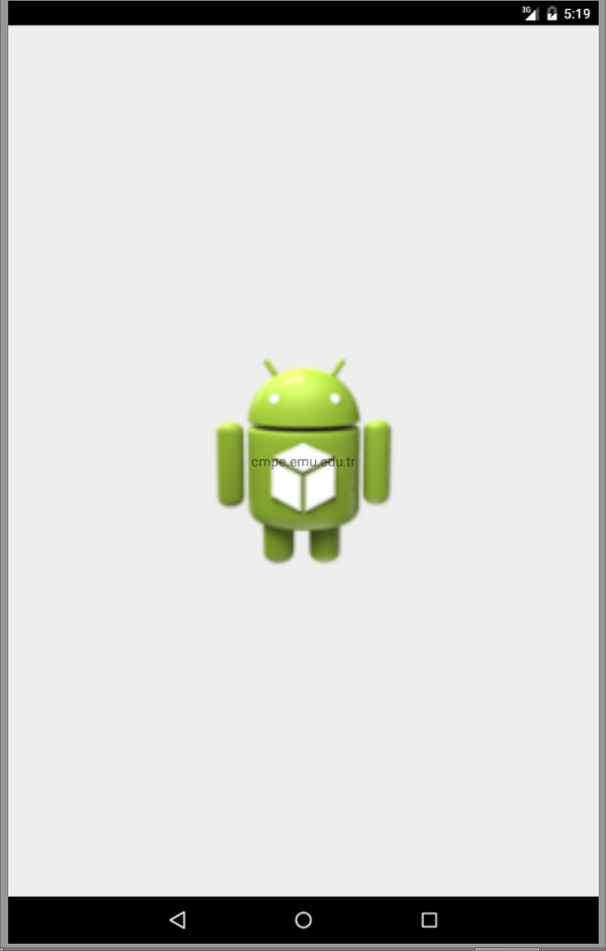
<FrameLayout xmlns:android="http://schemas.android.com/apk/res/android"
xmlns:tools="http://schemas.android.com/tools"
android:id="@+id/FrameLayout1"
android:layout_width="match_parent"
android:layout_height="match_parent"
tools:context="${relativePackage}.${activityClass}" >
<ImageView
android:id="@+id/imageView1"
android:layout_width="244dp"
android:layout_height="244dp"
android:layout_gravity="center"
android:adjustViewBounds="true"
android:src="@drawable/ic_launcher" />
<TextView
android:id="@+id/textView1"
android:layout_width="wrap_content"
android:layout_height="wrap_content"
android:layout_gravity="center"
android:text="cmpe.emu.edu.tr" />
</FrameLayout>
Gravity specifies where the text appears within its container, so I set that to center. If I had not set a gravity then the text would have appeared at the top left of the screen.

Slide 11
3) RelativeLayout
RelativeLayout lays out elements based on their relationships with one another, and with the parent container.
This is arguably the most complicated layout, and we need several properties to actually get the layout we want.

Slide 12
Relative To Container
These properties will layout elements relative to the parent container.
android:layout_alignParentBottom – Places the bottom of the element on the bottom of the container
android:layout_alignParentLeft – Places the left of the element on the left side of the container
android:layout_alignParentRight – Places the right of the element on the right side of the container
android:layout_alignParentTop – Places the element at the top of the container
android:layout_centerHorizontal – Centers the element horizontally within its parent container
android:layout_centerInParent – Centers the element both horizontally and vertically within its container
android:layout_centerVertical – Centers the element vertically within its parent container
Relative To Other Elements
These properties allow you to layout elements relative to other elements on screen. The value for each of these elements is the id of the element you are using to layout the new element. Each element that is used in this way must have an ID defined using android:id=”@+id/XXXXX” where XXXXX is replaced with the desired id. You use “@id/XXXXX” to reference an element by its id. One thing to remember is that referencing an element before it has been declared will produce an error.
android:layout_above – Places the element above the specified element
android:layout_below – Places the element below the specified element
android:layout_toLeftOf – Places the element to the left of the specified element
android:layout_toRightOf – Places the element to the right of the specified element
Alignment With Other Elements
These properties allow you to specify how elements are aligned in relation to other elements.
android:layout_alignBaseline – Aligns baseline of the new element with the baseline of the specified element
android:layout_alignBottom – Aligns the bottom of new element in with the bottom of the specified element
android:layout_alignLeft – Aligns left edge of the new element with the left edge of the specified element
android:layout_alignRight – Aligns right edge of the new element with the right edge of the specified element
android:layout_alignTop – Places top of the new element in alignment with the top of the specified element

Slide 13
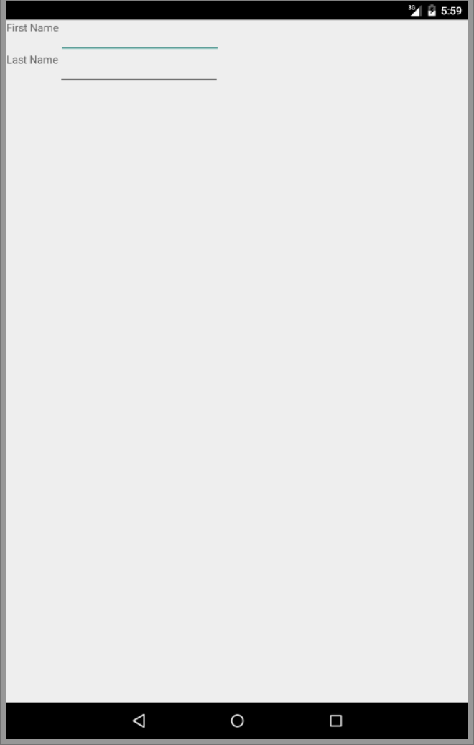
<RelativeLayout xmlns:android="http://schemas.android.com/apk/res/android"
xmlns:tools="http://schemas.android.com/tools"
android:id="@+id/RelativeLayout1"
android:layout_width="match_parent"
android:layout_height="match_parent"
tools:context="${relativePackage}.${activityClass}" >
<TextView
android:id="@+id/textView1"
android:layout_width="wrap_content"
android:layout_height="wrap_content"
android:text="First Name" />
<EditText
android:id="@+id/editText1"
android:layout_width="wrap_content"
android:layout_height="wrap_content"
android:layout_toRightOf="@+id/textView1"
android:ems="10" >
<requestFocus />
</EditText>
<TextView
android:id="@+id/textView2"
android:layout_width="wrap_content"
android:layout_height="wrap_content"
android:layout_below="@+id/editText1"
android:text="Last Name" />
<EditText
android:id="@+id/editText2"
android:layout_width="wrap_content"
android:layout_height="wrap_content"
android:layout_toRightOf="@+id/textView2"
android:layout_below="@+id/editText1"
android:ems="10" />
</RelativeLayout>

Slide 14
4) TableLayout
TableLayout organizes content into rows and columns. The rows are defined in the layout XML, and the columns are determined automatically by Android. This is done by creating at least one column for each element. So, for example, if you had a row with two elements and a row with five elements then you would have a layout with two rows and five columns.
You can specify that an element should occupy more than one column using android:layout_span. This can increase the total column count as well, so if we have a row with two elements and each element has android:layout_span=”3″ then you will have at least six columns in your table.
By default, Android places each element in the first unused column in the row. You can, however, specify the column an element should occupy using android:layout_column.

Slide 15
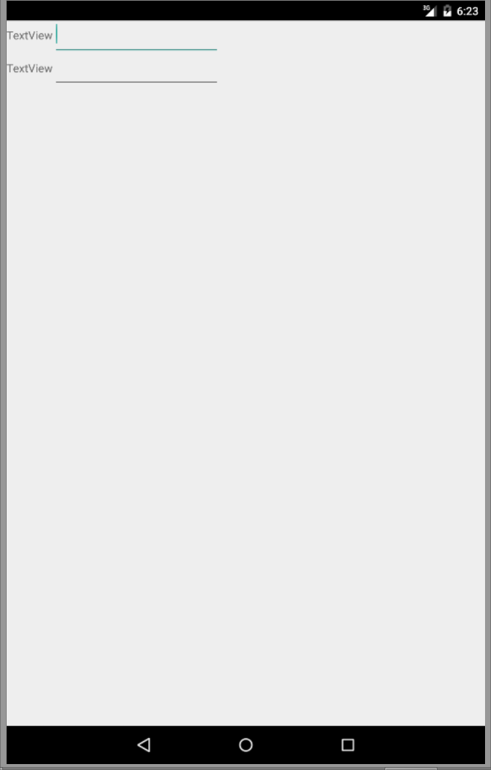
<TableLayout xmlns:android="http://schemas.android.com/apk/res/android"
xmlns:tools="http://schemas.android.com/tools"
android:id="@+id/TableLayout1"
android:layout_width="match_parent"
android:layout_height="match_parent"
android:stretchColumns="2"
tools:context="${relativePackage}.${activityClass}" >
<TableRow
android:id="@+id/tableRow1"
android:layout_width="wrap_content"
android:layout_height="wrap_content" >
<TextView
android:id="@+id/textView1"
android:layout_width="wrap_content"
android:layout_height="wrap_content"
android:text="TextView" />
<EditText
android:id="@+id/editText1"
android:layout_width="wrap_content"
android:layout_height="wrap_content"
android:ems="10" >
<requestFocus />
</EditText>
</TableRow>
<TableRow
android:id="@+id/tableRow2"
android:layout_width="wrap_content"
android:layout_height="wrap_content" >
<TextView
android:id="@+id/textView2"
android:layout_width="wrap_content"
android:layout_height="wrap_content"
android:text="TextView" />
<EditText
android:id="@+id/editText2"
android:layout_width="wrap_content"
android:layout_height="wrap_content"
android:ems="10" />
</TableRow>
</TableLayout>

Slide 16
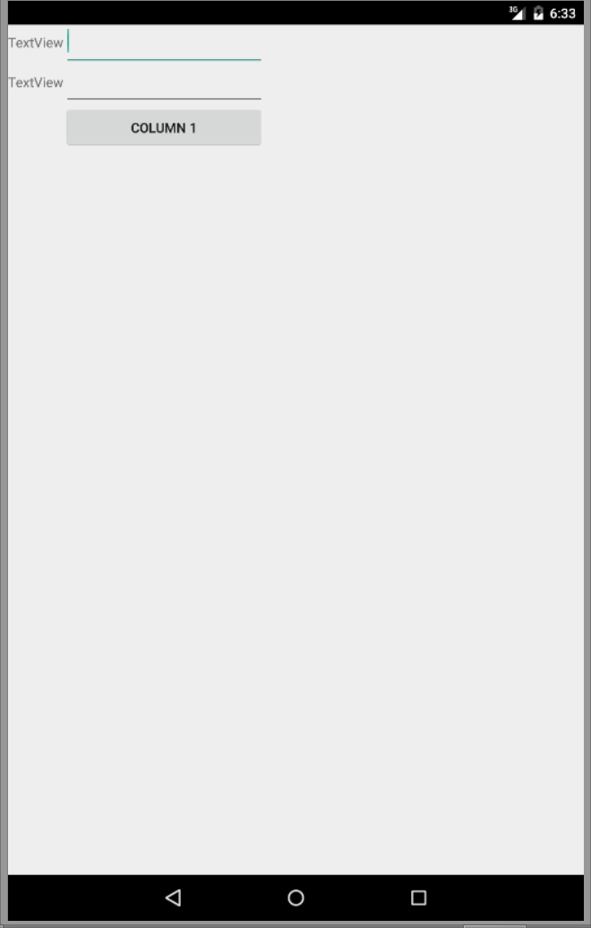
<TableLayout xmlns:android="http://schemas.android.com/apk/res/android"
xmlns:tools="http://schemas.android.com/tools"
android:id="@+id/TableLayout1"
android:layout_width="match_parent"
android:layout_height="match_parent"
android:stretchColumns="2"
tools:context="${relativePackage}.${activityClass}" >
<TableRow
android:id="@+id/tableRow1"
android:layout_width="wrap_content"
android:layout_height="wrap_content" >
<TextView
android:id="@+id/textView1"
android:layout_width="wrap_content"
android:layout_height="wrap_content"
android:text="TextView" />
<EditText
android:id="@+id/editText1"
android:layout_width="wrap_content"
android:layout_height="wrap_content"
android:ems="10" >
<requestFocus />
</EditText>
</TableRow>
<TableRow
android:id="@+id/tableRow2"
android:layout_width="wrap_content"
android:layout_height="wrap_content" >
<TextView
android:id="@+id/textView2"
android:layout_width="wrap_content"
android:layout_height="wrap_content"
android:text="TextView" />
<EditText
android:id="@+id/editText2"
android:layout_width="wrap_content"
android:layout_height="wrap_content"
android:ems="10" />
</TableRow>
<TableRow
android:id="@+id/tableRow3"
android:layout_width="wrap_content"
android:layout_height="wrap_content" >
<Button
android:id="@+id/button1"
android:layout_width="wrap_content"
android:layout_height="wrap_content"
android:layout_column="1"
android:text="Column 1" />
</TableRow>
</TableLayout>

Slide 17
Views
Android ListView example
Android GridView example

Slide 18
Android ListView example
Android ListView is a view group that displays a list of scrollable items. If you have a date which is repeated in the form of a collection or list, the listview is the best User Interface element to use. ListView helps you in displaying repeating data in the form of a scrollable list. Users can then select any listitem by clicking on it.
ListView is widely used in Android Applications. A simple example of ListView is your contact book, where you have a list of your contacts displayed in a ListView.

Slide 19
Using Android ListView
Android provides ListView or ExpandableListView. ExpandableListView contains list items which can be expanded. To use a listview in Android you can drag and drop the listview control from the palette to your UI.
Here is how your Android listview code looks:

Slide 20
<LinearLayout xmlns:android="http://schemas.android.com/apk/res/android"
xmlns:tools="http://schemas.android.com/tools"
android:id="@+id/LinearLayout1"
android:layout_width="match_parent"
android:layout_height="match_parent"
android:orientation="vertical"
android:paddingBottom="@dimen/activity_vertical_margin"
android:paddingLeft="@dimen/activity_horizontal_margin"
android:paddingRight="@dimen/activity_horizontal_margin"
android:paddingTop="@dimen/activity_vertical_margin"
tools:context="com.CMPE419.listviews.MainActivity" >
<ListView
android:id="@+id/listView1"
android:layout_width="match_parent"
android:layout_height="wrap_content"
android:layout_gravity="center" >
</ListView>
</LinearLayout>

Slide 21
Basic ListView with ArrayAdapter
ArrayAdapter
Whenever you have a list of single items which is backed by an array, you can use ArrayAdapter. For instance, list of countries or names.
By default, ArrayAdapter expects a Layout with single TextView. If you want to use more complex views, please avoid ArrayAdapter and use custom adapter(we will see this in the next section).
Android ListView Example (ArrayAdapter)
Open ListViewWithSimpleAdapter Class
For ArrayAdapter to work you need to have an array of data, let's create an Array of Code Learn Tutorial Chapter:
String[] codeLearnChapters = new String[] { "Android Introduction","Android Setup/Installation","Android Hello World","Android Layouts/Viewgroups","Android Activity & Lifecycle","Intents in Android"};
Since we have the data now, let's create a new Object of ArrayAdapter.
ArrayAdapter<String> codeLearnArrayAdapter = new ArrayAdapter<String>(this, android.R.layout.simple_list_item_1, codeLearnChapters);
Observe the parameters for creating ArrayAdapter:
First Parameter is context
Second Parameter is the Layout, which this ArrayAdapter will use to bind the data from codeLearnChapters Array. Android comes pre bundled with some common layout which you can refer with android.R.layout. Here we are using - simple_list_item_1, which is just a simple text view.
Third parameter is the data, in this case the String Array.
Now that we have ArrayAdapter created, let's bind the Adapter with the listview.
Let's get the reference of listview
ListView codeLearnLessons = (ListView)findViewById(R.id.listView1);
Once you have a reference of listview, you can just call setAdapter method by passing the ArrayAdapter to be bound.
codeLearnLessons.setAdapter(codeLearnArrayAdapter);

Slide 22
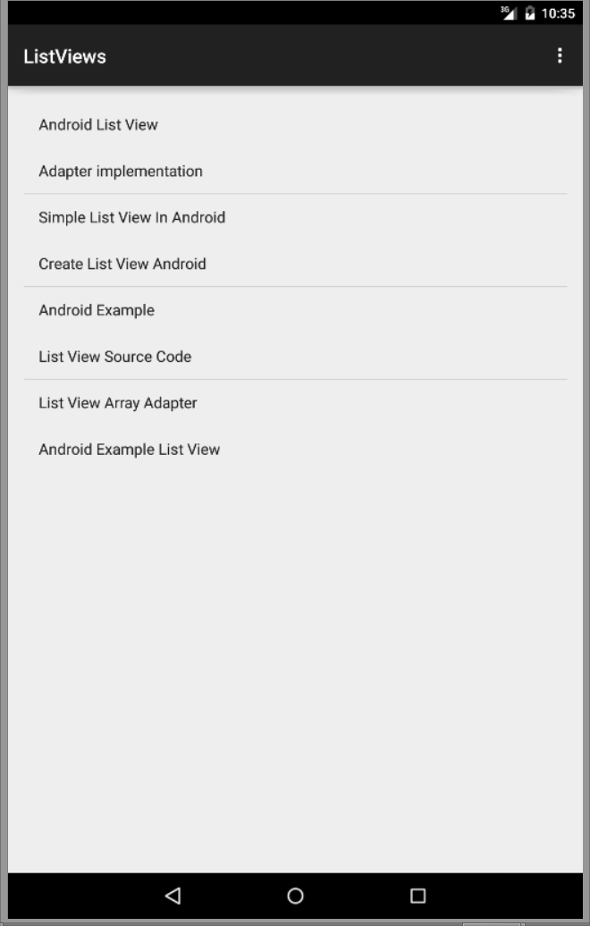
public class MainActivity extends ActionBarActivity {
ListView listView ;
@Override
protected void onCreate(Bundle savedInstanceState) {
super.onCreate(savedInstanceState);
setContentView(R.layout.activity_main);
// Get ListView object from xml
listView = (ListView) findViewById(R.id.listView1);
// Defined Array values to show in ListView
String[] values = new String[] { "Android List View",
"Adapter implementation",
"Simple List View In Android",
"Create List View Android",
"Android Example",
"List View Source Code",
"List View Array Adapter",
"Android Example List View"
};
// Define a new Adapter
// First parameter - Context
// Second parameter - Layout for the row
// Third parameter - ID of the TextView to which the data is written
// Forth - the Array of data
ArrayAdapter<String> adapter = new ArrayAdapter<String>(this,
android.R.layout.simple_list_item_1, android.R.id.text1, values);
// Assign adapter to ListView
listView.setAdapter(adapter);
// ListView Item Click Listener
listView.setOnItemClickListener(new OnItemClickListener() {
@Override
public void onItemClick(AdapterView<?> parent, View view,
int position, long id) {
// ListView Clicked item index
int itemPosition = position;
// ListView Clicked item value
String itemValue = (String) listView.getItemAtPosition(position);
// Show Alert
Toast.makeText(getApplicationContext(),
"Position :"+itemPosition+" ListItem : " +itemValue , Toast.LENGTH_LONG) .show();
}
});
}

Slide 23
Android GridView example
In Android, GridView let you arranges components in a two-dimensional scrolling grid.
Normal GridView example
Display characters from A to Z in GridView layout.

Slide 24
<LinearLayout xmlns:android="http://schemas.android.com/apk/res/android"
xmlns:tools="http://schemas.android.com/tools"
android:id="@+id/LinearLayout1"
android:layout_width="match_parent"
android:layout_height="match_parent"
android:orientation="vertical"
tools:context="${relativePackage}.${activityClass}" >
<GridView
android:id="@+id/gridView1"
android:layout_width="match_parent"
android:layout_height="wrap_content"
android:layout_gravity="center"
android:numColumns="5" >
</GridView>
</LinearLayout>

Slide 25
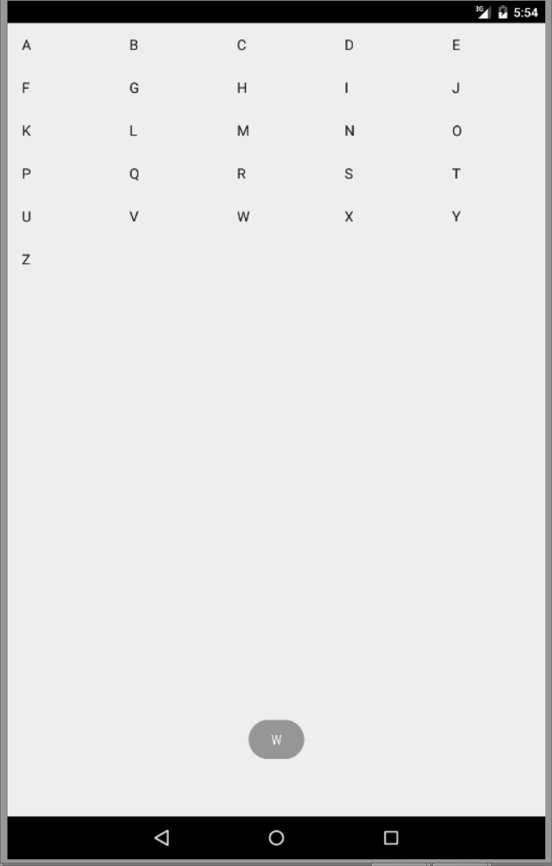
package com.CMPE419.gridview;
import android.app.Activity;import android.os.Bundle;
import android.widget.AdapterView;
import android.widget.AdapterView.OnItemClickListener;
import android.widget.ArrayAdapter;
import android.widget.GridView;
import android.widget.TextView;
import android.widget.Toast;import android.view.View;
public class MainActivity extends Activity {
GridView gridView;
static final String[] numbers = new String[] {
"A", "B", "C", "D", "E",
"F", "G", "H", "I", "J",
"K", "L", "M", "N", "O",
"P", "Q", "R", "S", "T",
"U", "V", "W", "X", "Y", "Z"};
@Override protected void onCreate(Bundle savedInstanceState) {
super.onCreate(savedInstanceState);
setContentView(R.layout.activity_main);
gridView = (GridView) findViewById(R.id.gridView1);
ArrayAdapter<String> adapter = new ArrayAdapter<String>(this, android.R.layout.simple_list_item_1, numbers);
gridView.setAdapter(adapter);
gridView.setOnItemClickListener(new OnItemClickListener() {
@Override
public void onItemClick(AdapterView<?> parent, View v,int position, long id) {
Toast.makeText(getApplicationContext(),((TextView) v).getText(), Toast.LENGTH_SHORT).show(); } }); }}

