Slide 1
CMPE419
Mobile Application Development
Asst.Prof.Dr.Ahmet Ünveren
2017-2018 SPRING
Computer Engineering Department

Slide 2
Android & SQLite

Slide 3
Overview
  Many well known applications and Internet browsers use SQLite due to its very small size (~250 Kb). Also it is not an external program, and is instead bundled with the application using it.
  Google Chrome / Firefox’s Caching / Skype
  Most mobile platforms including IOS, Android, Blackberry
  Especially for Audio/Video files, SMS/MMS storage, Contacts, and Calendar Events
  Even Mac OS X 10.4 onward on Desktops/Laptops

Slide 4
In Android OS
  SQLite is Open Source, and completed embedded within the Android OS. It does not require any additional setup.
  Database is automatically managed for you!
  Supports standard SQL syntax and data types (TEXT [String], INTEGER [Long], REAL [Double]). Other data types must be converted.
  Individual Applications are assigned their own SQLite databases which are inherently private.
  You can share them with a ‘ContentProvider’ Object to other applications if you wish to share the Database. (Ex: An app which uses your contact list, or your music library)

Slide 5
Configuring/Installing Android
  Install Java JRE and JDK
  Install Eclipse
  Install Android SDK and Plugin for Eclipse
  Configure AVD (Android Virtual Device) to run programs on the built in Emulator.
Code style:
- Java code with XML classes for menus, layouts, global variables.

Slide 6
Using SQLite in Android Architecture (1)
- import android.database.sqlite to use the library
- Extend the SQLiteOpenHelper class and overwrite the methods
- Overwrite onCreate() method to create the database
- Overwrite onUpgrade() method to update the schema any time it is modified
- Pass in SQLiteDatabase object to these methods, which represents the database itself
- getReadableDatabase() provides read-only access to the database
- getWriteableDatabase() lets you read and write to/from the database

Slide 7
Using SQLite in Android Architecture (2)
- Primary keys are denoted by the _id identifier- You can directly execute SQL statements via the execSQL() method.
- Example:
public static void onCreate(SQLiteDatabase database) {
database.execSQL("create table todo "
+ "(_id integer primary key autoincrement, "
+ "category text not null, " + "summary text not null,"
+ " description text not null);";);
}

Slide 8
Using SQLite in Android Architecture (3)
- SQLiteDatabase allows methods to open the database connection, perform queries and query updates, and close the database [insert() update() and delete()]
- You can define keys and values for queries via the ContentValues object. This is necessary for Insert and Update calls. Delete only requires the Row Number.
- The Key is the Column, and the Value is the selected key's value. For instance a Key may be Age with a Value of 25.

Slide 9
Using SQLite in Android Architecture (4)
- Insert the specified values into DB_TABLE at the next available incremented row.
public long createTodo(String priority, String title, String description) {
ContentValues values = createContentValues(priority, title,
description);
return db.insert(DB_TABLE, null, values);
}
- Update the specified values in DB_TABLE at the specified rowId, and check if the new data is different from the old data.
public boolean updateTodo(long rowId, String priority, String title,
String description) {
ContentValues values = createContentValues(priority, title,
description);
return db.update(DB_TABLE, values, KEY_ROWID + "=" + rowId, null) > 0;
}

Slide 10
Using SQLite in Android Architecture (5)
- Delete the specified row from DB_TABLE if it exists.
public boolean deleteTodo(long rowId) {
return db.delete(DB_TABLE, KEY_ROWID + "=" + rowId, null) > 0;
}

Slide 11
Query Methods (1)
- Two methods... query() and rawQuery(), both return a Cursor object, essentially a pointer to one or more rows in a List-like format.
- Cursors always point to one row which is one reason SQLite is so efficient. You can use various Iterators such as moveToFirst() and moveToNext() to traverse the list, and isAfterLast() to check if data is remaining. Specific columns can be accessed as well by index.
- rawQuery() is more MySQL-like in nature:
Cursor getAllDepts() {
SQLiteDatabase db=this.getReadableDatabase();
Cursor cur=db.rawQuery("SELECT "+colDeptID+" as _id, "
+colDeptName+" from "+deptTable,new String [] {});
return cur;
}
Two parameters:
- String query: The select statement
- String[] selection args: The arguments if a WHERE clause is included in the select statement

Slide 12
Query Methods (2)
- query() has the following parameters:
  String Table Name: The name of the table to run the query against
  String [ ] columns: The projection of the query, i.e., the columns to retrieve, null means all columns.
  String WHERE clause: where clause, if none pass null
  String [ ] selection args: The parameters of the WHERE clause
  String Group by: Filter for grouping rows.
  String Having: Additional filter for rows.
  String Order By by: Ordering for the rows.
public Cursor getEmpByDept(String Dept) {
SQLiteDatabase db=this.getReadableDatabase();
String [] columns = new String[]{"_id",colName,
colAge,colDeptName};
Cursor c=db.query(viewEmps, columns,
colDeptName+"=?", new String[]{Dept}, null, null, null); return c;
}

Slide 13
Android Program
- Utilized Foundation Activity classes to create a simple personal task manager application.
- Information is permanently saved (Until Deleted) on a SQLite Database
- Can Insert new Tasks, Update existing Tasks, and Delete.
- Two main screens, Overview and Details Screen.

Slide 14
List of Classes (1)
- Overview Activity class shows the list of all tasks
- Details Activity class shows the currently selected task.
- Table class with the onCreate() and onUpgrade() methods
- onPause() and onResume() are implemented in the Details Activity and save the state on minimizing/exiting the Application, and restore it upon resuming.
- Helper class which extends SQLiteOpenHelper and calls the Table class methods
- Adapter class to allow for queries, creates, updates. open() method opens the database by calling the helper class. Creates and Updates are handled via the ContentValues class

Slide 15
List of Classes (2)
- XML Resources are especially important.
- Strings are defined in res/values/strings.xml
- Task Priority is defined in res/values/priority.xml
- Menus are defined in res/menu
- listmenu.xml defines the Option Menu
- todo_list.xml is the layout for the view of the entire task list.
- todo_row.xml is the layout for the individual task rows of the list
- todo_edit.xml is the layout of the current task being viewed for an insert/update.
- res/drawable folders are for icons within the application.
- Last but not least... androidManifest.xml file contains some very important information such as Version requirements, entrypoint for the ‘Main’ class, Application names, requirements, icons, permissions.

Slide 16
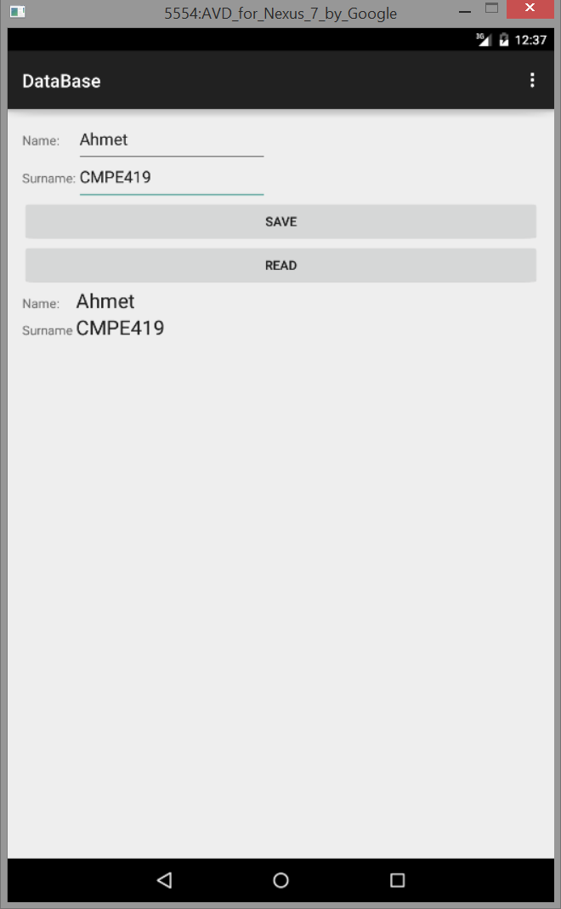
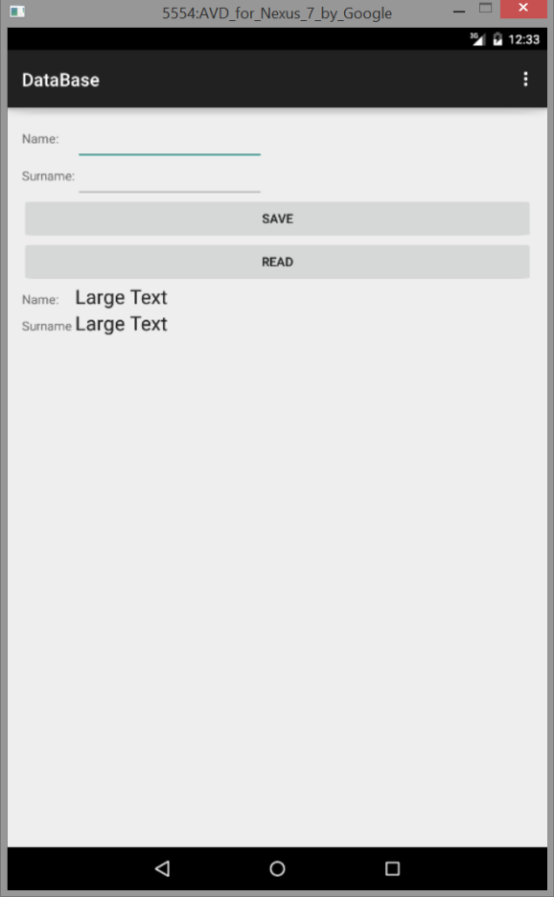
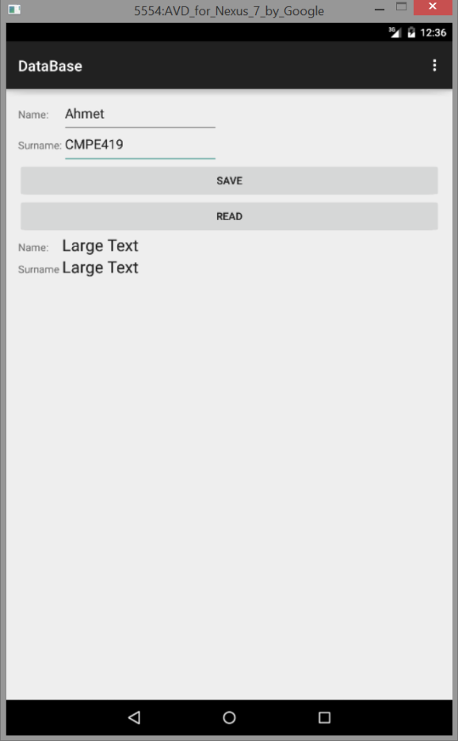
Example:
In this example we will learn
  How to create a Table
  Add a data to table
  Get a data from a table

Slide 17
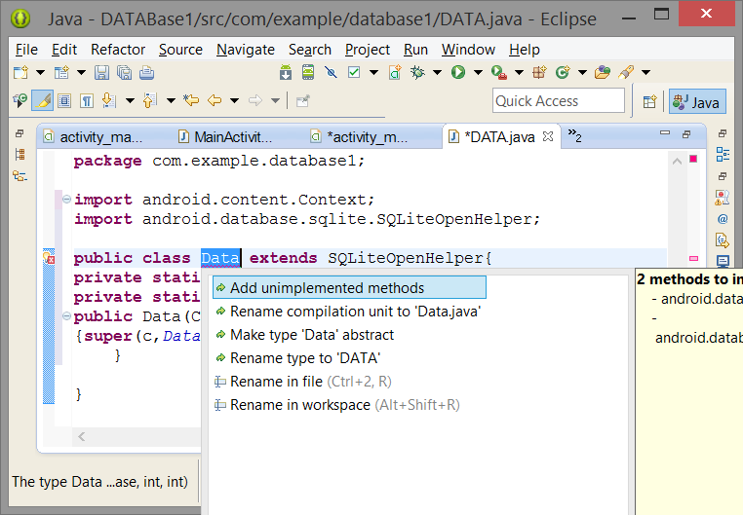
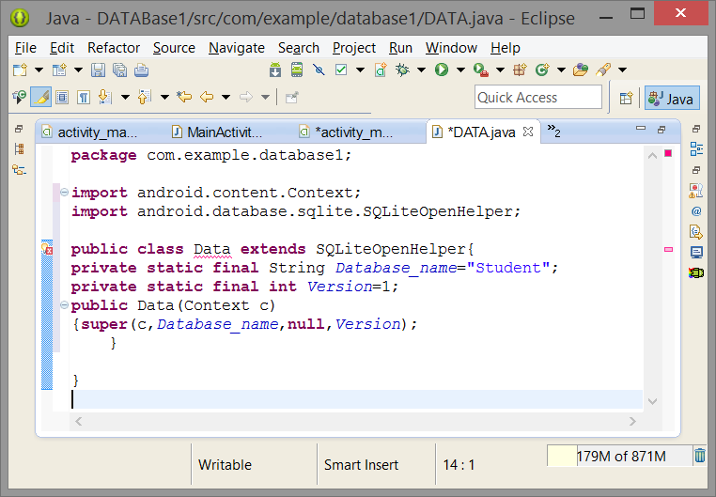
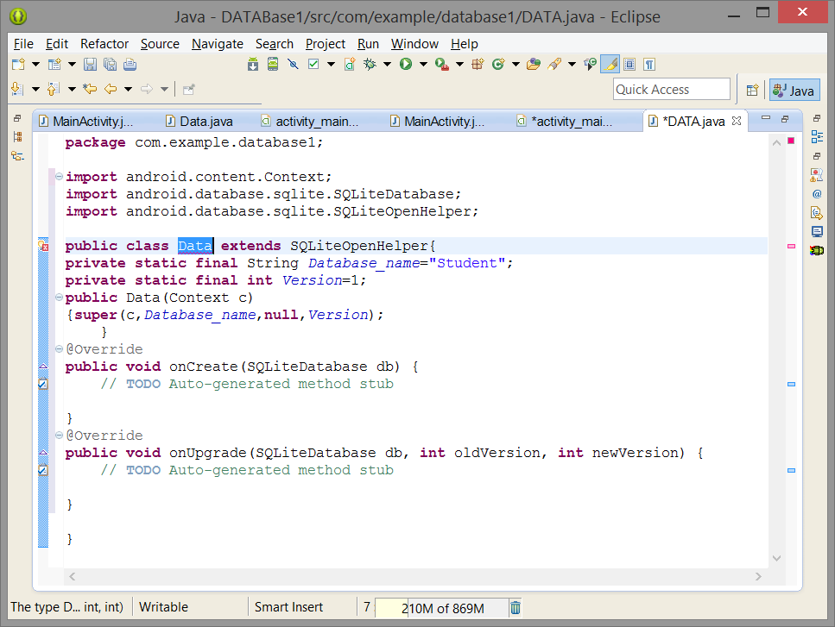
First Lets create a Class that contains basic informations related with your database:
package com.example.database;
import android.content.Context;
import android.database.sqlite.SQLiteDatabase;
import android.database.sqlite.SQLiteOpenHelper;
public class Data extends SQLiteOpenHelper{
private static final String Database_name="Student";
private static final int Version=1;
public Data(Context c)
{super(c,Database_name,null,Version);
}
@Override
public void onCreate(SQLiteDatabase db) {
// TODO Auto-generated method stub
db.execSQL("CREATE TABLE Mydata(name TEXT, surname TEXT);");
}
@Override
public void onUpgrade(SQLiteDatabase db, int oldVersion, int newVersion) {
// TODO Auto-generated method stub
db.execSQL("DROP TABLE IF EXIST Mydata");
}}

Slide 18
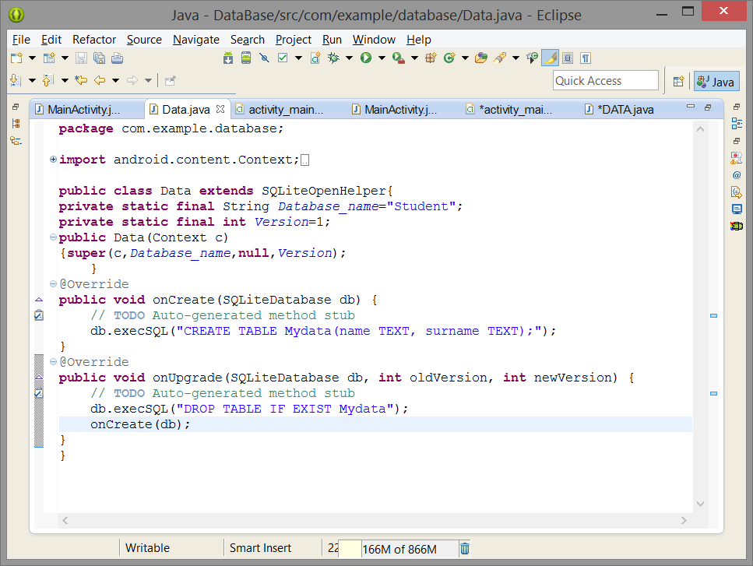
Table with name Mydata
Columns: Name - Surname
Deletes Mydata table

Slide 19
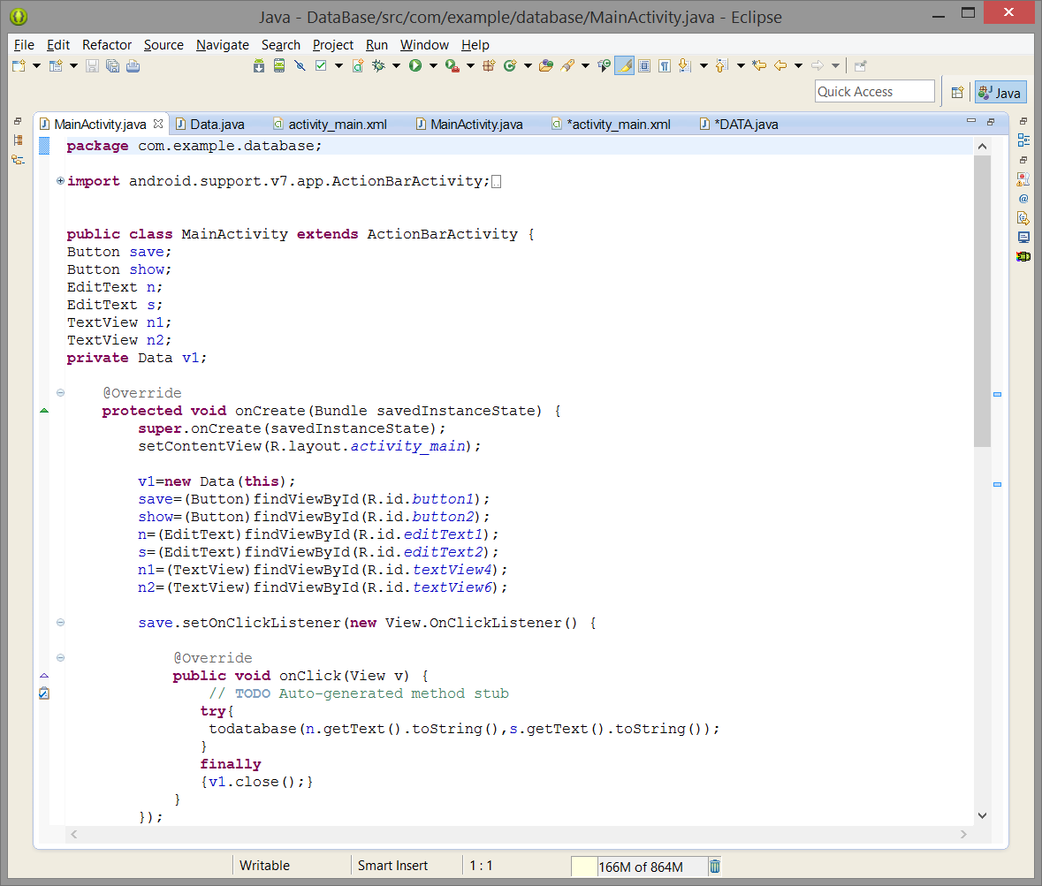
Define Objects for Views
Define an Object for DataBase
Create an Object for Database
Create Links to Views
Listener for save button
Method that takes to parameters
If there is an error close your table

Slide 20
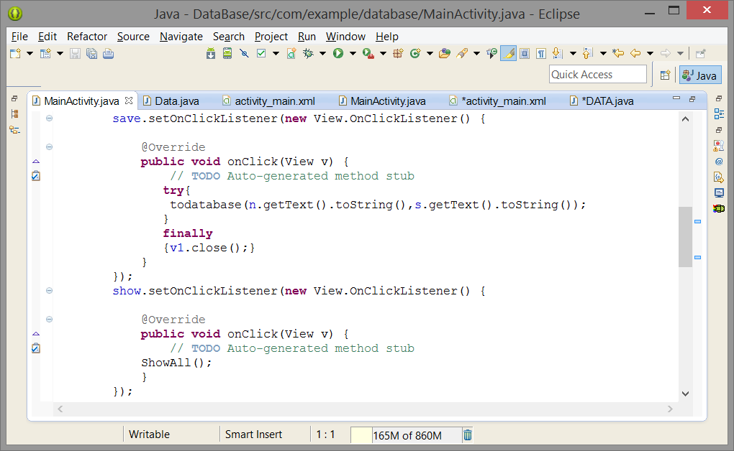
Listener for show button
Method for reading from database

Slide 21
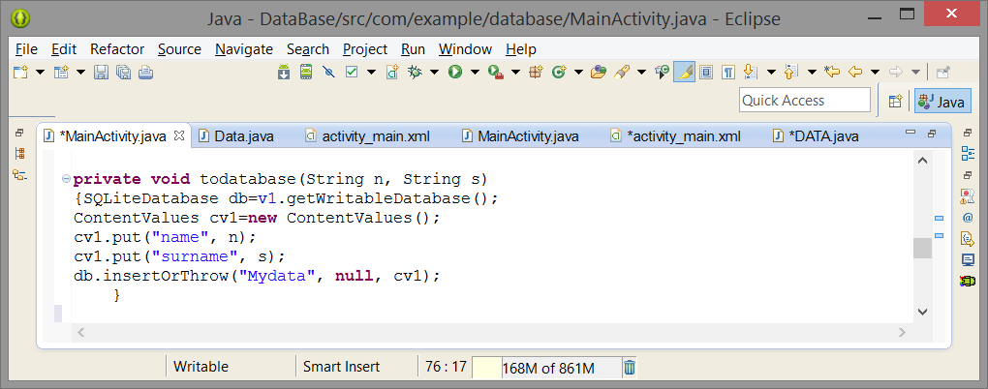
Create db object and prepare your database for writing
Create cv1 object for defining values that will be inserted into database
Use insertOrThrow() or insert() methods to insert values to db

Slide 22
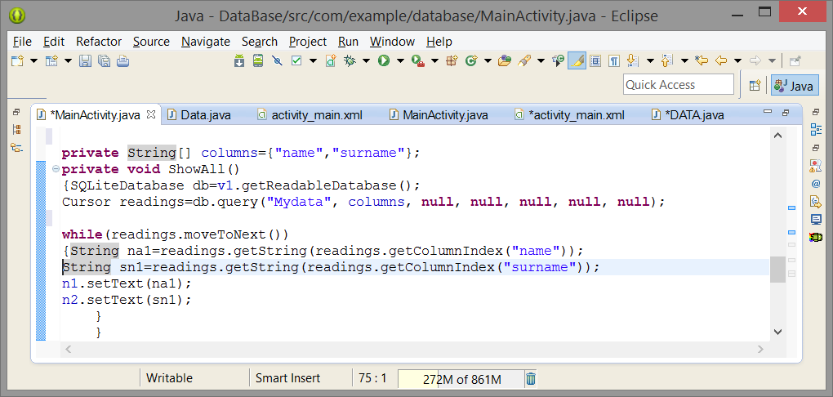
Define columns that you will read
Create db object and prepare your database for reading
Create reading object that halps you to move in columns
5 null values:
where clause, where clause values, groupby, having, orderby.

Slide 23
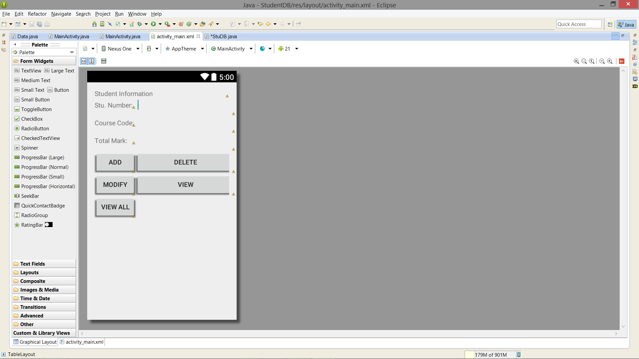
EXAMPLE: Add-Delete-View
Step 1: Design your GUI

Slide 24
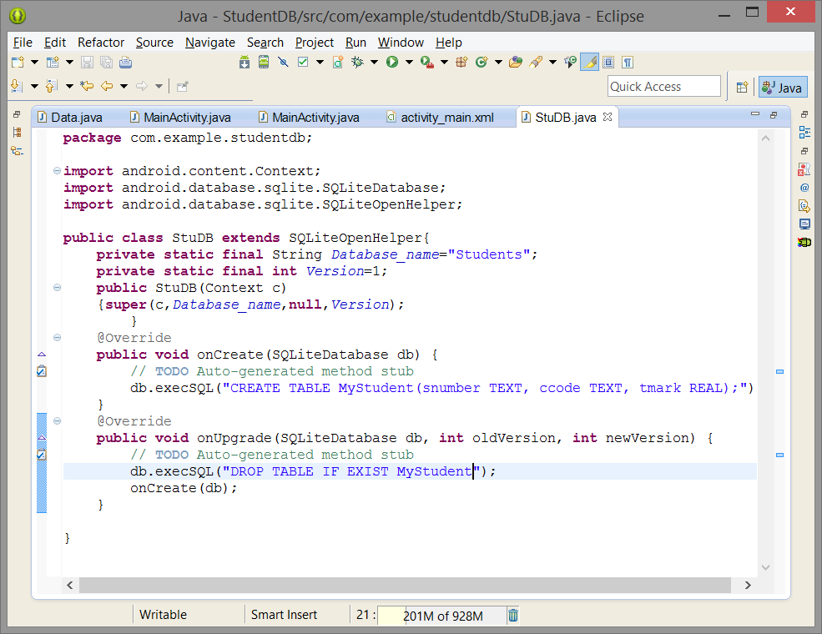
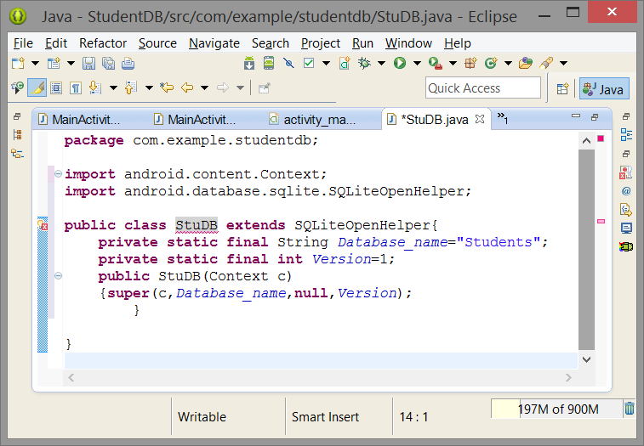
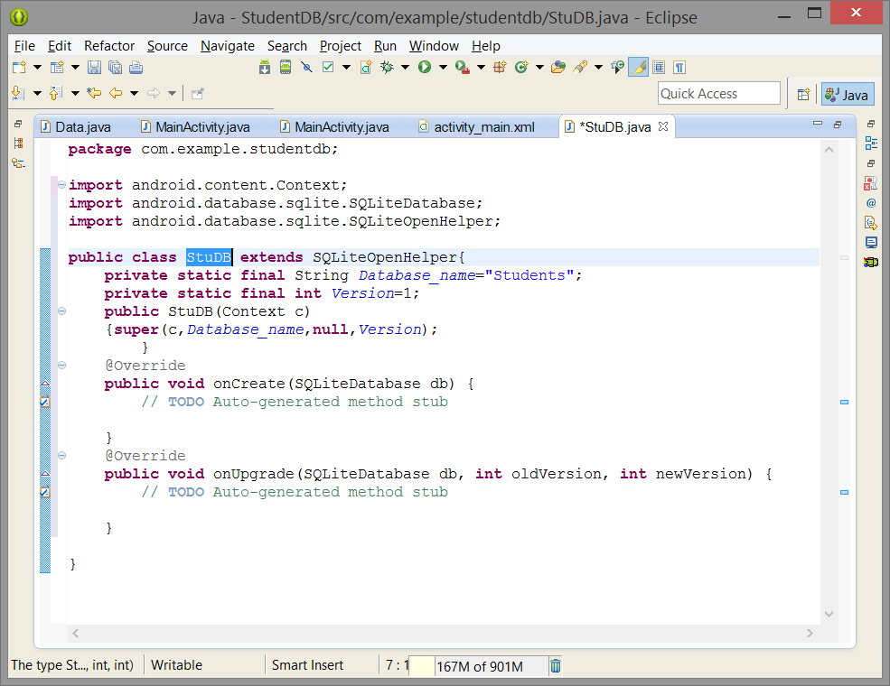
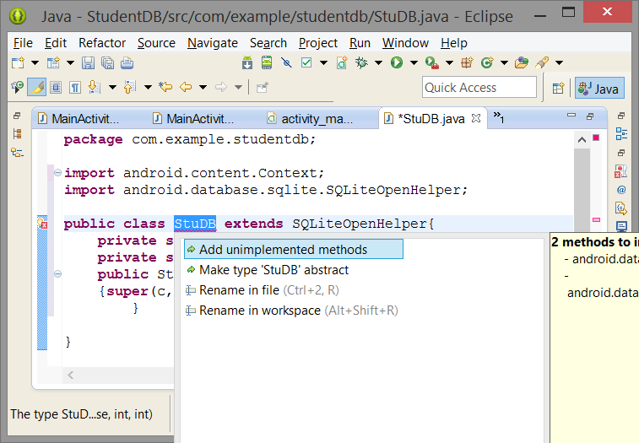
Step 2: Create Database controller Java Code (StuDB.Java)

Slide 25
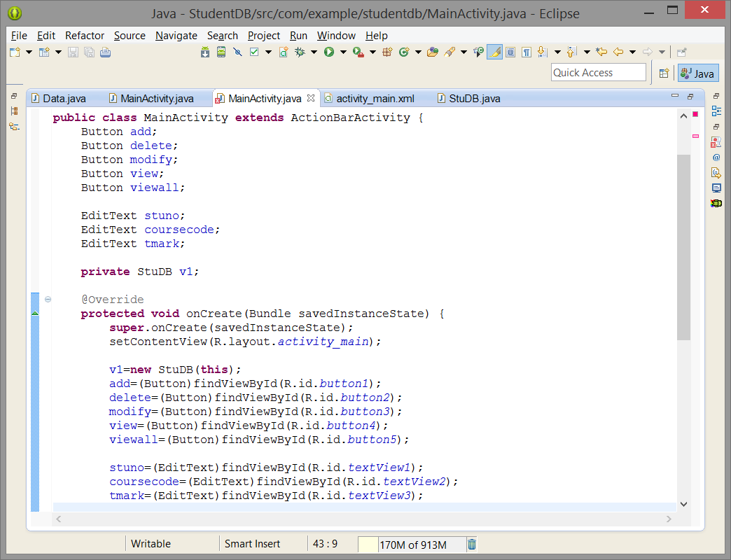
Step 3: Create View Links between JAVA and HML codes:

Slide 26
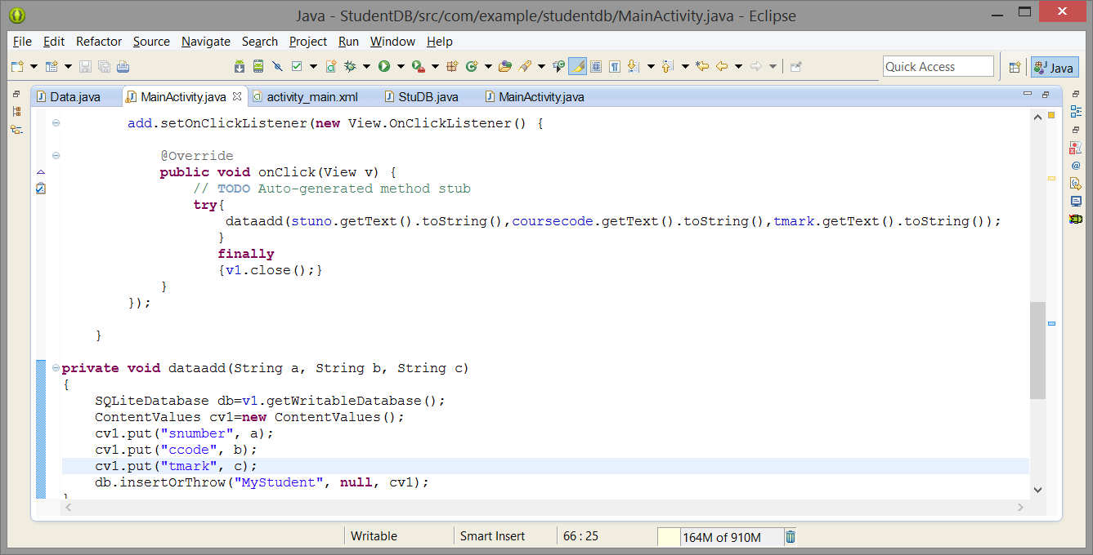
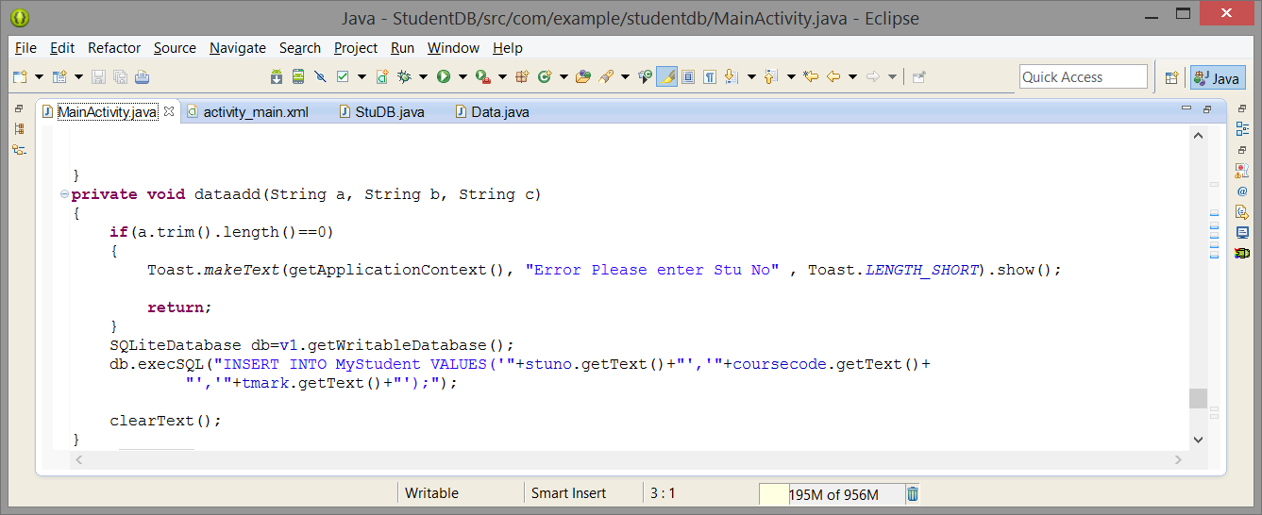
Step 4: Button Listeners

Slide 27
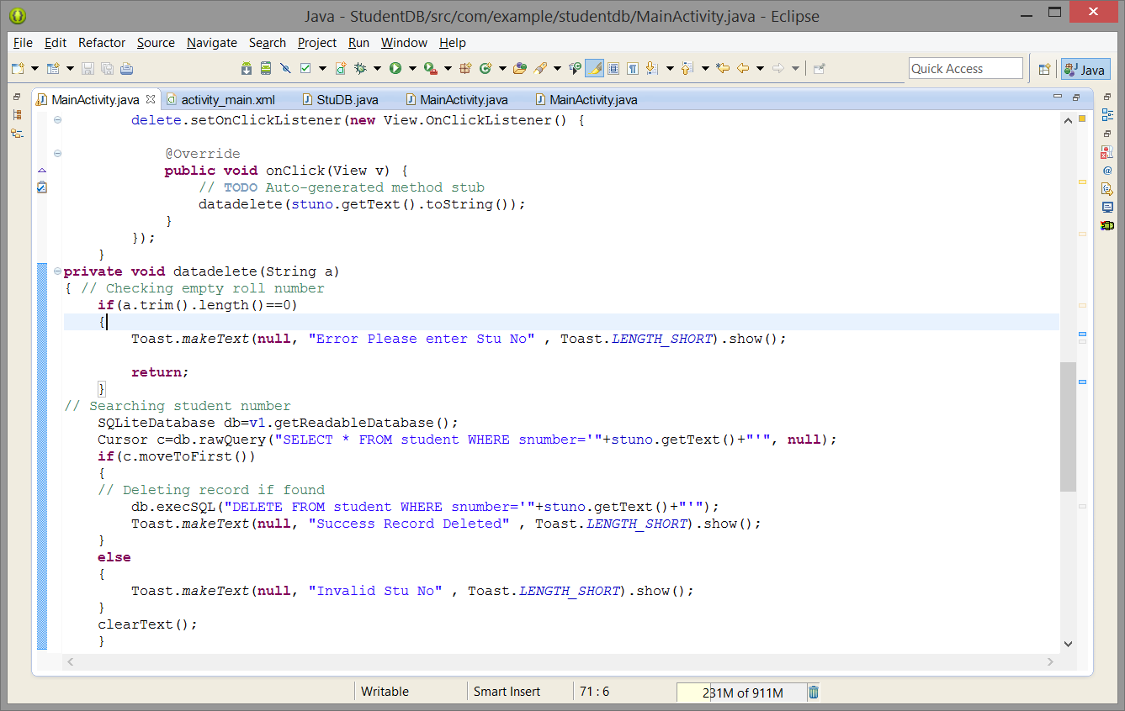

Slide 28
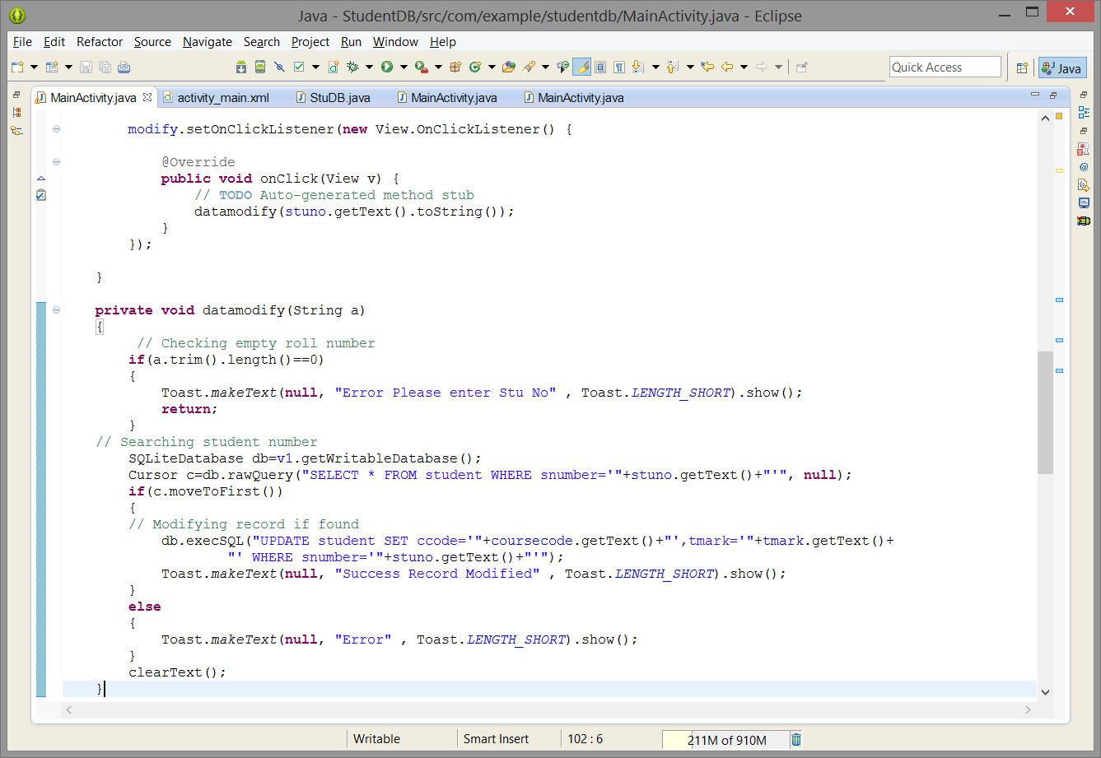

Slide 29
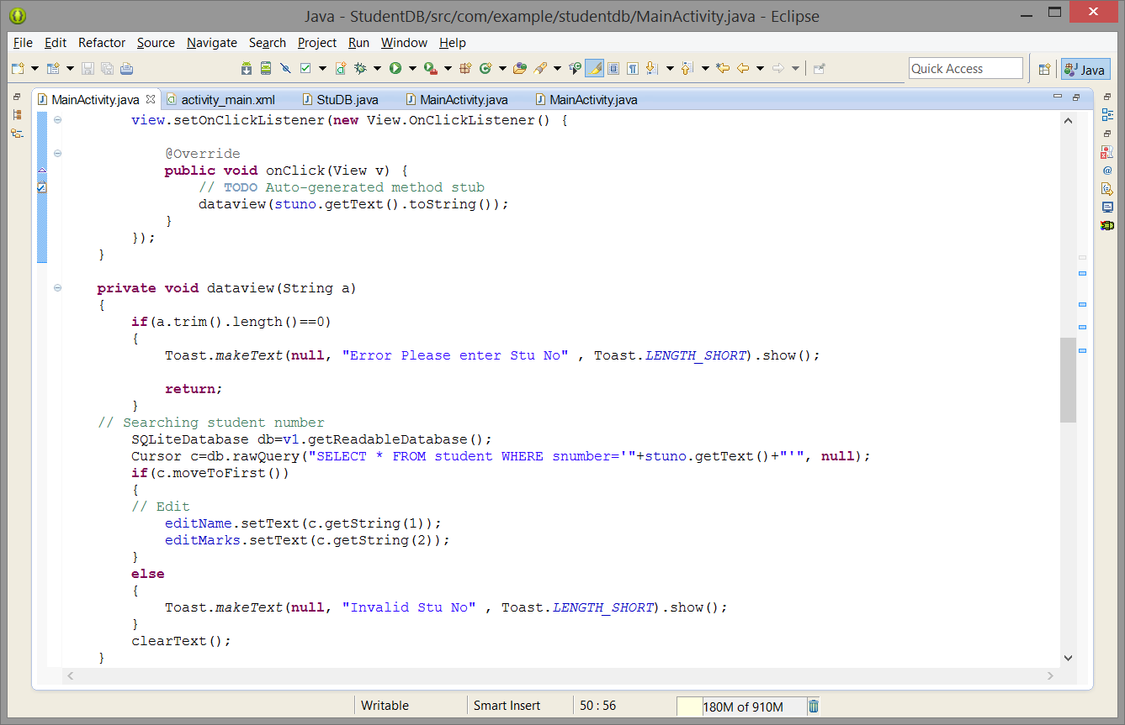

Slide 30
Reference Links:
http://www.sqlite.org/ - Official Website
http://en.wikipedia.org/wiki/SQLite - Wikipedia Entry for SQLite for general information.
http://www.codeproject.com/KB/android/AndroidSQLite.aspx - Sample SQLite Queries
http://developer.android.com/guide/index.html - Android Developer Guide
http://www.stackoverflow.com - The Google of Programming

