Slide 1
CMPE419 Mobile Application Development
Asst.Prof.Dr.Ahmet Ünveren
2017-2018 SPRING
Computer Engineering Department

Slide 2
Topics in This Section
Motivation
Web Apps vs. Mobile Apps
iPhone Apps vs. Android Apps
Books and references
Android Architecture

Slide 3
Web Apps vs. Android Apps

Slide 4
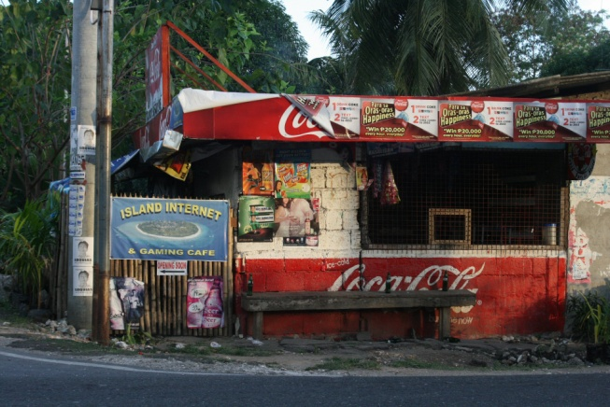
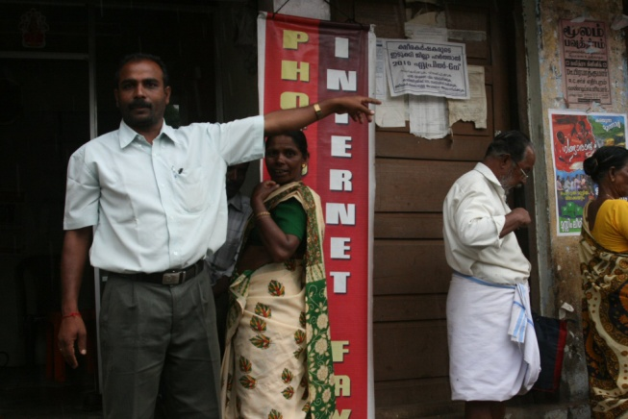

Advantages of Web Apps
Universal access
Browsers are everywhere
Any device on the network can access content
PCs, Macs, Linux, Android, iPhone, Blackberry, etc.
Automatic “updates”
Content comes from server, so is never out of date
Well-established tools and methodologies
In multiple languages
Java, PHP, .NET, Ruby/Rails, CGI, etc.

Slide 5
Disadvantages of Web Apps
Few and weak GUI controls
Textfield, text area, button, checkbox, radio, list box, combo box. That’s it! No direct drawing (except for HTML5 Canvas)
Cannot interact with local resources
Cannot read files, call programs, or access devices on the user’s machine
Inefficient communication
HTTP is weak protocol
Hard to write
Requires knowledge of many technologies
Java, HTML, HTTP, CSS, JavaScript, jQuery, XML
Designed for large displays with mouse
So harder to use on small phone displays with touch screen

Slide 6
Advantages of Mobile Apps
Many GUI controls
Textfield, text area, button, checkbox, radio, list box, combo box, clock, calendar, date picker, dialog box, image gallery, etc.
Comparable to options in desktop programming
Supports direct drawing
So animated games ala Angry Birds possible
Can interact with local resources
Can read files (e.g., contacts list), have local database, access GPS, initiate phone calls, get input from microphone, create voice output, read screen orientation, etc.

Slide 7
Advantages of Mobile Apps (Continued)
Efficient communication
Can use any networking protocols you want
Easier (?) to write
Requires knowledge of one language only
Java for Android
Objective C for iPhone
Designed for small displays with touch screen
So, many apps and GUI controls are optimized for this environment

Slide 8
Disadvantages of Mobile Apps
No universal access
Apps must be installed one at a time on each phone
An Android app cannot run on iPhone, Blackberry, PC, Mac, or Linux box
Difficult to manage updates
User must intervene to get latest versions
Newer (esp. Android)
So, fewer established tools and methodologies
On the other hand, Android programming is similar to desktop Java programming, and there are plenty of established approaches there

Slide 9
Android Apps vs. iPhone Apps

Slide 10
Installing Apps
General apps
iPhone has larger selection
Android trying to catch up
In-house-developed corporate apps
iPhone apps can only be installed via the App Store
iPhone requires you to submit app to the Apple App Store and get approval, even for apps from your own company
Unless you jailbreak your phone
Android apps can be installed through
Google App Store
Amazon App Store
USB connection from PC
Email
Corporate Web site

Slide 11
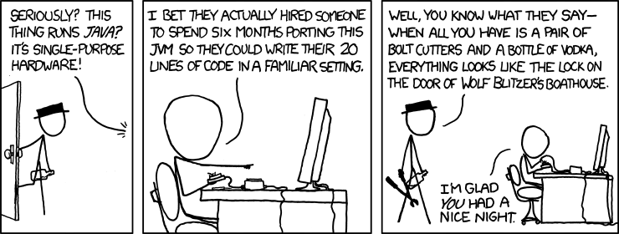
Languages for Apps
iPhone
Objective-C
Similar to, but not exactly the same as, C++
Virtually no corporate presence for Objective-C, other than for mobile apps
Android
Java
The single most widely used language inside corporations
C/C++
Can call native apps (with some difficulty) via an approach similar to JNI for desktop Java
The real reason Android runs Java
From Randall Munroe and xkcd.com

Slide 12
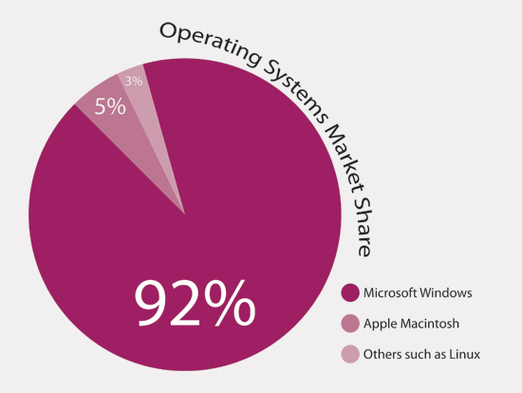
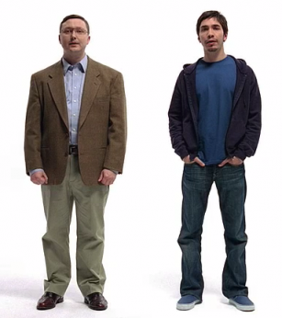
Operating Systems for Developing Apps
iPhone
Macs
Android
Anything with Java and Eclipse
Macs
PCs
Linux
Solaris
Issue
Not so much which is cooler and which you personally prefer, but rather which is already installed in corporate environments.
From http://www.hongkiat.com/blog/mac-vs-pc-myth-busting-consumer-guide/

Slide 13
Bottom Line: iPhone vs. Android
Which to use personally
iPhone has large market share, bigger app store, cooler interface (?), and more loyal users
Android more open and growing more rapidly
Bottom line: no clear winner, personal preferences prevail, but iPhone has edge
Which to use for in-house corporate apps
iPhone apps very hard to install, Android simple
iPhone uses Objective C, Android uses Java
Bottom line: Android is clear winner

Slide 14
References
Books (in rough order of preference)
Professional Android 4 Application Development (Meier)
Busy Coder’s Guide to Android Development (Murphy)
Online only: http://commonsware.com/Android/
Android Cookbook (Darwin)
Pro Android 3 (Komateni et al)
Android Developer’s Cookbook (Steele & To)
Android in Action, 2nd Edition (Ableson, Sen, & King)
Android Application Development for Dummies (Felker)
Online references
http://developer.android.com/
By far the most important single reference.
Android forum on StackOverflow
http://stackoverflow.com/questions/tagged/android
Android widget gallery
http://www.droiddraw.org/widgetguide.html

Slide 15
Summary
Web apps vs. Android apps
Web apps can run on Android, iPhone, Blackberry and regular computers. But, they have weaker GUIs, cannot use local resources (files, databases, GPS, camera), and are often ill-suited to small screens
Android apps can local resources, are optimized for small screens, have richer GUIs, but cannot be accessed on other phone types or on regular computers
iPhone vs. Android
For personal use, situation is unclear, but edge to iPhone
For building corporate apps, Android is clear winner

Slide 16
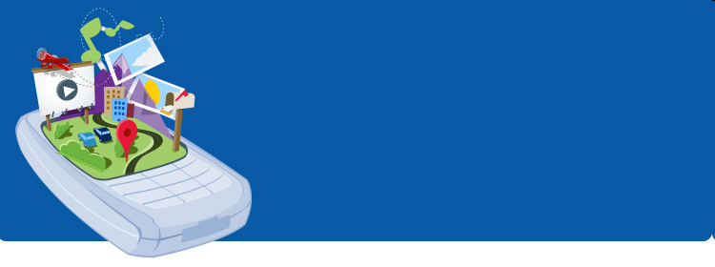
What is Android?
Android is a software stack for mobile devices that includes an operating system, middleware and key applications.
Android is an open source operating system, created by Google specifically for use on mobile devices (cell phones and tablets)

Slide 17
Platform Versions
Version | Codename | API | Distribution
2.2 | Froyo | 8 | 0.4%
2.3.3 - 2.3.7 | Gingerbread | 10 | 6.4%
4.0.3 - 4.0.4 | Ice Cream Sandwich | 15 | 5.7%
4.1.x | Jelly Bean | 16 | 16.5%
4.2.x |  | 17 | 18.6%
4.3 |  | 18 | 5.6%
4.4 | KitKat | 19 | 41.4%
5.0 | Lollipop | 21 | 5.0%
5.1 |  | 22 | 0.4%

Slide 18
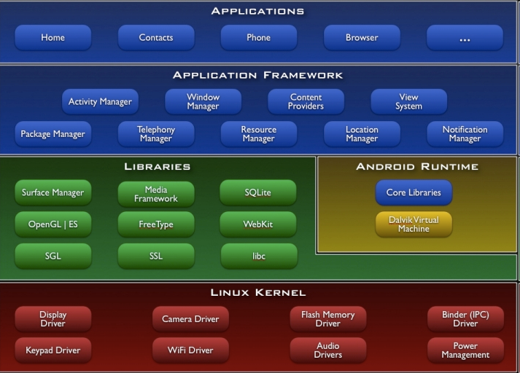
Architecture
}
Stack
Architecture

Slide 19
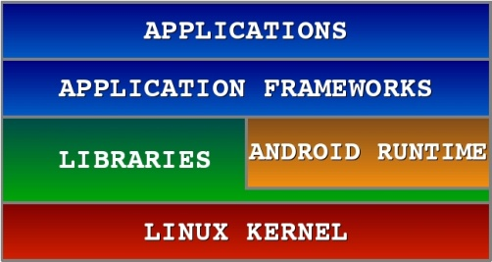
Android S/W Stack - Application
Applications
(Written in Java code)
Android Play Store
Entertainment
Productivity
Personalization
Education
Geo-communication
….
Android provides a set of core applications:
Email Client
SMS Program
Calendar
Maps
Browser
Contacts
Etc
All applications are written using the Java language.

Slide 20
Android S/W Stack –App Framework
Enabling and simplifying the reuse of components
Developers have full access to the same framework APIs (Application programming interface: set of rouitnes, protocols and tools for building software application ) used by the core applications.
Users are allowed to replace components.
Feature | Role
View System | Used to build an application, including lists, grids, text boxes, buttons, and embedded web browser
Content Provider | Enabling applications to access data from other applications or to share their own data
Resource Manager | Providing access to non-code resources (localized strings, graphics, and layout files)
Notification Manager | Enabling all applications to display customer alerts in the status bar
Activity Manager | Managing the lifecycle of applications and providing a common navigation backstack

Slide 21
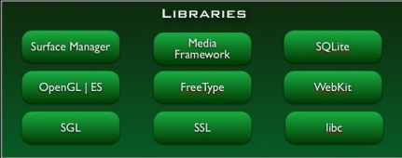
Android S/W Stack - Libraries
Native Libraries
(C/C++ code)
Graphics (Surface Manager)
Multimedia (Media Framework)
Database DBMS (SQLite)
Font Management (FreeType)
WebKit
C libraries (Bionic)
….
Including a set of C/C++ libraries used by components of the Android system
Exposed to developers through the Android application framework

Slide 22
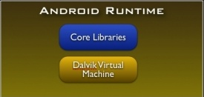
Android S/W Stack - Runtime
Dalvik Virtual Machine (VM)
Novel Java Virtual Machine implementation (not using the Oracle JVM)
Open License (Oracle JVM is not open!)
Optimized for memory-constrained devices
Faster than Oracle JVM
….
Core Libraries
Providing most of the functionality available in the core libraries of the Java language
APIs
Data Structures
Utilities
File Access
Network Access
Graphics
Etc

Slide 23
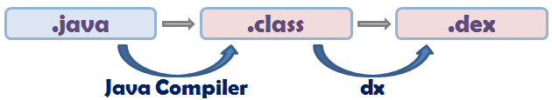
Dalvik Virtual Machine
Providing environment on which every Android application runs
Each Android application runs in its own process, with its own instance of the Dalvik VM.
Dalvik has been written such that a device can run multiple VMs efficiently.
Register-based virtual machine
Executing the Dalvik Executable (.dex) format
.dex format is optimized for minimal memory footprint.
Compilation
Relying on the Linux Kernel for:
Threading
Low-level memory management

Slide 24
Dalvik Java Virtual Machine (JVM)
Java Source
Code
Java Source
Code
Java Standard Edition
Java
Compiler
Java
Compiler
Java Byte
Code
Java Byte
Code
Dex
Compiler
Stack-based
byte-code
Dalvik Byte
Code
Register-based
byte-code
Java Virtual Machine (JVM)
Dalvik Virtual Machine (VM)

Slide 25
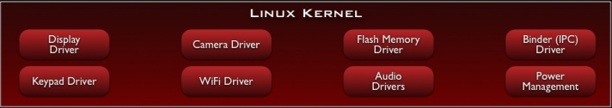
Android S/W Stack – Linux Kernel
Built on top of Linux kernel (v. 2.6-3.0)
Advantages:
Portability (i.e. easy to compile on different harwdare architectures)
Security (e.g. secure multi-process environment)
Power Management
Relying on Linux Kernel 2.6 for core system services
Memory and Process Management
Network Stack
Driver Model
Security
Providing an abstraction layer between the H/W and the rest of the S/W stack

Slide 26
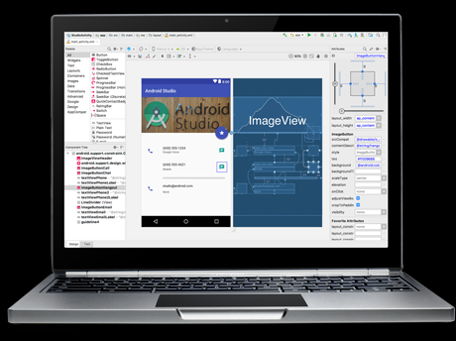
Android Studio
https://developer.android.com/studio/index.html

Slide 27
Android Application Development
Android
SDK
Eclipse IDE
Android
Mobile
Device
Android
Emulator

Slide 28
Android development
Java Source
Android Manifest
Generated Class
Java Compiler
.dex
File
Dalvik
VM
Resource XML
Android Libraries

Slide 29
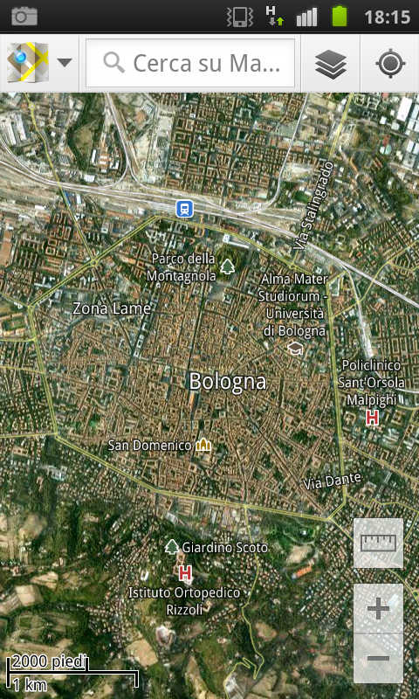
Android Applications Design
APPLICATION COMPONENTS
Activities
Intents
Services
Content Providers
Broadcast Receivers

Slide 30
Android Components: Activities
An Activity corresponds to a single screen of the Application.
An Application can be composed of multiples screens (Activities).
The Home Activity is shown when the user launches an application.
Different activities can exhange information one with each other.
Hello World!
Android HelloWorld
Button1

Slide 31
Android Components: Activities
Each activity is composed by a list of graphics components.
Some of these components (also called Views) can interact with the user by handling events (e.g. Buttons).
Two ways to build the graphic interface:
PROGRAMMATIC APPROACH
MainActivity.java
Example:
Button button=new Button (this);
TextView text= new TextView();
text.setText(“Hello world”);

Slide 32
Android Components: Activities
Each activity is composed by a list of graphics components.
Some of these components (also called Views) can interact with the user by handling events (e.g. Buttons).
Two ways to build the graphic interface:
DECLARATIVE APPROACH
activity_main.xml
Example:
< TextView android.text=@string/hello” android:textcolor=@color/blue android:layout_width=“fill_parent” android:layout_height=“wrap_content” />
< Button android.id=“@+id/Button01” android:textcolor=“@color/blue” android:layout_width=“fill_parent” android:layout_height=“wrap_content” />

Slide 33
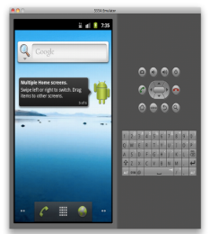
Android Components: Activities
EXAMPLE
Build the application layout through XML files (like HTML)
Define two different XML layouts for two different devices
At runtime, Android detects the current device configuration and loads the appropriate resources for the application
No need to recompile!
Just add a new XML file if you need to support a new device
Device 1
HIGH screen pixel density
Device 2
LOW screen pixel density
Java App Code
XML Layout File
Device 1
XML Layout File
Device 2

Slide 34
Android Components: Activities
Android applications typically use both the approaches!
DECLARATIVE APPROACH
Define the Application layouts and resources used by the Application (e.g. labels).
XML Code
PROGRAMMATIC APPROACH
Manages the events, and handles the interaction with the user.
Java Code

Slide 35
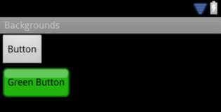
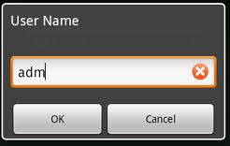
Android Components: Activities
Views can generate events (caused by human interactions) that must be managed by the Android-developer.
Button
TextEdit
Example
public void onClick(View arg0) {
if (arg0 == Button) {
// Manage Button events
}
}

Slide 36
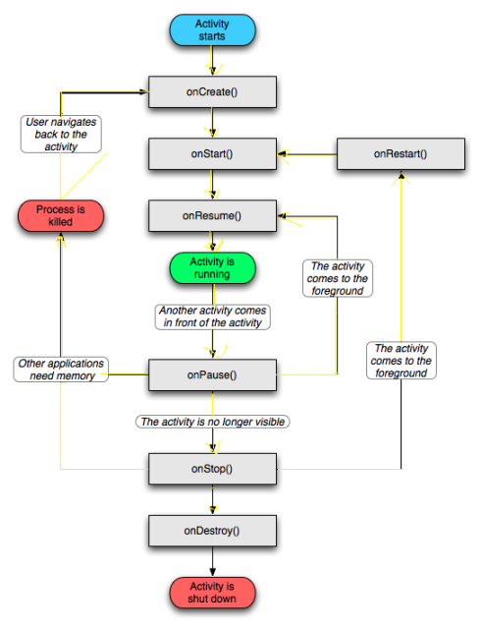
Android Components: Activities
The Activity Manager is responsible for creating, destroying, managing activities.
Activities can be on different states: starting, running, stopped, destroyed, paused.
Only one activity can be on the running state at a time.
Activities are organized on a stack, and have an event-driven life cycle (details later …)

Slide 37
Android Components: Activities
Main difference between Android-programming and Java (Oracle) -programming:
Mobile devices have constrained resource capabilities!
Activity lifetime depends on users’ choice (i.e. change of visibility) as well as on system constraints (i.e. memory shortage).
Developer must implement lifecycle methods to account for state changes of each Activity …

Slide 38
Android Components: Activities
public class MyApp extends Activity {
public void onCreate() { ... }
public void onPause() { ... }
public void onStop() { ... }
public void onDestroy(){ ... }
….
}
Called when the Activity
is created the first time.
Called when the Activity
is created the first time.
Called when the Activity
is partially visible.
Called when the Activity
is no longer visible.
Called when the Activity
is dismissed.

Slide 39
Android Components: Intents
Intents: asynchronous messages to activate core Android components (e.g. Activities).
Explicit Intent → The component (e.g. Activity1) specifies the destination of the intent (e.g. Activity 2).
LOGIN
Welcome Unveren!
unveren
Activity1
PASSWORD
Activity2
**********
Login Intent
Login

Slide 40


Android Components: Intents
Intents: asynchronous messages to activate core Android components (e.g. Activities).
Implicit Intent → The component (e.g. Activity1) specifies the type of the intent (e.g. “View a video”).
Multiple choices
might be available
to the user!
Activity2
}
Activity1
Intent-
Filters
View
Implicit Intent
Activity2

Slide 41
Android Components: Services
Services: like Activities, but run in background and do not provide an user interface.
Used for non-interactive tasks (e.g. networking).
Service life-time composed of 3 states:
Starting
Destroyed
onCreate()
onStart()
onDestroy()
Running
(on background)

Slide 42


Android Components: Content Providers
Each Android application has its own private set of data (managed through files or through SQLite database).
Content Providers: Standard interface to access and share data among different applications.
insert()
APP
update()
DB
Content
Provider
delete()
query()
e.g. Photo Gallery

Slide 43
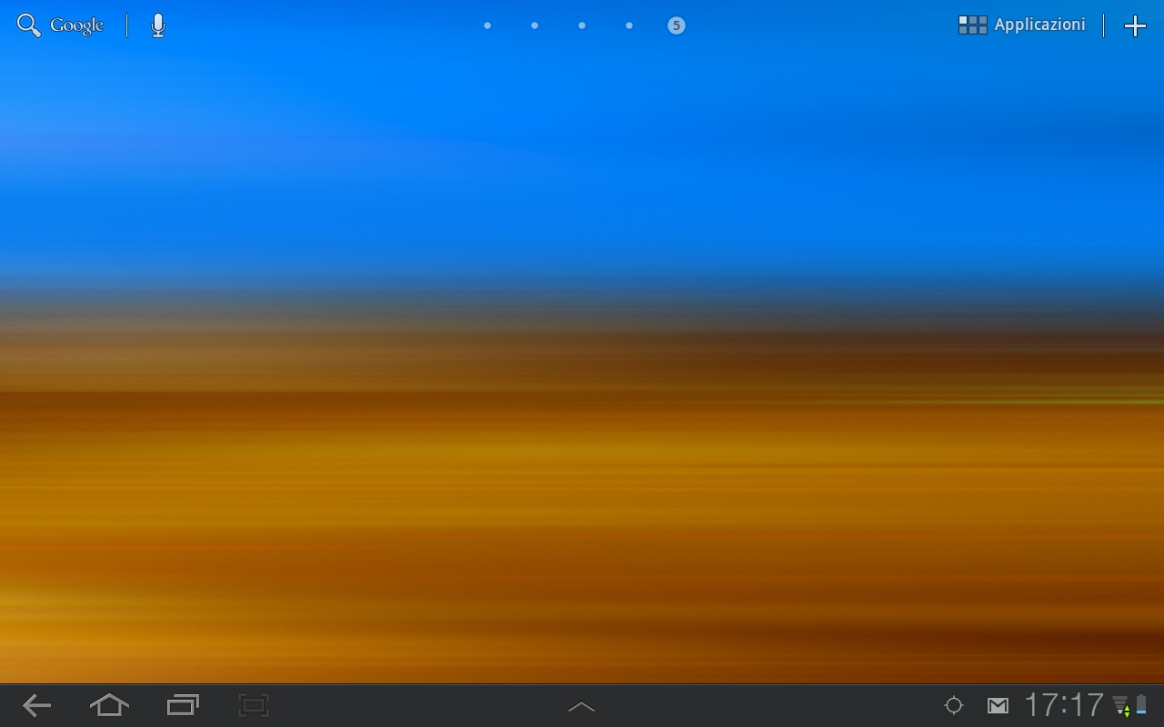
Android Components: Broadcast Receivers
Publish/Subscribe paradigm
Broadcast Receivers: An application can be signaled of external events.
Notification types: Call incoming, SMS delivery, Wifi network detected, etc

Slide 44
Android Components: Broadcast Receivers
BROADCAST RECEIVER example
class WifiReceiver extends BroadcastReceiver {
public void onReceive(Context c, Intent intent) {
String s = new StringBuilder();
wifiList = mainWifi.getScanResults();
for(int i = 0; i < wifiList.size(); i++){
s.append(new Integer(i+1).toString() + ".");
s.append((wifiList.get(i)).toString());
s.append("\\n");
}
mainText.setText(sb);
}
}

Slide 45
Android Components: Broadcast Receivers
BROADCAST RECEIVER example
public class WifiTester extends Activity {
WifiManager mainWifi;
WifiReceiver receiverWifi;
List<ScanResult> wifiList;
public void onCreate(Bundle savedInstanceState) {
…
mainWifi = (WifiManager) getSystemService(Context.WIFI_SERVICE);
receiverWifi = new WifiReceiver();
registerReceiver(receiverWifi, new IntentFilter(WifiManager.SCAN_RESULTS_AVAILABLE_ACTION));
mainWifi.startScan();
}

Slide 46
Android Components: System API
Using the components described so far, Android applications can then leverage the system API …
Telephon Manager data access (call, SMS, etc)
Sensor management (GPS, accelerometer, etc)
Network connectivity (Wifi, bluetooth, NFC, etc)
Web surfing (HTTP client, WebView, etc)
Storage management (files, SQLite db, etc)
….
SOME EXAMPLEs …

Slide 47



Android Components: Google API
… or easily interface with other Google services:

Slide 48
Android Application Distribution
Each Android application is contained on a single APK file.
Java Byte-code (compiled for Dalvik JVM)
Resources (e.g. images. videos, XML layout files)
Libraries (optimal native C/C++ code)
APK
FILE
C
XML
Files

Slide 49
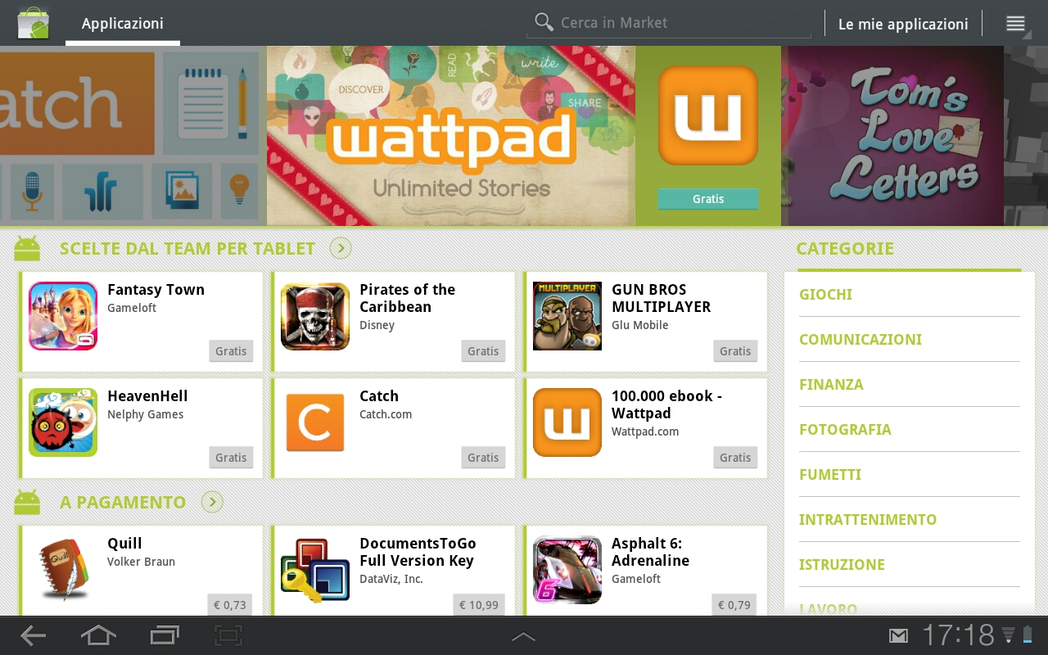
Android Application Distribution
Each application must be signed through a key before being distributed.
Applications can be distributed via Web or via Stores.
Android Play Store: application store run by Google … but several other application stores are available (they are just normal applications).

Slide 50
Android Application Security
Android applications run with a distinct system identity (Linux user ID and group ID), in an isolated way.
Applications must explicitly share resources and data. They do this by declaring the permissions they need for additional capabilities.
Applications statically declare the permissions they require.
User must give his/her consensus during the installation.
ANDROIDMANIFEST.XML
<uses-permission android:name=“android.permission.IACCESS_FINE_LOCATION" />
<uses-permission android:name=“android.permission.INTERNET" />

