Slide 1
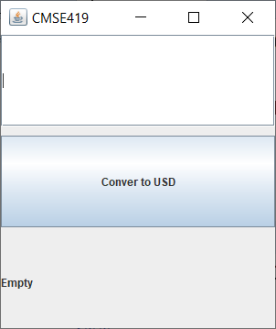

Slide 2
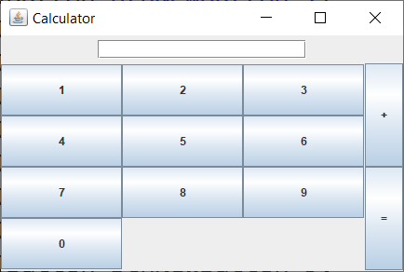

Slide 3
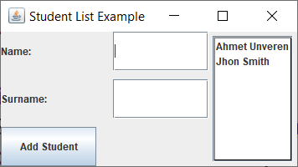
textField
JLabel
JList
JButton

Slide 4
JList
DefaultListModel<String> ListStu=new DefaultListModel<>();
JList list = new JList(ListStu);

