Slide 1
CMSE419 Mobile Application Development
Asst.Prof.Dr.Ahmet Ünveren
2022-2023 SPRING
Computer Engineering Department
https://staff.emu.edu.tr/ahmetunveren/en/teaching/

Slide 2
CATALOGUE DESCRIPTION
This course is an introduction to mobile device programming that will cover the fundamental programming principles, software architecture and their development environments. Event-driven programming, object-oriented programming, graphical user interface design, and database programing for mobile devices will be the main topics of this course.

Slide 3
METHOD OF ASSESSMENT
Assessment | Method | No | Percentage
 | Lab Work(s) | 10-12 | 15%
 | Assignment | 1 | 5%
 | Mid Term Examination | 1 | 40%
 | Final Examination | 1 | 40%

Slide 4
References
This course is a brief overview of some major concepts…Android is much richer and more complex
Developer’s Guide
http://developer.android.com/sdk/index.html
API Reference
http://developer.android.com/reference/packages.html

Slide 5
Tools
Setting up Eclipse and the Android SDK will give you the basic tools you need to get started making an Android app. As with any project, you should start by gathering up your tools and learning to use them first.
Phone (Phone emulator)
Eclipse ( http://www.eclipse.org/downloads/ )
Android Plugin (ADT)
Android SDK ( http://developer.android.com/sdk/index.html )
Install everything except Additional SDK Platforms, unless you want to
Android Studio

Slide 6
Java
&
Android Programming

Slide 7
Java
Java is an object-oriented language, with a syntax similar to C
Structured around objects and methods
A method is an action or something you do with the object
Avoid those overly complicated features of C++:
Operator overloading, pointer, templates, friend class, etc.

Slide 8
Java Basics
Introduction
Java programming language
Java Virtual Machine
JDK and JRE
Setting up your machine for Java programming
Hello World in Java
Using a text Editor
Using an IDE
Java Primitive Data Type
Naming
Arrays
Control Flow
If/Else and Switch
Switch statement
While loop
For Loop
Object Oriented Programming
Introduction
Object Oriented Programming
Objects
Classes
Inheritance
Interface
Access Modifiers
Constructors
Method overriding and overloading
Polymorphism

Slide 9
How it works…!
Compile-time
Run-time
Class Loader
Java Class
Libraries
Java
Source
(.java)
Java
Bytecodes
move locally
or through
network
Java
Interpreter
Just in Time
Compiler
Java
Compiler
Java
Virtual
machine
Java
Bytecode
(.class )
Runtime System
Operating System
Hardware

Slide 10
What is Android?
Android is a software stack for mobile devices that includes an operating system, middleware and key applications.
Android is an open source operating system, created by Google specifically for use on mobile devices (cell phones and tablets)

Slide 11
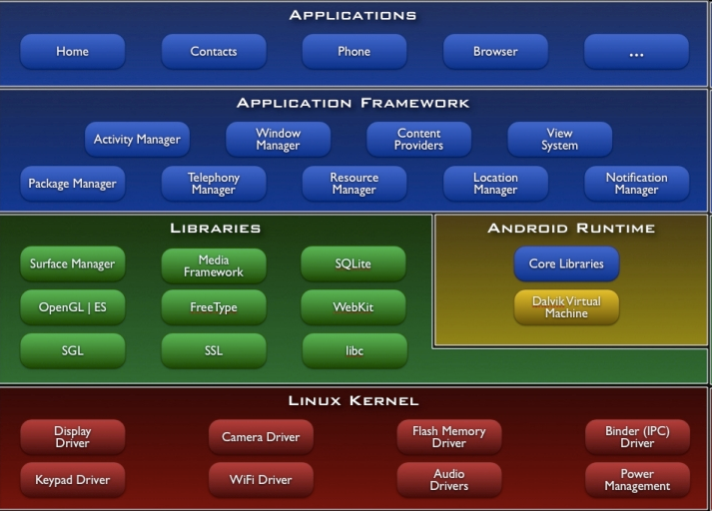
Architecture

Slide 12
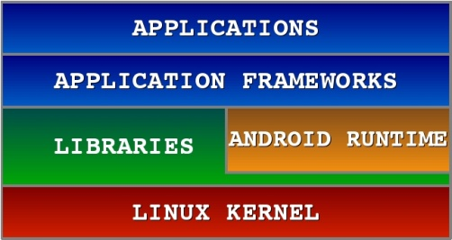
Android S/W Stack - Application
Android provides a set of core applications:
Email Client
SMS Program
Calendar
Maps
Browser
Contacts
Etc
All applications are written using the Java language.

Slide 13
Android S/W Stack –App Framework
Enabling and simplifying the reuse of components
Developers have full access to the same framework APIs (Application programming interface: set of rouitnes, protocols and tools for building software application ) used by the core applications.
Users are allowed to replace components.
Feature | Role
View System | Used to build an application, including lists, grids, text boxes, buttons, and embedded web browser
Content Provider | Enabling applications to access data from other applications or to share their own data
Resource Manager | Providing access to non-code resources (localized strings, graphics, and layout files)
Notification Manager | Enabling all applications to display customer alerts in the status bar
Activity Manager | Managing the lifecycle of applications and providing a common navigation backstack

Slide 14
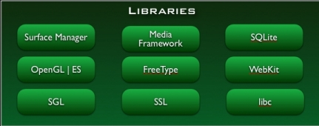
Android S/W Stack - Libraries
Including a set of C/C++ libraries used by components of the Android system
Exposed to developers through the Android application framework

Slide 15
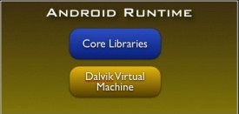
Android S/W Stack - Runtime
Core Libraries
Providing most of the functionality available in the core libraries of the Java language
APIs
Data Structures
Utilities
File Access
Network Access
Graphics
Etc

Slide 16
Dalvik Virtual Machine
Providing environment on which every Android application runs
Each Android application runs in its own process, with its own instance of the Dalvik VM.
Dalvik has been written such that a device can run multiple VMs efficiently.
Register-based virtual machine
Executing the Dalvik Executable (.dex) format
.dex format is optimized for minimal memory footprint.
Compilation
Relying on the Linux Kernel for:
Threading
Low-level memory management

Slide 17
Android S/W Stack – Linux Kernel
Relying on Linux Kernel 2.6 for core system services
Memory and Process Management
Network Stack
Driver Model
Security
Providing an abstraction layer between the H/W and the rest of the S/W stack

Slide 18
Android Application Development
Android
SDK
Eclipse IDE/
Android Studio
Android
Mobile
Device
Android
Emulator

Slide 19
Android development
Java Source
Android Manifest
Generated Class
Java Compiler
.dex
File
Dalvik
VM
Resource XML
Android Libraries

