Slide 1
CMPE419 Mobile Application Development
Asst.Prof.Dr.Ahmet Ünveren
2019-2020 SPRING
Computer Engineering Department

Slide 2
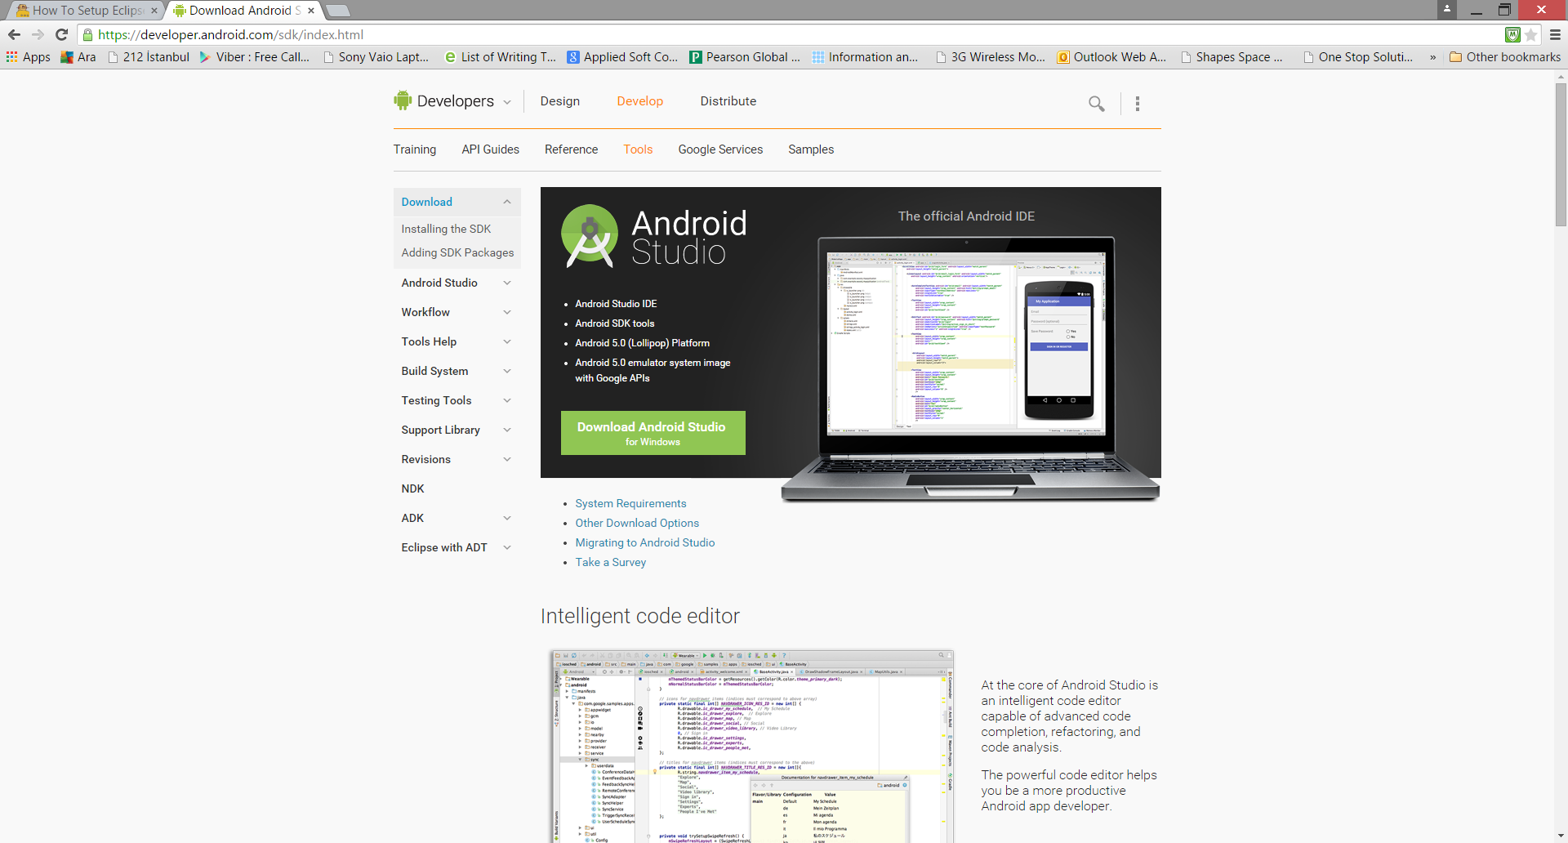
Installation:
https://developer.android.com/sdk/index.html

Slide 3
Android Introduction
Hello World

Slide 4
Goal
Create a very simple application
Run it on a real device
Run it on the emulator
Examine its structure
Start a new project
Step 1: Start and configure the project
Step 2: Select form factors and API level
Step 3: Add an activity
Step 4: Configure your activity

Slide 5
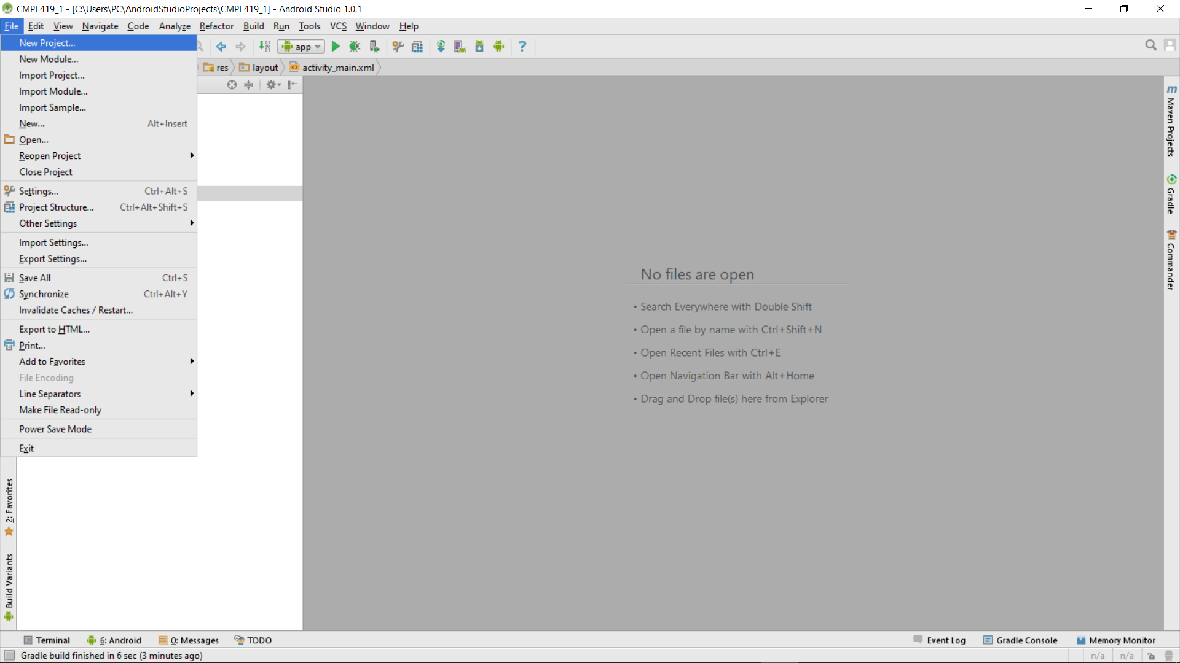
Your First Application
To begin creating an Android application, go with the Java perspective and select
File > New Project.
Doing so will launch the application creation wizard, and you will be prompted to enter meta-information about your project in three categories:
Contents, Build Target, and Properties.

Slide 6
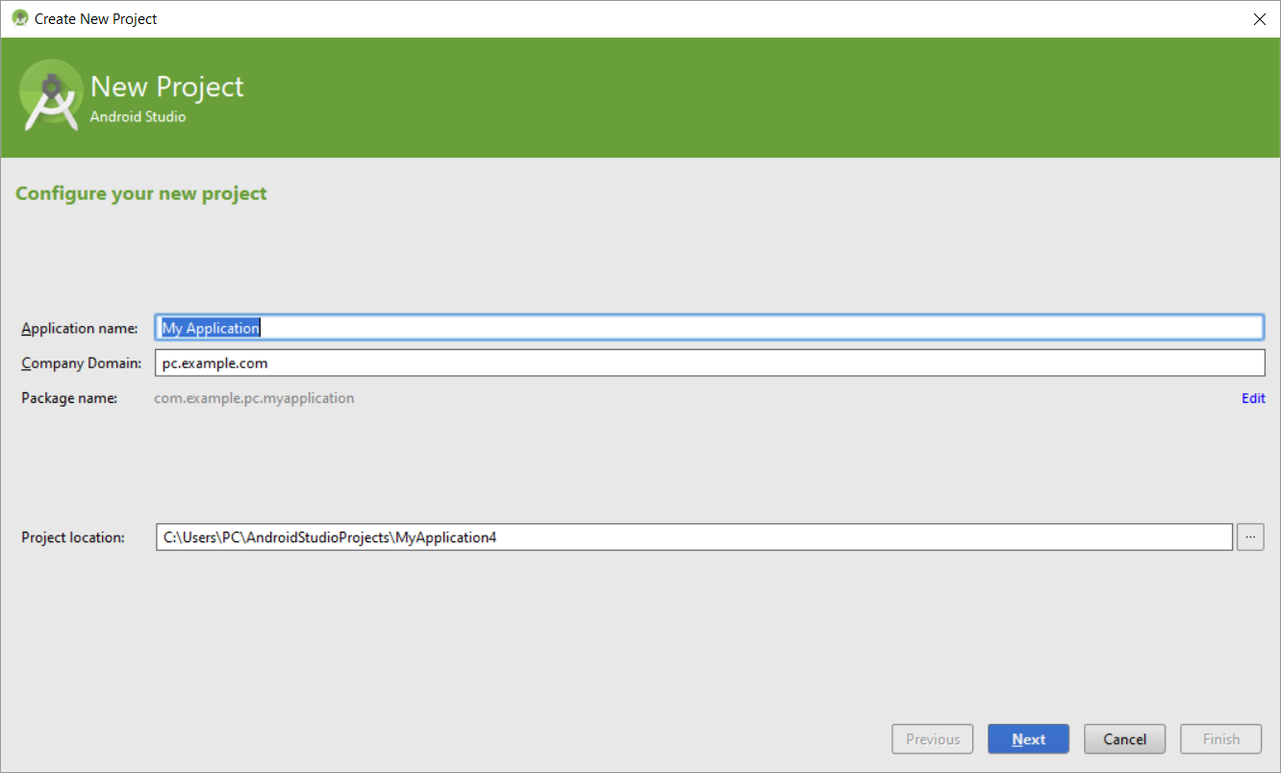

Slide 7
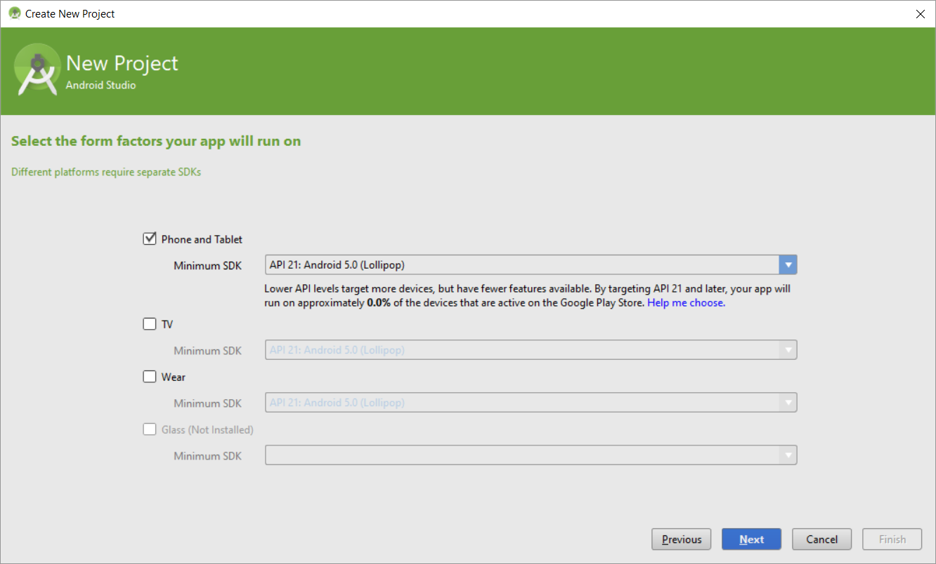

Slide 8
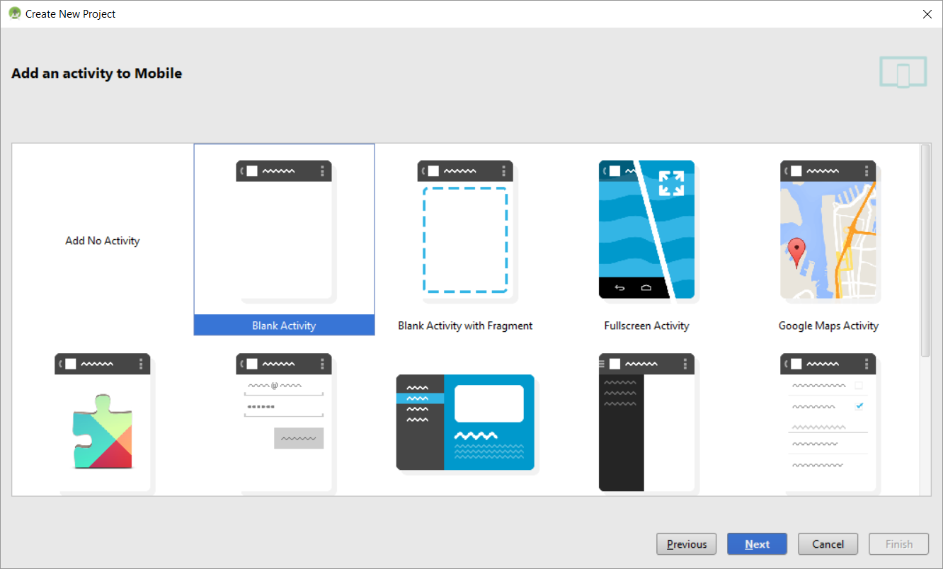

Slide 9
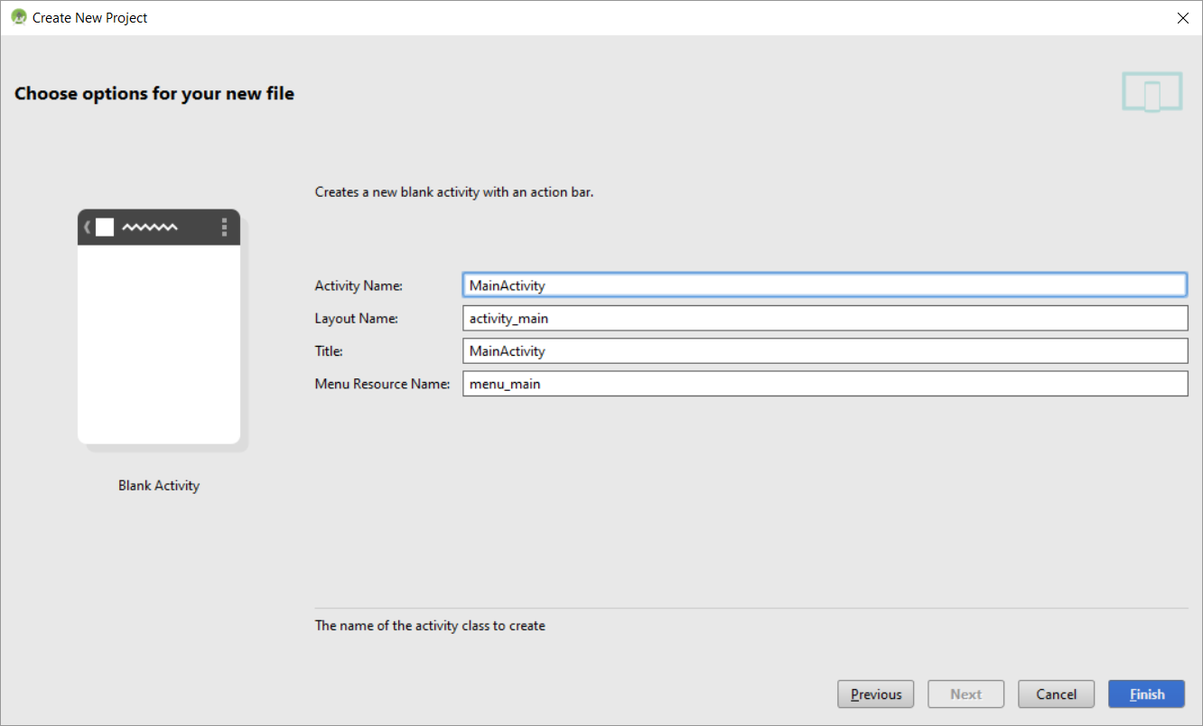

Slide 10
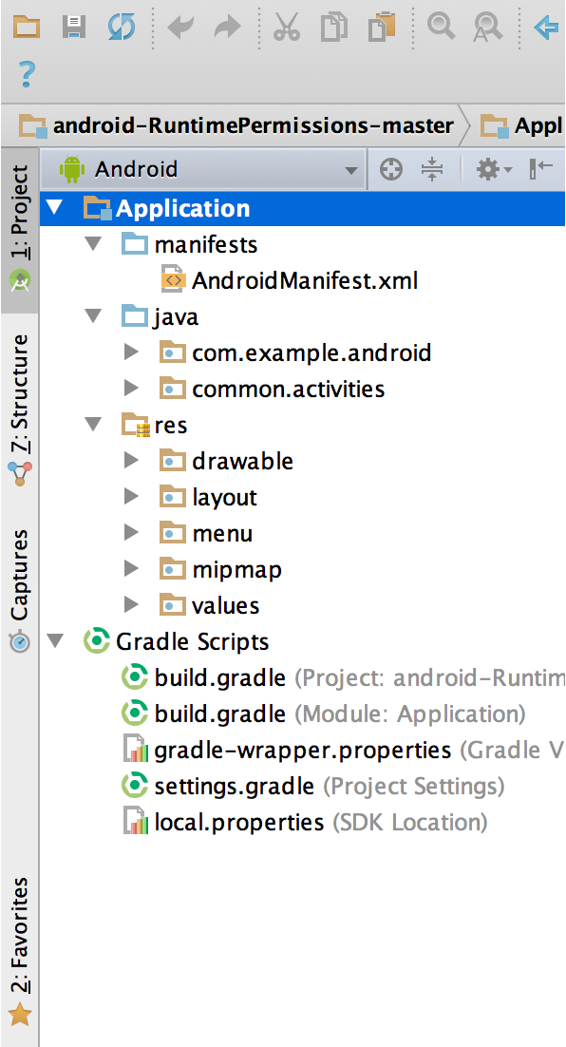
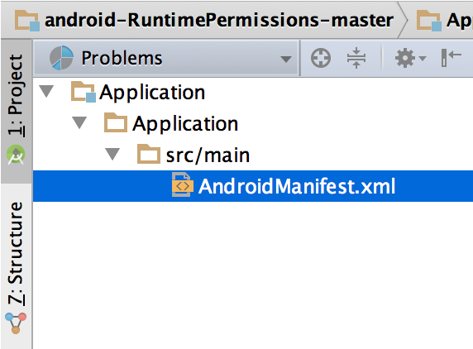
Project Structure
Each project in Android Studio contains one or more modules with source code files and resource files. Types of modules include:
Android app modules
Library modules
Google App Engine modules
By default, Android Studio displays your project files in the Android project view, as shown in figure 1. This view is organized by modules to provide quick access to your project's key source files.
All the build files are visible at the top level under Gradle Scripts and each app module contains the following folders:
manifests: Contains the AndroidManifest.xml file.
java: Contains the Java source code files, including JUnit test code.
res: Contains all non-code resources, such as XML layouts, UI strings, and bitmap images.
The Android project structure on disk differs from this flattened representation. To see the actual file structure of the project, select Project from the Project dropdown (in figure 1, it's showing asAndroid).
You can also customize the view of the project files to focus on specific aspects of your app development. For example, selecting the Problems view of your project displays links to the source files containing any recognized coding and syntax errors, such as a missing XML element closing tag in a layout file.

Slide 11
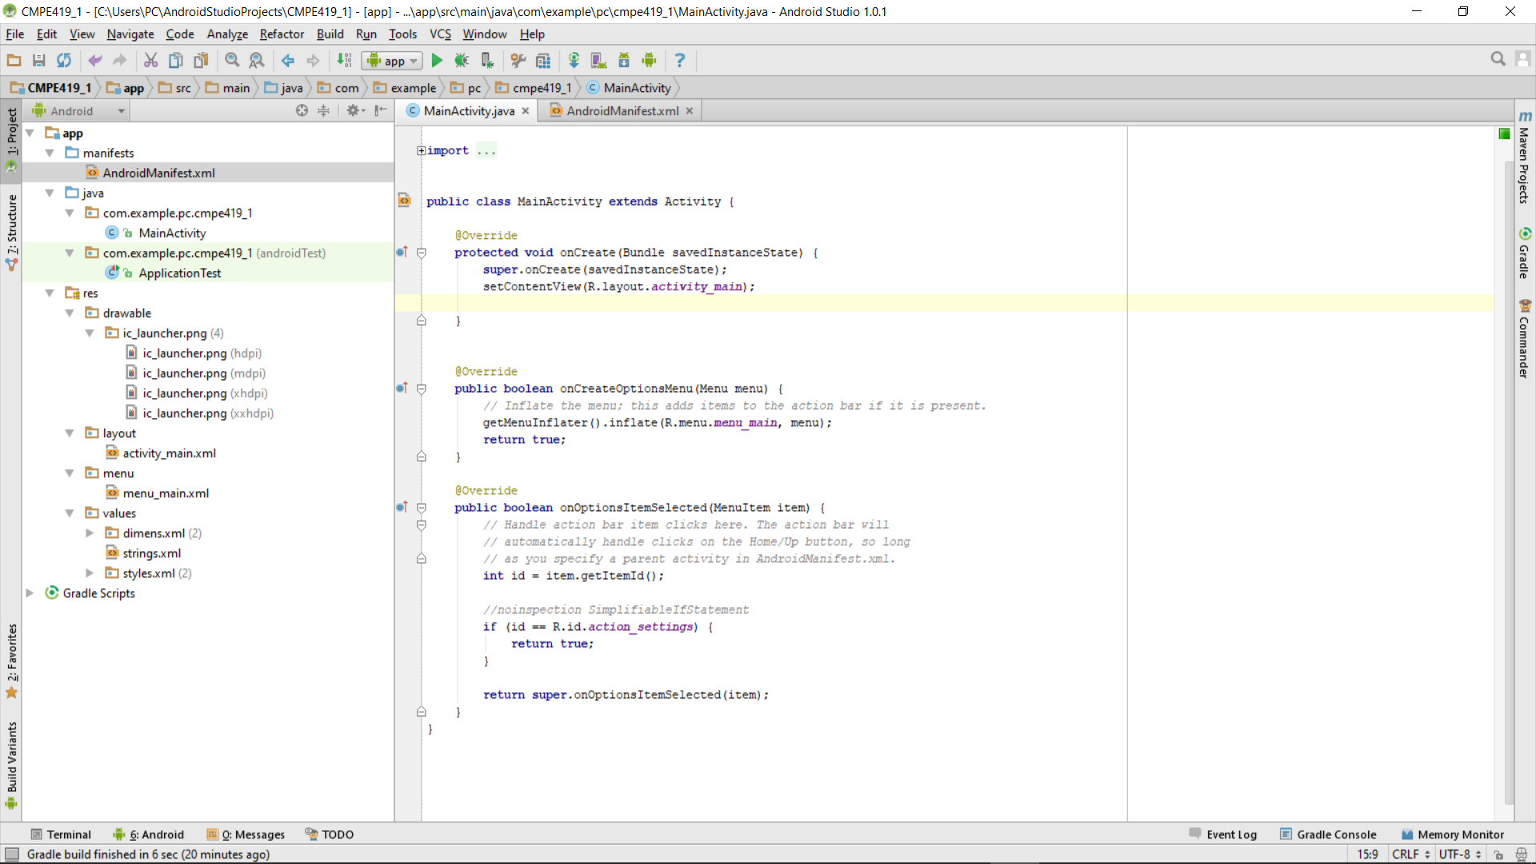
All source code here (packages and activities)
Java code for our activity
All non-code
resources
Images
Layout of the activity
Strings used in the
program
Android Manifest

Slide 12
The AndroidManifest.xml file
The AndroidManifest.xml file provides metadata about your application that the Android OS will need to run the app properly. The name of the application, used for both the app icon and the activity titlebar, and the app icon are defined under Application Attributes.
You will notice that the Name field doesn't actually contain the name text, but "@string/app_name" instead.
This is a string reference and can be used anytime a string is expected. The actual string text is then defined in one of the XML files found under the res/values folder. The app creation wizard generated a file there called strings.xml.
The Application Nodes section is where all the activities are defined for the application. Our app's single activity is called MainActivity and listed here.

Slide 13
Java Code
package com.example.pc.cmpe419_1;
import android.app.Activity;
import android.os.Bundle;
import android.view.Menu;
import android.view.MenuItem;
public class MainActivity extends Activity {
@Override
protected void onCreate(Bundle savedInstanceState) {
super.onCreate(savedInstanceState);
setContentView(R.layout.activity_main);
}
@Override
public boolean onCreateOptionsMenu(Menu menu) {
// Inflate the menu; this adds items to the action bar if it is present.
getMenuInflater().inflate(R.menu.menu_main, menu);
return true;
}
@Override
public boolean onOptionsItemSelected(MenuItem item) {
// Handle action bar item clicks here. The action bar will
// automatically handle clicks on the Home/Up button, so long
// as you specify a parent activity in AndroidManifest.xml.
int id = item.getItemId();
//noinspection SimplifiableIfStatement
if (id == R.id.action_settings) {
return true;
}
return super.onOptionsItemSelected(item);
}
}

Slide 14
XML files Activiti_main.xml
<RelativeLayout xmlns:android="http://schemas.android.com/apk/res/android"
xmlns:tools="http://schemas.android.com/tools"
android:layout_width="match_parent"
android:layout_height="match_parent"
android:paddingBottom="@dimen/activity_vertical_margin"
android:paddingLeft="@dimen/activity_horizontal_margin"
android:paddingRight="@dimen/activity_horizontal_margin"
android:paddingTop="@dimen/activity_vertical_margin"
tools:context="com.example.helloworld.HelloMainActivity" >
<TextView
android:layout_width="wrap_content"
android:layout_height="wrap_content"
android:text="@string/hello_world" />
</RelativeLayout>

Slide 15
String.xml
<?xml version="1.0" encoding="utf-8"?>
<resources>
<string name="app_name">HelloWorld</string>
<string name="hello_world">Hello world!</string>
</resources>

Slide 17
androidmanifest.xml
<?xml version="1.0" encoding="utf-8"?>
<manifest xmlns:android="http://schemas.android.com/apk/res/android"
package="com.example.helloworld"
android:versionCode="1"
android:versionName="1.0" >
<uses-sdk
android:minSdkVersion="8"
android:targetSdkVersion="21" />
<application
android:allowBackup="true"
android:icon="@drawable/ic_launcher"
android:label="@string/app_name"
android:theme="@style/AppTheme" >
<activity
android:name=".MainActivity"
android:label="@string/app_name" >
<intent-filter>
<action android:name="android.intent.action.MAIN" />
<category android:name="android.intent.category.LAUNCHER" />
</intent-filter>
</activity>
</application>
</manifest>

Slide 18
With application name
package com.example.helloworld;
import android.os.Bundle;
import android.support.v7.app.ActionBarActivity;
public class HelloMainActivity extends ActionBarActivity {
@Override
protected void onCreate(Bundle savedInstanceState) {
super.onCreate(savedInstanceState);
setContentView(R.layout.activity_hello_main);
}
}

Slide 20
Import an existing project
To import an existing project into Android Studio, proceed as follows:
Click File > New > Import Project.
In the Select Eclipse or Gradle Project to Import window that appears, navigate to the root directory of the project you want to import.
Click OK.
Android Studio then opens the project in a new IDE window.
If you are importing a project from version control, use the File > New > Project from Version Control menu. For more information about importing projects from version control, read IntelliJ’s VCS-Specific Procedures.
If you are importing an existing Eclipse ADT project into Android Studio, how you add the project depends on its structure. To read more about importing projects from Eclipse, see Migrate to Android Studio from Eclipse.

Slide 21
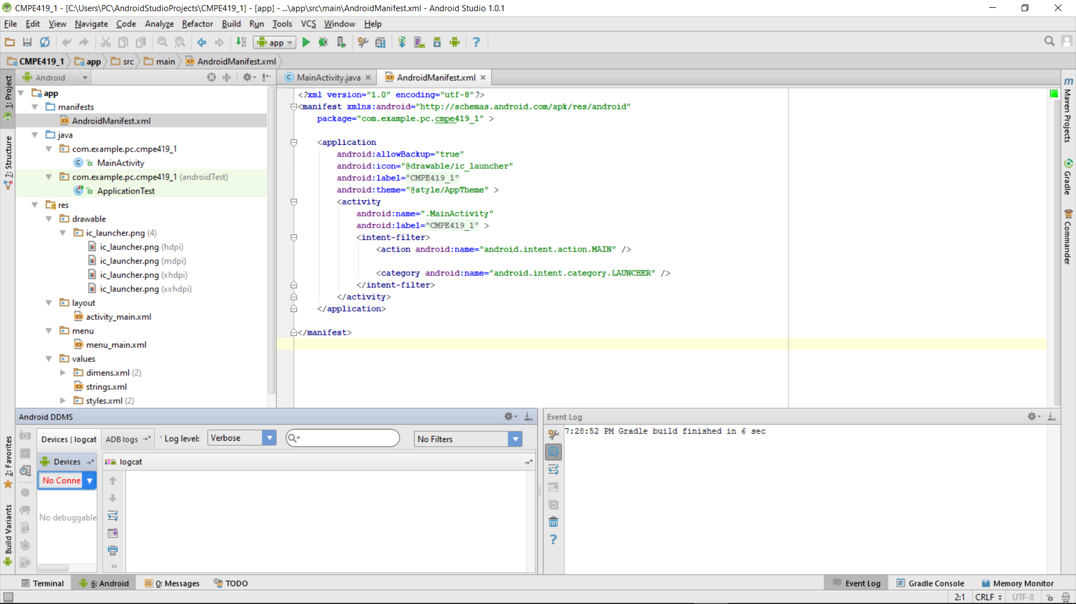
Write and View Logs with Logcat
The Logcat window in Android Studio displays system messages, such as when a garbage collection occurs, and messages that you added to your app with the Log class. It displays messages in real time and keeps a history so you can view older messages.

Slide 22
Write log messages
The Log class allows you to create log messages that appear in logcat. Generally, you should use the following log methods, listed in order from the highest to lowest priority (or, least to most verbose):
Log.e(String, String) (error)
Log.w(String, String) (warning)
Log.i(String, String) (information)
Log.d(String, String) (debug)
Log.v(String, String) (verbose)

Slide 23
Examples
Log.i("Hi", "Internet connection created");
Log.w("OOps", "Password wrong");
public void onCreate(Bundle savedInstanceState){ super.onCreate(savedInstanceState); setContentView(R.layout.activity_main); Log.i("LogHi", "Your first program.");
try { int c = 7 / 0;
} catch (Exception err) {
Log.e("LogHi", «Serrious error: " + err.getLocalizedMessage()); } }

Slide 24
Activity
An activity is a single, focused thing that the user can do. Almost all activities interact with the user, so the Activity class takes care of creating a window for you in which you can place your UI with setContentView(View). While activities are often presented to the user as full-screen windows, they can also be used in other ways: as floating windows (via a theme with windowIsFloating set) or embedded inside of another activity (using ActivityGroup). There are two methods almost all subclasses of Activity will implement:
onCreate(Bundle) is where you initialize your activity. Most importantly, here you will usually call setContentView(int) with a layout resource defining your UI, and using findViewById(int) to retrieve the widgets in that UI that you need to interact with programmatically.
onPause() is where you deal with the user leaving your activity. Most importantly, any changes made by the user should at this point be committed (usually to the ContentProvider holding the data).
To be of use with Context.startActivity(), all activity classes must have a corresponding <activity> declaration in their package's AndroidManifest.xml.

Slide 25
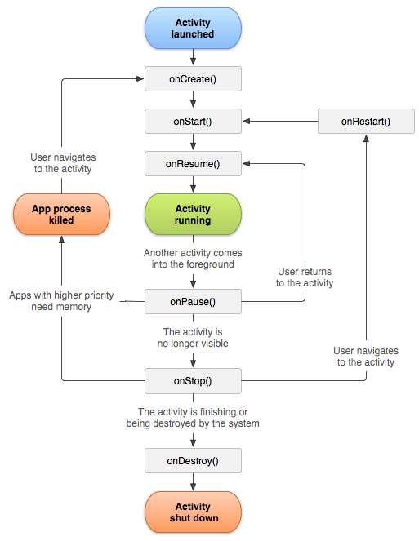
Activity Lifecycle

