Slide 1
Lecture III
Local search & Variable Neighborhood Search
to Guided Local Search

Slide 3
Metaheuristics
Unlike exact methods, metaheuristics allow to tackle large size problem instances by delivering satisfactory solutions in reasonable time.
There is no guarantee to find global optimal solutions.
In designing a metaheuristic, two contradictory criteria must be taken into account:
  exploration of the search space (diversification) and
  exploitation of the best solutions found (intensification).

Slide 4
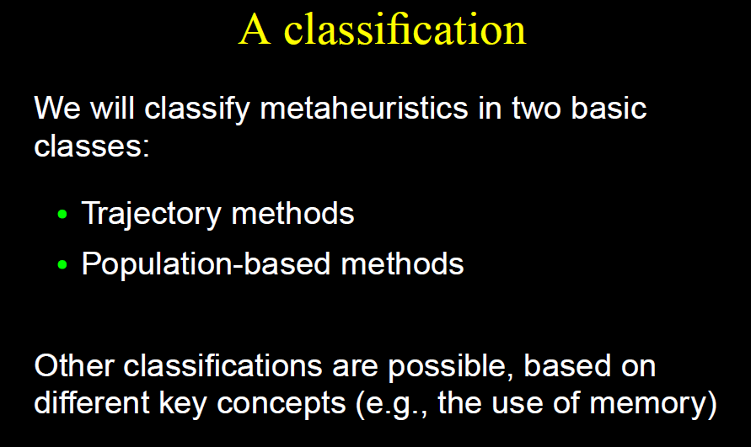
Single-Solution Based Methods

Slide 5
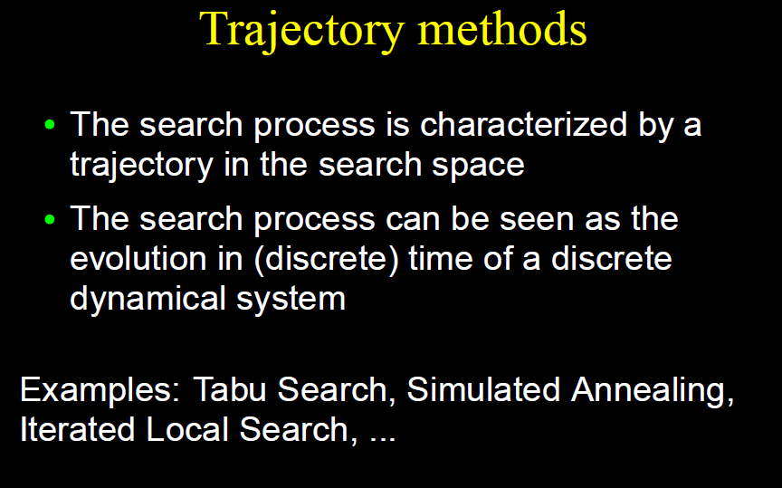

Slide 6
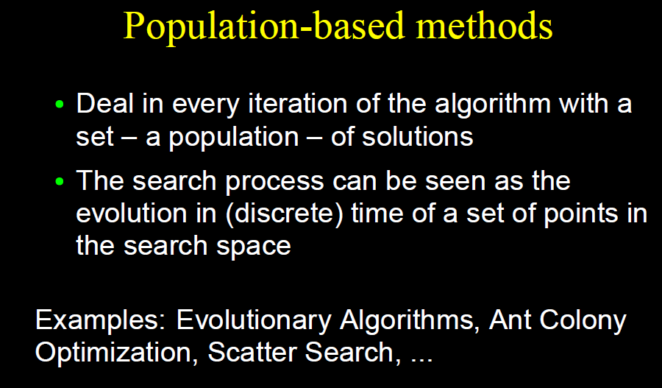

Slide 7
Types of metaheuristics
Nature inspired: Evolutionary algorithms, Simulated annealing.
No memory usage: Local search, GRASP, Simulated annealing.
Memory usage: Tabu search.
Deterministic: Local search, Tabu search.
Stochastic: Simulated annealing, evolutionary algorithms.
Population: Evolutionary algorithms.
Single solution: Local search, Simulated annealing.
Iterative: Starts with a (or a set of) complete solutions and transform it over time.
Greedy: Starts with an empty solution and a complete solution is built over time.

Slide 8
Main common concepts for metaheuristics
All iterative metaheuristics needs a representation of solutions handled by the algorithm and a definition of the objective function.
Representation
The representation must have the following characteristics:
Completeness: All solutions of the problem must be represented.
Connexity: A search path must exist between any two solutions.
Efficiency: The representation must be easy to manipulate by the algorithm.

Slide 9
Some common representations of classical problems are:
Binary encoding: 1001001101111, Knapsack problems
Vector of discrete values: (3, 5, 1, 7, 3), Assignment problems
Vector of real values: (2.5, 4.5, 1.0, 1.7, 3.3), Cont. opt.
Permutation: A–D–B–C–G–F–I–H–E, TSP

Slide 10





Single-Solution Based Metaheuristics(S-metaheuristics / Trajectory)
Improve a single solution
  walk though neighborhoods by performing iterative procedures that move from the current solution to another one in the search space
Have two iterative phases:
  Generation phase
  Replacement phase

Slide 11
Definition: Neighborhood
Local Search / Neighborhood Search
Let (S,f) be a COP-instance
A neighborhood function is a mapping from a solution to the set of possible solutions, reached by a move.
For a given solution , N defines a neighborhood of solutions, , that in some sense is ”near” to
is then a ”neighbor” of

Slide 12
Neighborhood Operator
Neighborhoods are most often defined by a given operation on a solution
Often simple operations
  Remove an element
  Add an element
  Interchange two or more elements of a solution
Several neighborhoods – qualify with an operator

Slide 13
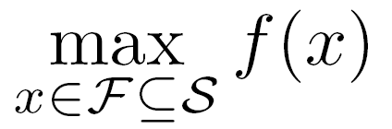
Terminology: Optima (1)
Assume we want to solve
Let x be our current (incumbent) solution in a local search
If f(x) ≥ f(y) for all y in F, then we say that x is a global optimum (of f)

Slide 14
Terminology: Optima (2)
Further assume that N is a neighborhood operator, so that N(x) is the set of neighbors of x
If f(x) ≥ f(y) for all y in N(x), then we say that x is a local optimum (of f, with respect to the neighborhood operator N)
Note that all global optima are also local optima (with respect to any neigborhood)

Slide 15

Neighborhood examples:
An example of neighborhood for a permutation problem of size 3.
For instance, the neighbors of the solution (2, 3, 1) are
(3, 2, 1), (2, 1, 3), and (1, 3, 2).

Slide 16
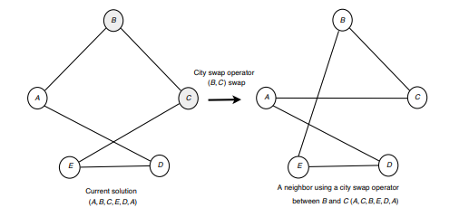
City swap operator for the TSP

Slide 17
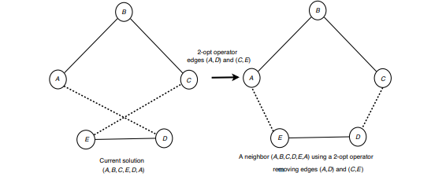
2-opt operator for the TSP

Slide 18
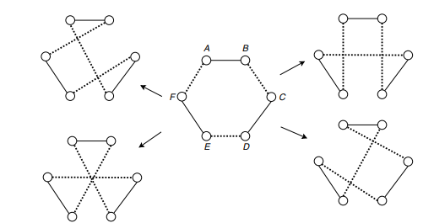
3-opt operator for the TSP. The neighbors of the solution (A,B,C,D,E,F ) are
(A,B,F,E,C,D), (A,B,D,C,F,E), (A,B,E,F,C,D), and (A,B,E,F,D,C).

Slide 19



Some other operators:
Insertion operator.
Exchange operator
Inversion operator

Slide 20
Local Search / Neighborhood Search (1)
Start with an initial solution
Iteratively search in the neighborhood for better solutions
Sequense of solutions
Strategy for which solution in the neighborhood that will be accepted as the next solution
Stopping Criteria
What happens when the neighborhood does not contain a better solution?
…

Slide 21
Local Search / Neighborhood Search (2)
We remember what a local optimum is:
  If a solution x is ”better” than all the solutions in its neighborhood, N(x), we say that x is a local optimum
  We note that local optimality is defined relative to a particular neighborhood
Let us denote by S_{N} the set of local optima
  S_{N} is relative to N
If S_{N} only contains global optima, we say that N is exact

Slide 22
Local Search / Neighborhood Search (3)
Heuristic method
Iterative method
Small changes to a given solution
Alternative search strategies:
  Accept first improving solution (”First Accept”)
  Search the full neighborhood and go to the best improving solution
    ”Steepest Descent”
    ”Hill Climbing”
    ”Iterative Improvement”
Strategies with randomization
  Random neighborhood search (”Random Walk”)
  ”Random Descent”

Slide 23
Local Search / Neighborhood Search (4)
In a local search need the following:
a Combinatorial Optimization Problem (COP)
a starting solution (e.g. random)
a defined search neighborhood (neighboring solutions)
a move (e.g. changing a variable from 0 → 1
or 1 → 0), going from one solution to a neighboring solution
a move evaluation function – a rating of the possibilities
  Often myopic
a neighborhood evaluation strategy
a move selection strategy
a stopping criterion – e.g. a local optimum

Slide 24
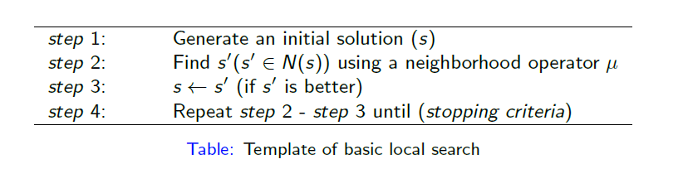
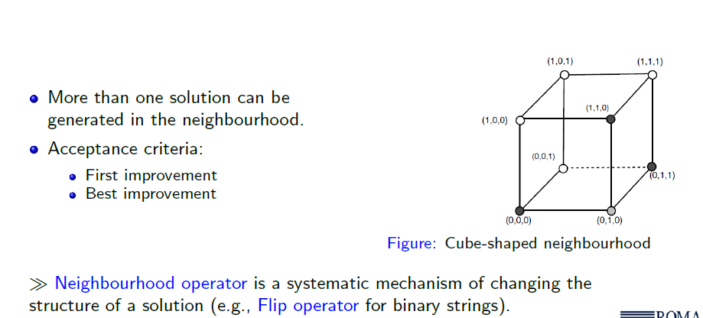

Slide 25
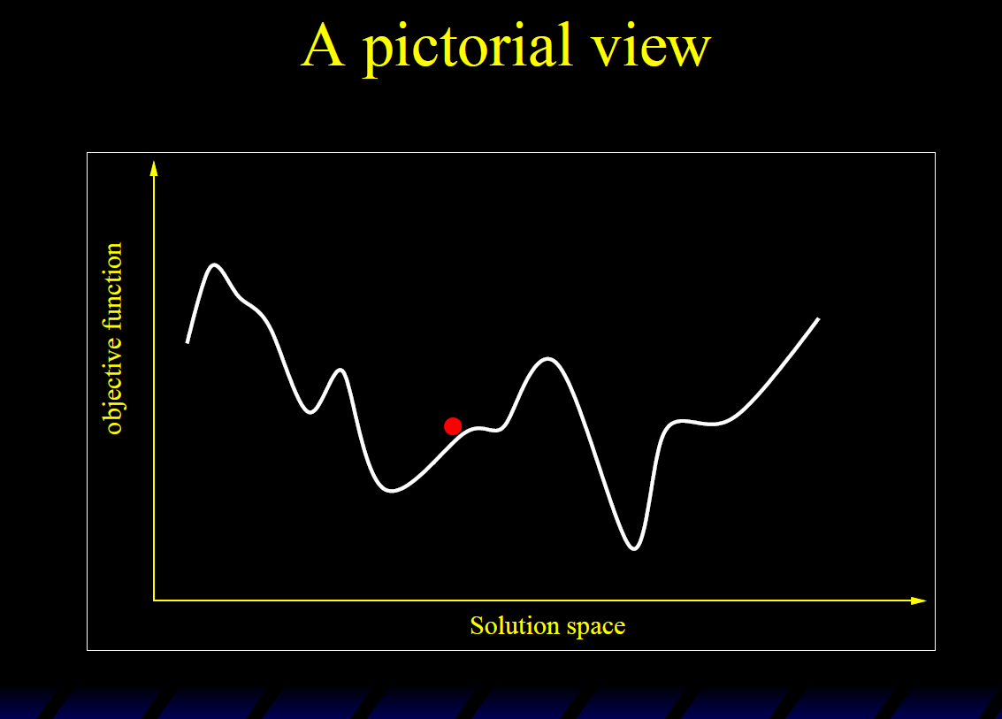
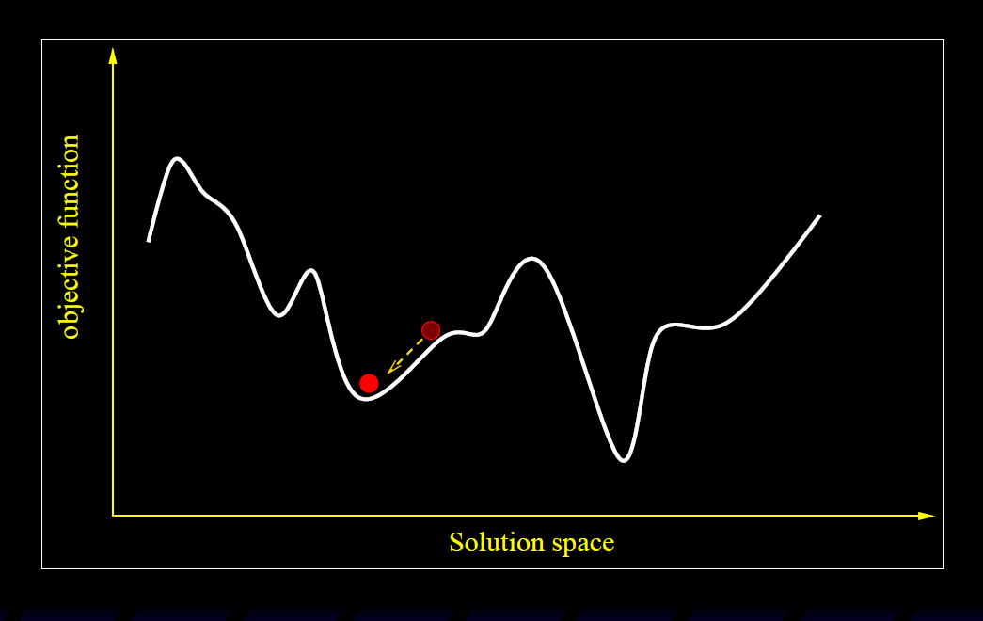
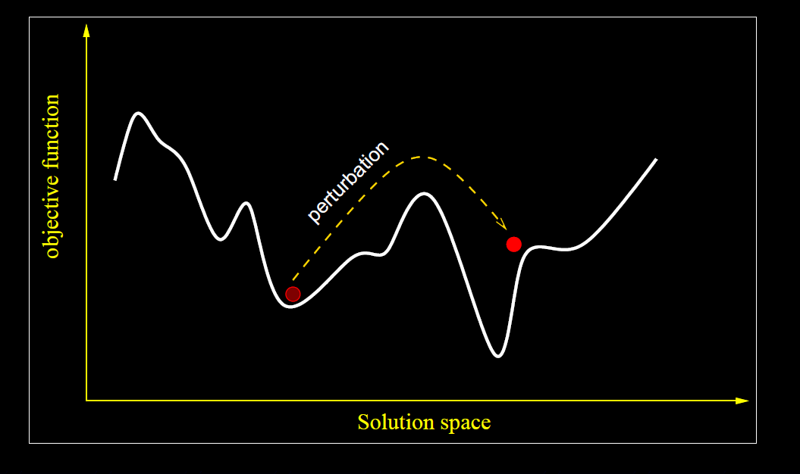
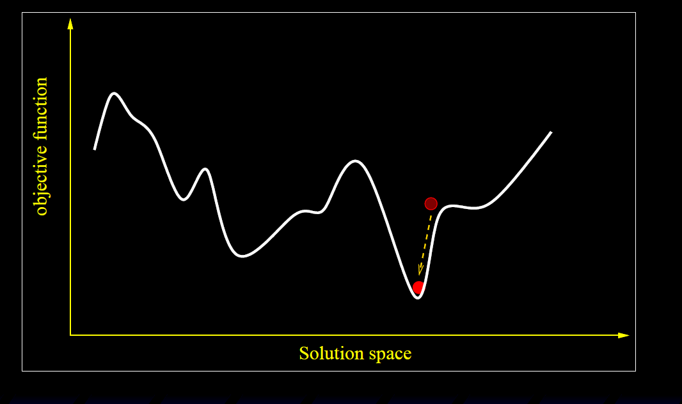

Slide 26
Selection of the Neighbor
Best improvement (steepest descent):
  In this strategy, the best neighbor (i.e., neighbor that improves the most the cost function) is selected.
  The neighborhood is evaluated in a fully deterministic manner. Hence, the exploration of the neighborhood is exhaustive, and all possible moves are tried for a solution to select the best neighboring solution. This type of exploration may be time-consuming for large neighborhoods
First improvement:
  This strategy consists in choosing the first improving neighbor that is better than the current solution. Then, an improving neighbor is immediately selected to replace the current solution.
  This strategy involves a partial evaluation of the neighborhood. In a cyclic exploration, the neighborhood is evaluated in a deterministic way following a given order of generating the neighbors. In the worst case (i.e., when no improvement is found), a complete evaluation of the neighborhood is performed.
Random selection: In this strategy, a random selection is applied to those neighbors improving the current solution.

Slide 27
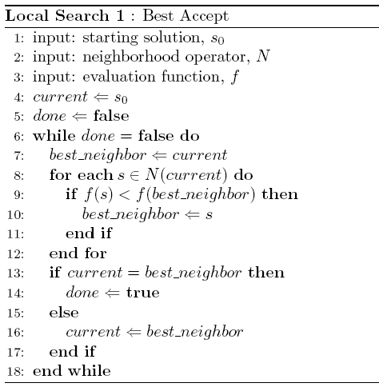

Slide 28
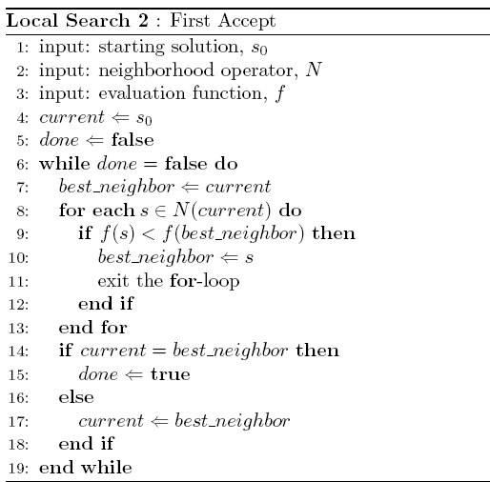

Slide 29
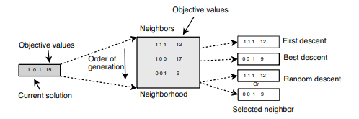
Selection strategies of improving neighbors

Slide 30
Observations
”Best Accept” and ”First Accept” stops in a local optimum
If the neighborhood N is exact, then the local search is an exact optimization algorithm
Local Search can be regarded as a traversal in a directed graph (the neighborhood graph), where the nodes are the members of S, and N defines the topolopy (the nodes are marked with the solution value), and f defines the ”topography”

Slide 31
Local Search: Traversal of the Neighborhood Graph
…
A move is the process of selecting a given solution in the
neighborhood of the current solution to be the current solution for the next iteration

Slide 32
Local and Global Optima
Solution value
Solution space

Slide 33
Example: The Knapsack Problem
n items {1,...,n} available, weight a_{i} profit c_{i}
A selection of the items shall be packed in a knapsack with capasity b
Find the items that maximizes the profit

Slide 34
Example (cont.)
The search space is the set of solutions
Feasibility is with respect to the constraint set
Evaluation is with respect to the objective function

Slide 35
Search Space
xxxx ⇒ Solution
Obj. Fun. Value
The search space is the set of solutions
0000
0100
1000
1100
0
11
5
16
0001
0101
1001
1101
7
18
12
23
0010
0110
1010
1110
9
20
14
25
0011
0111
1011
1111
16
27
21
32

Slide 36
Feasible/Infeasible Space
Infeasible
0000
0100
1000
1100
0
11
5
16
0001
0101
1001
1101
7
18
12
23
0010
0110
1010
1110
9
20
14
25
0011
0111
1011
1111
16
27
21
32

Slide 37
Add - Neighborhood
Current Solution
Neighbors
0000
0100
1000
1100
0
11
5
16
0001
0101
1001
1101
7
18
12
23
0010
0110
1010
1110
9
20
14
25
0011
0111
1011
1111
16
27
21
32

Slide 38
Flip Neighborhood
Current Solution
Neighbors
0000
0100
1000
1100
0
11
5
16
0001
0101
1001
1101
7
18
12
23
0010
0110
1010
1110
9
20
14
25
0011
0111
1011
1111
16
27
21
32

Slide 39
Local Search Methods:
Iterated local search
Variable neighbourhoods
  Variable neighbourhood decent
  Variable neighbourhood search
Guided local search
GRASP
Large neighbourhood search
Simulated annealing algorithm

Slide 40
Iterated Local Search (1)
We can look at a Local Search (using ”Best Improvement”-strategy) as a function
  Input: a solution
  Output: a solution
  LS: S → S
  The set of local optima (with respect to the neighborhood used) equals the range of the function
Applying the function to a solution returns a locally optimal solution (possibly the same as the input)

Slide 41
Iterated Local Search (2)
A simple algorithm (Multi-start Local Search):
  Pick a random starting solution
  Perform Local Search
  Repeat (record the best local optimum encountered)
Generates multiple independent local optima
Theoretical guarantee: will encounter the global optimum at some point (due to random starting solution)
Not very efficient: wasted iterations

Slide 42
Iterated Local Search (3)
Iterated Local Search tries to benefit by restarting close to a currently selected local optimum
  Possibly quicker convergence to the next local optimum (already quite close to a good solution)
  Has potential to avoid unnecessary iterations in the Local Search loop, or even unnecessary complete restarts
    Uses information from current solution when starting another Local Search

Slide 43
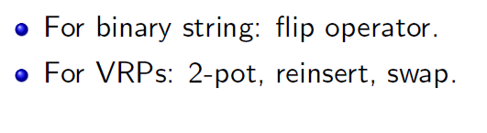
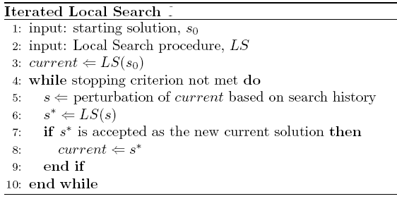
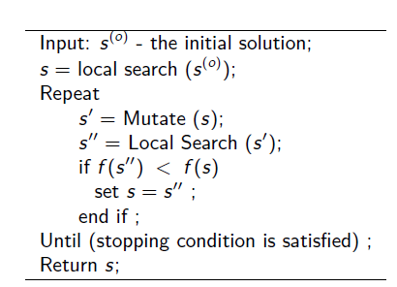

Slide 44
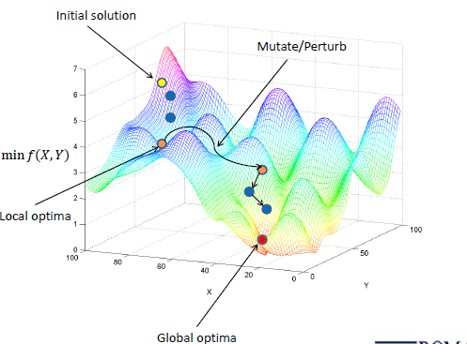
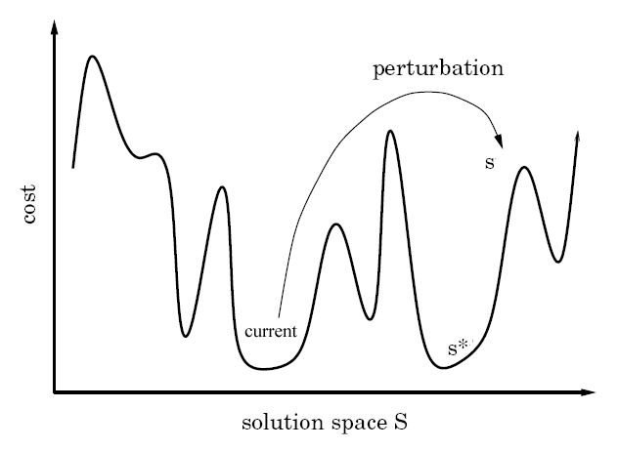
Pictorial Illustration of ILS

Slide 45
Principle of Iterated Local Search
The Local Search algorithm defines a set of locally optimal solutions
The Iterated Local Search metaheuristic searches among these solutions, rather than in the complete solution space
  The search space of the ILS is the set of local optima
  The search space of the LS is the solution space (or a suitable subspace thereof)

Slide 46
A Basic Iterated Local Search
Initial solution:
  Random solution
  Construction heuristic
Local Search:
  Usually readily available (given some problem, someone has already designed a local search, or it is not too difficult to do so)
Perturbation:
  A random move in a ”higher order neighborhood”
  If returning to the same solution (s*=current), then increase the strength of the perturbation?
Acceptance:
  Move only to a better local optimum

Slide 47
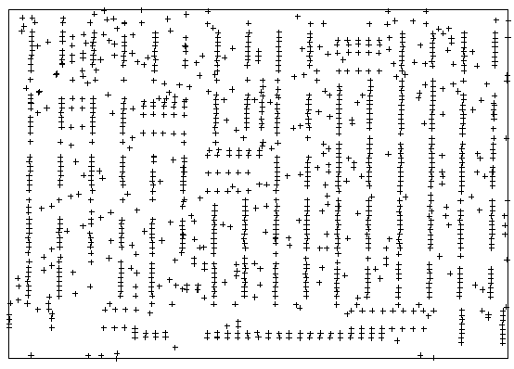
ILS Example: TSP (1)
Given:
  Fully connected, weighted graph
Find:
  Shorted cycle through all nodes
Difficulty:
  NP-hard
Interest:
  Standard benchmark problem
(Example stolen from slides by Thomas Stützle)

Slide 48
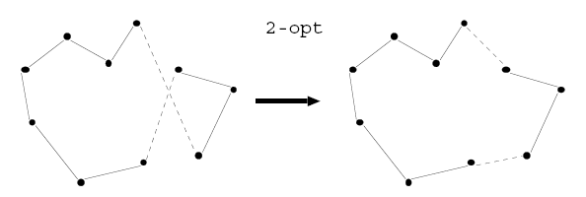
ILS Example: TSP (2)
Initial solution: greedy heuristic
Local Search: 2-opt
Perturbation: double-bridge move (a specific 4-opt move)
Acceptance criterion: accept s* if f(s*) ≤ f(current)

Slide 49
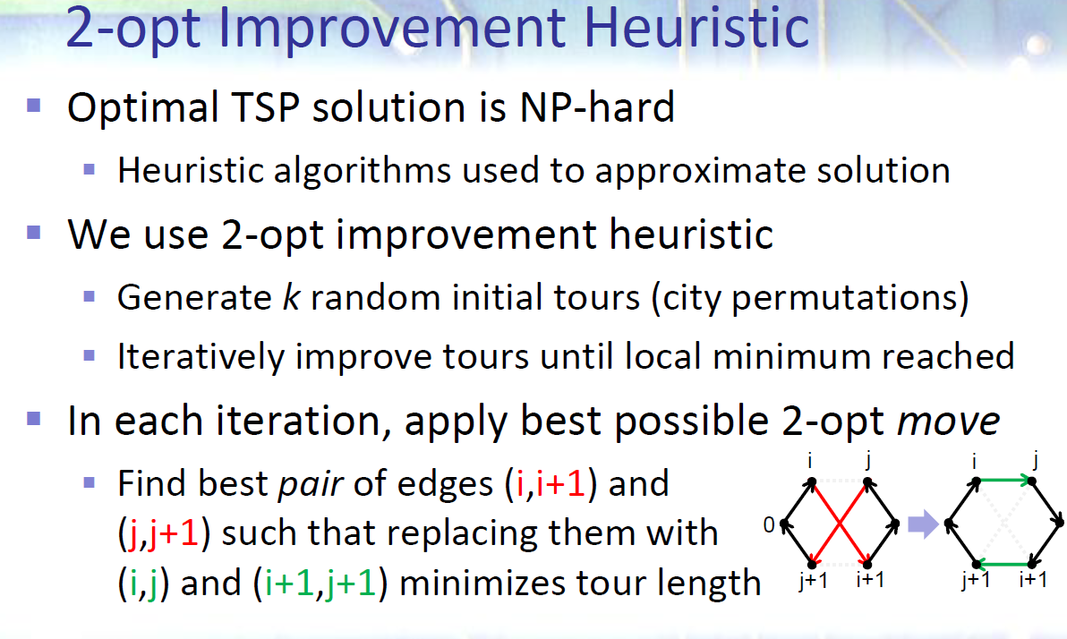

Slide 50
2-opt Exchange

Slide 51
2-opt Exchange

Slide 52
2-opt Exchange

Slide 53
2-opt Exchange

Slide 54
2-opt Exchange

Slide 55
2-opt Exchange

Slide 56
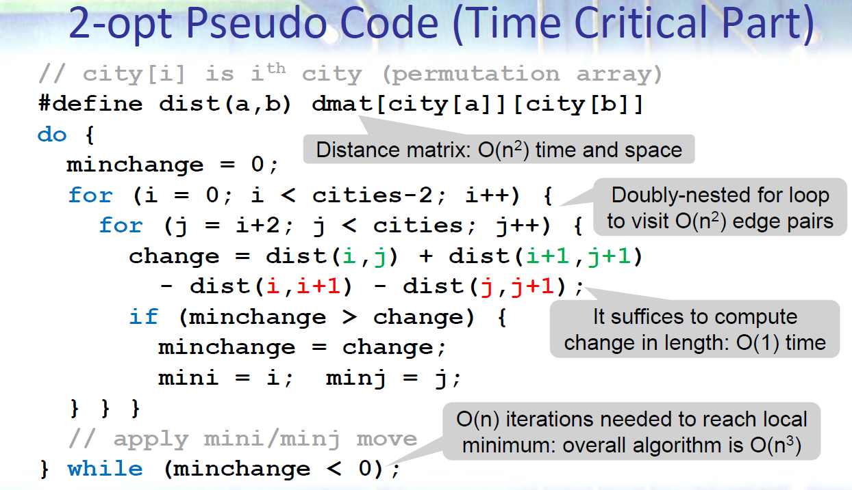

Slide 57
3-opt exchange
Select three arcs
Replace with three others
2 orientations possible

Slide 58
3-opt exchange

Slide 59
3-opt exchange

Slide 60
3-opt exchange

Slide 61
3-opt exchange

Slide 62
3-opt exchange

Slide 63
3-opt exchange

Slide 64
3-opt exchange

Slide 65
3-opt exchange

Slide 66
3-opt exchange

Slide 67
3-opt exchange

Slide 68
3-opt exchange

Slide 69
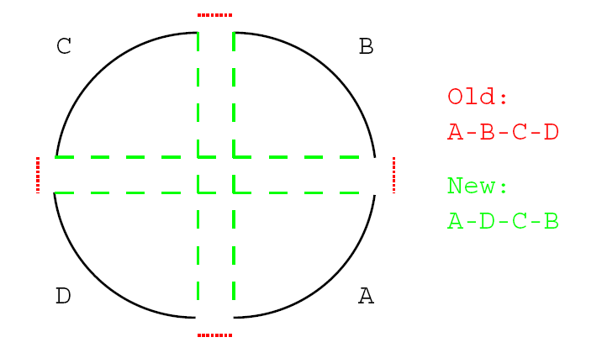
ILS Example: TSP (3)
Double-bridge move for TSP:

Slide 70
About Perturbations
The strength of the perturbation is important
  Too strong: close to random restart
  Too weak: Local Search may undo perturbation
The strength of the perturbation may vary at run-time
The perturbation should be complementary to the Local Search
  E.g., 2-opt and Double-bridge moves for TSP

Slide 71
About the Acceptance Criterion
Many variations:
  Accept s* only if f(s*)<f(current)
    Extreme intensification
    Random Descent in space of local optima
  Accept s* always
    Extreme diversification
    Random Walk in space of local optima
  Intermediate choices possible
For TSP: high quality solutions known to cluster
  A good strategy would incorporate intensification

Slide 72
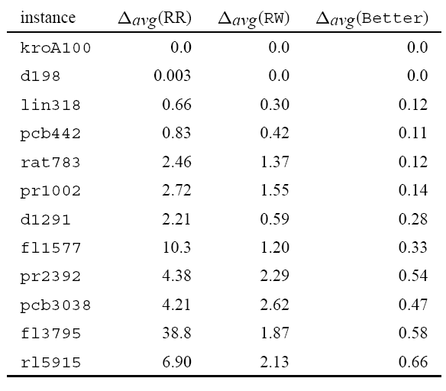
ILS Example: TSP (4)
Δ_{avg}(x) = average deviation from optimum for method x
RR: random restart
RW: ILS with random walk as acceptance criterion
Better: ILS with First Improvement as acceptance criterion

Slide 73
ILS: The Local Search
The Local Search used in the Iterated Local Search metaheuristic can be handled as a ”Black Box”
  If we have any improvement method, we can use this as our Local Search and focus on the other parts of the ILS
  Often though: a good Local Search gives a good ILS
Can use very complex improvement methods, even such as other metaheuristics (e.g., SA)

Slide 74
Guidelines for ILS
The starting solution should to a large extent be irrelevant for longer runs
The Local Search should be as effective and fast as possible
The best choice of perturbation may depend strongly on the Local Search
The best choice of acceptance criterion depends strongly on the perturbation and Local Search
Particularly important: the interaction among perturbation strength and the acceptance criterion

Slide 75
A Comment About ILS and Metaheuristics
After seeing Iterated Local Search, it is perhaps easier to understand what a metaheuristic is
ILS required that we have a Local Search algorithm to begin with
  When a local optimum is reached, we perturb the solution in order to escape from the local optimum
  We control the perturbation to get good behaviour: finding an improved local optimum
ILS ”controls” the Local Search, working as a ”meta”-heuristic (the Local Search is the underlying heuristic)
  Meta- in the meaning ”more comprehensive”; ”transcending”

Slide 76
Advantages of Local Search
For many problems, it is quite easy to design a local search (i.e., LS can be applied to almost any problem)
The idea of improving a solution by making small changes is easy to understand
The use of neigborhoods sometimes makes the optimal solution seem ”close”, e.g.:
  A knapsack has n items
  The search space has 2^{n} members
  From any solution, no more than n flips are required to reach an optimal solution!

Slide 77
Disadvantages of Local Search
The search stops when no improvement can be found
Restarting the search might help, but is often not very effective in itself
Some neighborhoods can become very large (time consuming to examine all the neighbors)

Slide 78
Main Challenge in Local Search
How can we avoid the search stopping in a local optimum?

Slide 79

Metaheuristics and Local Search
In Local Search, we iteratively improve a solution by making small changes until we cannot make further improvements
Metaheuristics can be used to guide a Local Search, and to help it to escape a local optimum
Several metaheuristics are based on Local Search, but the mechanisms to escape local optima vary widely
  We will look at Simulated Annealing and Tabu Search, as well as mention some others

Slide 80
Next Lecture
Variable neighbourhoods
  Variable neighbourhood decent
  Variable neighbourhood search
Guided local search
GRASP
Large neighbourhood search
Tabu Serach
Simulated annealing algorithm

