Slide 1
Lecture IV
Local Search Con.

Slide 2
Outline
Variable neighbourhoods
  Variable neighbourhood decent
  Variable neighbourhood search
Guided local search
GRASP
Large neighbourhood search
Tabu Search
Simulated annealing algorithm

Slide 3
Variable neighborhood Search (VNS)
Based on the following central observations
  A local minimum w.r.t. one neighborhood structure is not necessarily locally minimal w.r.t. another neighborhood structure
  A global minimum is locally optimal w.r.t. all neighborhood structures
  For many problems, local minima with respect to one or several neighborhoods are relatively close to each other

Slide 4
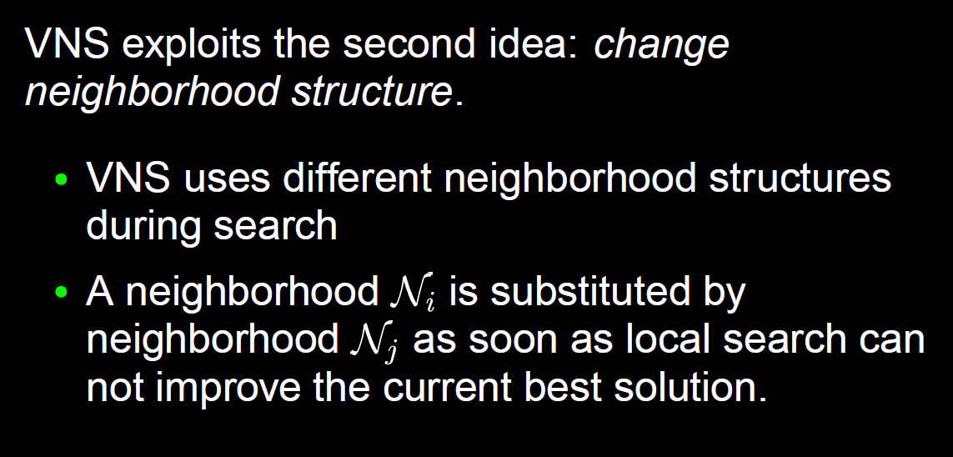
Variable neighborhood Search (VNS)

Slide 5
Variable Neighborhood Search
Basic principle: change the neighborhood during the search
Variations:
  Variable Neighborhood Descent
  Basic Variable Neighborhood Search
  Reduced Variable Neighborhood Search
  Variable Neighborhood Decomposition Search

Slide 6
Variable Neighborhood Search
The first task is to generate the different neighborhood structures
For many problems different neighborhood structures already exists
  E.g., for the VRP: 2-Opt, Cross, Swap, Exchange,…
Find neighborhoods that depend on some parameter
  k-Opt (k=2,3,…)
  Flip-neighborhoods can be extended to double-flip, triple-flip, etc…
Some neighborhoods are associated with distance measures: can increase the distance

Slide 7
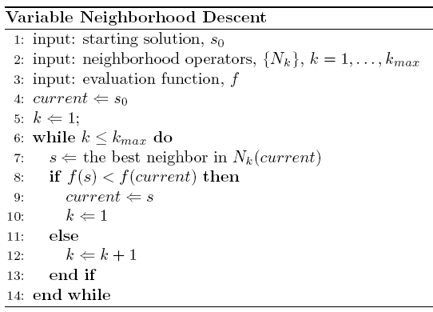

Slide 8
Variable Neighborhood Descent
The final solution is locally optimal with respect to all neighborhoods, N₁, N₂,…, N_{k-max}
”First Improvement” could be used instead of ”Best Improvement”
Typically, neighborhoods are ordered from smallest to largest
If Local Search Algorithms can be treated as Black-Box procedures:
  Sort the procedures
  Apply them in the given order
  Possibly reiterate starting the first one
  Advantage: solution quality and speed

Slide 9
Basic Variable Neighborhood Search
Use neighborhood structures N₁, N₂,…, N_{k-max}
Standard (”Best Improvement”) Local Search is applied in N₁
The other neighborhoods are explored only randomly
Exploration of the other neighborhoods are perturbations as in ILS
  Perturbation is systematically varied

Slide 10
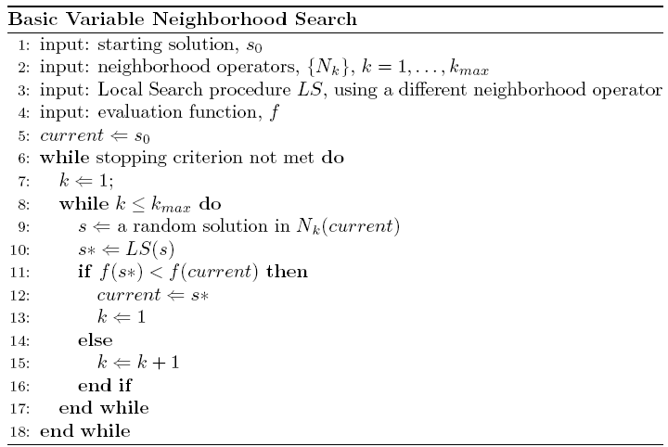
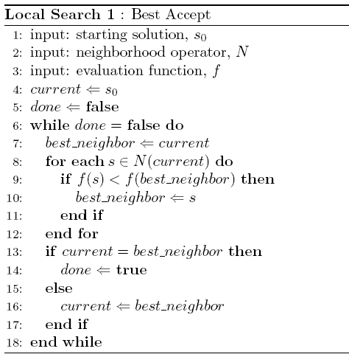

Slide 12
Variations of Basic VNS
The order of the neighborhoods
  Forward VNS: start with k=1 and increase
  Backward VNS: start with k=k_{max} and decrease
  Extended version:
    Parameters k_{min} and k_{step}
    Set k = k_{min}, and increase k by k_{step} if no improvement
Accepting worse solutions
  With some probability
  Skewed VNS: Accept if
    f(s*)-αd(s, s*) < f(s)
    d(s, s*) measures the distance between the solutions

Slide 13
Final Notes on VNS
Other variations exists
  Reduced VNS: same as Basic VNS, but no Local Search procedure
    Can be fast
  Variable Neighborhood Decomposition Search
    Fix some components of the solution, and perform Local Search on the remaining ”free” components

Slide 14
Final Notes on VNS
ILS and VNS are based on different underlying ”philosophies”
  ILS: Perturb and do Local Search
  VNS: Exploit different neighborhoods
ILS and VNS are also similar in many respects
ILS can be more flexible w.r.t. the optimization of the interaction between modules
VNS gives place to approaches such as VND for obtaining more powerful Local Search approaches

Slide 15
Conclusions about ILS and VNS
Based on simple principles
Easy to understand
Basic versions are easy to implement
Robust
Highly effective

Slide 16
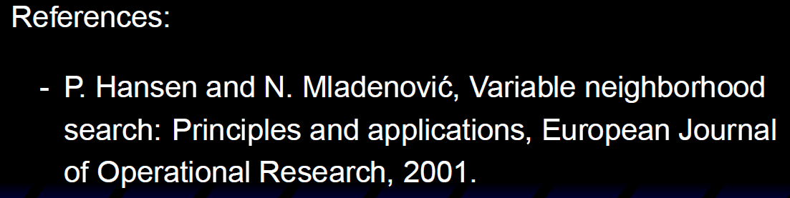

Slide 17
Guided Local Search
A general strategy, metaheuristic, used to guide a neighborhood search
Tries to overcome local optima by ”removing” them:
  Changes the ”topography” of the search space
  Uses an extended move evaluation function
    Original objective function + penalties
Focuses on promising parts of the search space

Slide 18
Features of a Solution
GLS assumes that we can find some features of a solution that we can penalize
What is a ”feature”?
  Something that is characteristic for the solution
  Something that might be different in another solution
  Problem dependent
Examples:
  TSP: whether city A follows immediately after city B in the tour or not
  Knapsack: whether item 5 is included or not

Slide 19
Features - Example: TSP
A solution (trip) is an ordered set of edges
An edge is a good choice for feature:
  Is either in a solution or not
  Feature cost = edge length
Let the set of all edges e_{ij} be features:
The cost for a feature e_{ij} is given by d_{ij} in the distance matrix:
5
2
3
7
1
6
4

Slide 20
Features & GLS
The modification of the move evaluation in GLS is based on features
The features each has a cost
  Represents (directly or indirectly) the influence of a solution on the (extended) move evaluation function
  Constant or variable (dependent on other features)
  GLS tries to avoid costly features
We use an indicator function as follows:
  I_{i}(s) = 1 if solution s has feature i
  I_{i}(s) = 0 if solution s does not have feature i

Slide 21
Extended Move Evaluation (1)
Until now we have only seen the use of the objective function in move evaluations
We let f be the objective function
  f(s) gives us the value of a solution s
We have always taken the best neighbor to be the neighbor s for which f(s) has the best value
This will make the search stop when a local optimum have been found

Slide 22

Extended Move Evaluation (2)
Let the set of features be denoted by
  F = {1,…,G}
We have our indicator function:
  I_{i}(s) = 1 if solution s has feature i
  I_{i}(s) = 0 if solution s does not have feature i
We create a penalty vector p=[p_{i} ], i=1…G
  p_{i} is the number of times feature i have been penalized until now
The extended move evaluation function becomes

Slide 23
Extended Move Evaluation (3)
The extended move evaluation function has two parts
  The original objective function
  A penalty term, which penalizes certain features of the solution
The parameter λ adjusts the influence of the penalties

Slide 24
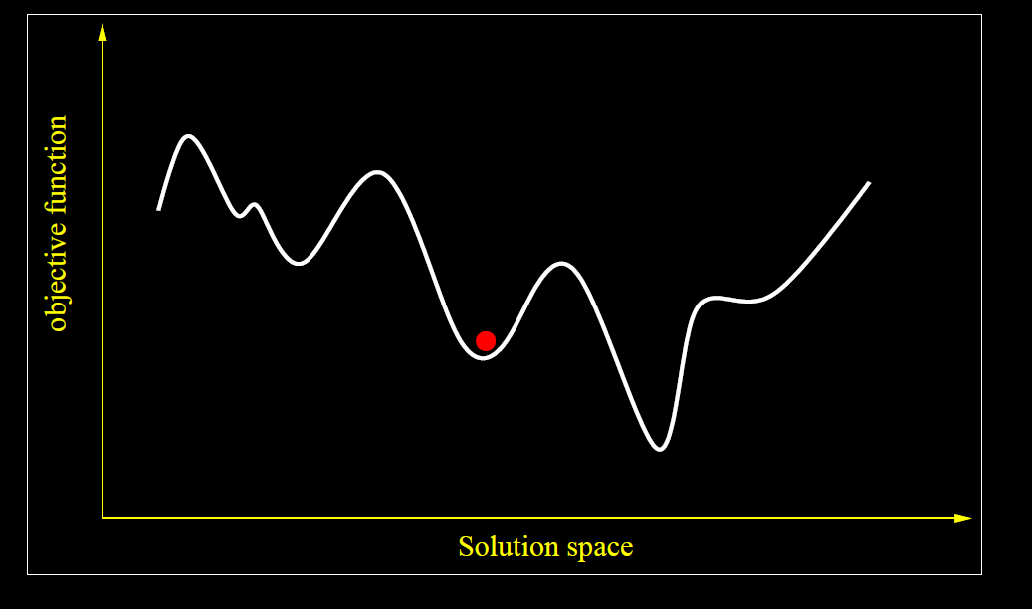
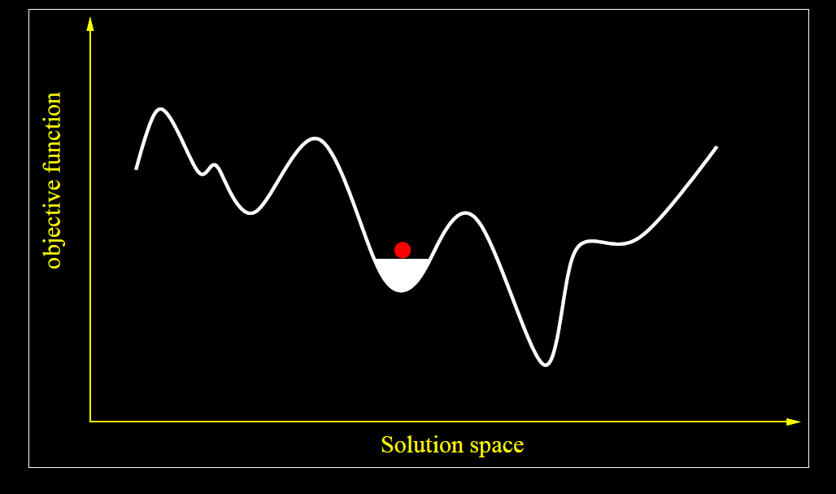

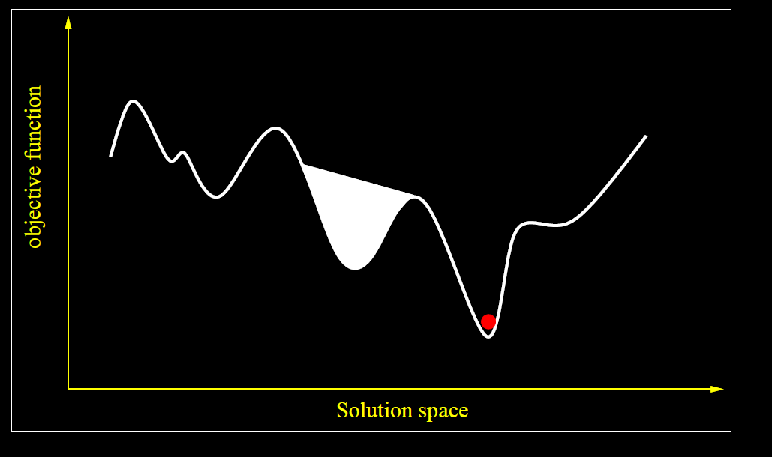
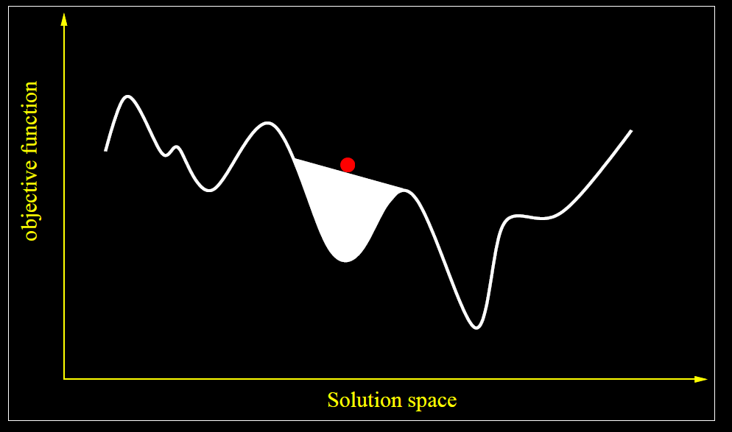

Slide 25
Penalties (1)
The penalties are initially equal to 0
When the search has reached a local optimum (with respect to the extended move evaluation function)
  The penalty is increased for some of the features of the current (locally optimal) solution
  This will make the current solution look worse in comparison to some neighboring solutions (which do not have the penalized features, and thus do not get the penalty)

Slide 26
Penalties (2)
How to select which feature to penalize?
Define the utility of a feature i in solution s as follows:
  u_{i}(s) = I_{i}(s) * c_{i} / (1+p_{i})
  Here, c_{i} is the cost of the feature (in objective function) and p_{i} is the previous penalty
In a local optimum, s, increase the penalty for the feature that has the highest utility value, u_{i}(s)
NB: Penalties are only adjusted when the search has reached a local optimum, and only for features included in the local optimum

Slide 27
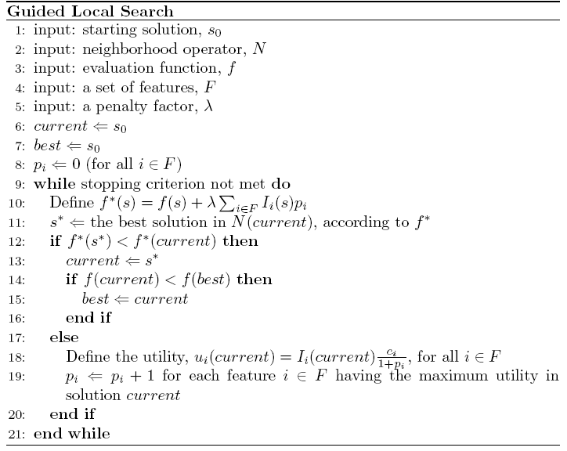

Slide 28
Comments on GLS
Uses the extended move evaluation function when deciding which neighbor is best
Could also use ”First Improvement”-strategy
Uses the normal objective function value to find the best solution
  if (f(current)<f(best) …
If all features er penalized equally, then f*(s) describes the same ”landscape” as f(s)

Slide 29
How to Select Lambda
The control parameter λ dictates the influence of the penalty on the extended move evaluation function
  Low value: intensification
  High value: diversification
Can be problematic to find values for λ, even though the method is robust for some value
Generally: fraction of the objective function value at a local minimum
  λ = α*f(a local minimum)/(#features in the local minimum)

Slide 30
GLS - Example : TSP (1)
5
Features: edges
Cost of the features: edge length
The feature associated with e₂₆ will be penalized in the solution on the right:
  In the next round of LS is the move evaluation function as before, f(s), except if e₂₆ is in the solution, when the value will be f(s)+λ
2
3
7
1
6
4
1
2
3
4
5
6
7
1
0
0
0
0
0
0
2
0
0
0
1
0
3
0
0
0
0
4
0
0
0
5
0
0
6
0

Slide 31

GLS - Example : TSP (2)
5
After the next LS e₃₄ is penalized
After this the move evaluation function is as before, f(s), except if e₂₆ or e₃₄ is in the solution
2
3
7
1
6
4
1
2
3
4
5
6
7
1
0
0
0
0
0
0
2
0
0
0
1
0
3
1
0
0
0
4
0
0
0
5
0
0
6
0

Slide 32
Applications of GLS
A fairly recent metaheuristic (evolved from another method called GENET)
Some applications:
  Workforce scheduling at BT (Tsang, Voudouris 97)
  TSP (Voudouris, Tsang 98)
  VRP (Kilby et. al. 97)
  Function optimization (Voudouris 98)
  …

Slide 33
Possibilities and Extensions
Limited life time of penalties
Diminishing penalties
Awards in addition to penalties
Automatic regulation of λ
New utility-functions to find features to penalize
Has been used for function optimization, good results on:

Slide 34
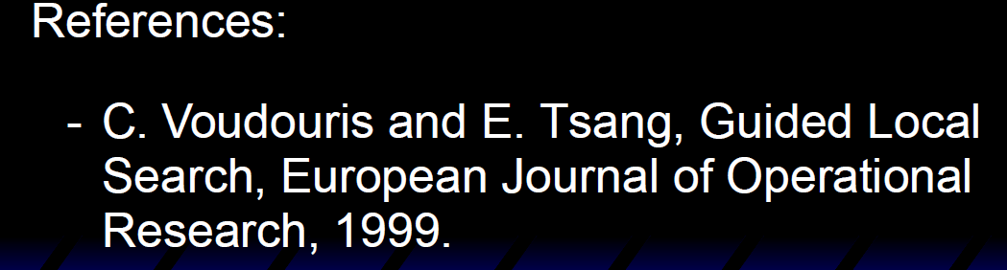

Slide 35
GRASP
Greedy Randomized Adaptive Search Procedures
A Metaheuristic that is based on Greedy Algorithms
  A constructive approach
  A multi-start approach
  Includes (optionally) a local search to improve the constructed solutions

Slide 36
Spelling out GRASP
Greedy: Select the best choice (or among the best choices)
Randomized: Use some probabilistic selection to prevent the same solution to be constructed every time
Adaptive: Change the evaluation of choices after making each decision
Search Procedure: It is a heuristic algorithm for examining the solution space

Slide 37
Two Phases of GRASP
GRASP is an iterative process, in which each iteration has two phases
Construction
  Build a feasible solution (from scratch) in the same way as using a Greedy Algorithm, but with some randomization
Improvement
  Improve the solution by using some Local Search (Best/First Improvement)
The best overall solution is retained

Slide 38
GRASP can be divided in two phases:
  Construction: where a feasible solution is built.
  Local Search: from the solution obtained a neighborhood is built and the search is then performed.
For N iterations
Construction Phase
Local Search Phase
Improved Solution
Best Solution
References:
T. A. Feo, and M. G. C. Resende. Greedy Randomized Adaptive Search Procedures. Journal of Global Optimization, no. 6, pp. 109-133, 1995.
M. G. C. Resende. Greedy Randomized Adaptive Search Procedures (GRASP). AT&T Labs Research Technical Report, 98.41.1, Dec. 1998.
M. G. C. Resende, and Celso C. Ribeiro. Greedy Randomized Search Procedures. AT&T Labs Research Technical Report TD-53RSJY, version 2, Aug. 2002
Notes:
GRASP can be divided in two parts,
The construction phase where a feasible solution is built
And a second phase where a local search is made on the neighborhood built from the solution obtained previously.
So…. Each GRASP iteration have a construction phase, a local search phase which generate a improved solution. Solution that can be or not better than the best solution found until that iteration.

Slide 39
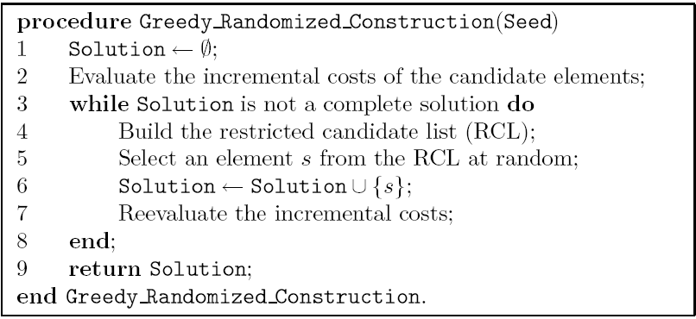
The Constructive Phase (1)

Slide 40
Construction Phase
The RCL (Restricted Candidate List) is built based on the α parameter:
  α is variable between 0 and 1:
    0 makes the construction too random.
    1 makes the construction too greedy.
  If β is the best free element and Σ represents the free elements, RCL is composed by:
    RCL U {Σ ≥ α.β}
Repeat until element list is empty
Initialize elements
Build RCL
Update Candidate List
Contructed Solution
Randomly choose an element
Update Solution
References:
T. A. Feo, and M. G. C. Resende. Greedy Randomized Adaptive Search Procedures. Journal of Global Optimization, no. 6, pp. 109-133, 1995.
M. G. C. Resende. Greedy Randomized Adaptive Search Procedures (GRASP). AT&T Labs Research Technical Report, 98.41.1, Dec. 1998.
M. G. C. Resende, and Celso C. Ribeiro. Greedy Randomized Search Procedures. AT&T Labs Research Technical Report TD-53RSJY, version 2, Aug. 2002
Notes:
In the construction phase,
We have the initialize elements phase where the cost of the elements is computed, this is, all de elements are evaluated with an objective function and the value of each element is used to order them.
Then we enter a cycle where we will add to the solution one element at a time.
In this cycle we start to build a RCL, which means Restricted candidate List , which is no more than a selection of the (1-α) % best elements.
This is, if alfa [which can vary between 0 and 1] has a value of one the construction will be too greedy, as it will pick only the free element with the best cost.
In other hand if alfa is zero the construction phase will be to random as it can pick any free item as all of them will be in the restricted candidate list.

Slide 41
Construction Phase
The randomness of GRASP is present when an element is picked by chance from the RCL.
After the element is added to the current solution the cost of each free element is updated:
  This is the adaptive part of the GRASP metaheuristic.
Repeat until element list is empty
Initialize elements
Build RCL
Update Candidate List
Contructed Solution
Randomly choose an element
Update Solution
References:
T. A. Feo, and M. G. C. Resende. Greedy Randomized Adaptive Search Procedures. Journal of Global Optimization, no. 6, pp. 109-133, 1995.
M. G. C. Resende. Greedy Randomized Adaptive Search Procedures (GRASP). AT&T Labs Research Technical Report, 98.41.1, Dec. 1998.
M. G. C. Resende, and Celso C. Ribeiro. Greedy Randomized Search Procedures. AT&T Labs Research Technical Report TD-53RSJY, version 2, Aug. 2002
Notes:
Then from RCL we pick one element at random. We can see that the randomness of the algorithm is related with the value of alfa.
The solution is updated with the element picked and we update the candidate list. The reason is that the cost of the remaining elements might have changed with the introduction of the last element in the solution.
When all the elements are placed into the solution we finish the construction phase. And the feasible solution found is passed to the next phase

Slide 42
The Constructive Phase (2)
Each step is both Greedy and Randomized
First, we build a Restricted Candidate List
  The RCL contains the best elements that we can add to the solution
Then we select randomly one of the elements in the Restricted Candidate List
We then need to reevaluate the remaining elements (their evaluation should change as a result of the recent change in the partial solution), and repeat

Slide 43
The Restricted Candidate List (1)
Assume we have evaluated all the possible elements that can be added to the solution
There are two ways of generate a restricted list
  Based on rank
  Based on value
In each case, we introduce a parameter α that controls how large the RCL will be
  Include the (1- α)% elements with highest rank
  Include all elements that has a value within α% of the best element

Slide 44
The Restricted Candidate List (2)
In general:
A small RCL leads to a small variance in the values of the constructed solutions
A large RCL leads to worse average solution values, but a larger variance
High values (=1) for α result in a purely greedy construction
Low values (=0) for α result in a purely random construction

Slide 45
The Restricted Candidate List (4)
The role of α is thus critical
Usually, a good choice will be to modify the value of α during the search
  Randomly
  Based on results
The approach where α is adjusted based on previous results is called ”Reactive GRASP”
  The probability distribution of α changes based on the performance of each value of α

Slide 46
Local Search Phase
The Create Neighborhood can be implement in several different ways:
  This is problem dependent.
  The stopping criteria varies with the implemented method.
Repeat until stopping criteria is satisfied
Contructed Solution
Create Neighborhood
Compare with Existing Best
Improved Solution
Select Best Solution
References:
T. A. Feo, and M. G. C. Resende. Greedy Randomized Adaptive Search Procedures. Journal of Global Optimization, no. 6, pp. 109-133, 1995.
M. G. C. Resende. Greedy Randomized Adaptive Search Procedures (GRASP). AT&T Labs Research Technical Report, 98.41.1, Dec. 1998.
F. Parreño, R. Alvarez-Valdes, J. F. Oliveira, and J. M. Tamarit. A hybrid GRASP/VND algorithm for two- and three-dimensional bin packing. Annals of Operations Research, vol. 179, no. 1, pp. 203-220, Oct. 2008.
Notes:
In the local search phase a neighborhood is created from the feasible solution.
The neighborhood can be built in many different ways depending on the problem.
It is needed also to define a stopping criteria to stop the search of the neighborhood and compare the solution of this GRASP iteration with the best solution found.
For example the stopping criteria could be stop after finding the first solution that gives an improvement. Or stop only after searching all the neighborhood and selecting the best solution of them all.

Slide 47
GRASP Overview
GRASP is easy to implement:
  Few parameters need to be set and tuned.
  Effort can be transferred to the implementation of efficient data structures.
GRASP is also easily implemented in parallel.
For N iterations
Construction Phase
Local Search Phase
Improved Solution
compare
Best Solution
Construction Phase
Local Search Phase
Improved Solution
References:
T. A. Feo, and M. G. C. Resende. Greedy Randomized Adaptive Search Procedures. Journal of Global Optimization, no. 6, pp. 109-133, 1995.
M. G. C. Resende. Greedy Randomized Adaptive Search Procedures (GRASP). AT&T Labs Research Technical Report, 98.41.1, Dec. 1998.
M. G. C. Resende, and Celso C. Ribeiro. Greedy Randomized Search Procedures. AT&T Labs Research Technical Report TD-53RSJY, version 2, Aug. 2002
Notes:
GRASP is easy to implement as it has few parameters to be set and tuned. And so the effort can be used in the implementation of efficient data structures.
GRASP can take advantage of multiprocessors platforms:
Where each parallel task has a copy of the procedure, instance data, and independent random sequence.
And where only the overall best solution is viewed by all processors. In order to pick the best one.

Slide 48
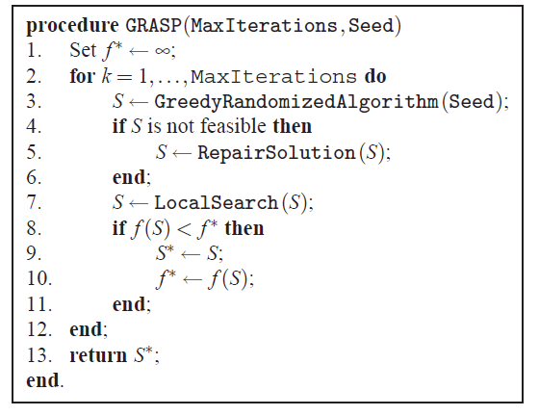

Slide 49
GRASP vs. Other Methods (1)
GRASP is the first pure constructive method that we have seen
However, GRASP can be compared to Local Search based methods in some aspects
That is, a GRASP can sometimes be interpreted as a Local Search where the entire solution is destroyed (emptied) whenever a local optimum is reached
  The construction reaches a local optimum when no more elements can be added

Slide 50
GRASP vs. Other Methods (2)
In this sense, we can classify GRASP as
  Memoryless (not using adaptive memory)
  Randomized (not systematic)
  Operating on 1 solution (not a population)
Potential improvements of GRASP would involve adding some memory
  Many improvements have been suggested, but not too many have been implemented/tested
  There is still room for doing research in this area

Slide 51
Large Neighbourhood Search
Partial restart heuristic
Create initial solution
Remove a part of the solution
Complete the solution as per step 1
Repeat, saving best

Slide 52
LNS – Construct

Slide 53
LNS – Construct

Slide 54
LNS – Construct

Slide 55
LNS – Construct

Slide 56
LNS – Construct

Slide 57
LNS – Construct

Slide 58
LNS – Construct

Slide 59
LNS – Construct

Slide 60
LNS – Construct

Slide 61
LNS – Construct

Slide 62
LNS – Construct

Slide 63
LNS – Destroy

Slide 64
LNS – Destroy

Slide 65
LNS – Destroy

Slide 66
LNS – Destroy

Slide 67
LNS – Construct

Slide 68
LNS – Construct

Slide 69
LNS
The magic is choosing which part of the solution to destroy
Different problems (and different instances) need different heuristic

