Slide 1
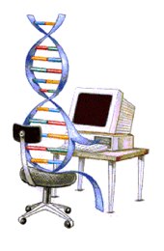
Lecture VII
Genetic Algorithms

Slide 2
Introduction To Genetic Algorithms (GAs)

Slide 3
Agenda
Short overview of Local Search and Local Search-based Metaheuristics
Introduction to Genetic Algorithms

Slide 4
Local Search
Basic Idea: Improve the current solution
Start with some solution
Find a set of solutions (called neighbors) that are ”close” to the current solution
If one of these neighbors are better than the current solution, move to that solution
Repeat until no improvements can be made

Slide 5
Local Search
Variations
  Best Improvement (always select the best neighbor)
  First Improvement (select the first improving neighbor)
  Random Descent (select neighbors at random)
  Random Walk (move to neighbors at random)
Problem: Gets stuck in a local optimum
  (except Random Walk, which isn’t a good method anyway)

Slide 6
Local Search Based Metaheuristics
Main goal
  To avoid getting stuck in local optima
Additional goals
  Explore a larger part of the search space
  Attempt to find the global (not just a local) optimum
  Give a reasonable alternative to exact methods (especially for large/hard problem instances, and where the solution time is important)

Slide 7
Local Search Based Metaheuristics
The different methods employ very different techniques in order to escape local optima
  Simulated Annealing relies on controlled random movement
  Tabu Search relies on memory structures, recording enough information to prevent looping between solutions

Slide 8
Local Search Based Metaheuristics
The different methods employ very different techniques in order explore a larger part of the search space
  Simulated Annealing relies on controlled random movement
  Tabu Search relies on memory structures, recording enough information to guide the search to different areas of the search space (e.g., frequency based diversification)

Slide 9
Local Search Based Metaheuristics
Which method is better?
Depends on your needs
  SA is easier to implement?
  SA is easier to use/understand?
  TS is more flexible and robust?
  TS requires a better understanding of the problem?
  TS requires more ”tuning”?
  TS produces better overall results?

Slide 10
Genetic Algorithms
We have now studied many Metaheuristics based on the idea of a Local Search
It is time to look at methods that are based on different mechanisms
The first such method will be the Genetic Algorithm

Slide 11
The Genetic Algorithm
Directed search algorithms based on the mechanics of biological evolution
Developed by John Holland, University of Michigan (1970’s)
  To understand the adaptive processes of natural systems
  To design artificial systems software that retains the robustness of natural systems

Slide 12
Genetic Algorithms
Provide efficient, effective techniques for optimization and machine learning applications
Widely-used today in business, scientific and engineering circles

Slide 13
Genetic Algorithms (GA)
Function Optimization
AI (Games,Pattern recognition ...)
Basic idea:
  intelligent exploration of the search space based on random search
  analogies from biology

Slide 14
GA - Analogies with biology
Representation of complex objects by a vector of simple components
Chromosomes
Selective breeding
Darwinistic evolution
Classical GA: Binary encoding

Slide 15
Classes of Search Techniques

Slide 16
Basic Principle of Evolutionary Algorithms
Objective (Fitness) Function
Candidate Solution
Difficult Problem
Fitness
Evolutionary Algorithm
Mutation
Replacement
Selection
Recombination

Slide 17
Landscape Topology
Mutation operators lead to slight changes in the solution, which tend to lead to slight changes in fitness.
I.e. the fitnesses in the neighbourhood of s are often similar to the fitness of s.
Landscapes tend to be locally smooth
What about big mutations ??
It turns out that ….

Slide 18
Typical Landscapes
f(s)
members of S lined up along here
Typically, with large (realistic) problems, the huge majority of the
landscape has very poor fitness – there are tiny areas where the decent
solutions lurk.
So, big random changes are very likely to take us outside the nice areas.

Slide 19
Typical Landscapes II
Unimodal
Plateau
Multimodal
Deceptive
As we home in on the good areas, we can identify broad types of
Landscape feature.
Most landscapes of interest are predominantly multimodal.
Despite being locally smooth, they are globally rugged

Slide 20
What Are Genetic Algorithms (GAs)?
Genetic Algorithms are search and optimization techniques based on Darwin’s Principle of Natural Selection.
Notes:
What exactly are Genetic Algorithms?
As the name suggests, Genetic Algorithms or Gas borrow their basic working principle from natural genetics.
Genetic Algorithms are search and optimization methods based on Darwin’s principle of Natural Selection.

Slide 21
Darwin’s Principle Of Natural Selection
IF there are organisms that reproduce, and
IF offsprings inherit traits from their progenitors, and
IF there is variability of traits, and
IF the environment cannot support all members of a growing population,
THEN those members of the population with less-adaptive traits (determined by the environment) will die out, and
THEN those members with more-adaptive traits (determined by the environment) will thrive
The result is the evolution of species.

Slide 22
Basic Idea Of Principle Of Natural Selection
“Select The Best, Discard The Rest”
Notes:
Darwin’s principle of Natural Selection can be stated very simply as “ select the best and discard the rest”.
Let us consider an example. Consider a population of animals of a particular species in a jungle. This population of animals has some animals which are stronger than the others and have characteristics that help them survive better in that environment as compared to the others. Now, the resources, like food,water,etc in the jungle are limited. So, these animals have to compete with one another for these resources. Ultimately, only the strongest, or fittest individuals survive and the rest perish. In other words, in this “struggle for existence” , nature selects the best, and discards the rest.
Now, these surviving animals mate amongst themselves and propagate their favorable characteristics from one generation to another.
What is mating? At the genetic level it can be seen as the crossover of 2 chrmosomes, one from each parent. They exchange some genetic matter and give rise to the new chromosome of the child that has both the parents’ features.Thus the favorable characteristics of the parents that helped them survive in that environment are propagated from one generation to the next till the species becomes best adapted to it’s environment. This is called evolution.

Slide 23
An Example of Natural Selection
Giraffes have long necks.
Giraffes with slightly longer necks could feed on leaves of higher branches when all lower ones had been eaten off.
→ They had a better chance of survival.
→ Favorable characteristic propagated through generations of giraffes.
→ Now, evolved species has long necks.
NOTE: Longer necks may have been a deviant characteristic (mutation) initially but since it was favorable, was propagated over generations. Now an established trait.
So, some mutations are beneficial.

Slide 24
Evolution Through Natural Selection
Initial Population Of Animals
Struggle For Existence-Survival Of the Fittest
Surviving Individuals Reproduce, Propagate Favorable Characteristics
Millions Of Years
Evolved Species
(Favorable Characteristic Now A Trait Of Species)

Slide 25
Genetic Algorithms Implement Optimization Strategies By Simulating Evolution Of Species Through Natural Selection.

Slide 26
Taxonomy
Search Techniques
Informed
Uninformed
DFS
BFS
A*
Hill Climbing
Evolutionary Algorithms
Simulated Annealing
Evolutionary Strategies
Swarm Intelligence
Genetic Programming
Genetic Algorithms

Slide 27
Working Mechanism Of GAs
Begin
Initialize population
Evaluate Solutions
T =0
Optimum Solution?
N
Selection
Y
T=T+1
Stop
Crossover
Mutation
Notes:
GAs implement optimization techniques by simulating this natural law of evolution in the biological world.
We start with a population of randomly generated solutions. Each of these solutions is evaluated to determine how good or bad it is.In other words to determine how “fit” that solution is. We then check a terminating condition, to see if our solutions are good enough? If yes, we stop. If not, we have to optimize the solutions.
So, we select the best solutions from the initial population (selection). This is similar to “natural selection”.
Then we allow these good solutions to exchange their information, in order to get even better solutions. This step is similar to reproduction among animals or crossover among chrmosomes and is called “cross-over”. We may then randomly mutate some small % of the solutions thus obtained after crossover.
Mutation is very imp. It could be a bad thing, it could be a good thing. In the boliogical sense it mean, making a small change in a gene. In GAs, it means, making a small change to the solution.
Then again, we evaluate each of the sokutions, and check the termination condition. As you see , this is an optmization method.

Slide 28
Simple Genetic Algorithm
Simple_Genetic_Algorithm()
{
Initialize the Population;
Calculate Fitness Function;
While(Fitness Value != Optimal Value)
{
Selection;
//Natural Selection, Survival Of Fittest
Crossover;
//Reproduction, Propagate favorable characteristics
Mutation;
//Mutation
Calculate Fitness Function;
}
}

Slide 29
Nature to Computer Mapping
Nature | Computer
Population Individual Fitness Chromosome Gene Reproduction | Set of solutions. Solution to a problem. Quality of a solution. Encoding for a Solution. Part of the encoding of a solution. Crossover
Notes:
So after this discussion, it should be clear to you that Gas mimic the natural process of evolution to a large extent. To summarize the similarities , I have a slide here.

Slide 30
Components of a GA
A problem to solve, and ...
  Encoding technique (gene, chromosome)
  Initialization procedure (creation)
  Evaluation function (environment)
  Selection of parents (reproduction)
  Genetic operators (mutation, recombination)
  Parameter settings (practice and art)
Notes:
Encoding technique = representation, i.e. How do we represent potential solutions to the problem?

Slide 31
Some Terms Used in Evolutionary Computation
Algorithm Type
  Generational
  Steady State
  Elitist
Recombination (Crossover)
  Single-point
  Multi-point
  Uniform
Selection
  Rank-Biased
  Roulette Wheel
  Tournament
Replacer
  Weakest
  First weaker
Mutation
Parameters
  Population size
  Generations/iterations
  Mutation rate
  Crossover rate
  Tournament size….
  Etc

Slide 32
GA terminology
Population
  The collection of potential solutions (i.e. all the chromosomes)
Parents/Children
  Both are chromosomes
  Children are generated from the parent chromosomes
Generations
  Number of iterations/cycles through the GA process

Slide 33
Genotype, Phenotype, Population
Genotype
  chromosome
  Coding of chromosomes
  coded string, set of coded strings
Phenotype
  The physical expression
  Properties of a set of solutions
Population – a set of solutions

Slide 34
The GA cycle
chosen
parents
recombination
children
selection
modification
modified
children
parents
population
evaluation
evaluated children
deleted
members
discard
Notes:
Modifications are stochastically triggered
Operator types are:
Mutation
Crossover (recombination)

Slide 35
GA Operators and Parameters

Slide 36
Encoding
The process of representing the solution in the form of a string that conveys the necessary information.
Just as in a chromosome, each gene controls a particular characteristic of the individual, similarly, each bit in the string represents a characteristic of the solution.
Chromosomes could be:
  Bit strings (0101 ... 1100)
  Real numbers (43.2 -33.1 ... 0.0 89.2)
  Permutations of element (E11 E3 E7 ... E1 E15)
  Lists of rules (R1 R2 R3 ... R22 R23)
  Program elements (genetic programming)
  ... any data structure ...
Notes:
The very first step in Gas, is coming up with a random population of solutions. Each of these solutions is represented in the form of a string and this process is called encoding.
Just as we have chromosomes in animals that are made up of a string of genes, similarly the solutions in Gas are represnted in the form of strings, which are made up of characters, each of which stand for and control a particular aspect of the solution.
There are many methods of encoding, the common ones are binary encoding, real encoding ,etc. The method chosen depends on the problem at hand.

Slide 37
Encoding Methods
Binary Encoding – Most common method of encoding. Chromosomes are strings of 1’s and 0’s and each position in the chromosome represents a particular characteristic of the problem.
Chromosome A
10110010110011100101
Chromosome B
11111110000000011111

Slide 38
Genetic Algorithms:
Binary-Coded Representations
For Example, let’s say that we are trying to optimize the following function,
  f(x) = x²
  for 2 ≥ x ≥ 1
If we were to use binary-coded representations we would first need to develop a mapping function form our genotype representation (binary string) to our phenotype representation (our Candidate Solution). This can be done using the following mapping function:
  d(ub,lb,l,chrom) = (ub-lb) decode(chrom)/2^{l}-1 + lb

Slide 39
Binary-Coded Representations
d(ub,lb,l,c) = (ub-lb) decode(c)/2^{l}-1 + lb , where
  ub = 2,
  lb = 1,
  l = the length of the chromosome in bits
  c = the chromosome
The parameter, l, determines the accuracy (and resolution of our search).

Slide 40
Binary Coded Representations
2.69
1.65
(1.64)=2.69

Slide 41
Encoding Methods (contd.)
Permutation Encoding – Useful in ordering problems such as the Traveling Salesman Problem (TSP). Example. In TSP, every chromosome is a string of numbers, each of which represents a city to be visited.
Chromosome A
1 5 3 2 6 4 7 9 8
Chromosome B
8 5 6 7 2 3 1 4 9

Slide 42
Encoding Methods (contd.)
Value Encoding – Used in problems where complicated values, such as real numbers, are used and where binary encoding would not suffice.
Good for some problems, but often necessary to develop some specific crossover and mutation techniques for these chromosomes.
Chromosome A
1.235 5.323 0.454 2.321 2.454
Chromosome B
(left), (back), (left), (right), (forward)

Slide 43
Real-Coded Representations

Slide 44
Fitness Function
A fitness function quantifies the optimality of a solution (chromosome) so that that particular solution may be ranked against all the other solutions.
A fitness value is assigned to each solution depending on how close it actually is to solving the problem.
Ideal fitness function correlates closely to goal + quickly computable.
Example. In TSP, f(x) is sum of distances between the cities in solution. The lesser the value, the fitter the solution is.

Slide 45
Recombination
The process that determines which solutions are to be preserved and allowed to reproduce and which ones deserve to die out.
The primary objective of the recombination operator is to emphasize the good solutions and eliminate the bad solutions in a population, while keeping the population size constant.
“Selects The Best, Discards The Rest”.
“Recombination” is different from “Reproduction”.

Slide 46
Recombination
Identify the good solutions in a population.
Make multiple copies of the good solutions.
Eliminate bad solutions from the population so that multiple copies of good solutions can be placed in the population.

Slide 47
Roulette Wheel Selection
Parent Selection Methods
Each current string in the population has a slot assigned to it which is in proportion to it’s fitness.
We spin the weighted roulette wheel thus defined n times (where n is the total number of solutions).
Each time Roulette Wheel stops, the string corresponding to that slot is created.
Strings that are fitter are assigned a larger slot and hence have a better chance of appearing in the new population.

Slide 48
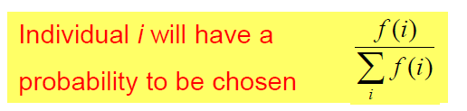
Example Of Roulette Wheel Selection
No. | String | Fitness | % Of Total
1 | 01101 | 169 | 14.4
2 | 11000 | 576 | 49.2
3 | 01000 | 64 | 5.5
4 | 10011 | 361 | 30.9
Total |  | 1170 | 100.0

Slide 49
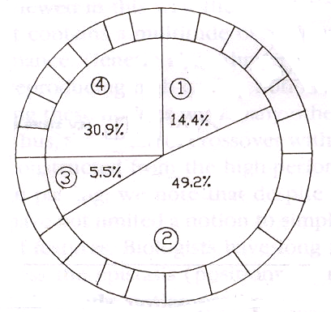
Roulette Wheel For Example

Slide 50
Roulette wheel selection can be implemented as follows
1. Sum the fitnesses of all the population members. Call this TF (total fitness).
Total=1170
2. Generate a random number m, between 0 and TF.
m=300
3. Return the first population member whose fitness added to the preceding population members is greater than or equal to m.
sum=169, sum=169+576 >m select second individual.

Slide 51
Pseudo code of Selection process
Function select(popsize, sumfitness, population) {
  Begin
    Partsum=0 j=0
    rand= rand*sumfitness
    Repeat
      j=j+1
      partsum=partsum+pop[j].fitness
      Until(partsum>=rand) or (j=popsize)
      Return individual number
      Select=j
      end

Slide 52
Tournament Selection
In Tournament Selection, q individuals are randomly selected from the population and the best of the q individuals is returned as a parent.
Selection Pressure increases as q is increased and decreases a q is decreased.

Slide 53
Genetic Algorithms:
Genetic Procreation Operators
Genetic Algorithms typically use two types of operators:
  Crossover (Sexual Recombination), and
  Mutation (Asexual)
Crossover is usually the primary operator with mutation serving only as a mechanism to introduce diversity in the population.
However, when designing a GA to solve a problem it is not uncommon that one will have to develop unique crossover and mutation operators that take advantage of the structure of the CSs comprising the search space.

Slide 54
Crossover
It is the process in which two chromosomes (strings) combine their genetic material (bits) to produce a new offspring which possesses both their characteristics.
Two strings are picked from the mating pool at random to cross over.
The method chosen depends on the Encoding Method.

Slide 55
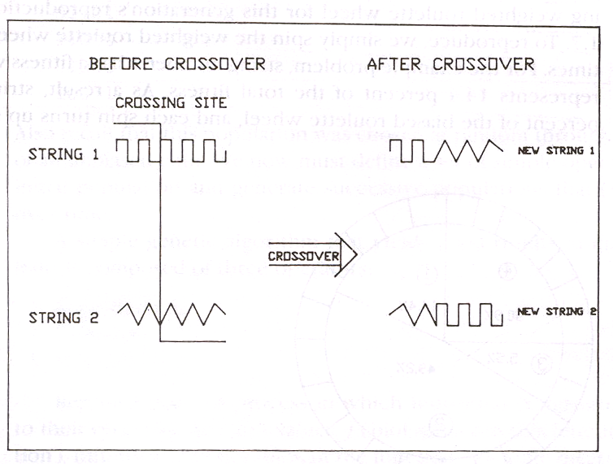
Crossover Methods
Single Point Crossover- A random point is chosen on the individual chromosomes (strings) and the genetic material is exchanged at this point.

Slide 56
Crossover Methods (contd.)
Single Point Crossover
Chromosome1 | 11011 | 00100110110
Chromosome 2 | 11011 | 11000011110
Offspring 1 | 11011 | 11000011110
Offspring 2 | 11011 | 00100110110

Slide 57
Crossover Methods (contd.)
Two-Point Crossover- Two random points are chosen on the individual chromosomes (strings) and the genetic material is exchanged at these points.
Chromosome1 | 11011 | 00100 | 110110
Chromosome 2 | 10101 | 11000 | 011110
Offspring 1 | 10101 | 00100 | 011110
Offspring 2 | 11011 | 11000 | 110110
NOTE: These chromosomes are different from the last example.

Slide 58
Crossover Methods (contd.)
Uniform Crossover- Each gene (bit) is selected randomly from one of the corresponding genes of the parent chromosomes.
Chromosome1 | 11011 | 00100 | 110110
Chromosome 2 | 10101 | 11000 | 011110
Offspring | 10111 | 00000 | 110110
NOTE: Uniform Crossover yields ONLY 1 offspring.

Slide 59
Crossover (contd.)
Crossover between 2 good solutions MAY NOT ALWAYS yield a better or as good a solution.
Since parents are good, probability of the child being good is high.
If offspring is not good (poor solution), it will be removed in the next iteration during “Selection”.

Slide 60
Real-Coded Crossover Operators
For Real-Coded representations there exist a number of other crossover operators:
  Mid-Point Crossover,
  Flat Crossover (BLX-0.0),
  BLX-0.5

Slide 61
Mid-Point Crossover
Given two parents where X and Y represent a floating point number:
  Parent 1: X
  Parent 2: Y
  Offspring: (X+Y)/2
If a chromosome contains more than one gene, then this operator can be applied to each gene with a probability of P_{mp}.

Slide 62
Flat Crossover (BLX-0.0)
Flat crossover was developed by Radcliffe (1991)
Given two parents where X and Y represent a floating point number:
  Parent 1: X
  Parent 2: Y
  Offspring: rnd(X,Y)
Of course, if a chromosome contains more than one gene then this operator can be applied to each gene with a probability of P_{blx-0.0}.

Slide 63
BLX-α
Developed by Eshelman & Schaffer (1992)
Given two parents where X and Y represent a floating point number, and where X < Y:
  Parent 1: X
  Parent 2: Y
  Let Δ = α(Y-X), where α = 0.5
  Offspring: rnd(X-Δ, Y+ Δ)
Of course, if a chromosome contains more than one gene then this operator can be applied to each gene with a probability of P_{blx-α}.

Slide 64
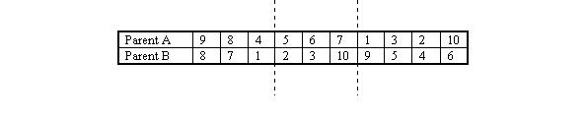
Partially Matched Crossover (PMX)
PMX is similar to order-based crossover in that it can be used for problems such as the travelling salesman problem. An example is probably the best way to shows how PMX operates. This example is taken from (Goldberg, 1989).
Given two parents, A and B, two crossover points are chosen.

Slide 65
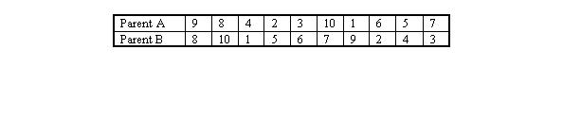
Now, looking at B, we consider the genes between the crossover site. The first, 2, maps to 5 in parent A. Therefore, we swap gene 2 with gene 5 in parent B. Following the same principle we swap 3 and 6 and 10 and 7.
A similar procedure is followed for parent A (swapping 5 and 2, 6 and 3 and 7 and 10). The resulting chromosomes are shown below.

Slide 66
Elitism
Elitism is a method which copies the best chromosome to the new offspring population before crossover and mutation.
When creating a new population by crossover or mutation the best chromosome might be lost.
Forces GAs to retain some number of the best individuals at each generation.
Has been found that elitism significantly improves performance.

Slide 67
Mutation
It is the process by which a string is deliberately changed so as to maintain diversity in the population set.
We saw in the giraffes’ example, that mutations could be beneficial.
Mutation Probability- determines how often the parts of a chromosome will be mutated.

Slide 68
Example Of Mutation
For chromosomes using Binary Encoding, randomly selected bits are inverted.
Offspring | 11011 00100 110110
Mutated Offspring | 11010 00100 100110
NOTE: The number of bits to be inverted depends on the Mutation Probability.

Slide 69
Genetic Algorithms:
Selection Who Survives
Basically, there are two types of GAs commonly used.
These GAs are characterized by the type of replacement strategies they use.
A Generational GA uses a (μ,μ) replacement strategy where the offspring replace the parents.
A Steady-State GA usually will select two parents, create 1-2 offspring which will replace the 1-2 worst individuals in the current population even if the offspring are worse than the individuals they replace.

Slide 70
Genetic Algorithm:
Example by Hand
Now that we have an understanding of the various parts of a GA let’s evolve a simple GA (SGA) by hand.
A SGA is :
  binary-coded,
  Uses proportionate selection
  uses single-point crossover (with a crossover usage rate between 0.6-1.0),
  uses a small mutation rate, and
  is generational.

Slide 71
Genetic Algorithms:
Example
The SGA for our example will use:
  A population size of 6,
  A crossover usage rate of 1.0, and
  A mutation rate of 1/7.
Let’s try to solve the following problem
  f(x) = x², where -2.0 ≤ x ≤ 2.0,
  Let l = 7, therefore our mapping function will be
    d(2,-2,7,c) = 4*decode(c)/127 - 2

Slide 72
Genetic Algorithms:
An Example Run (by hand)
Randomly Generate an Initial Population
Genotype Phenotype Fitness
Person 1: 1001010 0.331 Fit: ?
Person 2: 0100101 - 0.835 Fit: ?
Person 3: 1101010 1.339 Fit: ?
Person 4: 0110110 - 0.300 Fit: ?
Person 5: 1001111 0.488 Fit: ?
Person 6: 0001101 - 1.591 Fit: ?

Slide 73
Genetic Algorithms:
An Example Run (by hand)
Evaluate Population at t=0
Genotype Phenotype Fitness
Person 1: 1001010 0.331 Fit: 0.109
Person 2: 0100101 - 0.835 Fit: 0.697
Person 3: 1101010 1.339 Fit: 1.790
Person 4: 0110110 - 0.300 Fit: 0.090
Person 5: 1001111 0.488 Fit: 0.238
Person 6: 0001101 - 1.591 Fit: 2.531

Slide 74
Genetic Algorithms:
An Example Run (by hand)
Select Six Parents Using the Roulette Wheel
Genotype Phenotype Fitness
Person 6: 0001101 - 1.591 Fit: 2.531
Person 3: 1101010 1.339 Fit: 1.793
Person 5: 1001111 0.488 Fit: 0.238
Person 6: 0001101 - 1.591 Fit: 2.531
Person 2: 0100101 - 0.835 Fit: 0.697
Person 1: 1001010 0.331 Fit: 0.109

Slide 75
Genetic Algorithms:
An Example Run (by hand)
Create Offspring 1 & 2 Using Single-Point Crossover
Genotype Phenotype Fitness
Person 6: 00|01101 - 1.591 Fit: 2.531
Person 3: 11|01010 1.339 Fit: 1.793
Child 1 : 0001010 - 1.685 Fit: ?
Child 2 : 1101101 1.433 Fit: ?

Slide 76
Genetic Algorithms:
An Example Run (by hand)
Create Offspring 3 & 4
Genotype Phenotype Fitness
Person 5: 1001|111 0.488 Fit: 0.238
Person 6: 0001|101 - 1.591 Fit: 2.531
Child 3 : 1011100 0.898 Fit: ?
Child 4 : 0001011 - 1.654 Fit: ?

Slide 77
Genetic Algorithms:
An Example Run (by hand)
Create Offspring 5 & 6
Genotype Phenotype Fitness
Person 2: 010|0101 - 0.835 Fit: 0.697
Person 1: 100|1010 0.331 Fit: 0.109
Child 5 : 1101010 1.339 Fit: ?
Child 6 : 1010101 0.677 Fit: ?

Slide 78
Genetic Algorithms:
An Example Run (by hand)
Evaluate the Offspring
Genotype Phenotype Fitness
Child 1 : 0001010 - 1.685 Fit: 2.839
Child 2 : 1101101 1.433 Fit: 2.054
Child 3 : 1011100 0.898 Fit: 0.806
Child 4 : 0001011 - 1.654 Fit: 2.736
Child 5 : 1101010 1.339 Fit: 1.793
Child 6 : 1010101 0.677 Fit: 0.458

Slide 79
Genetic Algorithms:
An Example Run (by hand)
Population at t=0
Genotype Phenotype Fitness
Person 1: 1001010 0.331 Fit: 0.109
Person 2: 0100101 - 0.835 Fit: 0.697
Person 3: 1101010 1.339 Fit: 1.793
Person 4: 0110110 - 0.300 Fit: 0.090
Person 5: 1001111 0.488 Fit: 0.238
Person 6: 0001101 - 1.591 Fit: 2.531
Is Replaced by:
Genotype Phenotype Fitness
Child 1 : 0001010 - 1.685 Fit: 2.839
Child 2 : 1101101 1.433 Fit: 2.053
Child 3 : 1011100 0.898 Fit: 0.806
Child 4 : 0001011 - 1.654 Fit: 2.736
Child 5 : 1101010 1.339 Fit: 1.793
Child 6 : 1010101 0.677 Fit: 0.458

Slide 80
Genetic Algorithms:
An Example Run (by hand)
Population at t=1
Genotype Phenotype Fitness
Person 1: 0001010 - 1.685 Fit: 2.839
Person 2: 1101101 1.433 Fit: 2.054
Person 3: 1011100 0.898 Fit: 0.806
Person 4: 0001011 - 1.654 Fit: 2.736
Person 5: 1101010 1.339 Fit: 1.793
Person 6: 1010101 0.677 Fit: 0.458

Slide 81
Genetic Algorithms:
An Example Run (by hand)
The Process of:
  Selecting six parents,
  Allowing the parents to create six offspring,
  Mutating the six offspring,
  Evaluating the offspring, and
  Replacing the parents with the offspring
Is repeated until a stopping criterion has been reached.

Slide 82
Genetic Algorithms:
An Example Run (Steady-State GA)
Randomly Generate an Initial Population
Genotype Phenotype Fitness
Person 1: 1001010 0.331 Fit: ?
Person 2: 0100101 - 0.835 Fit: ?
Person 3: 1101010 1.339 Fit: ?
Person 4: 0110110 - 0.300 Fit: ?
Person 5: 1001111 0.488 Fit: ?
Person 6: 0001101 - 1.591 Fit: ?

Slide 83
Genetic Algorithms:
An Example Run (Steady-State GA)
Evaluate Population at t=0
Genotype Phenotype Fitness
Person 1: 1001010 0.331 Fit: 0.109
Person 2: 0100101 - 0.835 Fit: 0.697
Person 3: 1101010 1.339 Fit: 1.790
Person 4: 0110110 - 0.300 Fit: 0.090
Person 5: 1001111 0.488 Fit: 0.238
Person 6: 0001101 - 1.591 Fit: 2.531

Slide 84
Genetic Algorithms:
An Example Run (Steady-State GA)
Select 2 Parents and Create 2 Using Single-Point Crossover
Genotype Phenotype Fitness
Person 6: 00|01101 - 1.591 Fit: 2.531
Person 3: 11|01010 1.339 Fit: 1.793
Child 1 : 0001010 - 1.685 Fit: ?
Child 2 : 1101101 1.433 Fit: ?

Slide 85
Genetic Algorithms:
An Example Run (Steady-State GA)
Evaluate the Offspring
Genotype Phenotype Fitness
Child 1 : 0001010 - 1.685 Fit: 2.839
Child 2 : 1101101 1.433 Fit: 2.054

Slide 86
Genetic Algorithms:
An Example Run (Steady-State GA)
Find the two worst individuals to be replaced
Genotype Phenotype Fitness
Person 1: 1001010 0.331 Fit: 0.109
Person 2: 0100101 - 0.835 Fit: 0.697
Person 3: 1101010 1.339 Fit: 1.790
Person 4: 0110110 - 0.300 Fit: 0.090
Person 5: 1001111 0.488 Fit: 0.238
Person 6: 0001101 - 1.591 Fit: 2.531

Slide 87
Genetic Algorithms:
An Example Run (Steady-State GA)
Replace them with the offspring
Genotype Phenotype Fitness
Person 1: 1001010 0.331 Fit: 0.109
Child 1 : 0001010 - 1.685 Fit: 2.839
Person 3: 1101010 1.339 Fit: 1.790
Child 2 : 1101101 1.433 Fit: 2.054
Person 5: 1001111 0.488 Fit: 0.238
Person 6: 0001101 - 1.591 Fit: 2.531

Slide 88
Genetic Algorithms:
An Example Run (Steady-State GA)
This process of:
  Selecting two parents,
  Allowing them to create two offspring, and
  Immediately replacing the two worst individuals in the population with the offspring
Is repeated until a stopping criterion is reached
Notice that on each cycle the steady-state GA will make two function evaluations while a generational GA will make P (where P is the population size) function evaluations.
Therefore, you must be careful to count only function evaluations when comparing generational GAs with steady-state GAs.

Slide 89
Advantages Of GAs
Global Search Methods: GAs search for the function optimum starting from a population of points of the function domain, not a single one. This characteristic suggests that GAs are global search methods. They can, in fact, climb many peaks in parallel, reducing the probability of finding local minima, which is one of the drawbacks of traditional optimization methods.

Slide 90
Advantages of GAs (contd.)
Blind Search Methods: GAs only use the information about the objective function. They do not require knowledge of the first derivative or any other auxiliary information, allowing a number of problems to be solved without the need to formulate restrictive assumptions. For this reason, GAs are often called blind search methods.

Slide 91
Advantages of GAs (contd.)
GAs use probabilistic transition rules during iterations, unlike the traditional methods that use fixed transition rules.
This makes them more robust and applicable to a large range of problems.

Slide 92
Advantages of GAs (contd.)
GAs can be easily used in parallel machines- Since in real-world design optimization problems, most computational time is spent in evaluating a solution, with multiple processors all solutions in a population can be evaluated in a distributed manner. This reduces the overall computational time substantially.

Slide 93

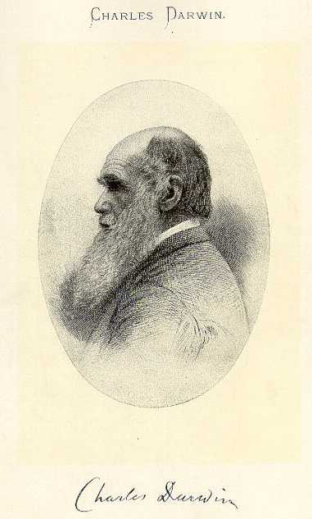
Knapsack Problem
Problem Description:
You are going on a picnic.
And have a number of items that you could take along.
Each item has a weight and a benefit or value.
You can take one of each item at most.
There is a capacity limit on the weight you can carry.
You should carry items with max. values.

Slide 94
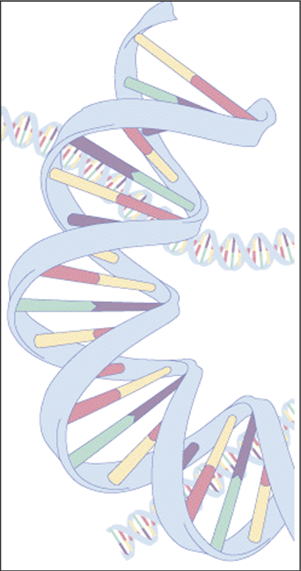

Knapsack Problem
Example:
Item: 1 2 3 4 5 6 7
Benefit: 5 8 3 2 7 9 4
Weight: 7 8 4 10 4 6 4
Knapsack holds a maximum of 22 pounds
Fill it to get the maximum benefit

Slide 95
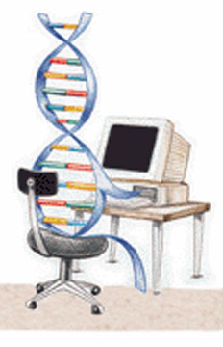
Genetic Algorithm
Outline of the Basic Genetic Algoritm
[Start]
  Encoding: represent the individual.
  Generate random population of n chromosomes (suitable solutions for the problem).
[Fitness] Evaluate the fitness of each chromosome.
[New population] repeating following steps until the new population is complete.
[Selection] Select the best two parents.
[Crossover] cross over the parents to form a new offspring (children).

Slide 96
Genetic Algorithm
Outline of the Basic Genetic Algoritm Cont.
[Mutation] With a mutation probability.
[Accepting] Place new offspring in a new population.
[Replace] Use new generated population for a further run of algorithm.
[Test] If the end condition is satisfied, then stop.
[Loop] Go to step 2 .

Slide 97
Basic Steps
Start
Encoding: 0 = not exist, 1 = exist in the Knapsack
  Chromosome: 1010110
  => Items taken: 1, 3 , 5, 6.
Generate random population of n chromosomes:
  0101010
  1100100
  0100011
7 | 6 | 5 | 4 | 3 | 2 | 1 | Item.
0 | 1 | 1 | 0 | 1 | 0 | 1 | Chro
n | y | y | n | y | n | y | Exist?

Slide 98
Basic Steps Cont.
Fitness & Selection
✗
0101010: Benefit= 19, Weight= 24
1100100: Benefit= 20, Weight= 19.
0100011: Benefit= 21, Weight= 18.
7 | 6 | 5 | 4 | 3 | 2 | 1 | Item
0 | 1 | 0 | 1 | 0 | 1 | 0 | Chro
4 | 9 | 7 | 2 | 3 | 8 | 5 | Benefit
4 | 6 | 4 | 10 | 4 | 8 | 7 | Weight
✓
✓
=> We select Chromosomes b & c.

Slide 99
Basic Steps Cont.
Crossover & Mutation
Parent 1
1 1 0 0 1 0 0
Parent 2
0 1 0 0 0 1 1
Child 1
1 1 0 0 0 1 1
Child 2
0 1 0 0 1 0 1
Mutation
0 1 0 0 1 0 0

Slide 100
Basic Steps Cont.
Accepting, Replacing & Testing
Place new offspring in a new population.
Use new generated population for a further run of algorithm.
If the end condition is satisfied, then stop. End conditions:
  Number of populations.
  Improvement of the best solution.
Else, return to step 2 [Fitness].

Slide 101
Genetic Algorithm
Conclusion
GA is nondeterministic – two runs may end with different results
There’s no indication whether best individual is optimal

Slide 102
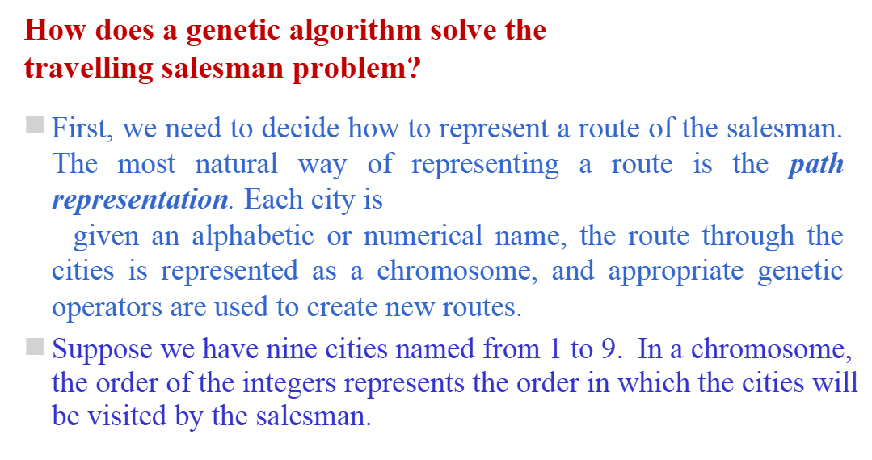

Slide 103
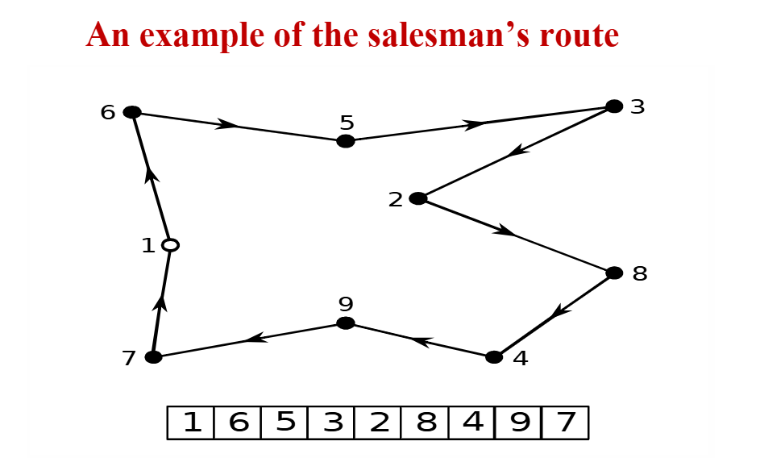

Slide 104
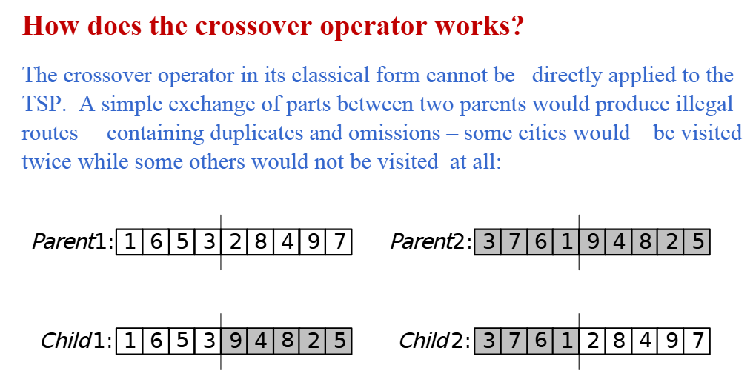

Slide 105
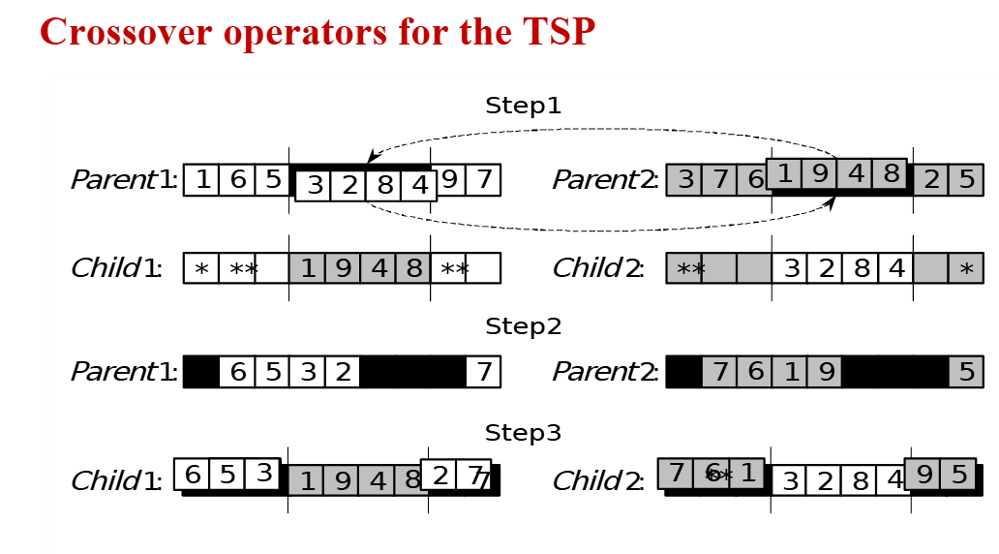

Slide 106
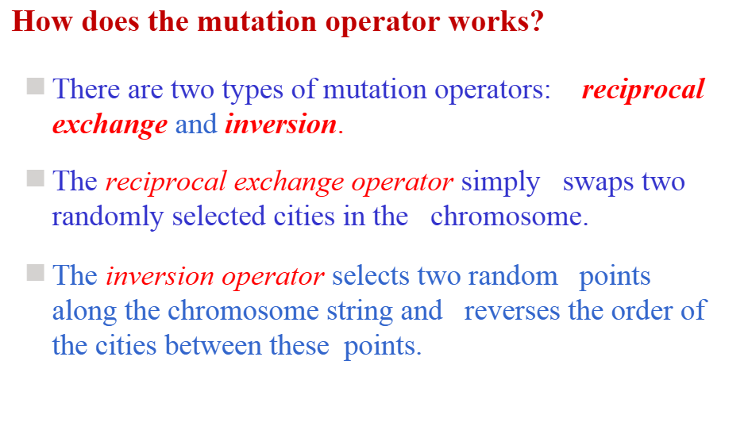

Slide 107
