Slide 1
Differential Evolution (DE)

Slide 2
What is differential evolution?
Differential Evolution (DE) is an EA for continuous function optimization proposed by Kenneth Price and Rainer Storn in 1994
DE is also a population based algorithm, in which each individual is called an agent, and is often represented as multi-dimensional real vector.
The basic idea is to use vector differences for perturbing (mutating) the vector population, instead of conventional crossover and mutation used in GA.

Slide 3
More specifically DEs basic strategy can be described as follows:
Initialization: an initial population is generated randomly with a distribution uniform
Where, i=1,...,N (N: population size)
j=1,...,D (D: length of the agent)

Slide 4
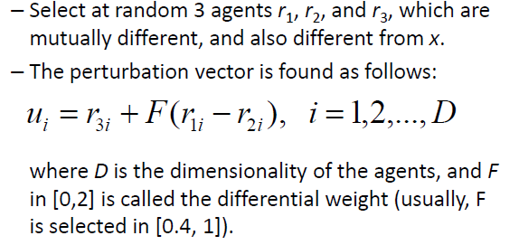
Mutation (perturbation): randomly select three vectors that are different, subtract two of them and the differences are applied weight given to them by a factor and finally add the difference to the third vector difference
An agent x is perturbed in two steps:
Step 1: Find perturbation vector u:

Slide 6
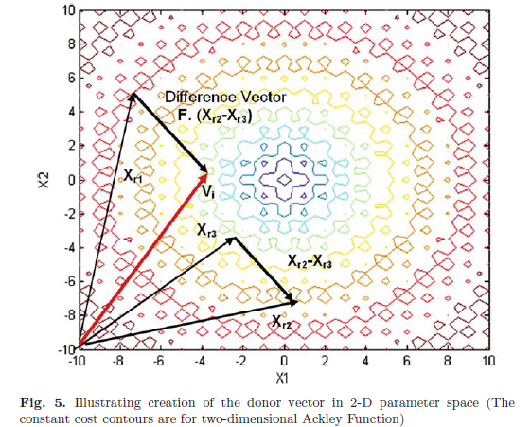

Slide 7
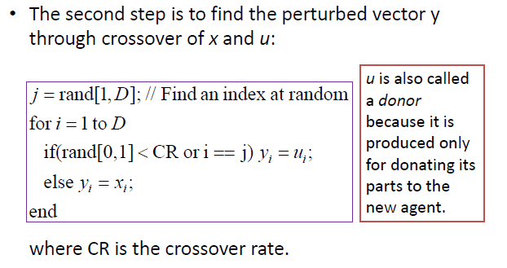

Slide 8
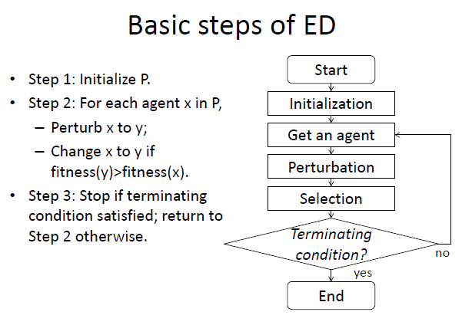
DE

Slide 9
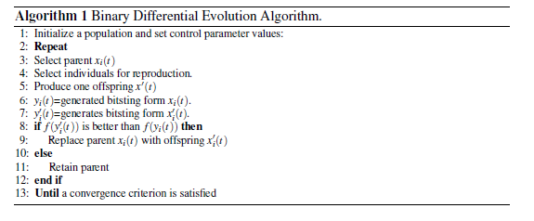

Slide 10
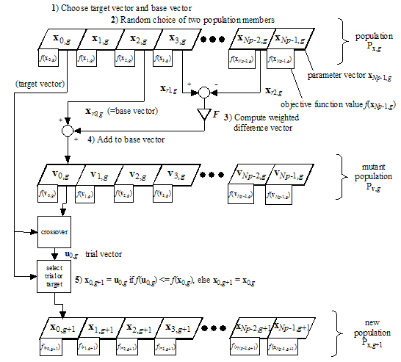

Slide 11
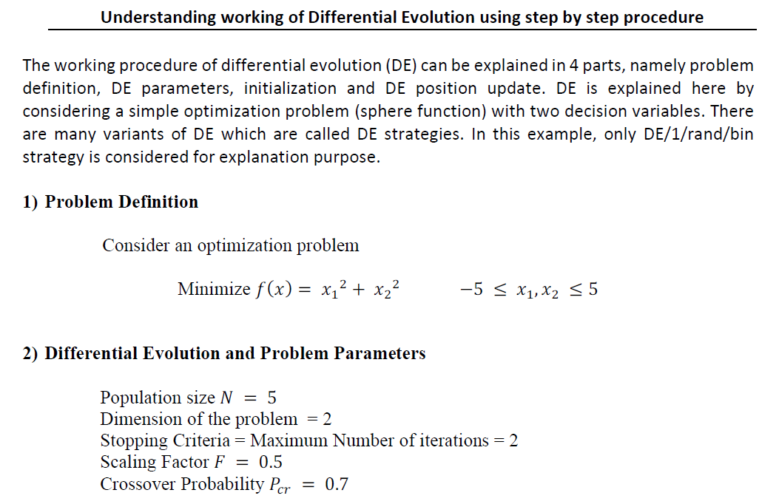

Slide 12
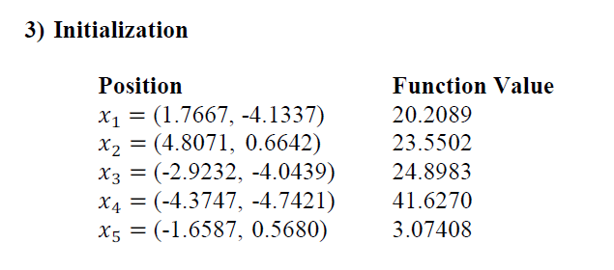
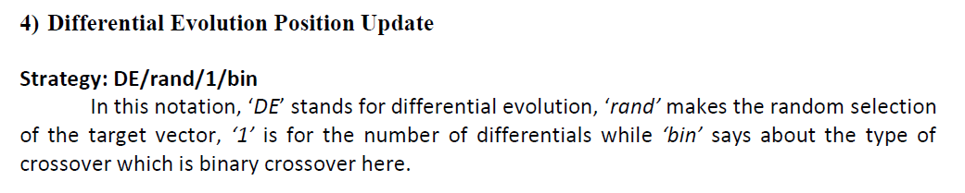

Slide 13
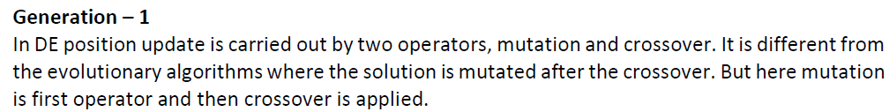
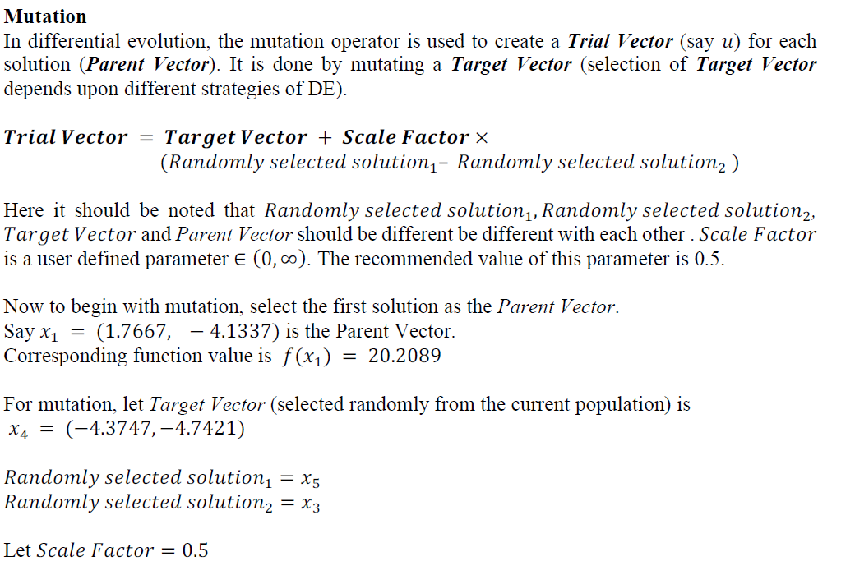

Slide 14
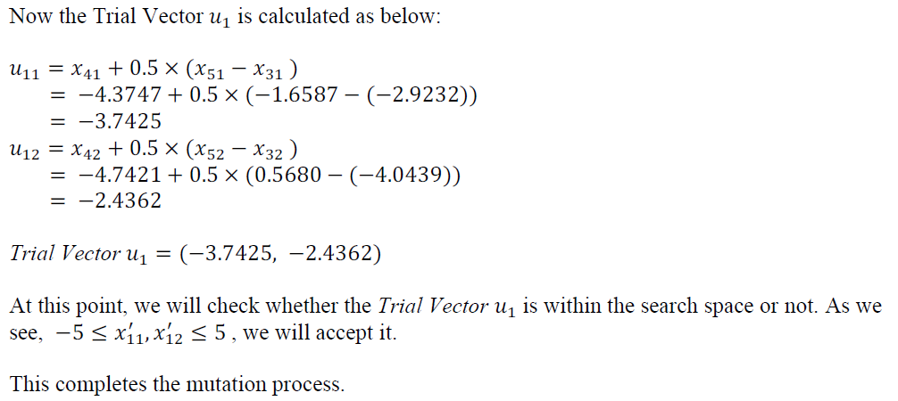

Slide 15
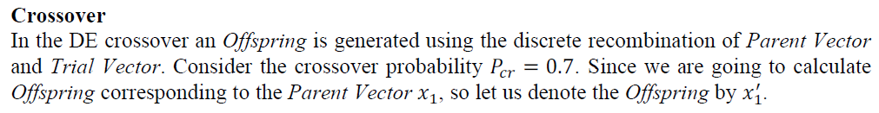
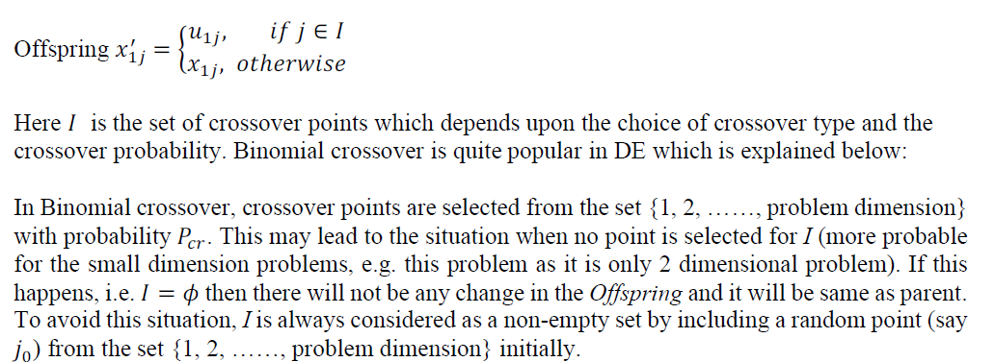

Slide 16
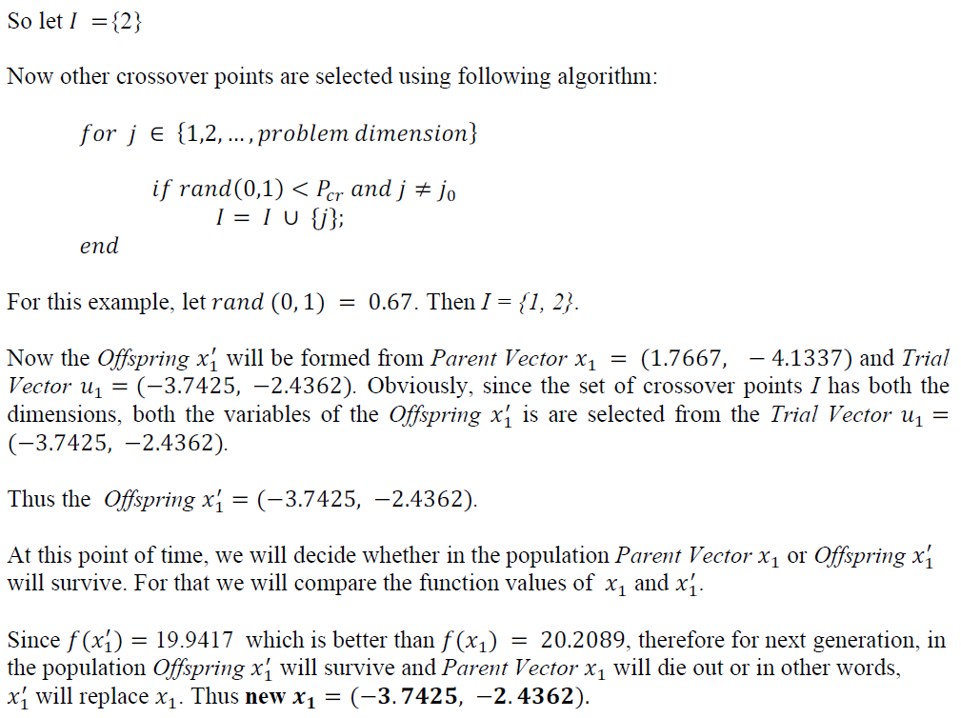

Slide 17
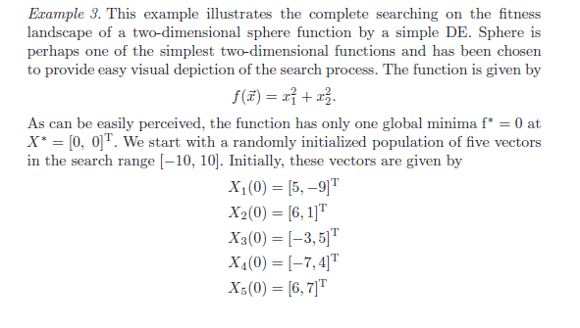

Slide 18
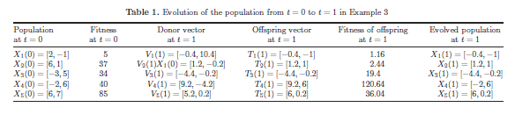

Slide 19
The Complete DE Family of Storn and Price
Actually, it is the process of mutation, which demarcates one DE scheme from another.
In the former section, we have illustrated the basic steps of a simple DE. The mutation scheme uses a randomly selected vector Xr1 and only one weighted difference vector F · (Xr2 − Xr3) is used to perturb it.
Hence, in literature the particular mutation scheme is referred to as DE/rand/1.
We can now have an idea of how different DE schemes are named. The general convention used, is DE/x/y.
DE stands for DE, x represents a string denoting the type of the vector to be perturbed (whether it is randomly selected or it is the best vector in the population with respect to fitness value) and y is the number of difference vectors considered for perturbation of x. Below we outline the other different mutation schemes, suggested by Price et al.

Slide 20
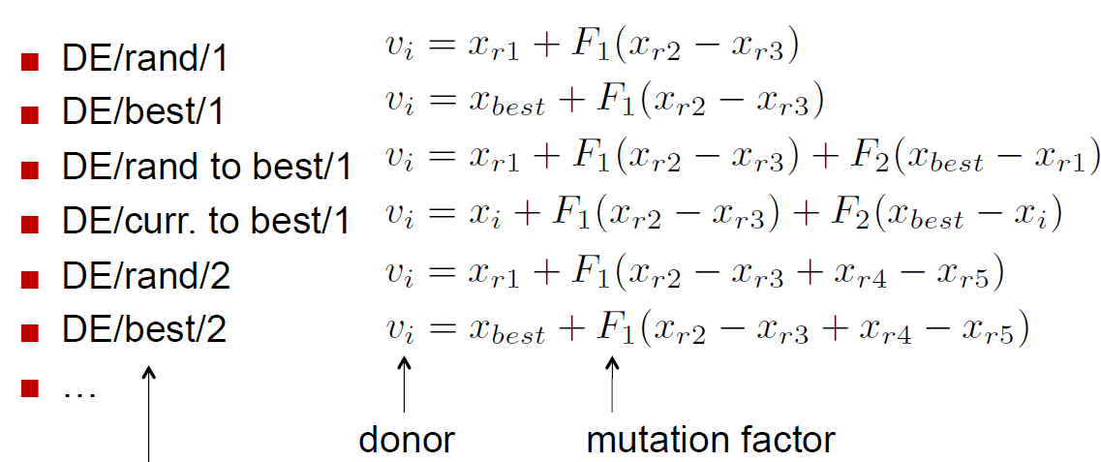

Slide 21
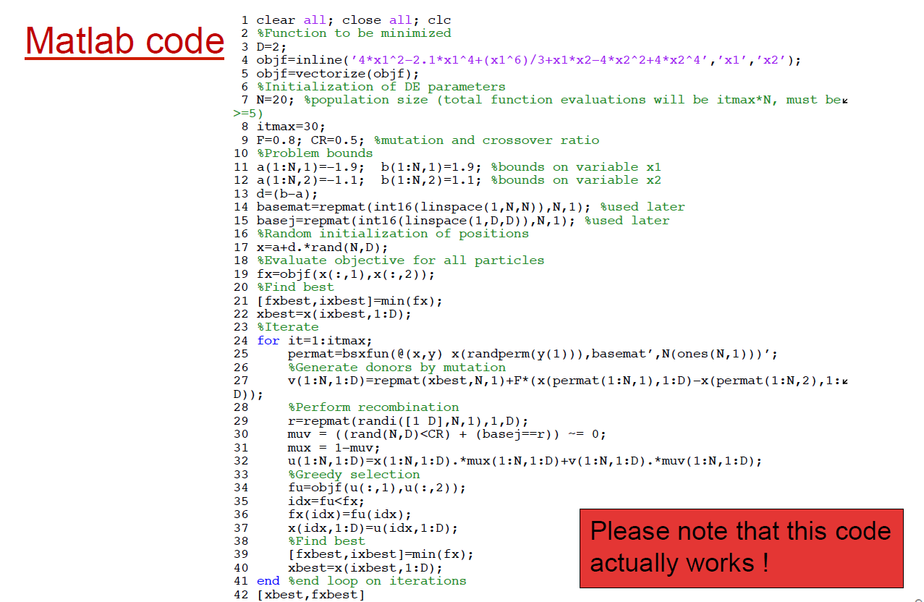

Slide 22
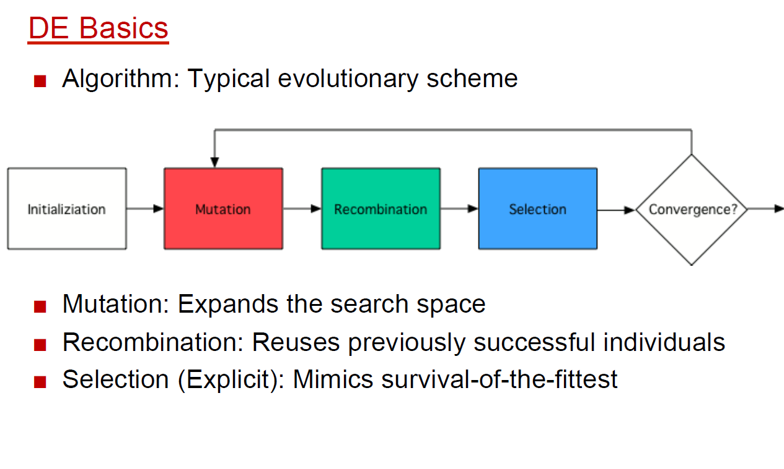

Slide 23
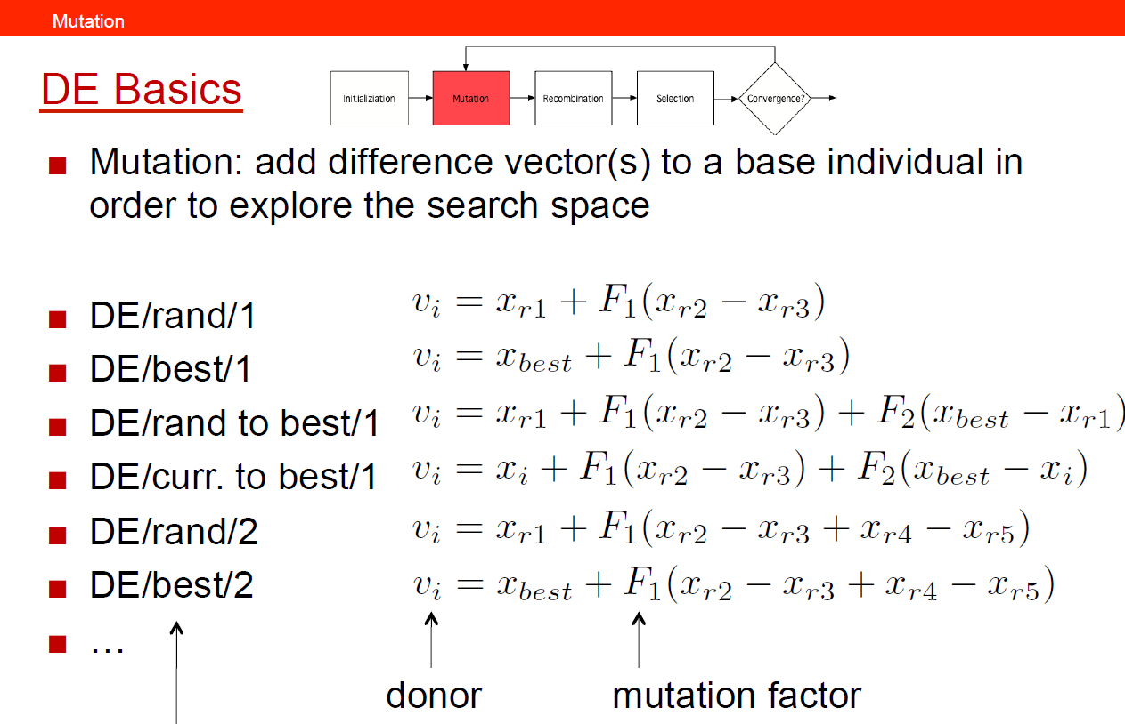

Slide 24
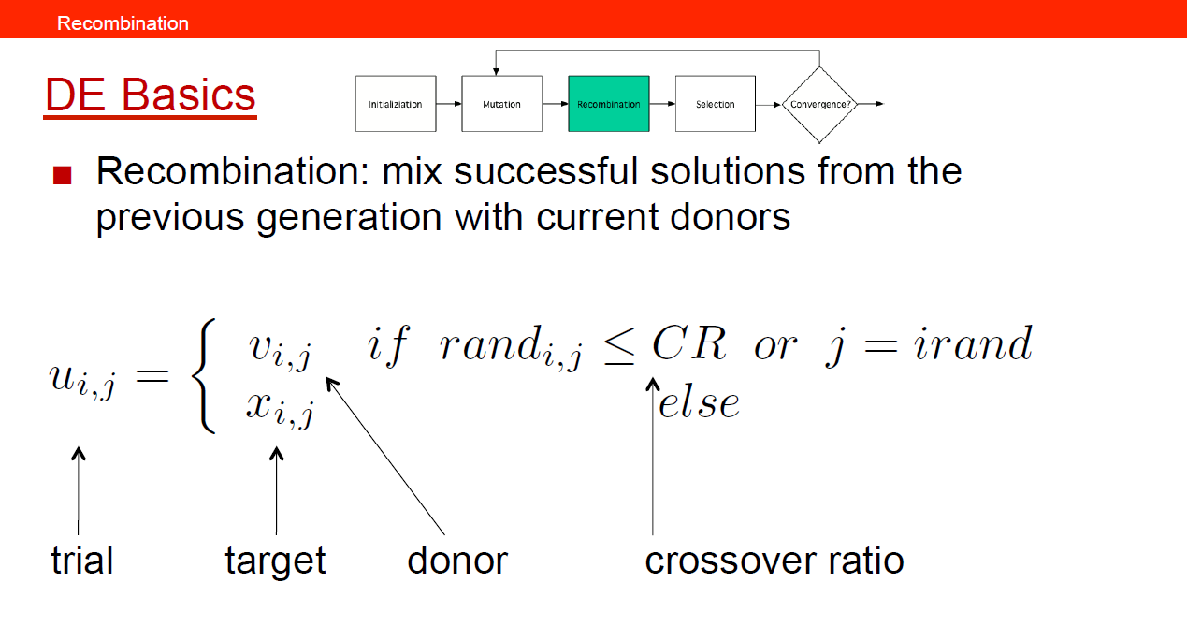

Slide 25
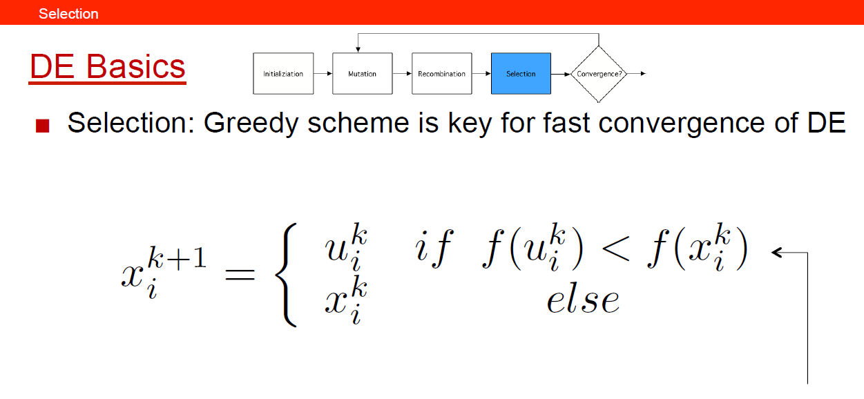

Slide 26
