Slide 1
Swarm Intelligence

Slide 2
What is swarm intelligence?
Swarm intelligence (SI) is also a group of population based optimization (search) algorithms.
Instead of trying to emulate the evolution process, SI tries to emulate the “collective behaviors” of bacterial, ants, birds, fish, animals, etc.
In nature, different “agents” are often governed by some very simple rules. They make decisions in a local and decentralized way, but as a whole, some “intelligent” behaviors often emerge.

Slide 3
Particle Swarm Optimization (PSO)

Slide 4


Introduction to the PSO: Origins
Particle swarm optimization (PSO) is an algorithm that tries to find the best solution to a problem. It is inspired by the social behavior of animals like birds flocking or fish schooling.
Inspired from the nature social behavior and dynamic movements with communications of insects, birds and fish

Slide 5
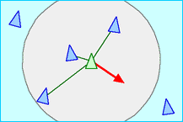
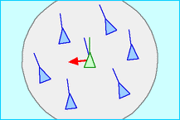
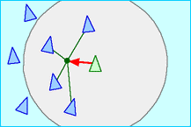
Introduction to the PSO: Origins
In 1986, Craig Reynolds described this process in 3 simple behaviors:
Separation
avoid crowding local flockmates
(Each agent tries to
move away from its neighbors if
they are too close.)
Alignment
move towards the average heading of local flockmates (or Each agent steers towards the average heading of its neighbors.
Cohesion
move toward the average position of local flockmates

Slide 6
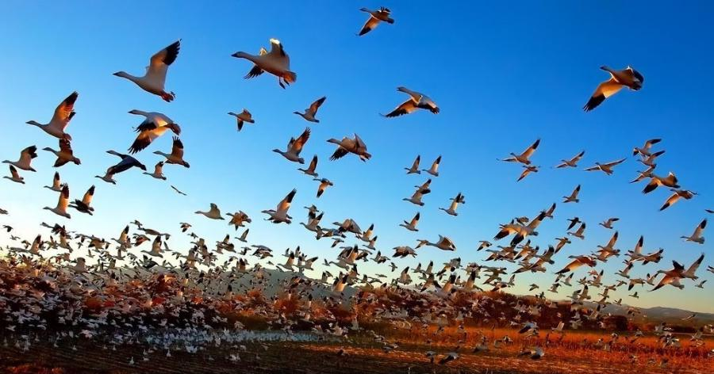
Introduction to the PSO: Origins
Application to optimization: Particle Swarm Optimization
Proposed by James Kennedy & Russell Eberhart (1995)
Combines self-experiences with social experiences

Slide 7
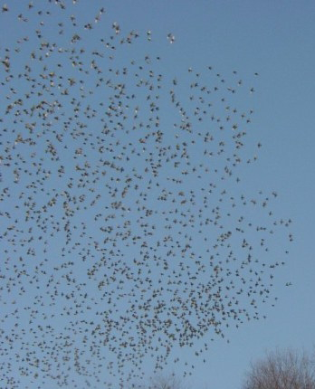
Introduction to the PSO: Concept
Uses a number of agents (particles) that constitute a swarm moving around in the search space looking for the best solution
Each particle in search space adjusts its “flying” according to its own flying experience as well as the flying experience of other particles

Slide 8
Introduction to the PSO: Concept
Collection of flying particles (swarm - set of particles (S)) - Changing solutions
Search area - Possible solutions
Movement towards a promising area to get the global optimum
Each particle keeps track:
  its best solution, personal best, pbest
  the best value of any particle, global best, gbest

Slide 9
Particle Swarm Optimization
Swarm: a set of particles (S)
Particle: a potential solution
  Position:
  Velocity:
Each particle maintains
  Individual best position (PBest)
Swarm maintains its global best (GBest)
Fitness function
Fitness value
S

Slide 10
Introduction to the PSO: Concept
pbest
gbest
Each particle modifies its position according to:
  its current position
    its current velocity
    the distance between its current position and pbest
    the distance between its current position and gbest

Slide 11
PSO Algorithm
Particle’s velocity
x(k+1)
PBest
GBest
social
v(k+1)
cognitive
v(k)
x(k)
Inertia

Slide 12
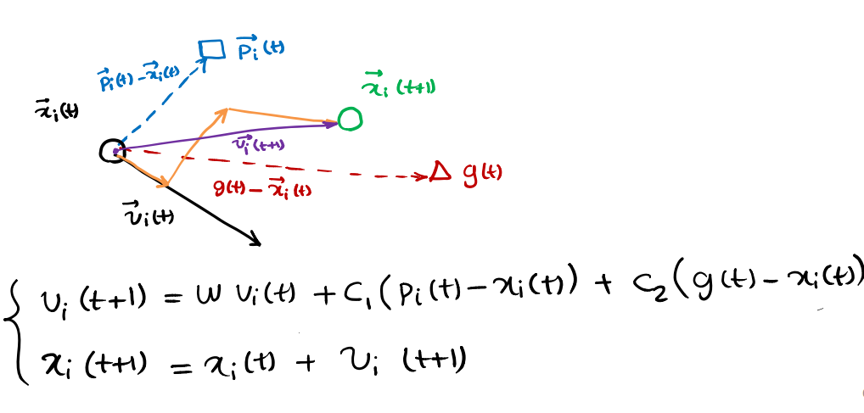
My best perf.
p_{i}
Here I am!
The best perf. of my neighbours
x
p_{g}
v

Slide 13
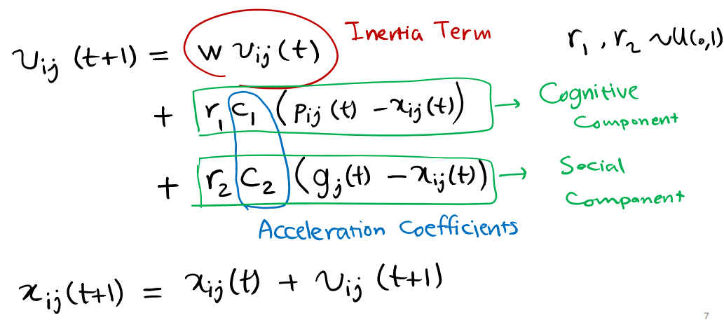

Slide 14
Introduction to the PSO: Algorithm - Neighborhood
geographical
social

Slide 15
Introduction to the PSO: Algorithm - Neighborhood
global

Slide 16
PSO Algorithm
Basic algorithm of PSO
  Initialize the swarm form the solution space
  Evaluate the fitness of each particle
  Update individual and global bests
  Update velocity and position of each particle
  Go to step2, and repeat until termination condition

Slide 17
Introduction to the PSO:
Algorithm - Parameterss
  Algorithm parameters
  A : Population of agents
  p_{i} : Position of agent a_{i} in the solution space
  f : Objective function
  v_{i} : Velocity of agent’s a_{i}
  V(a_{i}) : Neighborhood of agent a_{i} (fixed)
  The neighborhood concept in PSO is not the same as the one used in other meta-heuristics search, since in PSO each particle’s neighborhood never changes (is fixed)

Slide 18
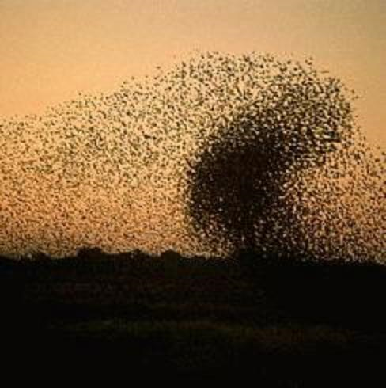
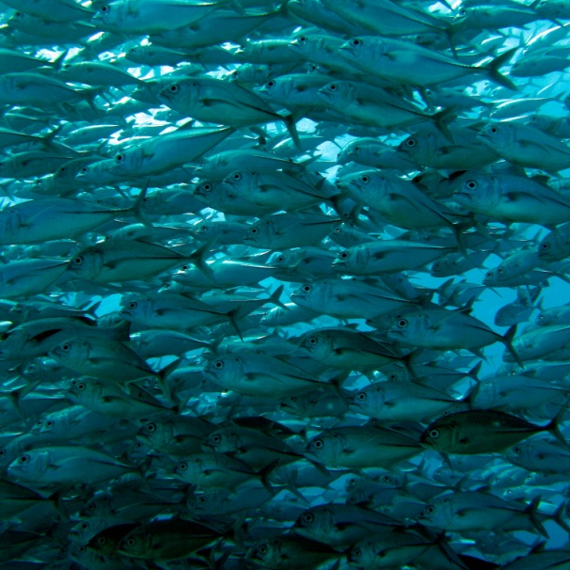
Introduction to the PSO: Algorithm
[x*] = PSO()
P = Particle_Initialization();
For i=1 to it_max
For each particle p in P do
fp = f(p);
If fp is better than f(pBest)
pBest = p;
end
end
gBest = best p in P;
For each particle p in P do
v = v + c1*rand*(pBest – p) + c2*rand*(gBest – p);
p = p + v;
end
end

Slide 19
Introduction to the PSO: Algorithm
  Particle update rule
    p = p + v
    with
      v = v + c₁ * rand * (pBest – p) + c₂ * rand * (gBest – p)
    where
  p: particle’s position
  v: path direction
  c₁: weight of local information
  c₂: weight of global information
  pBest: best position of the particle
  gBest: best position of the swarm
  rand: random variable
Notes:
c1, c2 : The balance factors between the effect of self-knowledge and social knowledge in moving the particle towards the target. Usually the value 2 is suggested for both factors in the literature)
rand :A random number between 0 and 1, and different at each iteration
w : Inertia weight
pbest : The best position of a particle
gbest : The best position within the swarm
prtvel : The velocity of jth particle in ith iteration
prtpos : The position of jth particle in ith iteration

Slide 20
Introduction to the PSO: Algorithm - Parameters
  Number of particles usually between 10 and 50
  C₁ is the importance of personal best value
  C₂ is the importance of neighborhood best value
  Usually C₁ + C₂ = 4 (empirically chosen value)
  If velocity is too low → algorithm too slow
  If velocity is too high → algorithm too unstable

Slide 21
Introduction to the PSO: Algorithm
Create a ‘population’ of agents (particles) uniformly distributed over X
Evaluate each particle’s position according to the objective function
If a particle’s current position is better than its previous best position, update it
Determine the best particle (according to the particle’s previous best positions)

Slide 22
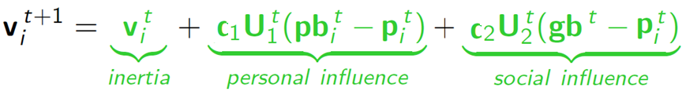

Introduction to the PSO: Algorithm
Update particles’ velocities:
Move particles to their new positions:
Go to step 2 until stopping criteria are satisfied

Slide 23
Introduction to the PSO: Algorithm
Particle’s velocity:
1. Inertia
Makes the particle move in the same direction and with the same velocity
Improves the individual
Makes the particle return to a previous position, better than the current
Conservative
2. Personal Influence
3. Social Influence
Makes the particle follow the best neighbors direction

Slide 24
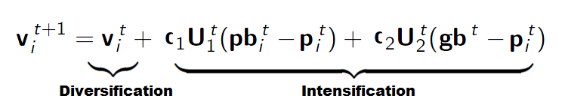
Introduction to the PSO: Algorithm
  Intensification: explores the previous solutions, finds the best solution of a given region
  Diversification: searches new solutions, finds the regions with potentially the best solutions
  In PSO:

Slide 25
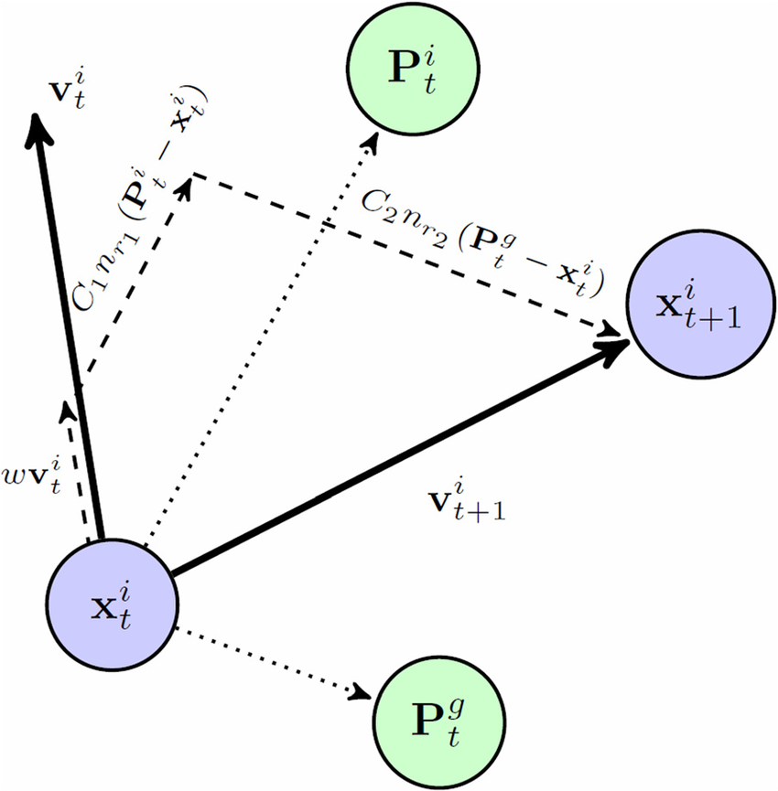

Slide 26
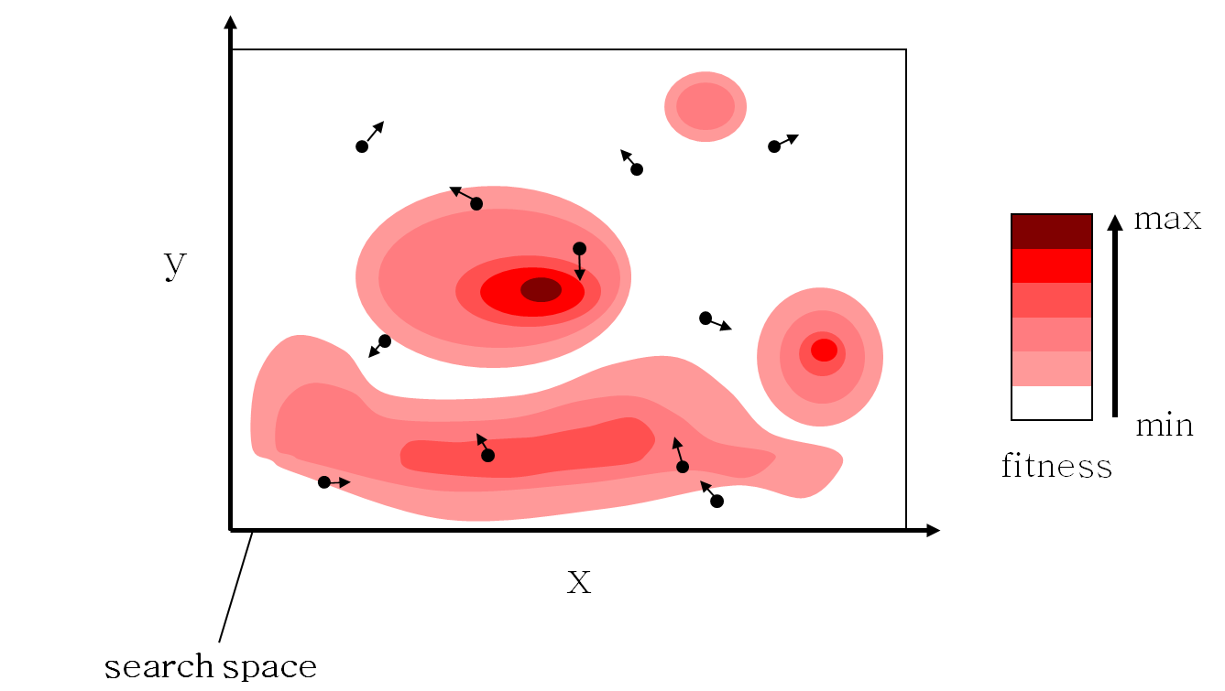
Introduction to the PSO: Algorithm - Example

Slide 27
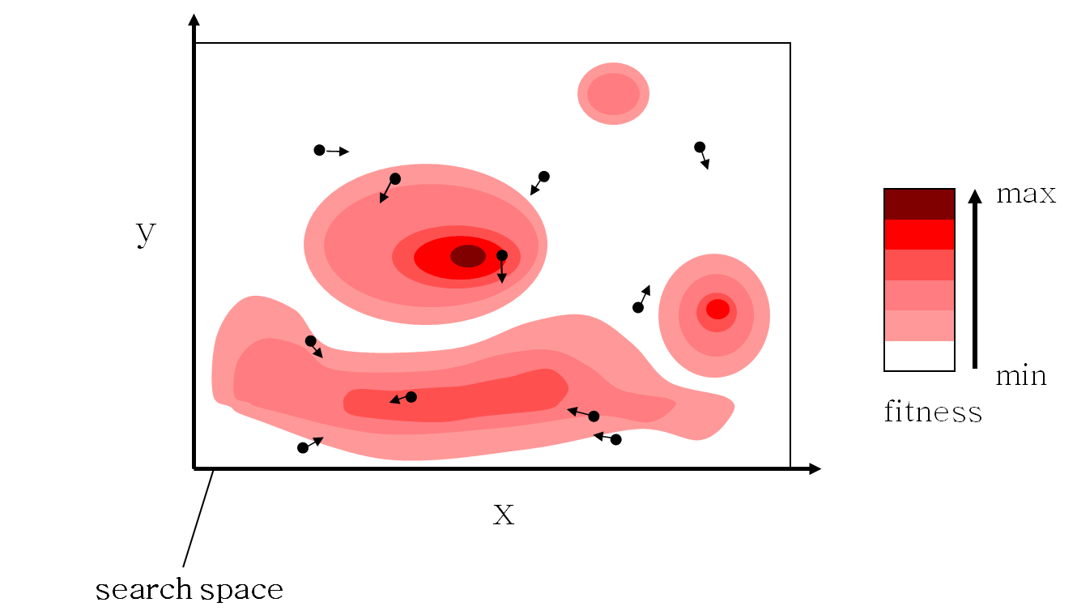
Introduction to the PSO: Algorithm - Example

Slide 28
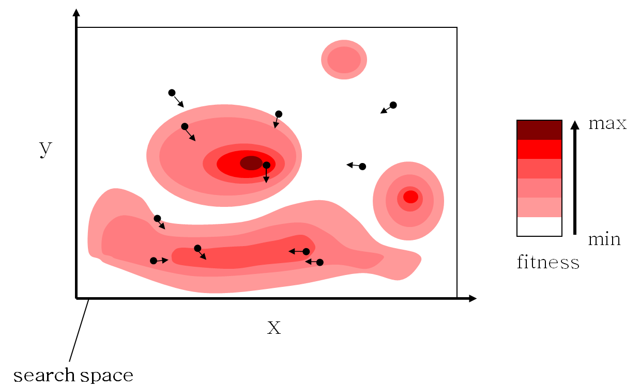
Introduction to the PSO: Algorithm - Example

Slide 29

Introduction to the PSO: Algorithm - Example

Slide 30

Introduction to the PSO: Algorithm - Example

Slide 31
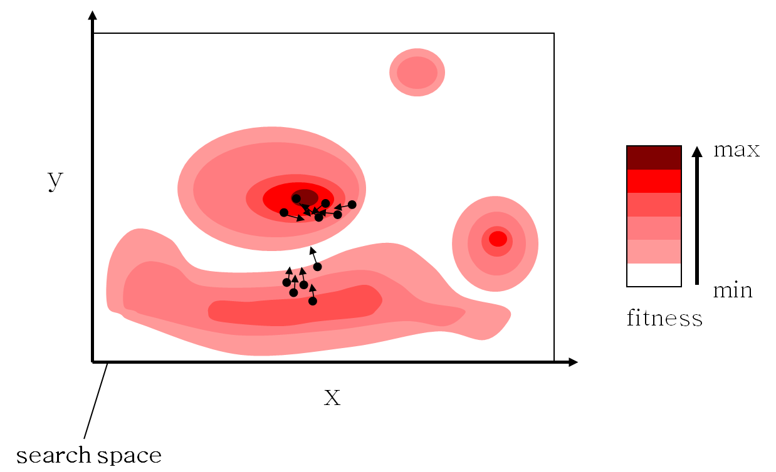
Introduction to the PSO: Algorithm - Example

Slide 32
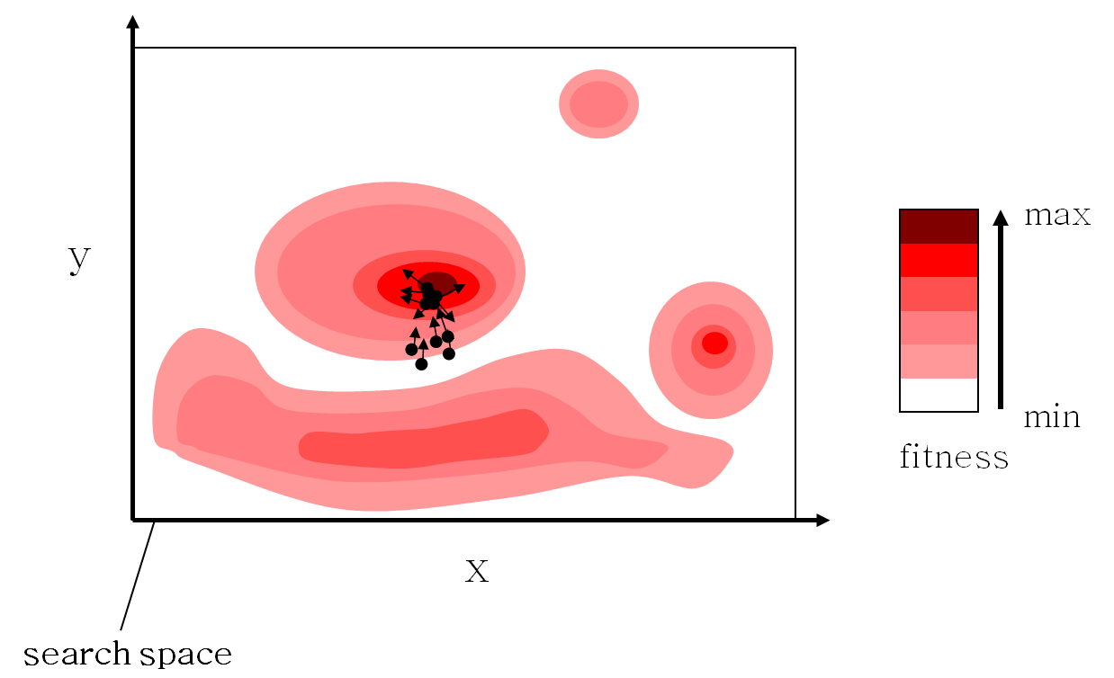
Introduction to the PSO: Algorithm - Example

Slide 33

Introduction to the PSO: Algorithm - Example

Slide 34
Introduction to the PSO: Algorithm Characteristics
Advantages
  Insensitive to scaling of design variables
  Simple implementation
  Easily parallelized for concurrent processing
  Derivative free
  Very few algorithm parameters
  Very efficient global search algorithm
Disadvantages
  Tendency to a fast and premature convergence in mid optimum points
  Slow convergence in refined search stage (weak local search ability)

Slide 35
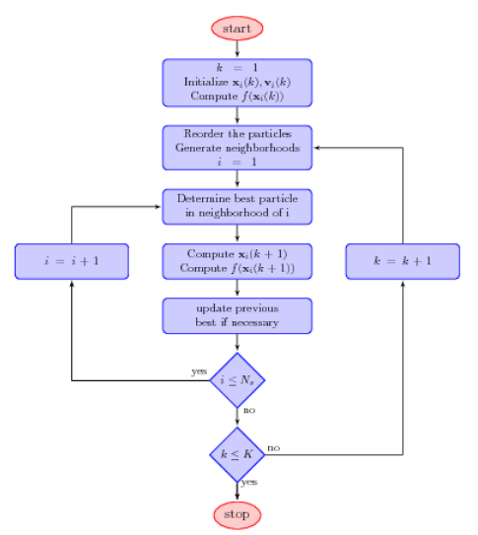

Slide 36
PSO: Example
Formally, let f: ℝ^{n} → ℝ be the fitness or cost function which must be minimized.
Let S be the number of particles in the swarm, each having a position x_{i} ∈ ℝ^{n} in the search-space and a velocity v_{i} ∈ ℝ^{n}.
Let p_{i} be the best known position of particle i and
let g be the best known position of the entire swarm.

Slide 37
Basic PSO Algorithm - init
For each particle i = 1, ..., S do:
  Initialize the particle's position with a uniformly distributed random vector: x_{i} ~ U(b_{lo}, b_{up}), where b_{lo} and b_{up} are the lower and upper boundaries of the search-space.
  Initialize the particle's best known position to its initial position: p_{i} ← x_{i}
  If (f(p_{i}) < f(g)) update the swarm's best known position: g ← p_{i}
  Initialize the particle's velocity: v_{i} ~ U(-|b_{up}-b_{lo}|, |b_{up}-b_{lo}|)
The parameters ω, φ_{p}, and φ_{g} are selected by the practitioner and control the behaviour and efficacy of the PSO method.

Slide 38
Basic PSO – Main Loop
Until a termination criterion is met (e.g. number of iterations performed, or adequate fitness reached), repeat:
  For each particle i = 1, ..., S do:
    Pick random numbers: r_{p}, r_{g} ~ U(0,1)
    Update the particle's velocity: v_{i} ← ω v_{i} + φ_{p} r_{p} (p_{i}-x_{i}) + φ_{g} r_{g} (g-x_{i})
    Update the particle's position: x_{i} ← x_{i} + v_{i}
    If (f(x_{i}) < f(p_{i})) do:
      Update the particle's best known position: p_{i} ← x_{i}
      If (f(p_{i}) < f(g)) update the swarm's best known position: g ← p_{i}
Now g holds the best found solution.

Slide 39
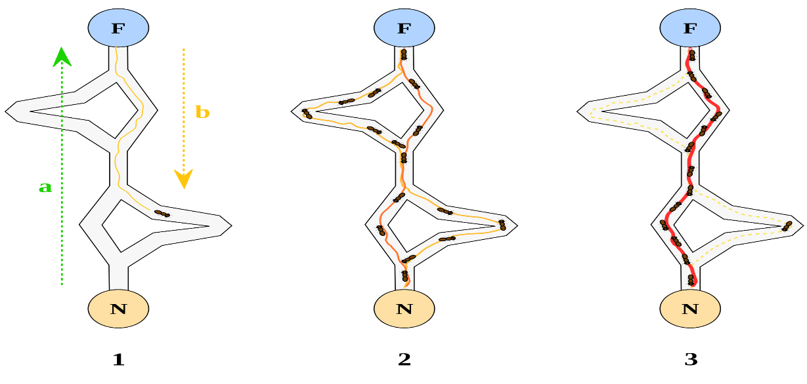

Ant Colony Optimization
“Ant Colony Optimization (ACO) studies artificial systems that take inspiration from the behavior of real ant colonies and which are used to solve discrete optimization problems.” ACO Website [1]
Source: http://upload.wikimedia.org/wikipedia/commons/thumb/a/af/Aco_branches.svg/2000px-Aco_branches.svg.png
Notes:
Was first introduced in Marco Dorigo’s Ph.D. thesis.
As we have seen, the TSP provides an excellent test environment…
In problems like the quadratic assignment problem and the sequential ordering problem these ACO algorithms outperform all known algorithms on vast classes of benchmark problems.

Slide 40
Ant Colony Optimization
Probalistic Techniques to solve optimization Problem
It is a population based metaheuristic used to find approximate solution to an optimization problem.
The Optimization Problem must be written in the form of path finding with a weighted graph
Application of ACO
Shortest paths and routing
Assignment problem
Set Problem

Slide 41
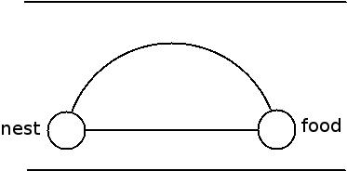
Idea
The way ants find their food in shortest path is interesting.
Ants hide pheromones to remember their path.
These pheromones evaporate with time.
Whenever an ant finds food , it marks its return journey with pheromones.
Pheromones evaporate faster on longer paths.

Slide 42
Idea (cont.)
Shorter paths serve as the way to food for most of the other ants.
The shorter path will be reinforced by the pheromones further.
Finally , the ants arrive at the shortest path.

Slide 43
ACO Concept
Ants navigate from nest to food source. Ants are blind!
Shortest path is discovered via pheromone trails. Each ant moves at random
Pheromone is deposited on path
More pheromone on path increases probability of path being followed

Slide 44

Ant Colony Optimization
Source: http://upload.wikimedia.org/wikipedia/commons/thumb/a/af/Aco_branches.svg/2000px-Aco_branches.svg.png

Slide 45
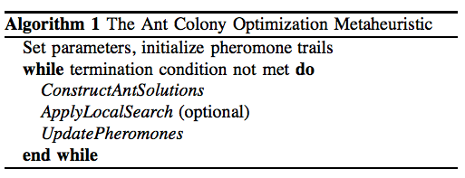
Ant Colony Algorithm
ConstructAntSolutions: Partial solution extended by adding an edge based on stochastic and pheromone considerations.
ApplyLocalSearch: problem-specific, used in state-of-art ACO algorithms.
UpdatePheromones: increase pheromone of good solutions, decrease that of bad solutions (pheromone evaporation).

