Slide 1
Multy- Objective
Differential Evolution (MODE)

Slide 2
What is differential evolution?
Differential Evolution (DE) is an EA for continuous function optimization proposed by Kenneth Price and Rainer Storn in 1994
DE is also a population based algorithm, in which each individual is called an agent, and is often represented as multi-dimensional real vector.
The basic idea is to use vector differences for perturbing (mutating) the vector population, instead of conventional crossover and mutation used in GA.

Slide 3
More specifically DEs basic strategy can be described as follows:
Initialization: an initial population is generated randomly with a distribution uniform
Where, i=1,...,N (N: population size)
j=1,...,D (D: length of the agent)

Slide 4
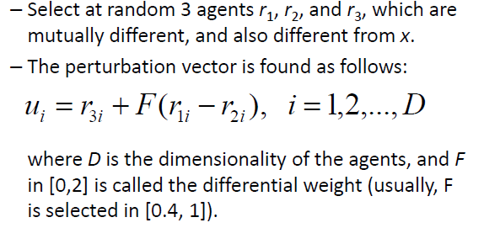
Mutation (perturbation): randomly select three vectors that are different, subtract two of them and the differences are applied weight given to them by a factor and finally add the difference to the third vector difference
An agent x is perturbed in two steps:
Step 1: Find perturbation vector u:

Slide 6
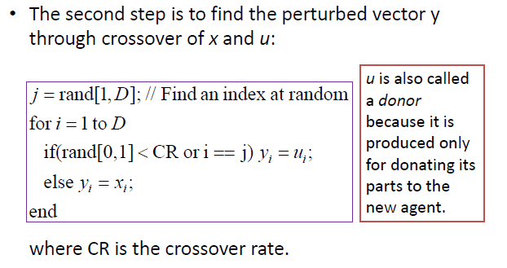

Slide 7
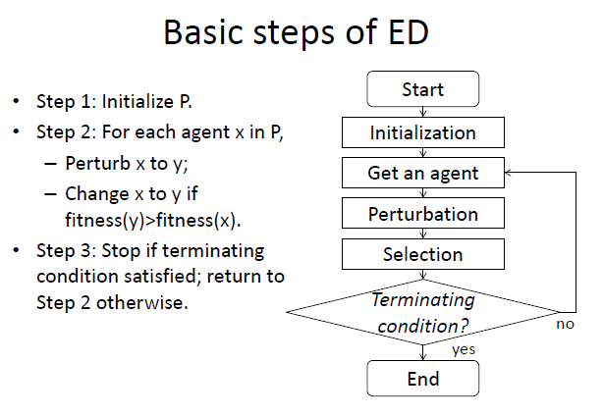
DE

Slide 8
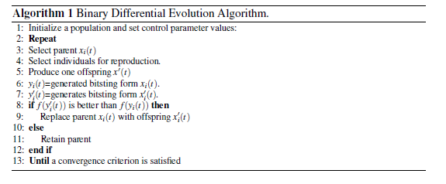

Slide 9
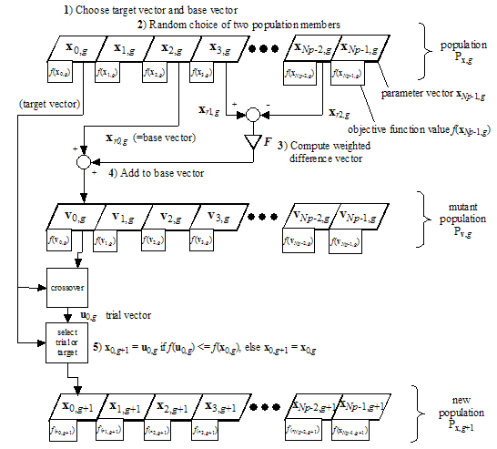

Slide 10
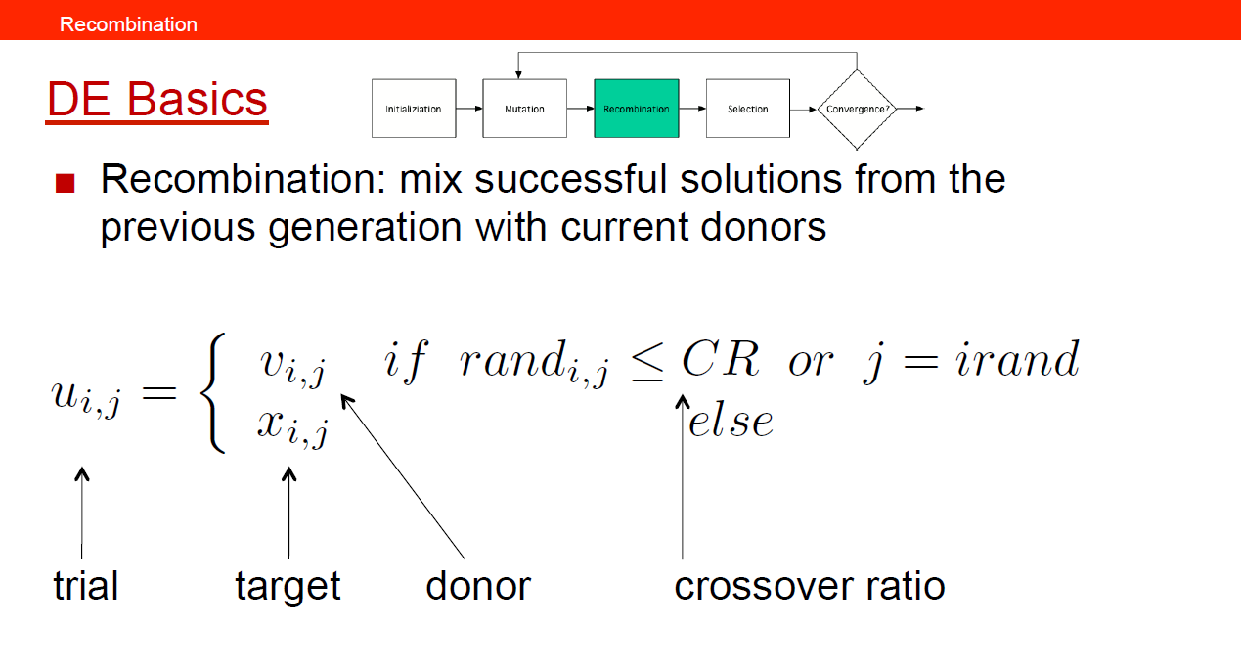

Slide 11
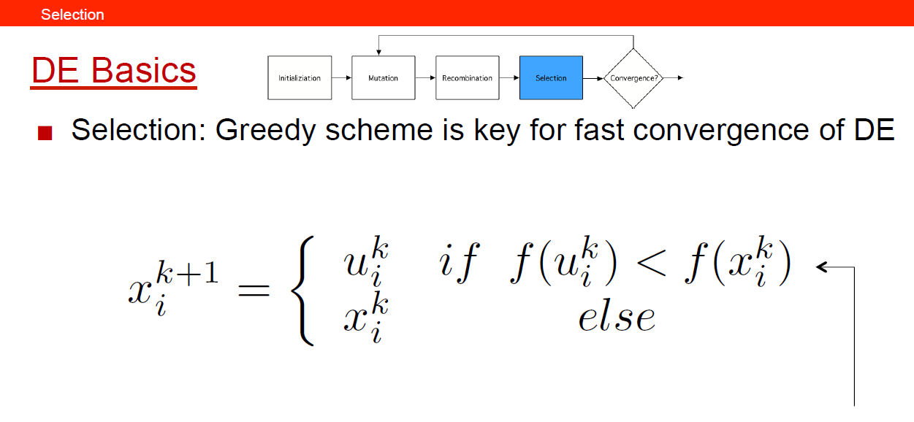

Slide 12
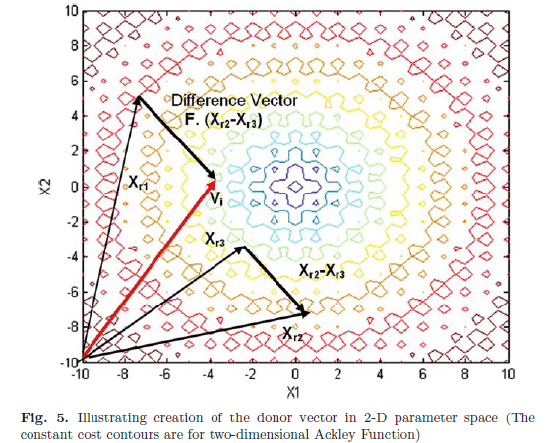

Slide 13
The Complete DE Family of Storn and Price
Actually, it is the process of mutation, which demarcates one DE scheme from another.
In the former section, we have illustrated the basic steps of a simple DE. The mutation scheme uses a randomly selected vector Xr1 and only one weighted difference vector F · (Xr2 − Xr3) is used to perturb it.
Hence, in literature the particular mutation scheme is referred to as DE/rand/1.
We can now have an idea of how different DE
schemes are named. The general convention used, is DE/x/y.
DE stands for DE, x represents a string denoting the type of the vector to be perturbed (whether it is randomly selected or it is the best vector in the population with respect to fitness value) and y is the number of difference vectors considered for perturbation of x. Below we outline the other different mutation schemes, suggested by Price et al.

Slide 14
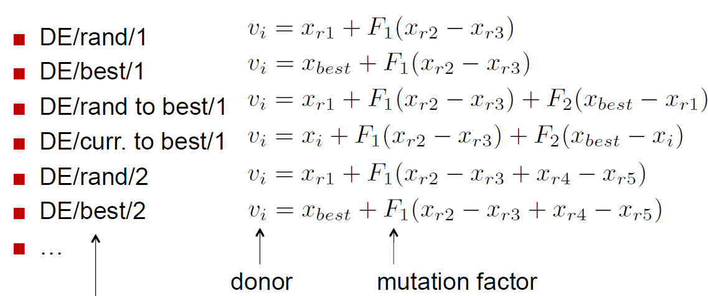

Slide 15
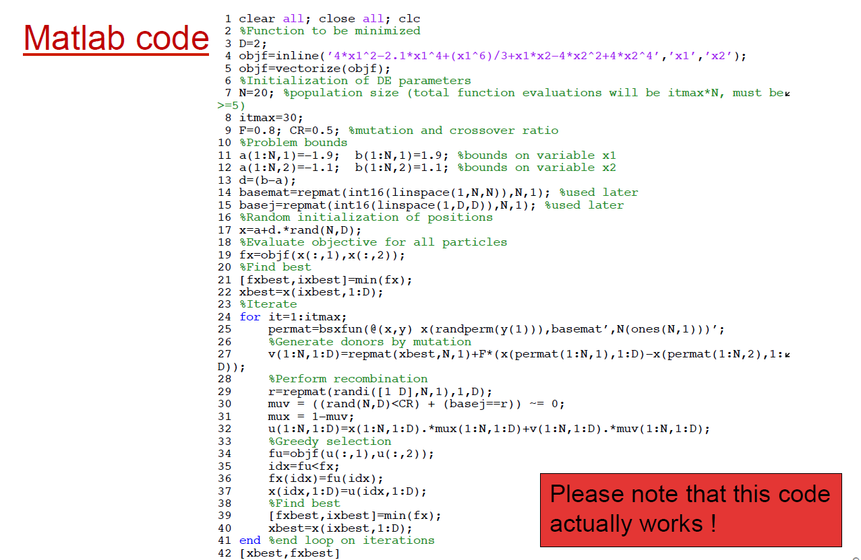

Slide 16
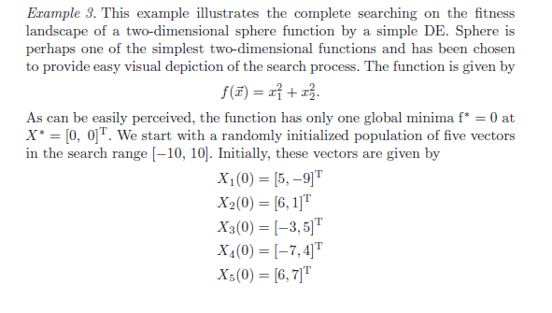

Slide 17
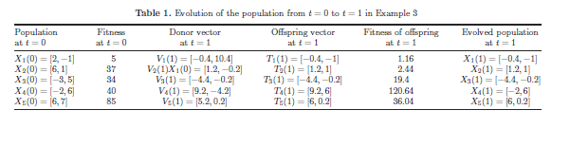

Slide 18
MODE
The MODE approach has three major components, those are
  reproduction,
  Pareto-based evaluation, and
  selection.
These components will be described in detail in this section.

Slide 19
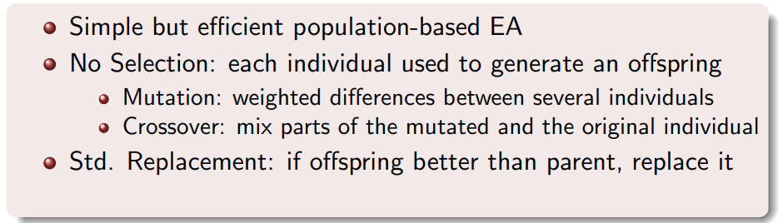
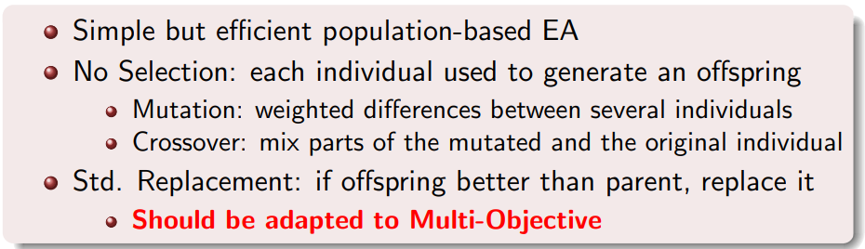
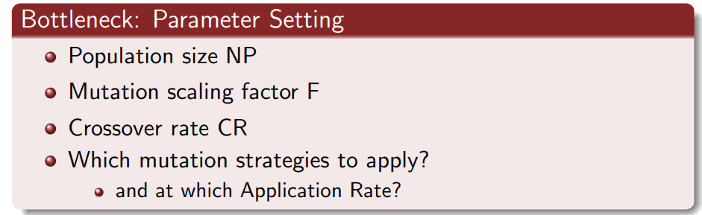

Slide 20
1) Pareto-based evaluation:
Fitness assignment to the individuals in a evolving population of a multi-objective evolutionary algorithm is rather different than the single-objective counterpart. There are different approaches to evaluating individual fitness of a population, all of which can be regarded as the variants of the non-dominated sorting schema suggested by Goldberg [19]. This Pareto-based rank assignment is employed in a way to assign ranks to individuals based on their Pareto dominance relation to other individuals in the same population. At first, the whole population is considered and all the non-dominated solutions are assigned rank 1, which indicates they have the highest fitness values in the population. At the next step, the already labeled solutions are removed from the population and only the rest subset population is considered and the non-dominated solutions in that subset population are identified and assigned rank 2, which indicates t they have the next highest fitness values. The above process continues until every individual in the population is assigned a fitness value. This process is illustrated in Figure 2 where the whole population i s divided into multiple ranks with all individuals in each rank assigned the same fitness values. (Non dominated sorting)

Slide 21
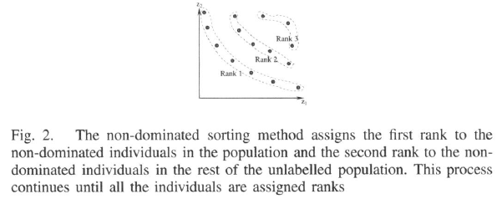

Slide 22
2) Pareto-based reproduction operator:
In order to mimic the reproduction operator in the DE approach described above, we need to define two kinds of vectors:
  the differential vector and
  the perturbation vectors
for each individual in the population for its reproduction of offspring.
In the proposed MODE, a Pareto-based approach is introduced to implement the selection of the best individual to define the differential vector for the reproduction operation of an individual.
As described in the Pareto-based evaluation procedure above, the whole population is divided into multiple ranks.
The algorithm can identify the set non-dominated solutions (those assigned as first rank) of the population at each generation of the evolutionary process. In order to apply the reproduction operation to an individual, pi , we need to examine whether the individual is dominated or not. If this is a dominated individual, a subset non-dominated individuals, Di , that dominates this individual can be identified.
A "best" solution, Pbest , is chosen randomly from the set Di.

Slide 23
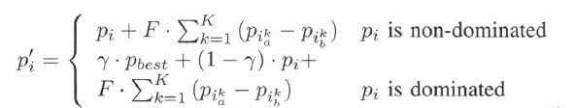
A "best" solution, Pbest , is chosen randomly from the set Di.
The vector defined between pi and Pbest becomes the differential vector for the reproduction operation of the individual pi.
If the individual is already a non-dominated individual, the Pbest will be the individual itself. In this case, the differential vector becomes 0 and only perturbation vectors play effect.

Slide 24
In the proposed MODE, all the parent and the children (one parental individual generates one child) are put together to compete for entering into the next generation based on their ranks and the crowd distance metrics.

