Slide 1
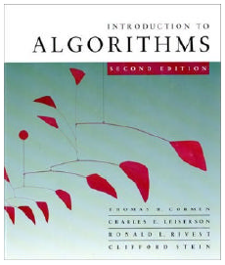
CMPE371
Analysis of Algorithms
FALL 2025-2026
Lecture 5
Algorithm Design Techniques

Slide 2
Analysis of Algorithms
Part II: Algorithm Design Techniques
Programming paradigms
Brute force approach
Divide and conquer
Dynamic programming:
  matrix chain multiplication problem
  knapsack problem
  longest common subsequence problem
  rod cuting problem
Greedy algorithms:
  activity selection problem
  fractional knapsack problem

Slide 3
Brute Force Approach
A straightforward approach of trying exhaustively all possible potential alternatives for the solution of the given problem, usually based directly on the problem’s statement and definitions of the concepts involved.
Example: Selection sort algorithm.

Slide 4
Brute-Force Sorting Algorithm
Selection Sort Scan the array to find its smallest element and swap it with the first element. Then, starting with the second element, scan the elements to the right of it to find the smallest among them and swap it with the second elements. Generally, on pass i (0 ≤ i ≤ n-2), find the smallest element in A[i..n-1] and swap it with A[i]:
A[0] ≤ . . . ≤ A[i-1] | A[i], . . . , A[min], . . ., A[n-1]
in their final positions
Example: 7 3 2 5

Slide 5
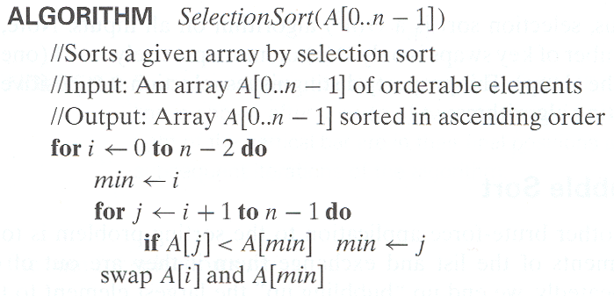
Analysis of Selection Sort
Time efficiency:
Space efficiency:
Θ(n²)
Θ(n).

Slide 6
Brute-Force String Matching
pattern: a string of m characters to search for
text: a (longer) string of n characters to search in
problem: find a substring in the text that matches the pattern
Brute-force algorithm
Step 1 Align pattern at beginning of text
Step 2 Moving from left to right, compare each character of
pattern to the corresponding character in text until
    all characters are found to match (successful search); or
    a mismatch is detected
Step 3 While pattern is not found, and the text is not yet
exhausted, realign pattern one position to the right and
repeat Step 2

Slide 7
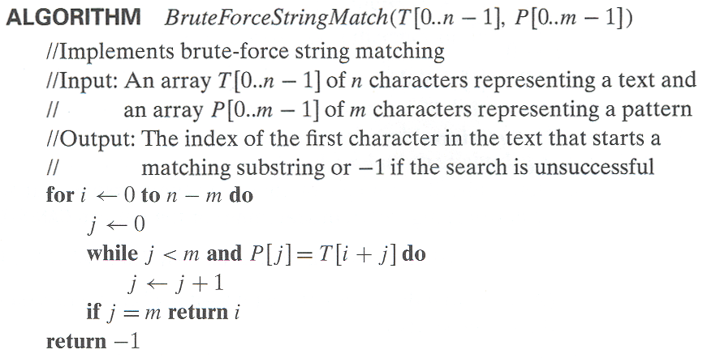
Pseudocode and Efficiency
Time efficiency: θ(m.n) in the worst case.

Slide 8
Examples of Brute-Force String Matching
Pattern: 001011 Text: 10010101101001100101111010
Pattern: happy Text: It is never too late to have a happy childhood.

Slide 9
Brute-Force Polynomial Evaluation
Problem: Find the value of polynomial
p(x) = a_{n}x^{n} + a_{n-1}x^{n-1} +… + a₁x¹ + a₀
at a point x = x₀
Brute-force algorithm
Efficiency: θ(n²)
p ← 0.0
for i ← n downto 0 do
power ← 1
  for j ← 1 to i do //compute x^{i}
  power ← power ∗ x
  p ← p + a[i] ∗ power
return p

Slide 10
Polynomial Evaluation: Improvement
We can do better by evaluating from right to left:
Better brute-force algorithm
Efficiency:
p ← a[0]
power ← 1
for i ← 1 to n do
    power ← power ∗ x
  p ← p + a[i] ∗ power
  return p
Θ(n) multiplications

Slide 11
Brute-Force Strengths and Weaknesses
Strengths
  wide applicability
  simplicity
  yields reasonable algorithms for some important problems
  (e.g., matrix multiplication, sorting, searching, string matching)
Weaknesses
  rarely yields efficient algorithms
  some brute-force algorithms are unacceptably slow
  not as constructive as some other design techniques

Slide 12
Exhaustive Search
A brute force solution to a problem involving search for an element with a special property, usually among combinatorial objects such as permutations, combinations, or subsets of a set.
Method:
  generate a list of all potential solutions to the problem in a systematic manner
  evaluate potential solutions one by one, disqualifying infeasible ones and, for an optimization problem, keeping track of the best one found so far
  when search ends, announce the solution(s) found

Slide 13
Example : Traveling Salesman Problem

Slide 17
Example 1: Traveling Salesman Problem
Given n cities with known distances between each pair, find the shortest tour that passes through all the cities exactly once before returning to the starting city
Alternatively: Find shortest Hamiltonian circuit in a weighted connected graph
Example:
2
a
b
5
3
8
4
c
d
7
How do we represent a solution (Hamiltonian circuit)?

Slide 18
TSP by Exhaustive Search
Tour Cost
a→b→c→d→a 2+3+7+5 = 17
a→b→d→c→a 2+4+7+8 = 21
a→c→b→d→a 8+3+4+5 = 20
a→c→d→b→a 8+7+4+2 = 21
a→d→b→c→a 5+4+3+8 = 20
a→d→c→b→a 5+7+3+2 = 17
Efficiency:
Θ((n-1)!)

Slide 19
Example 2: Knapsack Problem
Given n items:
  weights: w₁ w₂ … w_{n}
  values: v₁ v₂ … v_{n}
  a knapsack of capacity W
Find most valuable subset of the items that fit into the knapsack
Example: Knapsack capacity W=16
item weight value
2 $20
5 $30
10 $50
5 $10

Slide 20
Knapsack Problem by Exhaustive Search
Subset Total weight Total value
{1} 2 $20
{2} 5 $30
{3} 10 $50
{4} 5 $10
{1,2} 7 $50
{1,3} 12 $70
{1,4} 7 $30
{2,3} 15 $80
{2,4} 10 $40
{3,4} 15 $60
{1,2,3} 17 not feasible
{1,2,4} 12 $60
{1,3,4} 17 not feasible
{2,3,4} 20 not feasible
{1,2,3,4} 22 not feasible
Efficiency:
Θ(2^n)

Slide 21
Example 3: The Assignment Problem
There are n people who need to be assigned to n jobs, one person per job. The cost of assigning person i to job j is C[i,j]. Find an assignment that minimizes the total cost.
Job 0 Job 1 Job 2 Job 3
Person 0 9 2 7 8
Person 1 6 4 3 7
Person 2 5 8 1 8
Person 3 7 6 9 4
Algorithmic Plan: Generate all legitimate assignments, compute
their costs and select the cheapest one.
How many assignments are there?
Pose the problem as one about a cost matrix:
n!
cycle cover in a graph

Slide 22
Assignment Problem by Exhaustive Search
9 2 7 8
6 4 3 7
5 8 1 8
7 6 9 4
Assignment (col.#s) Total Cost
1, 2, 3, 4 9+4+1+4=18
1, 2, 4, 3 9+4+8+9=30
1, 3, 2, 4 9+3+8+4=24
1, 3, 4, 2 9+3+8+6=26
1, 4, 2, 3 9+7+8+9=33
1, 4, 3, 2 9+7+1+6=23
etc.
(For this particular instance, the optimal assignment can be found by exploiting the specific features of the number given. It is: )
C =
2,1,3,4

Slide 23
Final Comments on Exhaustive Search
Exhaustive-search algorithms run in a realistic amount of time only on very small instances
In some cases, there are much better alternatives!
  Euler circuits
  shortest paths
  minimum spanning tree
  assignment problem
In many cases, exhaustive search or its variation is the only known way to get exact solution

Slide 24

Divide-and-Conquer

Slide 25
Divide-and-Conquer
The most-well known algorithm design strategy:
Divide instance of problem into two or more smaller instances
Solve smaller instances recursively
Obtain solution to original (larger) instance by combining these solutions

Slide 26
Divide-and-Conquer Technique (cont.)
a problem of size n
(instance)
subproblem 1
of size n/2
subproblem 2
of size n/2
a solution to
subproblem 1
a solution to
subproblem 2
a solution to
the original problem
It general leads to a recursive algorithm!

Slide 27
Divide-and-Conquer Examples
Sorting: mergesort and quicksort
Binary tree traversals
Binary search (?)
Multiplication of large integers
Matrix multiplication: Strassen’s algorithm
Closest-pair and convex-hull algorithms

Slide 28
General Divide-and-Conquer Recurrence
T(n) = aT(n/b) + f (n) where f(n) ∈ Θ(n^{d}), d ≥ 0
Master Theorem: If a < b^{d}, T(n) ∈ Θ(n^{d})
If a = b^{d}, T(n) ∈ Θ(n^{d} log n)
If a > b^{d}, T(n) ∈ Θ(n^{log b a} )
Note: The same results hold with O instead of Θ.
Examples: T(n) = 4T(n/2) + n ⇒ T(n) ∈ ?
T(n) = 4T(n/2) + n² ⇒ T(n) ∈ ?
T(n) = 4T(n/2) + n³ ⇒ T(n) ∈ ?
Θ(n^2)
Θ(n^2log n)
Θ(n^3)

Slide 29
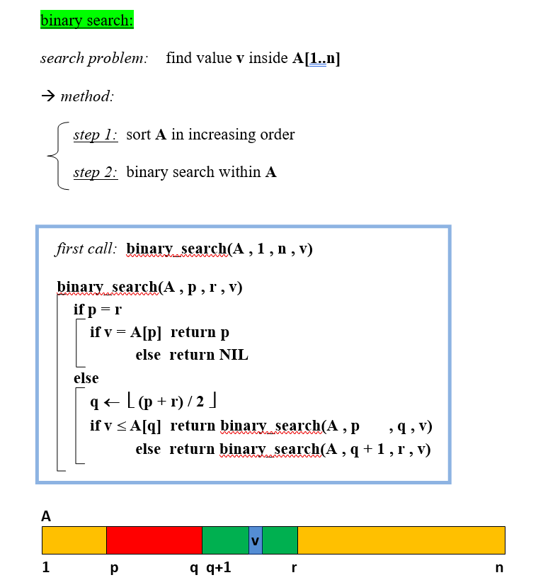

Slide 30
Mergesort
Split array A[0..n-1] into about equal halves and make copies of each half in arrays B and C
Sort arrays B and C recursively
Merge sorted arrays B and C into array A as follows:
  Repeat the following until no elements remain in one of the arrays:
    compare the first elements in the remaining unprocessed portions of the arrays
    copy the smaller of the two into A, while incrementing the index indicating the unprocessed portion of that array
  Once all elements in one of the arrays are processed, copy the remaining unprocessed elements from the other array into A.

Slide 31
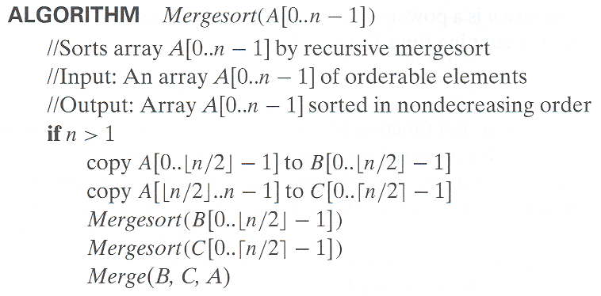
Pseudocode of Mergesort

Slide 32
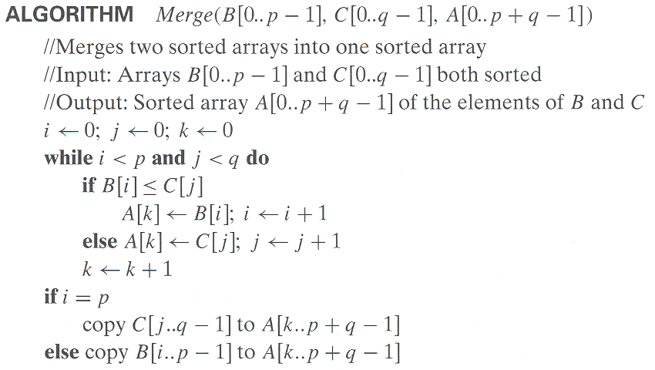
Pseudocode of Merge
Time complexity: Θ(p+q) = Θ(n) comparisons

Slide 33
Mergesort Example
The non-recursive version of Mergesort starts from merging single elements into sorted pairs.
Notes:
Go over this example in detail, then do another example of merging, something like:
(1 2 5 7 9)
(3 4 6)

Slide 34
Analysis of Mergesort
All cases have same efficiency: Θ(n log n)
Number of comparisons in the worst case is close to theoretical minimum for comparison-based sorting:
  ⎡log₂ n!⎤ ≈ n log₂ n - 1.44n
Space requirement: Θ(n) (not in-place)
Can be implemented without recursion (bottom-up)
T(n) = 2T(n/2) + Θ(n), T(1) = 0
Notes:
even if not analyzing in detail, show the recurrence for mergesort in worst case:
T(n) = 2 T(n/2) + (n-1)
worst case comparisons for merge

