Slide 1
Software Development Processes
(Ch 2.1)

Slide 2
Topics covered
SOFTWARE PROCESS MODELS
PROCESS ACTIVITIES (Ch 2.1)
COPING WITH CHANGE (1-PROTOTYPE, 2- DESİGN AS A NEW INCREMENT) (Ch 2.1)
PROCESS IMPROVEMENT (Ch 2.1)

Slide 3
II. PROCESS ACTIVITIES
Real software development processes are interleaved sequences of technical, collaborative and managerial activities with the overall goal of specifying, designing, implementing and testing a software system.

Slide 4
Software Development Process activities
The four basic process activities of:
(1) specification (SRS), (2) design (SDS) & development, (3) validation and (4) evolution
are organized differently in different development processes.
  For example, in the waterfall model, they (specification, development, validation and evolution activities) are organized in sequence, whereas in incremental development they are interleaved activities.

Slide 5
Software Development Process activities
The four basic process activities of:
(1) SPECIFICATION (SRS),
(2) DESIGN (SDS) AND DEVELOPMENT,
(3) VALIDATION (TEST, REVIEWS, CUSTOMER APPROVAL)
(4) EVOLUTION

Slide 6
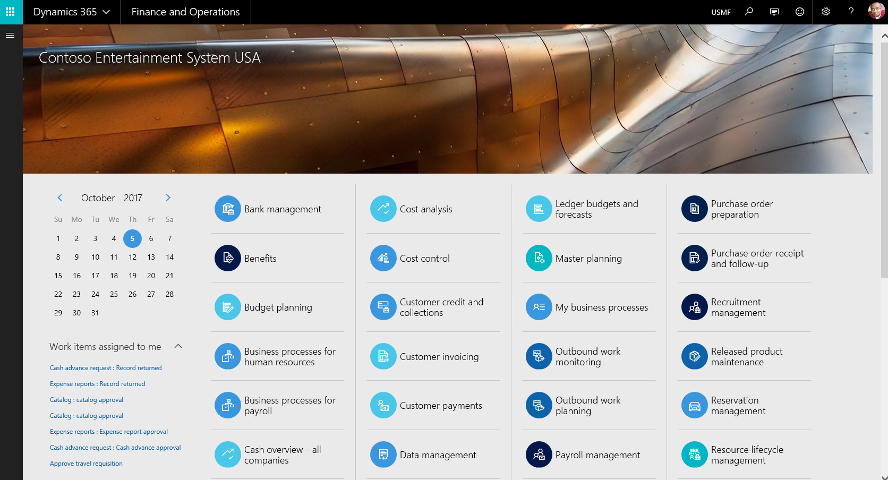
Our problem: difficult to understand the business operations of our customers due to complexity!

Slide 7
1-SOFTWARE SPECIFICATION
The process involves:
  What services are required and
  The constraints (development cost, HW cost, operational cost, training cost, etc.) during the system’s operation and development.
REQUIREMENTS ENGINEERING PROCESSES
  Requirements elicitation and analysis
    What do the system stakeholders require or expect from the system?
    Main aim of the system?
  Requirements specification
    Defining the requirements in detail (functions)
  Requirements validation
    Checking the validity of the requirements

Slide 8
The requirements engineering process
Validated SRS DOCUMENT???
iterative
Rectangles are intermediate outputs
Ovals are SW process activities
Main aims
of the system
Actor funcs
Validated SRS

Slide 9
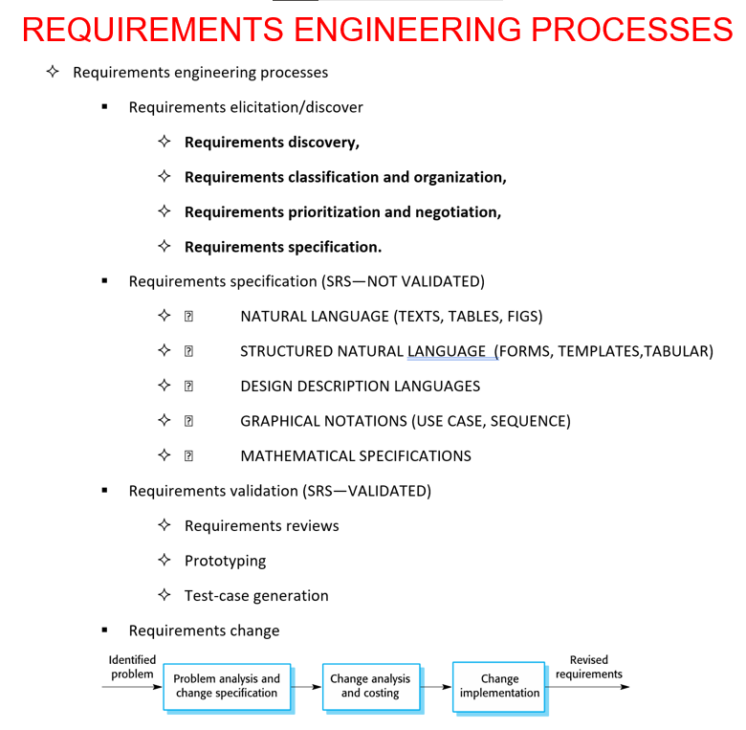
1-SOFTWARE SPECIFICATION
Validated SRS

Slide 10
Software Development Process activities
The four basic process activities of:
(1) SPECIFICATION (SRS),
(2) DESIGN (SDS) AND DEVELOPMENT,
(3) VALIDATION (TEST, REVIEWS, CUSTOMER APPROVAL)
(4) EVOLUTION

Slide 11
2-SOFTWARE DESIGN & IMPLEMENTATION

Slide 12
2-SOFTWARE DESIGN & IMPLEMENTATION
Aim is converting the system specifications into an executable system.
Software design
  Design a software structure that realises the specification;
Implementation
  Translate this structure into an executable program;
The activities of design and implementation are closely related and may be inter-leaved.

Slide 13
2.1-DESIGN ACTIVITIES
Architectural design, where you identify the overall structure of the system, the principal components (subsystems or modules), their relationships and how they are distributed.
Interface design, where you define the interfaces between system components.
Component selection and design, where you search for reusable components.
Database design, where you design the system data structures and how these are to be represented in a database.

Slide 14
A general model of the design process

Slide 15
2.2-SYSTEM IMPLEMENTATION ACTIVITIES
The software is implemented either by developing a program/programs or by configuring an application system.
Design and implementation are interleaved activities for most types of software system.
Programming is an individual activity with no standard process.
Debugging is the activity of finding program faults and correcting these faults.

Slide 16
Software Development Process activities
The four basic process activities of:
(1) SPECIFICATION (SRS),
(2) DESIGN (SDS) AND DEVELOPMENT,
(3) VALIDATION (TEST, REVIEWS, CUSTOMER APPROVAL)
(4) EVOLUTION

Slide 17
3-SOFTWARE VALIDATION (TEST, REVIEWS, CUSTOMER APPROVAL)

Slide 18
3-SOFTWARE VALIDATION
VERIFICATION AND VALIDATION (V & V) is intended to show that a system fits to its specification and
show that the system meets the customer requirements.
Involves CHECKING & REVIEW processes, and SYSTEM TESTING.
System testing involves executing the system with test cases that are derived from the specification of the real data to be processed by the system.
Testing is the most commonly used V & V activity.

Slide 19
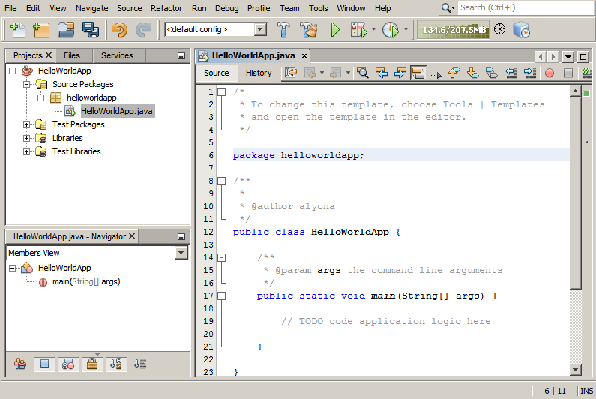
3.1- Stages of testing
Functions/Modules
UNIT TEST
Entire system
Testing with
customer data

Slide 20
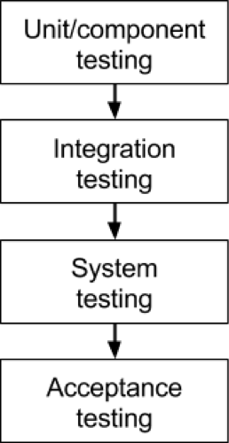
Testing stages
Component Testing/Unit testing
  Individual components are tested independently;
  Components may be functions or objects or coherent groupings of these entities.
System Testing
  Testing of the system as a whole.
  Testing of SYSTEM FEATURES developed is particularly important.
Customer Testing (USER ACCEPTANCE)
  Testing with customer data to check that the system meets the customer’s needs.

Slide 21
Testing phases in a plan-driven software process (V-model/Waterfall)
1
2
3
4
Coding
+
1-2
2-3
3-4
9
8
7
6
5
Seven Testing Principles: https://www.youtube.com/watch?v=rFaWOw8bIMM
How to write a Test Case: https://www.youtube.com/watch?v=BBmA5Qp6Ghk
Unit Testing Example: https://www.youtube.com/watch?v=lj5nnGa_DIw
Integration Testing Example: https://www.youtube.com/watch?v=QYCaaNz8emY
System Testing & Acceptance Testing: https://www.youtube.com/watch?v=N8-qNMHOVyw
Top 5 Software Testing Interview Questions: https://www.youtube.com/watch?v=Vb0_bY1tHfQ

Slide 22
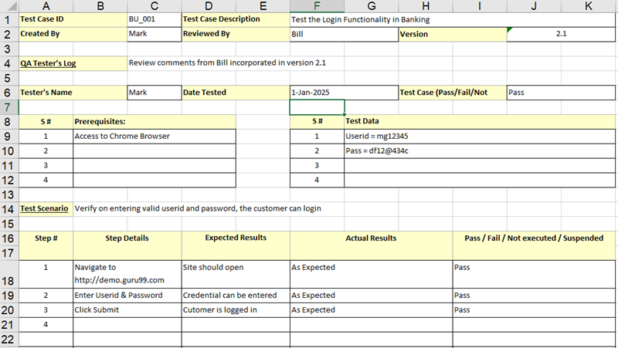
Example-2

Slide 23
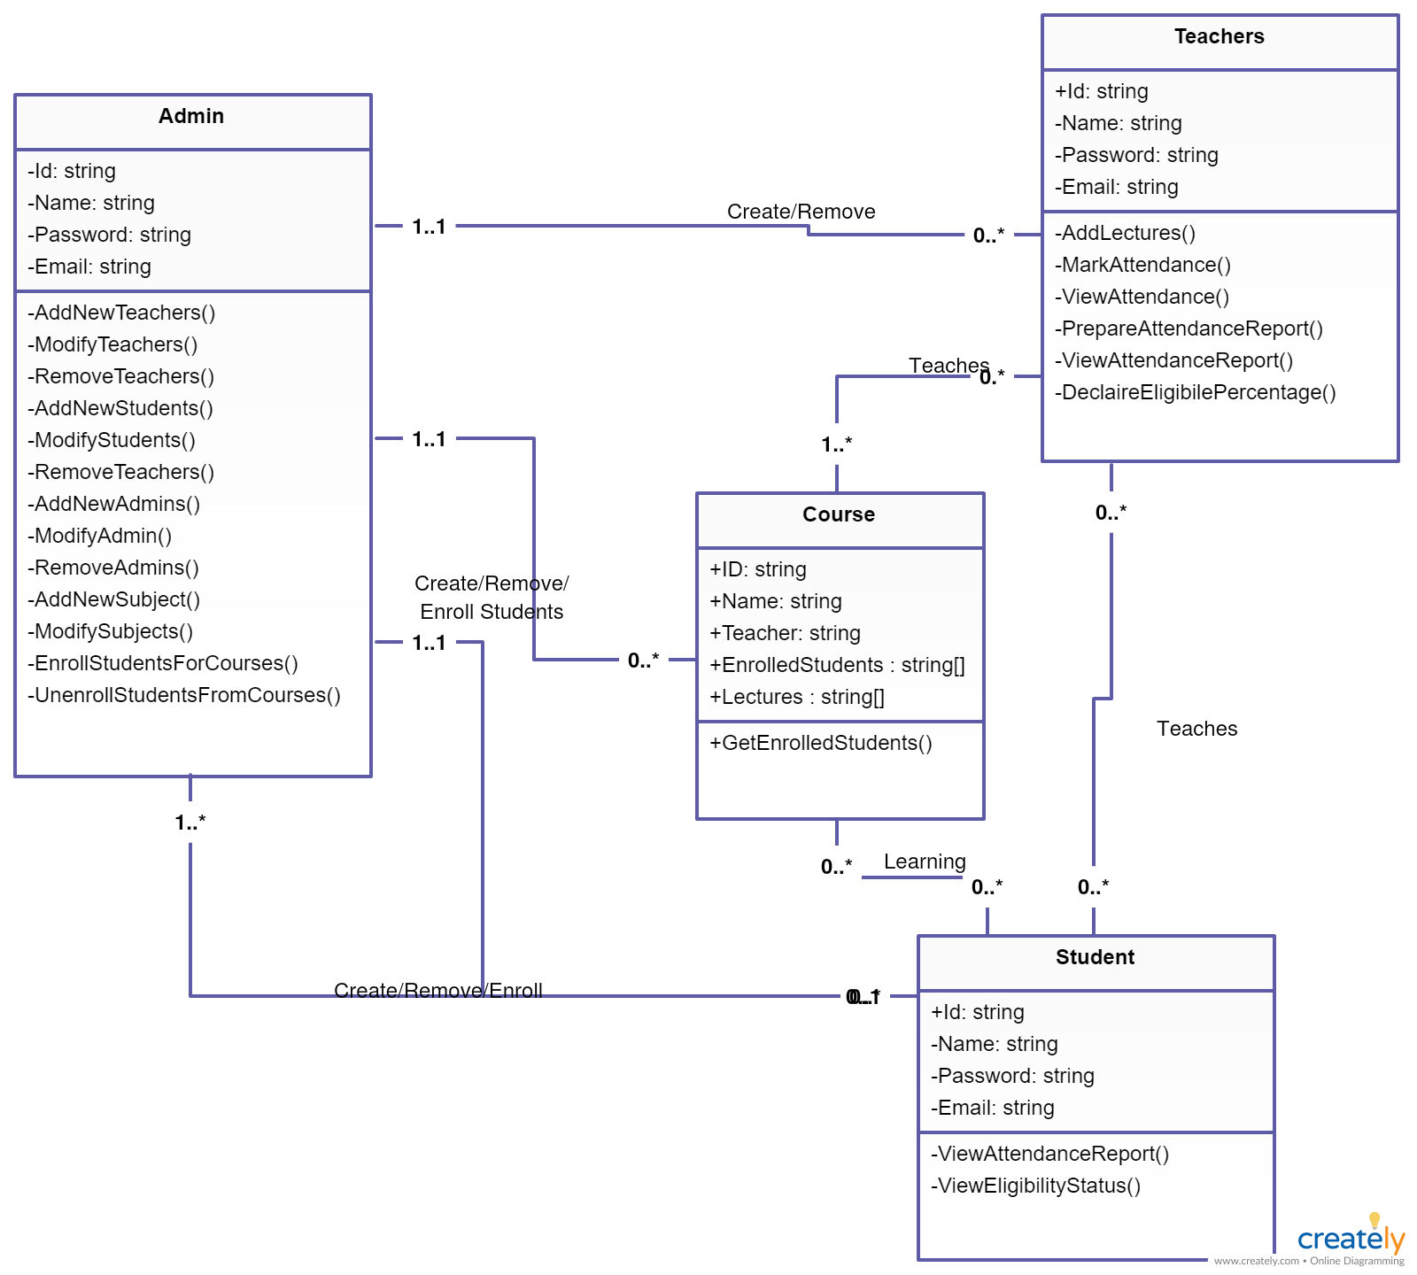
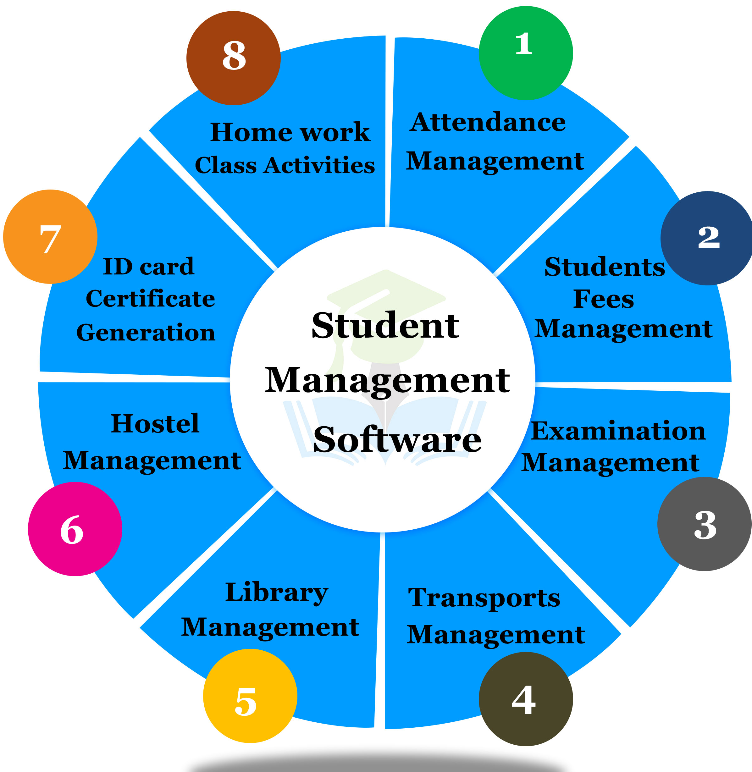
Student Management System:
Modules and their classes
Module 1 Classes

Slide 24
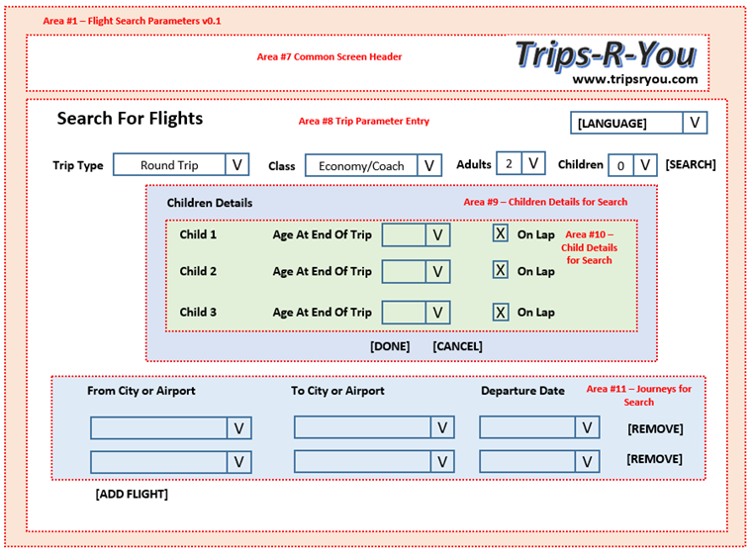
CUSTOMER APPROVAL:
User acceptance test plan is created from our customer requirements on Flight Search process

Slide 25
Software Development Process activities
The four basic process activities of:
(1) SPECIFICATION (SRS),
(2) DESIGN (SDS) AND DEVELOPMENT,
(3) VALIDATION (TEST, REVIEWS, CUSTOMER APPROVAL)
(4) EVOLUTION

Slide 26
4-SOFTWARE EVOLUTION

Slide 27
4-SOFTWARE EVOLUTION
Software is flexible and changeable in nature.
As requirements change, through changing business conditions, the software used that supports the business must also evolve and change.
Although there has been a separation between development and evolution (maintenance), this is increasingly irrelevant fewer if the systems are completely new.
  If your System is New → Evolution Need is Less.

Slide 28
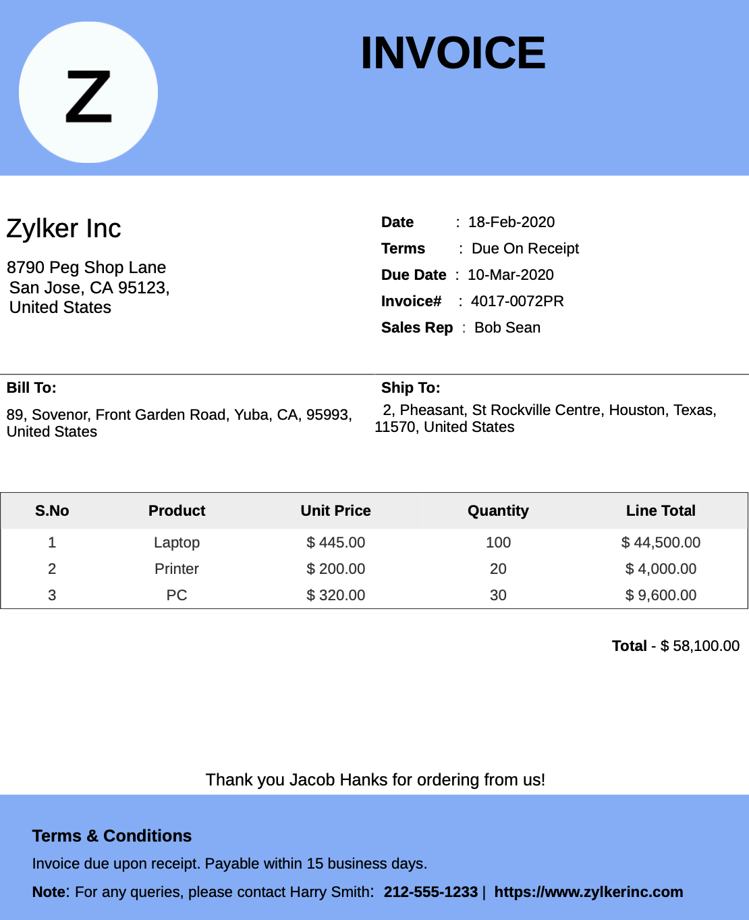
System evolution is needed?
What we need
as new functions?
Assume that
you need to add a new «Product Category» column???

Slide 29
Topics covered
SOFTWARE PROCESS MODELS
PROCESS ACTIVITIES
COPING WITH CHANGE (1-PROTOTYPE, 2- DESİGN AS A NEW INCREMENT)
PROCESS IMPROVEMENT

Slide 30
III. COPING WITH CHANGE (1-PROTOTYPE, 2- DESİGN AS A NEW INCREMENT)

Slide 31
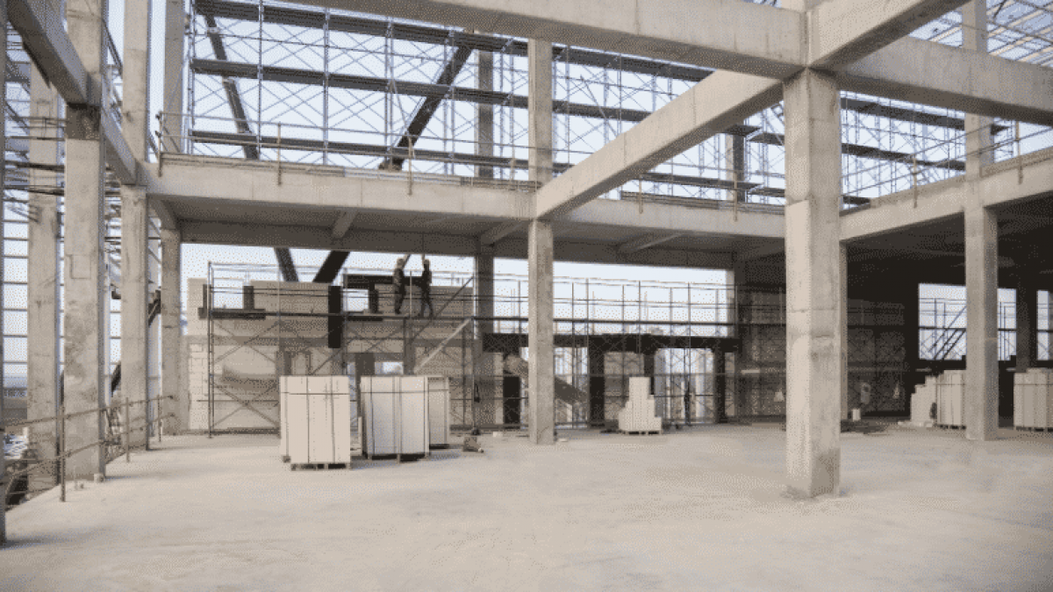
Coping with change
Similar To Changing Any/Some of Beams & Columns In Structural Engineering….

Slide 32
Coping with change
Change is inevitable in all large software projects.
  e.g. Company business operations’ changes may cause new requirements or modifying existing system requirements.
  Another reason to make changes, new technologies allows new possibilities for improving business processes (of SWs).
But required changes push to REWORK.
So the total costs of changes include both rework costs (e.g. re-analyzing requirements) as well as the costs of implementing new functionalities...
Total Cost= ReWorkCost(Change Existing Funcs)+Cost(New Funcs)

Slide 33
Reducing the costs of rework
Change Avoidance Process: foresee/predict possible changes before significant rework is required (e.g., develop prototype system) It reduces the effort required in rework.
  Solution: a prototype could be developed to show some key features of the system.
Change Tolerance Process: is a development process should be designed and the changes needed can be implemented at relatively low cost (e.g., incremental development)
So the changes can be made at a relatively low cost:
  Similar the format of incremental development.
  Proposed changes may be implemented as increments that have not yet been developed.
  If this is impossible, then only a single increment (a small part of the system) may have be altered to integrate the change.

Slide 34

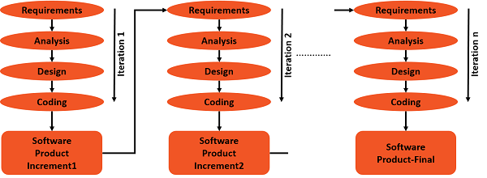
Reducing the costs of rework
SOLUTION:
In summary, for reducing costs of rework due to potential requirement changes, you can use:
(1) PROTOTYPING,
(2) DESIGN & DEVELOP THEM AS A SINGLE INCREMENT…

Slide 35
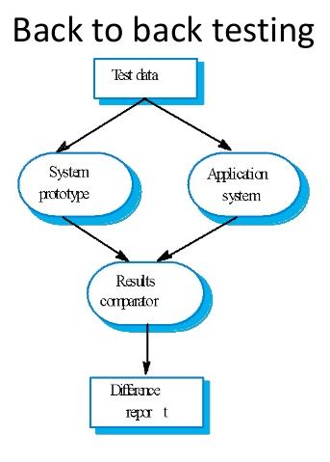
(1) PROTOTYPING : Software prototyping
A prototype is an initial version of a system used to:
  Demonstrate Concepts
  Show/Make Clear Design Options.
When a prototype can be used:
  ANALYSIS: Requirement engineering process to help in requirements elicitation and validation.
  DESIGN: In design processes to discover options and develop a UI design; Designers are able to validate product designs quicker, cheaper, and with less risk than building a fully functional product.
  TEST: In the testing process to run back-to-back tests.

Slide 36
The process of prototype development

Slide 37
Benefits of prototyping
Improved system usability.
A closer match to customers/users’ real needs.
Better design quality.
Improved maintainability. Provide evolving system in future.
Reduces development effort.
  If you clearly understand the REQs via a prototype, you can implement the system as perfectly as possible at once.

Slide 38
Prototype development
You can use rapid prototyping languages or tools
However, prototyping may bypass some functions, such as;
  Error checking and recovery functions may not be included in the prototype (e.g. Email control, password checking, username control etc.);
  Focuses on functional requirements rather than non-functional requirements such as reliability and security
Prototype can be used on the areas of the product business operations that are not well-understood;

Slide 39
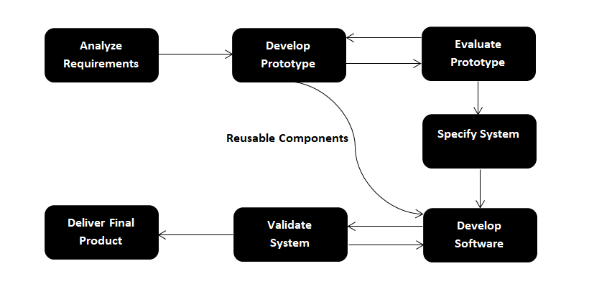
Throw-away prototypes
Prototypes should be discarded after development as they are not a good basis for a production system:
  It may be impossible to produce the system to meet non-functional requirements;
  Prototypes are normally undocumented;
  The prototype structure may usually degraded/corrupted through rapid change;
  The prototype probably may not meet normal organizational quality standards.

Slide 40
(2) DESIGN AS A SINGLE INCREMENT
Lowest priority reqs /changes noticed late
highest priority reqs

Slide 41
Incremental development and delivery
Incremental development
  Develop the system in increments and
  Evaluate each increment before starting to the development of the next increment;
  Normal approach used in agile methods;
  Evaluation done by user/customer proxy. Not started use it.
Incremental delivery
  Deliver and Install an increment for use by end-users;
  More realistic evaluation about practical use of the software;
  The modes is difficult to implement for replacement systems as initial increments have less functionality than the system (being replaced).
  Therefore, users may want to use all of the functionality of the old system and they are often unwilling to use with an incomplete new system.
Notes:
Artımlı gelişim
Sistemi artışlarla geliştirin ve bir sonraki artışa geçmeden önce her bir artışı değerlendirin;
Çevik yöntemlerde kullanılan normal yaklaşım;
Kullanıcı / müşteri vekili tarafından yapılan değerlendirme.
Artımlı teslimat
Son kullanıcılar tarafından kullanılmak üzere bir artış dağıtın;
Yazılımın pratik kullanımı hakkında daha gerçekçi değerlendirme;
Değişim sistemleri için uygulanması zor, çünkü artışlar değiştirilen sistemden daha az işlevselliğe sahiptir.

Slide 42
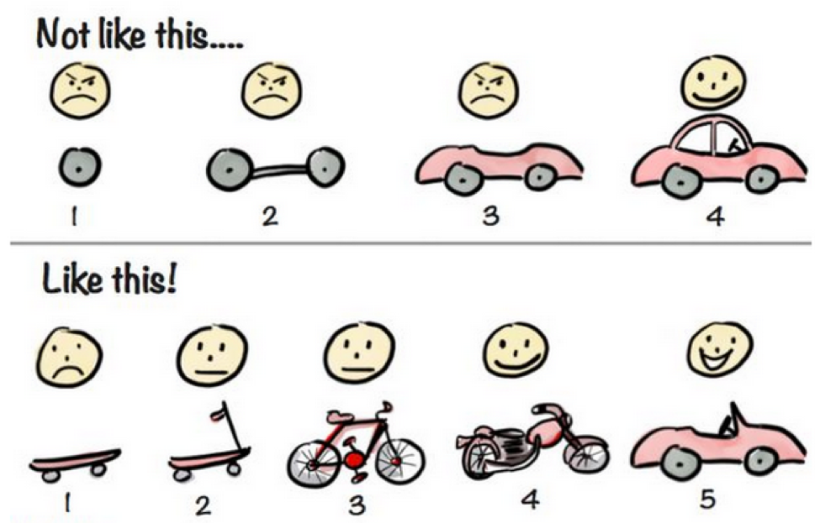
Incremental delivery

Slide 43
Incremental delivery

Slide 44
Incremental delivery advantages
Customer value can be delivered with each increment so system is available earlier for our customers.
Early increments act as a prototype to help find new requirements for later increments.
Lower risk of overall project failure.
The highest priority services/functions of the system may take the most testing.

Slide 45
Incremental delivery problems
In the incremental approach, there is no complete system specification until the final increment is specified.
This requires a new form of contract, bcz customers such as government institutions may find difficult to accommodate.
  Yeni tür bir kontrat gerektiriyor, hükümet kurumları vb kurumlar için yazılım yaparken uyum zor.
Total cost is higher than waterfall.
As requirements are not defined in detail until an increment is to be implemented, it can be hard to identify common functions that are needed by all increments.
Therefore, this model needs a clear and complete definition of the entire system before it can be broken down and built incrementally.

Slide 46
When to use the Incremental model:
This model can be used when the requirements of the complete system are clearly defined and understood.
Major requirements must be defined; however, some details can evolve over time.
If your customer needs a product urgently and needs to take place to market with that product early….
If a new technology is being used.
If resources with needed skill set are not available.
If there are some high risk features and goals.

Slide 47
Topics covered
SOFTWARE PROCESS MODELS
PROCESS ACTIVITIES
COPING WITH CHANGE (1-PROTOTYPE, 2- DESİGN AS A NEW INCREMENT)
PROCESS IMPROVEMENT

Slide 48
IV. PROCESS IMPROVEMENT

Slide 49
Process improvement
Many software companies have turned to Software Process Improvement as a way of
  enhancing the quality of their software,
  reducing costs,
  accelerating their development processes.
Process improvement means:
  understanding existing processes and
  changing these processes to
      (1) increase product quality and/or
      (2) reduce costs during business operations and
      (3) reduce development/operation time.

Slide 50
Approaches to improvement
Process Maturity Approach, which focuses on improving process and project management and introducing good software engineering practice.
  The level of process maturity reflects the extent to which good technical and management practice has been adopted in organizational software development processes.
The agile approach, which focuses on iterative development and the reduction of overheads in the software development processes.
  The primary characteristics of agile methods are rapid delivery of functionality and response to changing customer requirements.

Slide 51
The process improvement cycle

Slide 52
Process improvement activities
Process measurement
  You measure one or more attributes of the process or product.
  The measurements give an idea that helps you decide if the process improvement has been required or not.
Process analysis
  The current process is assessed, and process weaknesses and bottlenecks are identified.
  Process models (sometimes called process maps) that describe the process may be developed.
Process change
  Process changes are proposed to address some of the identified process weaknesses.
  Propose solutions or necessary improvements are done!

Slide 53
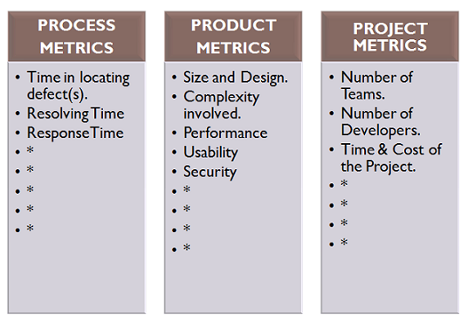
1-Process measurement
We can measure anything using metrics:

Slide 54
1-Process measurement
Wherever possible, quantitative process data (numerical measurements) should be collected
  However, where organisations do not have clearly defined process standards this is very difficult as you don’t know what to measure.
  A process may have to be defined before any measurement is possible.
Process measurements should be used to assess improvement,,, is it necessary or not??.
  But this does not mean that measurements should determine the improvements.
  The improvement driver should be the organizational objectives.
    We need to consider the future aims/strategies of our company when defining the improvements of the existing processes in company.

Slide 55
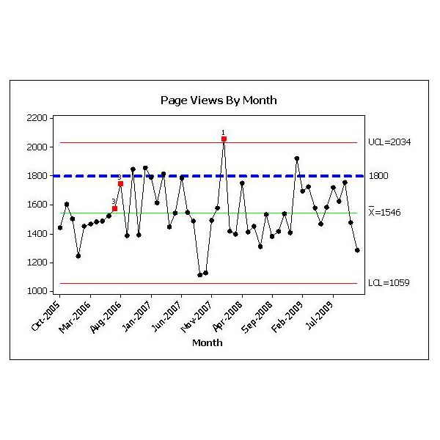
Process metrics
Time taken for process activities to be completed
  E.g. Calendar time or effort to complete an activity or process.
Resources required for processes or activities
  E.g. Total effort in person-days.
Number of occurrences of a particular event
  E.g. Number of defects discovered.
    Number of web page views per month.

Slide 56
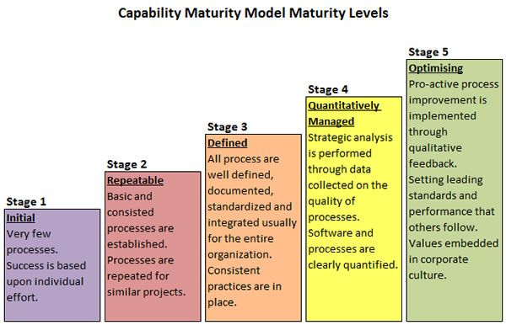
Software Engineering Institute (SEI)
Capability Maturity Model (CMM)
What is SEI Capability Maturity Model?
The SEI CMM specifies an increasing series of levels of a software development organization.
The higher level (that mean is you have better the software development process)
reaching each level is an expensive and time-consuming process.

Slide 57
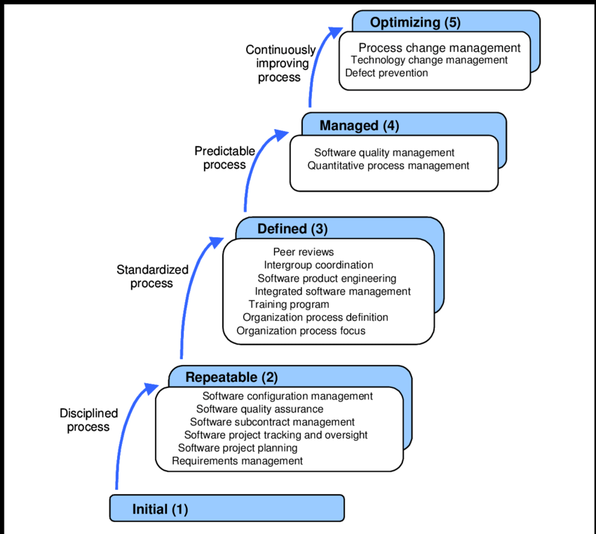
CMM in SE

Slide 58
Key points
Software processes are the activities involved in producing a software system. Software process models are abstract representations of these processes.
General process models describe the organization of software processes.
  Examples of these general models include the ‘waterfall’ model, incremental development, and reuse-oriented development.
Requirements engineering is the process of developing a software specification.

Slide 59
Key points
Design and implementation processes are concerned with transforming a requirements specification into an executable software system.
Software validation is the process of checking that the system conforms to its specification and that it meets the real needs of the users of the system.
Software evolution takes place when you change existing software systems to meet new requirements. The software must evolve to remain useful.
Processes should include activities such as prototyping and incremental delivery to cope with change.

Slide 60
Key points
Processes may be structured for iterative development and delivery so that changes may be made without disrupting the system as a whole.
The principal approaches to process improvement are agile approaches, geared to reducing process overheads, and maturity-based approaches based on better process management and the use of good software engineering practice.
The SEI process maturity framework identifies maturity levels that essentially correspond to the use of good software engineering practice.

