Slide 1
Chapter 9 – Software Testing

Slide 2
Topics covered
Development testing
Test-driven development
Release testing
User testing

Slide 3
Program testing
Testing is intended to show that a program does what it is intended to do and to discover program defects before it is put into use.
When you test software, you execute a program using artificial data.
You check the results of the test run for errors, anomalies or information about the program’s non-functional attributes.
Aim is to reveal the presence of errors NOT their absence.
Testing is part of a more general verification and validation process, which also includes static validation techniques.

Slide 4
Program testing goals
To demonstrate to the developer and the customer that the software meets its requirements.
  For custom software, this means that there should be at least one test for every requirement in the requirements-SRS- document.
  For generic software products, it means that there should be tests for all of the system features, plus combinations of these features, that will be incorporated in the product release.
To discover situations in which the behavior of the software is incorrect, undesirable or does not conform to its specification.
  Defect testing is concerned with rooting out undesirable system behavior such as system crashes, unwanted interactions with other systems, incorrect computations and data corruption.

Slide 5
Validation vs Defect Testing and Goals
The first goal leads to validation testing
  Validation testing (includes smoke testing, functional testing, regression testing, systems testing, etc.)
    To demonstrate to the developer and the customer that the software meet the pre-defined and specified business requirements (SRS).
    A successful test shows that the system operates as intended.
    Aim is to learn is the product working right?
The second goal leads to defect testing
  Defect testing
    To discover faults or defects in the software where its behavior is incorrect or not in conformance with its specification.
    Defects are defined as the deviation of the actual and expected result of software application.
    Defects are caused by the developer in development phase of software.
    When a developer or programmer during the development phase makes some mistake then that turns into bugs that are called defects.
    A successful defect test is a test that what makes the system perform incorrectly and so find out a defect in the system.

Slide 6
An input-output model of program testing
Erroneous input data or input causes errors

Slide 7
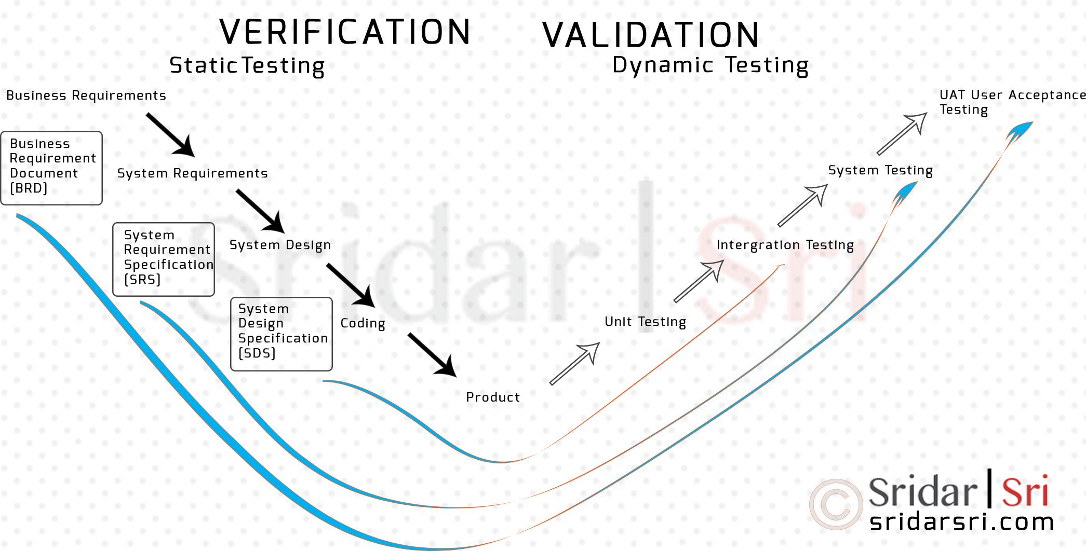
Verification vs validation
Both, the verification and validation is a software testing activity, and verification is followed by the validation.
Validation is usually performed at the end of the software development.
Verification:
"Are we building the product right”.
  The software should conform to its specifications.
Validation:
"Are we building the right product”.
  The software should do what the user really requires.
  Checking pre-determined business processes/services as requirements are implemented right or not?!!!

Slide 8
Verification & Validation
Verification checks whether the software confirms a specification (e.g. one Func Req, NF req) whereas Validation checks whether the software meets the requirements and expectations.
Verification finds the bugs early in the development cycle whereas Validation finds the bugs that verification can not catch.
Each organization should clearly define each of the four primary verification methods: Test, Demonstration, Inspection, and Analysis.
  Verification by Inspection (static verification) is when you can use one of your senses to prove if the system meets a requirement. You don’t have to execute the system; you can observe the results of your observations or inspections (activities) to prove the system meets a requirement.
  Verification by Test (dynamic verification) involves special test equipment and/or instrumentation. It also involves running multiple “tests” (activities) to collect data on the system that will show proof the requirement has been met.
Notes:
FOR VERIFICATION: "Are we building the product right”????
SOFTWARE INSPECTIONS: Concerned with analysis of
the static system representation to discover problems (static verification)
May be supplement by tool-based document and code analysis.
Discussed in Chapter 15.
SOFTWARE TESTING: is about testing and observing product behaviour (dynamic verification)
The system is executed with test data and its operational behaviour is observed.

Slide 9
Inspections and testing

Slide 10
Software Inspections (Static Verification)
These involve people investigative the source representations (e.g. SRS, SDS, data etc..) with the aim of discovering anomalies and defects.
Inspections not require execution of a system so may be used before implementation.
Inspections may be applied to any representation of the system (requirements, design, configuration data, test data, etc.)…not only to source codes.
inspections is an effective technique for discovering program errors.

Slide 11
Advantages of inspections
During testing, errors can mask (hide) other errors. Because inspection is a static process, you don’t have to interest with interactions between errors.
Incomplete versions of a system can be inspected without additional costs.
But for a TEST, if a program is incomplete, then you need to develop specialized test harnesses/codes to test the parts that are available.
As well as searching for program defects, an inspection can also study broader QUALITY ATTRIBUTES of the SW, such as compliance with standards, portability and maintainability.

Slide 12
Inspections and testing
INSPECTIONS and TESTING are complementary verification techniques, NOT OPPOSITE.
Both should be used during the V & V process.
Inspections can check conformance with a specification but not conformance with the customer’s real requirements.
Inspections cannot check non-functional characteristics such as performance, usability, etc.

Slide 13
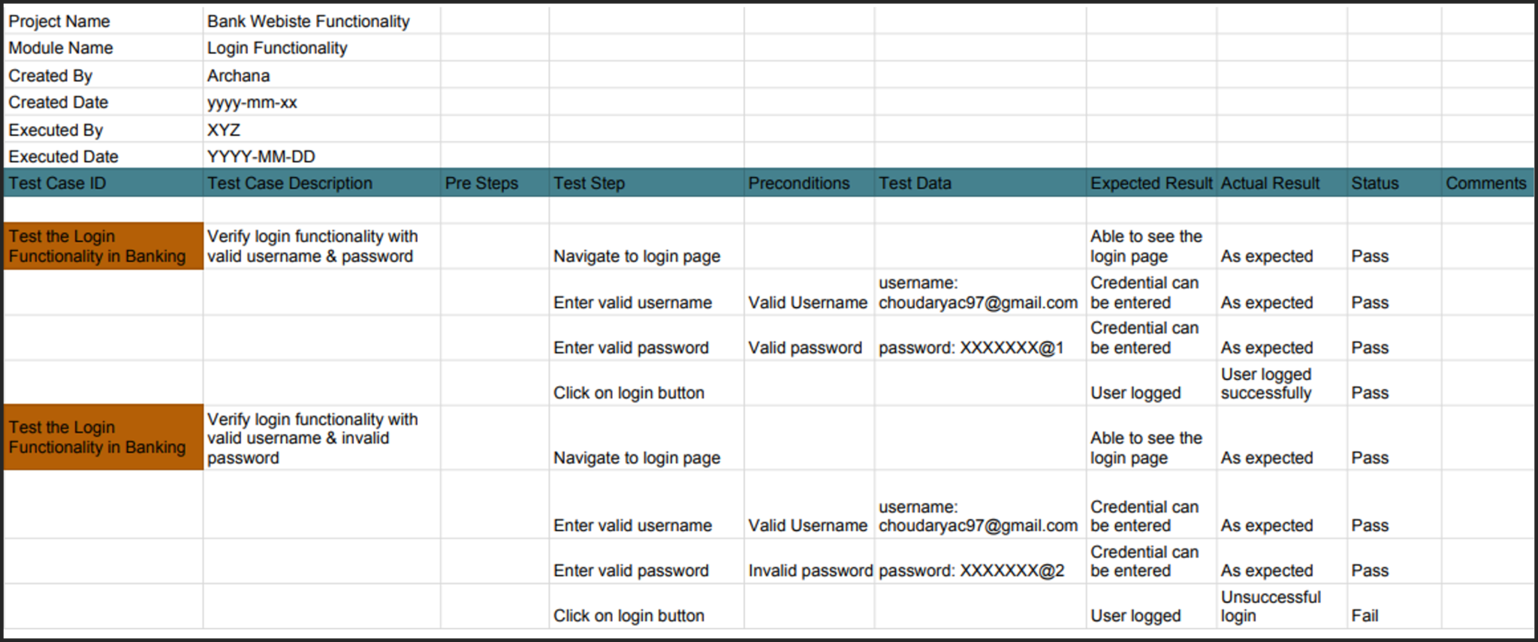
Here’s a sample test case for checking login functionality, with two possibilities.

Slide 14
A model of the software testing process

Slide 15
Stages of testing
Development Tests (UNIT, COMPONENT, SYSTEM), where the system is tested during development to discover bugs and defects.
Release testing, where a separate testing team → test a complete version of the system before it is released to users.
User testing (ALFHA, BETA, USER ACCEPTANCE TEST), where users or potential users of a system test the system in their own environment.
C1

Slide 16
Development testing

Slide 17
Development testing
Development testing includes all testing activities that are carried out by the team developing the system.
  UNIT TESTING, where individual program units or object classes are tested. Unit testing should focus on testing the functionality of objects or methods.
  COMPONENT TESTING, where several individual units are integrated to create composite components. Component testing should focus on testing component interfaces.
  SYSTEM TESTING, where some or all of the components in a system are integrated and the system is tested as a whole. System testing should focus on testing component interactions.

Slide 18
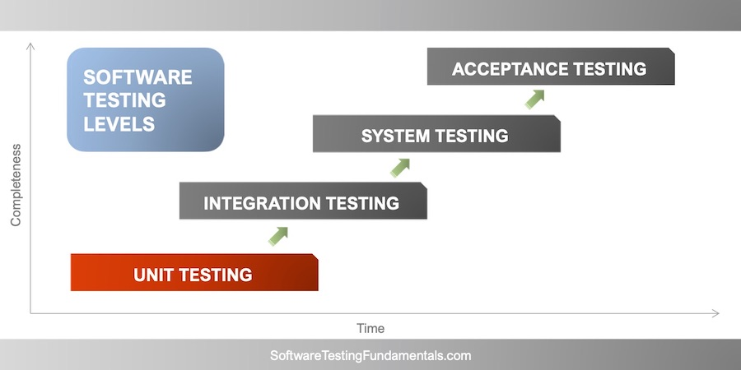
Development testing
Development testing includes:
  UNIT TESTING
  COMPONENT TESTING
  SYSTEM TESTING

Slide 19
Unit testing
Unit testing is the process of testing individual components in isolation.
It is a defect testing process.
Units may be:
  Individual functions or methods within an object
  Object classes with several attributes and methods
  Composite components with defined interfaces used to access their functionality.

Slide 20
Object class testing
Complete test coverage of a class involves
  Testing all operations associated with an object
  Setting and questioning all object attributes
  Exercising the object in all possible states.
Inheritance makes it more difficult to design object class tests as the information to be tested is not localised.

Slide 21
The weather station object interface

Slide 22
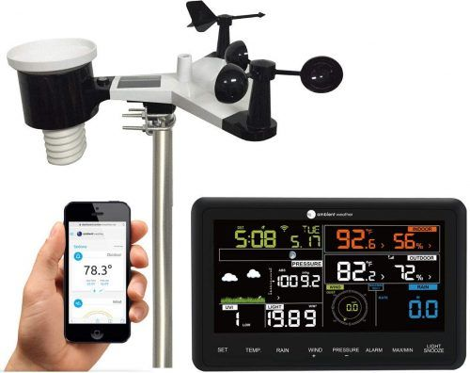
Weather station testing
Need to create test cases for reportWeather, calibrate, test, startup and shutdown of the device.
Using a state modelling, identify sequences of state transitions to be tested and the event sequences to cause these transitions.
For example:
  Shutdown -> Running-> Shutdown
  Configuring-> Running-> Testing -> Transmitting -> Running
  Running-> Collecting-> Running-> Summarizing -> Transmitting -> Running

Slide 23
Weather Station State Diagram

Slide 24
Automated testing
Whenever possible, unit testing should be automated so that tests are run and checked without manual intervention.
  https://reqtest.com/testing-blog/unit-testing-frameworks/
In automated unit testing, you make use of a test automation framework (such as JUnit) to write and run your program tests.
Unit testing frameworks provide generic test classes that you extend to create specific test cases.
They can then run all of the tests that you have implemented and report, often through some GUI, on the success of otherwise of the tests.

Slide 25
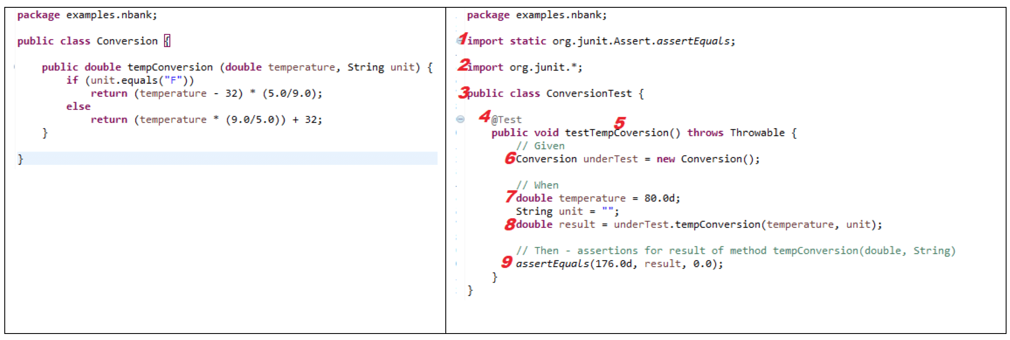
Automated test components
A setup part, where you initialize the system with the test case, namely the inputs and expected outputs.
A call part, where you call the object or method to be tested.
An assertion part where you compare the result of the call with the expected result. If the assertion evaluates to true, the test has been successful. if false, then it has failed.

Slide 26
Here’s a sample test case for checking login functionality, with two possibilities.
setup part
assertion part
call part

Slide 27
Choosing unit test cases
The test cases should show that, when used as expected, the component that you are testing does what it is supposed to do.
If there are defects in that component, these should be revealed by test cases.
This leads to 2 types of unit test case:
  The first of these should reflect normal operation of a program and should show that the component works as expected.
  The other kind of unit test case should be based on testing experience of where common problems arise.
    It should use abnormal inputs to check that these are properly processed and do not crash the component.
    See login test case example below.

Slide 28
Here’s a sample test case for checking login functionality, with two possibilities.
reflect normal operation
reflect normal operation
Check common problems
use abnormal inputs

Slide 29
Testing strategies
Partition testing, where you identify groups of inputs that have common characteristics and should be processed in the same way.
  You should choose tests from within each of these groups.
Guideline-based testing, where you use testing guidelines to choose test cases.
  These guidelines show previous experience of the kinds of errors that programmers often make when developing components.
    Which test cases are proper to find out which type common errros of users?
    Hangi test case hangi tür hata için uygundur hk kılavuz!

Slide 30
Equivalence partitioning
Input data and output results often fall into different classes where all members of a class are related.
Each of these classes is an equivalence partition or domain where the program behaves in an equivalent way for each class member.
Test cases should be chosen from each partition.

Slide 31
Equivalence partitions
Choose especially the limit values
for test cases
Test cases should be chosen from each partition.

Slide 32
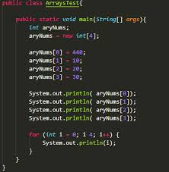
Testing guidelines (sequences)
Test software with sequences which have only a single value.
Use sequences of different sizes in different tests.
Derive tests so that the first, middle and last elements of the sequence are accessed.
Test with sequences of zero length.

Slide 33
General testing guidelines
Choose your inputs that force the system to generate all error messages.
Select your inputs that cause input buffers to overflow.
Repeat the same input or series of inputs numerous times.
Force invalid outputs to be generated.
Force computation results to be too large or too small.

Slide 34
Development testing
Development testing includes:
  UNIT TESTING
  COMPONENT TESTING
  SYSTEM TESTING
C1

Slide 35
Component testing
Software components are often composite components that are made up of several interacting objects.
  For example, in the weather station system, the reconfiguration component includes objects that deal with each aspect of the reconfiguration.

Slide 36
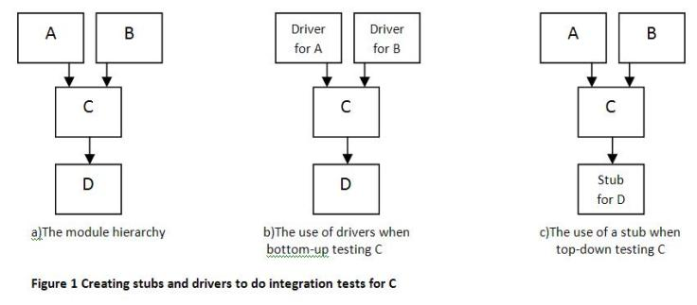
Stubs and Drivers
Stubs and Drivers are two types of Test Harness.
Test harness are the collection of software and test data which is configured so that we can test a program unit by simulating different set of conditions, while monitoring the behavior and outputs.
Stubs and drivers both are dummy modules and are only created for test purposes.

Slide 37
Stubs
Stubs are used in top down testing approach, when you have the major modules ready to test, but the sub modules are still not ready yet.
For eg. suppose you have three different modules : Login, Home, User. Suppose login module is ready for test, but the two minor modules Home and User, which are called by Login module are not ready yet for testing.
At this time, we write a piece of dummy code, which simulates the called methods of Home and User. These dummy pieces of code are the stubs.

Slide 38
Drivers
Drivers are the ones, which are the “calling” programs.
Drivers are generally used in bottom up testing approach.
Drivers are dummy code, which is used when the sub modules are ready, but the main module is still not ready.
Suppose this time, the User and Home modules are ready, but the Login module (main module) is not ready to test.
Now since Home and User return values from Login module, so we write a dummy piece of code, which simulates the Login module. This dummy code is then called Driver.

Slide 39
Component testing
You access the functionality of these objects/classes through the defined component interface.
Testing composite components should therefore focus on showing that the component interface behaves according to its specification.
  You can assume that unit tests on the individual objects within the component have been completed.

Slide 40
Interface testing

Slide 41
Interface testing
Objectives are to detect faults due to interface errors or invalid assumptions about interfaces.
Interface types
  Parameter interfaces Data passed from one method or procedure to another.
  Shared memory interfaces Block of memory is shared between procedures or functions.
  Procedural interfaces Sub-system encapsulates a set of procedures to be called by other sub-systems.
  Message passing interfaces Sub-systems request services from other sub-systems

Slide 42
Interface errors
Interface misuse
  A calling component calls another component and makes an error in its use of its interface e.g. parameters in the wrong order.
Interface misunderstanding
  A calling component embeds assumptions about the behaviour of the called component which are incorrect.
Timing errors
  The called and the calling component operate at different speeds and out-of-date information is accessed.

Slide 43
Interface testing guidelines
Design tests so that parameters to a called procedure are at the extreme ends of their ranges.
Always test pointer parameters with null pointers.
Design tests which cause the component to fail.
Use stress testing in message passing systems.
In shared memory systems, vary the order in which components are activated.

Slide 44
Development testing
Development testing includes:
  UNIT TESTING
  INTEGRATION TESTING
  COMPONENT TESTING
  SYSTEM TESTING

Slide 45
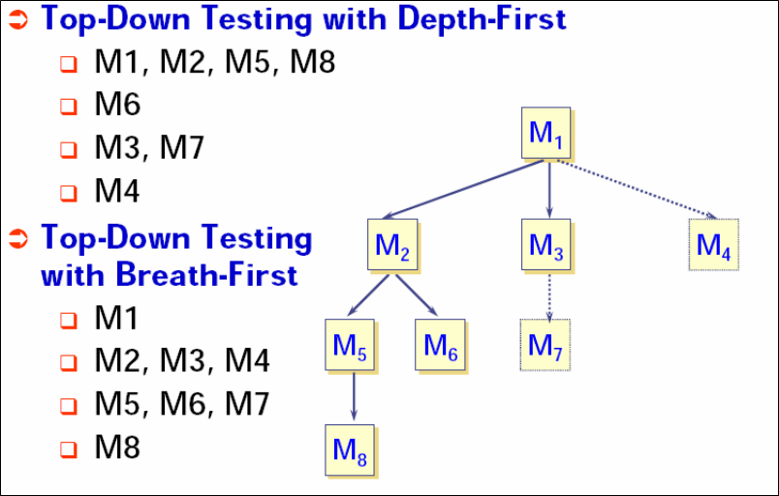
System testing
System testing during development involves integrating components/modules to create one version of the system and then testing the system.
The focus in system testing is testing the interactions between components.
System testing checks that all components are compatible, interact correctly and transfer the right data at the right time across their interfaces.
System testing tests the developing behavior of a system.

Slide 46
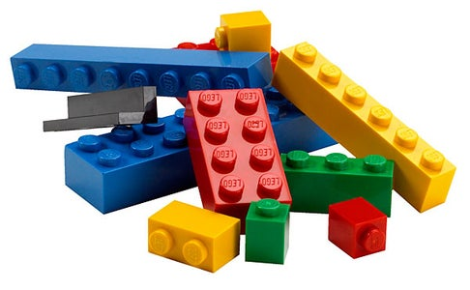
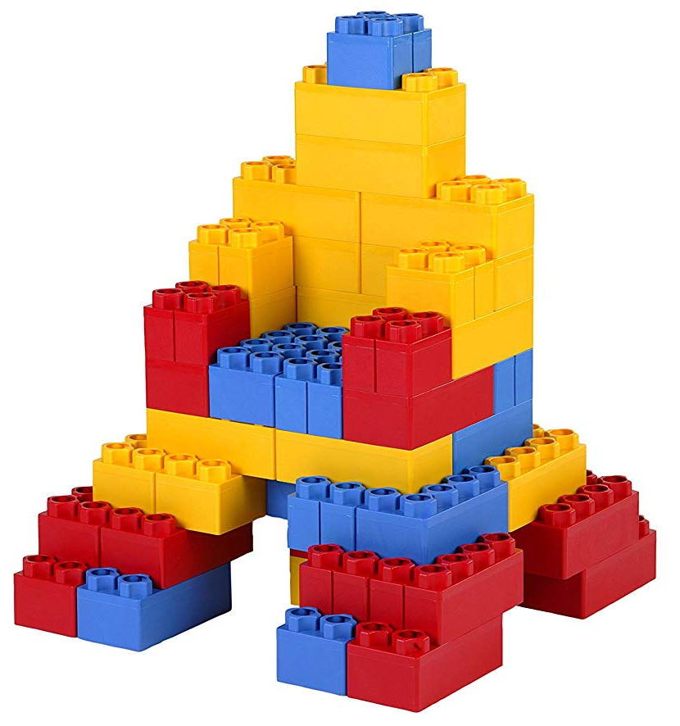
System and component testing
During system testing, reusable components (that have been separately developed and off-the-shelf systems) may be integrated with newly developed components. The complete system is then tested.
Components developed by different team members or sub-teams may be integrated at this stage.
System testing is a collective rather than an individual process.
In some companies, system testing may involve a separate testing team with no involvement from designers and programmers.

Slide 47
Use-case testing (focus on interactions)
The use-cases to identify system interactions can be used as a basis for system testing.
Each use case usually involves several system components so testing the use case forces these interactions to occur.
The sequenced diagrams related with a use case gives the components and interactions that are being tested.

Slide 48
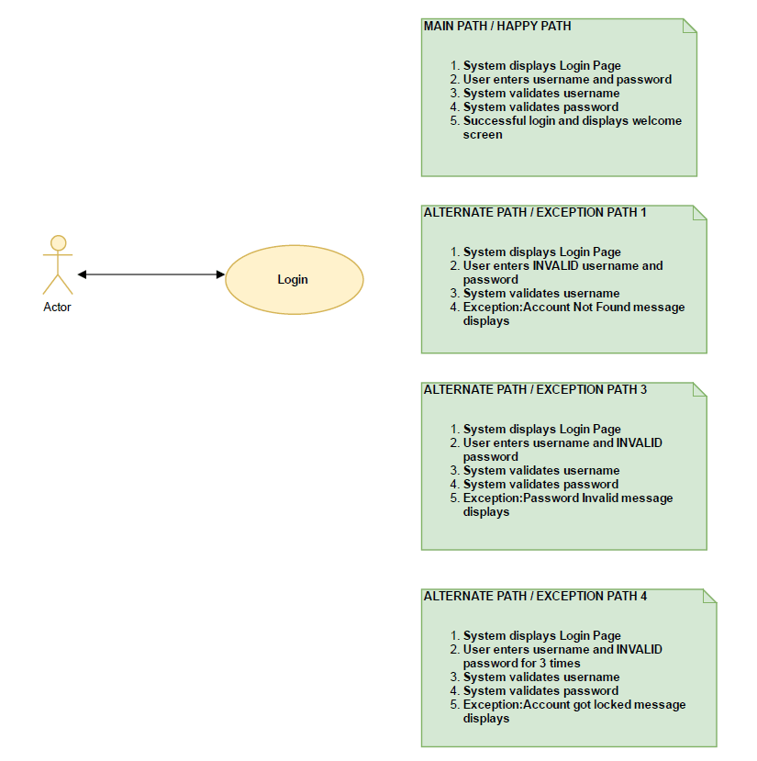
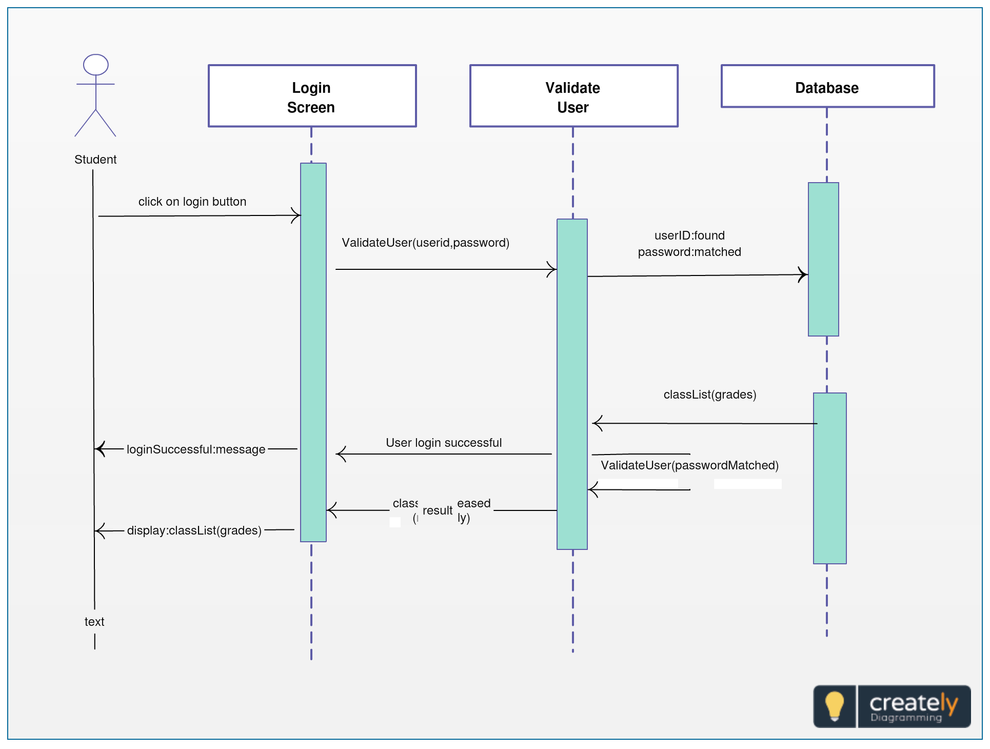
Example-1
Sequenced diagrams/screens used
for providing user-system interactions

Slide 49
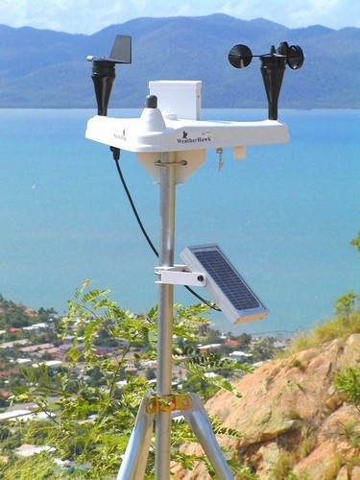
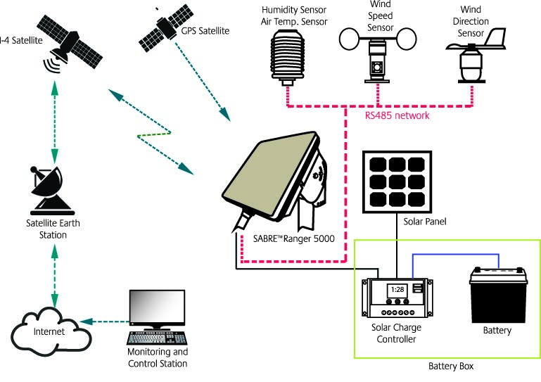
Example 2: Collect weather data sequence chart
An input request to WeatherStation for a report returns a summarized report being generated…

Slide 50
Test cases derived from sequence diagram
An input of a request for a report should have an associated acknowledgement.
A report should finally be returned from the request.
    You should create summarized data that can be used to check that the report is correctly organized.
An input request for a report to WeatherStation returns a summarized report being generated (özet rapor oluşturuluyor).
    Can be tested by creating raw data corresponding to the summary that you have prepared for the test of SatComms and checking that the WeatherStation object correctly produces this summary.
    This raw data is also used to test the WeatherData object.

Slide 51
Testing policies
Exhaustive system testing is impossible so testing policies which define the required system test coverage may be developed.
Examples of testing policies:
  All system functions that are accessed through menus should be tested.
  Combinations of functions (e.g. text formatting) that are accessed through the same menu must be tested.
  Where user input is provided, all functions must be tested with both correct and incorrect input.

Slide 52
Test-driven development

Slide 53
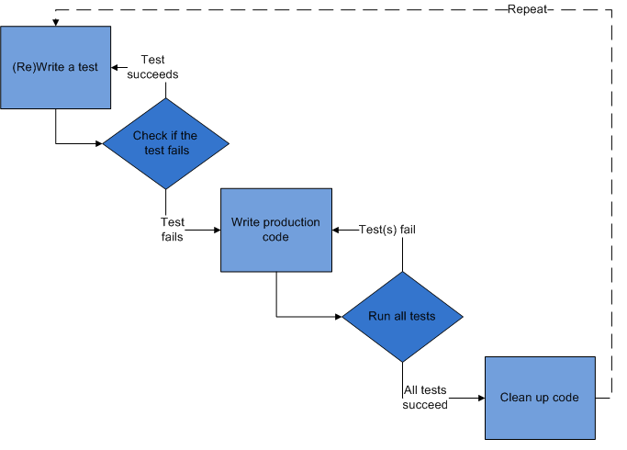
Test-driven development
Test-driven development (TDD) is an approach for program development in which you sequential TESTING & CODE development.
TDD promotes a test-then-code approach!
Tests are written before code and ‘passing’ the tests is the critical driver of development.
You develop your code incrementally, along with a test for that increment.
You don’t move on to the next increment until the code that you have developed passes its test.
TDD was introduced as part of agile methods such as Extreme Programming.
However, it can also be used in plan-driven development processes.

Slide 54
TDD process activities
See next figure.
Start by identifying the increment of functionality that is required. This should normally be small and implementable in a few lines of code. (e.g. search a book)
Write a test for this functionality (e.g. for the requirement) and implement this as an automated test.
Run the test, along with all other tests that have been implemented. Initially, you do not implement the functionality so the new test will fail.
Implement the functionality and re-run the test.
Once all tests run successfully, you move on to implementing the next chunk of functionality.

Slide 55
Test-driven development
6
2
3
4
1
5
revise
identifying your increment,firstly

Slide 56
Benefits of test-driven development
Code coverage (kod kapsamına göre test case yaz)
Every code segment that you generate has at least one associated test.
    so all code parts has at least one test.
Regression testing
  A regression test suite is developed incrementally as a program is developed.
Simplified debugging
  When a test fails, it should be understandable where the problem lies. The (only last) newly written code needs to be checked and modified.
Ease the system documentation
  The tests themselves are a form of documentation that describe what the code should be doing.

Slide 57
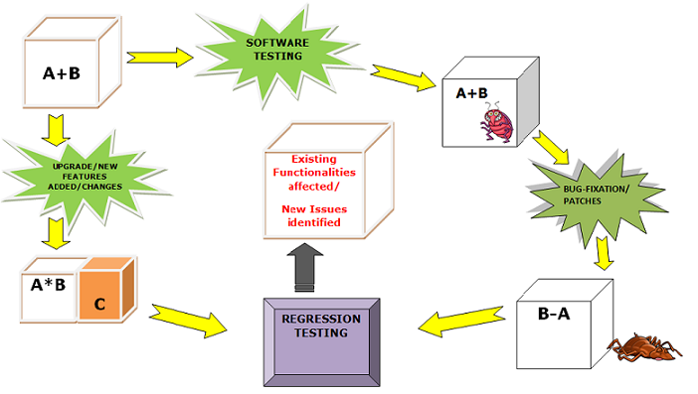
Regression testing (if any change applied)
Regression testing is testing the system to check that changes have not ‘broken’ previously working code.
In a manual testing process, regression testing is expensive but, with automated testing, it is simple and straightforward.
All tests are rerun every time a change is made to the program.
Tests must run ‘successfully’ before the change is committed/applied.

Slide 58
Release testing

Slide 59
Release testing (Sürüm Testi)
Release testing is the process of testing a particular release of a system that is intended for use outside of the development team/environment.
The primary goal of the release testing process is to satisfy the end users of the system that it is good enough for use.
  Release testing, therefore, has to show that the system delivers its specified functionality, performance and dependability, and that it does not fail during normal use.

Slide 60
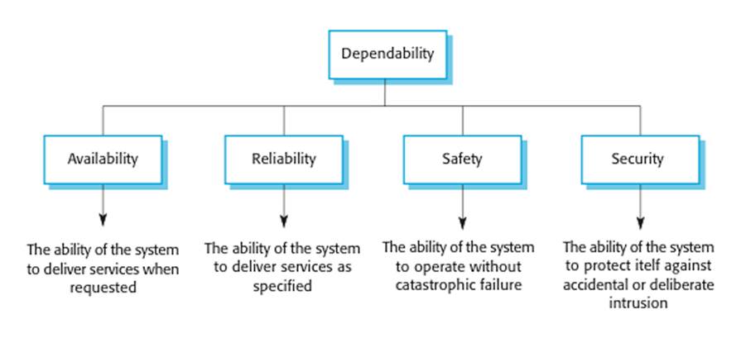
Release testing (Sürüm Testi)
Release testing is usually a black-box testing process where tests are only derived from the system specifications.

Slide 61
Release testing and system testing
Release testing is a form of system testing.
Important differences btw Release and System:
  A separate team is established (but the team members should not be selected from the development team members), who should be responsible for release testing.
  System testing is done by the development team, they should focus on discovering bugs in the system (defect testing).
    System Testing → Bugs, DEFECTS
  The objective of release testing is to check that the system meets its requirements and is good enough for external use (validation testing).
    Release Testing → F/NF Requirements

Slide 62
Requirements based testing
Requirements-based testing involves examining each requirement and developing a test or tests for it.
Mentcare system TWO requirements:
  If a patient is known to be allergic to any particular medication, then prescription of that medication shall give a warning message being issued to the system user.
  If a prescriber (doctor) chooses to ignore an allergy warning, they shall provide a reason why this has been ignored.

Slide 63
Requirements tests (examples for test cases)
Set up a patient record with a known allergy (e.g.aspirine). Prescribe the medication to that the patient is allergic to, and check that the warning is issued by the system (Req # 1).
Set up a patient record with no known allergies. Prescribe medication for allergies that are known to exist. Check that a warning message is not issued by the system.
Set up a patient record in which allergies to two or more drugs are recorded. Prescribe both of these drugs separately and check that the correct warning message for each drug is issued (Req # 1).
Prescribe two drugs that the patient is allergic to. Check that two warnings are correctly issued (Req # 1).
Prescribe a drug that issues a warning and overrule that warning. Check that the system requires the user to provide information explaining why the warning was overruled.

Slide 64
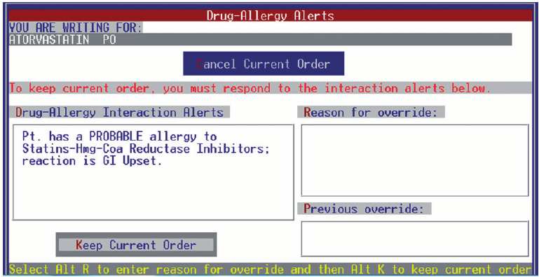
Set up a patient record with a known allergy (e.g. Statins). Prescribe the medication to that the patient is allergic to, and check that the warning is issued by the system (Req # 1).
Prescribe: Statins

Slide 65
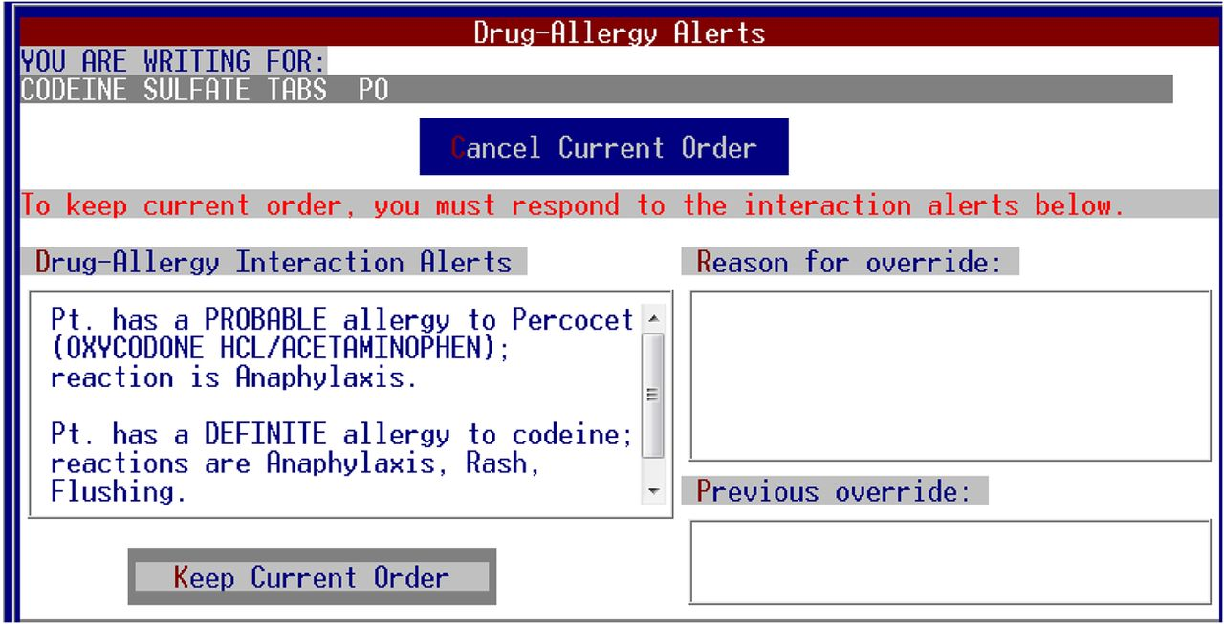
Set up a patient record in which allergies to two or more drugs are recorded. Prescribe both of these drugs separately and check that the correct warning message for each drug is issued (Req # 1).
1ST Prescribe: PERCOCET
2ND Prescribe: CODEINE

Slide 66
Prescribe two drugs that the patient is allergic to. Check that two warnings are correctly issued (Req # 1).
Prescribe both: PERCOCET and CODEINE

Slide 67
A usage scenario for the Mentcare system
George is a nurse who specializes in mental healthcare. One of his responsibilities is to visit patients at home to check that their treatment is effective and that they are not suffering from medication side effects.
On a day for home visits, George logs into the Mentcare system and uses it to print his schedule of home visits for that day, along with summary information about the patients to be visited. He requests that the records for these patients be downloaded to his laptop. He is prompted for his key phrase to encrypt the records on the laptop.
One of the patients that he visits is Jim, who is being treated with medication for depression. Jim feels that the medication is helping him but believes that it has the side effect of keeping him awake at night. George looks up Jim’s record and is prompted for his key phrase to decrypt the record. He checks the drug prescribed and queries its side effects. Sleeplessness is a known side effect so he notes the problem in Jim’s record and suggests that he visits the clinic to have his medication changed. Jim agrees so George enters a prompt to call him when he gets back to the clinic to make an appointment with a physician. George ends the consultation and the system re-encrypts Jim’s record.
After, finishing his consultations, George returns to the clinic and uploads the records of patients visited to the database. The system generates a call list for George of those patients who He has to contact for follow-up information and make clinic appointments.

Slide 68
These features tested by scenario
Authentication by logging on to the system.
Downloading and uploading of specified patient records to a laptop.
Home visit scheduling.
Encryption and decryption of patient records on a mobile device.
Record retrieval and modifications.
Links with the drugs database that maintains side-effect information.
The system for call prompting (prepare a call list follow-up information and make clinic appointments).

Slide 69
Performance testing
It is a part of release testing
It may involve testing the developing assets of a system, such as PERFORMANCE and RELIABILITY.
  The tests should reflect the profile of use of the system.
Performance tests usually involve planning a series of tests where the load is steadily increased until the system performance becomes unacceptable.

Slide 70
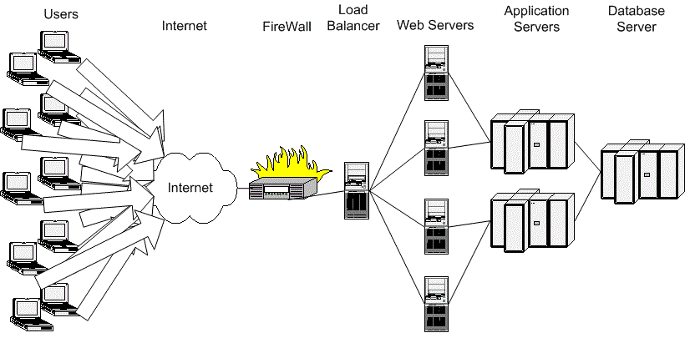
Stress testing
Stress testing is a form of performance testing where the system is consciously overloaded to test its failure behavior (sistemin arıza davranışını test etmek için)

Slide 71
User testing

Slide 72
User testing
User or customer testing is a stage in the testing process in which users or customers provide input and advice on system testing.
User testing is essential, even when complete system and release testing have been carried out.
  The reason for this is that influences from the user’s working environment have a major effect on the reliability, performance, usability and robustness of a system.
  These cannot be replicated/obtained in a testing environment.

Slide 73
Types of user testing
Alpha testing
  End Users of the software work with the development team to test the software at the developer’s site.
  Testing done at developer’s site (developers).
Beta testing
  A release of the software is made available to end users to allow them to test/experiment and to raise problems that they discover with the system developers.
  Testing done at customer’s site (developers & customer users).
User Acceptance testing (customer final decision)
  Customers test a system to decide whether or not it is ready to be accepted from the developers and deployed in the customer environment. Primarily for custom systems.

Slide 74
The acceptance testing process

Slide 75
Stages in the acceptance testing process
Define acceptance criteria
Plan acceptance testing
Derive acceptance tests
Run acceptance tests
Negotiate test results
Reject/accept system

Slide 76
Agile methods and acceptance testing
In agile methods, the user/customer is part of the development team and is responsible for making decisions on the acceptability of the system.
Tests are defined by the user/customer and are integrated with other tests in that they are run automatically when changes are made.
There is no separate acceptance testing process.
Main problem here is whether the user is ‘typical’ or not and can represent the interests of all system stakeholders.

Slide 77
Key points
Testing can only show the presence of errors in a program. It cannot demonstrate that there are no remaining faults.
Development testing is the responsibility of the software development team. A separate team should be responsible for testing a system before it is released to customers.
Development testing includes unit testing, in which you test individual objects and methods component testing in which you test related groups of objects and system testing, in which you test partial or complete systems.

Slide 78
Key points
When testing software, you should try to ‘break’ the software by using experience and guidelines to choose types of test case that have been effective in discovering defects in other systems.
Wherever possible, you should write automated tests. The tests are embedded in a program that can be run every time a change is made to a system.
Test-first development is an approach to development where tests are written before the code to be tested.
Scenario testing involves inventing a typical usage scenario and using this to derive test cases.
Acceptance testing is a user testing process where the aim is to decide if the software is good enough to be deployed and used in its operational environment.

