Slide 1
Sinusoidal Steady State Analysis
Chapter #10

Slide 2
After completing this chapter, you will learn
Basic Approach to ac circuit analysis
Nodal Analysis in ac circuits
Mesh Analysis in ac circuits
Superposition Theorem in ac circuits
Source Transformation in ac circuits
Thevenin and Norton Equivalent Circuits in ac circuits

Slide 3
10.1 Basic Approach to ac circuit analysis.
Steps to Analyze AC Circuits:
Transform the circuit to the phasor or frequency domain.
Solve the problem using circuit techniques (nodal analysis, mesh analysis, superposition, etc.).
Transform the resulting phasor to the time domain.
Time to Freq
Solve variables in Freq
Freq to Time

Slide 4
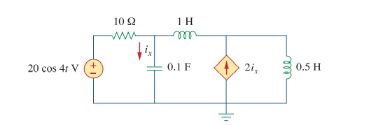
10.2 Nodal Analysis in AC Circuits
Example:
Solution:
Step #1 Transform the circuit to the phasor or frequency domain.

Slide 5
Step #2 Solve the problem using circuit Nodal analysis

Slide 6
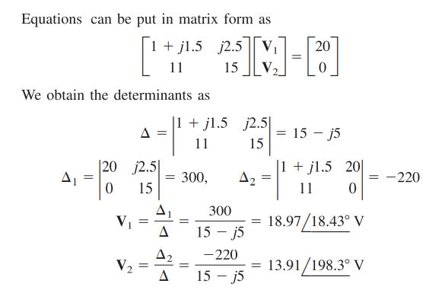

Slide 7
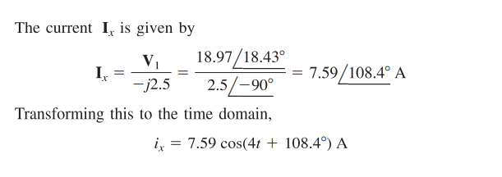
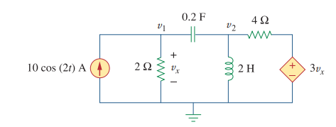
Step# 3 Transform the resulting phasor to the time domain
Practice Problem 10.1

Slide 8
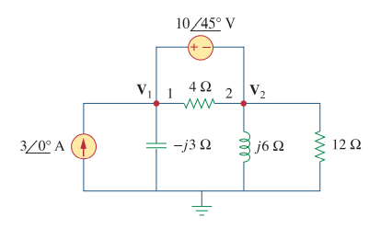
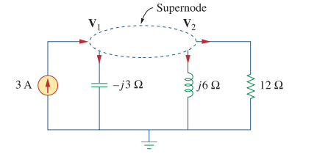
Example:
Solution:

Slide 9
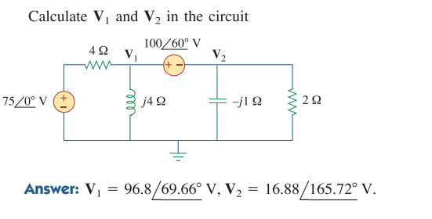
Practice Problem 10.2

Slide 10
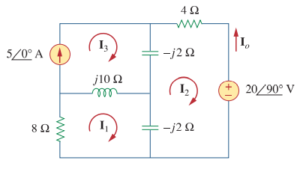
2.2 Mesh Analysis in AC Circuits
Example:
Solution:

Slide 11
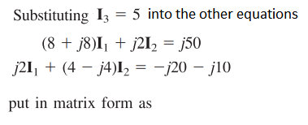
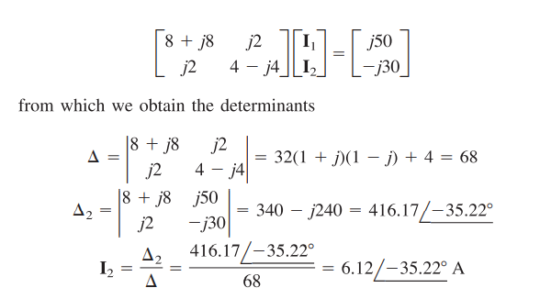

Slide 12
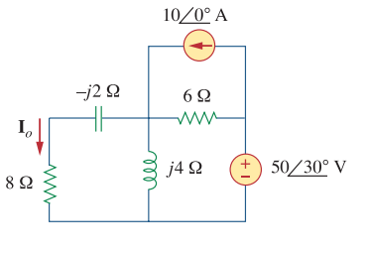
Practice Problem 10.3

Slide 13
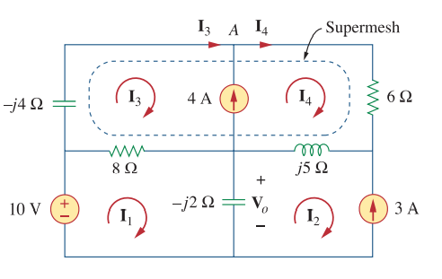
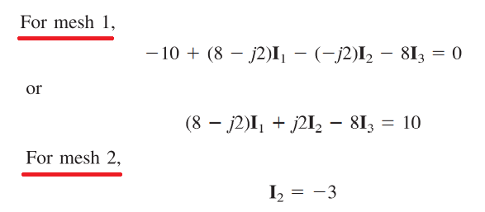
Example:
A
Solution:

Slide 14
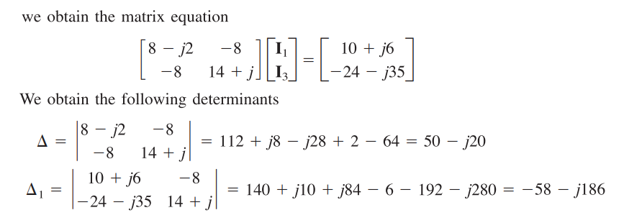
By substituting and we will have two unknown and two equation

Slide 15
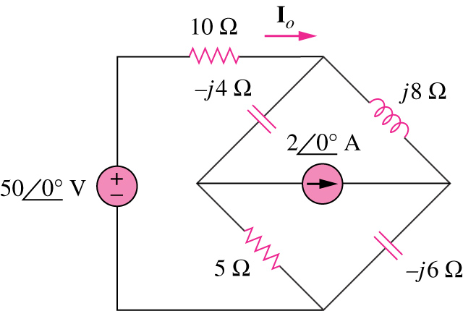
Practice Problem 10.4

Slide 16
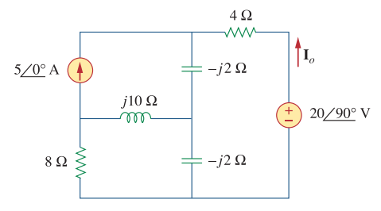
2.3 Superposition Theorem
Superposition Theorem applies to AC circuits as well.
For sources having different frequencies, the total response must be obtained by adding individual responses in time domain.
Example:

Slide 17
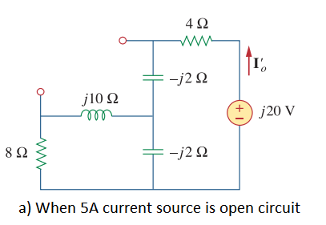
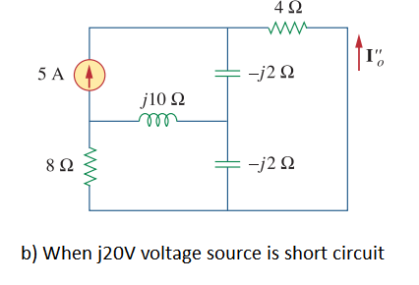
Solution:

Slide 18
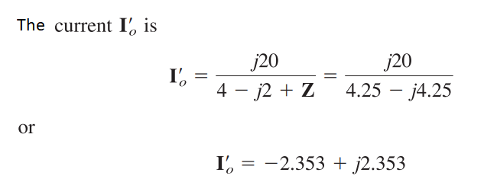

Slide 19
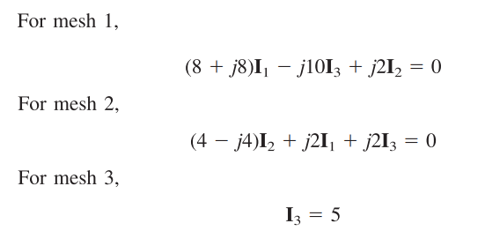
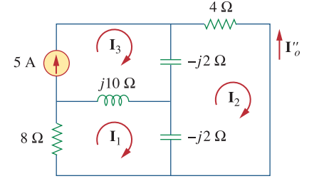

Slide 20
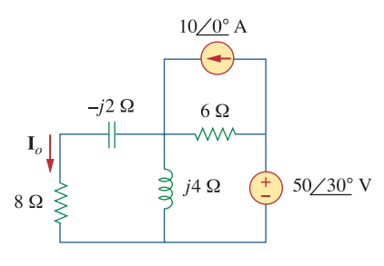
Practice Problem 10.5

Slide 21
Example:
Solution:
Where are the inductor and capacitor?

Slide 22
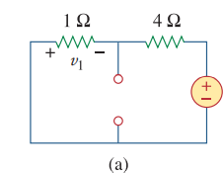
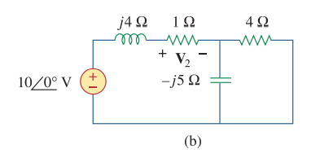

Slide 23
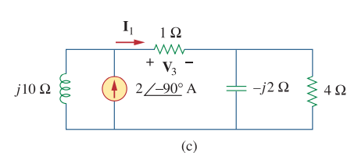

Slide 24
Practice Problem 10.6

Slide 25
2.3 Source Transformation
Transform a voltage source in series with an impedance to a current source in parallel with an impedance for simplification or vice versa.

Slide 26
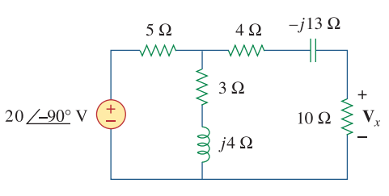
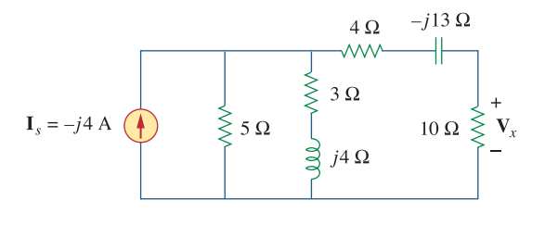
Example:
Solution:

Slide 27
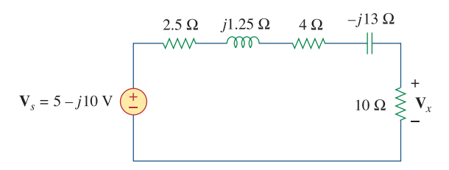

Slide 28
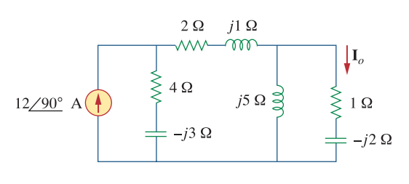
Practice Problem 10.7

Slide 29
2.4 Thevenin and Norton Equivalent Circuits
Thévenin’s theorem, as stated for sinusoidal AC circuits, is changed only to include the term impedance instead of resistance.
Any two-terminal linear ac network can be replaced with an equivalent circuit consisting of a voltage source and an impedance in series.
V_{Th} is the Open circuit voltage between the terminals a-b.
Z_{Th} is the impedance seen from the terminals when the independent sources are set to zero.

Slide 30
Norton Equivalent Circuit
The linear circuit is replaced by a current source in parallel with an impedance. I_{N} is the Short circuit current flowing between the terminals a-b when the terminals are short circuited.
Thevenin and Norton equivalents are related by:

Slide 31
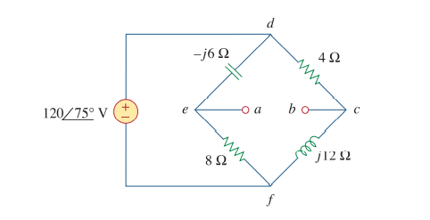
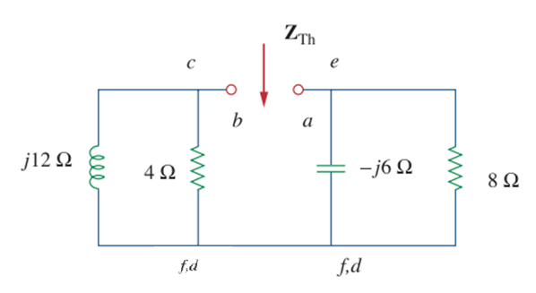
Example:
Solution:

Slide 32
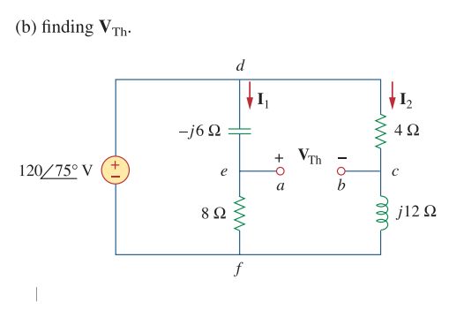
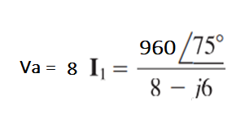
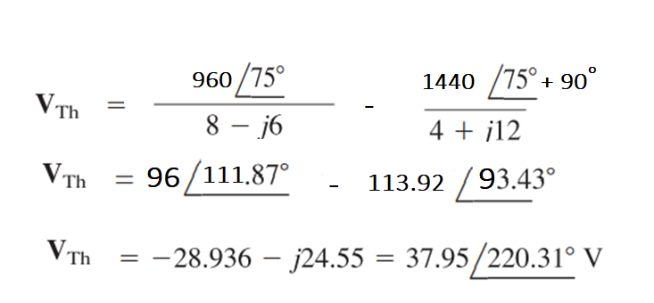

Slide 33
Practice Problem 10.8

Slide 34
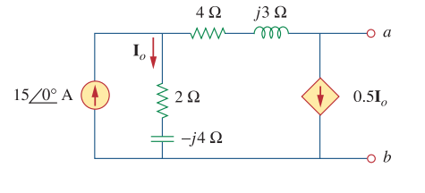
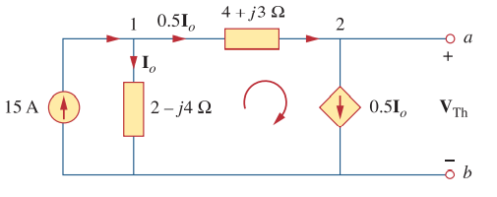
Example:
Solution:

Slide 35
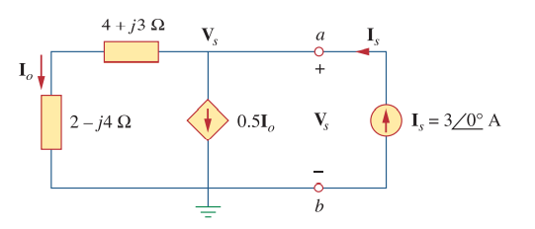

Slide 36
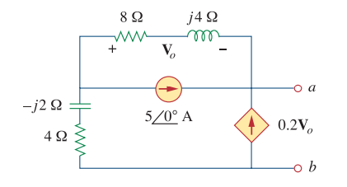
Practice Problem 10.9

Slide 37
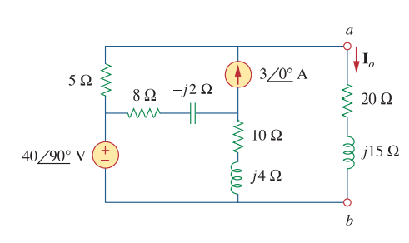
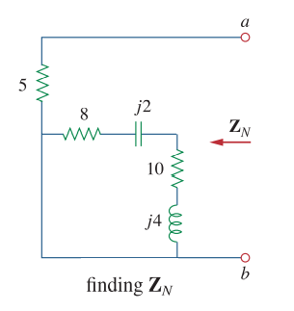
Example:
Solution:

Slide 38
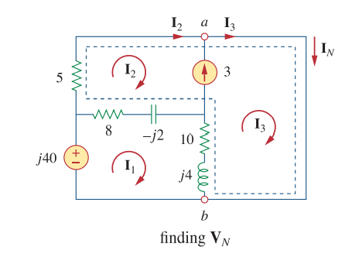

Slide 39
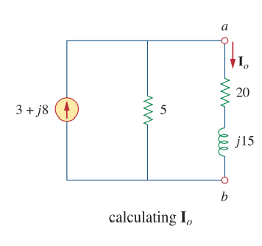
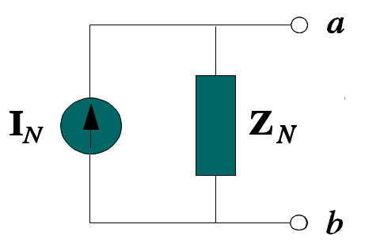

Slide 40
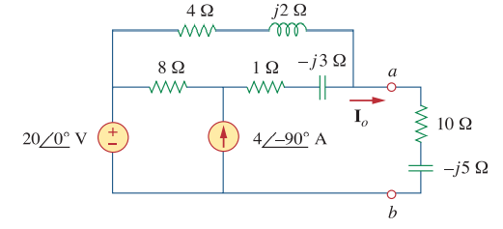
Practice Problem 10.10

