Slide 1
Three-Phase Circuits
Chapter #12

Slide 2
After completing this chapter, you will learn
different three-phase configurations and how to analyze them.
the difference between balanced and unbalanced circuits
about power in a balanced three-phase system
how to analyze unbalanced three-phase systems

Slide 3
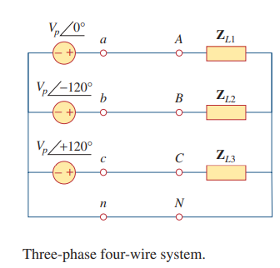
12.1 Introduction
Circuits or systems in which the ac sources operate at the same frequency but different phases are known as polyphase. A three-phase system is produced by a generator consisting of three sources having the same amplitude and frequency but out of phase with each other by 120º . Since the three-phase system is by far the most prevalent and most economical polyphase system, this chapter is mainly on three-phase systems

Slide 4
Three-phase systems are important for at least three reasons
1.
All electric power is generated and distributed in three-phase, at the operating frequency of 60 Hz in the United States or 50 Hz in some other parts of the world. When one-phase or two-phase inputs are required, they are taken from the three-phase system rather than generated independently.
2.
The instantaneous power in a three-phase system can be constant. This results in uniform power transmission and less vibration of three-phase machines.
3.
For the same amount of power, the three-phase system is more economical than the single-phase. The amount of wire required for a three-phase system is less than that required for an equivalent single-phase system.

Slide 5
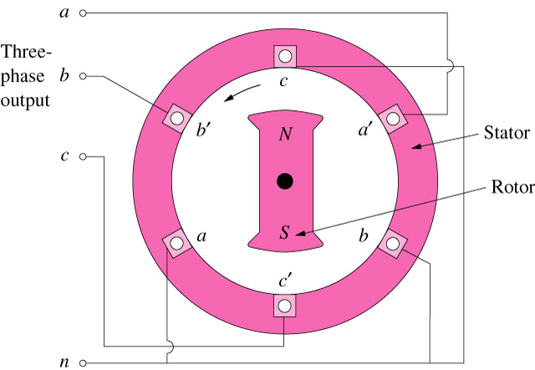
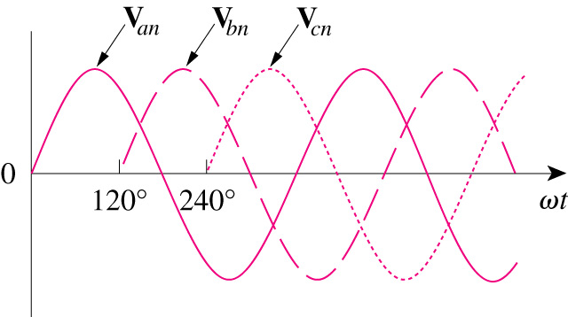
12.2 Balanced Three-Phase Voltages
Three-phase voltages are often produced with a three-phase ac generator (or alternator) whose cross-sectional view is shown below.
The three-phase generator has three induction coils placed 120° apart on the stator.
The three coils have an equal number of turns, the voltage induced across each coil will have the same peak value, shape and frequency.
Voltages having 120° phase difference

Slide 6
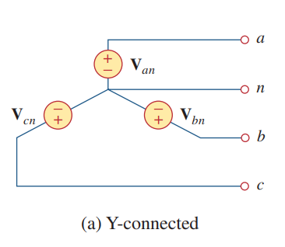
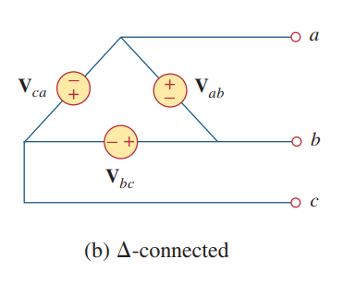

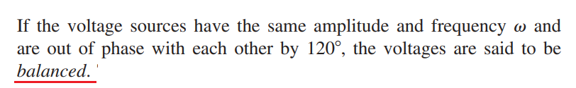
The voltage sources can be either wye-connected or delta-connected as shown figure below.

Slide 7
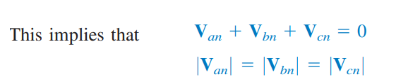

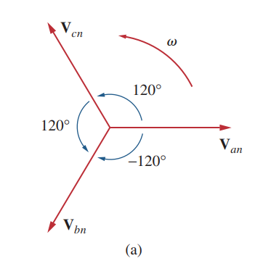
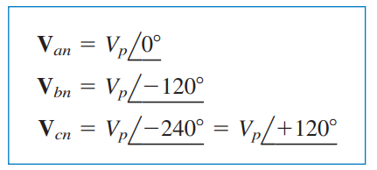
Since the three-phase voltages are out of phase with each other, there are two possible combinations.
This sequence is produced when the rotor rotates counterclockwise.
As a common tradition in power systems, voltage and current in this chapter are in rms values unless otherwise stated

Slide 8
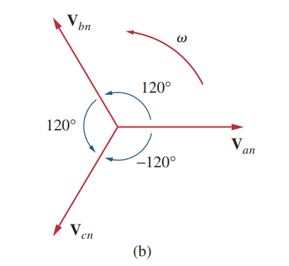
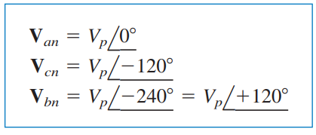

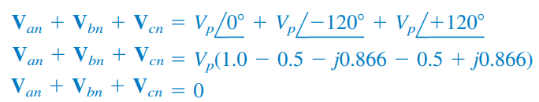
The other possibility is shown below.
This sequence is produced when the rotor rotates clockwise.
It is easy to show that the voltages

Slide 9






Example:
Determine the phase sequence of the set of voltages
Solution:
The voltages can be expressed in phasor form as
Practice Problem 12.1

Slide 10
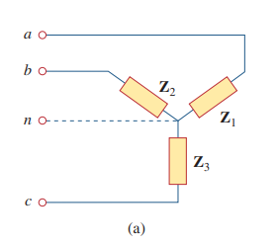
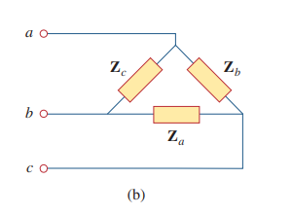
Like the generator connections, a three-phase load can be either wye-connected or delta-connected, depending on the end application.
A wye- or delta-connected load is said to be unbalanced if the phase impedances are not equal in magnitude or phase.

Slide 11




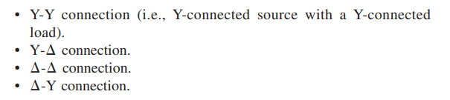
For a balanced wye-connected load,
For a balanced delta connected load,
We know that a wye-connected load can be transformed into a delta connected load, or vice versa, using
Since both the three-phase source and the three-phase load can be either wye- or delta-connected, we have four possible connections:

Slide 12




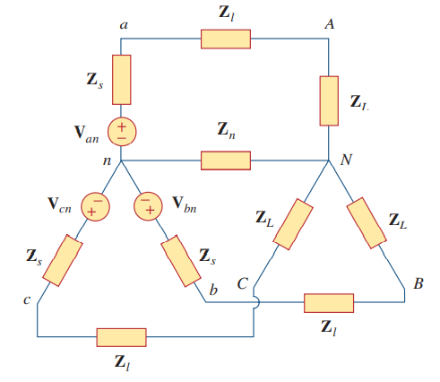


12.3 Balanced Wye-Wye Connection

Slide 13
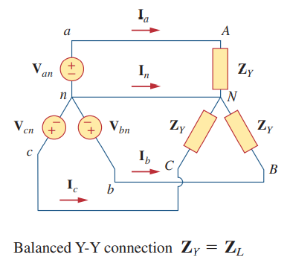












Assuming the positive sequence, the phase voltages (or line-to neutral voltages) are

Slide 14
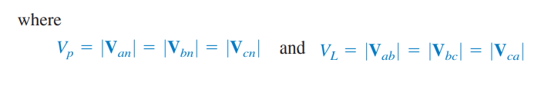
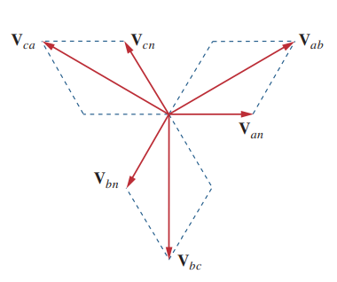
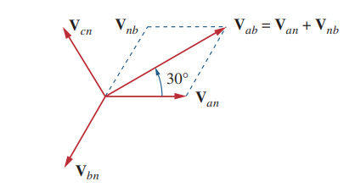


Slide 15






Applying KVL to each phase in figure below, we obtain the line currents as
We can readily infer that the line currents add up to zero,
So that
The voltage across the neutral wire is zero
The neutral line can thus be removed without affecting the system.
In the Y-Y system, the line current is the same as the phase current.

Slide 16


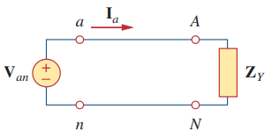

An alternative way of analyzing a balanced Y-Y system is to do so on a “per phase” basis. We look at one phase, say phase a, and analyze the single-phase equivalent circuit shown below.

Slide 17
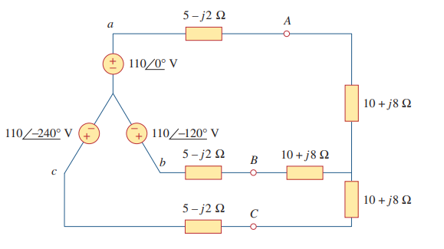


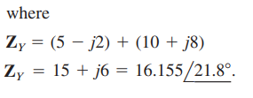


Example:
Calculate the line currents in the three-wire Y-Y system shown below.
Solution:
The three-phase circuit is balanced; we may replace it with its single-phase equivalent circuit shown below.
Since the source voltages in system are in positive sequence, the line currents are also in positive sequence.

Slide 18

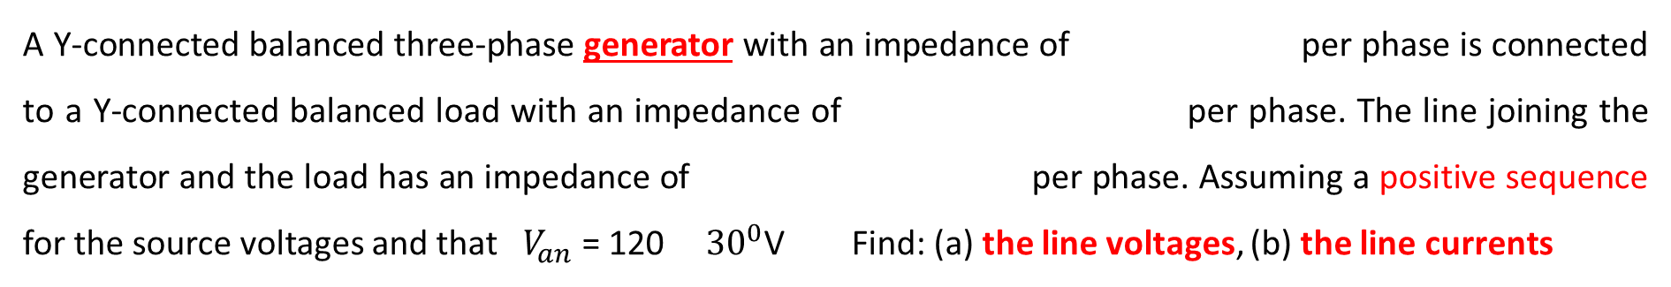
Practice Problem 12.2
A Y-connected balanced three-phase generator with an impedance of per phase is connected to a Y-connected balanced load with an impedance of per phase. The line joining the generator and the load has an impedance of per phase. Assuming a positive sequence for the source voltages and that $V_{an}$ = 120 ${30}^{0}$V Find: (a) the line voltages, (b) the line currents

Slide 19


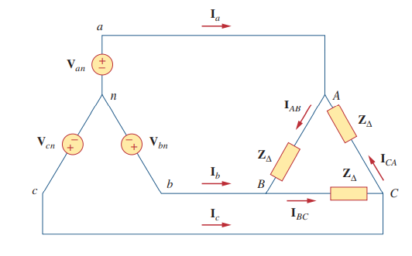








12.4 Balanced Wye-Delta Connection
There is, of course, no neutral connection from source to load for this case. Assuming the positive sequence, the phase voltages are
The line voltages are
From these voltages, we can obtain the phase currents as
These currents have the same magnitude but are out of phase with each other by

Slide 20







Another way to get these phase currents is to apply KVL. For example, applying KVL around loop aABbna gives
This is the more general way of finding the phase currents.
By applying KCL at nodes A, B, and C.

Slide 21
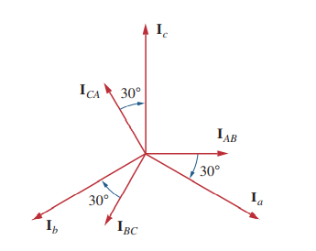

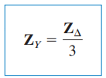
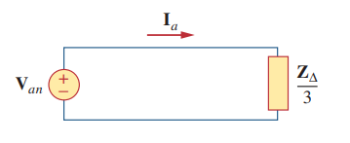
The line currents lag the corresponding phase currents by
An alternative way of analyzing the circuit is to transform the -connected load to an equivalent Y-connected load. Using the transformation formula .
After this transformation, we now have a Y-Y system

Slide 22
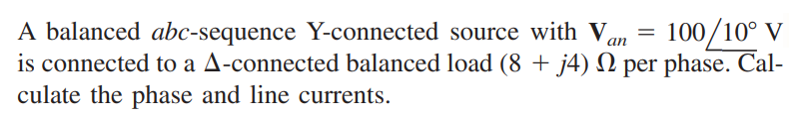









Example:
Solution:
This can be solved in two ways.

Slide 23
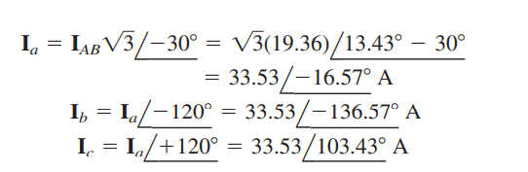


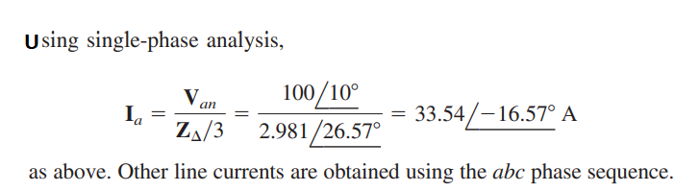

Slide 24
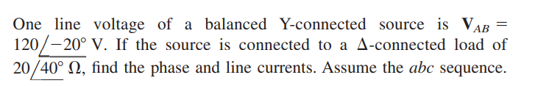
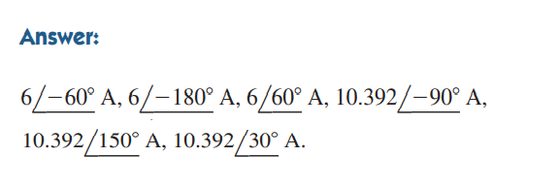
Practice Problem 12.3

Slide 25

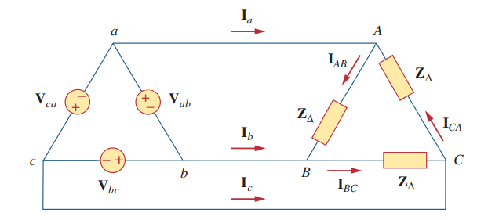
12.5 Balanced Delta-Delta Connection
Assuming a positive sequence, the phase voltages for a delta-connected source are
The line voltages are the same as the phase voltages.

Slide 26












Assuming there is no line impedances, the phase voltages of the delta connected source are equal to the voltages across the impedances.
The phase currents are
The line currents are obtained from the phase currents by applying KCL at nodes A, B, and C
Also, as shown in the last section, each line current lags the corresponding phase current by
The magnitude of the line current is times the magnitude of the phase current,

Slide 27
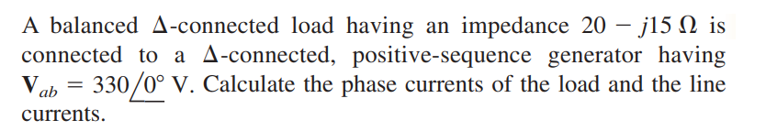

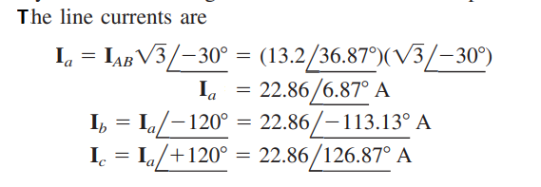



Example:
Solution:

Slide 28
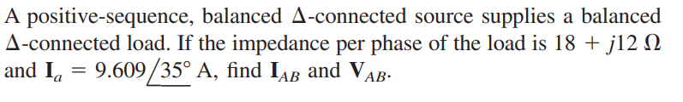

Practice Problem 12.4

Slide 29




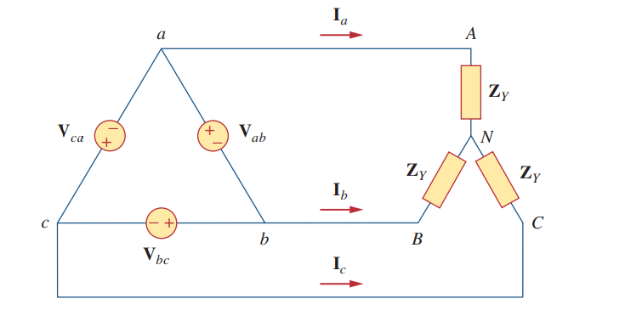
12.6 Balanced Delta-Wye Connection
Again, assuming the abc sequence, the phase voltages of a delta-connected source are

Slide 30


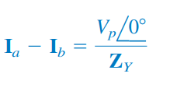
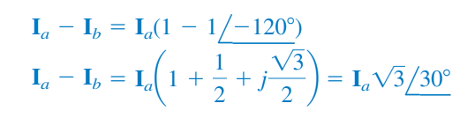
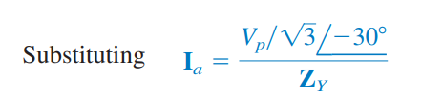



We can obtain the line currents in many ways. One way is to apply KVL to loop aANBba

Slide 31
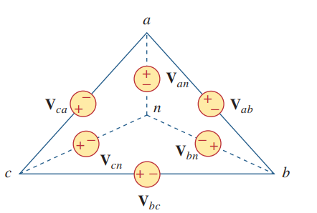




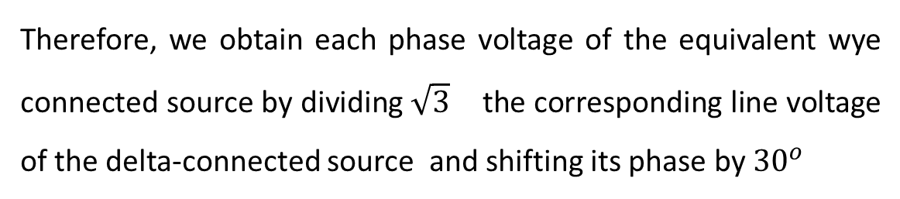
Another way to obtain the line currents is to replace the delta connected source with its equivalent wye-connected source, as shown below.
We found that the line-to-line voltages of a wye-connected source lead their corresponding phase voltages by
Therefore, we obtain each phase voltage of the equivalent wye connected source by dividing $\sqrt{3}$ the corresponding line voltage of the delta-connected source and shifting its phase by ${30}^{o}$

Slide 32
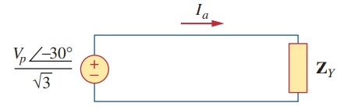



Once the source is transformed to wye, the circuit becomes a wye-wye system. Therefore, we can use the equivalent single-phase circuit shown below.
The line current for phase a is
From this, we obtain the other line currents and using the positive phase sequence,

Slide 33
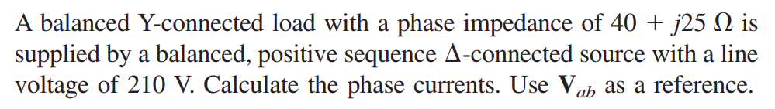






Example:
Solution:
When the - connected source is transformed to a Y-connected source
The line currents are
which are the same as the phase currents

Slide 34

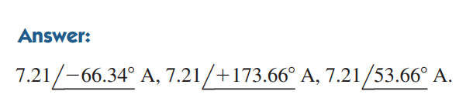
Practice Problem 12.5

Slide 35






12.7 Power in a Balanced System
For a Y-connected load, the phase voltages

Slide 36
The important consequences of the instantenous power equation of a balanced three phase system are:

Slide 37
The complex power per phase is S_{p}. The total complex power for all phases is S.

Slide 38
The complex power per phase is S_{p}. The total complex power for all phases is S.

Slide 39
Notice the values of V_{p}, V_{L}, I_{p}, I_{L} for different load connections.
I_{p}
V_{p}
V_{p}
I_{p}
V_{p}
V_{L}
V_{L}
V_{L}
I_{p}
V_{L}
I_{p}
V_{p}
V_{p}
V_{L}
V_{p}
I_{p}
I_{p}
V_{L}
Y connected load.
Δ connected load.

Slide 40
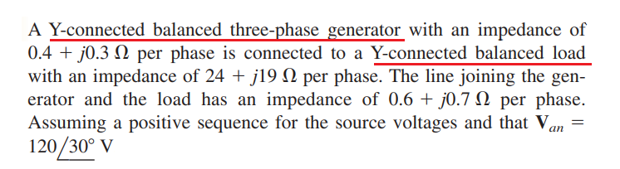
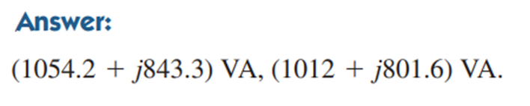
Practice Problem 12.6
Calculate the complex power at the source and at the load

Slide 41


Example:
A three-phase motor can be regarded as a balanced Y-load. A three phase motor draws 5.6 kW when the line voltage is 220 V and the line current is 18.2 A. Determine the power factor of the motor
Solution:
The apparent power is
Since the real power is
the power factor is

Slide 42

Practice Problem 12.7
Calculate the line current required for a 30-kW three-phase motor having a power factor of 0.85 lagging if it is connected to a balanced source with a line voltage of 440 V

Slide 43
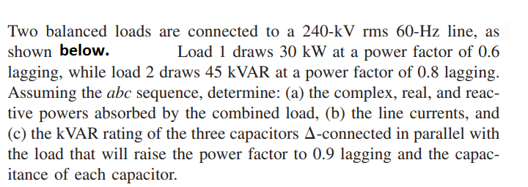
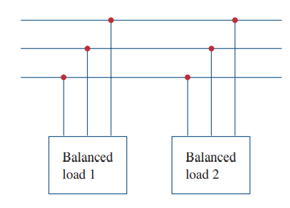



Example:

Slide 44















Solution:

Slide 45













Slide 46








Alternatively, we could obtain the current from the total complex power

Slide 47








Slide 48


Practice Problem
12.8

Slide 49




4.8 Unbalanced Three-Phase Systems
An unbalanced system is caused by two possible situations: (1) The source voltages are not equal in magnitude and/or differ in phase by angles that are unequal, or (2) load impedances are unequal
To simplify analysis, we will assume balanced source voltages, but an unbalanced load.
The line currents are
This set of unbalanced line currents produces current in the neutral line, which is not zero as in a balanced system. Applying KCL at node N gives the neutral line current as

Slide 50






Example:
Solution:

Slide 51




Practice Problem 12.9

Slide 52





Example:
For the unbalanced circuit shown below, find: (a) the line currents, (b) the total complex power absorbed by the load, and (c) the total complex power absorbed by the source
Solution:
(a)

Slide 53






Slide 54








Slide 55

(b)

Slide 56



(c)

Slide 57


Practice Problem 12.10
Find the line currents in the unbalanced three-phase circuit shown below and the real power
absorbed by the load.

