Slide 1
Magnetically Coupled Circuits
Chapter#13

Slide 2
After completing this chapter, you will
Understand magnetically coupled circuits.
Learn the concept of mutual inductance.
Be able to determine energy in a coupled circuit.
Learn how to analyze circuits involving linear and ideal transformers.
Be familiar with ideal autotransformers.
Learn how to analyze circuits involving three-phase transformers.

Slide 3
12.1 Introduction
The circuits we have considered so far may be regarded as conductively coupled, because one loop affects the neighboring loop through current conduction
When two loops with or without contacts between them affect each other through the magnetic field generated by one of them, they are said to be magnetically coupled
The transformer is an electrical device designed on the basis of the concept of magnetic coupling. It uses magnetically coupled coils to transfer energy from one circuit to another.

Slide 4
They are used in electronic circuits such as radio and television receivers for such purposes as impedance matching, isolating one part of a circuit from another, and again for stepping up or down ac voltages and currents.
We will begin with the concept of mutual inductance and introduce the dot convention used for determining the voltage polarities of inductively coupled components. Based on the notion of mutual inductance, we then introduce the circuit element known as the transformer. We will consider the linear transformer, the ideal transformer, the ideal autotransformer

Slide 5

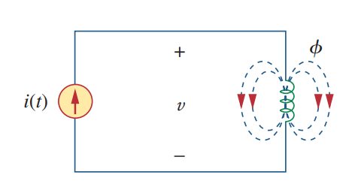





12.2 Mutual Inductance
When two inductors (or coils) are in a close proximity to each other, the magnetic flux caused by current in one coil links with the other coil, thereby inducing voltage in the latter. This phenomenon is known as mutual inductance
According to Faraday’s law, the voltage induced in the coil

Slide 6
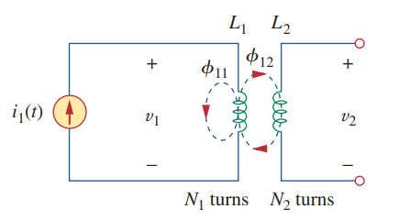







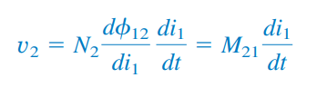
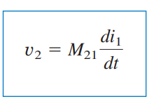


Slide 7
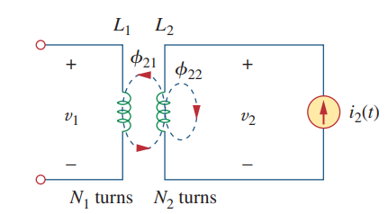
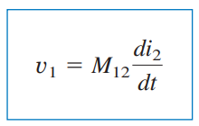

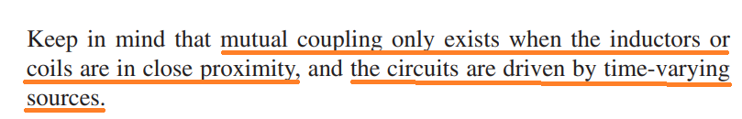
Mutual inductance of coil 1 with respect to coil 2.

Slide 8
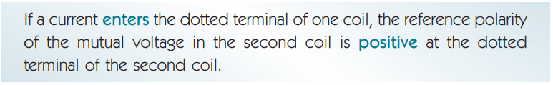

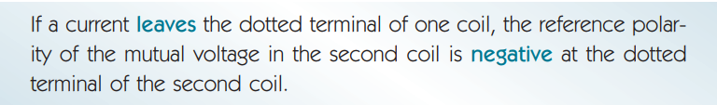
Dot Convention is used to establish the choice of correct sign for the mutually induced voltages in coupled circuits.
The dots are used along with the dot convention to determine the polarity of the mutual voltage. The dot convention is stated as follows:
Thus, the reference polarity of the mutual voltage depends on the reference direction of the inducing current and the dots on the coupled coils.

Slide 9
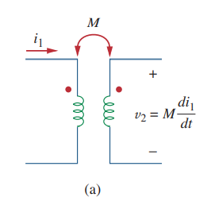
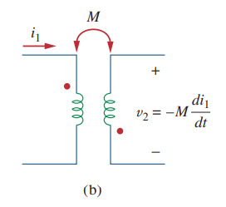
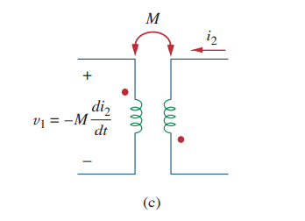
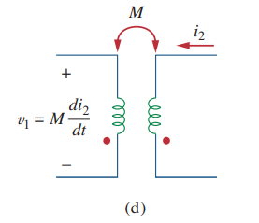
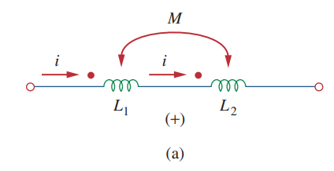
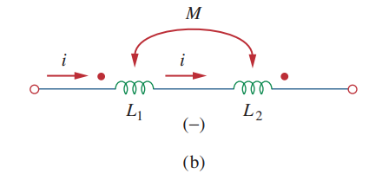

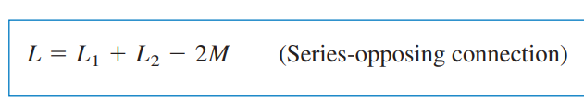
Examples illustrating how to apply the dot convention.

Slide 10
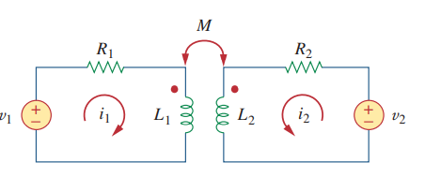







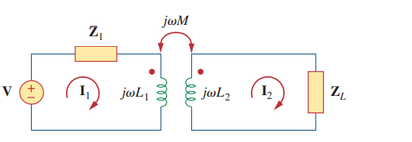




and

Slide 11
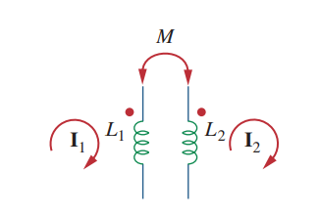
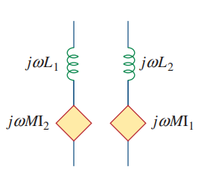
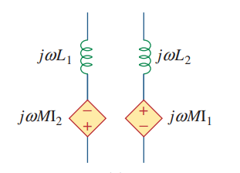
Model that makes analysis of mutually coupled easier to solve.
We first determine the value of the induced voltages and then we determine the appropriate signs.
I1 induces a voltage within the second coil represented by the value j $ω_{M}$I1 and I2 induces a voltage of j $ω_{M}$ I2 in the first coil.
Since I1 enters L1 at the dotted end, it induces a voltage in L2 that tries to force a current out of the dotted end of L2 which means that the source must have a plus on top .
I2 leaves the dotted end of L2 which means that it induces a voltage in L1 which tries to force a current into the dotted end of L1 requiring a dependent source that has a plus on the bottom.

Slide 12
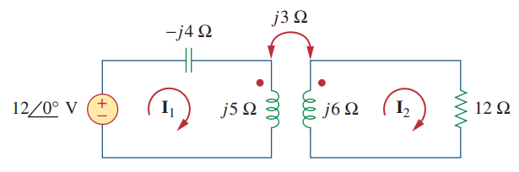







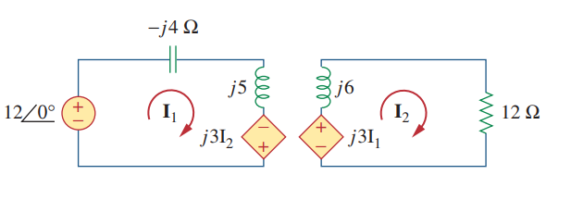


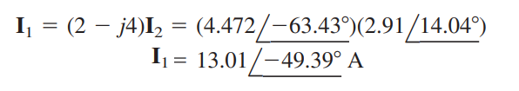
Example:
Solution:

Slide 13
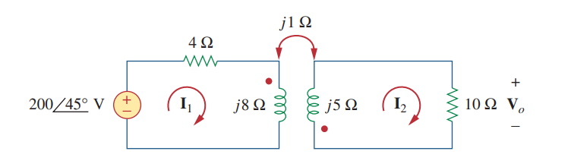

Practice Problem 13.1

Slide 14
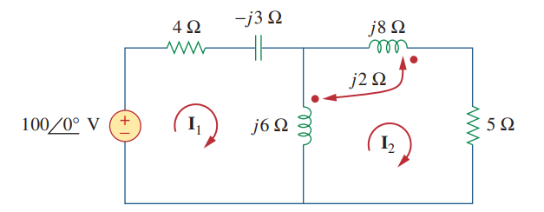



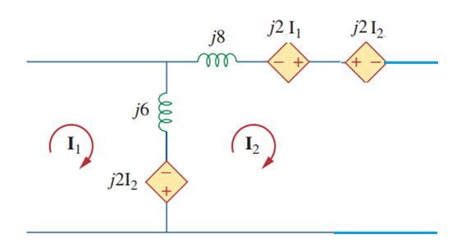



Example:
Calculate the mesh currents in the circuit shown below.
Solution:

Slide 15
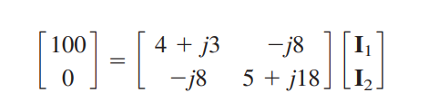

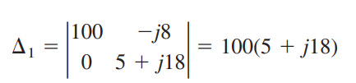




Slide 16
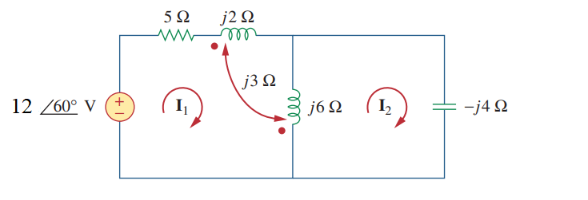


Practice Problem 13.2

Slide 17
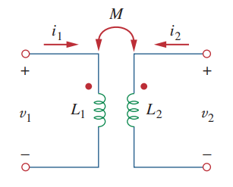
5.3 Energy in a Coupled Circuit
The total energy w stored in a mutually coupled inductor is:
Positive sign is selected if both currents ENTER or LEAVE the dotted terminals.
Otherwise we use Negative sign.

Slide 18






We will now establish an upper limit for the mutual inductance M.
The extent to which the mutual inductance M approaches the upper limit is specified by the coefficient of coupling k, given by
The Coupling Coefficient k is a measure of the magnetic coupling between two coils
  If the entire flux produced by one coil links another coil, then and we have 100 percent coupling, or the coils are said to be perfectly coupled. For coils are said to be loosely coupled; and for they are said to be tightly coupled.

Slide 19
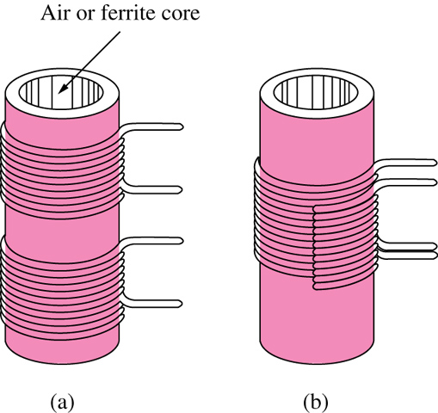
Loosely coupled coil b) Tightly coupled coil
We expect k to depend on the closeness of the two coils, their core, their orientation, and their windings
The air-core transformers used in radio frequency circuits are loosely coupled, whereas iron-core transformers used in power systems are tightly coupled

Slide 20
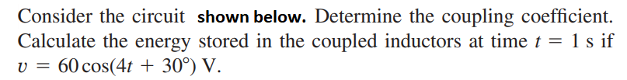
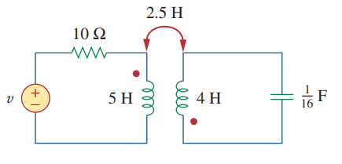

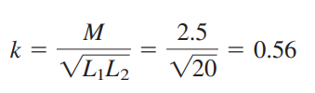

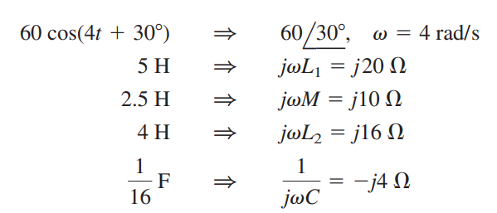
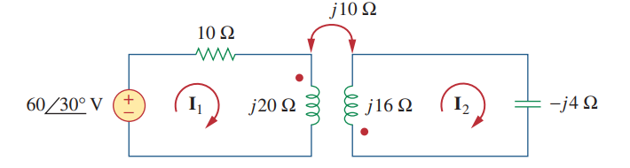
Example:
Solution:

Slide 21
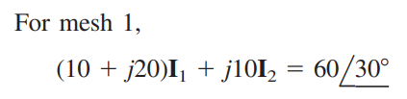
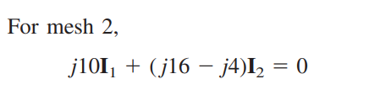













Substituting this into above equation

Slide 22
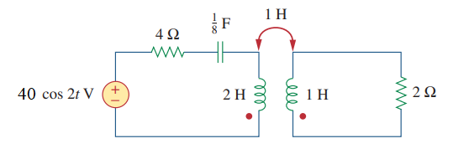

Practice Problem 13.3
For the circuit shown below, determine the coupling coefficient and the energy stored in the coupled inductors at t = 1.5 s.

Slide 23
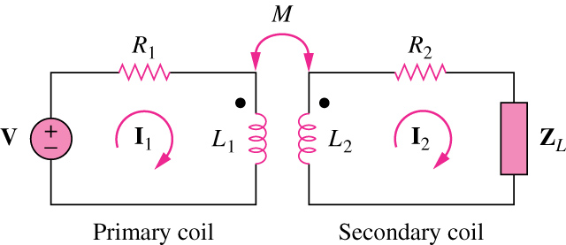
12.4 Linear Transformers
A transformer is generally a four-terminal device comprising two or more magnetically coupled coils.
The transformer is called LINEAR if the coils are wound on magnetically linear material.
For a LINEAR TRANSFORMER flux is proportional to current in the windings.
Resistances R₁ and R₂ account for losses in the coils.
The coils are named as PRIMARY and SECONDARY.

Slide 24
Let us obtain the input impedance as seen from the source,
Z_{R}
Secondary impedance seen from the primary side is the Reflected Impedance.

Slide 25
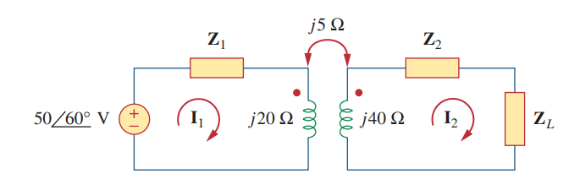
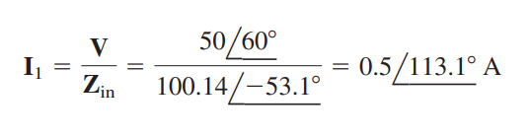




Example:
Assume that it is Linear transformer.
Solution:
It should be noted that the result in Z in is not affected by the location of the dots on the transformer.

Slide 26
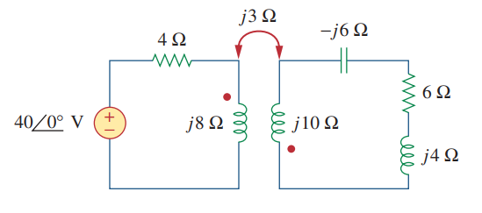
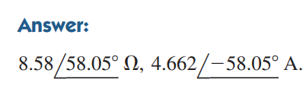
Practice Problem13.4:
Find the input impedance of the linear transformer circuit shown below and the current from the voltage source.

Slide 27
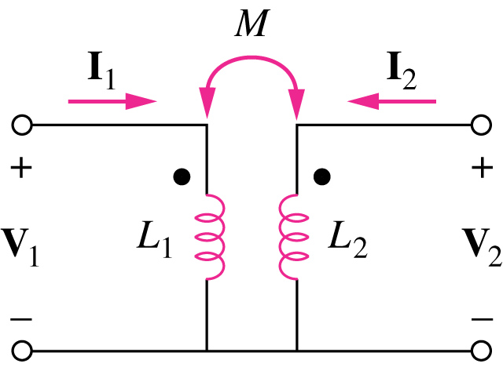
Equivalent T Circuit for Linear Transformers
The coupled transformer can equivalently be represented by an EQUIVALENT T circuit using UNCOUPED INDUCTORS.
Transformer circuit b) Equivalent T circuit of the transformer

Slide 28
Equivalent П Circuit for Linear Transformers
The coupled transformer can equivalently be represented by an EQUIVALENT П circuit using uncoupled inductors.
Transformer circuit b) Equivalent Π circuit of the transformer

Slide 29
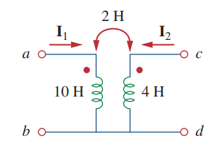






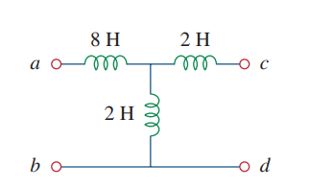
Example:
Determine the T-equivalent circuit of the linear transformer shown below.
Solution:

Slide 30

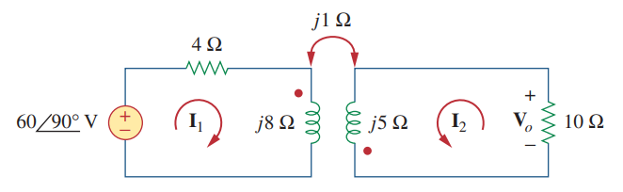
Example:
Solution:
We need to replace the magnetically coupled coils with the T-equivalent circuit. First, due to the current reference directions and voltage polarities, we need to replace –M. Since Ꙍ is not specified, we can assume Ꙍ = 1 rad\sec or any other value;

Slide 31
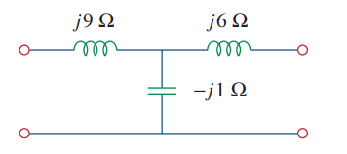









Substituting

Slide 32





Practice Problem 13.5

Slide 33





13.5 Ideal Transformers
A Ideal Transformer is a unity Coupled, lossless transformer in which the primary and secondary coils have infinite self inductances.
A Transformer is ideal if:
1.) Large reactance coils;
2.) Unity Coupling k=1.
3.) Coils are lossless (R₁=R₂=0)
Ideal transformer
Circuit symbol for the Ideal transformer

Slide 34
An ideal transformer has no power loss; all power applied to the primary is all delivered to the load. Actual transformers depart from this ideal model. Some loss mechanisms are:
Winding resistance: Causing power to be dissipated in the windings.
Hysteresis loss: Due to the continuous reversal of the magnetic field.
Core losses: Due to circulating current in the core (eddy currents).
Flux leakage: Flux from the primary that does not link to the secondary.
Winding capacitance: It has a bypassing effect for the windings.
The ideal transformer does not dissipate power. Power delivered from the source is passed on to the load by the transformer.
The efficiency of a transformer is the ratio of power delivered to the load (Pout) to the power delivered to the primary (Pin).

Slide 35
Input-Output Variables of an Ideal Transformer
The input and output voltages and currents of an ideal transformer are related only by the turns ratio.

Slide 36

Input-Output Variables of an Ideal Transformer
A Ideal Transformer is called:
1.) Step-up transformer if n > 1.
2.) Step-down transformer if n < 1.
3.) Isolation transformer if n=1.

Slide 37
Transformer Dot Convention
Transformer DOT convention is needed to assign the polarity of the output variables.
1.) If V₁ and V₂ are BOTH + or BOTH – at the dotted terminals use +n, otherwise –n.
2.) If I₁ and I₂ BOTH ENTER or BOTH LEAVE the dotted terminals use –n, otherwise +n.
In phase
Out of phase
Dot convention indicating the phase relationship between the input and the output.

Slide 38
Typical circuits illustrating polarity for voltages and direction of currents of an ideal transformer
Dot Convention for Ideal Transformers

Slide 39


The ability of a transformer to transform a given impedance to another value is very useful in IMPEDANCE MATCHING.
Reflected Impedance of Ideal Transformers
Z_{th}
a) Obtaining the V_{Th}. b) Obtaining the Z_{Th}.
Since terminals a-b are open, I1 = I2=0 so that V1=Vs2

Slide 40


Reflected impedance
Equivalent circuit of reflection of the secondary to primary side.
Equivalent circuit of reflection of the primary to secondary side.

Slide 41
Conservation of the Complex Power
An ideal transformer absorbs no power.
The complex power in the primary winding is equal to the complex power delivered to the secondary winding.
Transformer absorbs no power. We assume a lossless transformer.
S₁
S₂

Slide 42









Example:
An ideal transformer is rated at 2400/120 V, 9.6 kVA, and has 50 turns on the secondary side. Calculate: (a) the turns ratio, (b) the number of turns on the primary side, and (c) the current ratings for the primary and secondary windings
Solution:
(a) This is a step-down transformer, since
(b)
(c)

Slide 43
Practice Problem 13.6:
The primary current to an ideal transformer rated at 2200 / 110 V is 5 A.
Calculate: (a) the turns ratio, (b) the kVA rating, (c) the secondary current.
Answer: (a) 1/ 20 (b) 11 kVA (c) 100 A.

Slide 44




Example:
Solution:

Slide 45






Method II

Slide 46



Practice Problem 13.7:

Slide 47













Example:
Solution:
Reflection to the secondary or primary side cannot be done with this circuit. We apply mesh analysis
We now have four equations and four unknowns

Slide 48








Practice Problem 13.8

Slide 49
13.6 Ideal Autotransformers
An auto transformer is a transformer in which both the primary and secondary are in a single winding.
Autotransformers are smaller and lighter than an equivalent two winding transformer.
Electrical isolation is lost between the primary and secondary windings.
a) step-down autotransformer b) step-up autotransformer

Slide 50







Compare the power ratings of the two-winding transformer in (a) and the autotransformer in (b).

Slide 51

Example:

Slide 52












Solution:
This is a step-up autotransformer with

Slide 53



Practice Problem 13.9:

