Slide 1
Frequency Response
Chapter#14

Slide 2
After completing this chapter, you will
Understand the Concept of Transfer Functions.
Be Familiar with the Decibel Scale.
Learn how to make Bode Magnitude and Phase plots.
Learn about series and parallel resonant RLC circuits.
Know Different Types of Passive and Active Filters and their Characteristics.
Understand the use of scaling in circuit analysis.

Slide 3
14.1 Introduction
We have learned how to find voltages and currents in a circuit with a constant frequency source. If we let the amplitude of the sinusoidal source remain constant and vary the frequency, we obtain the circuit’s frequency response
What is Frequency Response of a Circuit?
It is the variation in a circuit’s behavior with change in signal frequency and may also be considered as the variation of the gain and phase with frequency.
The sinusoidal steady-state frequency responses of circuits are of significance in many applications, especially in communications and control systems. Filters are used in radio, TV, and telephone systems to separate one broadcast frequency from another.

Slide 4
14.2 Transfer Function
The transfer function H(ω) of a circuit is the is the frequency dependent ratio of the phasor output Y(ω) to a phasor input X(ω).
Considered input and output may be either the current or the voltage variable.
4 types of possible transfer functions.

Slide 5
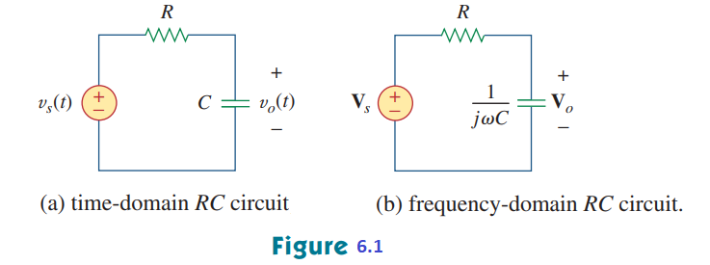
Example:
For the RC circuit in Fig.6.1(a), obtain the transfer function and its frequency response
Solution:

Slide 6
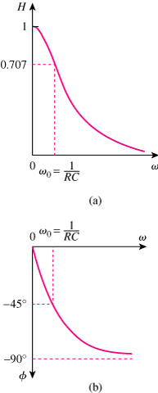
Drawing Frequency Response of RC Circuit
Low Pass Filter
a) Amplitude Response b) Phase Response
The frequency value of ω_{o} is of special interest.
Because output is considerable only at low values of frequency, the circuit is also called a LOW PASS FILTER.

Slide 7
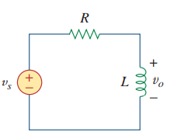
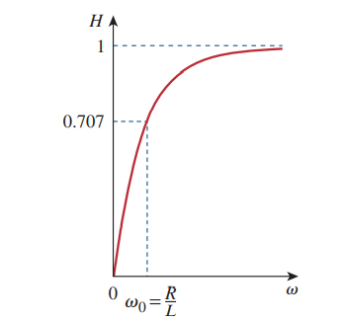
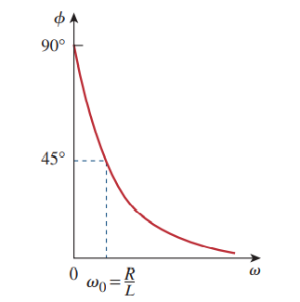
Practice Problem 14.1:
Obtain the transfer function of the RL circuit in Fig. 6.2, assuming . Sketch its frequency response.
a) Amplitude Response b) Phase Response

Slide 8
The transfer function H(ω) can be expressed in terms of its numerator polynomial N(ω) and its denominator polynomial D(ω).
The roots of N(ω)=0 are called ZEROS of H(ω) (jω=z₁, z₂, z₃, ….). Similarly The roots of D(ω)=0 are called POLES of H(ω) (jω=p₁, p₂, p₃, ….).
A zero as a root of the numerator polynomial, results in a zero value of the transfer function.
A pole as a root of the denominator polynomial, results in an infinite value of the transfer function.

Slide 9
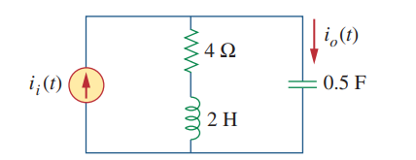
Example:
For the circuit in Fig.6.3, calculate the gain and its poles and zeros
Solution:
Fig.6.3

Slide 10
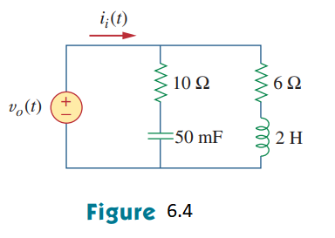
Practice Problem 14.2:
Find the transfer function for the circuit in Fig. 6.4. Obtain its zeros and poles.

Slide 11
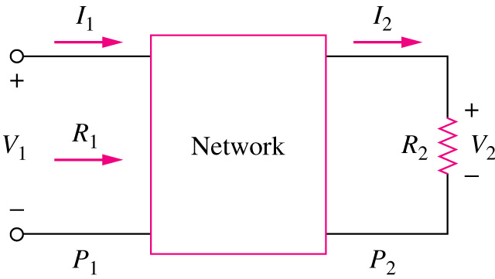
14.3 The Decibel Scale
A more systematic way of obtaining the frequency response is to use Bode plots. Before we begin to construct Bode plots, we should take care of two important issues:
(i) the use of logarithms and (ii) decibels in expressing gain.

Slide 12
14.4 Bode Plots
The magnitude in decibels is plotted against the logarithm of the frequency; on a separate plot, the phase in degrees is plotted against the logarithm of the frequency. Such semilogarithmic plots of the transfer function—known as Bode plots
A transfer function may be written in terms of factors that have real and imaginary parts.
This representation is called the STANDARD FORM. It has several different factors. We can draw the Bode plots by plotting each of the terms of the transfer function separately and then adding them.

Slide 13
The different factors of the transfer function are 1.) Gain term K. 2.) A pole (jω)⁻¹ or a zero (jω) at the origin. 3.) A simple pole or zero 4.) A quadratic pole or zero

Slide 14
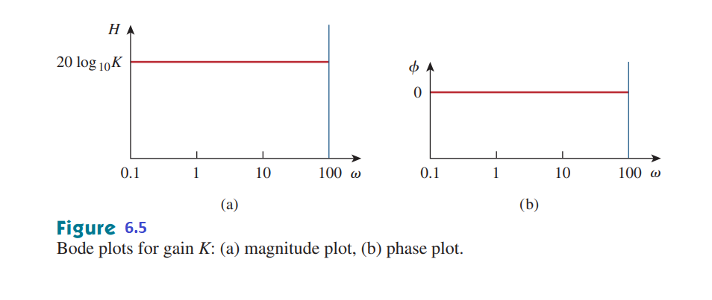
Constant term:

Slide 15
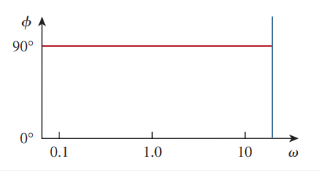
Pole/zero at the origin:
A DECADE is an interval between 2 frequencies with a ratio of 10 (between 10 Hz and 100 Hz or between 500 Hz and 5000 Hz). 20 dB/decade means that magnitude changes 20 dB whenever the frequency changes tenfold or one decade.
Slopes are expressed in dB/decade.
20 dB
One Decade
Figure 6.6 Bode plot for a zero at the origin: (a) magnitude plot, (b) phase plot.

Slide 16
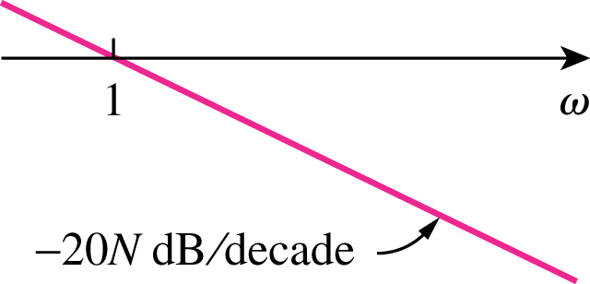
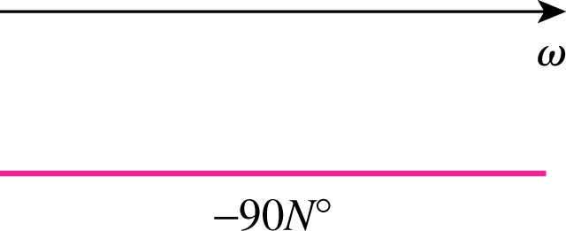
POLE AT THE ORIGIN

Slide 17
Simple pole/zero:

Slide 18
CORNER FREQUENCY
BREAK FREQUENCY
3 dB FREQUENCY

Slide 19
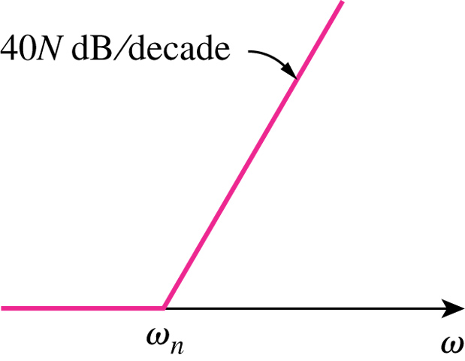
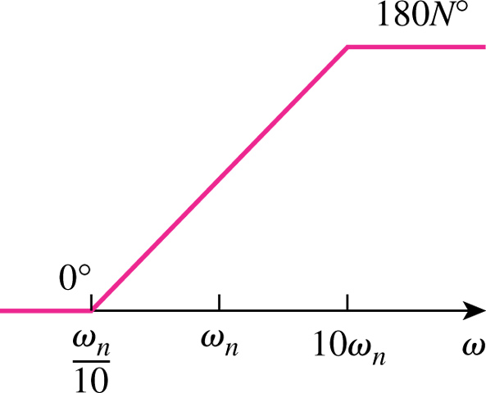
Quadratic pole/zero:
The EXACT responses can be approximated by BODE plots in terms of the corner frequency ω_{n}

Slide 20
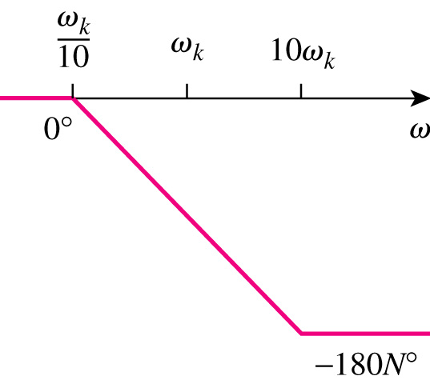
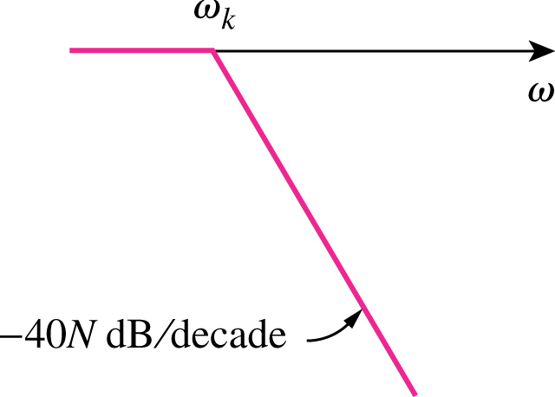

Slide 21
BODE PLOTS

Slide 22
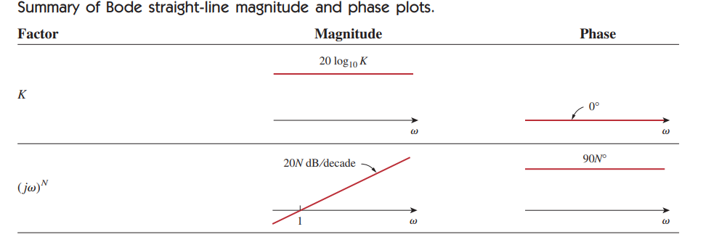

Slide 23
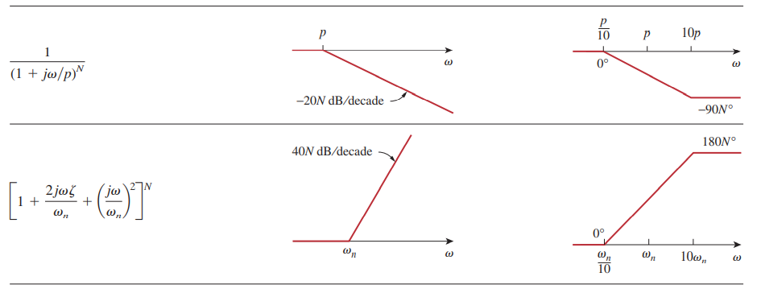

Slide 24
Procedure for Bode plot Construction
Express transfer function in Standard form.
Find the Pole and Zero frequencies.
Express the magnitude and phase responses.
Sketch each term of the magnitude and phase responses.
Add each term of magnitude response to find total magnitude response.
Add each term of phase response to find total phase response.
Another Procedure
Zeros cause an increase and poles cause a decrease in the slope .
Start with the lowest frequency of the Bode plot.
Move along the frequency axis and increase or decrease the slope at each corner frequency.
Repeat the same procedure for both the magnitude and the phase.

Slide 25
Example:
Construct the Bode plots for the transfer function
Solution:
Hence, the magnitude and phase are

Slide 26
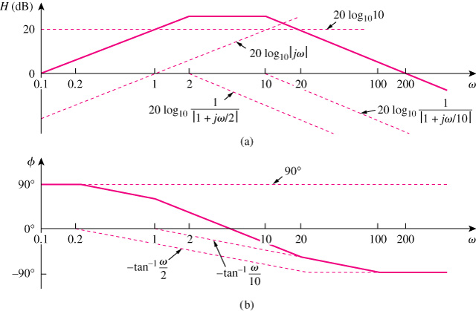
26 dB

Slide 27
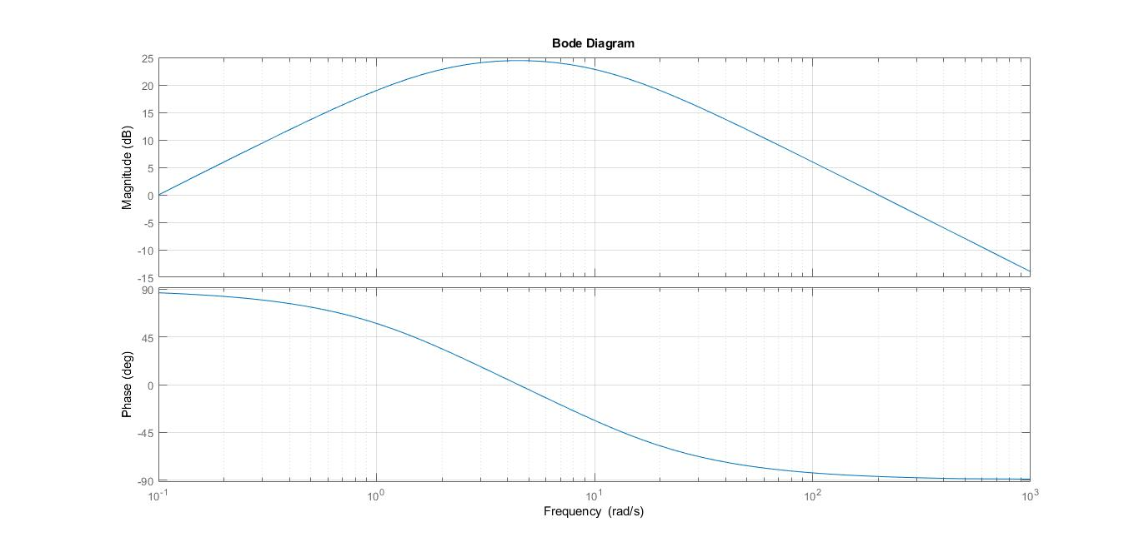
s=tf('s');H= (200*s)/((s+2)*(s+10));bode(H);grid

Slide 28
Example:
Construct the Bode plots for the transfer function
Solution:
$$H\left(ω\right)= \frac{(1+\frac{jω}{2})}{jω(1+\frac{jw}{10})}$$
$$H\left(ω\right)= \frac{|(1+\frac{jw}{2})|}{\left|jw\right| |1+\frac{jw}{10}|}$$
$$H_{dB}=20\log_{10}\left(1+\frac{jw}{2}\right)−20\log_{10}{(jw)}−20\log_{10}{(1+\frac{jw}{10} )}$$
$$∅=$$

Slide 29
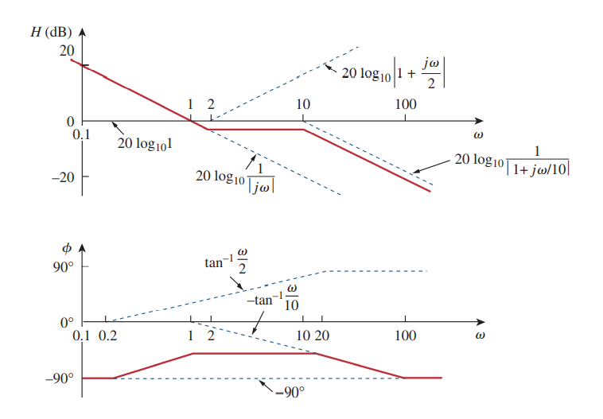

Slide 30
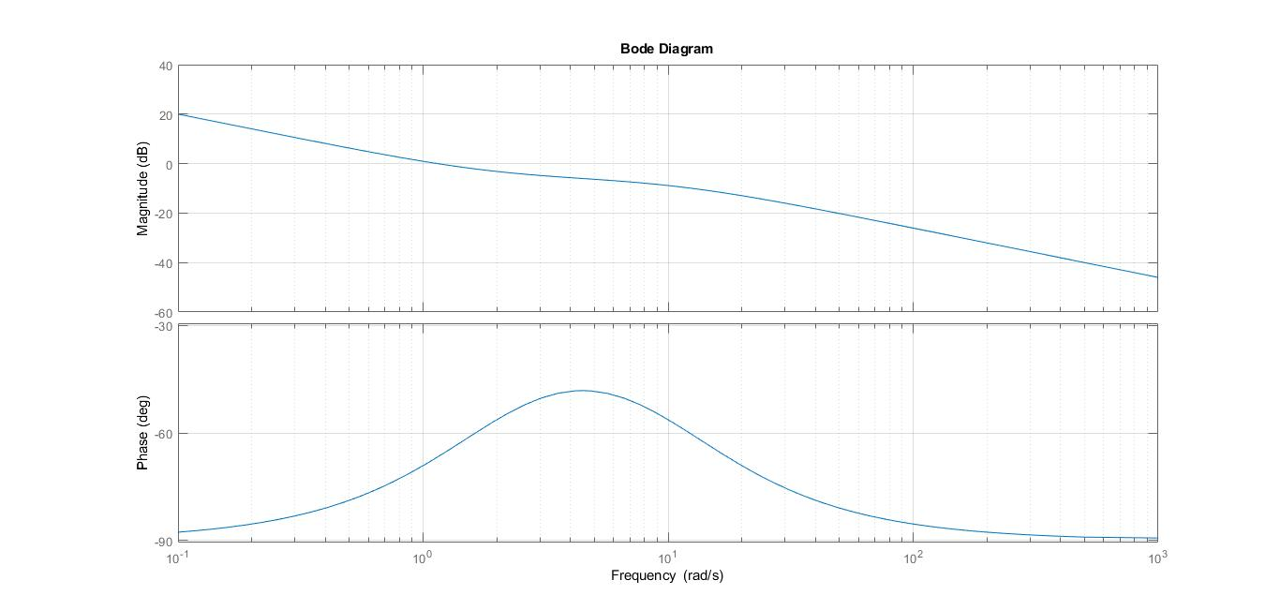
s=tf('s'); H= (5*(s+2)/(s*(s+10))); bode(H); grid

Slide 31
Example:
Obtain the Bode plots for the transfer function
Solution:

Slide 32
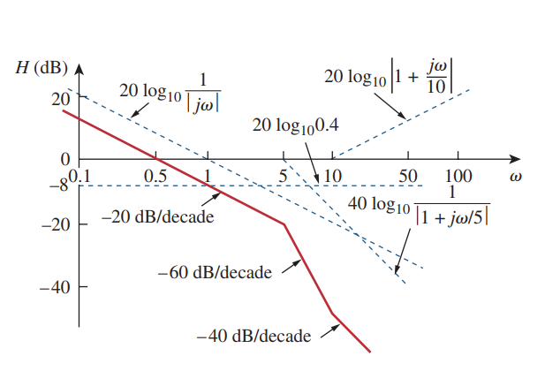
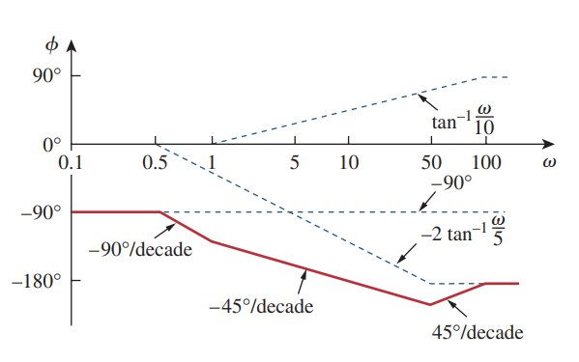

Slide 33
Example:
Obtain the Bode plots for the transfer function
Solution:

Slide 34
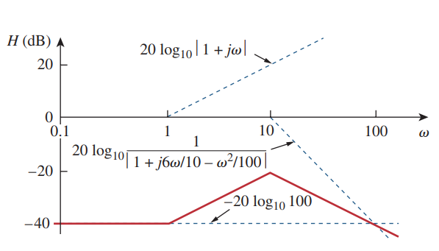
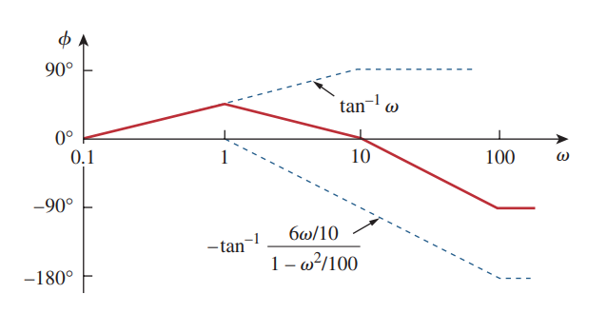

Slide 35
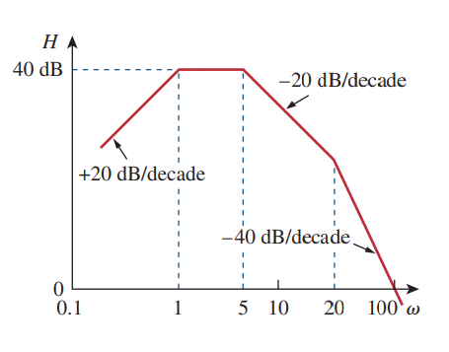
Example:
Given the Bode plot in figure below, obtain the transfer function .
Solution:

Slide 37
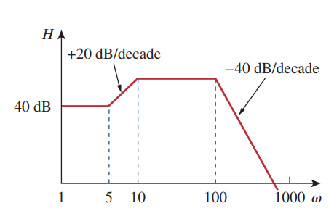
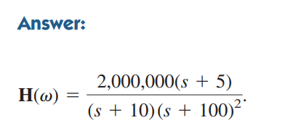
Practice Problem 14.2:

Slide 38
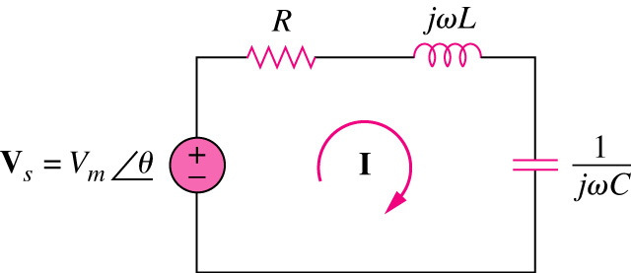
6.5 Series Resonance
Resonance is a condition in an RLC circuit in which the capacitive and inductive reactance are equal in magnitude, thereby resulting in purely resistive impedance.
Resonant circuits (series or parallel) are useful for constructing filters, as their transfer functions can be highly frequency selective. They are used in many applications such as selecting the desired stations in radio and TV receivers.
At SERIES resonance:
The supply voltage V_{s} and the current I are in phase (cos Ɵ = 1);
The impedance is purely resistive, Z = R. The LC series combination acts like a short circuit
The magnitude of the transfer function H(ω) = Z(ω) is minimum;
The inductor voltage and capacitor voltage can be much more than the source voltage.

Slide 40
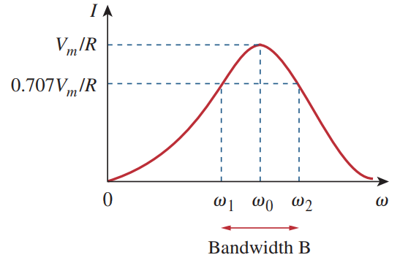
The frequency response of the circuit’s current magnitude is shown in Figure 6.8
The average power dissipated by the RLC circuit
The highest power dissipated occurs at resonance

Slide 41
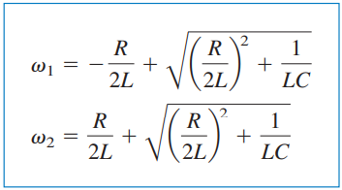
The following equation is showing that the resonant frequency is the geometric mean of the halfpower frequencies.
Although the height of the curve in Fig. 6.8 is determined by R, the width of the curve depends on other factors. The width of the response curve depends on the bandwidth B, which is defined as the difference between the two half-power frequencies

Slide 42
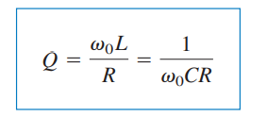
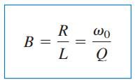
The “sharpness” of the resonance in a resonant circuit is measured quantitatively by the quality factor Q.
At resonance, the reactive energy in the circuit oscillates between the inductor and the capacitor
The relationship between the bandwidth B and the quality factor Q is

Slide 43
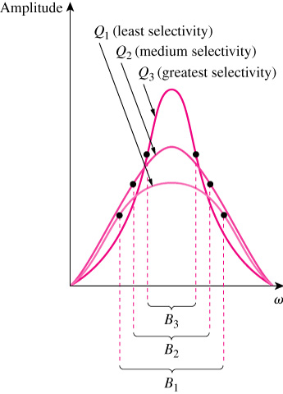
The SHARPNESS of the resonance is measured by the QUALITY FACTOR.
The higher the circuit Q, the smaller the bandwidth.
The quality factor is a measure of the selectivity (or “sharpness” of resonance) of the circuit.
A resonant circuit is designed to operate at or near its resonant frequency. It is said to be a high-Q circuit when its quality factor is equal to or greater than 10.
For high-Q circuits

Slide 44
We see that a resonant circuit is characterized by five related parameters:
the two half-power frequencies ,
the resonant frequency ,
the bandwidth B,
the quality factor Q.

Slide 45
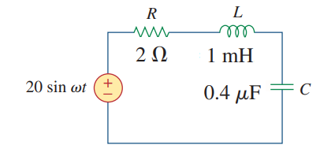
Example:
Find the resonant frequency and the half-power frequencies.
Calculate the quality factor and bandwidth.
Determine the amplitude of the current at
Solution:
The resonant frequency is

Slide 46
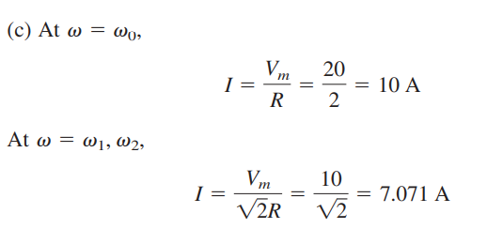

Slide 47
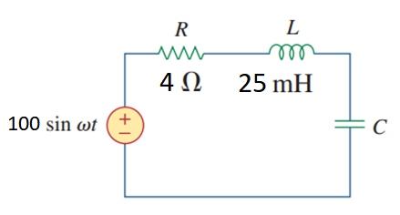
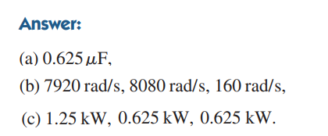
Practice Problem 14.3:

Slide 48
6.6 Parallel Resonance
Resonance is a condition in an RLC circuit in which the capacitive and inductive reactances are equal in magnitude, resulting in a purely resistive impedance.
Parallel resonance circuit behaves similarly but in opposite fashion compared to series resonant circuit.
The admitance is minimum at resonance or impedance is maximum.
Parallel resonant circuit.

Slide 49
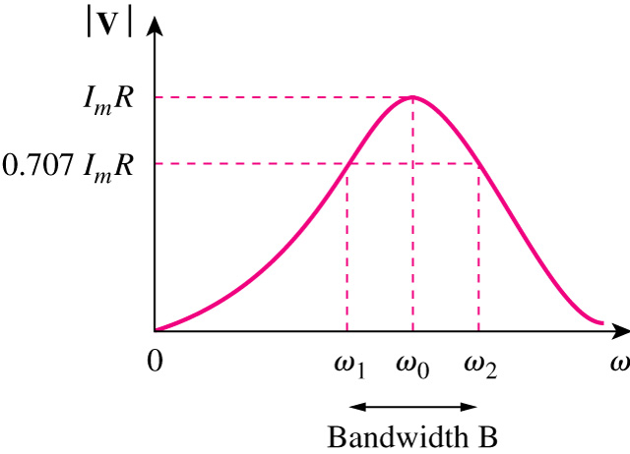
At Resonance frequency:
1) Admitance is purely resistive.
2) The voltage and current are in phase.
3) The transfer function H(ω)= Y(ω) is Minimum.
4) Inductor and capacitor currents can be much more than the source current.

Slide 50
Voltage versus frequency for the parallel resonant circuit.
The half-power frequencies can be obtained as:

Slide 51
Summary of series and parallel resonance circuits:
Characteristic | Series circuit | Parallel circuit
ω_{o}
Q
B
ω_{1,} ω₂
Q ≥ 10, ω_{1,} ω₂

Slide 52
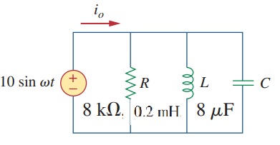
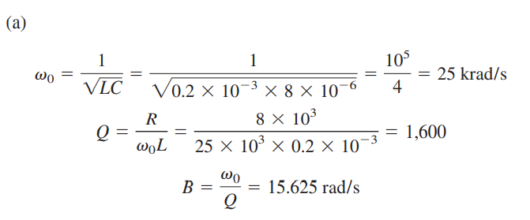
Example:
Solution:

Slide 53
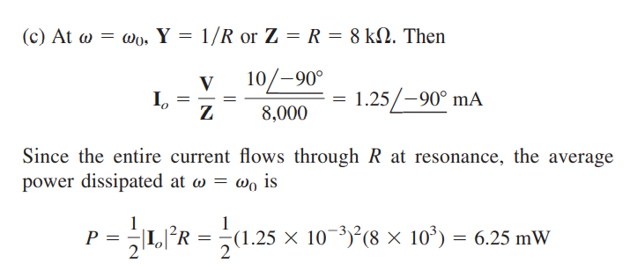

Slide 54
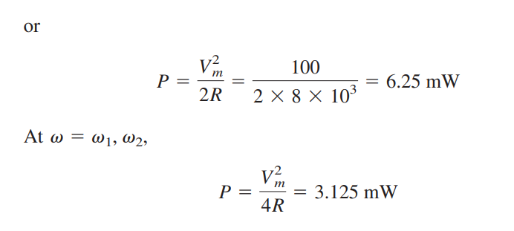
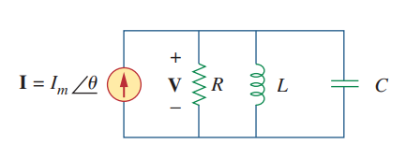
Practice Problem 14.4:

Slide 55
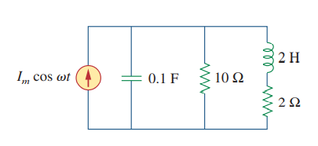
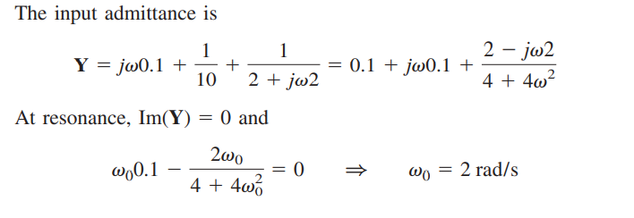
Example:
Solution:

Slide 56
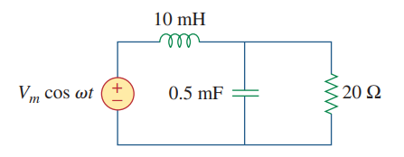
Practice Problem 14.4:
Calculate the resonant frequency of the circuit shown below.

Slide 57
6.7 Filters (passive and activee)
A filter is a circuit that is designed to pass signals with desired frequencies and reject or attenuate others.
As a frequency-selective device, a filter can be used to limit the frequency spectrum of a signal to some specified band of frequencies.
Filters are the circuits used in radio and TV receivers to allow us to select one desired signal out of a multitude of broadcast signals in the environment.
A filter is a passive filter if it consists of only passive elements R, L, and C.
It is said to be an active filter if it consists of active elements (such as transistors and op amps) in addition to passive elements R, L, and C.

Slide 58
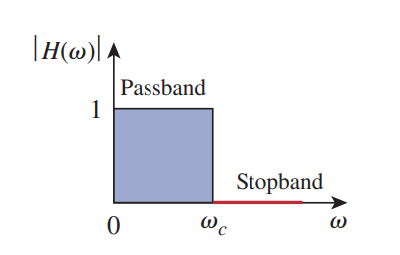
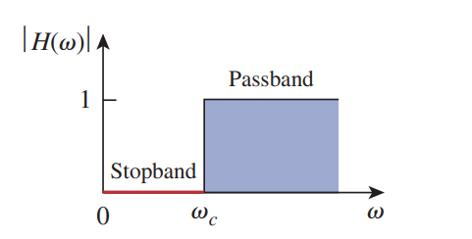
Ideal Filter Magnitude Responses
Magnitude responses of different type of ideal filter functions.
Lowpass Filter
Highpass Filter
Bandpass Filter
Bandstop Filter

Slide 59
Actual Filter Magnitude Responses

Slide 60
LOWPASS FILTER
Passive Filters
A low pass filter is designed to pas only frequencies from DC up to the cutoff frequency ω_{c}.

Slide 61
HIGHPASS FILTER
A high pass filter is designed to pass all the frequencies above its cutoff frequency ω_{c}.

Slide 62
BANDPASS FILTER
A bandpass filter is designed to pass all the frequencies within a band of frequencies, ω₁ < ω < ω₂

Slide 63
BANDSTOP FILTER
A Bandstop filter is designed to stop or eliminate all the frequencies within a band of frequencies ω₁ < ω < ω₂ .

Slide 64
Example:
Determine what type of filter is shown in figure below. Calculate the corner or cutoff frequency.
Solution:
Lowpass Filter

Slide 66
Practice Problem 14.5:

Slide 67
Example:
If the bandstop filter shown below is to reject a 200-Hz sinusoid while passing other frequencies, calculate the values of L and C. Take R= 150 Ω and the bandwidth as 100 Hz
Solution:
We use the formulas for a series resonant circuit

Slide 68
Active Filters
There are three major limitations to the passive filters.
They cannot generate gain greater than 1; passive elements cannot add energy to the network.
They may require bulky and expensive inductors.
They perform poorly at frequencies below the audio frequency range. (300 Hz < f < 3000 Hz )
Nevertheless, passive filters are useful at high frequencies
Active filters consist of combinations of resistors, capacitors, and op amps. They offer some advantages over passive RLC filters. They offer some advantages over passive RLC filters.
They are often smaller and less expensive, because they do not require inductors. This makes feasible the integrated circuit realizations of filters.
They can provide amplifier gain in addition to providing the same frequency response as RLC filters.
They can be combined with buffer amplifiers (voltage followers) to isolate each stage of the filter from source and load impedance effects. This isolation allows designing the stages independently and then cascading them to realize the desired transfer function.

Slide 69
Active first-order low-pass filter
Active filters use also active devices such as OP AMPs.
Passive filters use only passive devices such as inductors and capacitors only.

Slide 70
Active first-order High-pass filter

Slide 71
Active Bandpass Filter
A bandpass filter is obtained by cascading a LPF and a HPF together with an inverting amplifier to provide the desired gain.
Active Bandpass Filter Block Diagram. Frequency Response

Slide 72
Active Bandpass Filter Example
Three cascaded stages are used to realize the bandpass filter.
A LPF cascaded with a HPF and an inverter stage.

Slide 73
Active Bandreject Filter
A bandreject filter may be constructed by parallel combination of a LPF and a HPF filter and a summing amplifier.
Active Bandreject Filter Block Diagram. Frequency Response

Slide 74
Active Bandreject Filter Example

Slide 75
Example:
Design a lowpass active filter with a dc gain of 4 and a corner frequency of 500 Hz.
Solution:

Slide 76
Practice Problem 14.6:

