Slide 1
Sinusoids and Phasors
Chapter #9

Slide 2
After completing this chapter, you will learn
Sinusoids’ features
Phasors
Phasor relationships for circuit elements
Impedance and admittance
Kirchhoff’s laws in the frequency domain
Impedance combinations

Slide 3
9.1 Sinusoids
We now begin the analysis of circuits in which the source voltage or current is time-varying. In this chapter, we are particularly interested in sinusoidally time-varying excitation, or simply, excitation by a sinusoid. Circuits driven by sinusoidal current or voltage sources are called ac circuit
Definition
A sinusoid is a signal that has the form of the sine or cosine function
We are interested in sinusoids for a number of reasons;
Nature itself is characteristically sinusoidal.
A sinusoidal signal is easy to generate and transmit.

Slide 4
A general expression for the sinusoid,
where
Vm = the amplitude of the sinusoid
ω = the angular frequency in radians/s
Ф = the phase

Slide 5
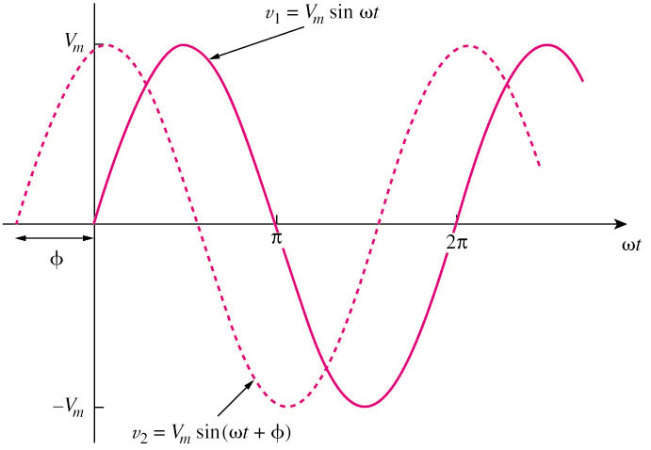
A periodic function is one that satisfies v(t) = v(t + nT), for all t and for all integers n.
T is called the period of sinusoid
f is known as the cyclic frequency of the sinusoid
f =1 / T
Only two sinusoidal values with the same frequency can be compared by their amplitude and phase difference.
If phase difference is zero, they are in phase; if phase difference is not zero, they are out of phase.

Slide 6
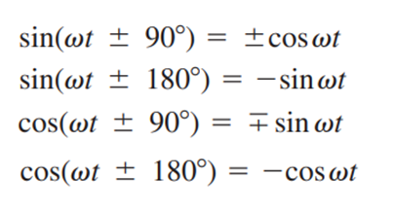
A sinusoid can be expressed in either sine or cosine form. When comparing two sinusoids, it is expedient to express both as either sine or cosine with positive amplitudes. This is achieved by using the following trigonometric identities.
With these identities, it is easy to show that

Slide 7
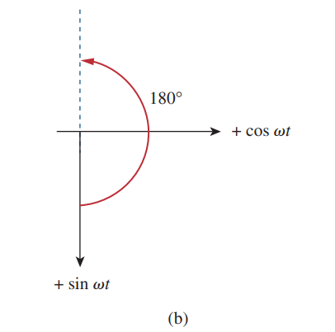
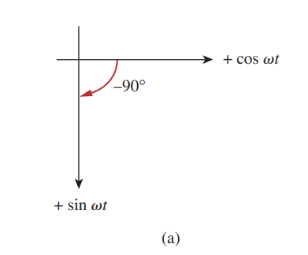
A graphical approach may be used to relate or compare sinusoids as an alternative to using the trigonometric identities

Slide 8
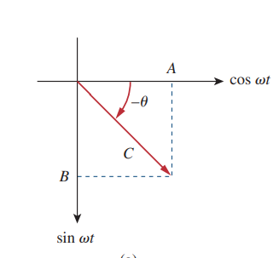
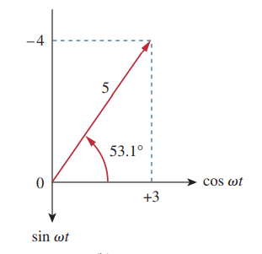
The graphical technique can also be used to add two sinusoids of the same frequency when one is in sine form and the other is in cosine form
where
For example

Slide 9
Example 1
Given a sinusoid, , calculate its amplitude, phase, angular frequency, period, and frequency.
Solution:
Amplitude = 5, phase = –60º, angular frequency = 4π rad/s,
Period ( T) = 0.5 s, frequency ( f )= 2 Hz.
Practice Problem 9.1
Given the sinusoid calculate its amplitude, phase, angular frequency, period, and frequency

Slide 10
Example 2
Find the phase angle between and and , State which State which sinusoid is leading?
Solution:
We have two ways. The first method use trigonometric identities, while the third method uses the graphical approach.
METHOD 1
In order to compare and we must express them in the same form. If we express them in cosine form with positive amplitudes,
and
he phase difference between and i
It can be deduced that the phase difference is

Slide 11
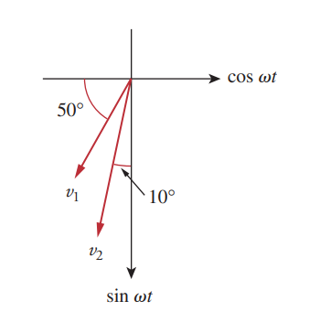
METHOD 2
If we express them in sine form with positive amplitudes, $v_{1 }=−10 Cos\left(ωt+{50}^{o}\right)=10 Sin\left(ωt−{40}^{o}\right) and v_{2}=12 Sin(ωt−{10}^{o})$ . It can be deduced that the phase difference is ${30}^{o}$.
METHOD 3

Slide 12
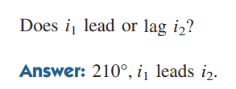
Practice Problem 9.2
Find the phase angle between

Slide 13
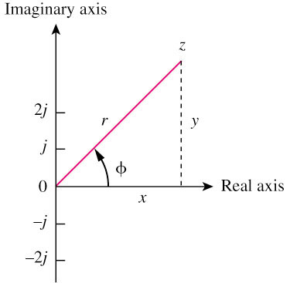
9.2 Phasor
A phasor is a complex number that represents the amplitude and phase of a sinusoid.
It can be represented in one of the following three forms:
Rectangular
Polar
Exponential
where

Slide 14
Mathematic operation of complex number:
Addition
Subtraction
Multiplication
Division
Reciprocal
Square root
Complex conjugate
Euler’s identity

Slide 15
Example
Evaluate the following complex numbers:
a.
b.
Solution:
a. –15.5 + j13.67
b. 8.293 + j2.2

Slide 16
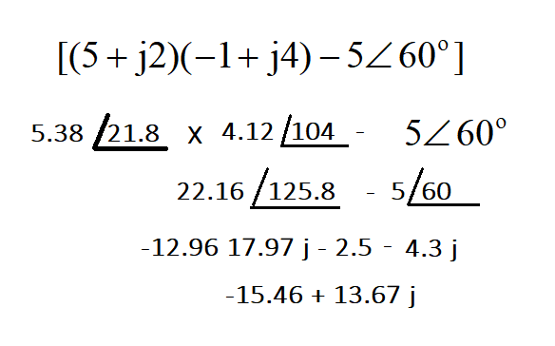
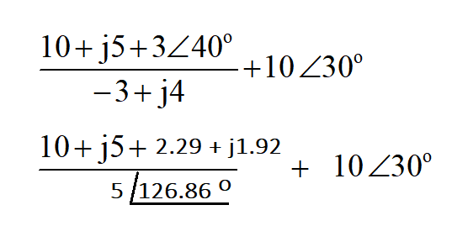
a.
b.

Slide 18
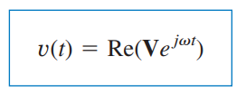
Given a sinusoid
We use Euler identity to express v(t) as
Thus,
V is thus the phasor representation of the sinusoid as we said earlier. In other words, a phasor is a complex representation of the magnitude and phase of a sinusoid

Slide 19
Transform a sinusoid to and from the time domain to the phasor domain:
(time domain) (phasor domain)
Amplitude and phase difference are two principal concerns in the study of voltage and current sinusoids.
Phasor will be defined from the cosine function in all our proceeding study. If a voltage or current expression is in the form of a sine, it will be changed to a cosine by subtracting from the phase.

Slide 20
The differences between v(t) and V:
v(t) is instantaneous or time-domain representation V is the frequency or phasor-domain representation.
v(t) is time dependent, V is not.
v(t) is always real with no complex term, V is generally complex.
Note: Phasor analysis applies only when frequency is constant; when it is applied to two or more sinusoid signals only if they have the same frequency.

Slide 21
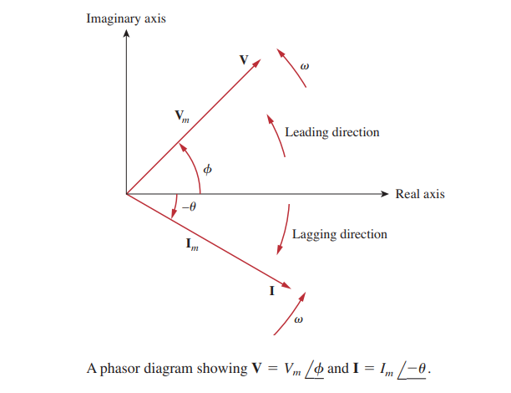
Since a phasor has magnitude and phase (“direction”), it behaves as a vector and is printed in boldface.
For example, phasors are graphically represented in below.
Such a graphical representation of phasors is known as a phasor diagram.

Slide 22
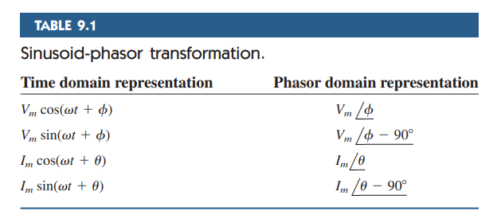
Example
Transform the following sinusoids to phasors:
a. i = 6cos(50t – 40º) A
b. v = –4sin(30t + 50º) V
Solution:
a. I A
b. Since –sin(A) = cos(A+90º);
v(t) = 4cos (30t+50º+90º) = 4cos(30t+140º) V
Transform to phasor => V V

Slide 23
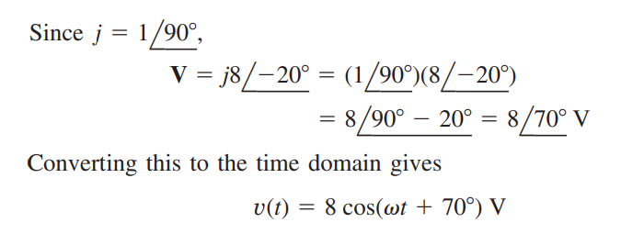
Example :
Transform the phasors corresponding to sinusoids :
c
Solution:
v(t) = 10cos(ωt + 210º) V
Since
i(t) = 13cos(ωt + 22.62º) A
c)

Slide 24
Practice Problem 9.3
Express these sinusoids as phasors:
Practice Problem 9.4
Find the sinusoids corresponding to these phasors:

Slide 25
Example
Given and find their sum
Solution
Current i is in the standard form. Its phasor is
We need to express in cosine form.
Its phasor is
Its phasor is

Slide 26
Practice Problem 9.5
Relationship between differential, integral operation in phasor listed as follow:

Slide 27
Example
Use phasor approach, determine the current i(t) in a circuit described by the
integro-differential equation.
Solution:
Phasor form of integro-differential eqn.
i(t) = 4.642cos(2t + 143.2º) A

Slide 28
Practice Problem 9.6
Find the voltage in a circuit described by the integro-differential equation using the phasor approach.

Slide 29
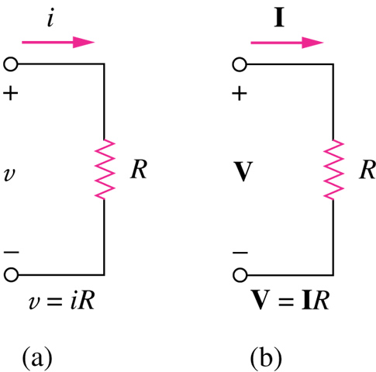
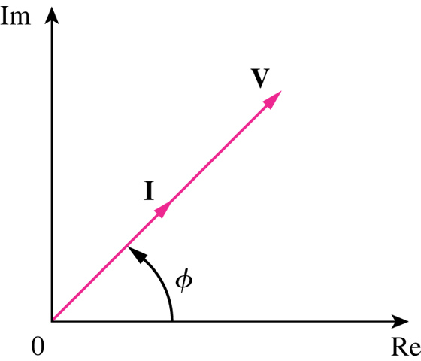
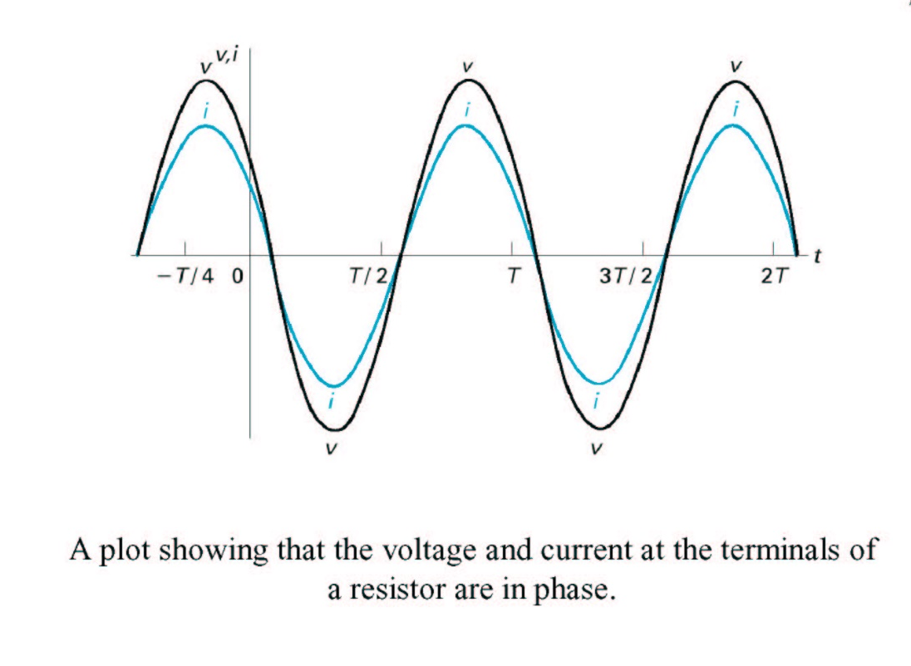
9.3 Phasor Relationships for Circuit Elements
Phasor Relationships for Resistor
Time Domain Frequency Domain
voltage and current are in phase
Phasor voltage and current of a resistor are in phase

Slide 30
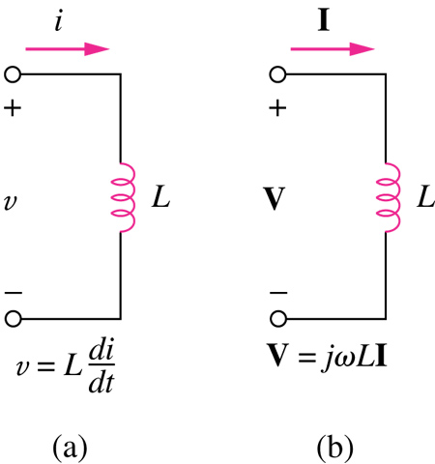
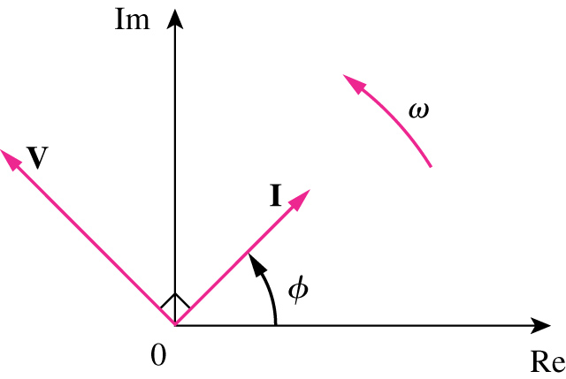
Phasor Relationships for Inductor
Phasor current of an inductor LAGS the voltage by 90 degrees.
Time Domain Frequency Domain

Slide 31
Frequency Domain
Time Domain
Phasor current of an inductor LAGS the voltage by 90 degrees.

Slide 32
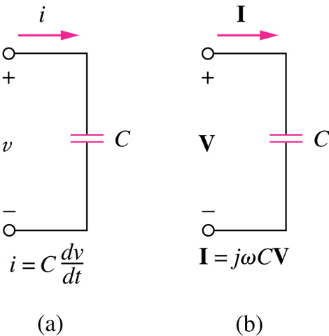
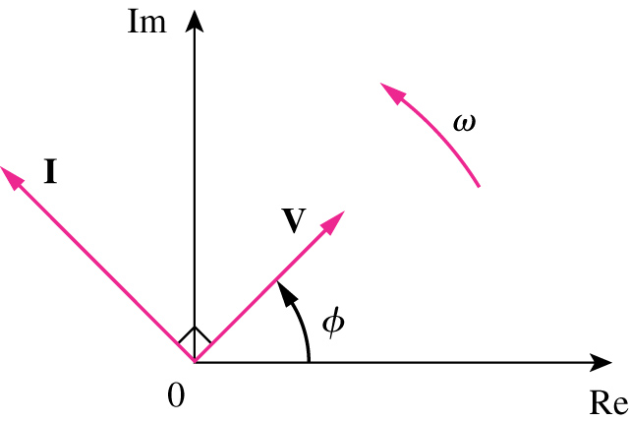
Phasor Relationships for Capacitor
Phasor current of a capacitor LEADS the voltage by 90 degrees.
Time Domain Frequency Domain

Slide 33
Phasor Relationships for Capacitor
Phasor current of a capacitor LEADS the voltage by 90 degrees.

Slide 34
Phasor Relationships for Circuit Elements

Slide 35
Example:
The voltage is applied to a 0.1-H inductor. Find the steady-state current through the inductor.
Solution:
Practice Problem 9.7
If voltage is applied to a 50 uF capacitor, calculate the current through the capacitor.

Slide 36
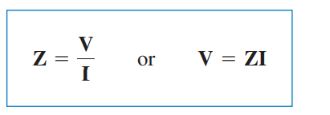
9.4 Impedance and Admittance
We obtained the voltage-current relations for the three passive elements as
These equations may be written in terms of the ratio of the phasor voltage to the phasor current a
From these three expressions, we obtain Ohm’s law in phasor form for any type of element as
where Z is a frequency-dependent quantity known as impedance, measured in ohms.

Slide 37
The Admitance Y of a circuit is the reciprocal of impedance measured in Simens (S).
Impedances and Admitances of passive elements.

Slide 38
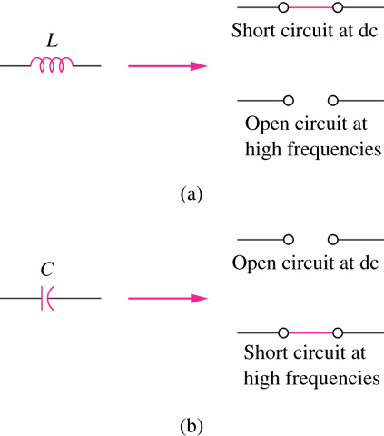
The Impedance Z of a circuit is a function of the frequency.
Inductor is SHORT CIRCUIT at DC and OPEN CIRCUIT at high frequencies. Capacitor is OPEN CIRCUIT at DC and SHORT CIRCUIT at high frequencies.

Slide 39
The Impedance Z represents the opposition of the circuit to the flow of sinusoidal current.
Where Re (Z) is the resistance and Im (Z) is the reactance.
The Reactance is Inductive if X is positive and it is Capacitive if X is negative.
Thus, impedance is said to be inductive or lagging since current lags voltage, while impedance is capacitive or leading because current leads voltage.

Slide 40
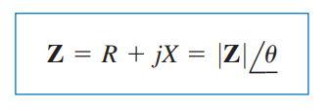
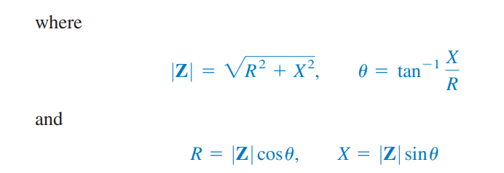
The impedance may also be expressed in polar form as

Slide 41
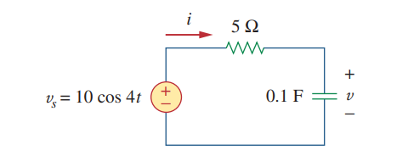
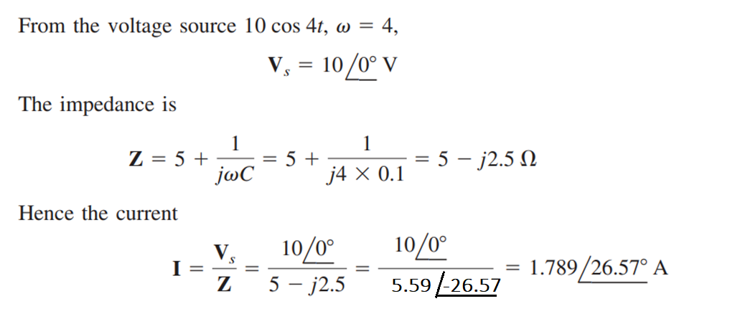
Example:
Find v(t) and i(t) in the circuit shown in figure below.
Solution:

Slide 43
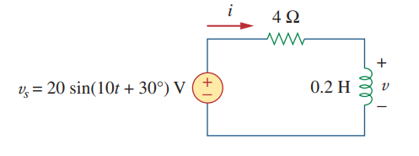
Practice Problem 9.8
Determine v(t) and i(t) for the given circuit.

Slide 44
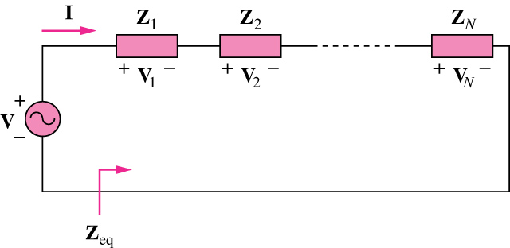
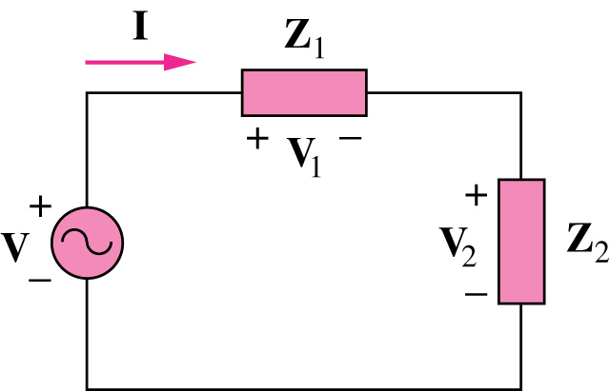
9.5 Application of KVL for Phasors
The Kirchoff”s Voltage Law (KVL) holds in the frequency domain. For series connected impedances:
The Voltage Division for two elements in series is:

Slide 45
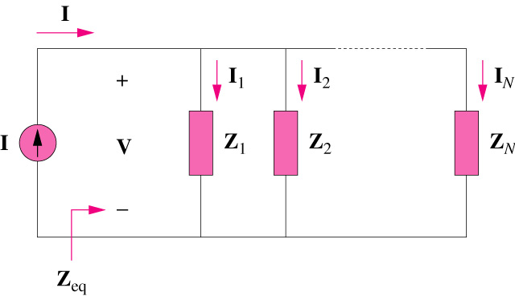
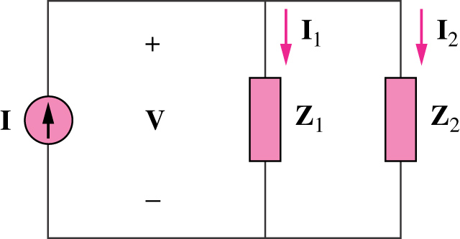
Parallel Combination for Phasors
The Kirchoff”s Voltage Law (KVL) holds in the frequency domain. For series connected impedances:
The Current Division for two elements is:

Slide 46
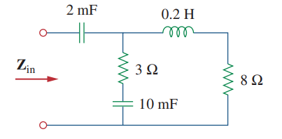
Example:
Find the input impedance of the circuit in below. Assume that the circuit operates at Ꙍ = 50 rad/sec
Solution:

Slide 47
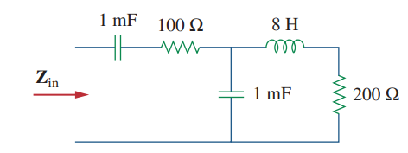
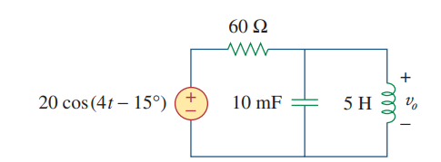
Practice Problem 9.9
Find the input impedance of the circuit in below. Assume that the circuit operates at Ꙍ = 10 rad/sec
Example:
Determine in the circuit shown below.

Slide 48
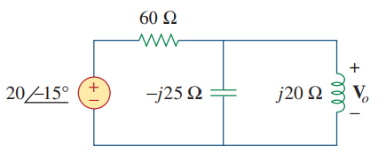
Solution:
First transform the time domain circuit to the phasor domain equivalent.

Slide 49
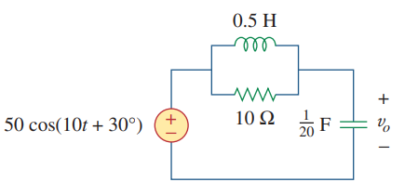
Practice Problem 9.10
Calculate in the circuit shown below.

Slide 50
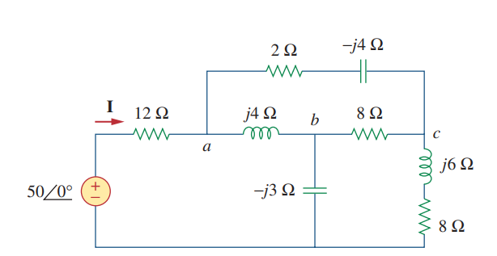
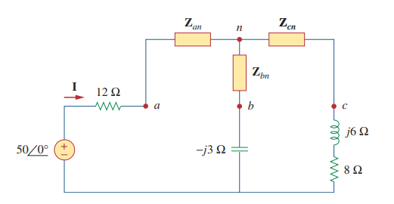
Example:
Find current I in the circuit shown below.
Solution:
The delta network connected to nodes a, b, and c can be converted to the Y network

Slide 51
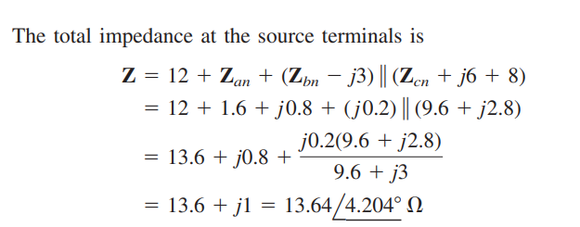

Slide 52
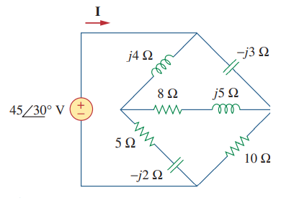
Practice Problem 9.11
Find current I in the circuit shown below.

