Slide 1
DIODES
Lecture-3

Slide 2
Ideal Diodes
An Ideal diode is a two terminal device having a symbol on Fig. 3.1 a) and Fig. 3.1 b) shows the i – v characteristic of the ideal diode
c) equivalent circuit in reverse direction
d) equivalent circuit in forward direction

Slide 3

  When an Ideal diode operates like in Fig. 3.1 c) is said to be reveresed bias or said to be reversed direction. An ideal diode has zero current when operated in reverse direction and said to be cut off.
  When an positive current is applied to an ideal diode, zero voltage drop appears across the diode. In other words, the ideal diode behaves as a short circuit in the forward direction and said to be turned on or simply on
  The following figure a) shows the forward bias and b) shows the revers bias circuits Obviously the voltage drop on forward bias in Fig. a) is zero and the current is determined by the current limiting resistor. Fig. b) shows the voltage drop accros the ideal diode is equal to the source voltage value and the current is zero. Obviously the diode on fig (a) operates the vertical part of the $i −v$ characteristic but the diode on fig (b) operates the horizontal part of the $i −v$ characteristic.

Slide 4
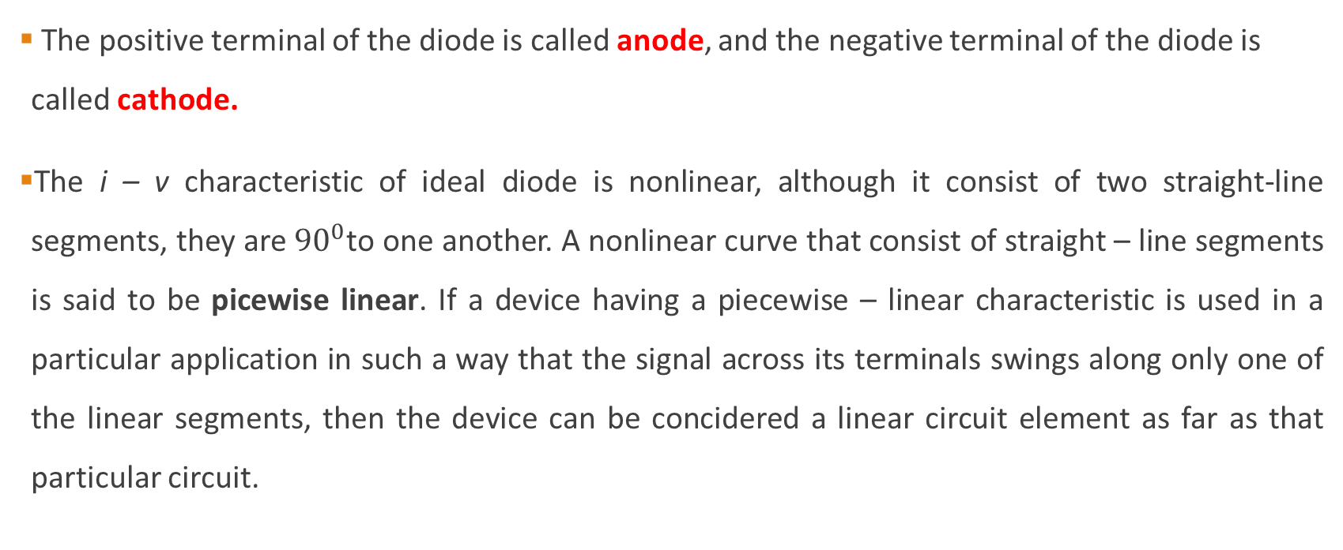
The positive terminal of the diode is called anode, and the negative terminal of the diode is called cathode.
The i – v characteristic of ideal diode is nonlinear, although it consist of two straight-line segments, they are ${90}^{0}$to one another. A nonlinear curve that consist of straight – line segments is said to be picewise linear. If a device having a piecewise – linear characteristic is used in a particular application in such a way that the signal across its terminals swings along only one of the linear segments, then the device can be concidered a linear circuit element as far as that particular circuit.

Slide 5
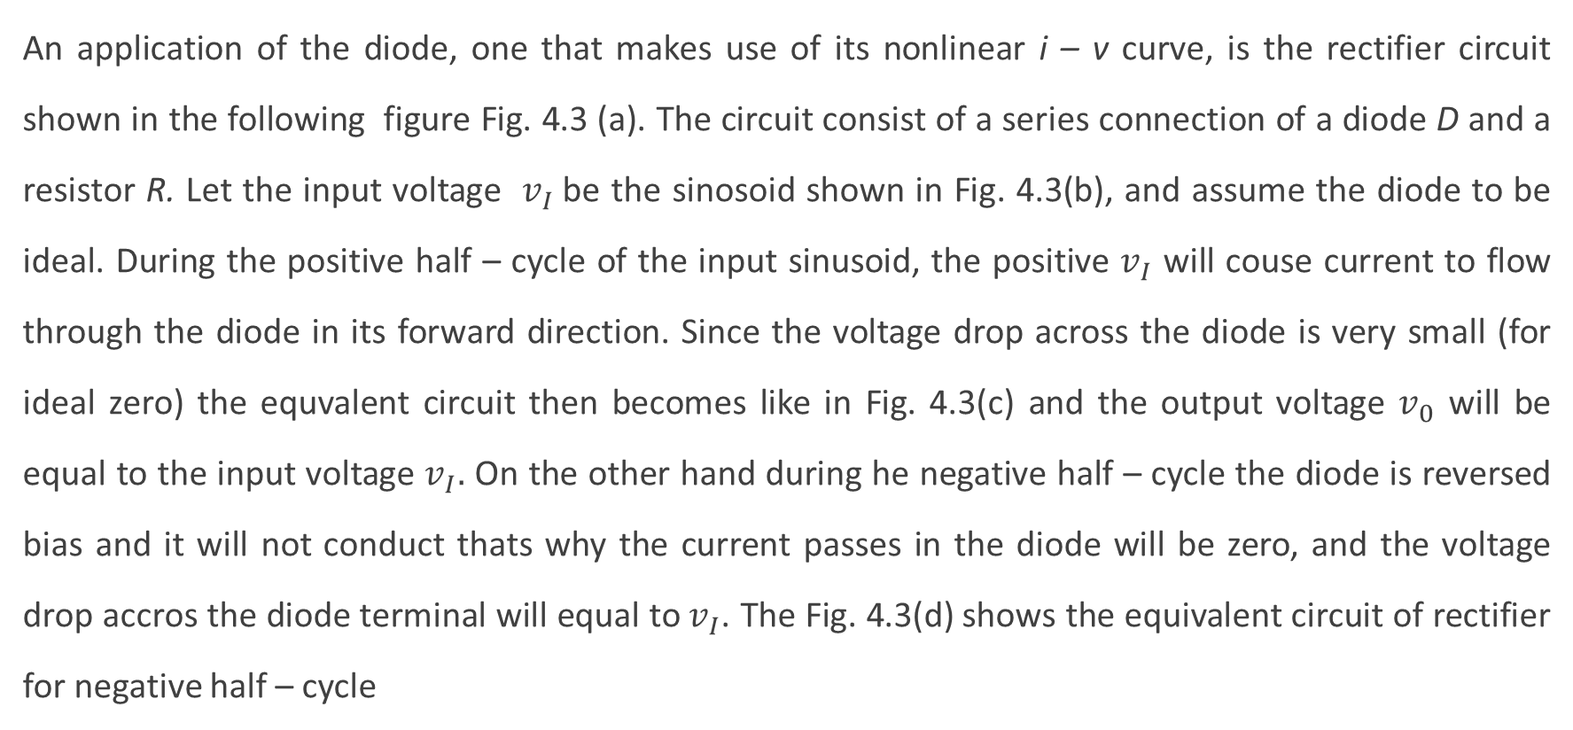
The rectifier
An application of the diode, one that makes use of its nonlinear i – v curve, is the rectifier circuit shown in the following figure Fig. 4.3 (a). The circuit consist of a series connection of a diode D and a resistor R. Let the input voltage $v_{I}$be the sinosoid shown in Fig. 4.3(b), and assume the diode to be ideal. During the positive half – cycle of the input sinusoid, the positive $v_{I}$ will couse current to flow through the diode in its forward direction. Since the voltage drop across the diode is very small (for ideal zero) the equvalent circuit then becomes like in Fig. 4.3(c) and the output voltage $v_{0}$ will be equal to the input voltage $v_{I}.$ On the other hand during he negative half – cycle the diode is reversed bias and it will not conduct thats why the current passes in the diode will be zero, and the voltage drop accros the diode terminal will equal to $v_{I}$. The Fig. 4.3(d) shows the equivalent circuit of rectifier for negative half – cycle

Slide 6
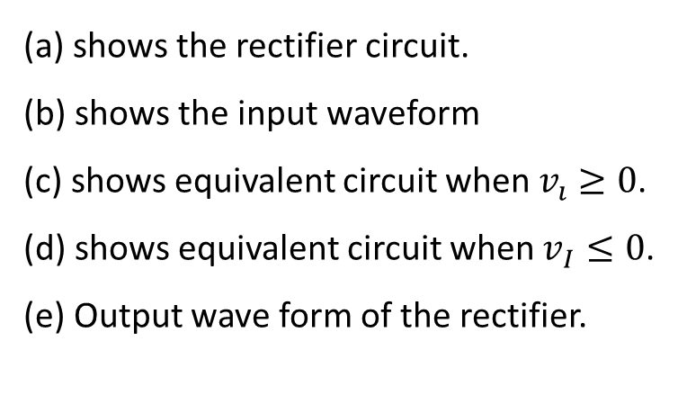
(a)
(b)
(d)
(a) shows the rectifier circuit.
(b) shows the input waveform
(c) shows equivalent circuit when $v_{ı}≥0$.
(d) shows equivalent circuit when $v_{I}≤0$.
(e) Output wave form of the rectifier.
(e)
(c)
Fig. 4.3

Slide 7
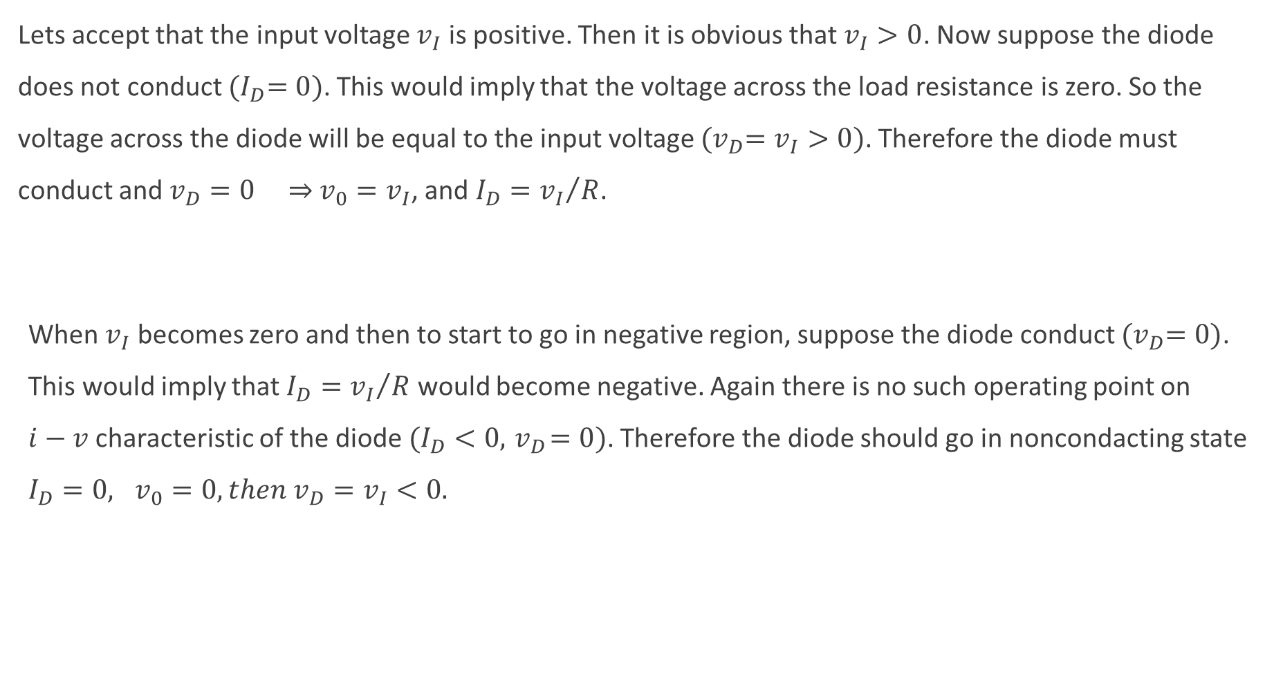
Lets accept that the input voltage $v_{I}$ is positive. Then it is obvious that $v_{I}>0$. Now suppose the diode does not conduct ${(I}_{D}=0)$. This would imply that the voltage across the load resistance is zero. So the voltage across the diode will be equal to the input voltage ${(v}_{D}=v_{I}>0)$. Therefore the diode must conduct and $v_{D}=0$ ⇒ $v_{0}=v_{I}$, and $I_{D}={v_{I}}/R$.
When $v_{I}$ becomes zero and then to start to go in negative region, suppose the diode conduct ${(v}_{D}=0)$. This would imply that $I_{D}={v_{I}}/R$ would become negative. Again there is no such operating point on $i−v$ characteristic of the diode $(I_{D}<0, { v}_{D}=0)$. Therefore the diode should go in noncondacting state $I_{D}=0, v_{0}=0, then v_{D}=v_{I}<0.$
Notes:
Excercises 4.1
Exakple 4.1

Slide 8
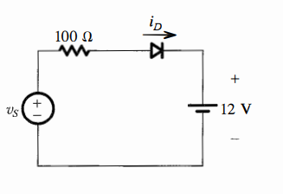
Example 3.0
Figure below shows a circuit for charging a 12-V battery. If Vs is a sinusoid with 24-V peak amplitude and 50 Hz. Find the peak value of the diode current and the maximum reverse-bias voltage that appears across the diode.

Slide 9
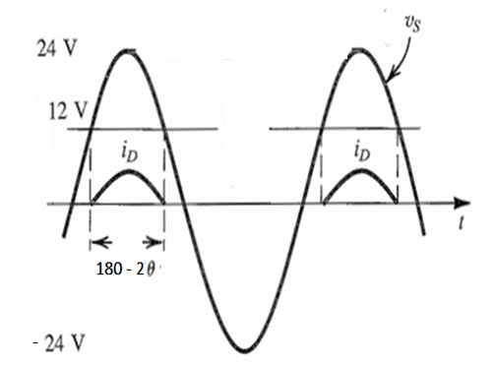


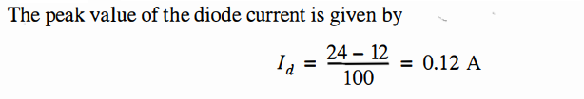

Solution 3.0
= V_{KA}

Slide 10
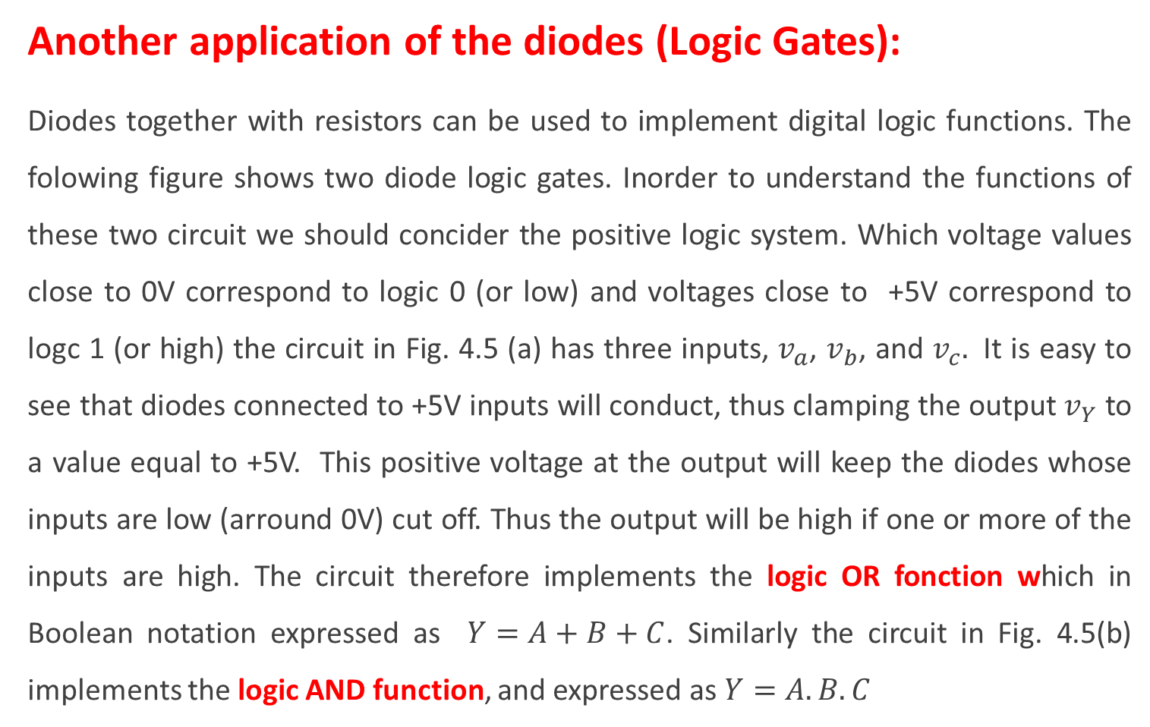
Another application of the diodes (Logic Gates):
Diodes together with resistors can be used to implement digital logic functions. The folowing figure shows two diode logic gates. Inorder to understand the functions of these two circuit we should concider the positive logic system. Which voltage values close to 0V correspond to logic 0 (or low) and voltages close to +5V correspond to logc 1 (or high) the circuit in Fig. 4.5 (a) has three inputs, $v_{a}$, $v_{b}$, and $v_{c}.$ It is easy to see that diodes connected to +5V inputs will conduct, thus clamping the output $v_{Y}$ to a value equal to +5V. This positive voltage at the output will keep the diodes whose inputs are low (arround 0V) cut off. Thus the output will be high if one or more of the inputs are high. The circuit therefore implements the logic OR fonction which in Boolean notation expressed as $Y=A+B+C$. Similarly the circuit in Fig. 4.5(b) implements the logic AND function, and expressed as $Y=A.B.C$
Fig. 4.5

Slide 11
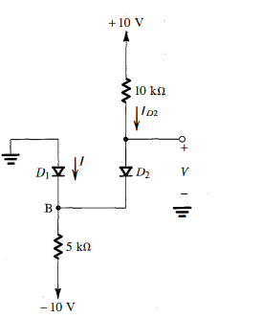
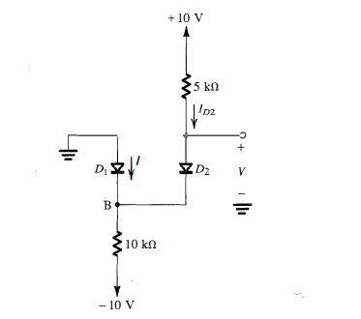
Example 3.1
Assuming the diodes to be ideal, find the values of current I and voltage V in the circuits of below.

Slide 12
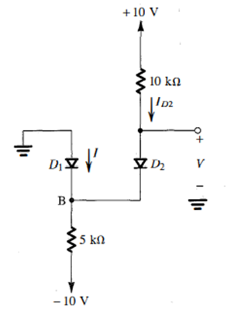




Solution 3.1
For the circuit in (a), Assume that both diodes are conducting and ideal
Writing a node equation at B,
So our assumption is correct. Both diodes are conducting.

Slide 13

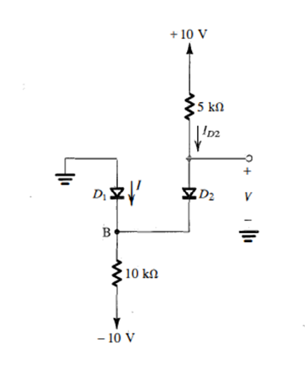


b) Assume that both diodes are conducting.

Slide 14
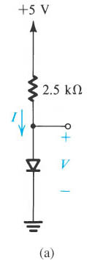
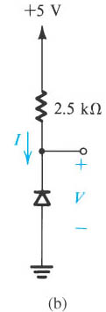
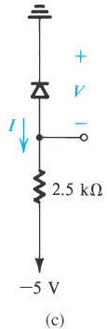
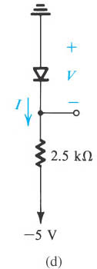
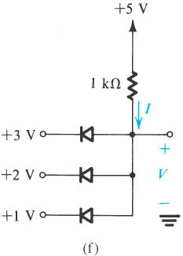
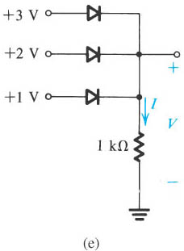
Practice Problem 3.1:
Find I and V for each circuit below.

Slide 15
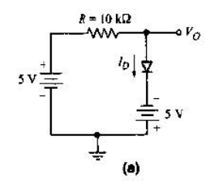
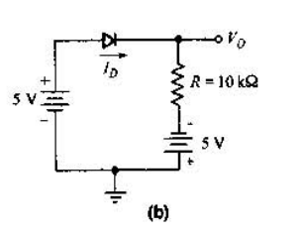
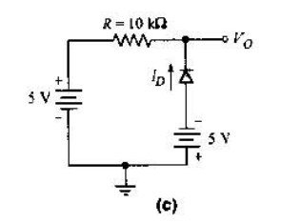
Practice Problem 3. 2:
For each circuit below determine the diode current I_{D} and output voltage V_{o} by using ideal model with repect to ground pottential.

Slide 16
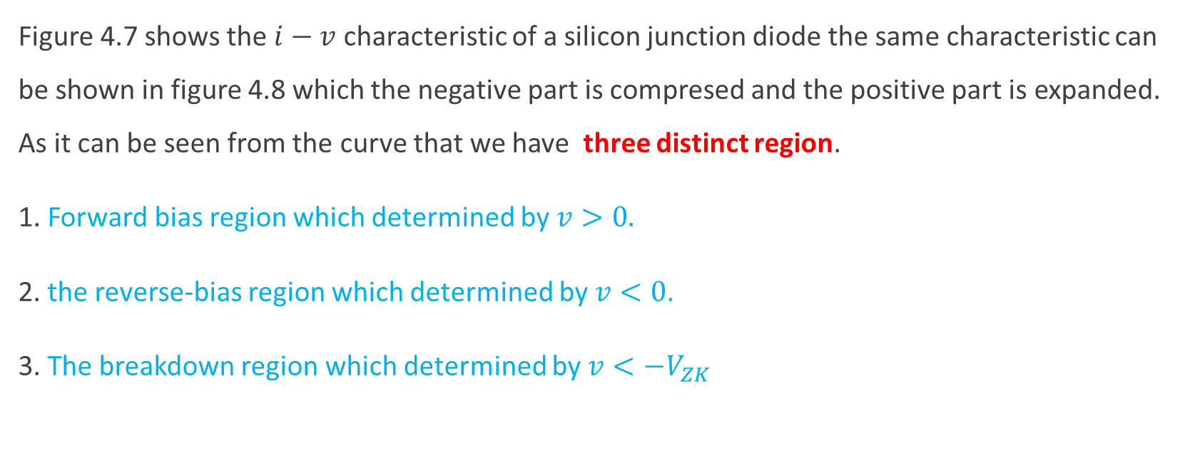
i-v characteristics of Junjtion diodes
Figure 4.7 shows the $i−v$ characteristic of a silicon junction diode the same characteristic can be shown in figure 4.8 which the negative part is compresed and the positive part is expanded. As it can be seen from the curve that we have three distinct region.
1. Forward bias region which determined by $v>0.$
2. the reverse-bias region which determined by $v<0$.
3. The breakdown region which determined by $v<−V_{ZK}$

Slide 17
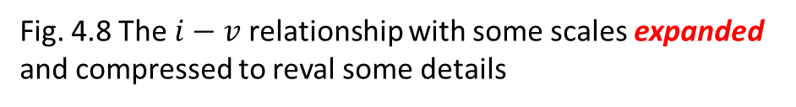
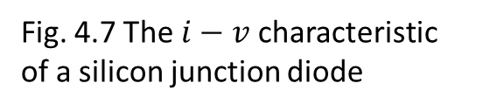
Fig. 4.7 The $i−v$ characteristic of a silicon junction diode
Fig. 4.8 The $i−v$ relationship with some scales expanded and compressed to reval some details

Slide 18
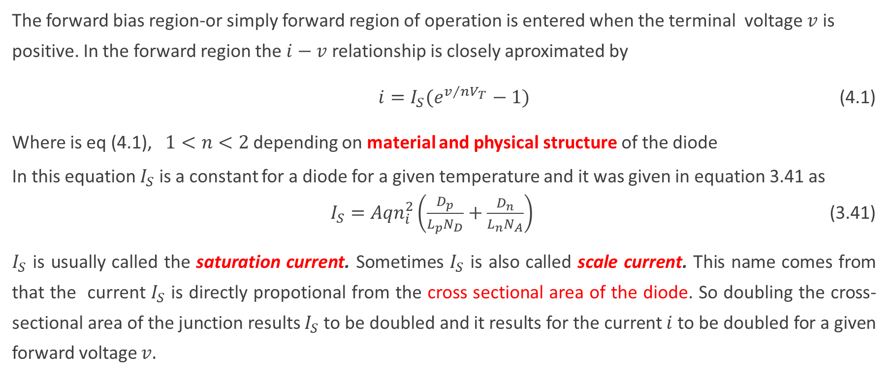
(i) Forward bias region, $v>0.$
The forward bias region-or simply forward region of operation is entered when the terminal voltage $v$ is positive. In the forward region the $i−v$ relationship is closely aproximated by
$i=I_{S}(e^{v/{{nV}_{T}}}−1)$ (4.1)
Where is eq (4.1), $1<n<2$ depending on material and physical structure of the diode
In this equation $I_{S}$ is a constant for a diode for a given temperature and it was given in equation 3.41 as
$I_{S}={Aqn}_{i}^{2}\left(\frac{D_{p}}{L_{p}N_{D}}+\frac{D_{n}}{L_{n}N_{A}}\right)$ (3.41)
$I_{S}$ is usually called the saturation current. Sometimes $I_{S}$ is also called scale current. This name comes from that the current $I_{S}$ is directly propotional from the cross sectional area of the diode. So doubling the cross-sectional area of the junction results $I_{S}$ to be doubled and it results for the current $i$ to be doubled for a given forward voltage $v.$

Slide 19
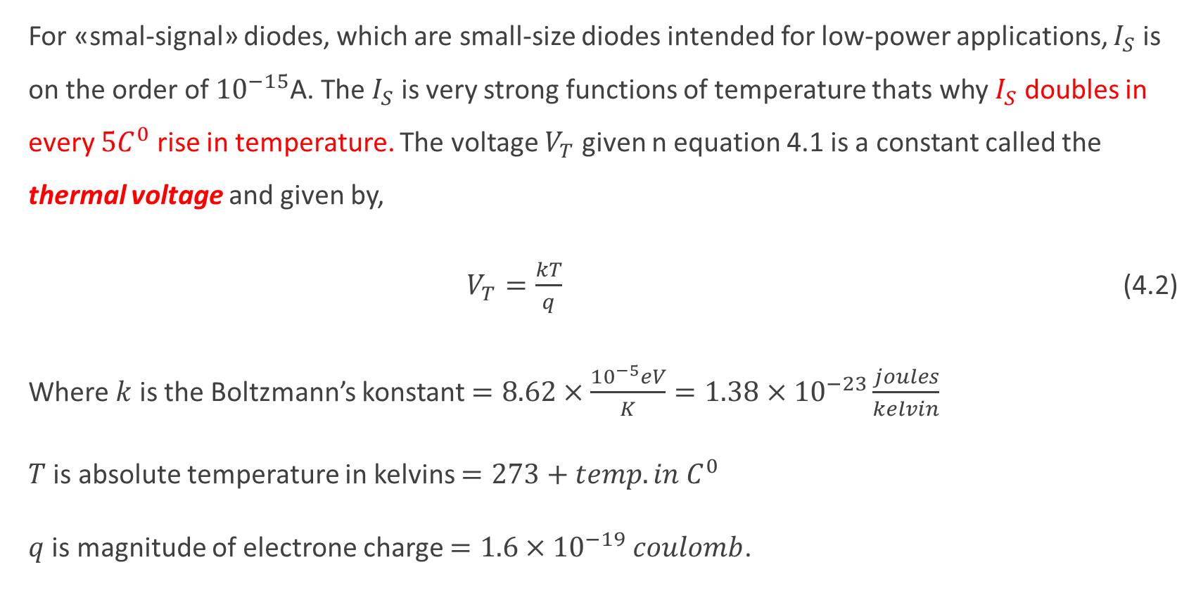
For «smal-signal» diodes, which are small-size diodes intended for low-power applications, $I_{S}$ is on the order of ${10}^{−15}$A. The $I_{S}$ is very strong functions of temperature thats why $I_{S}$ doubles in every ${5C}^{0}$ rise in temperature. The voltage $V_{T}$ given n equation 4.1 is a constant called the thermal voltage and given by,
$V_{T}=\frac{kT}{q}$ (4.2)
Where $k$ is the Boltzmann’s konstant $=8.62×\frac{{10}^{−5}eV}{K}=1.38×{10}^{−23}\frac{joules}{kelvin}$
$T$ is absolute temperature in kelvins $=273+{temp. in C}^{0}$
$q$ is magnitude of electrone charge $=1.6×{10}^{−19} coulomb$.

Slide 20
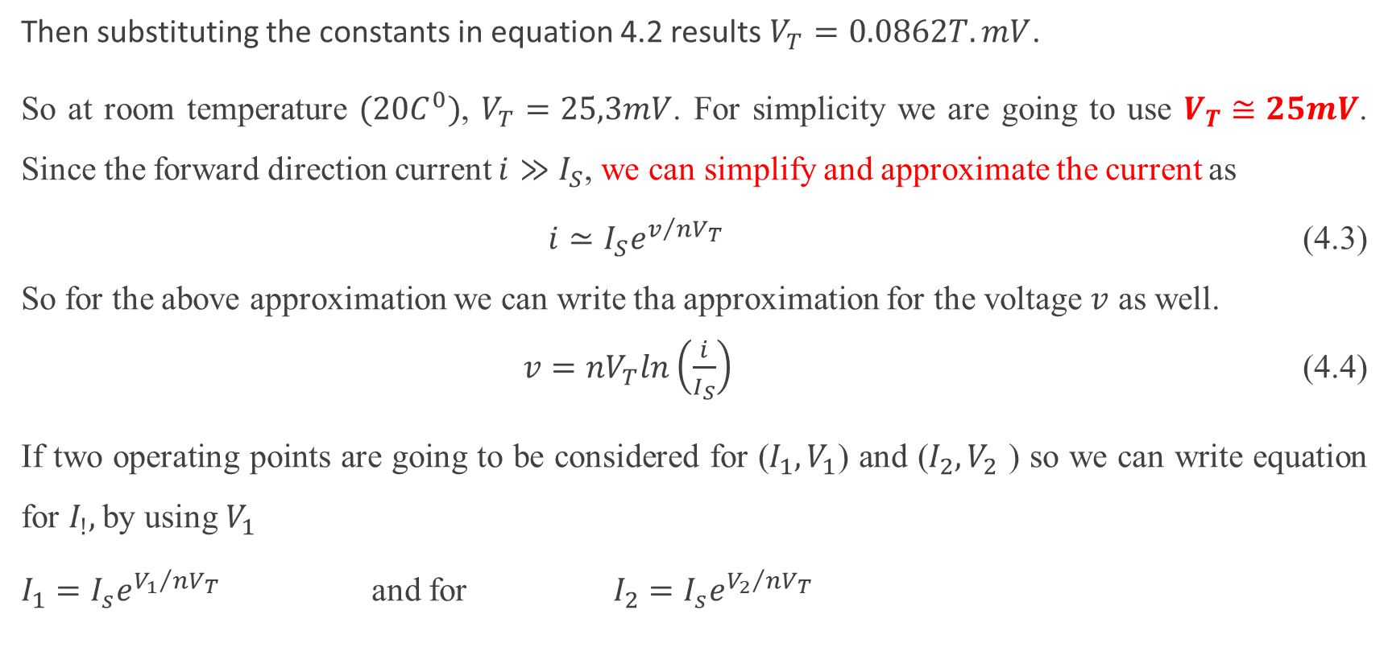
Then substituting the constants in equation 4.2 results $V_{T}=0.0862T.mV$.
So at room temperature $(20C^{0})$, $V_{T}=25,3mV$. For simplicity we are going to use $V_{T}≅25mV$. Since the forward direction current $i≫I_{S}$, we can simplify and approximate the current as
$i≃I_{S}e^{v/{{nV}_{T}}}$ (4.3)
So for the above approximation we can write tha approximation for the voltage $v$ as well.
$v={nV}_{T}ln\left(\frac{i}{I_{S}}\right)$ (4.4)
If two operating points are going to be considered for ($I_{1}, V_{1}$) and ($I_{2}, V_{2}$ ) so we can write equation for $I_{!},$ by using $V_{1}$
$I_{1}=I_{s}e^{{V_{1}}/{{nV}_{T}}}$ and for $I_{2}=I_{s}e^{{V_{2}}/{{nV}_{T}}}$

Slide 21
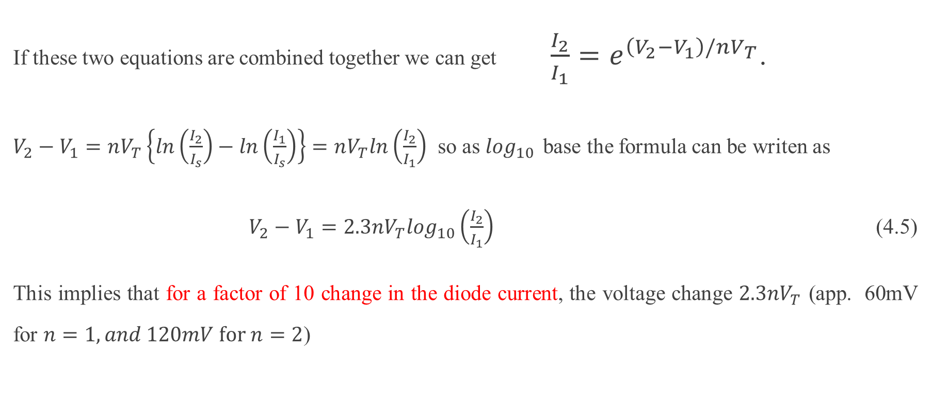
If these two equations are combined together we can get $\frac{I_{2}}{I_{1}}=e^{\left(V_{2}−V_{1}\right)/nV_{T}}$.
$V_{2}−V_{1}=nV_{T}\left\{ln\left(\frac{I_{2}}{I_{s}}\right)−ln\left(\frac{I_{1}}{I_{s}}\right)\right\}=nV_{T}ln\left(\frac{I_{2}}{I_{1}}\right)$ so as $\log_{10 }$base the formula can be writen as
$V_{2}−V_{1}=2.3{nV}_{T}\log_{10}\left(\frac{I_{2}}{I_{1}}\right)$ (4.5)
This implies that for a factor of 10 change in the diode current, the voltage change $2.3nV_{T}$ (app. 60mV for $n=1, and 120mV for n=2$)

Slide 22
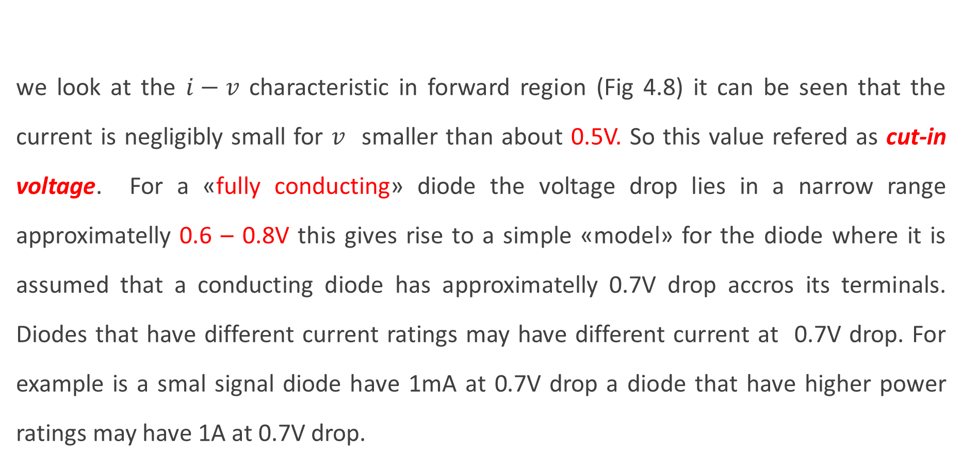
we look at the $i−v$ characteristic in forward region (Fig 4.8) it can be seen that the current is negligibly small for $v$ smaller than about 0.5V. So this value refered as cut-in voltage. For a «fully conducting» diode the voltage drop lies in a narrow range approximatelly 0.6 – 0.8V this gives rise to a simple «model» for the diode where it is assumed that a conducting diode has approximatelly 0.7V drop accros its terminals. Diodes that have different current ratings may have different current at 0.7V drop. For example is a smal signal diode have 1mA at 0.7V drop a diode that have higher power ratings may have 1A at 0.7V drop.

Slide 23

Since both $I_{s }$and $V_{T}$ are the functions of temperature the forward $i−v$ characteristic varies with temperature, as shown in the following figure. At a given constant diode current, the voltage drop across the diode decreases by approximately 2mV for every ${1C}^{0}$ increase in temperature.
Fig. 3.9 Temperature dependence of Diode forward charcteristic

Slide 24
Example 3.2
a)
b)
Solution 3.2
a)
b)
$$V_{2}−V_{1}=nV_{T}\left\{\ln\left(\frac{I_{2}}{I_{s}}\right)−\ln\left(\frac{I_{1}}{I_{s}}\right)\right\}=nV_{T}\ln\left(\frac{I_{2}}{I_{1}}\right)=2.3nV_{T}\log_{10}\left(\frac{I_{2}}{I_{1}}\right)$$
For a 100 change $V_{2}−V_{1}$= $4.6nV_{T}$= 4.6 x 1.5x 25mV = 172.5mV
$V_{2}−700mV=2.3x25mVx\log_{10}(\frac{0.1mA}{1mA}$) $→ V_{2}=642.5mV$
$V_{2}−700mV=2.3x25mVx\log_{10}(\frac{10mA}{1mA}$) $→ V_{2}=757.5mV$

Slide 25
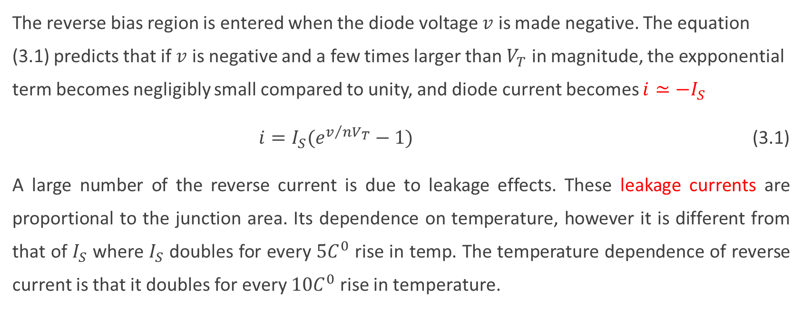
(ii) The reverse bias region, $v<0.$
The reverse bias region is entered when the diode voltage $v$ is made negative. The equation (3.1) predicts that if $v$ is negative and a few times larger than $V_{T}$ in magnitude, the expponential term becomes negligibly small compared to unity, and diode current becomes $i≃−I_{S}$
$i=I_{S}(e^{v/{nV_{T}}}−1)$ (3.1)
A large number of the reverse current is due to leakage effects. These leakage currents are proportional to the junction area. Its dependence on temperature, however it is different from that of $I_{S}$ where $I_{S}$ doubles for every ${5C}^{0}$ rise in temp. The temperature dependence of reverse current is that it doubles for every ${10C}^{0}$ rise in temperature.

Slide 26
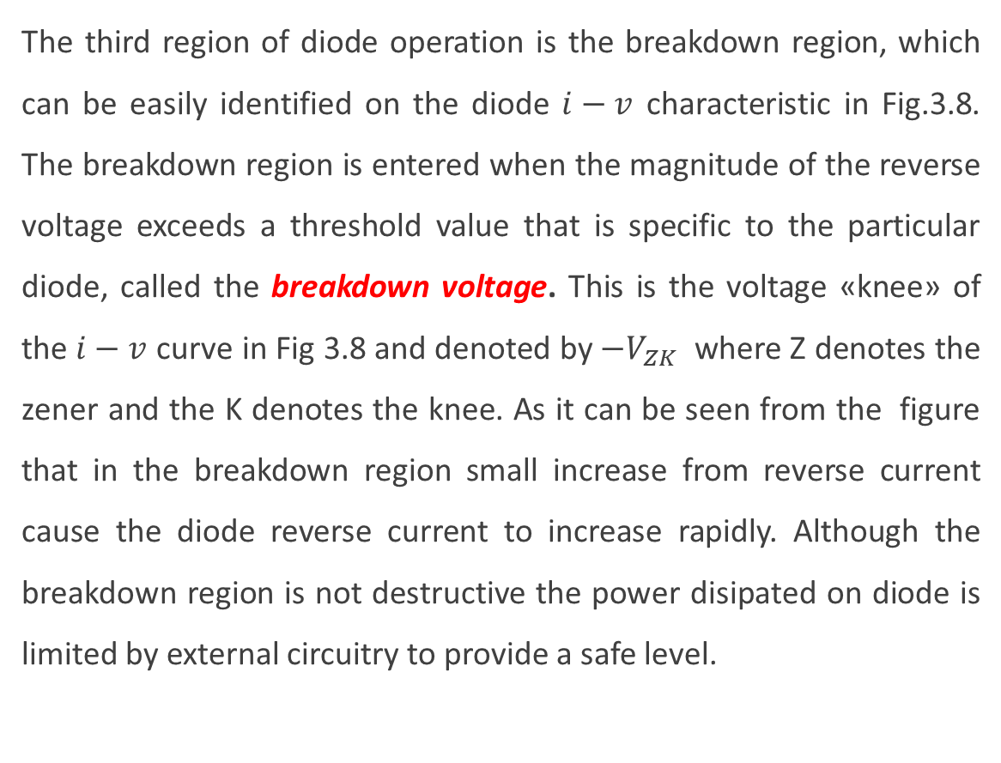

(iii) The break down region, $v<−V_{ZK}$
The third region of diode operation is the breakdown region, which can be easily identified on the diode $i−v$ characteristic in Fig.3.8. The breakdown region is entered when the magnitude of the reverse voltage exceeds a threshold value that is specific to the particular diode, called the breakdown voltage. This is the voltage «knee» of the $i−v$ curve in Fig 3.8 and denoted by $−V_{ZK}$ where Z denotes the zener and the K denotes the knee. As it can be seen from the figure that in the breakdown region small increase from reverse current cause the diode reverse current to increase rapidly. Although the breakdown region is not destructive the power disipated on diode is limited by external circuitry to provide a safe level.
Fig. 3.8

Slide 27
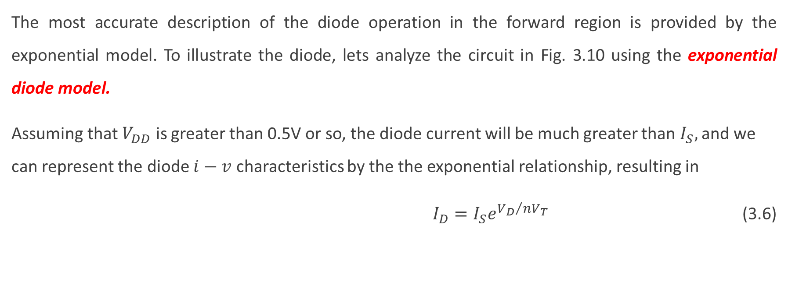
Modeling the diode forward characteristic
The most accurate description of the diode operation in the forward region is provided by the exponential model. To illustrate the diode, lets analyze the circuit in Fig. 3.10 using the exponential diode model.
Assuming that $V_{DD}$ is greater than 0.5V or so, the diode current will be much greater than $I_{S},$ and we can represent the diode $i−v$ characteristics by the the exponential relationship, resulting in
$I_{D}=I_{S}e^{{V_{D}}/{{nV}_{T}}}$ (3.6)
Fig. 3.10

Slide 28
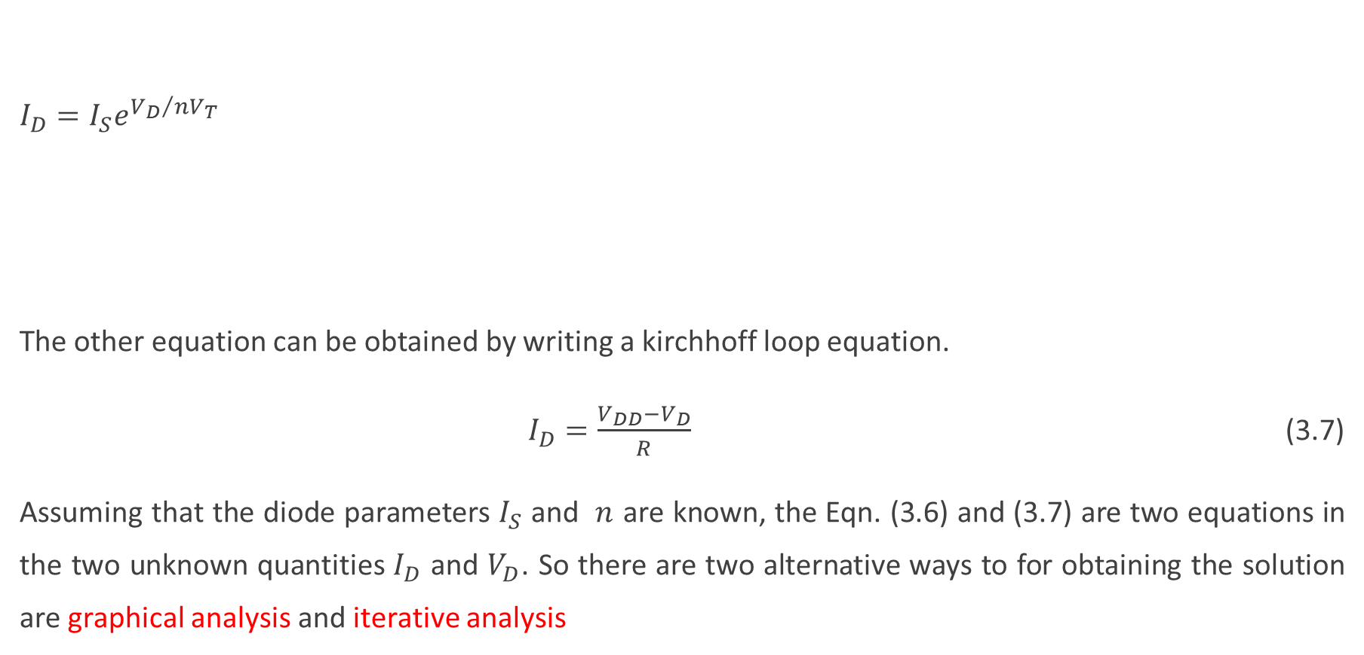
$I_{D}=I_{S}e^{{V_{D}}/{{nV}_{T}}}$
The other equation can be obtained by writing a kirchhoff loop equation.
$I_{D}=\frac{V_{DD}−V_{D}}{R}$ (3.7)
Assuming that the diode parameters $I_{S}$ and $n$ are known, the Eqn. (3.6) and (3.7) are two equations in the two unknown quantities $I_{D}$ and $V_{D}$. So there are two alternative ways to for obtaining the solution are graphical analysis and iterative analysis

Slide 29
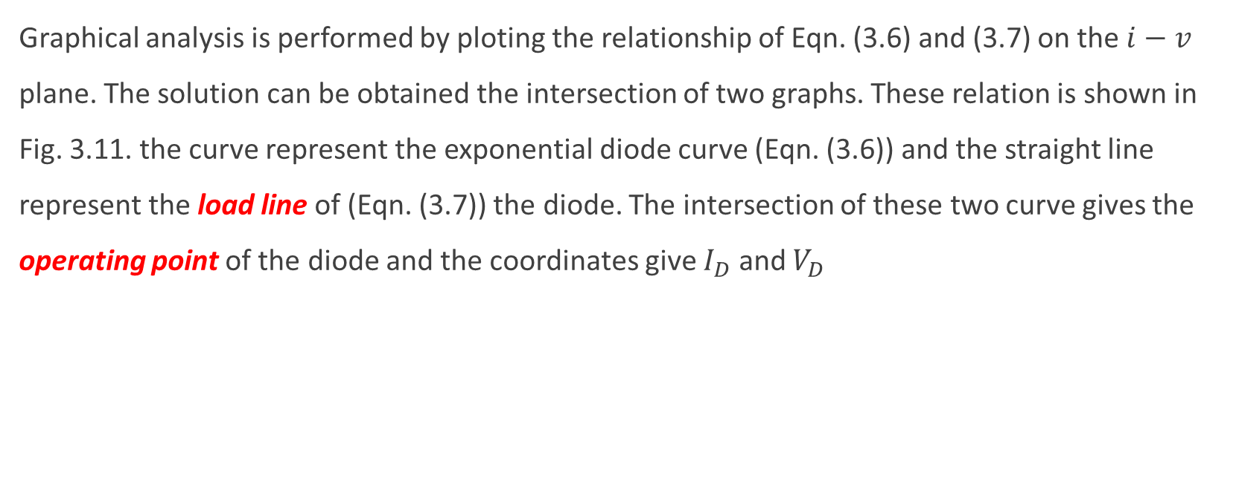
Grafical analysis using exponential model
Graphical analysis is performed by ploting the relationship of Eqn. (3.6) and (3.7) on the $i−v$ plane. The solution can be obtained the intersection of two graphs. These relation is shown in Fig. 3.11. the curve represent the exponential diode curve (Eqn. (3.6)) and the straight line represent the load line of (Eqn. (3.7)) the diode. The intersection of these two curve gives the operating point of the diode and the coordinates give $I_{D}$ and $V_{D}$
Fig. 3.11

Slide 30






Example 3.3 Iterative Analysis Using the Exponential Model
Solution 3.3

Slide 31

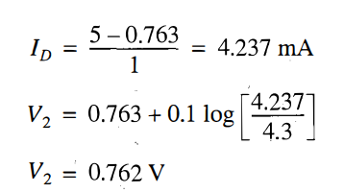
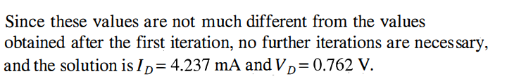

Slide 32
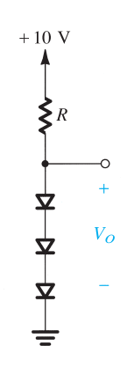
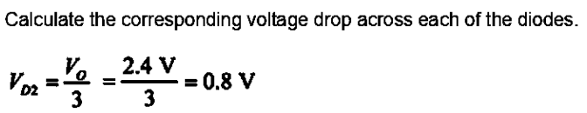
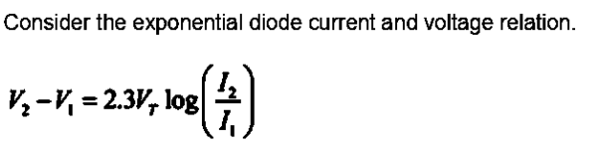
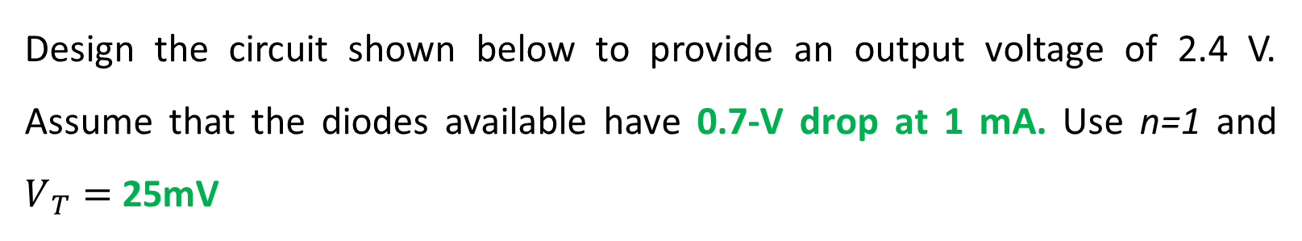
Example 3.4
Design the circuit shown below to provide an output voltage of 2.4 V. Assume that the diodes available have 0.7-V drop at 1 mA. Use n=1 and $V_{T}=$ 25mV
Solution 3.4

Slide 33
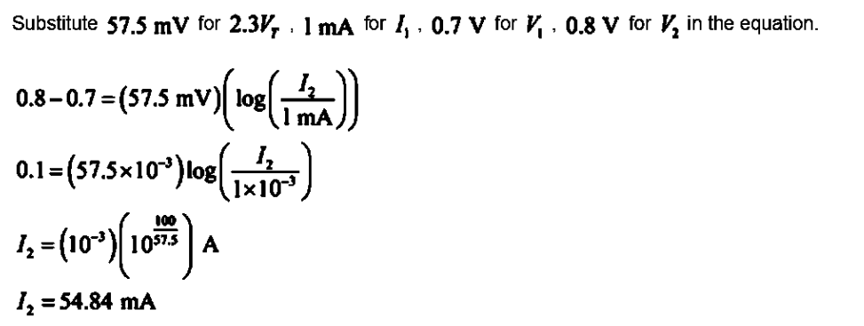
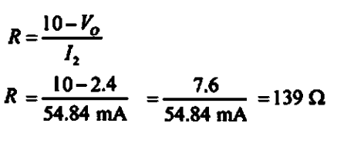

Slide 34
The Need for Rapid Analysis
The iterative analysis procedure utilized in the example above is simple and yields accurate results after two or three iterations.
To speed up the analysis process, one must be content with less precise results.
To speed up the analysis process, we must find a simpler model for the diode forward characteristic
(i) The Piecewice - Linear Model
(ii) Constant Voltage Drop Model
(iii) The Ideal-Diode Model
(iv) The small signal model

Slide 35
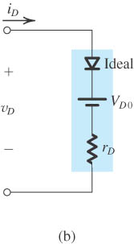
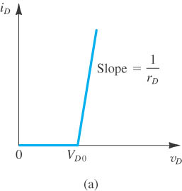

If we take the linear lines and seperate the graphic from the expponential one we will get the following graphic and circuit model
                $i_{D}=0$ $v_{D}≤V_{D0}$
                $i_{D}=\frac{v_{D}−V_{D0}}{r_{D}}$ $v_{D}>V_{D0}$

Slide 36
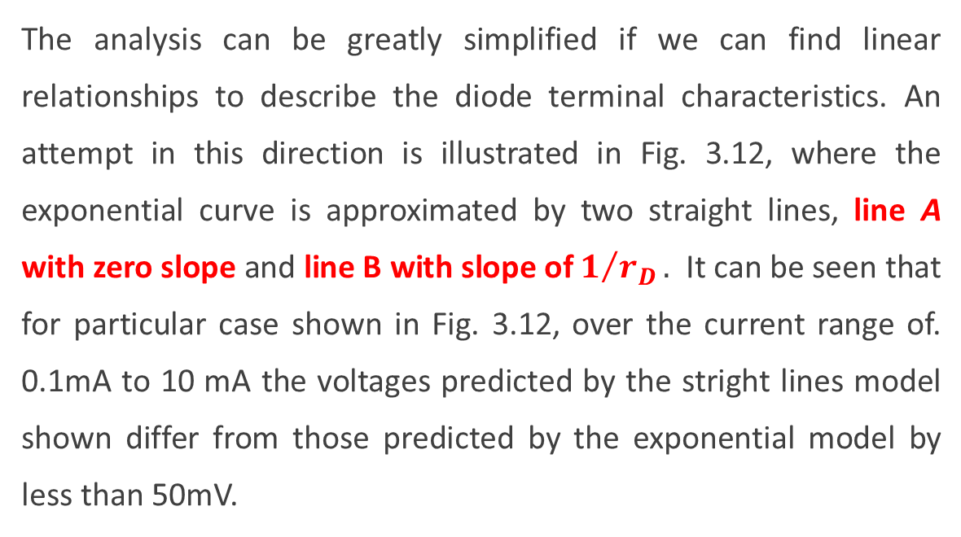
(i) The Piecewice - Linear Model
The analysis can be greatly simplified if we can find linear relationships to describe the diode terminal characteristics. An attempt in this direction is illustrated in Fig. 3.12, where the exponential curve is approximated by two straight lines, line A with zero slope and line B with slope of${ 1}/{r_{D}}.$ It can be seen that for particular case shown in Fig. 3.12, over the current range of. 0.1mA to 10 mA the voltages predicted by the stright lines model shown differ from those predicted by the exponential model by less than 50mV.
Fig. 3.12 Aproximating diode forward bias characteristic with two straight lines: the pecewice-linear model

Slide 37




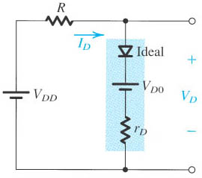
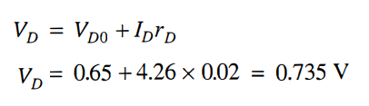
Example 3.5
Repeat the problem in Example 3.3 utilizing the piecewise-linear model whose parameters are given in Fig. 3.12. Note that the characteristics depicted in this figure are those of the diode described in Example 3.3. (l = 1 mA at 0.7 V and 0.1 V/decade).
Solution 3.5
Replacing the diode in the circuit

Slide 38
Practice Problem 3.3:
In the circuit below, diodes D₁ and D₂ are identical and have the piecewise linear model shown with the parameters
V_{D0} = 0.69 V and r_{D} = 1.1 Ω.
a) For I_{s} = 100 mA, find R so that V_{o} = 80 mV.
b) For R = 5 Ω, find I_{s} so that V_{o} = 110 mV.

Slide 39

Practice Problem 3.4:

Slide 40

(ii) Constant Voltage Drop Model
The simplest and most widely used diode model is the constant-voltage-drop model. This model is based on the observation that a forward-conducting diode has a voltage drop that varies in a relatively narrow rage, between 0.6 to 0.8V. The model assumes this voltage to be constant at a value, say 0.7V. This is illustrated in the Fig.3.16.
Fig. 3.16. The Voltage-drop-model of the diode forward characteristic and its equivalent circuit
(c)

Slide 41


Example 3.6
Repeat the problem in Example 3.3 utilizing the constant voltage drop model whose parameters are given in Fig. 3.16.
Solution 3.6
which are not too different from the values obtained before models.

Slide 42

Practice Problem 3.5:

Slide 43

(iii) The Ideal-Diode Model
In applications that involve voltages much greater than the diode voltage drop (0.6-0.8 V), we may neglect the diode voltage drop altogether while calculating the diode current. The result is the ideal-diode model,
For the circuit in Examples 3.4 and 3.5 (i.e., Fig. 3.10 with VDD = 5 V and R = 1 kΩ), utilization of the ideal-diode model leads to
However, the O.7-V-drop model yields much more realistic results. We note, however, that the greatest utility of the ideal-diode model is in determining which diodes are on and which are off in a multidiode circui

Slide 44

(iv) The small signal model
There are application in which a diode is biased to operate at a point on the forward $i−v$ characteristic and a small ac signal is superimposed on the dc quantities. For this situation, we first have to determine the dc operting point ${(V}_{D} and I_{D})$ of the diode using one of the models that was discussed before. Most frequently, the 0.7V drop model is used. Then for small signal operation arround the dc bias point, the diode is best modeled by a resistance equal to the inverse of the slope of tangent to the exponential $i−v$ characteristic at the bias point.

Slide 45
Fig. 3.17 Development of the diode small-signal model

Slide 46

Consider the circuit fig 3.17 (b) and the corresponding graphical representation in fig 3.17 (c). A dc voltage $V_{D}$, represented by a battery, is applied to the diode, and a time-variying signal $v_{d}(t)$, assumed to have a triangular waveform, is superimposed on the dc voltage $V_{D}$. In the absence of the signal $v_{d}(t)$ the diode voltage is equal to the dc voltage $V_{D}$, and correspondingly, the diode will conduct a dc current $I_{D}$ given by the following equation.
$I_{D}=I_{S}e^{{V_{D}}/{{nV}_{T}}}$ (3.9)
When the signal $v_{d}(t)$ is applied, the total instannaneous diode voltage $v_{D}\left(t\right)$ is given by
$v_{D}\left(t\right)=V_{D}+v_{d}(t)$ (3.10)
Correspondingly the total instantaneous diode current $i_{D}(t)$ will be,
$i_{D}\left(t\right)=I_{S}e^{{v_{D}}/{nV_{T}}}$ (3.11)

Slide 47


Substituting $v_{D}$ into eqn. 3.10 into eqn. 3.11 gives,
$i_{D}\left(t\right)=I_{S}e^{{{(V}_{D}+v_{d})}/{nV_{T}}}$
which can also be rewritten as,
$$i_{D}\left(t\right)=I_{S}e^{{V_{D}}/{nV_{T}}}e^{{v_{d}}/{nV_{T}}}$$
By using eqn. 3.9, then the equation can be written as,
$i_{D}\left(t\right)=I_{D}e^{{v_{d}}/{nV_{T}}}$ (3.12)
Since $\frac{v_{d}}{{nV}_{T}}≪1$ (3.13)
We may obtain the following approximation after exponential can be expanded and the first two terms of series truncated;

Slide 48

$i_{D}\left(t\right)=I_{D}\left(1+\frac{v_{d}}{{nV}_{T}}\right)$ (3.14)
This is the small-signall approximation. It is valid for signals whose amplitudes are smaller than about 10mV for the case n=2 and 5mV for n=1
Then Eqn. 3.14 can be written as $i_{D}\left(t\right)=I_{D}+\frac{I_{D}}{{nV}_{T}}v_{d}$ (3.15)
So $i_{D}=I_{D}+i_{d}$ (3.16)
where $i_{d}=\frac{I_{D}}{{nV}_{T}}v_{d}$ (3.17)
The quality relating the signal current $i_{d}$ to the signal voltage $v_{d}$, is known as the diode small-signal conductance. The inverse of this is the diode small-signall resistance or incremental resistance $r_{d}$. Note that this parameter is inversly proportional with $I_{D. }$ $r_{d}=\frac{{nV}_{T}}{I_{D}}$ (3.18)

Slide 49


Example 3.7
Consider the circuit shown below for the case in which R = I0 k$Ω$. The power supply V+ has a dc value of 10 V on which is superimposed a 60-Hz sinusoid of I-V peak amplitude. Calculate both the dc voltage of the diode and the amplitude of the sine-wave signal appearing across it. Assume the diode to have a 0.7-V drop at I-mA current and n = 2.

Slide 50


Slide 51




Solution 3.7

Slide 52

Zener Diodes
The very steep $i−v$ curve that the diode exhibits in the breakdown region (Fig.3.8) and the almost constant voltage drop that this indicates suggest that diodes operating in the breakdown region can be used in the design of voltage regulators. Voltage regulators are circuits that provide a constant dc output voltage in the face of changes in their load current and in the system power supply voltage. This is an important application of diodes operating in the reverse breakdown region,and special diodes are manufactured to operate specifically in the breakdown region. Such diodes are called zener diode.

Slide 53



Fig. 3.20 shows the symbol of the zener diode. In normal application of zener diodes, currents flows into the chathode, and the chathode is positive with respect to the anode. Thus $I_{Z}$ and $V_{Z}$ in the figure is positive values.
The manufacturer usually specifies the voltages across the zener diode $V_{Z}$ at specified test current $I_{ZT}.$ This is indicated in the fig. 3.21 as coordinates of point labeled as Q. For example a 6.8V zener diode will exhibit at 6.8V drop at specified test current of say 10mA.
Fig. 3.20
Zener diode symbol
Fig. 3.21 The $i−v$ characteristic with the break down region shown some detail

Slide 54
Zener diodes are specified to operate at a maximum power called the maximum dc power dissipation, P_{D(max)} . The dc power dissipation is determined by the formula;
P_{D(max)} = V_{Z} I_{Z(max)}
_{For example}
I_{Z(max)} = P_{D(max)} / V_{Z} = 1 W / 10 V = 100 mA
To provide voltage regulation I_{Z} should be varied by the minimum and maximum current values (I_{ZK} and I_{Z(max)}) with which the Zener can operate.

Slide 55

Model of the zener diode
As the current through the zener diode deviates $I_{ZT},$ the voltage across it will change, through only slightly. Figure 3.21 shows that corresponding to current ΔI the zener voltage changes by ΔV, which is related to ΔI by ΔV = $r_{Z} Δ$I where $r_{Z}$ is the inverse of the slope of the almost-linear $i−v$ curve at point Q. Resistance $r_{Z}$ is the incremental resistance of the zener diode at point Q. It is also known as the dynamic resistance of the zener, and its value is specified on device data sheet. The almost linear $i−v$ characteristiz of zener diode suggests that the device can be modeled as indicates in the following figure (Fig. 3.20).

Slide 56

The $V_{Z0}$ denotes the point at which the straight line of slope $1/{r_{z}}$ intersect the voltage axis. Although $V_{Z0}$ is shown in fig.3.21 to be slightly different from the knee voltage $V_{ZK},$ in practice their values are almost equal. So the equivalent circuit model of Fig.3.22 can be analitically described by,
$V_{Z}=V_{Z0}+r_{Z}I_{Z}$ (3.22)
I_{Z(max)} > $I_{Z}>I_{ZK}$ $V_{Z}>V_{Z0}$
Fig. 3.22 Zener Diode model

Slide 57

Use of zener as shunt regulator
Analysis $I_{Z}=I−I_{L}$ $V_{0}=V_{S}−RI=V_{S}−R\left(I_{L}+I_{Z}\right)=V_{Z0}+r_{Z}I_{Z}$
Solving for $I_{Z}:$ $I_{Z}=\frac{V_{S}−V_{Z0}−RI_{L}}{R+r_{Z}} ⇒V_{0}=V_{Z0}+r_{z}\left(\frac{V_{s}−V_{Z0}−RI_{L}}{R+r_{z}}\right)$
$Vo=\left(\frac{R}{R+r_{z}}\right)V_{Z0}+\left(\frac{r_{z}}{R+r_{z}}\right)V_{s}−\left(\frac{r_{z}R}{R+r_{z}}\right)I_{L}$

Slide 58


$$Vo=\left(\frac{R}{R+r_{z}}\right)V_{Z0}+\left(\frac{r_{z}}{R+r_{z}}\right)V_{s}−\left(\frac{r_{z}R}{R+r_{z}}\right)I_{L}$$
Line regulation =$\frac{ΔV_{0}}{ΔV_{s}} =\frac{∂V_{0}}{∂V_{s}}=\frac{r_{z}}{r_{z}+R}$
Load regulation $=\frac{ΔV_{0}}{ΔI_{L}} =\frac{∂V_{0}}{∂I_{L}}=−\left(\frac{r_{z}R}{r_{z}+R}\right)=−(r_{z}||R)$
By applying superposition theorem to equivalent model;
$I_{L}=\frac{V_{0}}{R_{L}} ⇒ V_{0}=\frac{(r_{z}||R_{L})}{(r_{z}||R_{L})+R}V_{s}+\frac{(R||R_{L})}{(R||R_{L})+r_{z}}V_{Z0}$
(load voltage in terms of load resistance)

Slide 59



Example 3.8
The 6.8-V zener diode in the circuit of (a) is specified to have V _{Z} = 6.8 V at I _{Z} = 5 mA, r _{z} = 20 Ω, and I _{ZK} = 0.2 mA. The supply voltage V + is nominally 10 V but can vary by ±1 V.

Slide 60


Solution 3.8
First we must determine the value of the parameter Vzo of the zener diode model.
Substituting V _{Z} = 6.8 V, l _{z} = 5 rnA, and r_{z} = 20 Ω, Vzo = 6.7 V
(a) With no load connected, the current through the zener is given by

Slide 61




(c) When a load resistance RL that draws a load current I_{L}= 1 mA is connected, the zener current will decrease by 1 mA. The corresponding change in zener voltage can be found from
(d) When a load resistance of 2 kQ is connected, the load current will be approximately 6.8V / 2 kΩ = 3.4 mA. Thus the change in Zener current will be ∆Iz = -3.4 mA, and the corresponding change in Zener voltage (output voltage) will thus be

Slide 62


(e)
(f)

Slide 63

Example 3.9
The Zener diode in the circuit below has the i-v characteristic shown, where $V_{zo}=7.3 V$, $r_{z}=20 Ω$. It is required to have a load voltage v_{o} = 7.5 V at a load current I_{L} = 5 mA, when v_{s} = 12 V. Find the required value of R.

Slide 64

Solution 3.9
$I_{z}=\frac{V_{z}−V_{z0}}{r_{z}}=\frac{7.5−7.3}{0.02} \text{mA}=10 \text{mA} ⇒ I_{s}=I_{z}+I_{L}=15 \text{mA}⇒$
$$R=\frac{V_{s}−V_{z}}{I_{s}}=\frac{12−7.5}{15} \text{k}Ω=300 Ω$$

Slide 65


Practice Problem 3.6:
The zener diode in the circuit has the i-v characteristic shown, where $V_{zo}=6.5 V$, $r_{z}=25 Ω$.
Find the value of R required so that the Zener diode is biased at V_{z} = 6.75 V at no load.
With R = 500 Ω find the minimum value of R_{L} before voltage regulation is lost (regulation is lost when V_{z} < V_{zo}).

Slide 66

Rectifier Circuits
One of the most important application of diodes is in the design of rectifier circuits. A diode rectifier forms an esential building block of the dc power supplies required to power electronic equipment. A block of such a power supply is shown in Fig. 3.24. As it can be seen from the figure that 120V (rms) 60Hz ac line, and it delivers a dc voltage $V_{0}$ to an electronic circuit represented by load block. The dc voltage $V_{0}$ required to be as constant as possible in spite of variations in the ac line voltage and in the current drown by the load
Fig. 3.24 Block diagram of cd power supply

Slide 67


The first block in a dc power supply is the power transformer. The transformer consist of two seperate coils wound arround an iron core that magnetically couples the two windings. The primary winding, having $N_{1}$ turns, is connected to the 240V (120V) ac power supply. And the secondary winding, having $N_{2}$ turns, is connected to the circuit of the dc power supply. Thus an ac voltages $v_{S}$ of 240 (120) $\left({N_{2}}/{N_{1}}\right)V (rms)$ develops between the two terminals of the secondary winding. By selecting an appropriate turns ratio $\left({N_{2}}/{N_{1}}\right)$ for the transformer. The voltage can be step down to the required value for the particular dc voltage output of the supply. For instance, a secondary voltage of 8V rms may be appropriate for a dc output of 5V. So this can be achived with a 30:1 (15:1) turns ratio

Slide 68
(b)
(a)
(d)
(c)
Fig.3.25 a) the half wave rectifier, b) rectifier with battery and resistance diode model, c) transfer characteristic, c) Input and output waveforms

Slide 69

The Half wave rectifier
The half wave rectifier utilizes alternate half cycle of the input sinusoid. The Fig. 3.25 (a) shows the circuit of a half-wave rectifier. Using the more realistic battery-plus-resistance diode model, we obtain the equivalent circuit shown in Fig 3.25 (b), from which we can write
$v_{0}=0,$ $v_{S}<V_{D0}$ (3.21a)
$v_{0}=\frac{R}{R+r_{D}}v_{s}−V_{D0}\frac{R}{R+r_{D}}$. $v_{S}≥V_{D0}$ (3.21b)
The transfer characteristic represented by these equations is shown in Fig. 3.23(c). In many applications, $r_{D}≪R$ and the second equation can be simplified to
$v_{0}≃v_{S}−V_{D0}$ (3.22)

Slide 70

In selecting diodes for rectifier design, two important parameters must be specified: The first one is the current handling capabilitiy required of the diode, determined by the largest current the diode is expected to conduct, I_{F(max)} and the second one is the peak inverse (PIV) voltage that the diode must be able to withstand without breakdown, determined by the lagest reverse voltage that is expected to appear across the diode. In the rectifier circuit of Fig. 3.25(a) it is observed that $v_{s}$ is negative the diode will be cut off and $v_{o}$ will be zero. It follows that the PIV is equal to the peak value of $v_{s}$
$PIV=V_{S}$ There are two point to note for rectifier.
1- It is possible to use diode transfer characteristic to get the exact transfer characteristic of the rectifier.
2- The circuit can not function properly if the input signal is low

Slide 71


Example 3.10

Slide 72





Solution 3.10
(a)
(b)
$$v_{0avg}=\frac{1}{2π}\int_{θ}^{π−θ}{\left(V_{S}sinφ−V_{D}\right).dφ}=\frac{1}{2π}{\left[−V_{S}cosφ−V_{D}φ\right]}_{θ}^{π−θ}$$
=$\frac{1}{2π}\left[V_{S}cosθ−V_{S}\cos\left(π−θ\right)−V_{D}(π−2θ)\right]$ since $θ$ is small
$v_{0avg}$ = ( $\frac{V_{S}}{π}−\frac{V_{D}}{2}$ )

Slide 73



(c)

Slide 74

Full Wave Rectifier
The full-wave rectifier utilizes both halves of the input sinusoid. To provide a unipolar output, it inverts the negative halves of the sine wave. One posible implementation is shown in Fig.3.26(a). Here the transformer secondary winding is centered-tapped to provide two equal voltages $v_{S}$ across the two halves of the secondary winding with the polarities indicated. Note that when the input line voltage is positive, both of the signals labeled $v_{S}$ will be positive. In this case $D_{1}$ will conduct and $D_{2}$ will be reversed biased. The current through $D_{1}$will flow through R and back to the center tap to secondary. So the circuit then behave like a half wave rectifier, and the output during the positive half-cycles when $D_{1}$ conducts will be identical to that produced by half-wave rectifier.

Slide 75
Full Wave Rectifier
(b)
(a)
Fig.3.26 (a) Full-wave rectifier (b) transfer characteristic (c) input and output wave-forms
(c)

Slide 76

Now during the negative half cycle of the ac line voltage, both of the voltages labeled $v_{S}$ will be negative. Thus $D_{1}$ will be cut off while $D_{2}$ will conduct. The current conducted by $D_{2}$ will flow through R and back to the center tap. It follows that during the negative half-cycle while $D_{2}$ conducts, the circuit behaves again as a half-wave rectifier. The important point here is that the current through R always flows in the same direction, and thus $v_{0}$ will be unipolar, as indicated in Fig. 3.26(c). The output shown is obtained by assuming that a conducting diode has a constant voltage drop $V_{D}$. Thus the transfer characteristic for the full-wave rectifier is shown in Fig. 3.26(b).
To find the PIV of the diode in the full-wave rectifier circuit, lets concider the situation during positive half-cycle. Diode $D_{1}$ is conducting, and $D_{2}$ is cut off. The voltage at the chathode of $D_{2}$ is $v_{0}$, and that at its anode is ${−v}_{0}$, thus the revers voltage across $D_{2}$ will be ${(v}_{0}+v_{S}),$ which will reach its maximum when $v_{0}$ is at its peak value of ${(V}_{S}−V_{D}),$and $v_{S }$is at its peak value of $V_{S}$; thus
$PIV=2V_{S}−V_{D}$
which is twice that of the half wave rectifier.

Slide 77

The period of a full-wave rectified voltage is half that of a half-wave rectified voltage. The output frequency of a full-wave rectifier is twice that of a half-wave rectifier

Slide 78


Example 3.11

Slide 79



Solution 3.11
(a)

Slide 80




(b)
The average value, which is the value measured on a dc voltmeter, for a full-wave rectified sinusoidal voltage is twice that of the half-wave,
$$V_{o(avg)}= \frac{2V_{p}}{π} − V_{D}$$
The output avarege voltage is
(c)

Slide 81
The bridge rectifier
(a)
(b)
Fig. 3.27 Bridge rectifier (a) The circuit (b) input and output wave-forms

Slide 82

This circuit is known as the bridge rectifier because of the similaritiy of its configuration that of the Weheatsone bridge, does not require a cener tap transformer, a distinct advantage over the full-wave rectifier circuit of Fig. 3.26. The bridge rectifier however requires four diodes as compared to two in the previous circuit. This is not accepted as disadvantage of this type rectifiers.
During positive half- cycle of the input voltage, $v_{s}$is positive and thus the current is conducted through diode $D_{1}$,resistor R, and diode $D_{2}.$ During this conduction $D_{3}, and{ D}_{4}$ are reversed biased. At this half cycle there are two diode in series. So the output voltage will belower than $v_{S}$ by two diode drops. This is the disadvantage of the bridge rectifier.
For the next half-cycle which is negative one then the diodes $D_{3}, and{ D}_{4}$ are conducting an the diodes
$D_{1}, and{ D}_{2}$ are reversed bias. During the conduction of $D_{1}, { D}_{2} and{ D}_{3}, { D}_{4}$ pair of the diodes the current through R is in the same direction.

Slide 83

To determine the peak inverse voltage (PIV) of each diode of the bridge rectifier, lets concider the positive half cyles. The reverse voltage across $D_{3}$ can be determined from the loop formed by $D_{3}, R and D_{2}$ as
$v_{D3}\left(reverse\right)=v_{0}+v_{D2}(forward)$
So the maximum value of $v_{D3}$ occurs at the peak of $v_{0}$ and it is given by,
$PIV=V_{S}−2V_{D}+V_{D}=V_{S}−V_{D}$
The advantage of the bridge rectifier is that PIV of the diode is the half of the full-wave rectifier that is used in center-tapped transformer. Another advantage of the bridge rectifier is that the transformer needs only half of the windings that the full bridge inverter needs.
.

Slide 84


Example 3.12

Slide 85

Solution 3.12
(a)

Slide 86


(b)

Slide 87
Rectifier with a filter capacitor
Fig. 3.28 a) simple circuit to illustrate the effect of the filter capacitor
b) the input and output waveforms that shows the effect of the filter capacitor

Slide 88

A simple way of reduce the variation of the output voltage is to pllace a capacitor across the load resistor. It will be shown that this filter-capacitor serves to reduce the variations in the rectifier output voltage.
Initially (t = 0) the capacitor is uncharged. When v_{I} starts to increase the diode is turned on and the capacitor voltage becomes equal to v_{I}. When v_{I} starts to decrease after it reaches its peak, the diode becomes reverse-biased because the capacitor cannot discharge through the diode. Hence, the capacitor voltage v_{o} stays at the value equal to the peak, V_{p} of the input voltage. When a load resistance is connected to the output terminals, the capacitor discharges through this resistance whenever the diode turns off. The capacitor discharges exponentially when D turs off. At $t_{1}$, $v_{I}$ equals to the capacitor voltage and D turns on. The capacitor voltage continues to be equal to $v_{I}$ until the diode current $i_{D}$ becomes equal to zero at $t_{2}$. After this instant, D turns off and becomes reverse biased as the input voltage drops below the slowly decade capacitor voltage.

Slide 89

(b)
Fig. 3.29 Voltage and current waveforms with the peak rectifier circuit with $CR≫T$
(c)

Slide 90

Analysis of the voltage ripple
In Fig. 3.29 (b) shows the steady-state input and output voltage waveforms under the assumtion that $CR≫T$, where the $T$ is the period of the input sinosoid. So the waveform of the load current is given by,
$i_{L}={v_{0}}/R$ (3.23)
And the diode current (when it is conducting), are shown in Fig. 3.29 (c )
$i_{D}=i_{C}+i_{L}$ (3.24)
$=C\frac{dv_{I}}{dt}+i_{L}$ (3.25)

Slide 91

The folloving observations are in order:
1- The diode conducts for a brief interval, $Δt$, near the peak of the input sinusoid. And supplies the capacitor with charge equal to that lost during the much longer discharge interval. This is approximatelly equal to the pariod T.
2- Assuming an ideal diode, the diode conduction starts at time $t_{1}$, at which the input $v_{I}$ equals the exponentially decaying output $v_{o}$. Conduction stops at $t_{2},$ shortly after the peak of $v_{I}$, the axact value of $t_{2}$ can be determined by setting $i_{D}=0$ in Eq. (3.25)
3- During the diode off interval, the capacitor discharges through R, and $v_{o}$decays exponentially with a time constant CR. The discharge interval starts just after the peak value of $v_{I}$. So $v_{0}=V_{P}−V_{r}$ where $V_{r}$ is the peak to peak ripple voltage. When CR>>T the value of $V_{r}$ is small.

Slide 92

4- when $V_{r}$ is small, $v_{0}$, is almast constant and equal to the peak valueof $v_{I}$. So the dc output voltage is approximately equal to the peak value of $V_{P}$. Similarly the current ${i }_{L}$ is almost constant, and its dc component $I_{L}$ is given by
$I_{L}=\frac{V_{P}}{R}$ (3.26)
More accurate output dc voltage can be calculated by taking the average extreme values of $v_{0}$,
$v_{o}=V_{P}−\frac{1}{2}V_{r}$ (3.27)
During the diode off interval $i_{C}=−\frac{v_{o}}{R}$ ⇒ $v_{0}=V_{P}e^{{−t}/{CR}}$
At the end of the discharge interval $V_{P}−V_{r}≅V_{P}e^{{−T}/{CR}}$ since $CR≫T$ by using approximation the equation can be simplified as $V_{r}≃V_{p}\frac{T}{CR}$

Slide 93


At the end of the discharge interval $V_{P}−V_{r}≅V_{P}e^{{−T}/{CR}}$ since $RC≫T$ by using approximation the equation can be simplified as Where $τ=RC$
$V_{r}≃V_{p}\frac{T}{CR}=\frac{2π}{ωτ}V_{P}$ (3.28)
$V_{r}$ can also be expressed in terms of frequency f.
${ V}_{r}=\frac{V_{P}}{fCR}$ for a half- wave rectifier. (3.29a)
By using Eq. 3.26 $V_{r}=\frac{I_{L}}{fC}$ (3.29b)
The average load current is approximatelly $I_{L}=\frac{V_{P}}{R}$
$V_{r}=\frac{V_{P}}{2fCR}$ for a full - wave rectifier.

Slide 94

The conduction angle of the diode
The conduction interval Δt can be determined from
$V_{P}\cos{(wΔ}$t)=$V_{P}−V_{r}$
where $ω=2πf={2π}/T$ is the angular frequency of $v_{I}$. Since $(wΔt)$ is a small angle, we can employ the approximation $\cos\left(wΔt\right)≃1−\frac{1}{2}(wΔ{t)}^{2}$ to obtain
$wΔt≃\sqrt{2{V_{r}}/{V_{p}}}=\sqrt{2/{fRC}}$ (3.30)
Since $V_{r}≪V_{P}$, the conduction angle $wΔt$ will be small as assumed.

Slide 95

Average diode current during conduction:
$i_{D}=i_{C}+i_{L}$ ⇒ $i_{D, av}=i_{C,av}+i_{L}$ $i_{L}:average load current$
To find $I_{c,av}$we can use the capacitor equation in integral form over (t₁, t₂)
$v_{c}(t_{2})=v_{c}(t_{1})+\frac{1}{C}\int_{t_{1}}^{t_{2}}{i_{c}dt} ⇒v_{c}(t_{2})−v_{c}(t_{1})≅V_{r} I_{c,av}=\frac{1}{t_{2}−t_{1}}\int_{t_{1}}^{t_{2}}{i_{c}dt}$
$V_{r}=\frac{Δt​I_{c,av}}{C} ⇒I_{c,av}=\frac{CV_{r}}{Δt}=\frac{ωCV_{r}}{ωΔt}=2πI_{L}\sqrt{\frac{V_{p}}{2V_{r}}}=πI_{L}\sqrt{\frac{2V_{p}}{V_{r}}}$
$⇒ I_{D,av}=I_{L}\left[1+π\sqrt{\frac{2V_{p}}{V_{r}}}\right]$ for a half- wave rectifier.

Slide 96

The diode current can be calculated as
$i_{C}=C\frac{dv_{I}}{dt}=C\frac{d}{dt}(V_{s}\sin{ω}t)=CV_{s}ω\cos{ω}t$
$i_{R}=\frac{v_{I}}{R}=\frac{V_{s}}{R}\sin{ω}t$
$i_{D}=i_{C}+i_{R}=\left(CV_{s}ω\right)\cos{ω}t+\left(\frac{V_{s}}{R}\right)\sin{ω}t=A\sin\left(ωt+φ\right)$
$A=\frac{V_{s}}{R}\sqrt{1+a^{2}} φ=\tan^{−1}{(}a) a=ωRC$
for a half- wave rectifier.

Slide 97


Slide 98

Example 3.13
Solution 3.13

Slide 99


Example 3.14

Slide 100

Solution 3.14

Slide 101


Example 3.15

Slide 102

Solution 3.15

Slide 103


Slide 104


Slide 105


Example 3.12

Slide 106

Solution 3.12

Slide 107

Example 3.13

Slide 108

Solution 3.13

Slide 109


Slide 110
Limiting and Clamping circuits
Diode Limiters
When a sine wave is applied to the limiter, the part above L₊ is clamped to L₊, and the part below L- is clamped to L-.
Fig 3.22 General transfer characteristic for a limiter
Fig. 3.34 Soft limiter

Slide 111
Basic limiting circuits using ordinary and zener diodes:

Slide 113


Slide 114





Slide 115

Diode Clampers
Clamper adds a dc level to an ac voltage. Clampers are sometimes known as dc restorers

Slide 116

If the RC time constant is 100 times the period, the clamping action is excellent.
RC > 100 T_{in}

Slide 117



