Slide 1
MOS Field-EffectTransistors (MOSFETs)
Lecture-5
1

Slide 2
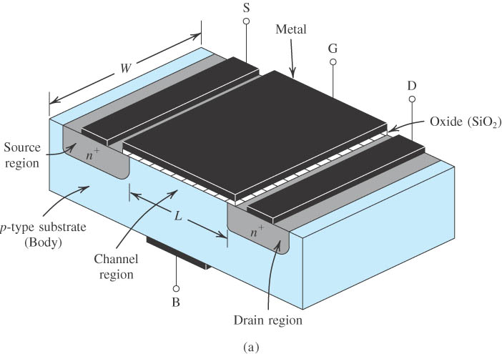
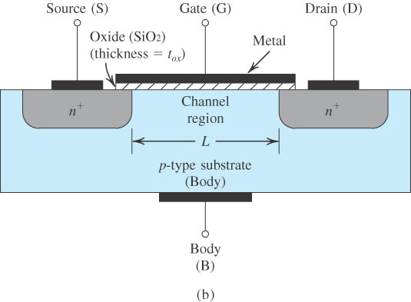
5.1 Device Structure
Figure 5.1 shows the physical structure of the n-channel enhancement-type MOSFET. The meaning of the names “enhancement” and “n-channel” will become apparent shortly. The transistor is fabricated on a p-type substrate, which is a single-crystal silicon wafer that provides physical support for the device
Figure 5.1
Thus four terminals are brought out: the gate terminal (G), the source terminal (S), the drain terminal (D), and the substrate or body terminal (B)

Slide 3
At this point it should be clear that the name of the device (metal-oxide-semiconductor FET) is derived from its physical structure.
The gate electrode is electrically insulated from the device body (by the oxide layer).
It will be shown that a voltage applied to the gate controls current flow between source and drain. This current will flow in the longitudinal direction from drain to source in the region labeled “channel region.” Note that this region has a length L and a width W, two important parameters of the MOSFET. Typically, L is in the range of 0.03 μm to 1 μm, and W is in the range of 0.05 μm to 100 μm.
Notes:
sedr42021_0401a.jpg

Slide 4
Operation with Zero Gate Voltage
With zero voltage applied to the gate, two back-to-back diodes exist in series between drain and source.
One diode is formed by the pn junction between the n+ drain region and the p-type substrate, and the other diode is formed by the pn junction between the p-type substrate and the n+ source region
These back-to-back diodes prevent current conduction from drain to source when a voltage vDS is applied. In fact, the path between drain and source has a very high resistance

Slide 5
Creating a Channel for Current Flow
Consider next the situation depicted in Fig. 5.2
With source and drain grounded, free holes under the gate region are repelled by the positive voltage, creating a depletion region of bound negative charge.
Electrons in the source and drain regions are forced into the channel, creating an n region under the gate terminal which connects the source and drain regions.
The value of v_{GS} at which a sufficient number of mobile electrons accumulate in the channel region to form a conducting channel is called the threshold voltage Vt.
Correspondingly, the MOSFET of Fig. 5.2 is called an n-channel MOSFET or, alternatively, an NMOS transistor. Note that an n-channel MOSFET is formed in a p-type substrate:The channel is created by inverting the substrate surface from p type to n type.

Slide 6
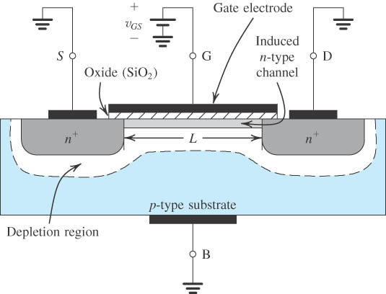
Figure 5.2 The enhancement-type NMOS transistor with a positive voltage applied to the gate. An n channel is induced at the top of the substrate beneath the gate.
Notes:
sedr42021_0402.jpg

Slide 7
Applying a Small v_{DS}
A small positive voltage v_{DS} is applied between drain and source. This causes a small current to flow in the induced channel. Current is carried by free electrons traveling from source to drain.
The magnitude of i_{D} depends on the density of electrons in the channel, which in turn depends on the magnitude of v_{GS}.
For v_{GS} = V_{t} channel is just induced; the current conducted is still negligibly small. (v_{GS} − V_{t}): excess gate voltage, overdrive voltage.

Slide 8
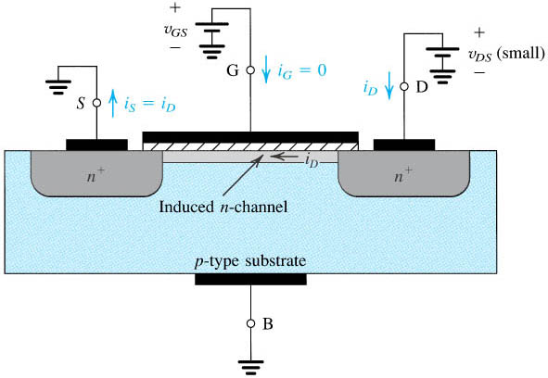
Figure 5.3
An NMOS transistor with v_{GS} > V_{t} and with a small v_{DS} applied. The device acts as a resistance whose value is determined by v_{GS}. Specifically, the channel conductance is proportional to v_{GS} – V_{t’} and thus i_{D} is proportional to (v_{GS} – V_{t}) v_{DS}.
Notes:
sedr42021_0403.jpg

Slide 9
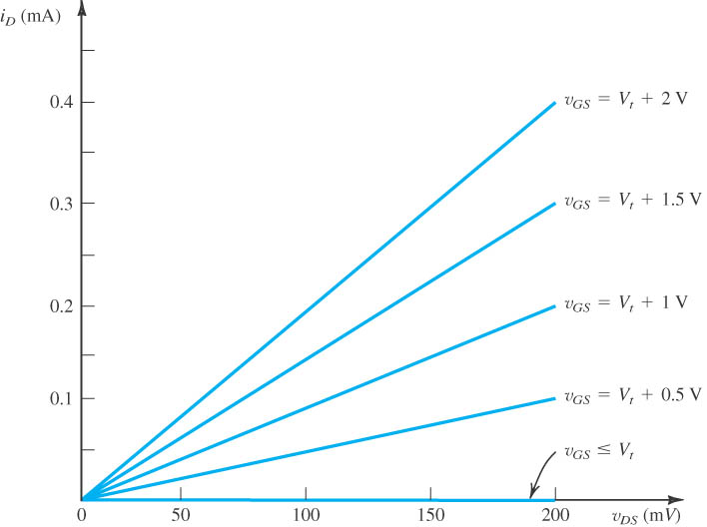
Figure 5.4
The i_{D}–v_{DS} characteristics of the MOSFET in Fig. 5.3 when the voltage applied between drain and source, v_{DS,} is kept small. The device operates as a linear resistor whose value is controlled by v_{GS}.
Notes:
sedr42021_0404.jpg

Slide 10
The operation of the MOSFET as a voltage-controlled resistance is further illustrated in Fig. 5.4, which is a sketch of i_{D} versus v_{DS} for various values of v_{GS}.
Observe that the resistance is infinite for V_{GS} ≤ Vt and decreases as V_{GS} is increased above Vt.
It is interesting to note that although V_{GS} is used as the parameter for the set of graphs in Fig. 5.4, the graphs in fact depend only on (V_{GS} – Vt)
The description above indicates that for the MOSFET to conduct, a channel has to be induced. Then, increasing V_{GS} above the threshold voltage Vt enhances the channel, hence the names enhancement-mode operation and enhancement-type MOSFET. Finally, we note that the current that leaves the source terminal (i_{S}) is equal to the current that enters the drain terminal (i_{D}), and the gate current i_{G} = 0.

Slide 11
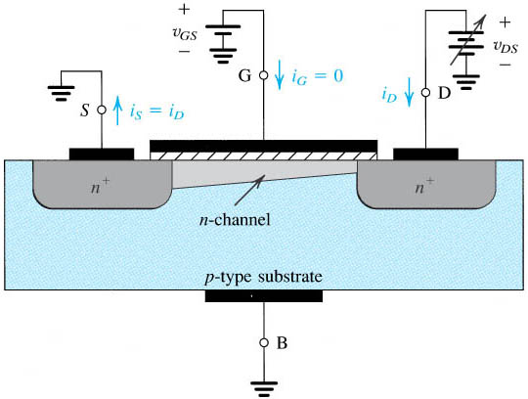
Operation as V_{DS} is increased
We next consider the situation as V_{DS} is increased. For this purpose, let V_{GS} be held constant at a value greater than V_{t}; that is, let the MOSFET be operated at a constant overdrive voltage V_{OV} .
Figure 5.5
Operation of the enhancement NMOS transistor as v_{DS} is increased. The induced channel acquires a tapered shape, and its resistance increases as v_{DS} is increased. Here, v_{GS} is kept constant at a value > V_{t}.

Slide 12
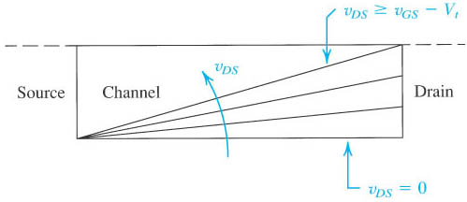
Figure 5.6
Increasing v_{DS} causes the channel to acquire a tapered shape. Eventually, as v_{DS} reaches v_{GS} – V_{t’} the channel is pinched off at the drain end. Increasing v_{DS} above v_{GS} – V_{t} has little effect (theoretically, no effect) on the channel’s shape.
Notes:
sedr42021_0407.jpg

Slide 13
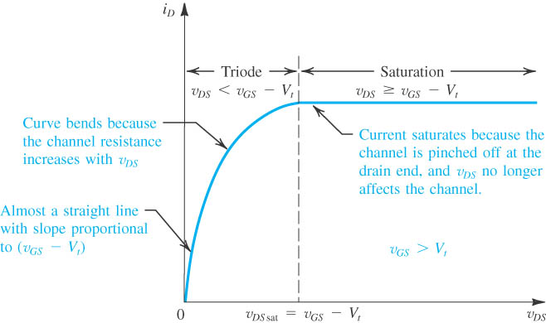
As V_{DS} is increased, the channel becomes more tapered and its resistance increases correspondingly. Thus, the i_{D}−V_{DS} curve does not continue as a straight line but bends as shown in Fig. 5.7.
Figure 5.7 The drain current i_{D} versus the drain-to-source voltage v_{DS} for an enhancement-type NMOS transistor operated with v_{GS} > V_{t}.

Slide 14
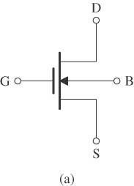
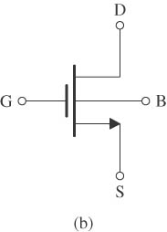
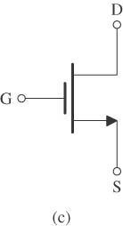
Circuit Symbol
Figure 5.8
Circuit symbol for the n-channel enhancement-type MOSFET.
Modified circuit symbol with an arrowhead on the source terminal to distinguish it from the drain and to indicate device polarity (i.e., n channel).
Simplified circuit symbol to be used when the source is connected to the body or when the effect of the body on device operation is unimportant.
Notes:
sedr42021_0406.jpg

Slide 15
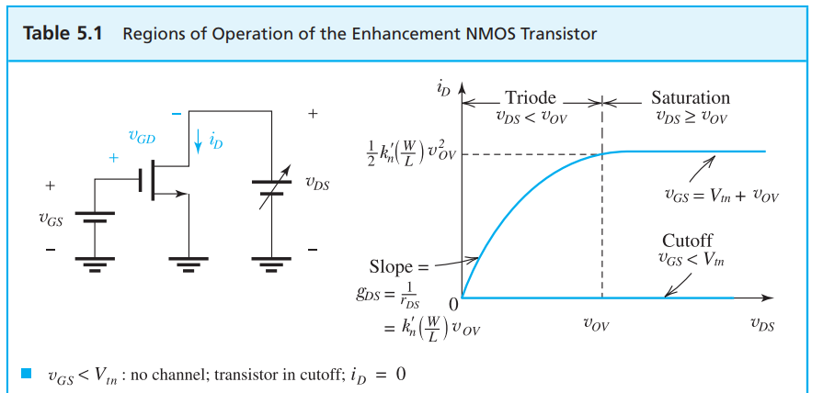
Current–Voltage Characteristics
Notes:
sedr42021_0405.jpg

Slide 16
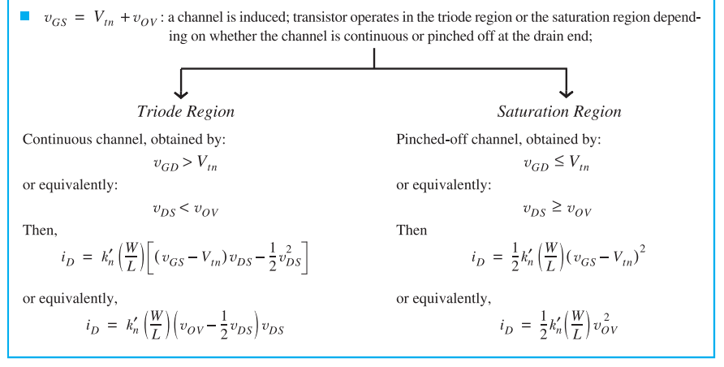
Notes:
sedr42021_0410a.jpg

Slide 17
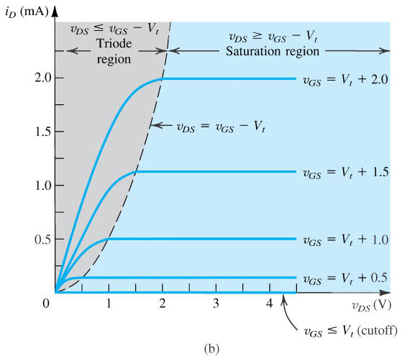
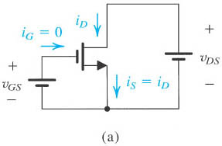
Figure 5.9 (a) An n-channel enhancement-type MOSFET with v_{GS} and v_{DS} applied and with the normal directions of current flow indicated. (b) The i_{D}–v_{DS} characteristics for a device with k’_{n} (W/L) = 1.0 mA/V².
Notes:
sedr42021_0411a.jpg

Slide 18
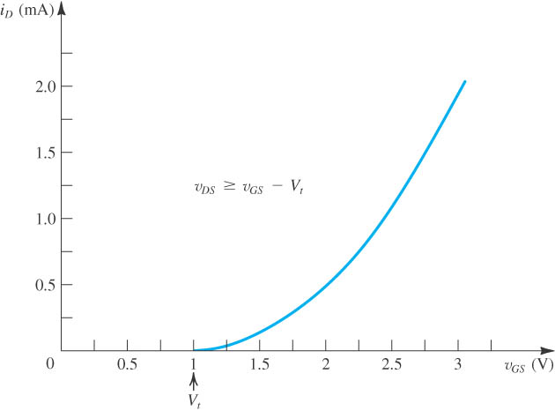
Figure 5.10 The i_{D}–v_{GS} characteristic for an enhancement-type NMOS transistor in saturation (V_{t} = 1 V, k’_{n} W/L = 1.0 mA/V²).
Notes:
sedr42021_0412.jpg

Slide 19
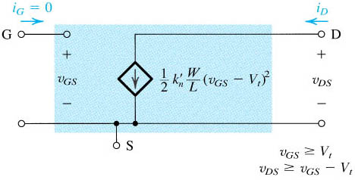
Figure 5.11 Large-signal equivalent-circuit model of an n-channel MOSFET operating in the saturation region.
Notes:
sedr42021_0413.jpg

Slide 20
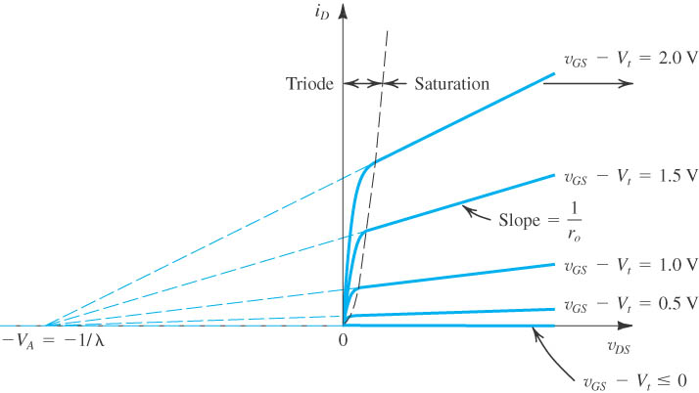
Figure 5.12
Effect of v_{DS} on i_{D} in the saturation region. The MOSFET parameter V_{A} depends on the process technology and, for a given process, is proportional to the channel length L.
Notes:
sedr42021_0416.jpg

Slide 21
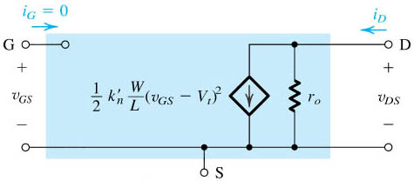
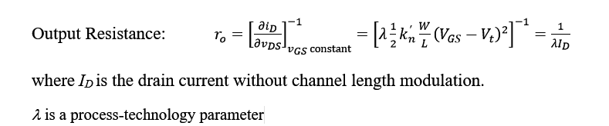
Figure 5.13
Large-signal equivalent circuit model of the n-channel MOSFET in saturation, incorporating the output resistance r_{o}. The output resistance models the linear dependence of i_{D} on v_{DS.}
Notes:
sedr42021_0417.jpg

Slide 22
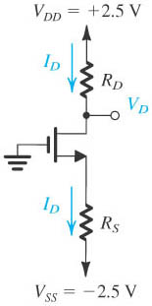

MOSFET Circuits at DC
Example 5.1:
Determine the values of R_{D} and R_{S} so that the transistor operates at
Solution 5.1:
To establish a dc voltage of +0.5 V at the drain, we must select R_{D} as follows:
$$V_{D}=0.5 \text{V} ⇒ R_{D}=\frac{V_{DD}−V_{D}}{I_{D}}=\frac{2.5−0.5}{0.4}=5 \text{k}Ω$$
Notes:
sedr42021_0420.jpg

Slide 23

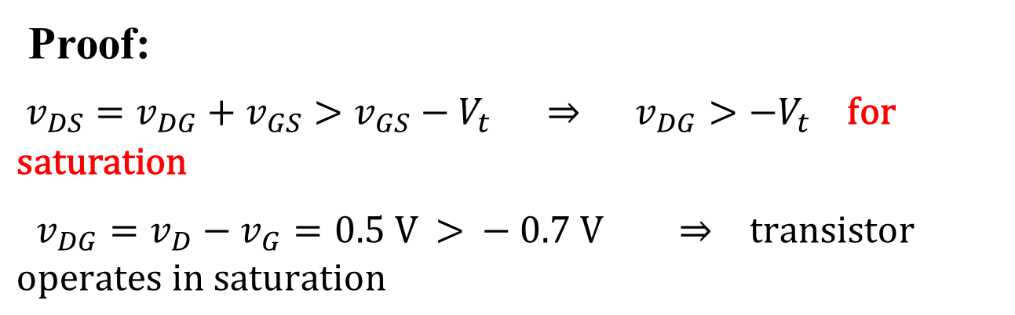
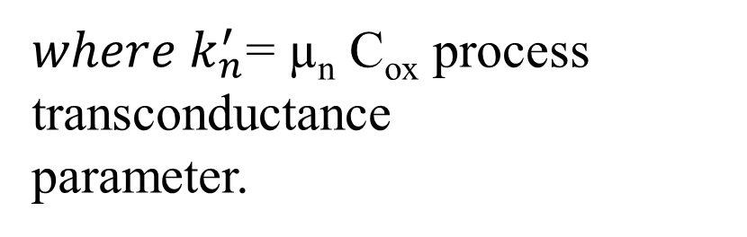
Since V_{D} = 0.5 V is greater than V_{G}, the NMOS transistor is operating in the saturation region, and we can use the saturation-region expression of i_{D} to determine the required value of V_{OV.}
Proof:
$v_{DS}=v_{DG}+v_{GS}>v_{GS}−V_{t} ⇒ v_{DG}>−V_{t} \text{f}\text{or} \text{saturation}$
$v_{DG}=v_{D}−v_{G}=0.5 \text{V}\text{ > }−0.7 \text{V} ⇒ \text{transistor} \text{operates} \text{in} \text{saturation}$
we can use the saturation-region expression of i_{D} to determine the required value of V_{OV} ,
${where k}_{n}^{′}$= µ_{n} C_{ox} process transconductance
parameter.

Slide 24
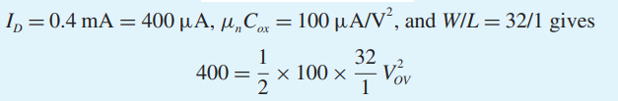




Slide 25
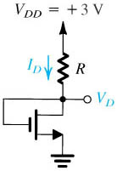

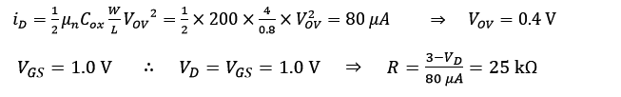
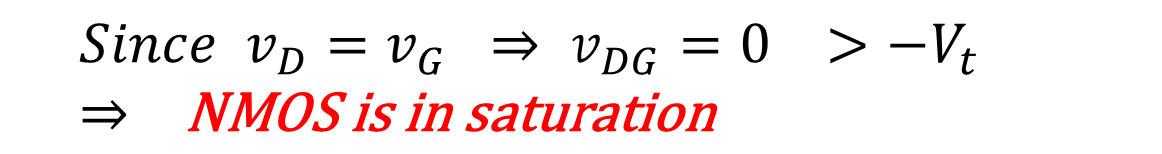
Example 5.2:
Find R in the circuit to obtain a current of 80 μA. Find also the drain voltage V_{D}.
Solution 5.2:
$${Since v}_{D}=v_{G} ⇒ v_{DG}=0 >−V_{t} ⇒ \text{NMOS} \text{is} \text{in} \text{saturation}$$
Notes:
sedr42021_0421.jpg

Slide 26

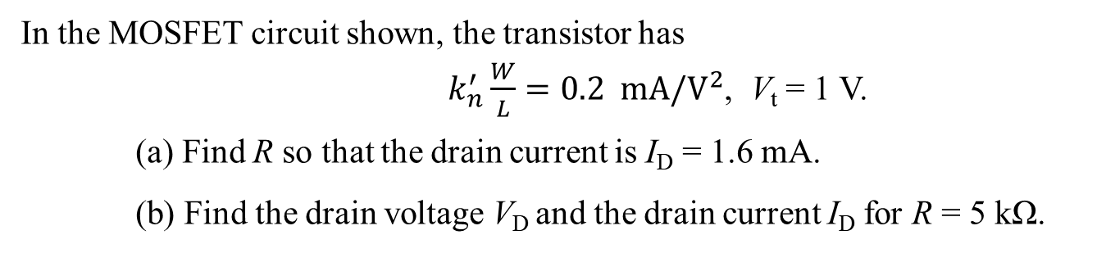

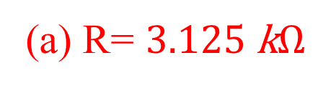
Practice Problem 5.1
In the MOSFET circuit shown, the transistor has
$k_{n}^{′}\frac{W}{L}=0.2 \text{mA}\text{/}{\text{V}}^{2}$, V_{t} = 1 V.
(a) Find R so that the drain current is I_{D} = 1.6 mA.
(b) Find the drain voltage V_{D} and the drain current I_{D} for R = 5 kΩ.
(a) R= $3.125 \text{k}Ω$
$${\left(b\right) I}_{D}=1.1282\text{mA}$$
$$V_{DS}=4.359 \text{V}$$

Slide 27
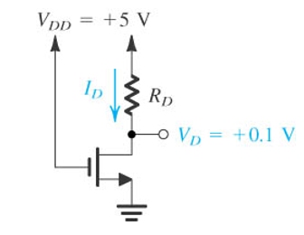

Example 5.3:
Solution 5.3:

Slide 28
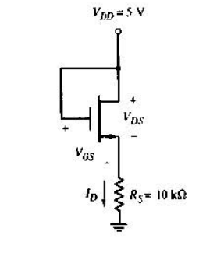



Practice Problem 5.2
In the MOSFET circuit shown, the transistor has the following parameters
0.5 $k_{n}^{′}\frac{W}{L}=\text{0.0} \text{5}\text{mA}\text{/}{\text{V}}^{2}$, $λ=0$ , V_{t} = 0.8 V
Find the drain current I_{D}, and the gate-source voltage V_{GS}.
State in which region of its characteristics the transistor operates.
$$I_{D}=0.2\text{13} \text{mA}$$
$$V_{GS}=\text{2.87} \text{V}$$

Slide 29
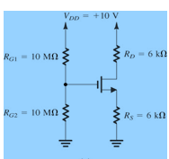
Example 5.4:
Determine the voltages at all nodes and currents in all branches.
$$V_{t}\text{=1.0 }\text{V}\text{,} k_{n}^{′}(W/L)=1 \text{mA}\text{/}{\text{V}}^{2}, λ=0$$

Slide 30
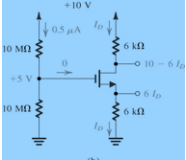



Solution 5.4:

Slide 31

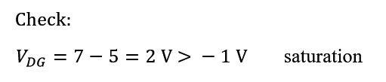

Slide 32
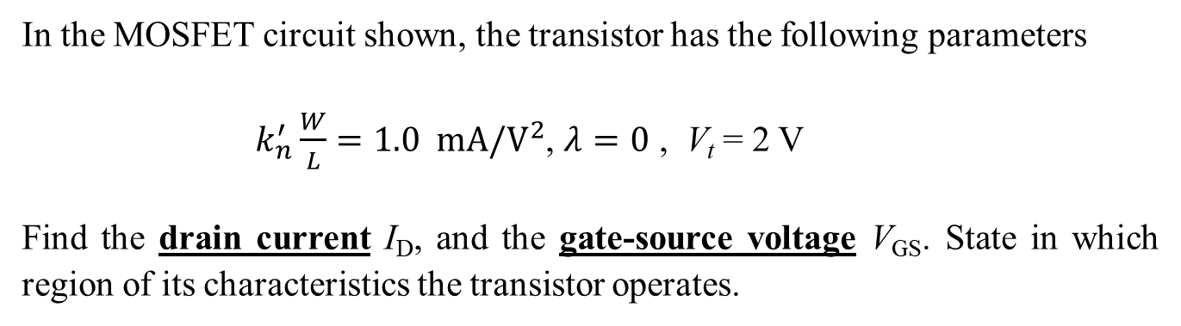


Practice Problem 5.3
In the MOSFET circuit shown, the transistor has the following parameters
$k_{n}^{′}\frac{W}{L}=1.0 \text{mA}\text{/}{\text{V}}^{2}$, $λ=0$ , V_{t} = 2 V
Find the drain current I_{D}, and the gate-source voltage V_{GS}. State in which region of its characteristics the transistor operates.
$$I_{D}=2 \text{mA}$$
$$V_{GS}=4 \text{V}$$

Slide 33
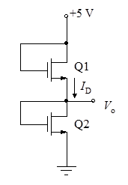

Practice Problem 5.4
In the MOSFET circuit shown below, the transistors have widths W1 = 10 μm, W2 = 40 μm, and their lengths are equal, i.e. L1 = L2 = 2 μm. Both transistors have k_{n} = 0.2mA/V² , and V_{t} = 1 V. Find the voltage Vo and the current I_{D}.
$$I_{D}=2 \text{mA}$$
$$V_{GS2}=\text{2} \text{V}$$

Slide 34
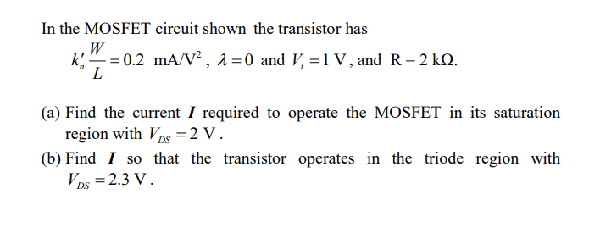
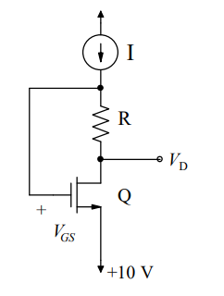
Practice Problem 5.5

Slide 35
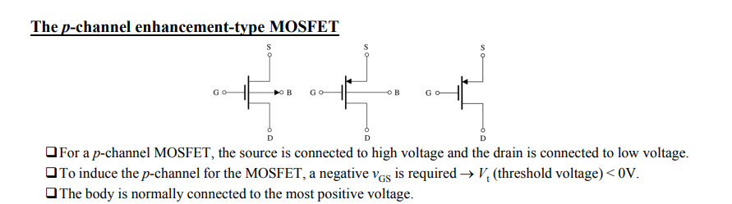
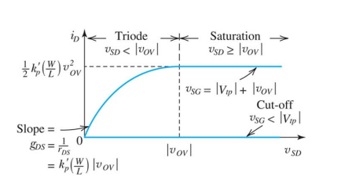

Slide 36

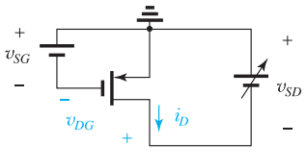
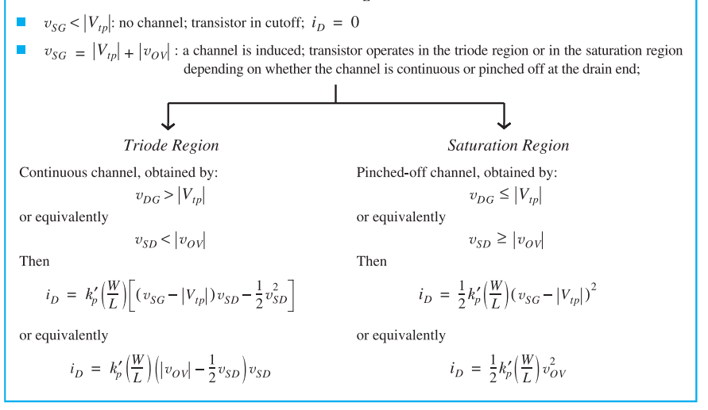

Slide 37
To turn a PMOS transistor on, the gate voltage has to be made lower than that of the source by at least |Vtp| .
To operate in the triode region, the drain voltage has to exceed that of the gate by at least |Vtp| ; otherwise, the PMOS operates in saturation.

Slide 38
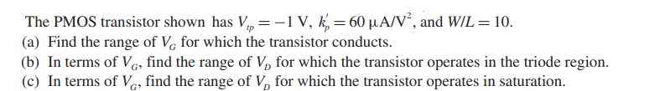
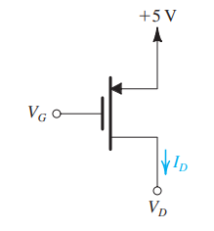
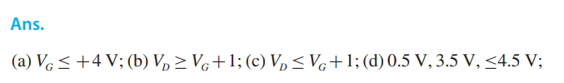
Exercises

Slide 40
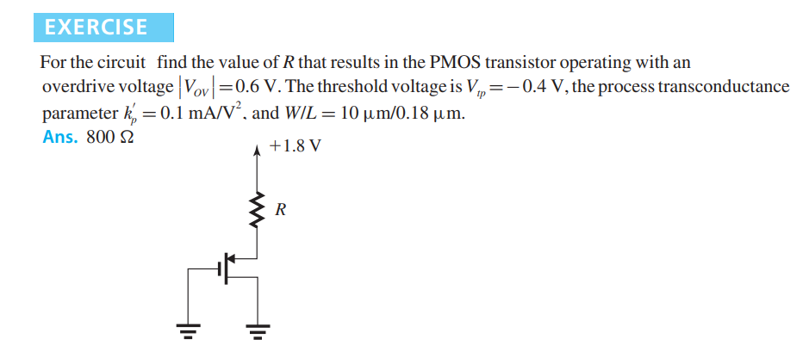

Slide 41
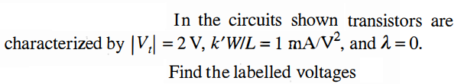
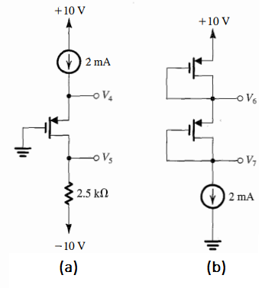

Slide 42
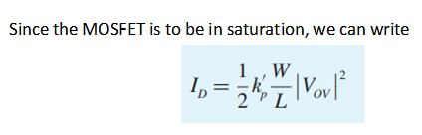


b)

Slide 43


$$V_{DG}=(10kx0.1mA)=1V since I_{G}=0 A$$
|V_{OV} |= 1 V
|V_{OV} |= V_{SG} - |V_{tP} |
So V_{SG} =1V+1V= 2V
Apply KVL, V_{DG} –V_{SG} + V_{SD} = 0 V
V_{SD} = 2V -1V= 1V

Slide 44



Recall that
V_{DG} –V_{SG} + V_{SD} = 0 V. To have
V_{SG} = V_{SD} , V_{DG} = 0 V.
Since V_{DG} = IxR and I$≠$0A then R= 0 Ω
Recall that
V_{DG} –V_{SG} + V_{SD} = 0 V. Put V_{SD}= $\frac{V_{SG}}{2}$
V_{DG} = $\frac{V_{SG}}{2}$ = 1V= 0.1mA xR
R= 10kΩ

Slide 45

Example 5.5:
Design the circuit shown below so that the transistor operates in saturation with ID = 0.5 mA and VD = +3 V. Let the PMOS transistor have Vtp = −1 V and kp(W/L) = 1 mA/V2 . Assume λ = 0. What is the largest value that RD can have while maintaining saturation-region operation?

Slide 46






Solution 5.5:
Since the MOSFET is to be in saturation, we can write
Saturation-mode operation will be maintained up to the point that V_{D} exceeds V_{G} by |Vt|; that is, until
This value of drain voltage is obtained with R_{D} given by

Slide 47



Example 5.6:
The NMOS and PMOS transistors in the circuit below are matched., Assuming λ=0 for both devices, find the drain currents i_{DN} and i_{DP}, as well as the voltage v_{O}, for v_{I} = 0 V, +2.5 V, and −2.5 V.

Slide 48


Solution 5.6:
We note that since Q_{N} and Q_{P} are perfectly matched and are operating at equal values of |V_{GS}| = 2.5 V, the circuit is symmetrical, which dictates that v_{O} = 0 V. Thus both Q_{N} and Q_{P} are operating with |V_{DG}| = 0 and, hence, in saturation. The drain currents can now be found from

Slide 49


Next, we consider the circuit with v_{I} = +2.5 V. Transistor Q_{P} will have a V_{SG} of zero and thus will be cut off, reducing the circuit to that shown below. We note that v_{O} will be negative, and thus v_{GD} will be greater than Vtn, causing Q_{N} to operate in the triode region. For simplicity we shall assume that v_{DS} is small and thus use
From the circuit diagram shown

Slide 50



Slide 51

The situation for the case v_{I} = −2.5 V
It will be the exact complement of the case v_{I} = +2.5 V: Transistor Q_{N} will be off. Thus I_{DN} = 0, Q_{P} will be operating in the triode region with I_{DP} = 0.244 mA and v_{O} = +2.44 V.

Slide 52



Notes:
sedr42021_e0412.jpg

Slide 53


Notes:
sedr42021_0422.jpg

Slide 54

Notes:
sedr42021_0423a.jpg

Slide 55




Notes:
sedr42021_0424.jpg

Slide 56





Slide 57

Since VOV = 0.2 V and VDS = 0.4 V, we see that the maximum allowable negative signal swing at the drain is 0.2 V. Thus the maximum symmetrical signal swing allowable at the drain is ± 0.2 V

Slide 58

Notes:
sedr42021_0425a.jpg

Slide 59


Figure (a) Basic structure of the common-source amplifier. (b) Graphical construction to determine the transfer characteristic of the amplifier in (a).
Notes:
sedr42021_0426a.jpg

Slide 60

Figure (Continued) (c) Transfer characteristic showing operation as an amplifier biased at point Q.
Notes:
sedr42021_0426c.jpg

Slide 61


Example 5.5:
(a) Find the quiescent operating point Q-point (ID, VDS) for the MOSFET in the fixed gate bias circuit below. Neglect channel-length modulation.

Slide 62





Solution 5.5:
Unknowns:
I_{D} , V_{DS} , and V_{GS}

Slide 63

We have V_{DS} = 5 V and V_{GS} − V_{T} = 2 V. Since V_{DS} exceeds V_{GS} − V_{T} , the transistor is indeed pinched-off and in the saturation region
Thus, the Q-point is (50.0 uA, 5.00 V) with VGS = 3V

Slide 64


Example 5.6:
Find the Q-point = (I_{D}, V_{DS}) for the MOSFET in the four resistor bias circuit shown below.
Solution 5.6:
The first step in our Q-point analysis of the equivalent circuit above is to assume that the MOSFET transistor is saturated

Slide 65






Slide 66


4= V_{GS} +
$$\frac{26μx39k}{2}{\text{(}V_{GS}−1)}^{2}$$
8.2=2V_{GS} +(V_{GS}-1)²
V_{GS} = 2.68V
V_{EQ} = V_{GS} + I_{D} R_{S}
I_{D} = $\frac{4V−2.68V}{39k}$ =34 uA
V_{DS} = 10V − [34uA x(75 k+ 39 k)] = 6.12 V
The saturation region assumption is consistent with the resulting Q-point: (34uA, 6.12 V) with V_{GS} = 2.68 V.

Slide 67






Slide 68



Slide 69


Notes:
sedr42021_0435.jpg

Slide 70


Slide 71



Notes:
sedr42021_0438a.jpg

Slide 72



Slide 73


Slide 74



Notes:
sedr42021_0434.jpg

Slide 75


Example 5.7:
Notes:
sedr42021_0436.jpg

Slide 76











Solution 5.7:
$$R_{s}=\frac{3.5V}{0.5mA}=7kΩ$$
$R_{D}$ =$\frac{15V−6V}{0.5mA}=18 kΩ$
It works in saturation mode. The drain current is
$$V_{GS}=V_{G}−V_{S}$$
$$V_{G}=5V$$
$$\frac{R_{G2}}{R_{G1}+R_{G2} }x15V=5V$$
$${2R}_{G2}=R_{G1}$$
${If R}_{G1}=5MΩ then R_{G2}$= 2.5 MΩ

Slide 77

Example 5.8:
For the CS amplifier of Example 5.7 determine Rin, Ro, and the overall voltage gain Gv where Rsig = 100 kΩ and RL = 20 kΩ.
Solution 5.8:
Notes:
sedr42021_0437a.jpg

Slide 78



Rin = (RG1 || RG2)= 5M||2.5M= 1.67MΩ
Ro=(RD || ro) = (18k || 200k) = 16.5 kΩ
Notes:
sedr42021_0439.jpg

Slide 79


Figure (a) Capacitively coupled common-source amplifier. (b) A sketch of the frequency response of the amplifier in (a) delineating the three frequency bands of interest.
Notes:
sedr42021_0449a.jpg

Slide 80

Practice Problem 5.6
The MOSFET in the common-source amplifier shown has the small-signal parameters
g_{m} = 2 mA/V, r_{o} = 50 kΩ.
Assume that the transistor is properly biased at a point in its saturation region.
(a) Draw the small-signal equivalent circuit of the amplifier.
(b) Find the voltage gain $A_{v}=v_{o}/v_{i}$, and the overall voltage gain $G_{v}=v_{o}/v_{sig}$.

