Slide 1
Semiconductor Electronics
Chapter#2

Slide 2
2.1 Semiconductor physics
Why do metals conduct electricity?
Metals have a large number of weakly bound electrons in what is called their conduction band. When an electric field is applied to a metal, the electrons migrate freely producing a current through the metal. Because of the ease by which large currents can flow in metals, they are called conductors.
Why do insulators not conduct electricity?
In contrast, other materials have atoms with valence electrons that are tightly bound, and when an electric field is applied, the electrons do not move easily. These materials are called insulators and do not normally sustain large electric currents

Slide 3
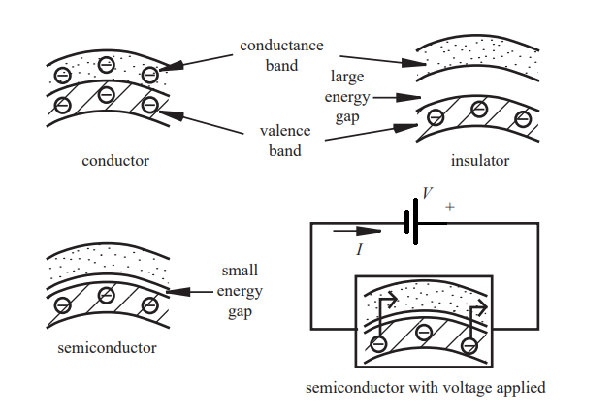
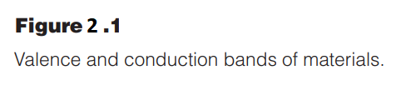
What is a semiconductor material?
In addition, a very useful class of materials, elements in group IV of the periodic table, have properties somewhere between conductors and insulators. They are called semiconductors. Semiconductors such as silicon and germanium have current-carrying characteristics that depend on temperature or the amount of light falling on them.
As illustrated in Figure 2.1 , when a voltage is applied across a semiconductor, some of the valence electrons easily jump to the conductance band and then move in the electric field to produce a current, although smaller than that which would be produced in a conductor.

Slide 4
The properties of pure semiconductor crystals can be significantly changed by inserting small quantities of elements from group III or group V of the periodic table into the crystal lattice of the semiconductor. These elements, known as dopants, can be diffused or implanted into semiconductors.
Properties really get interesting when different amounts and different types of dopants are added to semiconductors.
Silicon or Germanium has four valence electrons that form symmetrical electron bonds in the crystal lattice.
if arsenic or phosphorous from group V is added to the crystal lattice, one of the five valence electrons in each dopant atom remains freer to move around. In this case, the dopant is called a donor element because it enhances the electron conductivity of the semiconductor. The resulting semiconductor is called n-type silicon due to the electrons available in the crystal lattice as charge carriers.
if the silicon is doped with boron or gallium from group III, holes form due to missing electrons in the lattice where the so-called acceptor dopant atoms have replaced silicon atoms. This is because the dopant atom only has three valence electrons. The resulting semiconductor is called p-type silicon due to the holes, which are effectively positive charge carriers

Slide 5
In summary;
The purpose for doping a semiconductor such as silicon or germanium is to elevate and control the number of charge carriers in the semiconductor.
In an n-type semiconductor, the charge carriers are electrons, and in a p-type semiconductor, they are holes. As we will see shortly, the interaction between n-type and p-type semiconductor materials is the basis for most semiconductor electronic devices.

Slide 6
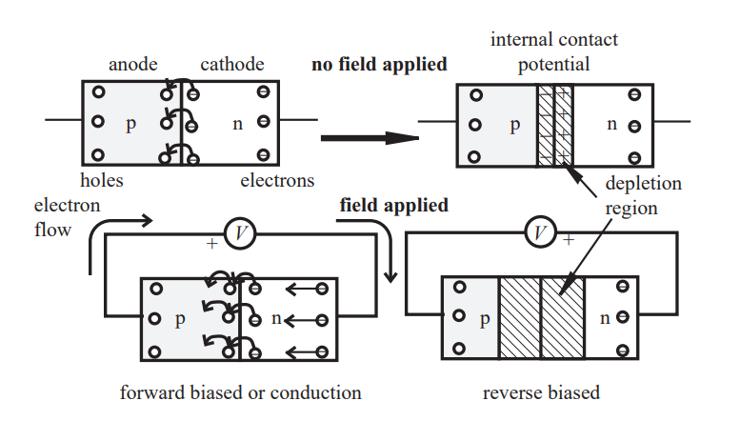

2.2 Diode
If a p-type region of silicon is created adjacent to an n-type region, a pn junction is the result.
The p-type side of the diode is referred to as the anode, and the n-type side is called the cathode
At the pn junction, electrons from the n-type silicon can diffuse to occupy the holes in the p-type silicon, creating what is called a depletion region.

Slide 7
A small electric field develops across this thin depletion region due to the diffusion of electrons. This results in a voltage difference across the depletion region called the contact potential. For silicon, the contact potential is on the order 0.6 V or 0.7 V.
From Figure 2.2 , if a voltage source is connected to the pn junction with the positive side of the voltage source connected to the anode and the negative side connected to the cathode forming a complete circuit, the diode is said to be forward biased.
The applied voltage overcomes the contact potential and shrinks the depletion region. The anode in effect becomes a source of holes and the cathode becomes a source of electrons so that holes and electrons are continuously replenished at the junction. As the applied voltage approaches the value of the contact potential (0.6–0.7 V for silicon), the current increases exponentially

Slide 8
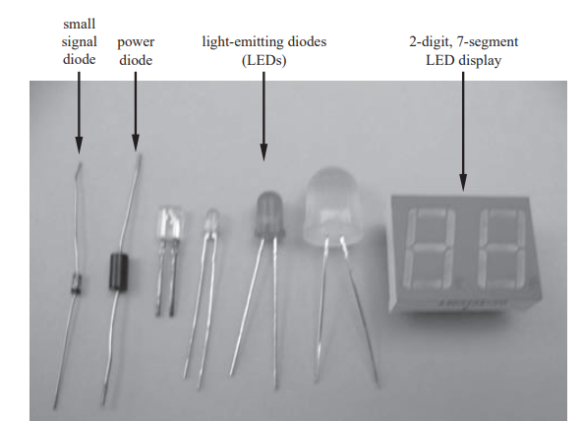
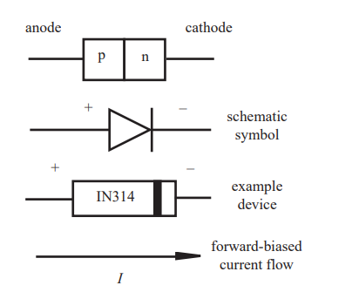

From Figure 3.2 , the anode is connected to the n-type silicon and the cathode to the p-type silicon, the depletion region is enlarged, inhibiting diffusion of electrons and thus current; and we say the junction is reverse biased. In this case current doesw not flow but it is extremely small amount of current flows.
Therefore, a pn junction passes current in only one direction. It is known as a silicon diode and is sometimes referred to as a rectifier. The schematic symbol for the silicon diode is included in Figure 2.3 .

Slide 9
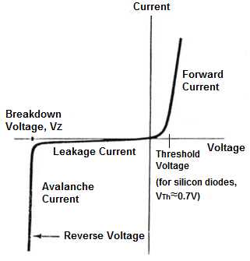
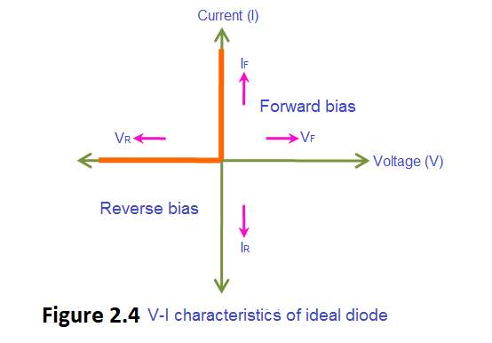
Figure 2.5 V-I characteristics of practical diode
When a real diode is reverse biased, it can withstand a reverse voltage up to a limit known as the breakdown voltage, where the diode will fail. For most diodes the breakdown value is at least 50 V.

Slide 10
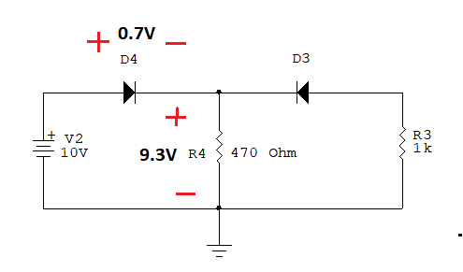
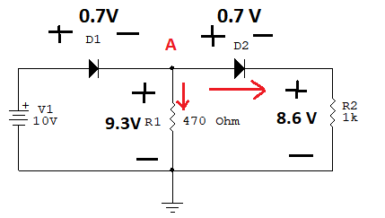






Example:
Calculate current flow through each silicon diode.
(a) (b)
Figure 2.6
Solution:
D1 and D2 are forward biased.
$I_{R1}=\frac{9.3 V}{0.47k}$ = 19.8 mA
$I_{R2}=\frac{8.6V}{1k}$ = 8.6 mA
$$I_{D1}=I_{R1}+I_{R2}$$
D1 forward and D2 are reverse biased.
$$I_{D1}=28.4 mA$$
$I_{R1}=\frac{9.3 V}{0.47k}$ = 19.8 mA
$${= I}_{D1}$$

Slide 11
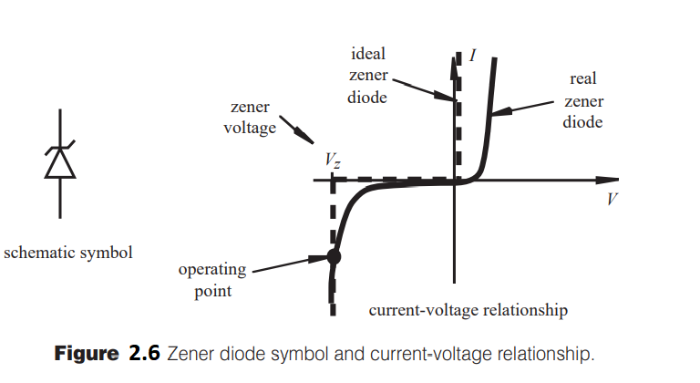
2.3 Zener Diode
A special class of diodes is designed to operate at breakdown region. They are known as zener, avalanche, or voltage-regulator diodes. This family of diodes can maintain a nearly constant voltage over a wide range of currents (see Figure 2.6 ). This characteristic makes them good candidates for building simple voltage regulators, because they can maintain a stable DC voltage in the presence of a variable supply voltage and variable load resistance.
To properly use the zener diode in a circuit, the zener should be reverse biased with a voltage kept in excess of its breakdown or zener voltage Vz .

Slide 12
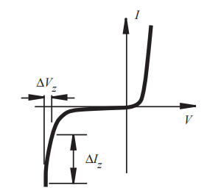
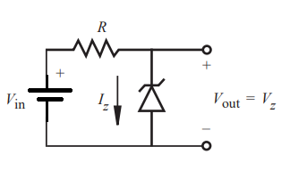

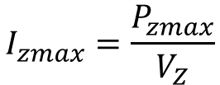

Figure 2.7 Zener diode voltage regulator.
For the circuit shown in Figure 2.7 , the zener current is
To operate properly
$$I_{zmin}≤I_{Z}≤I_{zmax}$$
Izmin: Minimum current and Izmax: maximum current
$$I_{zmax}=\frac{P_{zmax}}{V_{Z}}$$

Slide 13
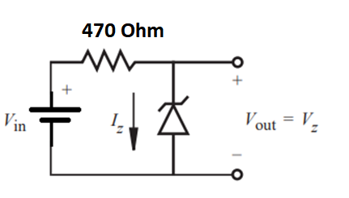

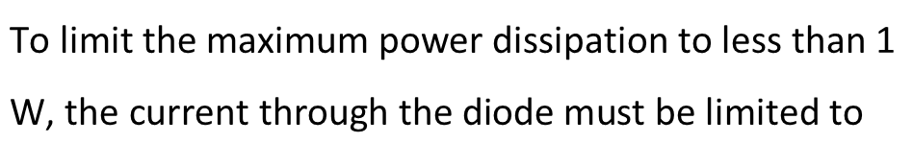





Example:
The maximum power dissipation of a diode is 1 W and It is 15 V. The minimum current is 17 mA.
Find the minimum and maximum input voltage
value of Vin.
Solution:
$$\text{To} \text{limit} \text{the} \text{maximum} \text{power} \text{dissipation} \text{to} \text{less} \text{than}\text{ 1 }\text{W}\text{, }\text{the} \text{current} \text{through} \text{the} \text{diode} \text{must} \text{be} \text{limited} \text{to}$$
$I_{zmax}=\frac{P_{zmax}}{V_{Z}}$= $\frac{1W}{15V}=66.7 mA$
$$V_{in\left(min\right)}$$
= $(17mAx0.47 k$)+ 15 V = 23V
$$V_{in\left(max\right)}$$
= $(66.7mAx0.47 k$)+ 15 V =46.3 V
$$23V≤V_{in}≤46.3V$$

Slide 14
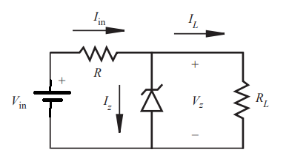





Figure 2.8 illustrates a simple voltage regulator circuit where RL is a load resistance and Vin is an unregulated source whose value exceeds the zener Vz.
The purpose of this circuit is to provide a constant DC voltage Vz across the load with a corresponding constant current through the load. Providing a stable regulated voltage to a system containing digital integrated circuits is a common application.
To operate properly
$$I_{zmin}≤I_{Z}≤I_{zmax}$$

Slide 15
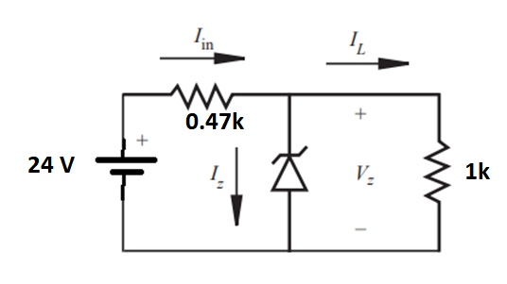



Example:
For the circuit shown below, Zener diode is 9 V. Find the currents
$I_{in}, I_{L}$and $I_{Z}$
Solution:
The Load current is
$$I_{L}= \frac{9V}{1k}=9 mA$$
$$I_{in}= \frac{24V−9V}{0.47 k}=31.9mA$$
The input current is
The current through Zener diode is
$$I_{Z}=31.9 mA −9 mA=22.9 mA$$

Slide 16
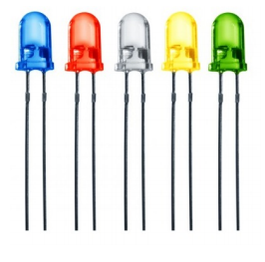
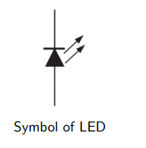
2.4 Optical Diodes
(a) The Light-Emitting Diode (LED)
In the Light Emitting Diodes (LED), if we apply a voltage across a pn junction resulting in a diode current, which in turn can produce photons and a light output of a particular color.

Slide 17
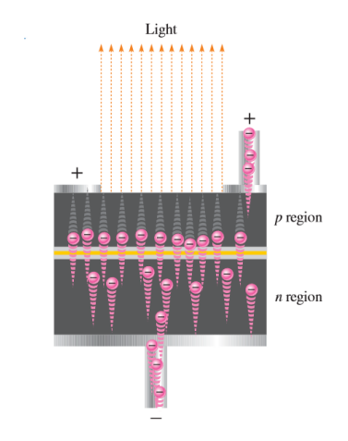
Basic Operation of LEDs
When the device is forward-biased, electrons cross the pn junction from the n-type material and recombine with holes in the p-type material.
These free electrons are in the conduction band and at a higher energy than the holes in the valence band.
When recombination takes place, the recombining electrons release energy in the form of photons.
The emitted light tends to be monochromatic (one color) that depends on the band gap (and other factors).
The material used in the LED fabrication is called (direct-bandgap materials) such as GaAs (Gallium arsenide).

Slide 18
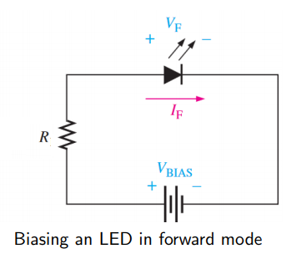
Biasing the LED:
The forward voltage across an LED is typically between 1.2 V and 3.2 V, depending on the material.
The reverse breakdown voltage for an LED is much less than for a silicon rectifier diode (3 V to 10 V).
The LED emits light if a sufficient forward current IF is passed through the LED circuit.
An increase in IF corresponds proportionally to an increase in light output.
LED currents should be less than the optimum allowed for the LED. The maximum current for the standard 5mm diameter LEDs is typically 20mA

Slide 19
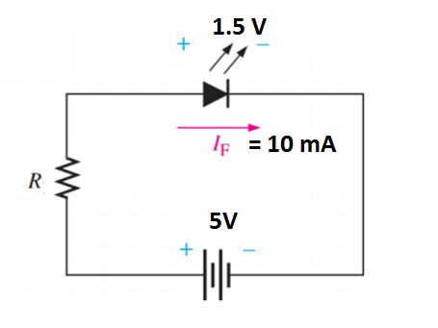
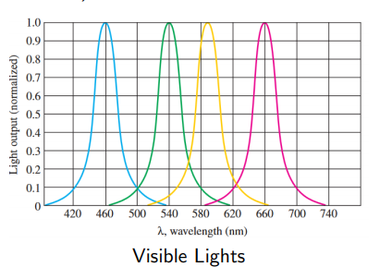
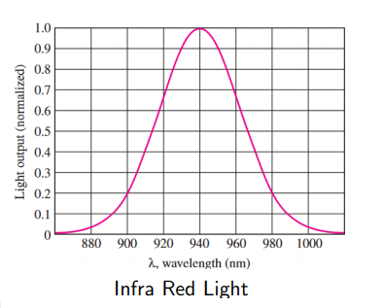

Example:
If Red LED is used and biasing current is 10 mA, find the value of current limiting resistance R? Vred = 1.5 V
Solution:
$R= \frac{5V−1.5V}{10mA}$= 350 $Ω$
An LED emits light over a specified range of wavelengths. The color of the output light depends on the material used in fabrication the LED. The output light may be visible (red, blue, . . . etc) or may be invisible (Infra Red LED)

Slide 20
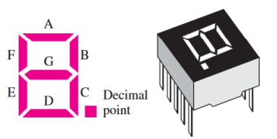
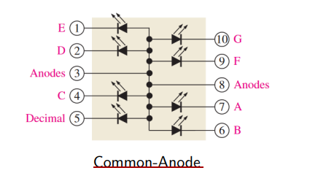
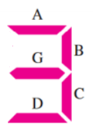
Seven-Segments Displays
Combinations of LEDs form light segments with the ten decimal digits. By forward-biasing selected combinations of segments, any decimal digit and a decimal point can be formed.
A B C D E F G
0V 0V 0V 0V 5V 5V 0V

Slide 21
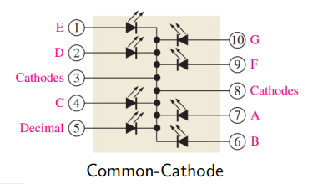
A B C D E F G
5V 5V 5V 5V 0V 0V 0V
TV/DVD Remote Control Unit:
One common application of an infrared LED is in remote control units for TV and DVD.
The IR LED sends out a beam of invisible light that is sensed by the receiver in your TV, for example.
For each button on the remote control unit, there is a unique code.
When a specific button is pressed, a coded electrical signal is generated that goes to the LED, which converts the electrical signal to a coded infrared light signal.
The TV receiver recognizes the code and takes appropriate action, such as changing the channel or increasing the volume.

Slide 22
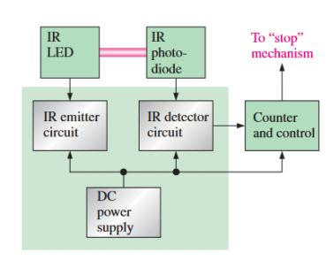
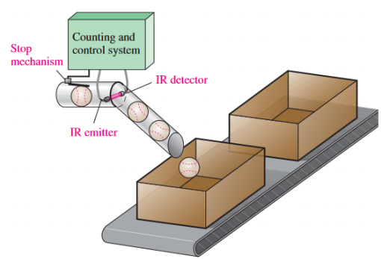
Industrial Applications:
In counting objects to be packaged

Slide 23
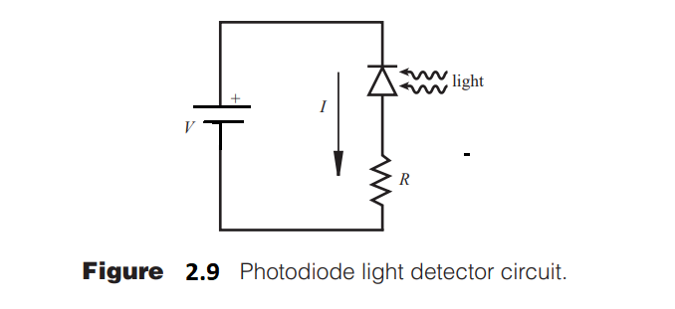
Earlier we said that a pn junction is sensitive to light. Special diodes, called photodiodes, are designed to detect photons and can be used in circuits to sense light as shown in Figure 2.9 . Note that it is the reverse current that flows through the diode when sensing light. It takes a considerable number of photons to provide detectable voltages with these devices.
The photodiode is based on quantum effects. If photons excite carriers in a reverse-biased pn junction, a very small current proportional to the light intensity flows. The sensitivity depends on the wavelength of the light.

Slide 24
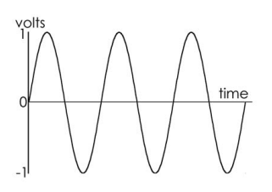
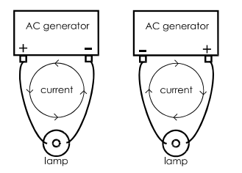
2.5 Diode Rectification and Power Supply Design
The current that we get from some kinds of generator (including mains generators) is different from this. It repeatedly changes its direction. This kind of current is called alternating current. This name is often shortened to AC. The voltage at one terminal of a typical AC generator is shown in this graph:
At one instant, the terminal is 1 V positive of the other. Then the voltage decreases until it is 1 V negative of the other terminal. Then it swings back again to become 1 V positive. This cycle is repeated indefinitely. The effect of this reversing voltage on the current in a circuit is shown.

Slide 25
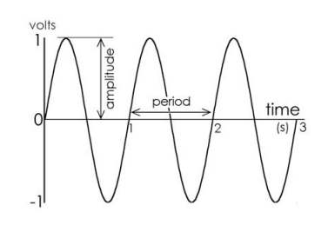
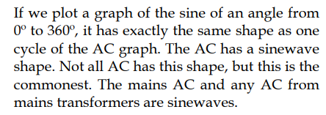
As the voltages at the terminals swing from positive to negative and back, the current repeatedly changes its direction. It is alternating current.
To describe an alternating current we need to state three things: • Amplitude: its maximum size, in amps. • Period: the time for one complete cycle from positive back to positive again.
The AC plotted above has an amplitude A = 1 V. It has a period T = 1 s.

Slide 26
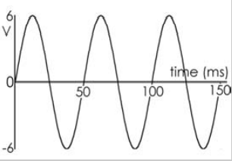
The unit of frequency is the hertz. Its symbol is Hz. The hertz is defined as a frequency of one cycle per second. The AC waveform shown in the graph has a frequency of 1 cycle per second, or 1 Hz. If the period of a waveform is T seconds, there are 1/T cycles in one second. Its frequency (f) is f = 1/T Hz
Self test
1. The frequency of the mains is 50 Hz. What is its period?
2. A musical note has a period of 3.9 ms. What is its frequency?
3. The ‘bleep’ of a microwave oven has a frequency of 1000 Hz. What is its period?
3. Describe this waveform

Slide 27
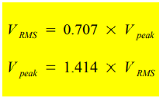
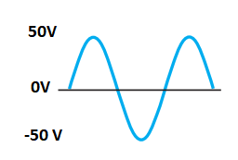
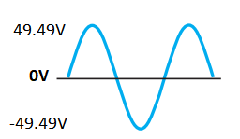
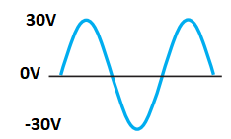
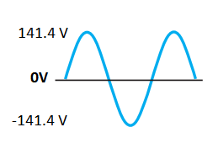




We have just uncovered two very useful expressions, which can help us easily convert from an AC RMS voltage to the peak voltage, and from the peak value of an AC voltage to AC RMS volts.
$$V_{rms}=0.707x50 V=35.35 V$$
$V_{rms}=35$V
$$V_{rms}=0.707x30 V=21.21 V$$
$V_{rms}=$100V

Slide 28
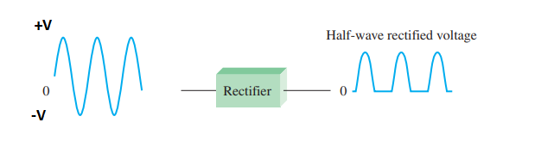

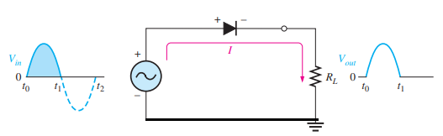
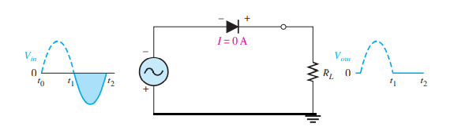

HALF-WAVE RECTIFIERS
The rectifier converts the ac input voltage to a pulsating dc voltage, called a half-wave rectified voltage

Slide 29
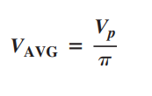
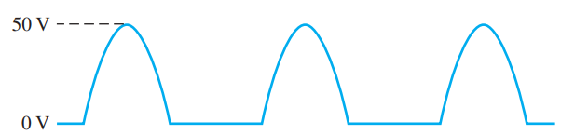
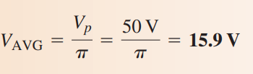
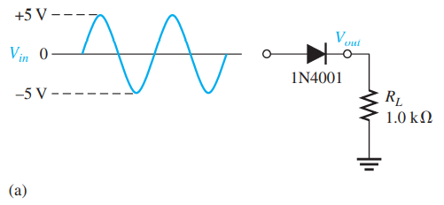

The average value of the half-wave rectified output voltage is the value you would measure on a dc voltmeter. Theoretically it is given by

Slide 30
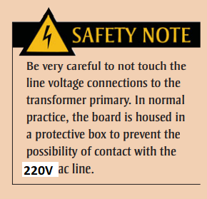








Transformer coupling provides two advantages. First, it allows the source voltage to be stepped down as needed. Second, the ac source is electrically isolated from the rectifier, thus preventing a shock hazard in the secondary circuit

Slide 31





Example:
Determine the peak value and average value of the output voltage
Solution:

Slide 32




FULL-WAVE RECTIFIERS
A full-wave rectifier allows unidirectional (one-way) current through the load during the entire ${360}^{0}$ of the input cycle, whereas a half-wave rectifier allows current through the load only during one-half of the cycle.
The result of full-wave rectification is an output voltage with a frequency twice the input frequency and that pulsates every half-cycle of the input, as shown below.
The average value, which is the value measured on a dc voltmeter, for a full-wave rectified sinusoidal voltage is twice that of the half-wave, as shown in the following formula

Slide 33



Bridge Full-Wave Rectifier Operation
The bridge rectifier uses four diodes connected as shown below.

Slide 34






Slide 35




Example:
Sketch the output voltage and determine the avarege voltage for the given circuit below.
Solution:
The seconder rms voltage is
$$V_{Sec rms}= \frac{220 Vrms}{20}= 11 Vrms$$
The output peak voltage is
$V_{out}=\left( \sqrt{2} x11 Vrms −1.4 V \right)=$14.15 V
14.15 V
$$V_{AVG }= \frac{2x 14.15 V}{π}=9 V$$

Slide 36





Capacitor-Input Filter
The filter is simply a capacitor connected from the rectifier output to ground. RL represents the equivalent resistance of a load
$$V_{C}=\left(\sqrt{2} x V_{\sec{rms}}−1.4\right)V$$

Slide 37






Example:
a) Sketch the output voltage voltage for the given circuit below with w/out C and then with C.
b) Detremine the current flow through 450 Ω resistor for the circuit.
Solution:
a)
The seconder rms voltage is
$$V_{Sec rms}= \frac{230 Vrms}{18}= 12. 78 Vrms$$
The output peak voltage w/out C is
$V_{out}=\left( \sqrt{2} x12.78 Vrms −1.4 V \right)=$16.67 V
16.67 V

Slide 38



b)
$I_{Load}= \frac{16.67 V}{450 Ω}$= 37 mA

Slide 39



Integrated Circuit Voltage Regulators
Although many types of IC regulators are available, the 78XX series of IC regulators is representative of three-terminal devices that provide a fixed positive output voltage. The three terminals are input, output, and ground as indicated in the standard fixed voltage configuration in Figure 2.10
Figure 2.10

Slide 40


The 79XX series is typical of three-terminal IC regulators that provide a fixed negative output voltage. This series is the negative-voltage counterpart of the 78XX series and shares most of the same features and characteristics except the pin numbers are different than the positive regulators. Figure 2–11 indicates the standard configuration and part numbers with corresponding output voltages that are available
Figure 2–11

Slide 41



