Slide 1
The Operatioanal Amplifier
Chapter#4

Slide 2
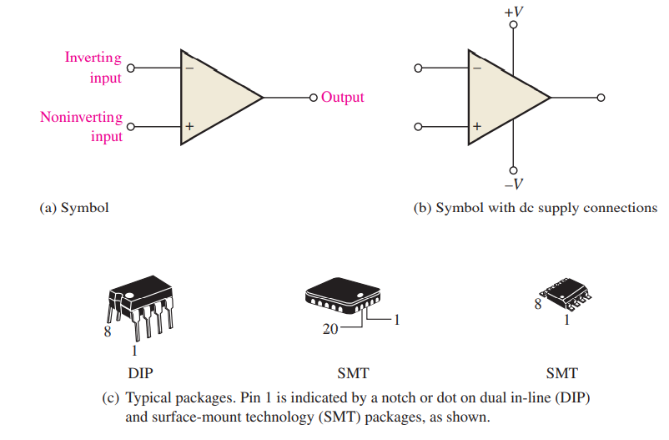
4.1 Introduction
The standard operational amplifier (op-amp) symbol is shown in Figure 4.1(a). It has two input terminals, the inverting (-) input and the noninverting (+) input, and one output terminal. Most op-amps operate with two dc supply voltages, one positive and the other negative, as shown in Figure 4.1(b), although some have a single dc supply. Usually these dc voltage terminals are left off the schematic symbol for simplicity but are understood to be there. Some typical op-amp IC packages are shown in Figure 4.1(c)
Figure 4.1

Slide 3
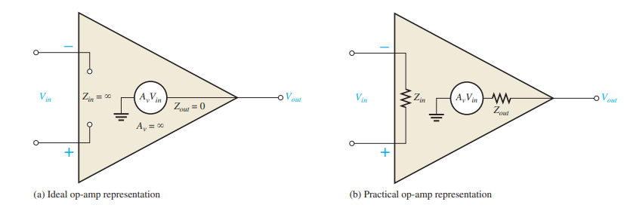
To illustrate what an op-amp is, let’s consider its ideal characteristics. A practical op-amp, of course, falls short of these ideal standards, but it is much easier to understand and analyze the device from an ideal point of view. First, the ideal op-amp has infinite voltage gain and infinite bandwidth. Also, it has an infinite input impedance (open) so that it does not load the driving source. Finally, it has a zero output impedance.
Characteristics of a practical op-amp are very high voltage gain, very high input impedance, and very low output impedanc
Figure 4.2 Basic op-amp representations

Slide 4
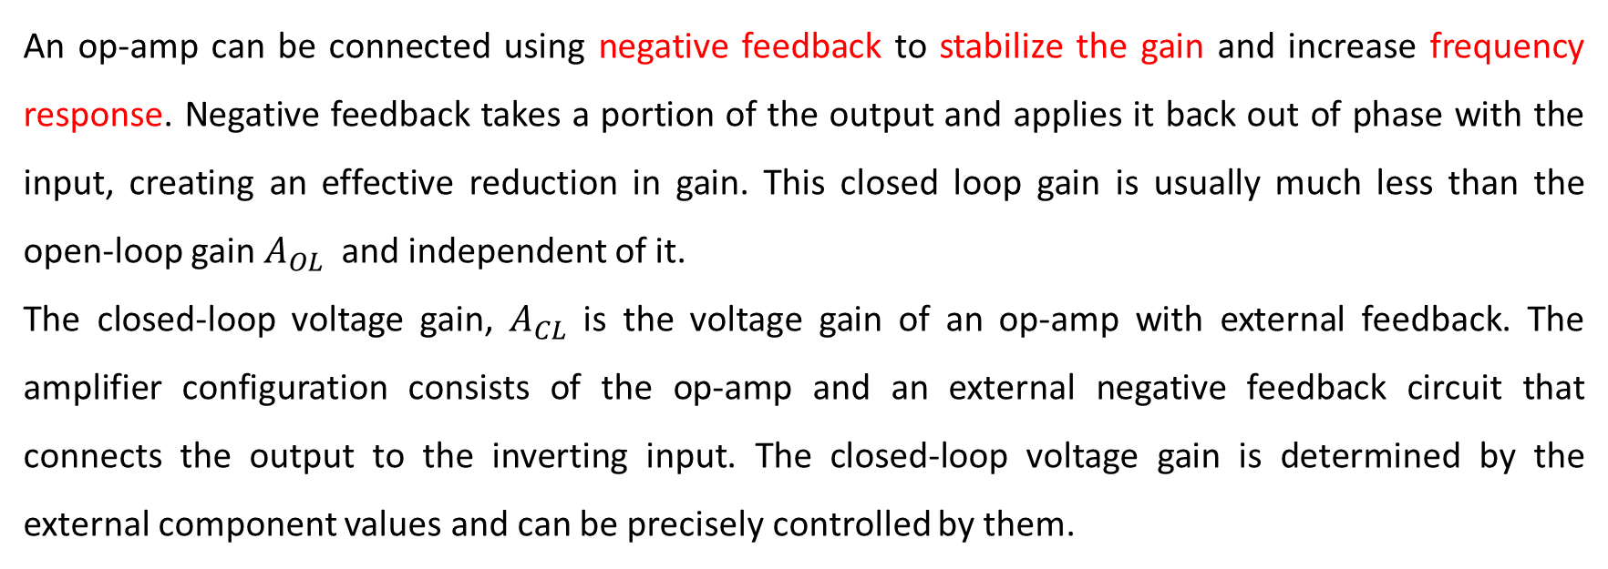
An op-amp can be connected using negative feedback to stabilize the gain and increase frequency response. Negative feedback takes a portion of the output and applies it back out of phase with the input, creating an effective reduction in gain. This closed loop gain is usually much less than the open-loop gain $A_{OL}$ and independent of it.
The closed-loop voltage gain, $A_{CL}$ is the voltage gain of an op-amp with external feedback. The amplifier configuration consists of the op-amp and an external negative feedback circuit that connects the output to the inverting input. The closed-loop voltage gain is determined by the external component values and can be precisely controlled by them.

Slide 5
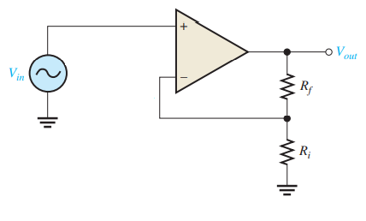
4.2 Op-amp as an amplifier
(i) Noninverting Amplifier
The input signal is applied to the noninverting (+) input. The output is applied back to the inverting input through the feedback circuit. The following circuit is known as noninverting amplifier because it does not make any phase or polarity inversion between the input and output. The closed loop gain is given by

Slide 6
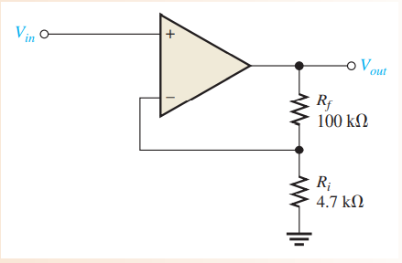
Example:
Determine the closed-loop voltage gain of the amplifier. If Vin is 0.1 V DC what is Vout?
Solution:
This is a noninverting op-amp configuration. Therefore, the closed-loop voltage gain is
Since
$$A_{CL }= \frac{V_{OUT}}{V_{in}}=22.3$$
$$V_{out}=22.3 x 0.1 V=2.23 V$$

Slide 7
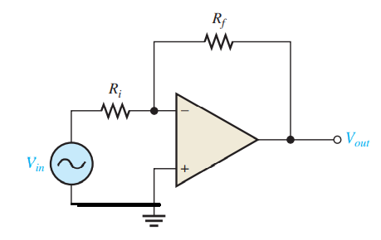
(ii) Inverting Amplifier
An op-amp connected as an inverting amplifier with a controlled amount of voltage gain is shown below. The input signal is applied through a series input resistor Ri to the inverting input. Also, the output is fed back through Rf to the same input. The noninverting (+) input is grounded.
The following circuit is known as inverting amplifier because it provides phase or polarity inversion between the input and output. This is shown by the negative sign at the closed loop gain equation.
The closed loop gain is given by

Slide 8
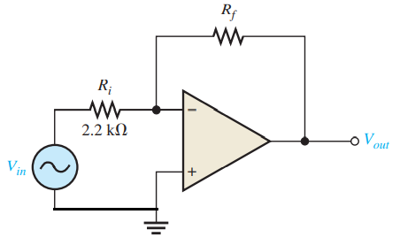
Example:
Given the op-amp configuration in figure below, determine the value of Rf required to produce a closed-loop voltage gain of -100
Solution:
Knowing that $R_{i}=2.2 kΩ$ the closed-loop gain is -100 and calculate Rf as follows
$$−100=− \frac{R_{f}}{2.2 kΩ}$$
$R_{f}$ = 100 x 2.2 kΩ = 220 kΩ

Slide 9
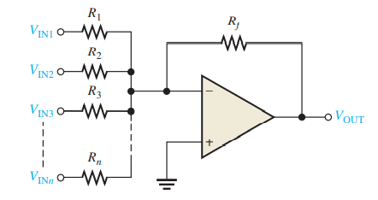
(iii) Summing Amplifier
A summing amplifier has two or more inputs, and its output voltage is proportional to the negative of the algebraic sum of its input voltages.

Slide 10
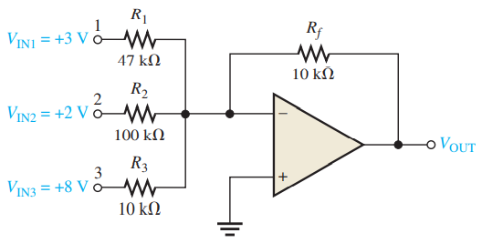
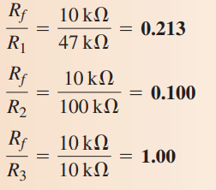
Example:
Given the op-amp configuration in figure below, determine the value of $V_{out}$
Solution:

Slide 11
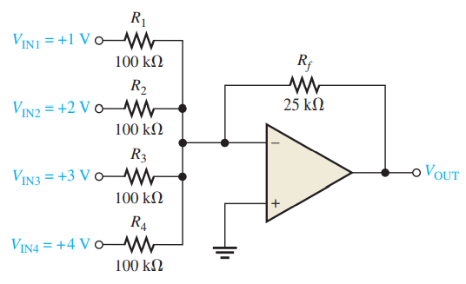
Example:
Show that the amplifier below produces an output whose magnitude is the mathematical average of the input voltages.
Solution:

Slide 12
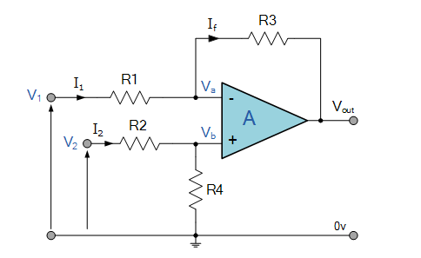
(iv) The Differential Amplifier
The differential amplifier amplifies the voltage difference present on its inverting and non-inverting inputs.
If R1 = R2 = R3 = R4 then the output voltage is
Vout = V₂ – V₁

Slide 13
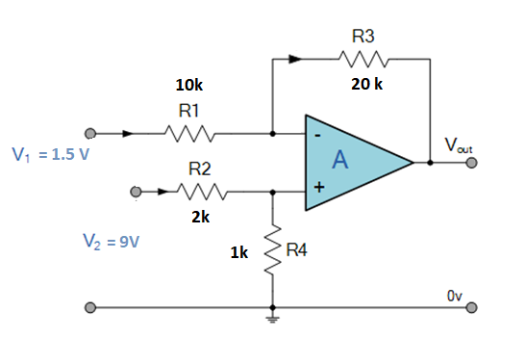
Example:
Given the op-amp configuration in figure below, determine the value of $V_{out}$.
Solution:
When V1= 0 V,
$V_{out1}= \frac{1k}{1k+2k} x \left(1+\frac{20k}{10k}\right)x 9 V=9 V$
When V2= 0 V,
$V_{out2}=− 1.5 Vx \left(\frac{20k}{10k}\right)=−3 V$
$V_{out}= V_{out1}$+$V_{out2}=9V−3V=6 V$

Slide 14
4.3 Op-amp as a comparator
The Op-amp comparator compares one analogue voltage level with another analogue voltage level, or some preset reference voltage, V_{REF} and produces an output signal based on this voltage comparison. In other words, the op-amp voltage comparator compares the magnitudes of two voltage inputs and determines which is the largest of the two.
Voltage comparators , either use positive feedback or no feedback at all (open-loop mode) to switch its output between two saturated states, because in the open-loop mode the amplifiers voltage gain is basically equal to A_{OL}. Then due to this high open loop gain, the output from the comparator swings either fully to its positive supply rail, +Vcc or fully to its negative supply rail, -Vcc on the application of varying input signal which passes some preset threshold value.

Slide 15
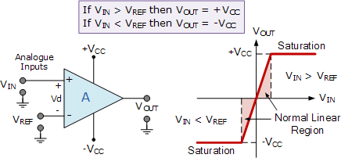
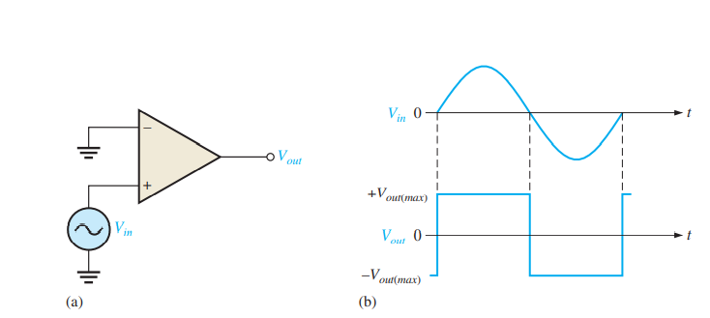
Op-amp Comparator Circuit

Slide 16
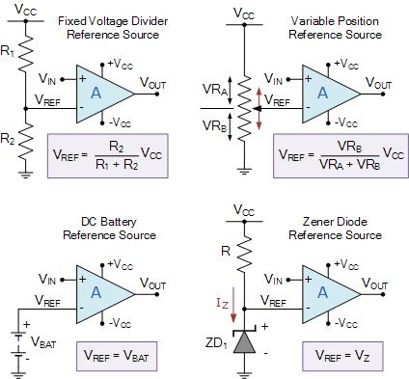
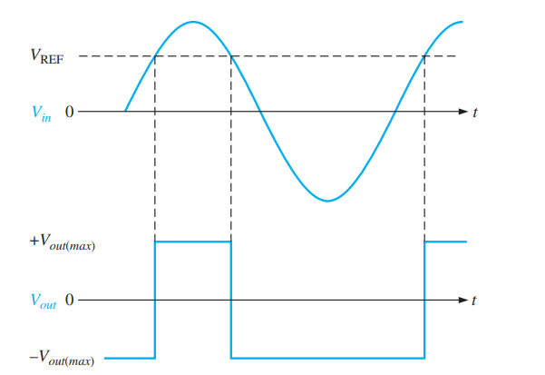
Comparator Reference Voltages

Slide 17
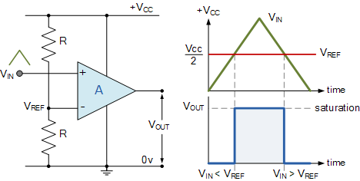
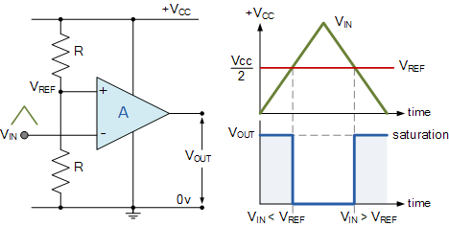

Slide 18
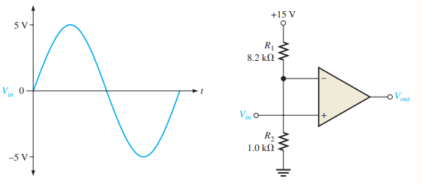
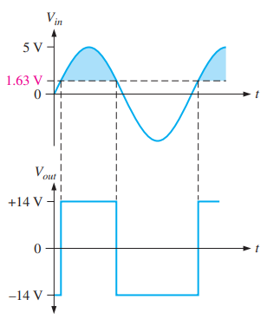
Example:
The input signal below is applied to the comparator circuit. Draw the output showing its proper relationship to the input signal. Assume the maximum output levels of the comparator are $±$14 V
Solution:

Slide 19
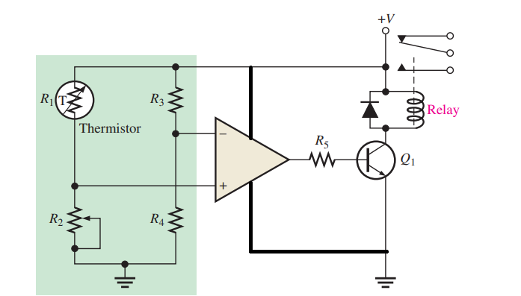

Slide 20
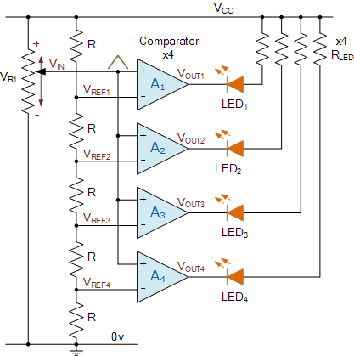
Comparator Voltage Level Detector

Slide 21
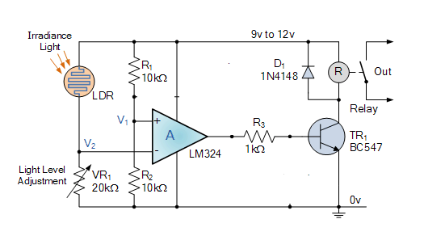
Light Activated Circuit
Here the circuit above acts as a light-activated switch which turns the output relay either “ON” or “OFF” as the light level detected by the LDR resistor exceeds or falls below some pre-set value

