Slide 1
Actuators
Chapter#6

Slide 2
6.1 Introduction
Most mechatronic systems involve motion or action. This motion or action can be applied to anything from a single atom to a large articulated structure. It is created by a force or torque that results in acceleration and displacement. Actuators are the devices used to produce this motion or action.
Actuators produce physical changes such as linear and angular displacement. They also modulate the rate and power associated with these changes. An important aspect of mechatronic system design is selecting the appropriate type of actuator.
Many actuators rely on electromagnetic forces to create their action. When a current carrying conductor is moved in a magnetic field, a force is produced in a direction perpendicular to the current and magnetic field directions. Lorentz’s force law, which relates force on a conductor to the current in the conductor and the external magnetic field, in vector form is

Slide 3
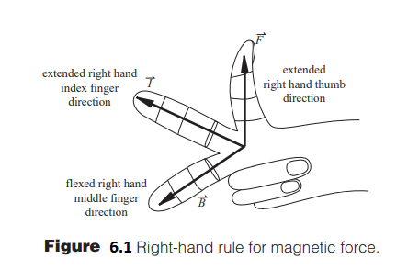
where F is the force vector (per unit length of conductor), I is the current vector, and B is the magnetic field vector. Figure 6.1 illustrates the relationship between these vectors and indicates the right-hand rule analogy, which states that if your right-hand index finger points in the direction of the current and your middle finger is aligned with the field direction, then your extended thumb (perpendicular to the index and middle fingers) will point in the direction of the force

Slide 4
6.2 Selonoid and Relay
An electromechanical relay is a type of actuator that mechanically switches electric circuits. Relays play an important role in many motor control systems. In addition to providing control logic by switching multiple control circuits, they are also used for controlling low-current pilot loads such as contactor and starter coils, pilot lights, and audible alarms.
Figure 6.2 shows a typical electromechanical control relay. This relay consists of a coil, wound on an iron core, to form an electromagnet. When the coil is energized by a control signal, the core becomes magnetized and sets up a magnetic field that attracts the iron arm of the armature to it. As a result, the contacts on the armature close. When the current to the coil is switched off, the armature is spring-returned to its normal de-energized position and the contacts on the armature open.

Slide 5
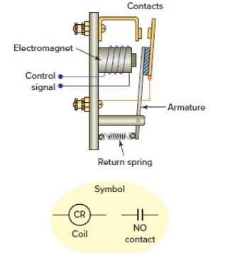
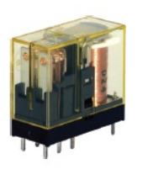
A small voltage input to the solenoid controls a potentially large current through the relay contacts. Applications include power switches and electromechanical control elements. A relay performs a function similar to a power transistor switch circuit but has the capability to switch much larger currents.
Relays, because they create a mechanical connection and don’t require voltage biasing, can be used to switch either DC or AC power.

Slide 6
Also, the input circuit of a relay is electrically isolated from the output circuit, unlike the common-emitter transistor circuit, where there is a common ground between the input and output.
Because the relay is electrically isolated, noise, induced voltages, and ground faults occurring in the output circuit have minimal impact on the input circuit. One disadvantage of relays is that they have slower switching times than transistors. And because they contain contacts and mechanical components, they wear out much faster.

Slide 7
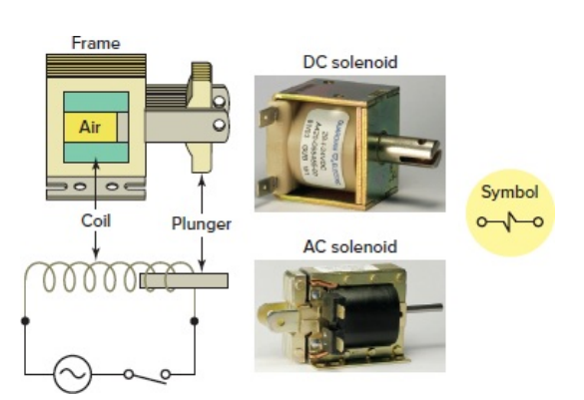
An electromechanical solenoid is a device that uses electrical energy to magnetically cause mechanical control action. A solenoid consists of a coil, frame, and plunger (or armature, as it is sometimes called). Figure 6.3 shows the basic construction and operation of a solenoid. The coil and frame form the fixed part. When the coil is energized, it produces a magnetic field that attracts the plunger, pulling it into the frame and thus creating mechanical motion. When the coil is de-energized, the plunger returns to its normal position through gravity or assistance from spring assemblies within the solenoid. The frame and plunger of an AC operated solenoid are constructed with laminated pieces instead of a solid piece of iron to limit eddy currents induced by the magnetic field.

Slide 8
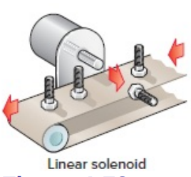
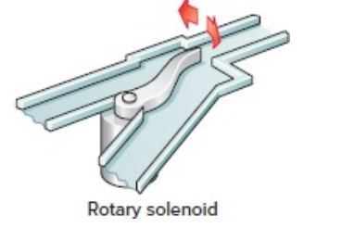
There are two main categories of solenoids: linear and rotary. The direction of movement, either rotary or linear, is based on the mechanical assembly within which the electromagnetic circuit is encased. Rotary solenoids incorporate a mechanical design that converts linear motion to rotary motion. Linear solenoids are usually classified as pull or push motion. Figure 6.4 illustrates common applications for linear and rotary solenoids. The linear solenoid application shown is used in part rejection processes in which electronic interfacing with a sensor produces an actuation signal to the solenoid. In the rotary solenoid application, the solenoid is used in a sorting conveyor to control a diverter gate
Figure 6.4

Slide 9
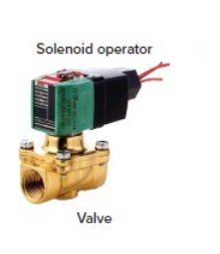
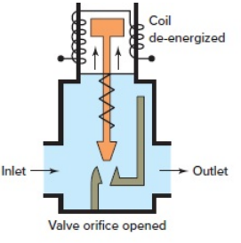
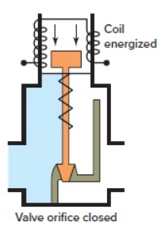
Solenoid valves are electromechanical devices that work by passing an electrical current through a solenoid, thereby changing the state of the valve. Normally, there is a mechanical element, which is often a spring, that holds the valve in its default position. A solenoid valve is a combination of a solenoid coil operator and valve, which controls the flow of liquids, gases, steam, and other media. When electrically energized, they either open, shut off, or direct the flow of media.
Figure 6.5 Solenoid valve.

Slide 10
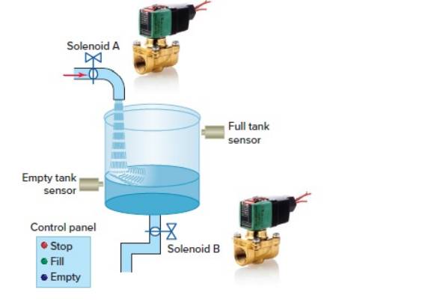
The main difference between Relay and Solenoid is, Relay is a switching device that switches or routs the electrical current or signal whereas the solenoid is an electromagnetic actuating device that pushes or pulls a shaft or any metallic arrangement.
Figure 6.6 Solenoid-operated tank filling and emptying operation

Slide 11
6.3 DC Motor and Control
The DC Motor is the motor which converts the direct current into the mechanical work. It works on the principle of Lorentz Law, which states that the current carrying conductor placed in a magnetic and electric field experience a force.
DC motor speeds can be smoothly controlled and in most cases are reversible. Since DC motors have a high ratio of torque to rotor inertia, they can respond quickly.
DC motors are classified into four categories: permanent magnet, shunt wound, series wound, and compound wound.
The permanent magnet (PM) motors are provided by permanent magnets, which require no external power source and therefore produce no $I^{2}$ R heating. A PM motor is lighter and smaller than other, equivalent DC motors because the field strength of permanent magnets is high.

Slide 12
PM motors are easily reversed by switching the direction of the applied voltage, because the current and field change direction only in the rotor. The PM motor is ideal in control applications because of the linearity of its torque-speed relation. The design of a controller is always easier when the actuator is linear since the system analysis is greatly simplified. When a motor is used in a position or speed control application with sensor feedback to a controller, it is referred to as a servomotor. PM motors are used only in low-power applications since their rated power is usually limited to 5 hp (3728 W) or less. PM DC motors can be brushed, brushless, or stepper motors.
The DC motor speed in general is directly proportional to the supply voltage, so if reduce the voltage from 9 volts to 4.5 volts then our speed become half of what it originally had. But in practice, for changing the speed of a DC motor we cannot go on changing the supply voltage all the time. The speed controller Pulse Width Modulation (PWM) for a DC motor works by varying the average voltage supplied to the motor.

Slide 13
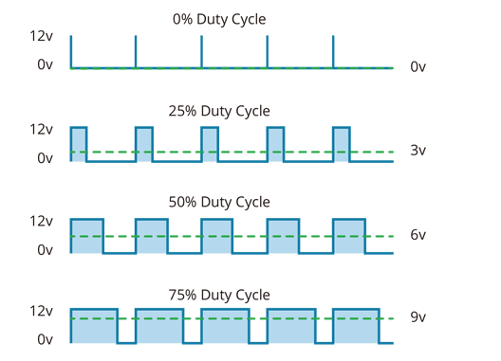
The principle of a PWM amplifier is shown in Figure 6.7 . A DC power supply voltage is rapidly switched at a fixed frequency f between two values (e.g., ON and OFF). This frequency is often in excess of 1 kHz.
The resulting asymmetric waveform has a duty cycle defined as the ratio between the ON time and the period of the waveform, usually specified as a percentage:
where T is the perion and t is the ON time duration

Slide 14
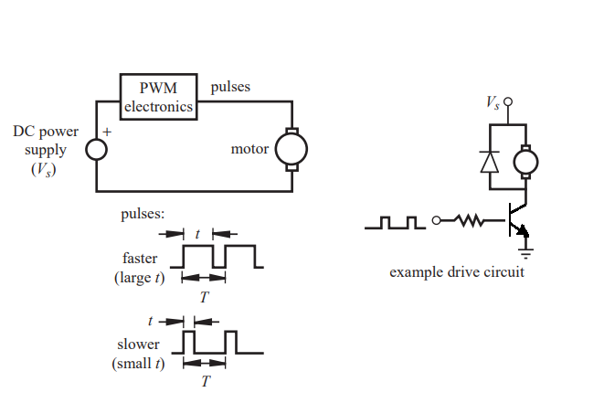
As the duty cycle is changed (by the controller), the average current through the motor changes, causing changes in speed and torque at the output. It is primarily the duty cycle, and not the value of the power supply voltage, that is used to control the speed of the motor.

Slide 15
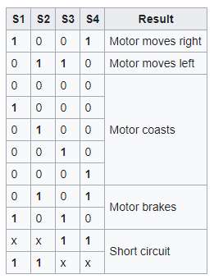
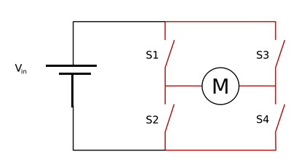
To control the direction of rotation of a DC Motor, the direction of current supplied to the motor must be reversible. This requires a current amplifier and some means to switch the current direction. The concept of an H-bridge meets these requirements. It uses four switches (relays or transistors) arranged in an H configuration around the DC motor (see the Figure 6.8). The switches are turned on one pair at a time for the desired direction of motion.
Figure 6.8

Slide 16
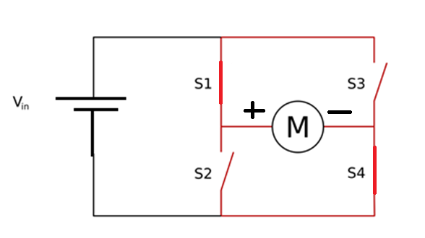
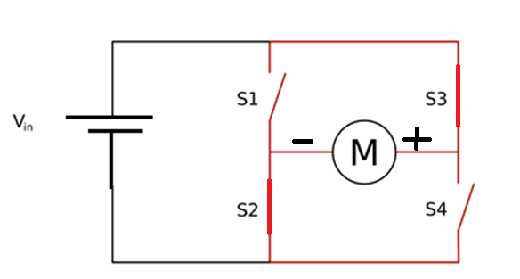
An H-bridge is built with four switches (solid-state or mechanical). When the switches S1 and S4 are closed (and S2 and S3 are open) a positive voltage is applied across the motor. By opening S1 and S4 switches and closing S2 and S3 switches, this voltage is reversed, allowing reverse operation of the motor.
Using the nomenclature above, the switches S1 and S2 should never be closed at the same time, as this would cause a short circuit on the input voltage source. The same applies to the switches S3 and S4. This condition is known as shoot-through.

Slide 17
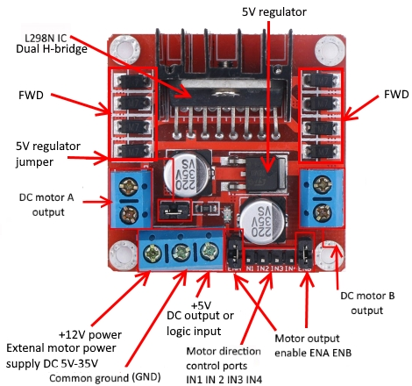
L298N Dual H Bridge Motor Driver is a motor controller breakout board which is typically used for controlling speed and direction of motors.
Pin descriptions of L298N Dual H Bridge Motor Driver:
Out 1: Motor A lead out 1
Out 2: Motor A lead out 2
Out 3: Motor B lead out 1
Out 4: Motor B lead out 2
GND: Ground
5V: 5V Logic Input
EnA: Enables PWM signal for Motor A
In1: Input for Motor A lead out 1
In2: Input for Motor A lead out 2
In3: Input for Motor B lead out 1
In4: Input for Motor B lead out 2
EnB: Enables PWM signal for Motor B

Slide 18
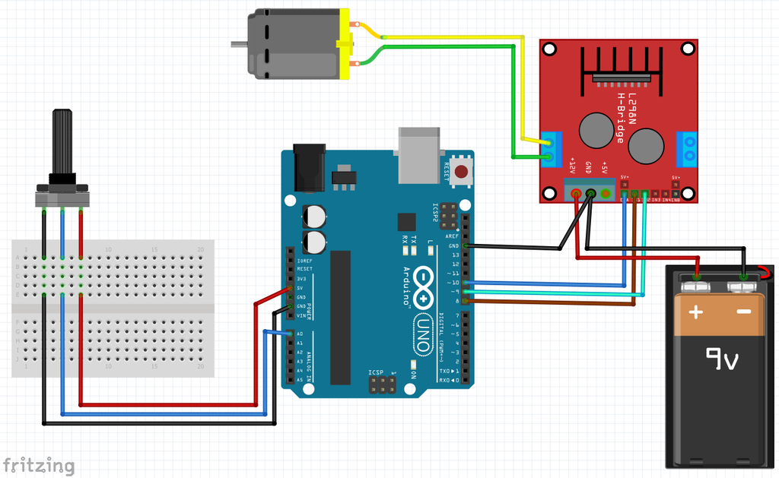
Control DC Motor Speed Using Potentiometer

Slide 19
//This code is to control the speed of a DC motor by a potentiometer using l298n driver
//We read the value from the analog input, calibrate it then inject to the module
int in1 = 8; //Declaring where our module is wired
int in2 = 9;
int ConA = 10;// Don't forget this is a PWM DI/DO
int speed1;
void setup() {
pinMode(8, OUTPUT);
pinMode(9, OUTPUT);
pinMode(10, OUTPUT);
}
void loop() {
TurnMotorA(); //one function that keeps looping you can add another one with different direction or stop
}
void TurnMotorA(){ //We create a function which control the direction and speed
digitalWrite(in1, LOW); //Switch between this HIGH and LOW to change direction
digitalWrite(in2, HIGH);
speed1 = analogRead(A0);
speed1 = speed1*0.2492668622; //We read thea analog value from the potentiometer calibrate it
analogWrite(ConA,speed1);// Then inject it to our motor
}

Slide 20
6.4 Servo Motor and Control
Servo motors have been around for a long time and are utilized in many applications. They are small in size but pack a big punch and are very energy-efficient. These features allow them to be used to operate remote-controlled or radio-controlled toy cars, robots and airplanes. Servo motors are also used in industrial applications, robotics, in-line manufacturing, pharmaceutics and food services.
The servo circuitry is built right inside the motor unit and has a positionable shaft, which usually is fitted with a gear (as shown Figure 6.9). The motor is controlled with an electric signal which determines the amount of movement of the shaft.

Slide 21
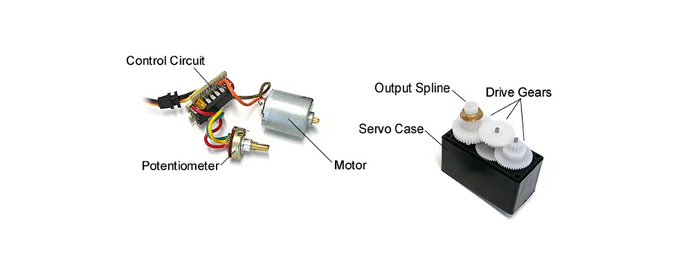
What's inside the servo motor?
To fully understand how the servo works, you need to take a look under the hood. Inside there is a pretty simple set-up: a small DC motor, potentiometer, and a control circuit. The motor is attached by gears to the control wheel. As the motor rotates, the potentiometer's resistance changes, so the control circuit can precisely regulate how much movement there is and in which direction.
Figure 6.9
When the shaft of the motor is at the desired position, power supplied to the motor is stopped. If not, the motor is turned in the appropriate direction. The desired position is sent via electrical pulses through the signal wire. The motor's speed is proportional to the difference between its actual position and desired position. So if the motor is near the desired position, it will turn slowly, otherwise it will turn fast. This is called proportional control.

Slide 22
How is the servo controlled?
Servos are controlled by sending an electrical pulse of variable width, or pulse width modulation (PWM), through the control wire. There is a minimum pulse, a maximum pulse, and a repetition rate. A servo motor can usually only turn 90° in either direction for a total of 180° movement. The motor's neutral position is defined as the position where the servo has the same amount of potential rotation in the both the clockwise or counter-clockwise direction. The PWM sent to the motor determines position of the shaft, and based on the duration of the pulse sent via the control wire; the rotor will turn to the desired position. The servo motor expects to see a pulse every 20 milliseconds (ms) and the length of the pulse will determine how far the motor turns. For example, a 1.5ms pulse will make the motor turn to the 90° position. Shorter than 1.5ms moves it in the counter clockwise direction toward the 0° position, and any longer than 1.5ms will turn the servo in a clockwise direction toward the 180° position.

Slide 23
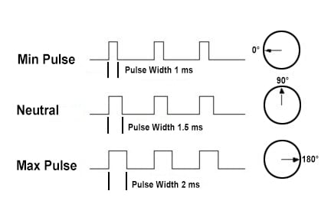
Variable Pulse width control servo position
When these servos are commanded to move, they will move to the position and hold that position. If an external force pushes against the servo while the servo is holding a position, the servo will resist from moving out of that position. The maximum amount of force the servo can exert is called the torque rating of the servo. Servos will not hold their position forever though; the position pulse must be repeated to instruct the servo to stay in position.

Slide 24
Servo Motor Applications
Servos are used in radio-controlled airplanes to position control surfaces like elevators, rudders, walking a robot, or operating grippers. Servo motors are small, have built-in control circuitry and have good power for their size. In food services and pharmaceuticals, the tools are designed to be used in harsher environments, where the potential for corrosion is high due to being washed at high pressures and temperatures repeatedly to maintain strict hygiene standards. Servos are also used in in-line manufacturing, where high repetition yet precise work is necessary.

Slide 25
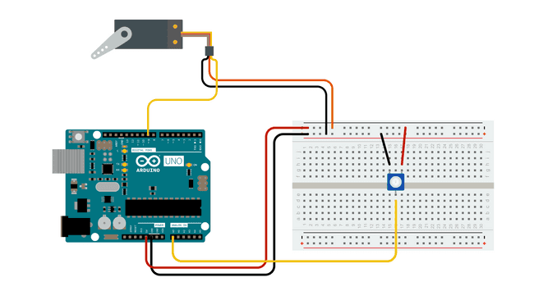
Servo Motor Basics with Arduino
You will find two easy examples that can be used by any Arduino board.
The first example controls the position of a RC (hobby) servo motor with a potentiometer.
The second example sweeps the shaft of a RC servo motor back and forth across 180 degrees.
Servo motors have three wires: power, ground, and signal. The power wire is typically red, and should be connected to the 5V pin on the Arduino board. The ground wire is typically black or brown and should be connected to a ground pin on the board. The signal pin is typically yellow or orange and should be connected to PWM pin on the board. In these examples, it is pin number 9.

Slide 26
Knob Circuit
For the Knob example, wire the potentiometer so that its two outer pins are connected to power (+5V) and ground, and its middle pin is connected to A0 on the board. Then, connect the servo motor to +5V, GND and pin 9.

Slide 27
#include <Servo.h>
Servo myservo; // create servo object to control a servo
int potpin = 0; // analog pin used to connect the potentiometer
int val; // variable to read the value from the analog pin
void setup() {
myservo.attach(9); // attaches the servo on pin 9 to the servo object
}
void loop() {
val = analogRead(potpin); // reads the value of the potentiometer (value between 0 and 1023)
val = map(val, 0, 1023, 0, 180); // scale it to use it with the servo (value between 0 and 180)
myservo.write(val); // sets the servo position according to the scaled value
delay(15); // waits for the servo to get there
}

Slide 28
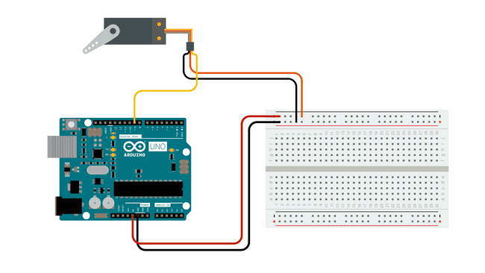
Sweep
Sweeps the shaft of a RC servo motor back and forth across 180 degrees.

Slide 29
#include <Servo.h>
Servo myservo; // create servo object to control a servo
// twelve servo objects can be created on most boards
int pos = 0; // variable to store the servo position
void setup() {
myservo.attach(9); // attaches the servo on pin 9 to the servo object
}
void loop() {
for (pos = 0; pos <= 180; pos += 1) { // goes from 0 degrees to 180 degrees
// in steps of 1 degree
myservo.write(pos); // tell servo to go to position in variable 'pos'
delay(15); // waits 15ms for the servo to reach the position
}
for (pos = 180; pos >= 0; pos -= 1) { // goes from 180 degrees to 0 degrees
myservo.write(pos); // tell servo to go to position in variable 'pos'
delay(15); // waits 15ms for the servo to reach the position
}
}

Slide 30
The following code will turn a servo motor to 0 degrees, wait 1 second, then turn it to 90, wait one more second, turn it to 180, and then go back.
// Include the Servo library
#include <Servo.h>
// Declare the Servo pin
int servoPin = 9;
// Create a servo object
Servo Servo1;
void setup() {
// We need to attach the servo to the used pin number
Servo1.attach(servoPin);
}
void loop(){
// Make servo go to 0 degrees
Servo1.write(0);
delay(1000);
// Make servo go to 90 degrees
Servo1.write(90);
delay(1000);
// Make servo go to 180 degrees
Servo1.write(180);
delay(1000);
}

Slide 31
6.4 Step Motor and Control
A special type of DC motor, known as a stepper motor, is a permanent that has the following performance characteristics:
it can rotate in both directions,
move in precise angular increments,
sustain a holding torque at zero speed, and
be controlled with digital circuits.
It moves in accurate angular increments, known as steps, in response to digital pulses sent to an electric drive circuit. The number and rate of the pulses control the position and speed of the motor shaft. Generally, stepper motors are manufactured with steps per revolution of 12, 24, 72, 144, 180, and 200, resulting in shaft increments of ${30}^{o}$ , ${15}^{o}$ , $5^{o}$ , ${2.5}^{o}$ , $2^{o}$ , and ${1.8}^{o}$per step. Special micro-stepping circuitry can be designed to allow many more steps per revolution, often 10,000 steps/rev or more.

Slide 32
Stepper motors are either bipolar, requiring two power sources or a switchable polarity power source, or unipolar, requiring only one power source. They are powered by DC sources and require digital circuitry to produce coil energizing sequences for rotation of the motor.
A unipolar stepper motor has current flowing through each of the coils in a single direction, and the bipolar stepper motor has current flowing in both directions of the coil.
(a) Unipolar Stepper Motors
Unipolar stepper motors only require current to flow in a single direction, which makes hardware design simpler because only a low side switch/driver is required. The high-side of the motor phase is connected directly to the supply voltage without a switch. Unipolar stepper motors can be driven by a stepper motor sequence using a peripheral driver - ULN2003A and TPL7407L are examples of devices that can drive these stepper motors.

Slide 33
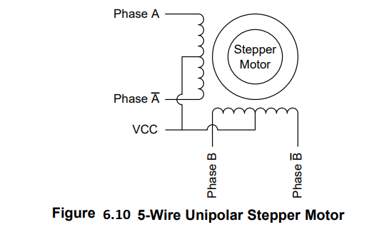
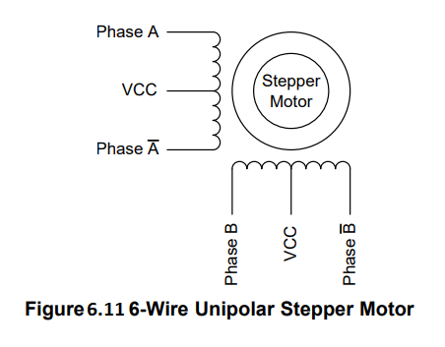
Unipolar stepper motors come in three primary wiring configurations, 5-wire, 6-wire, and 8-wire, where 5- wire and 6-wire stepper motors are the most common. In a 5-wire stepper motor the center tap connections are shorted together internally as shown in Figure 6.10. In a 6-wire stepper motor the center tap connections are separate connections as shown in Figure 6.11. A 6-wire stepper motor can effectively act as a 5-wire stepper motor by connecting the two center tap wires.

Slide 34
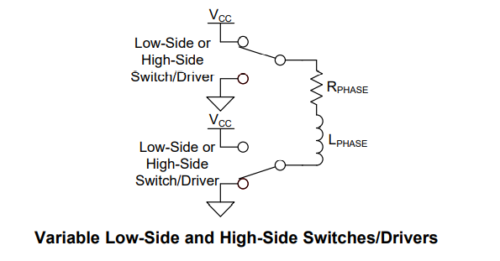
(b) Bipolar Stepper Motors
Bipolar stepper motors require both a low-side driver and a high-side driver. This allows the coils to be biased in both directions, requiring two Half-H drivers. The L293D is an example of a device that can drive these types of stepper motors.

Slide 35
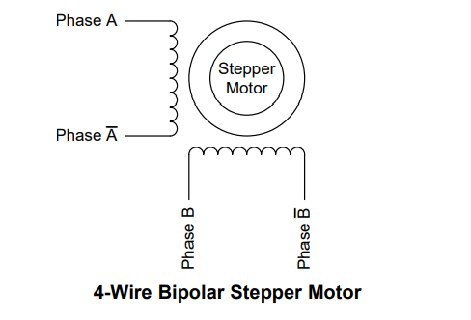
Bipolar stepper motors only come in a 4-wire configuration and do not have center tap connections

Slide 36
Stepper Motor Driving Patterns
Wave Drive Operation
The Wave Drive mode of operation is typically considered to be the most simple way of driving a stepper motor, but is also the least common mode of stepper motor driving, due to its shortfalls relative to Full-Step (torque) and Half-step (precision) patterns.
The wave drive mode would likely be used in applications where reduced power consumption is important and high torque is unnecessary.
For this mode of operation, each phase of the motor is activated in succession with only a single phase being activated at any point in time. Figure 6.12 and Figure 6.13 describe the step pattern required for the wave drive method, while Figure 6.14 provides a pictorial representation of the motor steps.

Slide 37
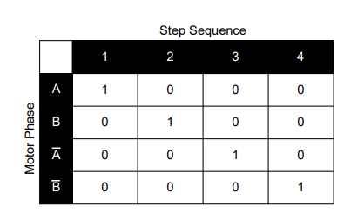
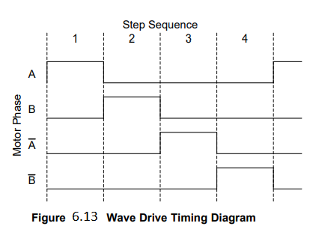

Slide 38
Full-Step Operation
The full-step mode of operation is the most commonly used way to drive a stepper motor, as it has improved torque over the wave drive method and constant torque relative to the half-step method.
For this mode of operation, two phases of the motor are activated simultaneously to provide an additional attractive force relative to the wave drive method, while still maintaining the resolution of the wave drive method. Figure 6.15 and Figure 6.16 describe the step pattern required for the full-step method, while Figure 6.17 provides a pictorial representation of the motor steps. Each step for the motor spins the motor 90°.

Slide 39
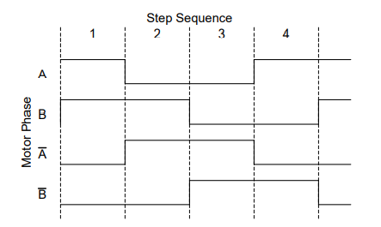
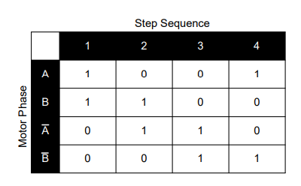

Slide 40
Half-Step Operation
The half-step mode of operation is less commonly used compared to the full-step method, but is typically more common than the wave drive method, as it enables better stepper resolution with the same motor. One disadvantage to the half-step method is that the torque swings between that of the wave drive method and that of the full-step method. Some devices, however, have internal circuitry to limit current and reduce torque ripple when half-stepping. The half-step mode would likely be used in applications where increased resolution is required.
For this mode of operation, two phases of the motor are activated simultaneously followed by a single phase. This ultimately provides additional resolution relative to both the wave drive and full-step methods. Figure 6.18 and Figure 6.19 describe the step pattern required for the half-step method, while Figure 6.20 provides a pictorial representation of the motor steps. Each step for the motor spins the motor 45°

Slide 41
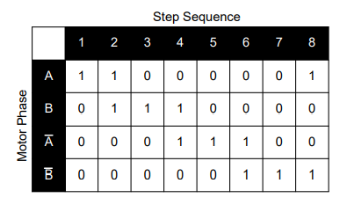
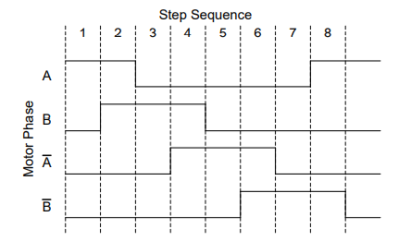

Slide 42
What is the difference between stepper motors and standard DC motors?
The rotation of stepper motors is incremental, slow and precise, while DC motors have a fast, continuous motion.
Stepper motors will generate some noise during operation while DC motors are quiet and relatively vibration-free.
The response time of the stepper motor is slower than the DC motor.
Stepper motors can be easily controlled with microprocessors like the Arduino. Compared to DC motors, they are more mechanically simple and easy to design and build. In contrast, DC motors are not so easily controlled with microprocessors

Slide 43
What is the difference between stepper motors and servo motors?
Stepper motors can move more accurately and precisely than the servo motor and are much easier to control.
Stepper motors are more suitable for applications with lower speeds of less than 2000 rpm (revolutions per minute), and servos are best suited for applications with high speeds greater than 2000 rpm.
Stepper motors operate at lower speeds than servo motors.

Slide 44
When would I choose a stepper motor over the other types?
The stepper motor does have its disadvantages as compared to the aforementioned two. However, you should still take stepper motors into consideration for its several critical advantages.
Precise Positioning – Stepper motors move in precise steps. As such, they do well in applications that require precise positionings, such as 3D printers and camera platforms.
Precise Speed control – Precise increments in movements enable excellent control of rotational speed for process automation and robotics.
High Torque at low speeds – Stepper motors are best suited for applications with low speed (less than 2000 rpm) as they have maximum torque at low speeds. In contrast, normal DC motors and servo motors do not have so much torque at low speeds.
Easy to control – Stepper motors can easily be controlled using a microcontroller like an Arduino. In fact, its ease of use has also been a major reason for its continued usage by stepper motor users.

Slide 45
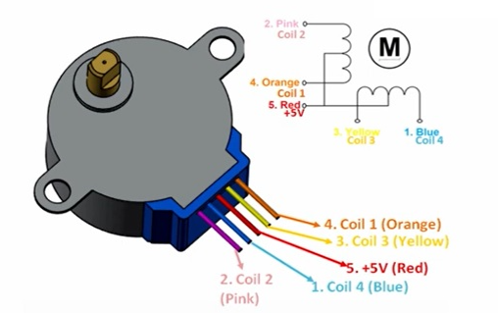
Stepper Motor and Unipolar Stepper Motor Driving
The 28BYJ-48 stepper motor is widely used to control a myriad of common devices we see every day. From blinds, car side mirror tilts and DVD players to security cameras and precise control machines,

Slide 46
The 28BYJ-48 stepper motor consumes high current and hence, we will need to use a driver IC like the ULN2003 in order to control the motor with a microcontroller like the Arduino. Known for its high current and high voltage capacity, the ULN2003 gives a higher current gain than a single transistor and enables the low voltage and low current output of a microcontroller to drive a higher current stepper motor.
For example, a stepper motor that needs 9V and 300mA to operate cannot be powered by an Arduino. Hence, we connect this IC to source for enough current and voltage for the motor. If you have to power anything more than 5V and 80mA, the ULN2003 driver board should be used.
The 28BYJ-48 typically consumes around 240mA. Since the motor draws a lot of power, it is best to power it directly from an external 5V power supply rather than drawing that power from the Arduino. Note that the motor consumes power even in stand still state to maintain its position.

Slide 47
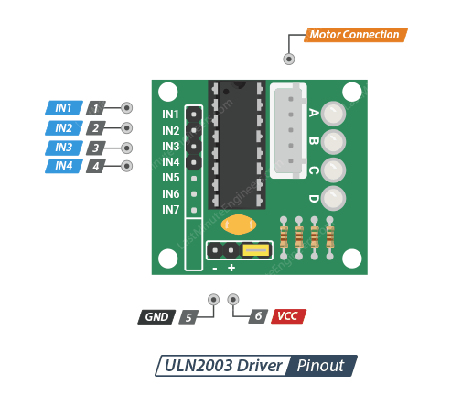
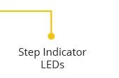
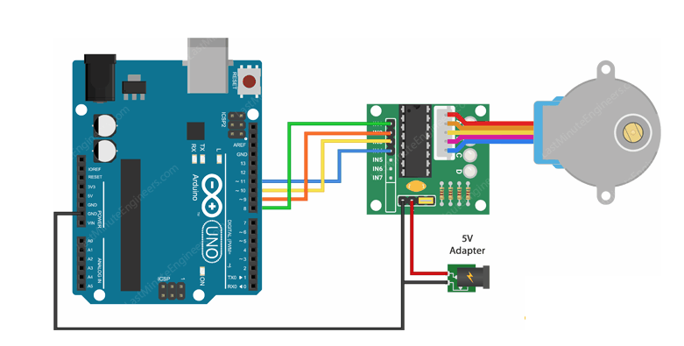
First we take a look at the easy to use Arduino Stepper library. This library is great when you are just starting out, but doesn’t have many extra features.The stepper library takes care of the stepping sequence and makes it easy to control a wide variety of stepper motors, both unipolar and bipolar. Here is the simple sketch that makes the stepper motor spin slowly clockwise and then rapidly counterclockwise.

Slide 48
//Includes the Arduino Stepper Library
#include <Stepper.h>
// Defines the number of steps per rotation
const int stepsPerRevolution = 2038;
// Creates an instance of stepper class
// Pins entered in sequence IN1-IN3-IN2-IN4 for proper step sequence
Stepper myStepper = Stepper(stepsPerRevolution, 8, 10, 9, 11);
void setup() {
// Nothing to do (Stepper Library sets pins as outputs)
}
void loop() {
// Rotate CW slowly at 5 RPM
myStepper.setSpeed(5);
myStepper.step(stepsPerRevolution);
delay(1000);
// Rotate CCW quickly at 10 RPM
myStepper.setSpeed(10);
myStepper.step(-stepsPerRevolution);
delay(1000);
}

Slide 49
Using AccelStepper library
The Arduino Stepper Library is perfectly fine for simple, single motor applications. But when you want to control multiple steppers, you’ll need a better library.
So, for our next experiment we will be using an advanced stepper motor library called AccelStepper library. It is much better than the standard Arduino Stepper library in several ways:
It supports acceleration and deceleration.
It supports half-step driving.
It supports multiple steppers at once, with independent concurrent stepping on each stepper.
This library is not included in the Arduino IDE, so you will need to install it first.

Slide 50
// Include the AccelStepper Library
#include <AccelStepper.h>
// Define step constant
#define FULLSTEP 4
// Creates an instance
// Pins entered in sequence IN1-IN3-IN2-IN4 for proper step sequence
AccelStepper myStepper(FULLSTEP, 8, 10, 9, 11);
void setup() {
// set the maximum speed, acceleration factor,
// initial speed and the target position
myStepper.setMaxSpeed(1000.0);
myStepper.setAcceleration(50.0);
myStepper.setSpeed(200);
myStepper.moveTo(2038);
}
void loop() {
// Change direction once the motor reaches target position
if (myStepper.distanceToGo() == 0)
myStepper.moveTo(-myStepper.currentPosition());
// Move the motor one step
myStepper.run();
}

Slide 51
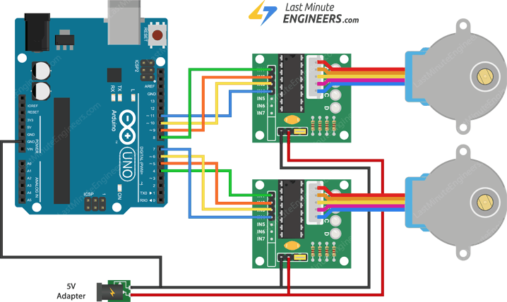
Control Two 28BYJ-48 Stepper Motors Simultaneously

Slide 52
// Include the AccelStepper Library
#include <AccelStepper.h>
// Define step constants
#define FULLSTEP 4
#define HALFSTEP 8
// Creates two instances
// Pins entered in sequence IN1-IN3-IN2-IN4 for proper step sequence
AccelStepper stepper1(HALFSTEP, 8, 10, 9, 11);
AccelStepper stepper2(FULLSTEP, 4, 6, 5, 7);
void setup() {
// set the maximum speed, acceleration factor,
// initial speed and the target position for motor 1
stepper1.setMaxSpeed(1000.0);
stepper1.setAcceleration(50.0);
stepper1.setSpeed(200);
stepper1.moveTo(2038);
// set the same for motor 2
stepper2.setMaxSpeed(1000.0);
stepper2.setAcceleration(50.0);
stepper2.setSpeed(200);
stepper2.moveTo(-2038);
}

Slide 53
void loop() {
// Change direction once the motor reaches target position
if (stepper1.distanceToGo() == 0)
stepper1.moveTo(-stepper1.currentPosition());
if (stepper2.distanceToGo() == 0)
stepper2.moveTo(-stepper2.currentPosition());
// Move the motor one step
stepper1.run();
stepper2.run();
}

