Slide 1
Architecture and Hardware (ITEC582 )
Eastern Mediterranean University
School of Computing and Technology
Master of Technology
Chapter 12
Instruction Sets: Characteristics and Functions

Slide 2
Learning Objectives
After studying this chapter, you should be able to
Present an overview of essential characteristics of machine instructions.
Describe the types of operands used in typical machine instruction sets.
Describe the types of operands supported by typical machine instruction sets.

Slide 3
1. Machine Instruction Characteristics
Elements of a Machine Instruction
The operation of the processor is determined by the instructions it executes, referred to as machine instructions or computer instructions.
The collection of different instructions that the processor can execute is referred to as the processor’s instruction set.
Each instruction must contain the information required by the processor for execution.

Slide 4
What are the typical elements of a machine instruction?
These elements are as follows;
Operation code , Source operand reference, Result operand reference
and Next instruction reference
■ Operation code: Specifies the operation to be performed (e.g., ADD, I/O). The operation is specified by a binary code, known as the operation code, or opcode.
■ Source operand reference: The operation may involve one or more source operands, that is, operands that are inputs for the operation.

Slide 5
■ Result operand reference: The operation may produce a result.
■ Next instruction reference: This tells the processor where to fetch the next instruction after the execution of this instruction is complete.
What types of locations can hold source and destination operands?
Source and result operands can be in one of four areas:
■ Main or virtual memory:
As with next instruction references,
the main or virtual memory address
must be supplied
■ Processor register:
A processor contains one or more registers that may be referenced by machine instructions.
■ Immediate:
The value of the operand is contained
in a field in the instruction being
executed
■ I/O device:
The instruction must specify the I/O
module and device for the operation.

Slide 6
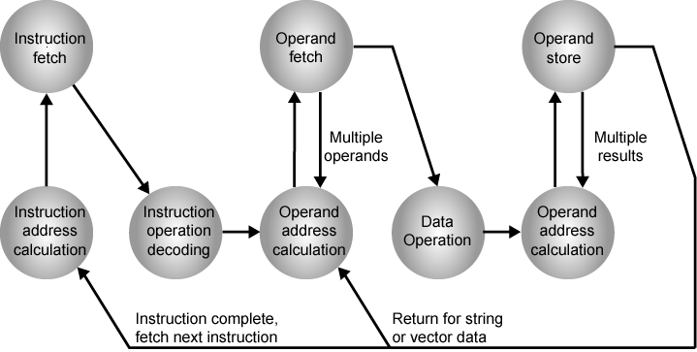
Elements of a Machine Instruction
Figure shows the steps involved in instruction execution and defines the elements of a machine instruction.
Instruction Cycle State Diagram
Notes:
3

Slide 7
Instruction Address Calculation − The address of the next instruction is computed. A permanent number is inserted to the address of the earlier instruction.
Instruction Fetch − The instruction is read from its specific memory location to the processor.
Instruction Operation Decoding − The instruction is interpreted and the type of operation to be implemented and the operand(s) to be used are decided.
Operand Address Calculation − The address of the operand is evaluated if it has a reference to an operand in memory or is applicable through the Input/Output.
Operand Fetch − The operand is read from the memory or the I/O.
Data Operation − The actual operation that the instruction contains is executed.
Store Operands − It can store the result acquired in the memory or transfer it to the I/O.

Slide 8
Instruction Representation
Within the computer, each instruction is represented by a sequence of bits.
The instruction is divided into fields, corresponding to the constituent elements of the instruction. A simple example of an instruction format is shown in the figure.
A simple instruction format
Notes:
5

Slide 9
Instruction Representation
In machine code each instruction has a unique bit pattern.
For human consumption (programmers) a symbolic representation of machine instructions is used.
Notes:
5

Slide 10
Instruction Representation
Opcodes are represented by abbreviations, called mnemonics, that indicate the operation.
Common examples include:
ADD - Add
SUB - Subtract
MUL - Multiply
DIV - Divide
LOAD - Load data from memory
STOR - Store data to memory
Notes:
5

Slide 11
Instruction Representation
Operands are also represented symbolically.
For example, the instruction ADD R,Y
(R R + Y ) may mean add the value contained in data location Y to the contents of register R.
In this example, Y refers to the address of a location in memory, and R refers to a particular register.
Note that the operation is performed on the contents of a location, not on its address.
Notes:
5

Slide 12
Instruction Types
Consider a high-level language instruction that could be expressed X=X+Y.
This statement instructs the computer to add the value stored in Y to the value stored in X and put the result in X.
Let us assume that the variables X and Y correspond to memory locations 513 and 514. This operation could be accomplished with three instructions:
Load a register with the contents of memory location 513
Add the contents of memory location 514 to the register
Store the contents of the register in memory location 513
Notes:
6

Slide 13
How are operations expressed in high level language and machine language?
This is a typical relationship between a high-level language and a machine language.
A high-level language expresses operations in a concise algebraic form, using variables.
A machine language expresses operations in a basic form involving the movement of data to or from registers.
Therefore, a computer should have a set of instructions that allows the user to formulate any data processing task.
Notes:
6

Slide 14
List and briefly discuss the four categories of instruction types
Thus, the set of machine instructions must be sufficient to express any of the instructions from a high-level language.
With this in mind we can categorize instruction types as follows:
Data processing: arithmetic and logic instructions
Data storage (main memory): data in/out to/from registers, memory locations
Data movement (I/O): I/O instructions
Program flow control: test and branch instructions
Notes:
6

Slide 15
Instruction Types
Arithmetic instructions provide computational capabilities for processing numeric data.
Logic (Boolean) instructions operate on the bits of a word. These operations are performed primarily on data in processor registers.
I/O instructions are needed to transfer programs and data into memory and the results of computations back out to the user.
Test instructions are used to test the value of a data word or the status of a computation.
Branch instructions are then used to branch to a different set of instructions depending on the decision made.
Notes:
6

Slide 16
Number of Addresses
One of the traditional ways of describing processor architecture is in terms of the number of addresses contained in each instruction.
What is the maximum number of addresses one might need in an instruction?
All arithmetic and logic operations are either unary (one source operand) or binary (two source operands).
Notes:
7

Slide 17
Thus, we would need a maximum of two addresses to reference source operands for arithmetic and logic operations.
The result of an operation must be stored, suggesting a third address, which defines a destination operand.
Finally, after completion of an instruction, the next instruction must be fetched, and its address is needed.
If an instruction contains four addresses, what might be the purpose of each address?
This line of reasoning suggests that an instruction could plausibly be required to contain four address references: two source operands, one destination operand, and the address of the next instruction.

Slide 18
In most architectures, many instructions have one, two, or three operand addresses, with the address of the next instruction being implicit (obtained from the program counter).
For example, the load and store multiple instructions of the ARM architecture, designate up to 17 register operands in a single instruction
Compare typical one-, two-, and three- address instructions that could be used to compute
Y = (A - B)/[C + (D * E)].

Slide 19
Number of Addresses
3 addresses format
Operand 1, Operand 2, Result
a = b + c;
With three-address instrcutions, each instruction specifies two source operand locations and a destination operand location.
This format is not common because it requires a relatively long instruction format to hold the three address references.
Notes:
7

Slide 20
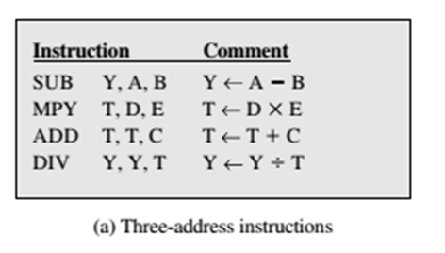
Write a program to compute by using three
address instructions.
Write a program to compute by using three
address instructions.

Slide 21
Number of Addresses
2 addresses format
One address doubles as operand and result
a = a + b
The two-address format reduces the space requirement and the length of instruction but requires some extra work.To avoid altering the value of an operand, a MOVE instruction is used to move one of the values to a result or temporary location before performing the operation.
Notes:
7

Slide 22
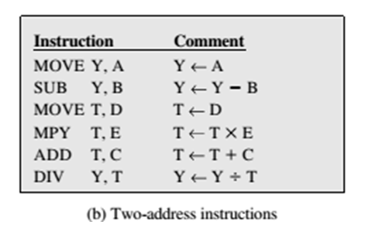
Write a program to compute by using two
address instructions.

Slide 23
Number of Addresses
Simpler yet is the one-address instruction. For this to work, a second address must be implicit.
This was common in earlier machines, with the implied address being a processor register known as the accumulator (AC). The accumulator contains one of the operands and is used to store the result.
Notes:
7

Slide 24
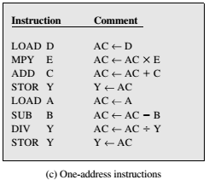
Write a program to compute by using one
address instructions.

Slide 25
Number of Addresses
In fact, it is possible to do with zero addresses for some instructions.
Zero-address instructions are applicable to a special memory organization, called a stack. A stack is a last-in-first-out set of locations.
The stack is in a known location and, often, at least the top two elements are in processor registers.
Notes:
7

Slide 26
Number of Addresses
Thus, zero-address instructions would reference the top two stack elements.
For example, c = a + b can be implemented by zero addresses as:
push a
push b
add
pop c
Notes:
10

Slide 27
Write a program to compute by using zero
address instructions.
PUSH A
PUSH B
SUB
PUSH C
PUSH D
PUSH E
MUL
ADD
DIV
POP Y

Slide 28
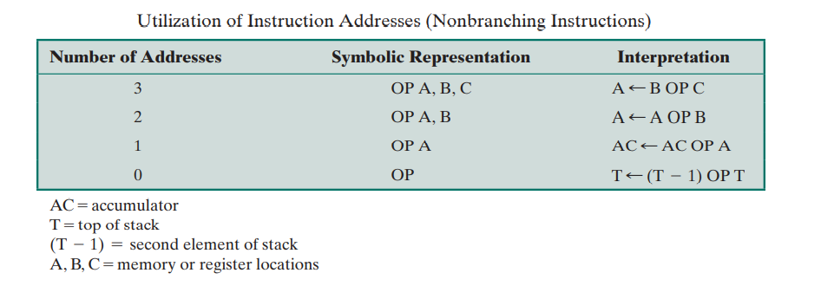
Table below summarizes the interpretations to be placed on instructions with zero, one, two, or three addresses. In each case in the table, it is assumed that the address of the next instruction is implicit, and that one operation with two source operands and one result operand is to be performed

Slide 29
How Many Addresses?
More addresses per instruction results;
More complex instructions
Fewer instructions per program
More registers
Fewer addresses per instruction results;
Less complex instructions
More instructions per program
Faster fetch/execution of instructions
For reasons of flexibility and ability to use multiple registers, most contemporary machines employ a mixture of two- and three-address instructions.
Notes:
11

Slide 30
Instruction Set Design
The design of an instruction set is very complex because it affects so many aspects of the computer system.
The instruction set defines many of the functions performed by the processor and thus has a significant effect on the implementation of the processor.
The instruction set is the programmer’s means of controlling the processor.
Notes:
12

Slide 31
List and briefly explain five important instruction set design issues
Instruction set design issues includes:
Operation repertoire
How many operations ? What can they do?
How complex are they?
Data types
Instruction formats
Length of op code field
Number of addresses
Registers
Number of CPU registers available and which operations can be performed on which registers?
Addressing modes by which the address of an operand is specified.
Notes:
12

Slide 32
2. Types of Operands
What types of operands are typical in machine instruction sets?
The most important general categories of data are:
Addresses (In many cases, some calculation must be performed on the operand reference in an instruction to determine the main or virtual memory address.)
Numbers (Integer/floating point)
Characters (ASCII etc.)
Logical Data (Bits or flags)
Notes:
14

Slide 33
Intel x86 Data Types
General
8 bit - byte
16 bit - word
32 bit - doubleword
64 bit - quadword
128 bit - double quadword
Integer
A signed binary value contained in a byte, word, or doubleword, using twos complement representation.
Ordinal
An unsigned integer contained in a byte, word, or doubleword.
Floating point
Notes:
15

Slide 34
ARM Data Types
ARM processors support data types of
8 bits – byte
16 bits – halfword
32 bits - word
Majority of implementations do not provide floating-point hardware
Saves power and area
Floating-point arithmetic implemented in software
ARM supports optional floating-point coprocessor that supports single- and double-precision floating point data types defined in IEEE 754

Slide 35
Types of Operations
The number of different opcodes varies widely from machine to machine. However, the same general types of operations are found on all machines.
A useful and typical categorization is the following:
Data Transfer
Arithmetic
Logical
Conversion
I/O
System Control
Transfer of Control
Notes:
18

Slide 36
Data Transfer
Transfer data from one location to another.
The data transfer instruction must specify the location of the source and destination operands.
Each location could be memory, a register, or the top of the stack.
If memory is involved:
Determine memory address
Perform virtual-to-actual-memory address transformation
Check cache
Initiate memory read/write
Notes:
19

Slide 37
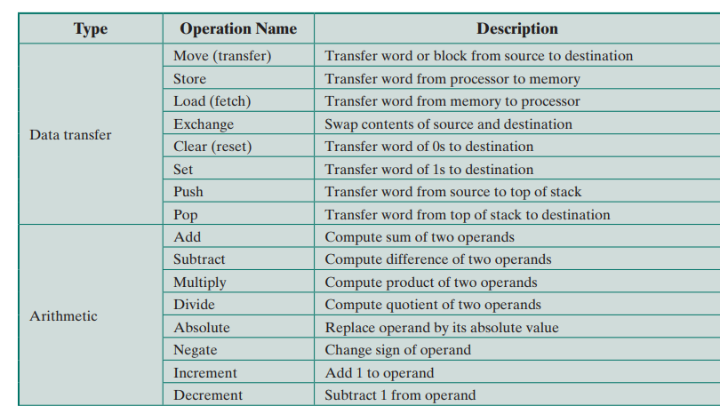

Slide 38
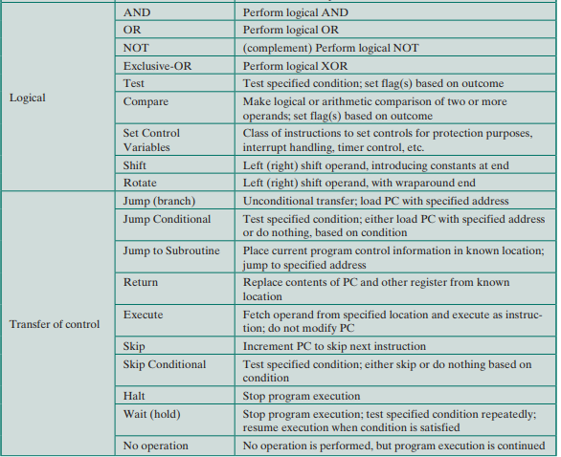

Slide 39
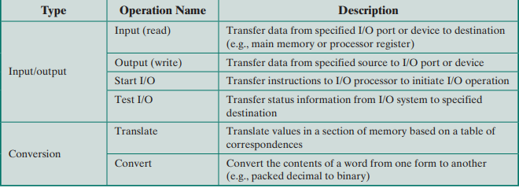

Slide 40
Data Transfer
The data transfer instruction must specify several things
The location of the source and destination operands must be specified. Each location could be memory, a register, or the top of the stack.
The length of data to be transferred must be indicated.
All instructions with operands, the mode of addressing for each operand must be specified.

Slide 41
In terms of processor action, data transfer operations are perhaps the simplest type.
If both source and destination are registers, then the processor simply causes data to be transferred from one register to another; this is an operation internal to the processor.
If one or both operands are in memory, then the processor must perform some or all of the following actions:
Calculate the memory address, based on the address mode.
If the address refers to virtual memory, translate from virtual to real memory address.
Determine whether the addressed item is in cache.
If not, issue a command to the memory module.

Slide 42
Arithmetic
May involve data transfer, before and/or after.
Perform function in ALU
Add, Subtract, Multiply, Divide
May include
Increment (a++)
Decrement (a--)
Absolute (|a|)
Negate (-a)
Set flags
Notes:
20

Slide 43
Logical
Bitwise operations
AND, OR, NOT, XOR, EQUALS
Notes:
21

Slide 44
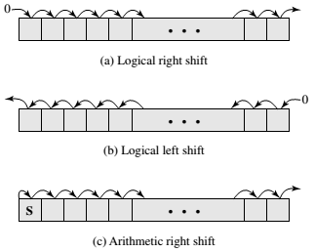
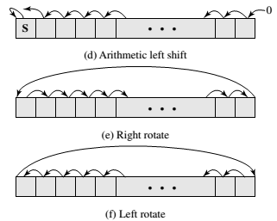
Logical and Arithmetical Operations
Most machines provide a variety of shift and rotate functions

Slide 45
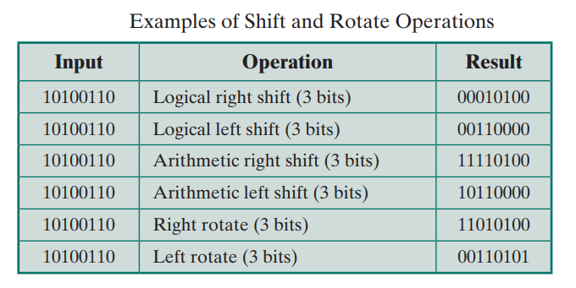
With a logical shift, the bits of a word are shifted left or right. On one end, the bit shifted out is lost. On the other end, a 0 is shifted in.
A right arithmetic shift corresponds to a division by 2, with truncation for odd numbers. An arithmetic left shift corresponds to a multiplication by 2
Rotate, or cyclic shift, operations preserve all of the bits being operated on. One use of a rotate is to bring each bit successively into the leftmost bit, where it can be identified by testing the sign of the data

Slide 46
Conversion
Conversion instructions are those that change the format or operate on the format of data.
An example is converting from decimal to binary.
May involve special logic to perform conversion.
Notes:
22

Slide 48
Input/Output
Issue command to I/O module
There are a variety of approaches including programmed I/O, interrupt driven I/O, DMA, and the use of an I/O processor.
Many implementations provide only a few I/O instructions, with the specific actions specified by parameters, codes, or command words.
Notes:
23

Slide 49
System Control
System control instructions are those that can be executed only while the processor is in a certain privileged state or is executing a program in a special privileged area of memory.
Typically, these instructions are reserved for the use of the operating system.
For example, a system control instruction may read or alter a control register.
Notes:
25

Slide 50
Transfer of Control
A significant fraction of the instructions in any program have as their function changing the sequence of instruction execution.
For these instructions, the operation performed by the processor is to update the program counter to contain the address of some instruction in memory.
The most common transfer of control operations found in instruction sets are branch, skip and procedure call.
Notes:
25

Slide 51
Branch instructions :
A branch instruction, also called a jump instruction, has as one of its operands the address of the next instruction to be executed.
Most often, the instruction is a conditional branch instruction.
The branch is made (update program counter to equal address specified in operand) only if a certain condition is met. Otherwise, the next instruction in sequence is executed
A branch instruction in which the branch is always taken is an unconditional branch.

Slide 52
On such a machine, there could be four different conditional branch instructions:
BRP X : Branch to location X if result is positive.
BRN X : Branch to location X if result is negative.
BRZ X : Branch to location X if result is zero.
BRO X : Branch to location X if overflow occurs
Another approach that can be used with a three-address instruction format is to perform a comparison and specify a branch in the same instruction.
For example,
BRE R1, R2, X
(Branch to X if contents of R1 = contents of R2)

Slide 53
Branch Instruction

Slide 54
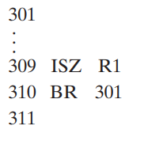
Skip Instruction
Another form of transfer- of- control instruction is the skip
instruction. The skip instruction includes an implied address.
A typical example is the increment-and-skip-if-zero (ISZ) instruction.

Slide 55
Procedure Calls
A procedure is a self contained computer program that is incorporated into a larger program.
At any point in the program the procedure may be invoked, or called
Two principal reasons for the use of procedures are economy and modularity.
The procedure mechanism involves two basic instructions: a call instruction that branches from the present location to the procedure, and a return instruction that returns from the procedure to the place from which it was called. Both of these are forms of branching instructions.

Slide 56
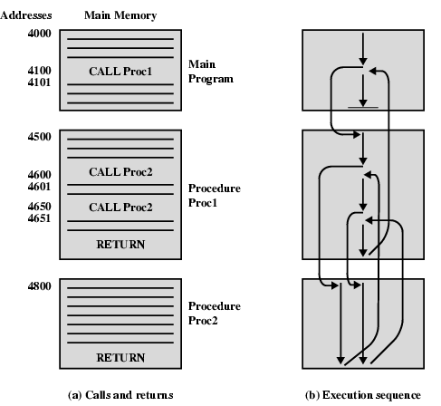

Slide 57
Use of stack
When the processor executes a call, it places the return address on the stack. When it executes the return, it uses the address on the stack.

