Slide 1
CMPE/CMSE318
Principles of Programming Languages
Tutorial Notes
2025-2026
Spring

Slide 2
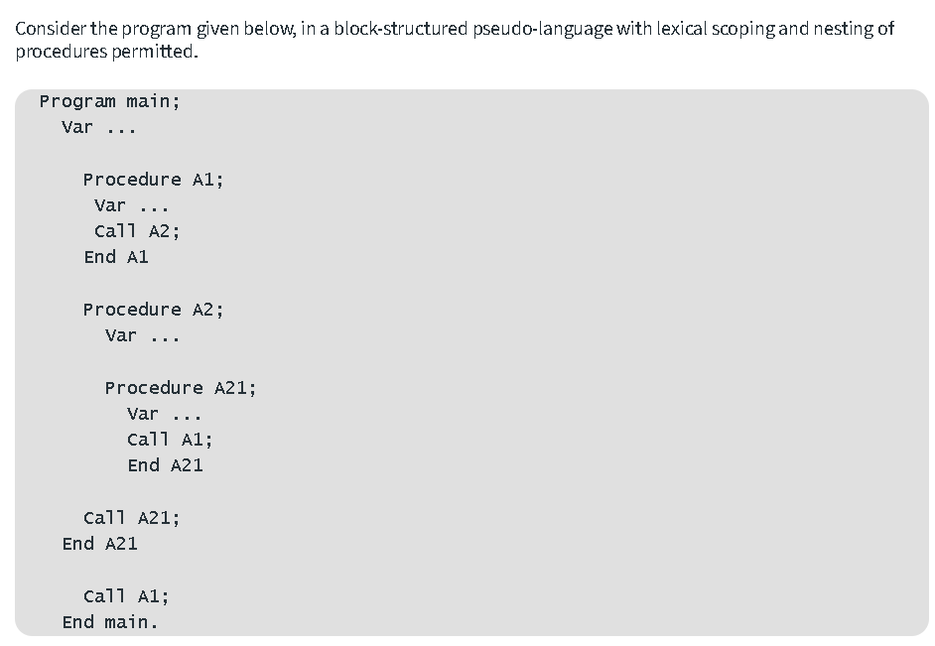
Q1.

Slide 3
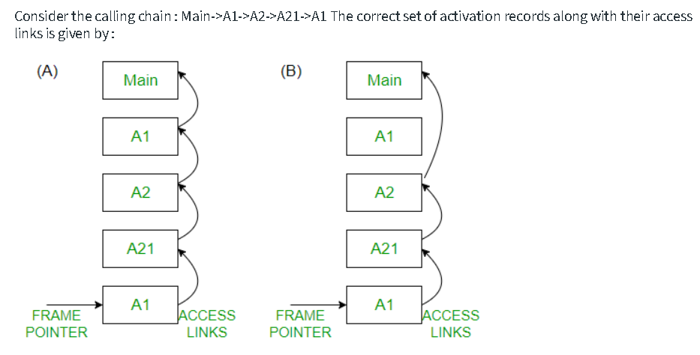
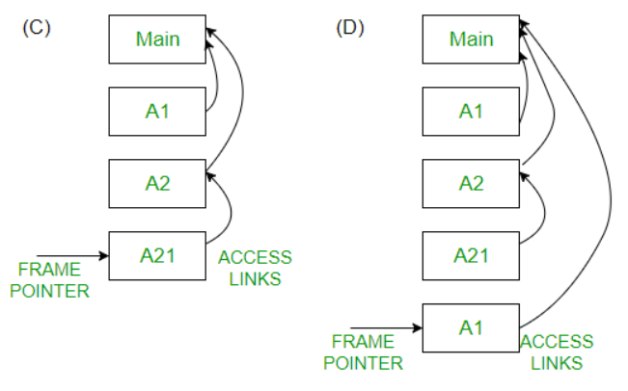

Slide 4
Answer. Access link is defined as link to activation record of closest lexically enclosing block in program text, so the closest enclosing blocks respectively for A1 ,A2 and A21 are main , main and A2 Since, Activation records are created at procedure entry time and destroyed at procedure exit time.
Here Calling sequence is given as,
Main->A1->A2->A21->A1
Now A1,A2 are defined under Main...So A1,A2 Access link are pointed to main A21 is defined under A2 hence its Access link will point to A2 .
Hence, correct anwers is D.

Slide 5
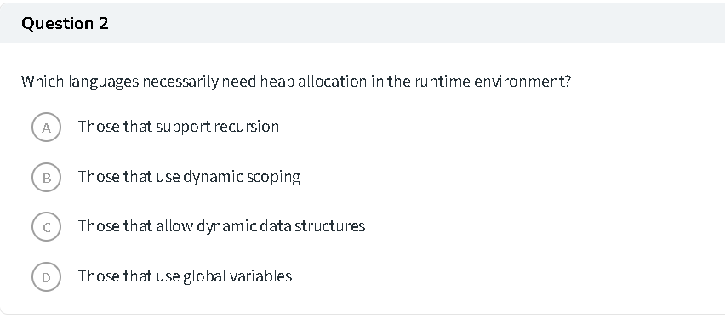

Slide 6
Answer: Heap allocation is needed for dynamic data structures like tree, linked list, etc.
Correct answer is C.

Slide 7
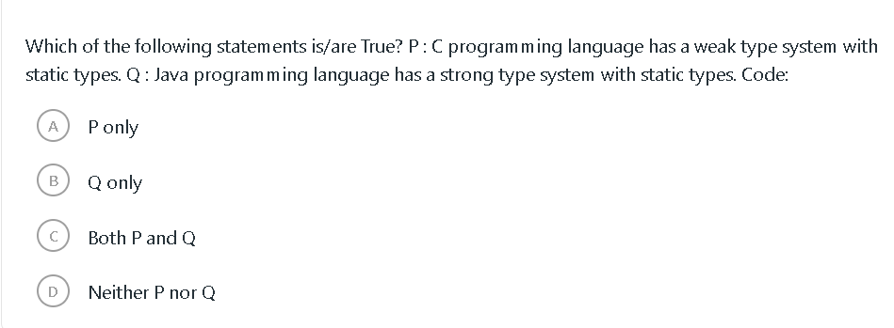
Q3.

Slide 8
Answer: C programming language has a weak type system with static types but Java programming language has a strong type system with static types. Both Statements are correct. So, option (C) is correct.

Slide 9
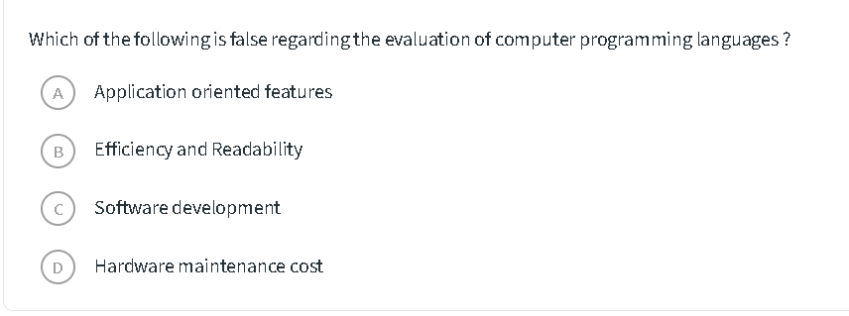
Q4.

Slide 10
Answer: Efficiency and Readability, Application oriented features and Software development are regarding to the evaluation of computer programming languages. But Hardware maintenance costs not regarding to the evaluation of computer programming languages.
So, option (D) is correct.

Slide 11
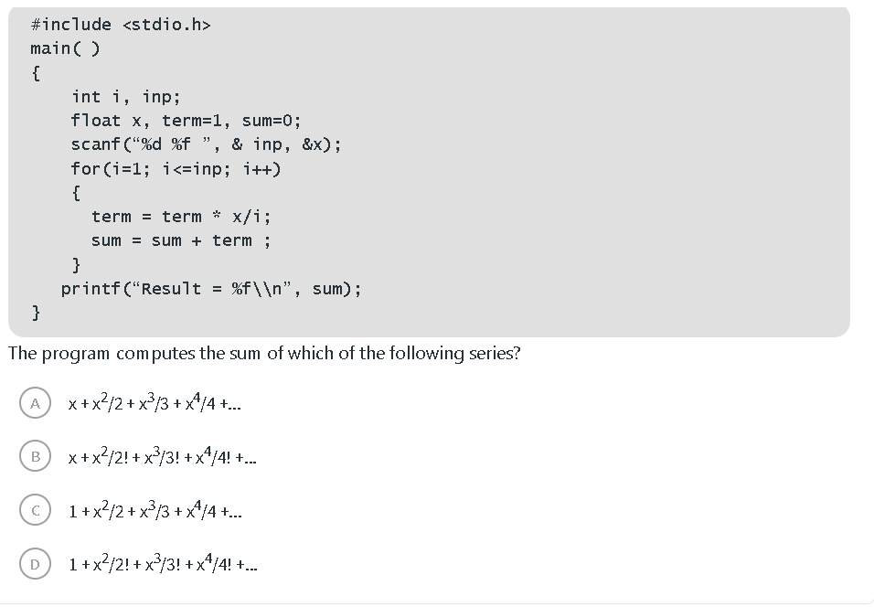
Q5.

Slide 12
Answer: Correct option is B

Slide 13
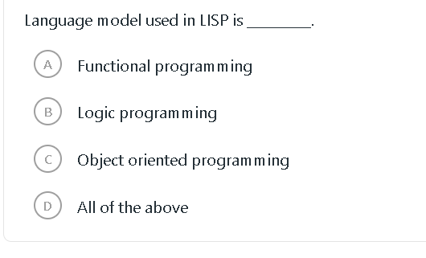
Q6.

Slide 14
Answer: Language model used in LISP is functional programming. Option A is the correct answer.

Slide 15
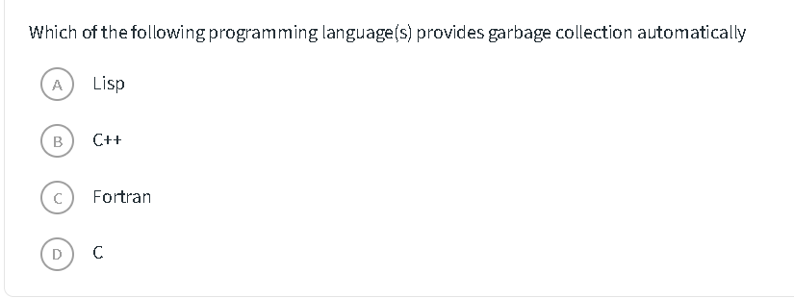
Q6.

Slide 16
Answer. Lisp is the first high-level programming language to introduce automatic garbage collection to simplify the concept of manual garbage collection. Rest of these languages- C, C++, FORTRAN do not perform automatic garbage collection but are capable of doing it manually. Option (A) is correct.

Slide 17
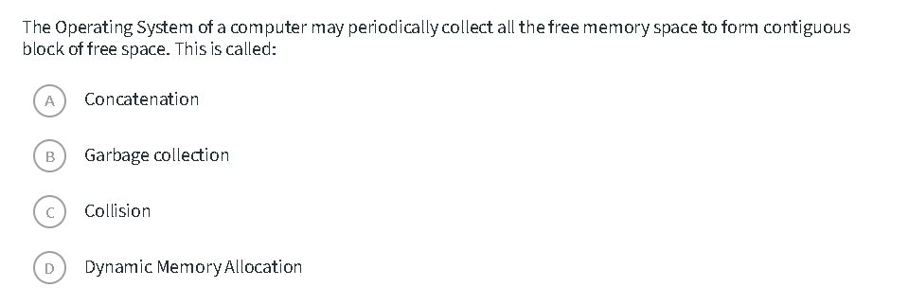
Q7.

Slide 18
Answer: All the objects which are created dynamically are allocated memory in the heap. On continuous creation of these objects, memory might get overflow. So we need to clear heap memory by releasing memory for all those objects which are no longer referenced by the program (or the unreachable objects) so that the space is made available for subsequent new objects. This memory can be released by garbage collection, it releases the heap memory for all the unreferenced objects. Option (B) is correct.

Slide 19
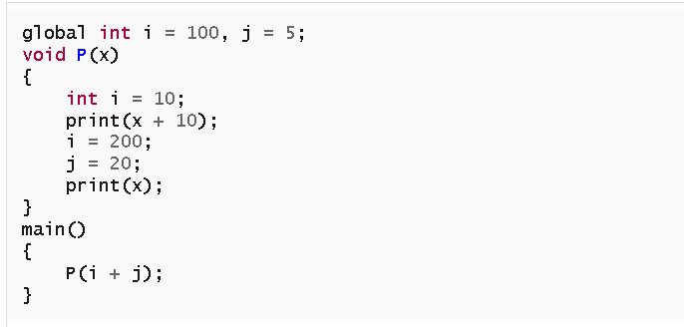
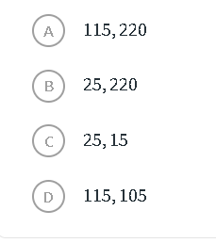
Q8.
The following program fragment is written in a programming language that allows variables and does not allow nested declarations of functions.
If the programming language uses static scoping and call by parameter passing mechanism, the values printed by the above program are

Slide 20
Answer: Value of variable x doesn’t change anytime in the function P(x). Hence, whatever its value is when this function is called, only that will be used in all the print statements. Clearly, 100+5+10, 100+5 i.e. 115, 105 will be printed by the program. Option D is the correct answer.

Slide 21
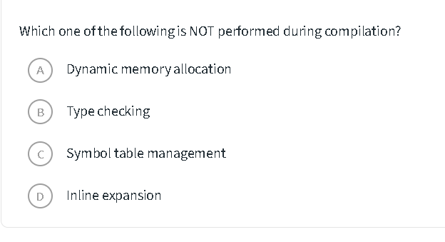
Q9.
Note: inline expansion, or inlining, is a manual or compiler optimization that replaces a function call site with the body of the called function.

Slide 22
Answer. Dynamic memory allocation happens at run time only. Compiler only compiles instructions for dynamic memory allocation like malloc(), calloc(). Option A is the correct answer.

Slide 23
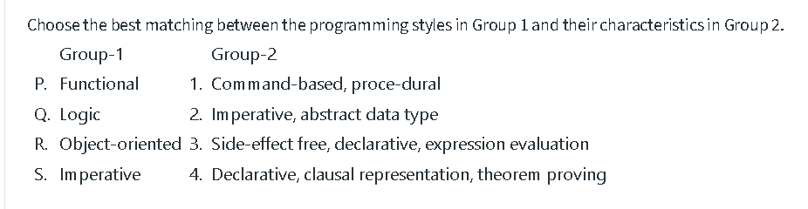
Q10.

Slide 24
Answer:
P: Functional Programming is declarative in nature, involves expression evaluation, & side effect free.
Q: Logic is also declarative but involves theorem proving.
R: Object oriented is imperative statement based & have abstract (general) data types.
S: Imperative: The programs are made giving commands & follows definite procedure & sequence
Option D is the correct answer.

Slide 25
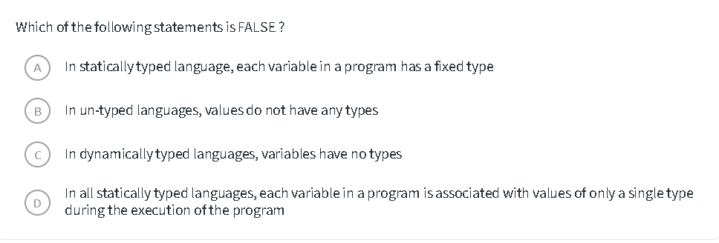
Q11.

Slide 26
Answer:
"Untyped language" has no standard well-formulated definition. According to one definition, un-type languages store values in form of bits, thus neither variables nor values have any types associated to them.
Statically typed languages have one type associated to a variable, which is fixed once it has been deduced. Though, types could either be specified while code editing by the coder (Eg. C, Java), or it can be inferred at compile time (Eg. Haskell). Hence, after compile-time, every variable is bound to one fixed type, making this statement.
Dynamically typed languages deduce types of values and bind them to the variables storing those values. Hence, values sure have fixed types, but variables don't have fixed types bound to them.
Correct anwer is C.

Slide 27
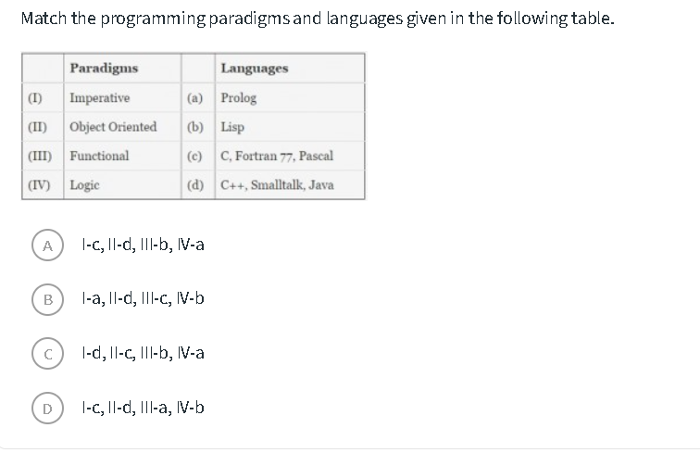
Q12.

Slide 28
Answer:
Correct answer is A.

Slide 29
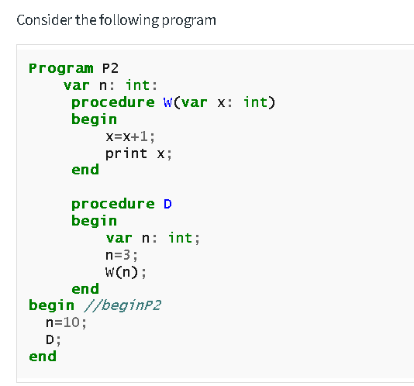
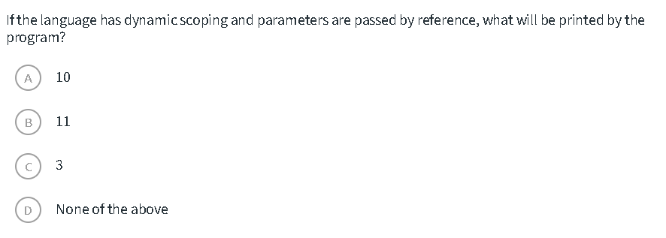
Q13.

Slide 30
Answer.
In dynamic scoping or run-time scoping the free variables are referred as the variables in the most recent frame of function call stack. In the given code in the function call of procedure W the local variable x is printed i.e 4. Under dynamic scoping if x would have not been there in procedure W then we would refer to x of the function in function call stack i.e procedure D and the main function but since x is a local variable not a free variable we referred to the local variable hence 4 will be printed.
Correct aswer is D.

Slide 31
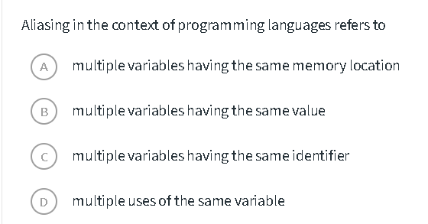
Q14.

Slide 32
Answer:
Correct answer is A

Slide 33
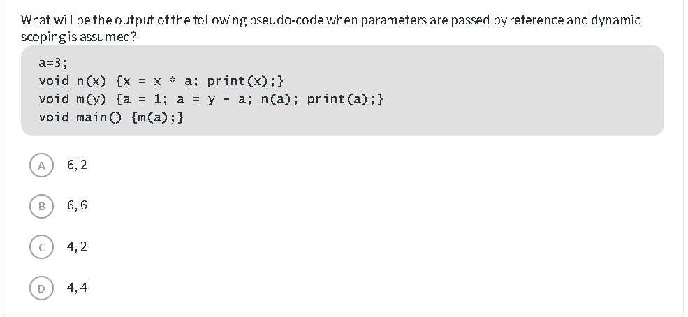
Q15.

Slide 34
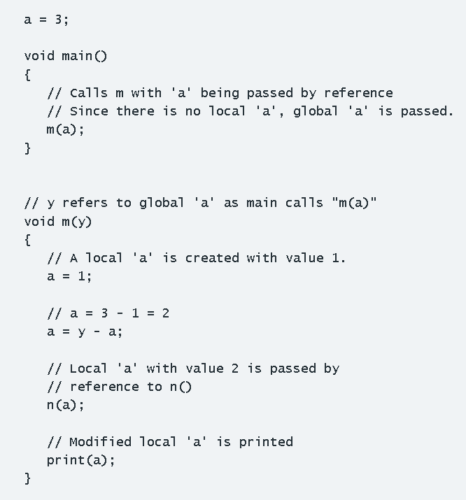
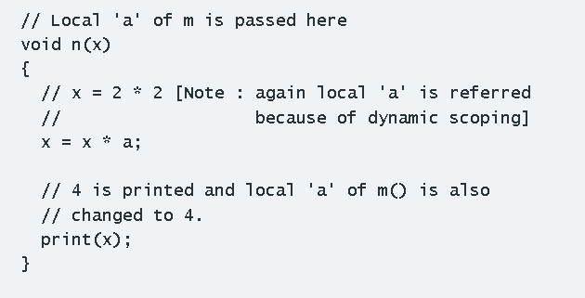
Answer: option D is the correct answer.

Slide 35
Q16.
Define Lexeme and Token
A lexeme is a raw sequence of characters in source code that matches a specific pattern (e.g., x, 10, if), representing a meaningful unit.
A token is a categorical pair—(Token Name, Attribute Value)—assigned to that lexeme by a lexical analyzer, such as IDENTIFIER, NUMBER, or KEYWORD.

Slide 36

Q17.

Slide 37
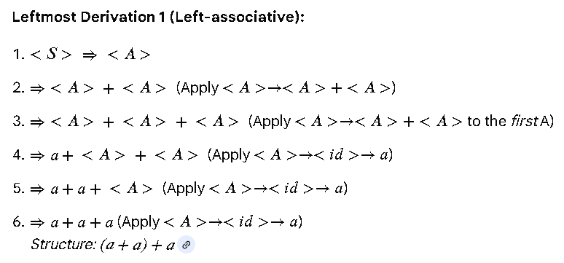
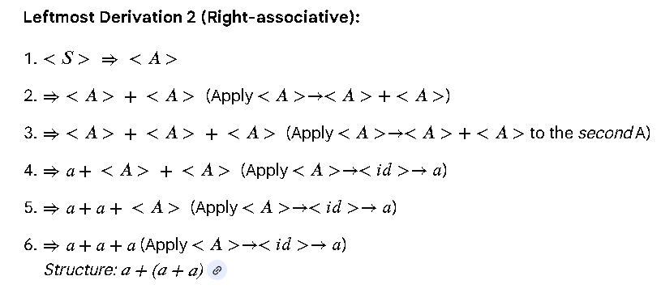
To prove that a grammar is ambiguous, we must show that there exists at least one string in the language generated by the grammar that has more than one leftmost derivation (or equivalently, more than one parse tree).
Let's conside the string a+a+a.

Slide 38
Q18.
What is primary use of attribute grammar?
The primary use of attribute grammar is to formally define and implement the static semantics of programming languages. While context-free grammars (like BNF) define the structure (syntax) of a language, attribute grammars add properties (attributes) to the grammar symbols to compute context-sensitive information, such as variable types, scope, and values.

Slide 39
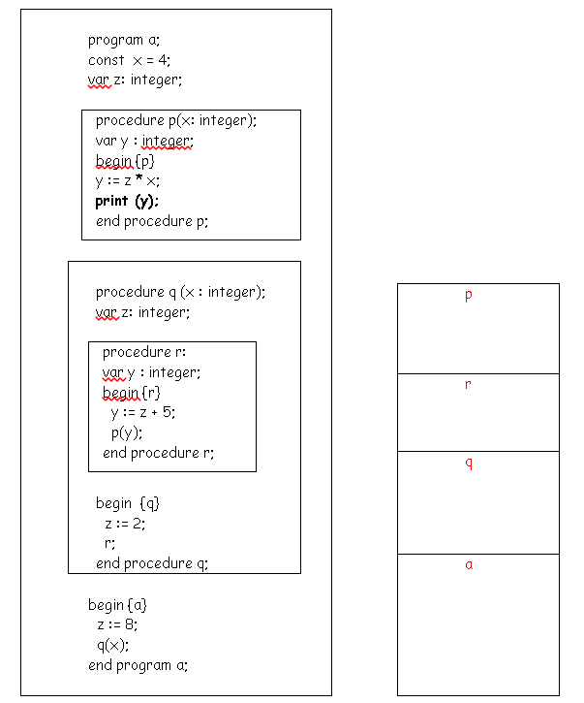
Here's a program written in pseudocode
What value will be printed if we assume that the program is using static scope rules? 56
What value will be printed if we assume that the program is using dynamic scope rules? 14

Slide 40
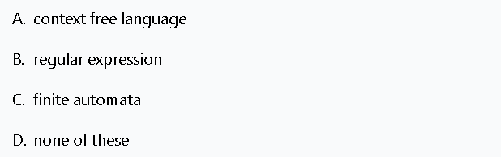
Q20.
For specifying the syntax of a language _____________ is used.

Slide 41
Answer: A

