Slide 1
CMPE/CMSE318
Principles of Programming Languages
Tutorial Notes #2
2025-2026
Spring

Slide 2
Q. 1
A data type is best defined as:
A
A reserved word used to declare a subprogram
B
A collection of data values together with a set of predefined operations on those values
C
A memory address that stores a single value
D
A statement that controls the flow of a program

Slide 3
Answer: A data type defines a collection of data values and a set of predefined operations on those values. Programs produce results by manipulating data, so the language must supply types that match the objects of the problem. Option (B) is correct.

Slide 4
Q. 2
Which of the following is the fundamental idea of an abstract data type (ADT)?
A
All operations on the type are performed at run time only
B
The type may only hold primitive values such as integers
C
The interface visible to the user is separated from the representation and operations, which are hidden
D
The type cannot be reused in more than one program

Slide 5
Answer: The fundamental idea of an abstract data type is that the interface of the type, which is visible to the user, is separated from the representation and the set of operations on its values, which are hidden from the user. Option (C) is correct.

Slide 6
Q. 3
A descriptor of a variable is:
A
The collection of the attributes of the variable
B
Only the run-time value stored in the variable
C
The name (identifier) of the variable alone
D
A pointer that always lives on the heap

Slide 7
Answer: A descriptor is the collection of the attributes of a variable. If all attributes are static, descriptors are needed only at compile time and are built by the compiler (often as part of the symbol table); for dynamic attributes the descriptor must be kept at run time. Option (A) is correct.

Slide 8
Q. 4
Which statement about strong typing is TRUE?
A
A strongly typed language never detects type errors
B
Strong typing means all type errors are always detected, which increases reliability
C
Coercion rules strengthen the benefits of strong typing
D
Java is not strongly typed because it has no type checking at all

Slide 9
Answer: Strong typing is the concept of requiring that all type errors be detected; its value is increased reliability. Coercion rules actually weaken the benefit of strong typing, and Java is considered not strongly typed because of coercions, not a lack of checking. Option (B) is correct.

Slide 10
Q. 5
What is a dangling pointer?
A
A pointer that has never been initialized to any value
B
A pointer that points to two different objects at once
C
A pointer that contains the address of a heap-dynamic variable that has been deallocated
D
A pointer used only for formal parameters

Slide 11
Answer: A dangling pointer is a pointer that contains the address of a heap-dynamic variable that has already been deallocated. Methods such as tombstones and the lock-and-key approach are used to avoid dangling pointers. Option (C) is correct.

Slide 12
Q. 6
The order in which operators of different precedence levels are evaluated in an expression is determined by:
A
Operator associativity rules only
B
Operator precedence rules
C
The order the variables were declared
D
The size of the operands

Slide 13
Answer: Operator precedence rules define the order in which operators of different precedence levels are evaluated. Associativity rules are used to decide the order only when operators have the same precedence. Option (B) is correct.

Slide 14
Q. 7
A short-circuit evaluation of a Boolean expression is one in which:
A
Both operands are always evaluated before the result is known
B
The result is determined without necessarily evaluating all operands or operators
C
The expression is evaluated twice for safety
D
Only arithmetic expressions are involved

Slide 15
Answer: In short-circuit evaluation the result is determined without evaluating all of the operands and/or operators. For example, (a >= 0) && (b < 10) is FALSE whenever a < 0, so the second operand need not be evaluated. Option (B) is correct.

Slide 16
Q. 8
In the C-based languages, which pair of operators performs short-circuit evaluation?
A
& and | (bitwise operators)
B
+ and - (arithmetic operators)
C
&& and || (logical operators)
D
== and != (relational operators)

Slide 17
Answer: In the C-based languages the usual logical AND and OR operators, && and ||, are short-circuit. The bitwise operators & and | are not short-circuit; they evaluate both operands. Option (C) is correct.

Slide 18
Q. 9
A coercion is best described as:
A
An explicit conversion requested by the programmer with a cast
B
An implicit type conversion performed automatically by the compiler
C
An error that always stops compilation
D
A way to overload an operator

Slide 19
Answer: A coercion is an implicit type conversion that is initiated by the compiler, as opposed to an explicit conversion (a cast) requested by the programmer. Widening coercions are generally safer than narrowing coercions. Option (B) is correct.

Slide 20
Q. 10
When a function called within an expression changes a variable that is also used elsewhere in that same expression, this is called a:
A
Functional side effect
B
Short-circuit evaluation
C
Type coercion
D
Operator overloading

Slide 21
Answer: A functional side effect occurs when a function changes a two-way (or global) parameter or a global variable that is also used in the expression that called it. Such side effects can make the value of an expression depend on operand evaluation order. Option (A) is correct.

Slide 22
Q. 11
An iterative statement (a loop) is one that:
A
Selects among alternative control flow paths
B
Causes a statement or collection of statements to be executed zero, one, or more times
C
Always transfers control unconditionally to a label
D
Can only be used to process scalar variables

Slide 23
Answer: An iterative statement, or loop, is one that causes a statement or collection of statements to be executed zero, one, or more times. Iteration is essential to the power of the computer. Option (B) is correct.

Slide 24
Q. 12
The two basic design questions that define the primary categories of iteration control statements are:
A
Which variable is used, and what its type is
B
How the iteration is controlled, and where the control mechanism appears in the loop
C
How many times to unroll, and whether to use recursion
D
Whether to use a goto, and whether to use a label

Slide 25
Answer: Iteration control statements are categorized by how the iteration is controlled (logical, counting, or a combination) and where the control mechanism appears (top or bottom of the loop). Option (B) is correct.

Slide 26
Q. 13
A control structure is best described as:
A
A single assignment statement
B
A control statement together with the collection of statements whose execution it controls
C
A data type with predefined operations
D
A pointer to a subprogram

Slide 27
Answer: A control structure is a control statement and the collection of statements whose execution it controls. Selection and iteration are the two kinds of control needed beyond simple sequencing. Option (B) is correct.

Slide 28
Q. 14
What is the main argument against the unrestricted use of unconditional branch (goto) statements?
A
They execute more slowly than loops
B
They harm readability and reliability of programs
C
They cannot be compiled by modern compilers
D
They require heap allocation

Slide 29
Answer: Unconditional branching (goto) statements are harmful primarily because their unrestricted use damages the readability and reliability of programs. This concern motivated structured programming and restricted forms of branching. Option (B) is correct.

Slide 30
Q. 15
Dijkstra's guarded command selection and iteration statements are notable mainly because they:
A
Eliminate the need for any Boolean expressions
B
Support nondeterminism and were a basis for reasoning about program correctness
C
Are the fastest control structures available
D
Can only be written using goto statements

Slide 31
Answer: Guarded commands, proposed by Dijkstra, allow nondeterministic choice among guards whose Boolean conditions are true, and they were influential as a basis for reasoning about program correctness and for concurrency constructs. Option (B) is correct.

Slide 32
Q. 16
Which of the following is a defining characteristic of a subprogram?
A
It has multiple entry points that may all be active at once
B
It has a single entry point, and only one subprogram is in execution at any given time
C
It can never have any parameters
D
It must always be recursive

Slide 33
Answer: Each subprogram has a single entry point, the calling program is suspended during execution of the called subprogram, and control always returns to the caller when the subprogram terminates. Only one subprogram is in execution at any given time. Option (B) is correct.

Slide 34
Q. 17
Parameters that appear in a subprogram's definition (header) are called:
A
Actual parameters
B
Formal parameters
C
Global parameters
D
Default parameters

Slide 35
Answer: Formal parameters are the names listed in the subprogram's header; actual parameters are the values or addresses supplied at the call. A binding of actual to formal parameters takes place at the call. Option (B) is correct.

Slide 36
Q. 18
Which parameter-passing method passes a copy of the argument's value into the subprogram, so changes to the formal parameter do NOT affect the caller's variable?
A
Pass-by-reference
B
Pass-by-result
C
Pass-by-value
D
Pass-by-name

Slide 37
Answer: Pass-by-value copies the value of the actual parameter into the formal parameter (in-mode), so modifications to the formal parameter are not reflected back to the caller. It is fast for scalars but can be costly to copy large structures. Option (C) is correct.

Slide 38
Q. 19
Aliasing through parameter passing is most associated with which method, because the formal parameter becomes another name for the caller's variable?
A
Pass-by-value
B
Pass-by-reference
C
Pass-by-result
D
Pass-by-value-result

Slide 39
Answer: Pass-by-reference passes an access path (address) rather than a copy, so the formal parameter becomes an alias for the caller's actual parameter. This is efficient but can create aliases and unexpected side effects. Option (B) is correct.

Slide 40
Q. 20
Two subprograms in the same referencing environment that have the same name but different parameter profiles are said to be:
A
Generic subprograms
B
Overloaded subprograms
C
Coroutines
D
Closures

Slide 41
Answer: An overloaded subprogram is one that has the same name as another subprogram in the same referencing environment but a different protocol (parameter profile). A generic (polymorphic) subprogram, by contrast, takes parameters of different types on different calls. Option (B) is correct.

Slide 42
Q. 21
Formal parameters are characterized by three semantics models. A parameter that can ONLY receive data from the actual parameter (and is not changed by the subprogram) uses which mode?
A
In mode
B
Out mode
C
Inout mode
D
Name mode

Slide 43
Answer: There are three semantics models of parameter passing: in mode (the formal parameter receives data from the actual parameter), out mode (the formal parameter transmits data to the actual parameter), and inout mode (it does both). A parameter that is not changed by the subprogram is in mode. Option (A) is correct.

Slide 44
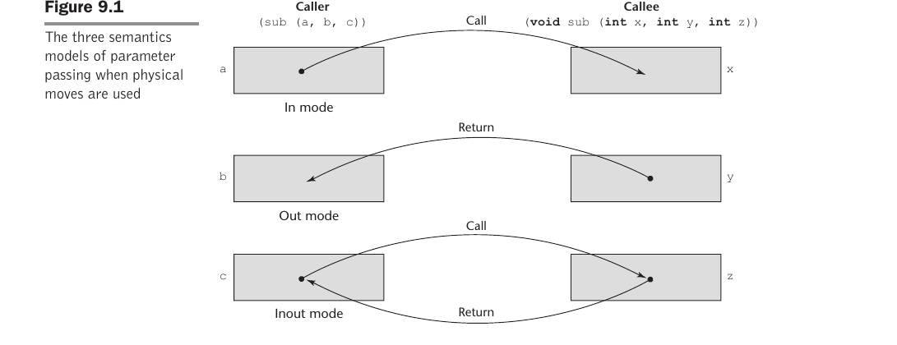
Q. 22
In the diagram below, the three semantics models of parameter passing (when values are physically copied) are illustrated. Which row corresponds to inout mode?
A
The row labeled 'In mode' (value copied only on the call)
B
The row labeled 'Out mode' (value copied only on the return)
C
The row labeled 'Inout mode' (value copied on both call and return)
D
None of the rows shows inout mode

Slide 45
Answer: Inout mode combines in mode and out mode: the value of the actual parameter is copied in on the call AND the (possibly changed) value is copied back on the return, as shown by the bottom row with both a Call and a Return arrow. Option (C) is correct.

Slide 46
Q. 23
Which statement about pass-by-result (an implementation model for out-mode parameters) is TRUE?
A
The value of the actual parameter is copied INTO the formal parameter at the call
B
No value is transmitted to the subprogram; the formal parameter acts as a local that is copied back to the actual parameter on return
C
It transmits an access path so no copying is ever needed
D
It is identical to pass-by-reference

Slide 47
Answer: Pass-by-result implements out mode: no value is transmitted to the subprogram. The formal parameter acts like a local variable whose value is copied to the corresponding actual parameter when control returns. It shares pass-by-value's extra storage/copy costs and can suffer from actual-parameter-collision and address-evaluation-time problems. Option (B) is correct.

Slide 48
Q. 24
Pass-by-value-result is an implementation model for inout-mode parameters. It is sometimes also called:
A
Pass-by-name
B
Pass-by-copy
C
Pass-by-reference
D
Pass-by-keyword

Slide 49
Answer: Pass-by-value-result copies the actual parameter's value in at the call and copies the (possibly changed) value back at return. Because actual values are physically moved both ways, it is sometimes called pass-by-copy. It avoids the aliasing problems of pass-by-reference but requires extra storage and copy time. Option (B) is correct.

Slide 50
Q. 25
Which parameter-passing implementation model is most likely to create aliases and make program verification harder, because the formal parameter shares storage with the actual parameter?
A
Pass-by-value
B
Pass-by-result
C
Pass-by-value-result
D
Pass-by-reference

Slide 51
Answer: Pass-by-reference transmits an access path (usually an address) rather than copying the value, so the formal parameter becomes an alias of the actual parameter. This is efficient (no copying) but introduces aliases that harm readability, reliability, and verification. Option (D) is correct.

Slide 52
Q. 26
Consider the pseudocode below using PASS-BY-VALUE. What is printed?
void swap(int x, int y) {
int temp = x;
x = y;
y = temp;
}
main() {
int a = 3, b = 8;
swap(a, b);
print(a, b);
}
A
3, 8
B
8, 3
C
8, 8
D
3, 3

Slide 53
Answer: With pass-by-value, copies of a and b are passed to x and y. The swap exchanges the LOCAL copies only; the caller's a and b are untouched. Therefore the program prints 3, 8 (unchanged). Option (A) is correct.

Slide 54
Q. 27
Now consider the SAME swap routine but using PASS-BY-REFERENCE. What is printed?
void swap(int &x, int &y) {
int temp = x;
x = y;
y = temp;
}
main() {
int a = 3, b = 8;
swap(a, b);
print(a, b);
}
A
3, 8
B
8, 3
C
8, 8
D
3, 3

Slide 55
Answer: With pass-by-reference, x and y are aliases for a and b, so the exchange acts directly on the caller's variables. After the call a = 8 and b = 3, so the program prints 8, 3. This is why pass-by-reference is the usual way to implement a working swap. Option (B) is correct.

Slide 56
Q. 28
The format (layout) of the noncode part of a subprogram — its local variables, parameters, and bookkeeping data — is called:
A
A symbol table
B
An activation record
C
A virtual method table
D
A static link

Slide 57
Answer: An activation record is the format/layout of the noncode part of a subprogram, because the data it describes are relevant only during the activation (execution) of the subprogram. The form of an activation record is static. Option (B) is correct.

Slide 58
Q. 29
What is the difference between an activation record and an activation record instance?
A
They are exactly the same thing
B
The activation record is the static format/layout; an activation record instance is a concrete collection of data in that format created for a particular activation
C
An activation record instance exists only at compile time
D
An activation record instance is the machine code of the subprogram

Slide 59
Answer: The activation record is the static form (the template/layout). An activation record instance (ARI) is a concrete example — an actual collection of data in the form of an activation record, created for one particular activation of the subprogram. Option (B) is correct.

Slide 60
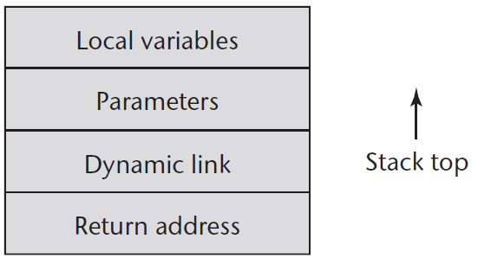
Q. 30
The figure shows an activation record for a 'simple' (non-nestable, static-local) subprogram. Why can it be allocated statically?
A
Because such languages allow recursion
B
Because the language has no parameters
C
Because there is no recursion, so only one active instance exists at a time and the record has fixed size
D
Because the return address is unknown at compile time

Slide 61
Answer: Languages with 'simple' subprograms do not support recursion, so there can be only one active instance of a given subprogram at a time, and its activation record has a fixed size. Therefore the activation record instance can be allocated statically (even attached to the code). Option (C) is correct.

Slide 62
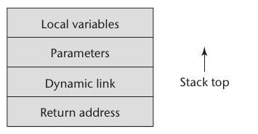
Q.31
The figure shows a typical activation record for a language with STACK-DYNAMIC local variables. The return address, dynamic link, and parameters are placed by the caller and therefore appear at the bottom. The return address normally consists of:
A
A copy of all local variables of the caller
B
A pointer to the instruction following the call in the caller's code segment
C
A pointer to the base of the callee's activation record
D
The functional return value

Slide 63
Answer: The return address usually consists of a pointer to the instruction following the call in the code segment of the calling program unit, so control can resume there after the subprogram returns. Option (B) is correct.

Slide 64
Q.32
In a stack-dynamic activation record, the DYNAMIC LINK is:
A
A pointer to the base of the activation record instance of the caller
B
A pointer to the lexically enclosing (static parent) activation record
C
The return value of a function
D
A copy of the program counter at program start

Slide 65
Answer: The dynamic link is a pointer to the base of the activation record instance of the caller. In static-scoped languages it supports run-time traceback; in dynamic-scoped languages it is used to access nonlocal variables. Option (A) is correct.

Slide 66
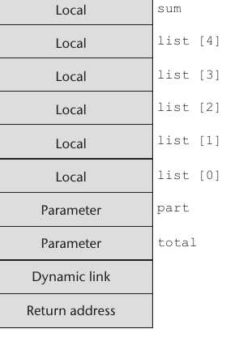
Q. 33
The figure shows the activation record for the C function 'sub' below. In which order (from the bottom/first-pushed upward) do the entries appear?
void sub(float total, int part) {
int list[5];
float sum;
...
}
A
Local variables, then parameters, then dynamic link, then return address
B
Return address, then dynamic link, then parameters, then local variables
C
Parameters, then return address, then local variables, then dynamic link
D
Dynamic link, then local variables, then return address, then parameters

Slide 67
Answer: Because the caller places the return address, dynamic link, and parameters, these appear first (at the bottom): return address, then dynamic link, then parameters (total, part). The callee allocates locals last (on top): list[0..4] and sum. Option (B) is correct.

Slide 68
Q. 34
Why are instances of activation records for languages with stack-dynamic locals naturally maintained on a run-time STACK?
A
Because subprograms never return
B
Because the subprogram last called is the first to complete (LIFO), which matches stack behavior
C
Because the heap cannot store activation records
D
Because the return address is always zero

Slide 69
Answer: Call/return semantics specify that the subprogram last called is the first to complete (last-in, first-out). This LIFO discipline matches a stack, so activation record instances are created on the run-time stack; each activation (recursive or not) gets its own instance. Option (B) is correct.

Slide 70
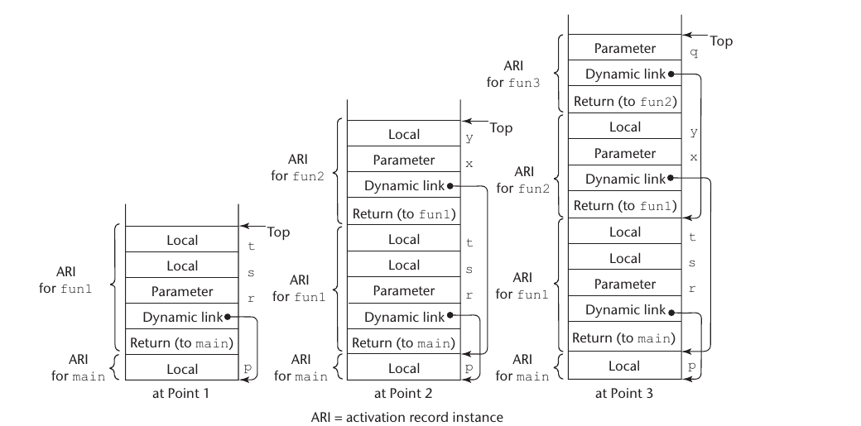
Q. 35
The collection of dynamic links present in the stack at a given time is called the dynamic chain (or call chain). What does it represent?
A
The lexical (static) nesting of the program text
B
The dynamic history of how execution reached its current position
C
The list of all global variables
D
The set of virtual method tables in use

Slide 71
Answer: The dynamic chain (call chain) is the collection of dynamic links in the stack; it represents the dynamic history of how execution got to its current position. In the figure, each Dynamic link points to the base of the caller's activation record instance, forming the chain. Option (B) is correct.

Slide 72
Q. 36
A local variable's location within an activation record can be represented as an offset from the start of the record, whose base address is stored in the environment pointer (EP). This offset is called the:
A
chain_offset
B
static_depth
C
local_offset
D
return address

Slide 73
Answer: References to local variables are represented in the code as offsets from the beginning of the local activation record (whose base is in the EP). Such an offset is called the local_offset, determined at compile time from the order, types, and sizes of the declared variables. Option (C) is correct.

Slide 74
Q. 37
In static-scoped languages that allow NESTED subprograms, the most common way to access nonlocal variables adds a pointer to the activation record that points to the static parent's activation record instance. This pointer is the:
A
Dynamic link
B
Return address
C
Static link (static scope pointer)
D
Local offset

Slide 75
Answer: Static chaining adds a static link (sometimes called a static scope pointer) to the activation record. It points to the base of the activation record instance of the static parent and is used to access nonlocal variables. Option (C) is correct.

Slide 76
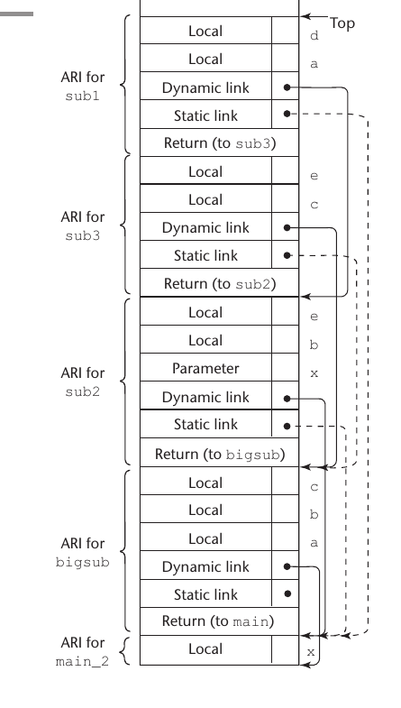
Q. 38
The figure shows a stack with both dynamic links and static links. What is the essential difference between the STATIC chain and the DYNAMIC chain?
A
They are always identical
B
The static chain follows lexical (static parent) nesting; the dynamic chain follows the actual sequence of calls
C
The static chain is built at run time only; the dynamic chain at compile time only
D
The static chain stores return values; the dynamic chain stores parameters

Slide 77
Answer: The static chain links each activation record instance to that of its static (lexical) parent, reflecting program text nesting and used for nonlocal access. The dynamic chain links to the caller, reflecting the actual run-time sequence of calls. They can differ, as the figure shows (static links dashed, dynamic links solid). Option (B) is correct.

Slide 78
Q. 39
static_depth indicates how deeply a scope is nested in the outermost scope. For a nonlocal reference to variable X, the number of static links that must be followed (the chain_offset / nesting_depth) equals:
A
The static_depth of X's declaring subprogram
B
The static_depth of the referencing subprogram minus the static_depth of X's declaring subprogram
C
The total number of subprograms in the program
D
Always exactly 1

Slide 79
Answer: The length of the static chain to reach the correct activation record instance for a nonlocal reference to X is the difference between the static_depth of the subprogram containing the reference and the static_depth of the subprogram containing X's declaration. This difference is the nesting_depth, or chain_offset. Option (B) is correct.

Slide 80
Chapter 10 - Implementing Subprograms
Question 40
A nonlocal reference can be represented at compile time by an ordered pair of integers (chain_offset, local_offset). What does each component mean?
A
chain_offset = number of static links to follow; local_offset = offset of the variable within that activation record
B
chain_offset = the variable's value; local_offset = its type code
C
chain_offset = number of parameters; local_offset = number of locals
D
chain_offset = return address; local_offset = dynamic link

Slide 81
Answer: A nonlocal reference is represented by the pair (chain_offset, local_offset): chain_offset is how many static links to follow to reach the activation record instance that contains the variable, and local_offset is the variable's offset within that activation record. Both are computable at compile time. Option (A) is correct.

Slide 82
Q. 41
In a language that uses DYNAMIC scoping, which link in the activation record is used to search for nonlocal variables?
A
The static link
B
The dynamic link
C
The return address
D
The local offset

Slide 83
Answer: In dynamic-scoped languages, the dynamic link is used to access nonlocal variables: a nonlocal reference is resolved by searching the dynamic chain (the call chain) for the most recent activation that declares the name. In static-scoped languages the dynamic link is used only for traceback. Option (B) is correct.

Slide 84
Q. 42
In object-oriented languages, dynamically bound (virtual) method calls are commonly implemented using a data structure that stores pointers to the method code for a class. This structure is called the:
A
Activation record
B
Static chain
C
Virtual method table (vtable)
D
Symbol table

Slide 85
Answer: A virtual method table (vtable) holds pointers to the (most-derived) implementations of a class's dynamically bound methods. Each object carries a pointer to its class's vtable, so a virtual call is resolved by indexing into the vtable at run time. Option (C) is correct.

Slide 86
Q. 43
Which statement about virtual method tables (vtables,vmt) is TRUE?
A
Each individual object stores its own complete copy of all method code
B
There is typically one vtable per class, and each object holds a pointer to its class's vtable
C
Vtables are used only for statically bound (non-virtual) calls
D
Vtables eliminate the need for activation records

Slide 87
Answer: Typically one vtable is created per class (shared by all instances of that class), and each object stores a single pointer to its class's vtable. A virtual call indexes the vtable to find the correct method, enabling dynamic dispatch with low per-object overhead. Option (B) is correct.

Slide 88
Q. 44
The mechanism by which the method actually invoked is determined by the run-time type of the object (rather than the compile-time type of the reference) is known as:
A
Static binding
B
Dynamic dispatch (dynamic binding)
C
Short-circuit evaluation
D
Aliasing

Slide 89
Answer: Dynamic dispatch (dynamic binding) selects the method implementation based on the object's actual run-time type, which is what makes overriding and polymorphism work. It is commonly implemented with virtual method tables. Option (B) is correct.

