Slide 1
Chapter 4 Lexical and Syntax Analysis
CMPE318 Concepts of Programming Languages
2025-2026 SPRING

Slide 2
Chapter 4 Topics
Introduction
Lexical Analysis
The Parsing Problem
Recursive-Descent Parsing
Bottom-Up Parsing

Slide 3
Introduction
Language implementation systems must analyze source code, regardless of the specific implementation approach.
Before execution, the system must understand the structure of the program written by the programmer.
This analysis is required in all implementation approaches:
Compilation
Interpretation
Hybrid Systems (JIT compilation)
Nearly all syntax analysis is based on a formal description of the syntax of the source language (BNF)

Slide 4
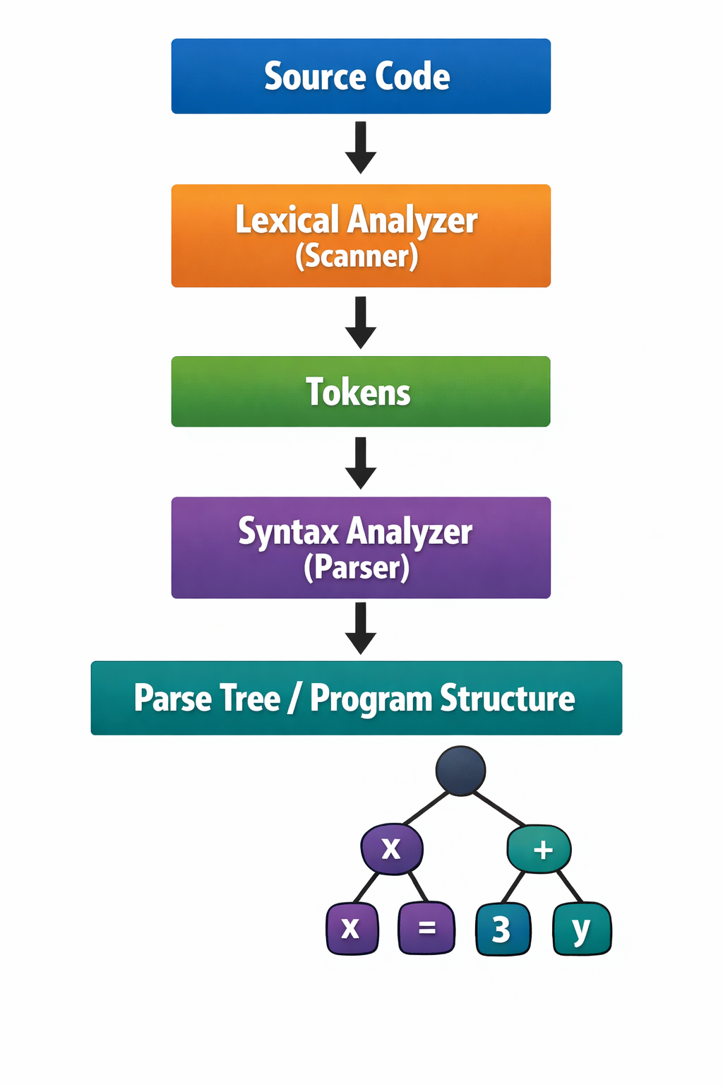
Introduction
First, the Source Code is given as input to the compiler. The Lexical Analyzer (Scanner) reads the source code and breaks it into small meaningful elements called tokens. Tokens are the basic units of the program such as keywords, identifiers, operators, and numbers.
Next, these tokens are passed to the Syntax Analyzer (Parser). The parser checks whether the sequence of tokens follows the grammar rules of the programming language. In other words, it verifies that the program is written in a syntactically correct way.
Finally, the output of this process is a Parse Tree (Program Structure). The parse tree visually represents the hierarchical structure of the program and shows how different parts of the code are organized according to the language’s grammar.

Slide 5
Formal Description of Syntax
Nearly all syntax analyzers are based on a formal description of the programming language syntax. The most common formal notation is Backus-Naur Form (BNF).
BNF is used to describe context-free grammars that define the structure of programs. Example rule:
<assignment> → <identifier> = <expression>
This rule states that an assignment statement must contain:
an identifier followed by the symbol =
followed by an expression
BNF rules like this are used by parsers to verify that programs follow the language syntax.

Slide 6
Syntax Analysis
The syntax analysis step of a language processor is usually divided into two main components:
Lexical Analyzer (Scanner) – Low-level analysis:
The lexical analyzer processes the raw sequence of characters from the source program.
It groups characters into meaningful units called lexemes.
Each lexeme is assigned to a token category.

Slide 7
Examples of tokens:
identifiers
keywords
numeric literals
Operators
From a theoretical perspective:
A lexical analyzer can be modeled as a finite automaton.
The patterns it recognizes are described using regular grammars (or regular expressions).
Because lexical analysis deals with small-scale language elements, it is considered the low-level part of syntax processing.

Slide 8
Syntax Analyzer (Parser) – High-level analysis:
The Syntax Analyzer, also called the Parser, works with the tokens produced by the lexical analyzer.
Its role is to determine whether the sequence of tokens forms a syntactically valid program.
The parser analyzes larger program structures, such as:
Expressions
Statements
Program Blocks
Complete Program Units

Slide 9
From a theoretical viewpoint:
A Syntax analyzer can be modeled as a pushdown automaton.
A Lexical analyzer can be modeled as a finite automaton.
The grammar used for syntax analysis is a context free grammar (CFG), commonly written using BNF.

Slide 10
Summary:
Lexical analysis handles the smallest elements of the language.
Syntax analysis handles the structural relationships between these elements.
Together, they ensure that the program follows the rules of the programming language.

Slide 11
Advantages of Using BNF to Describe Syntax
Provides clear and concise syntax description
The parser can be based directly on the BNF
Parsers based on BNF are easy to maintain

Slide 12
Advantages of Using BNF to Describe Syntax
Clear and Concise Syntax Description:
BNF provides a formal and precise way to describe the syntax of a programming language
Instead of informal descriptions in natural language, BNF defines syntax using grammar rules
These rules clearly specify how valid program constructs are formed.
Example:
<assignment> -> <identifier> = <expression>
This rule explicitly defines the structure of an assignment statement.

Slide 13
Advantages of Using BNF to Describe Syntax
Parsers can be built directly from BNF:
The grammar written in BNF can serve as the direct foundation for constructing a parser.
Many parsing algorithms and parser generators use the grammar rules to determine how input programs should be analyzed.
As a result, the syntax analyzer closely follows the structure of the BNF grammar.
Thus, this connection simplifies the process of implementing syntax analysis in compilers and interpreters.

Slide 14
Advantages of Using BNF to Describe Syntax
BNF-based parsers are easier to maintain:
Programming languages evolve over time and new syntax features may be added.
When syntax is defined using BNF, changes can often be made by modifying a small number of grammar rules.
Grammar rules are modular and structured, updating the parser becomes easier and less error-prone.

Slide 15
Reasons to Separate Lexical and Syntax Analysis
Simplicity - less complex approaches can be used for lexical analysis; separating them simplifies the parser
Efficiency - separation allows optimization of the lexical analyzer
Portability - parts of the lexical analyzer may not be portable, but the parser always is portable

Slide 16
Reasons to Separate Lexical and Syntax Analysis
Simplicity
Lexical analysis techniques are simpler than syntax analysis.
The lexical analyzer only needs to recognize small language elements such as
identifiers
numbers
keywords
operators
By separating lexical analysis from syntax analysis:
The parser does not need to handle low-level details
The parser becomes smaller and easier to design

Slide 17
Reasons to Separate Lexical and Syntax Analysis
Efficiency
Lexical analysis often consumes a significant portion of compilation time, because every character of the source program must be examined.
Separating lexical analyser allows it to be optimized independently
For example:
Faster scanning techniques
Efficient buffering
Specialized pattern matching
Meanwhile, the parser can remain focused only on structural analysis

Slide 18
Reasons to Separate Lexical and Syntax Analysis
Portability
The lexical analyzer interacts directly with the input program files and often includes:
file handling
input buffering
system-specific operations
Parts on the lexical analyzer may be platform dependent.
The parser, however, operates only on tokens, which are independent of the underlying machine or operating system
Separating these components helps isolate machine-dependent code, improving the portability of the language processor

Slide 19
Lexical Analysis
A lexical analyzer is responsible for reading the source program as a sequence of characters
It acts as a pattern matcher for character strings, meaning it detects patterns in the input that correspond to valid language elements.
The lexical analyzer is the front-end component of the parser, it processes the raw input and produces a stream of tokens that the parser can analyze.

Slide 20
Lexeme and Tokens
Lexical analyzer groups characters into meaningful sequences called lexemes.
A lexeme is a substring of the source program that represents a basic language element.
Example:
Variable names
Keywords
Numeric literals
Operators
Each lexeme is classified into a token, which represents a category of lexemes

Slide 21
Relationship between lexemes and tokens
A token represents a category or class of similar lexemes.
Lexeme
Sum
Total
X
=
Token
IDENT
IDENT
IDENT
ASSIGN
Here, sum is a lexeme (the actual text in the source program)
IDENT is the token that represents the category identifier

Slide 22
Role of lexical Analyzer
Lexical analyzer performs several important tasks:
Identifies lexemes in the source program
Converts lexemes into tokens
Skips whitespace and comments
Passes tokens one at a time to the syntax analyzer
Thus, the lexical analyzer prepares the input for syntax analysis

Slide 23
Lexical Analysis (continued)
In most language processors, the lexical analyzer is implemented as a function or module
The parser calls the lexical analyzer whenever it needs the next token from the source program.
Each call to the lexical analyzer typically performs the following steps:
Reads characters from the input program
Groups them into a lexeme
Determines the token category of the lexeme
Returns the token and lexeme to the parser
Therefore, the parser does not process characters directly, instead, it receives tokens produced by the lexical analyzer.

Slide 24
Approaches to building a lexical analyzer
Using a Lexical Analyzer Generator (Automatic Generation)
Write formal description of token patterns using a specification language based on regular expressions
A software tool reads this description and automatically generates the lexical analyzer.
Examples to tools:
Lex
Flex
Advantages:
Faster development
Less manual coding
Widely used in compiler construction

Slide 25
Implementing a State Diagram in Code
First design a state transition diagram that describes how tokens are recognized
Then write a program that follows the transitions in the diagram.
In this approach:
States represent recognition stages
Transitions represent input characters
This method provides greater control over the lexical analyzer behavior.

Slide 26
Table-driven Implementation of a State Diagram
Start with a state diagram describing token recognition
Convert the diagram into a transition table.
The lexical analyzer:
Uses the table to determine state transitions based on input characters
Advantages:
Often easier to modify
Efficient for implementation
Used in some automatically generated scanners (lexical analyzers)

Slide 27
State Diagram Design
A state diagram is commonly used to represent how a lexical analyzer recognizes tokens
In theory, a lexical analyzer could be designed with a transition for every possible character from every state.
This approach is called a naive state diagram.

Slide 28
Problem with a Naive State Diagram
Programming languages usually allow many possible characters:
Letters(A-Z, a-z)
Digits (0-9)
Operators (+,-,=,etc)
Punctuation symbols (!, ?, :, ;, etc)
If every state had a transition for each possible character, the number of transitions would become very large.
As a result, the state diagram would be:
Very complex
Difficult to design
Hard to maintain

Slide 29
Motivation for Simplification
Since naive state diagrams are too large, lexical analyzer design typically uses simplification techniques, such as:
Character classes (grouping similar characters together)
Shared transitions for multiple characters
Table-driven implementations
These techniques allow the state diagram to remain compact and manageable.
Example: suppose the lexical analyzer must recognize identifiers and an identifier can start with any letter (a-z,A-Z).
Start -> a, start ->b, ... Start -> Z.
Instead, simplify this by defining a character class: LETTER= {A-Z, a-z}
Now the diagram becomes Start -> LETTER

Slide 30
Character Classes for Integer Literals and Identifiers
When recognizing identifiers, all uppercase and lowercase letters play the same role. Example identifiers:
Sum
Value
Total
X1
Counter
When recognizing integer literals, all digits behave in the same way. Instead of creating transitions for each digit (0-9), we define a digit class. Example:
DIGIT = {0-9}
Using character classes:
Reduces the number of transitions in the state diagram
Makes the lexical analyzer simpler and easier to design
Improves readability and maintainability of the scanner design

Slide 31
In many programming languages, reserved words and identifiers have the same lexical pattern:
if
while
return
sum
value
count
From the perpective of the lexical analyzer, these are all strings of letters (and possibly digits)
Because they follow the same pattern, the lexical analyzer can recognize them using the same part of the state diagram
This avoids creating separate states or transitions for every reserved word, which would make the state diagram unnecessarily large

Slide 32
Using a Lookup Table
After the lexical analyzer recognizes a lexeme that matches the identifier pattern, it performs an additional step
The lexeme is checked against a table of reserved words
Process:
Recognize the lexeme as an identifier-like pattern
Check the lexeme in the reserved word table
If it is found, assign the reserved word token
If not found, assign the identifier token

Slide 33
Convenient utility subprograms:
In many lexical analyzer implementations, several utility subprograms are used to simplify the scanning process.
These helper functions manage reading characters, building lexemes, and identifying tokens.
getChar: reads the next character from the input source program.
It performs two main tasks:
Stores the character in a variable such as nextChar.
Determines the character class of the input characters.
Example characters classes:
LETTER -> A-Z, a-z
DIGIT -> 0-9
UNKNOWN -> operators or punctuation
The result is stored in a variable such as charClass.
This classification helps the lexical analyzer decide how to process the character.

Slide 34
addChar: adds the current character (nextChar) to the lexeme being constructed.
The lexeme is usually stored in a character array or string, often called lexeme.
Example, if the program contains «total», addChar builds the lexeme step by step:
t -> to -> tot -> tota -> total
This continues until the lexical analyzer determines that the lexeme is complete.
Lookup: this function checks whether the lexeme stored in lexeme corresponds to a reserved word or special symbol.
Lexeme
if
while
+
Returned Token
IF
WHILE
ADD_OP
If the lexeme is not a reserved word, it may be classified as a general identifier token (IDENT) token.

Slide 35
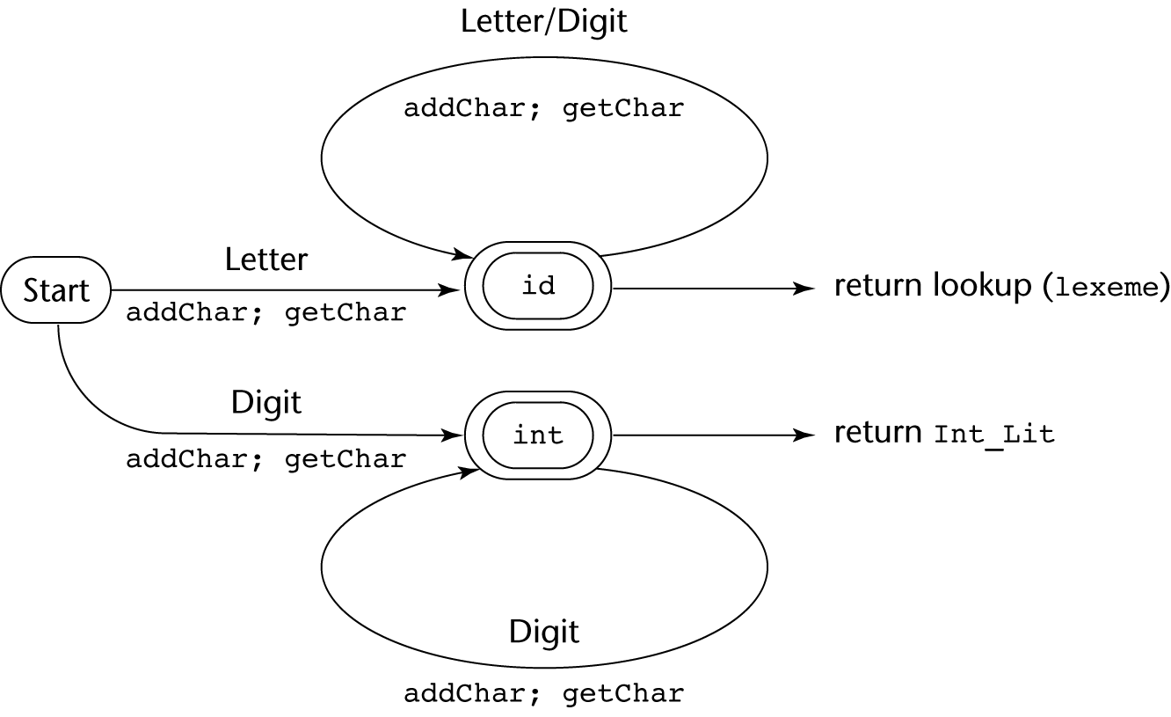
State Diagram

Slide 36
The Parsing Problem
Given an input program, the parser (syntax analyzer) has two main objectives:
Checks whether the sequence of tokens follows the grammar rules of the programming language. (The first objective)
If the program violates the grammar rules, the parser must:
Detect the syntax error
Produce a clear diagnostic error message
Produce the parse tree, or at least a trace of the parse tree, for the program

Slide 37
Example syntax error:
X =+ 5
Error message example:
Syntax error: unexpected operator + in assignment expression
After detecting an error, the parser should recover quickly and continue analyzing the rest of the program
This allows the compiler to report multiple errors in a single compilation, instead of stopping at the first error.

Slide 38
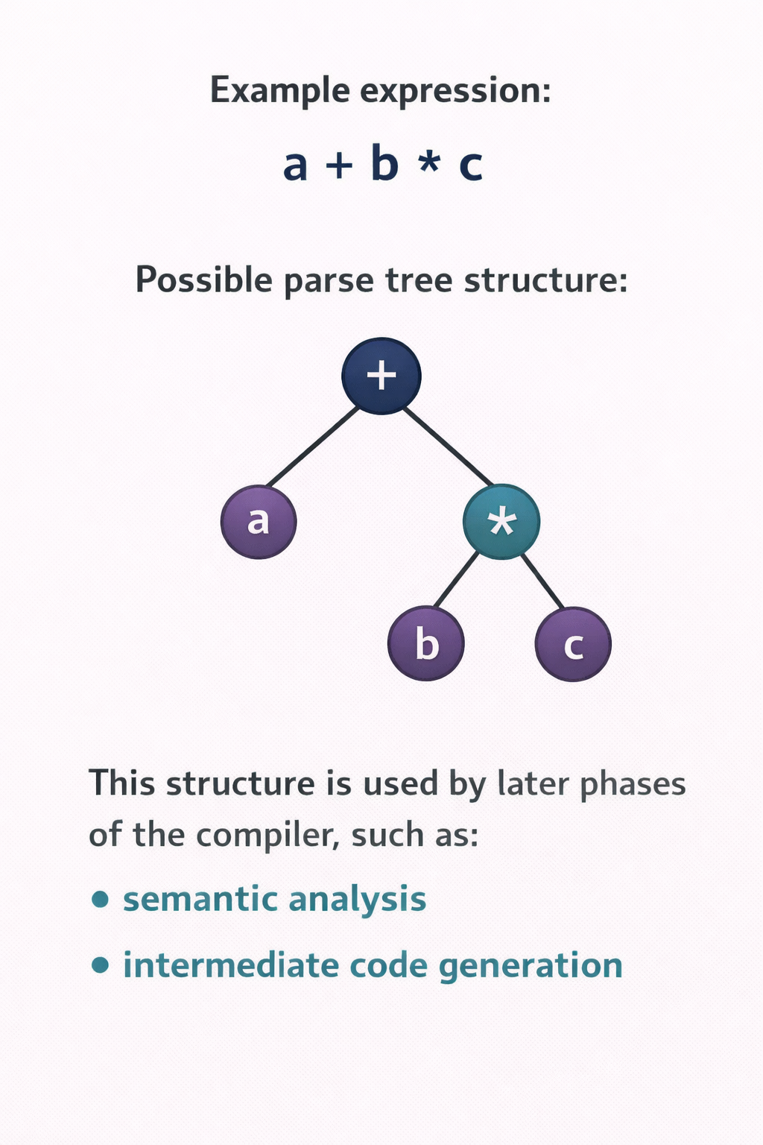
Construct the Parse Tree (Second objective):
If the program is syntatically correct, the parser builds a parse tree (or produces information needed to construct it).
A parse tree represents the hierarchical structure of the program according to the grammar rules.

Slide 39
Parsers can generally be divided into two main categories, depending on how they construct the parse tree:
Top down – construct the parse tree starting from the root and expanding toward the leaves.
The process follows a leftmost derivation, meaning that the parser repeatedly expands the leftmost nonterminal in the grammar.
In this approach:
The parser predicts which grammar rule to apply
It attempts to match the input tokens with the expected structure.
The parse tree is built in preorder traversal (root first, then its children)
Common top-down parsing techniques:
Recursive-descent parsing
LL parsers (table-driven implementation)

Slide 40
Parsers can generally be divided into two main categories, depending on how they construct the parse tree:
Bottom up parsers – construct the parse tree starting from the leaves (tokens) and working toward the root.
Instead of predicting grammar rules, they combine tokens and smaller structures into larger constructs.
This process corresponds to reverse of a rightmost derivation.
Example:
Tokens ↓ Combine tokens into phrases ↓ Build larger structures ↓ Reach the start symbol (root)
Common bottom-up parsing techniques:
LR parsers
Shift-reduce parsers

Slide 41
Most practical parsers look ahead only one token in the input stream to make parsing decisions
This approach is efficient and sufficient for most programming language grammars.
Example:
Current token -> decide next parsing action
This design helps parsers remain efficient and practical for compiler implementation

Slide 42
Top-down Parsers
A top-down parser builds the parse tree beginning from root
At each step, the parser considers a sentential form:
xAα
X: a string of terminal symbols that have already been processed
A: the leftmost nonterminal that must be expanded
Α: the remaining part of the string
The parser must select the correct grammar rule for A to produce the next step in the leftmost derivation.

Slide 43
Top-down Parsers
Parsing decision:
The key challenge is deciding which grammar rule to apply for the nonterminal A.
Top-down parsers usually make this decision by examining the next token of input, often called the lookahead token.
Example:
Current sentential form: xAα
Next input token: t
The parser chooses the rule for A whose right-hand side can generate t as its first symbol.

Slide 44
Common Top-down Parsing Algorithms
Two widely used approaches implement top-down parsing:
Recursive-descent parsing
Implement directly as a set of recursive functions, one for each nonterminal
Each function corresponds to a grammar rule
The parser class these functions to expand nonterminals
Example:
Expr()
Term()
Factor()

Slide 45
Common Top-down Parsing Algorithms
LL Parsers (Table-driven parsers)
Use a parsing table instead of explicit recursive code
The table determines which grammar rule to apply, based on:
The current nonterminal
The enxt input token
The name LL means:
L -> scan input from left to right
L-> construct a leftmost derivation
Example grammar:
A -> aB
A -> bC
A -> c
Suppose the parser sees:
Current form: xAα
Next token: b
The parser chooses:
A -> bC , since that rule begins with b.

Slide 46
Bottom-up Parsers
A bottom-up parser constructs the parse tree starting from the leaves (input tokens) and gradually works upward toward the root.
Instead of predicting grammar rules, the parser recognizes smaller parts of the input and combines them into larger structures
This process corresponds to the reverse of a rightmost derivation in the grammar.

Slide 47
At any step, the parser examines a right sentential form, represented as α
The parser must determine which substring of α corresponds to the right-hand side (RHS) of a grammar rule
Once the correct substring is found, the parser reduces it to the corresponding LHS of the rule.
This process is called reduction.

Slide 48
Example:
Suppose the grammar contains:
E -> E + T
T -> id
Given input tokens id + id
Bottom-up parsing works like:
id + id ↓ T + id ↓ E + id ↓ E
The parser repeatedly reduces substrings to grammar symbols until the start symbol is produced.

Slide 49
Common bottom-up parsing algorithms:
The most widely used bottom-up parsing algorithms belong to the LR family of parsers. These include:
LR(0)
SLR
LALR
Canonical LR
Properties of LR parsers:
Scan input from left to right
Construct the rightmost derivation in reverse

Slide 50
The Complexity of Parsing
Parsers that work for any unambiguous grammar are complex and inefficient ( O(n³), where n is the length of the input )
Compilers use parsers that only work for a subset of all unambiguous grammars, but do it in linear time ( O(n), where n is the length of the input )

Slide 51
Recursive-Descent Parsing
There is a subprogram for each nonterminal in the grammar, which can parse sentences that can be generated by that nonterminal
EBNF is ideally suited for being the basis for a recursive-descent parser, because EBNF minimizes the number of nonterminals

Slide 52
Recursive-Descent Parsing (continued)
A grammar for simple expressions:
<expr> → <term> {(+ | -) <term>}
<term> → <factor> {(* | /) <factor>}
<factor> → id | int_constant | ( <expr> )

Slide 53
Recursive-Descent Parsing (continued)
Assume we have a lexical analyzer named lex, which puts the next token code in nextToken
The coding process when there is only one RHS:
For each terminal symbol in the RHS, compare it with the next input token; if they match, continue, else there is an error
For each nonterminal symbol in the RHS, call its associated parsing subprogram

Slide 54
Recursive-Descent Parsing (continued)
This particular routine does not detect errors
Convention: Every parsing routine leaves the next token in nextToken

Slide 55
Recursive-Descent Parsing (continued)
A nonterminal that has more than one RHS requires an initial process to determine which RHS it is to parse
The correct RHS is chosen on the basis of the next token of input (the lookahead)
The next token is compared with the first token that can be generated by each RHS until a match is found
If no match is found, it is a syntax error

Slide 56
Recursive-Descent Parsing (continued)
/* Function factor
Parses strings in the language
generated by the rule:
<factor> -> id | (<expr>) */
void factor() {
/* Determine which RHS */
if (nextToken) == ID_CODE || nextToken == INT_CODE)
/* For the RHS id, just call lex */
lex();
/* If the RHS is (<expr>) – call lex to pass over the left parenthesis,
call expr, and check for the right parenthesis */
else if (nextToken == LP_CODE) {
lex();
expr();
if (nextToken == RP_CODE)
lex();
else
error();
} /* End of else if (nextToken == ... */
else error(); /* Neither RHS matches */
}

Slide 57
Recursive-Descent Parsing (continued)
- Trace of the lexical and syntax analyzers on (sum + 47) / total
Next token is: 25 Next lexeme is ( Next token is: 11 Next lexeme is total
Enter <expr> Enter <factor>
Enter <term> Next token is: -1 Next lexeme is EOF
Enter <factor> Exit <factor>
Next token is: 11 Next lexeme is sum Exit <term>
Enter <expr> Exit <expr>
Enter <term>
Enter <factor>
Next token is: 21 Next lexeme is +
Exit <factor>
Exit <term>
Next token is: 10 Next lexeme is 47
Enter <term>
Enter <factor>
Next token is: 26 Next lexeme is )
Exit <factor>
Exit <term>
Exit <expr>
Next token is: 24 Next lexeme is /
Exit <factor>

Slide 58
Recursive-Descent Parsing (continued)
The LL Grammar Class
The Left Recursion Problem
If a grammar has left recursion, either direct or indirect, it cannot be the basis for a top-down parser
A grammar can be modified to remove direct left recursion as follows:
For each nonterminal, A,
Group the A-rules as A → Aα₁ | … | Aα_{m} | β₁ | β₂ | … | β_{n}
where none of the β‘s begins with A
2. Replace the original A-rules with
A → β₁A’ | β₂A’ | … | β_{n}A’
A’ → α₁A’ | α₂A’ | … | α_{m}A’ | ε

Slide 59
Recursive-Descent Parsing (continued)
The other characteristic of grammars that disallows top-down parsing is the lack of pairwise disjointness
The inability to determine the correct RHS on the basis of one token of lookahead
Def: FIRST(α) = {a | α =>* aβ }
(If α =>* ε, ε is in FIRST(α))

Slide 60
Recursive-Descent Parsing (continued)
Pairwise Disjointness Test:
For each nonterminal, A, in the grammar that has more than one RHS, for each pair of rules, A → α_{i} and A → α_{j}, it must be true that
FIRST(α_{i}) ⋂ FIRST(α_{j}) = φ
Example:
A → a | bB | cAb
A → a | aB

Slide 61
Recursive-Descent Parsing (continued)
Left factoring can resolve the problem
Replace
<variable> → identifier | identifier [<expression>]
with
<variable> → identifier <new>
<new> → ε | [<expression>]
or
<variable> → identifier [[<expression>]]
(the outer brackets are metasymbols of EBNF)

Slide 62
Bottom-up Parsing
The parsing problem is finding the correct RHS in a right-sentential form to reduce to get the previous right-sentential form in the derivation

Slide 63
Bottom-up Parsing (continued)
Intuition about handles:
Def: β is the handle of the right sentential form
γ = αβw if and only if S =>*_{rm} αAw =>_{rm} αβw
Def: β is a phrase of the right sentential form
γ if and only if S =>* γ = α₁Aα₂ =>+ α₁βα₂
Def: β is a simple phrase of the right sentential form γ if and only if S =>* γ = α₁Aα₂ => α₁βα₂

Slide 64
Bottom-up Parsing (continued)
Intuition about handles (continued):
The handle of a right sentential form is its leftmost simple phrase
Given a parse tree, it is now easy to find the handle
Parsing can be thought of as handle pruning

Slide 65
Bottom-up Parsing (continued)
Shift-Reduce Algorithms
Reduce is the action of replacing the handle on the top of the parse stack with its corresponding LHS
Shift is the action of moving the next token to the top of the parse stack

Slide 66
Bottom-up Parsing (continued)
Advantages of LR parsers:
They will work for nearly all grammars that describe programming languages.
They work on a larger class of grammars than other bottom-up algorithms, but are as efficient as any other bottom-up parser.
They can detect syntax errors as soon as it is possible.
The LR class of grammars is a superset of the class parsable by LL parsers.

Slide 67
Bottom-up Parsing (continued)
LR parsers must be constructed with a tool
Knuth’s insight: A bottom-up parser could use the entire history of the parse, up to the current point, to make parsing decisions
There are only a finite and relatively small number of different parse situations that could have occurred, so the history could be stored in a parser state, on the parse stack

Slide 68
Bottom-up Parsing (continued)
An LR configuration stores the state of an LR parser
(S₀X₁S₁X₂S₂…X_{m}S_{m}, a_{i}a_{i+1}…a_{n}$)

Slide 69
Bottom-up Parsing (continued)
LR parsers are table driven, where the table has two components, an ACTION table and a GOTO table
The ACTION table specifies the action of the parser, given the parser state and the next token
Rows are state names; columns are terminals
The GOTO table specifies which state to put on top of the parse stack after a reduction action is done
Rows are state names; columns are nonterminals

Slide 70
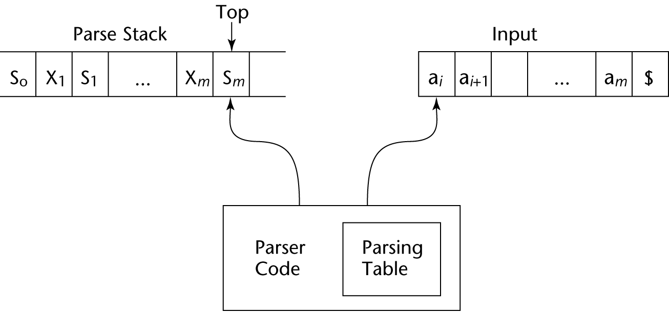
Structure of An LR Parser

Slide 71
Bottom-up Parsing (continued)
Initial configuration: (S₀, a₁…a_{n}$)
Parser actions:
For a Shift, the next symbol of input is pushed onto the stack, along with the state symbol that is part of the Shift specification in the Action table
For a Reduce, remove the handle from the stack, along with its state symbols. Push the LHS of the rule. Push the state symbol from the GOTO table, using the state symbol just below the new LHS in the stack and the LHS of the new rule as the row and column into the GOTO table

Slide 72
Bottom-up Parsing (continued)
Parser actions (continued):
For an Accept, the parse is complete and no errors were found.
For an Error, the parser calls an error-handling routine.

Slide 73
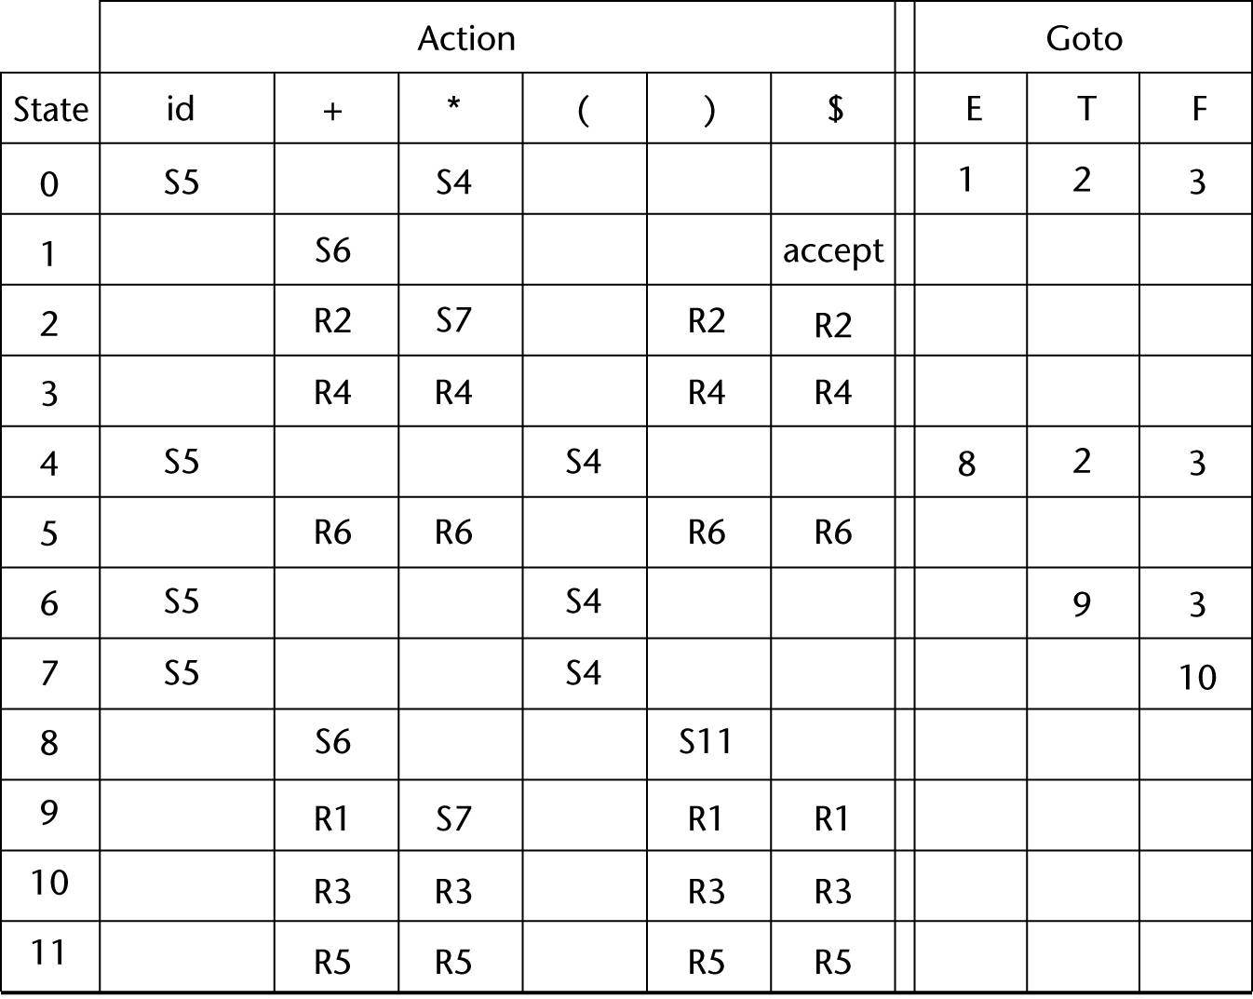
LR Parsing Table

Slide 74
Bottom-up Parsing (continued)
A parser table can be generated from a given grammar with a tool, e.g., yacc or bison

Slide 75
Summary
Syntax analysis is a common part of language implementation
A lexical analyzer is a pattern matcher that isolates small-scale parts of a program
Detects syntax errors
Produces a parse tree
A recursive-descent parser is an LL parser
EBNF
Parsing problem for bottom-up parsers: find the substring of current sentential form
The LR family of shift-reduce parsers is the most common bottom-up parsing approach

