Slide 1
Chapter 4
Lexical and Syntax Analysis

Slide 2
Chapter 4 Topics
Introduction
Lexical Analysis
The Parsing Problem
Recursive-Descent Parsing
Bottom-Up Parsing

Slide 3
Introduction
Language implementation systems must analyze source code, regardless of the specific implementation approach.
Before execution, the system must understand the structure of the program written by the programmer.
This analysis is required in all implementation approaches:
  Compilation
  Interpretation
  Hybrid Systems (JIT compilation)
Nearly all syntax analysis is based on a formal description of the syntax of the source language (BNF)

Slide 4
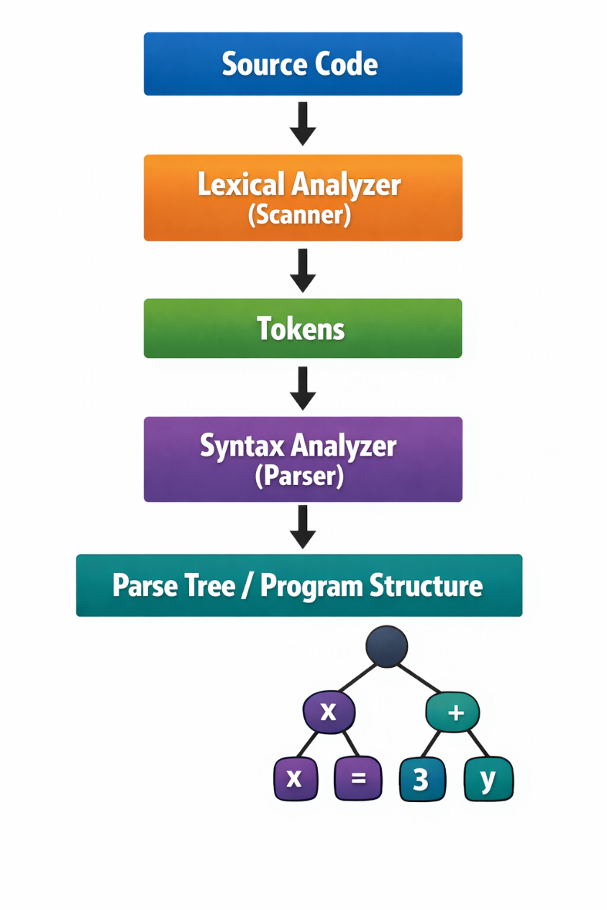
Introduction
First, the Source Code is given as input to the compiler. The Lexical Analyzer (Scanner) reads the source code and breaks it into small meaningful elements called tokens. Tokens are the basic units of the program such as keywords, identifiers, operators, and numbers.
Next, these tokens are passed to the Syntax Analyzer (Parser). The parser checks whether the sequence of tokens follows the grammar rules of the programming language. In other words, it verifies that the program is written in a syntactically correct way.
Finally, the output of this process is a Parse Tree (Program Structure). The parse tree visually represents the hierarchical structure of the program and shows how different parts of the code are organized according to the language’s grammar.

Slide 5
Formal Description of Syntax
Nearly all syntax analyzers are based on a formal description of the programming language syntax. The most common formal notation is Backus-Naur Form (BNF).
BNF is used to describe context-free grammars that define the structure of programs. Example rule:
  <assignment> → <identifier> = <expression>
This rule states that an assignment statement must contain:
  an identifier followed by the symbol =
  followed by an expression
  BNF rules like this are used by parsers to verify that programs follow the language syntax.

Slide 6
Syntax Analysis
The syntax analysis step of a language processor is usually divided into two main components:
  Lexical Analyzer (Scanner) – Low-level analysis:
    The lexical analyzer processes the raw sequence of characters from the source program.
    It groups characters into meaningful units called lexemes.
    Each lexeme is assigned to a token category.

Slide 7
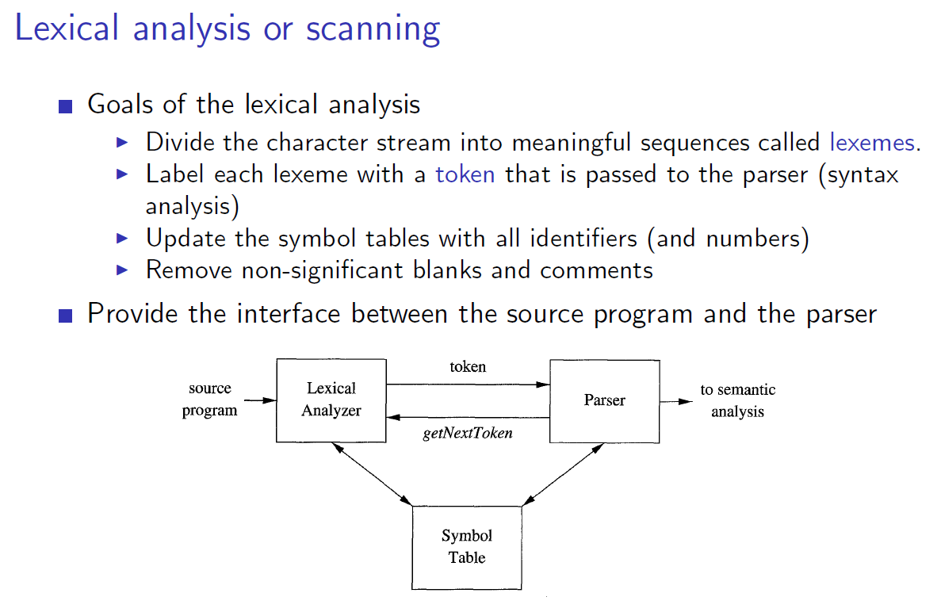

Slide 8
Examples of tokens:
  identifiers
  keywords
  numeric literals
  Operators
From a theoretical perspective:
  A lexical analyzer can be modeled as a finite automaton.
  The patterns it recognizes are described using regular grammars (or regular expressions).
Because lexical analysis deals with small-scale language elements, it is considered the low-level part of syntax processing.

Slide 9
  Syntax Analyzer (Parser) – High-level analysis:
    The syntax analyzer, also called the parser, works with the tokens produced by the lexical analyzer.
    Its role is to dtermine whether the sequence of tokens forms a syntactically valid program.
  The parser analyzes larger program structures, such as:
    Expressions
    Statements
    Program Blocks
    Complete Program Units

Slide 10
  From a theoretical viewpoint:
    A syntax analyzer can be modeled as a pushdown automaton.
    A Lexical analyzer can be modeled as a finite automaton.
    The grammar used for syntax analysis is a context free grammar (CFG), commonly writeen using BNF.

Slide 11
  Summary:
    Lexical analysis handles the smallest elements of the language.
    Syntax analysis handles the structural relationships between these elements.
    Together, they ensure that the program follows the rules of the programming language.

Slide 12
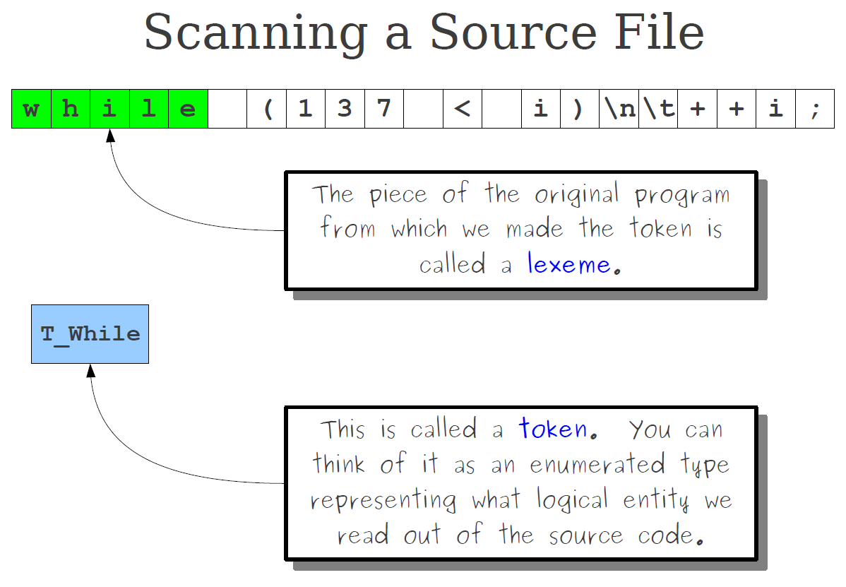

Slide 13
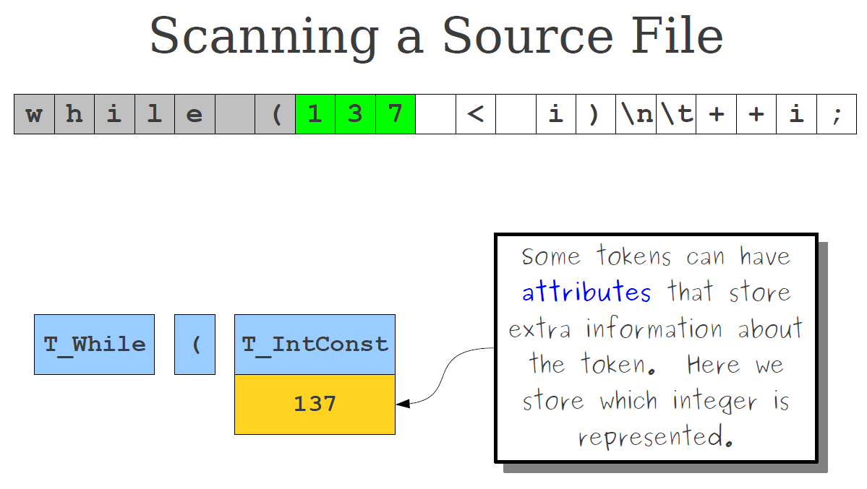

Slide 14
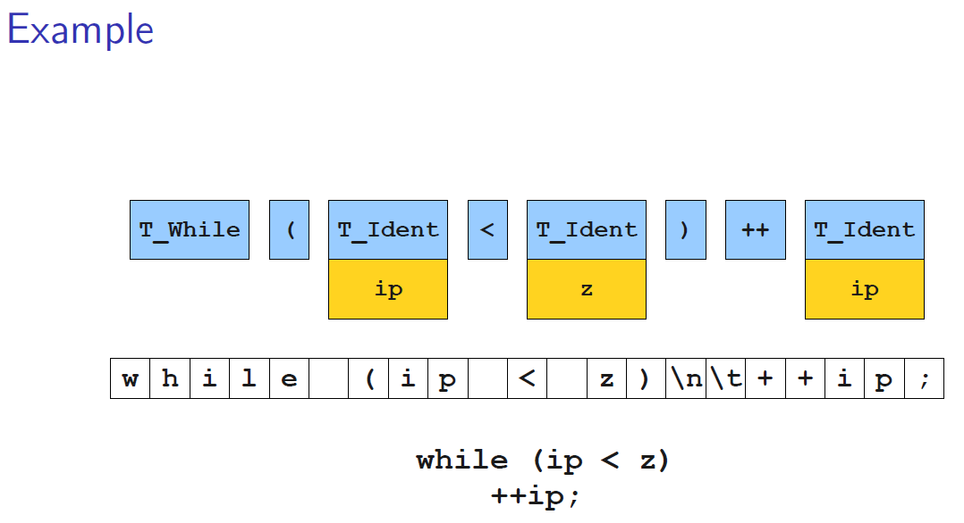

Slide 15
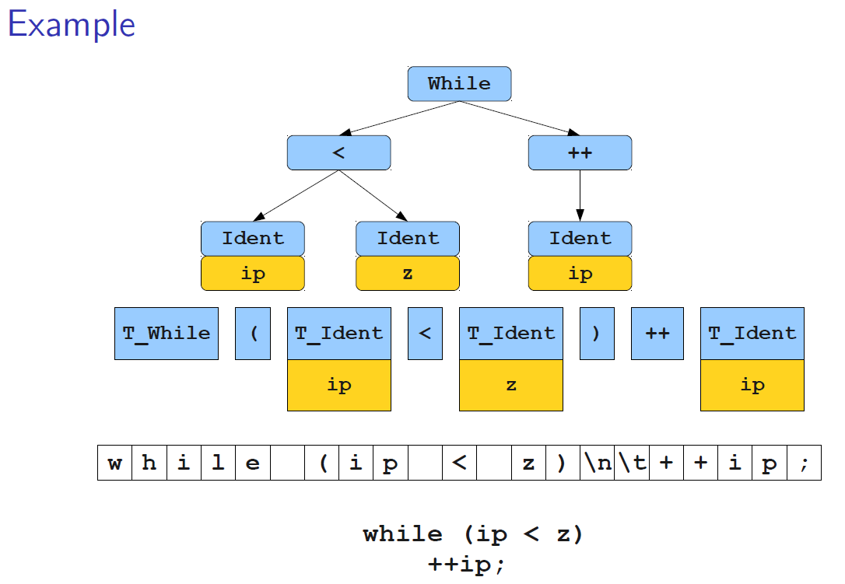

Slide 16
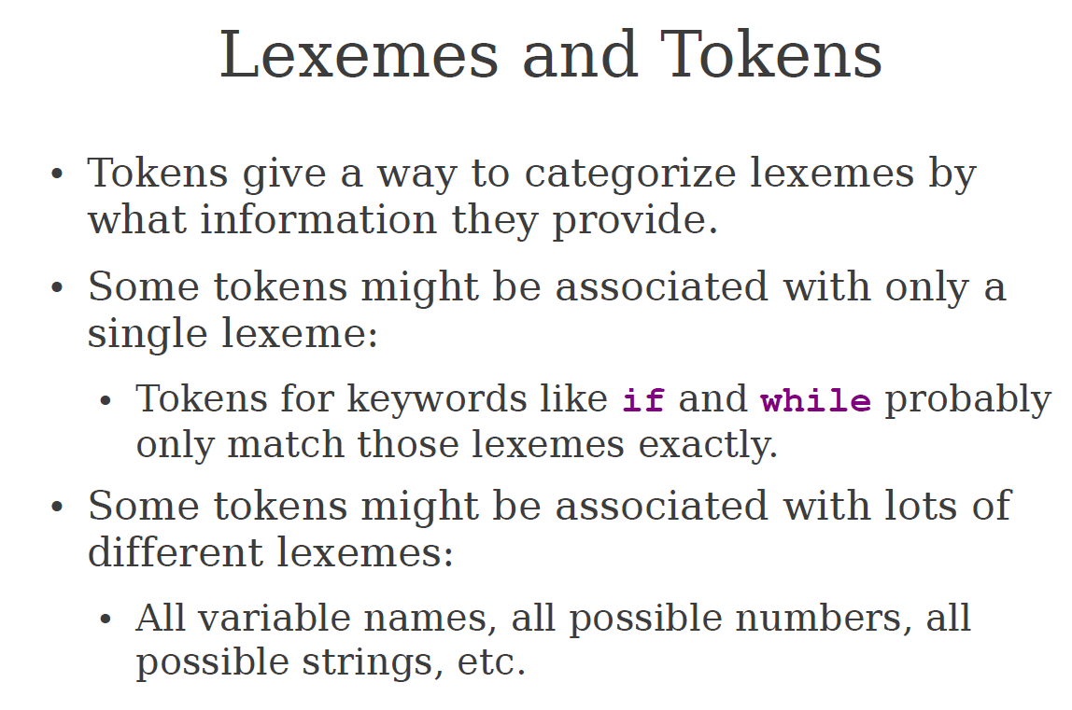

Slide 17
Advantages of Using BNF to Describe Syntax
Parsers can be built directly from BNF:
  The grammar written in BNF can serve as the direct foundation for constructing a parser.
  Many parsing algorithms and parser generators use the grammar rules to determine how input programs should be analyzed.
  As a result, the syntax analyzer closely follows the structure of the BNF grammar.
  Thus, this connection simplifies the process of implementing syntax analysis in compilers and interpreters.

Slide 18
Reasons to Separate Lexical and Syntax Analysis
Simplicity - less complex approaches can be used for lexical analysis; separating them simplifies the parser
Efficiency - separation allows optimization of the lexical analyzer
Portability - parts of the lexical analyzer may not be portable, but the parser always is portable

Slide 19
Lexical Analysis
In most language processors, the lexical analyzer is implemented as a function or module
The parser calls the lexical analyzer whenever it needs the next token from the source program.
Each call to the lexical analyzer typically performs the following steps:
  Reads characters from the input program
  Groups them into a lexeme
  Dertermintes the token category of the lexeme
  Returns the token and lexeme to the parser
Therefore, the parser does not process characters directly, intead, it receives tokens produced by the lexical analyzer.

Slide 20
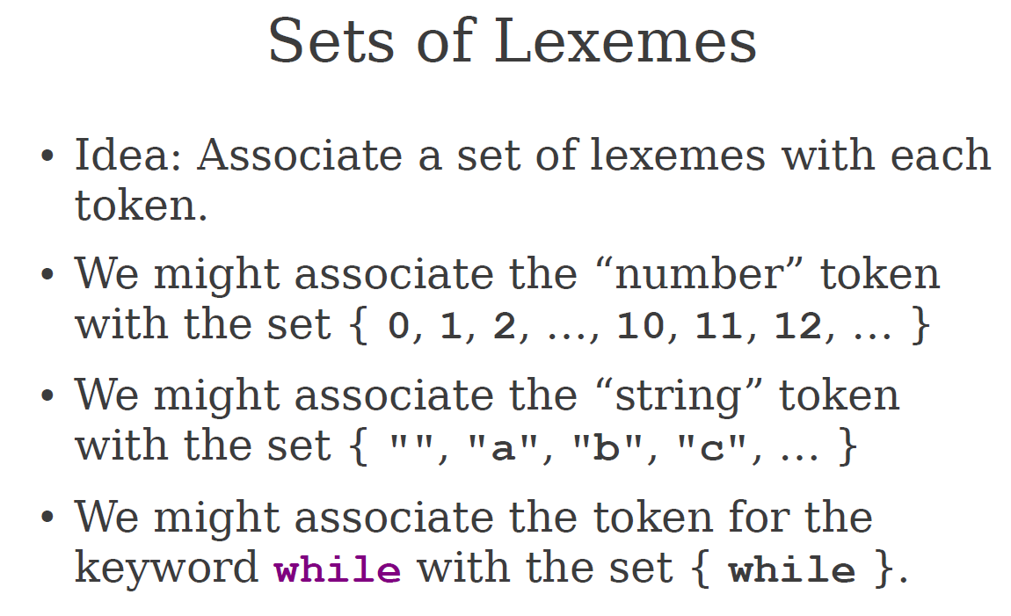

Slide 21
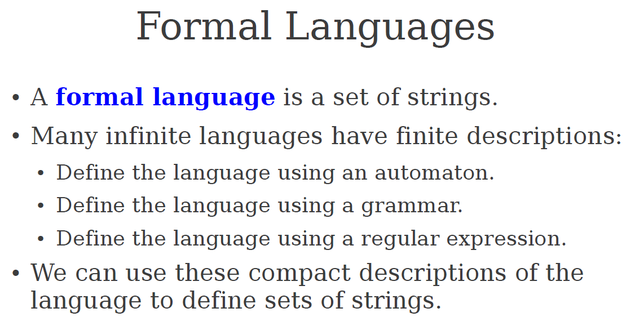

Slide 22
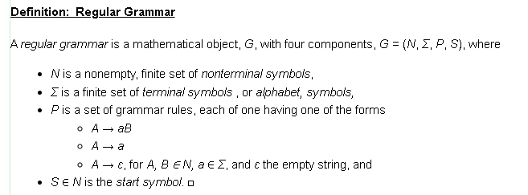
Regular Grammars
A regular grammar is a formal, restricted type of grammar in computer science that generates regular languages, which are recognizable by finite automata. These grammars are restricted to specific production rules (either all left-linear or all right-linear) and are crucial for lexical analysis, pattern matching, and text processing due to their efficiency

Slide 23
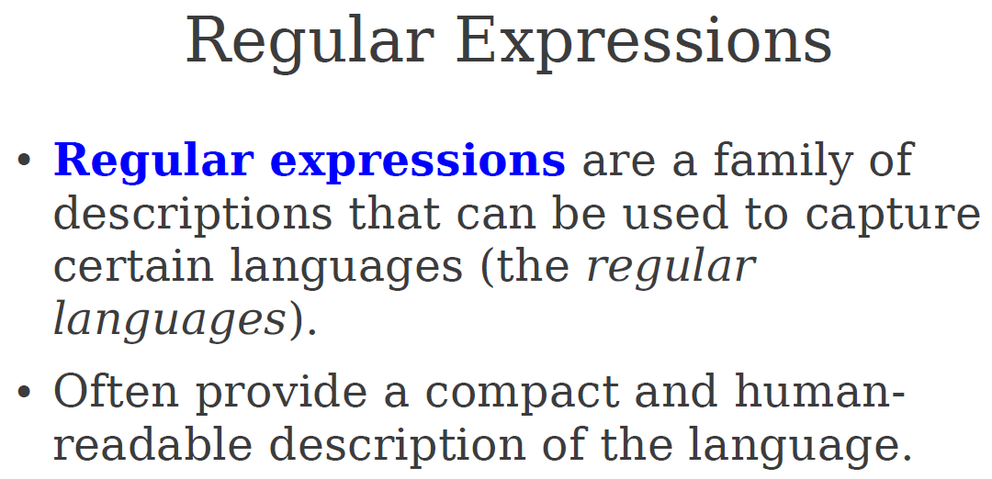

Slide 24
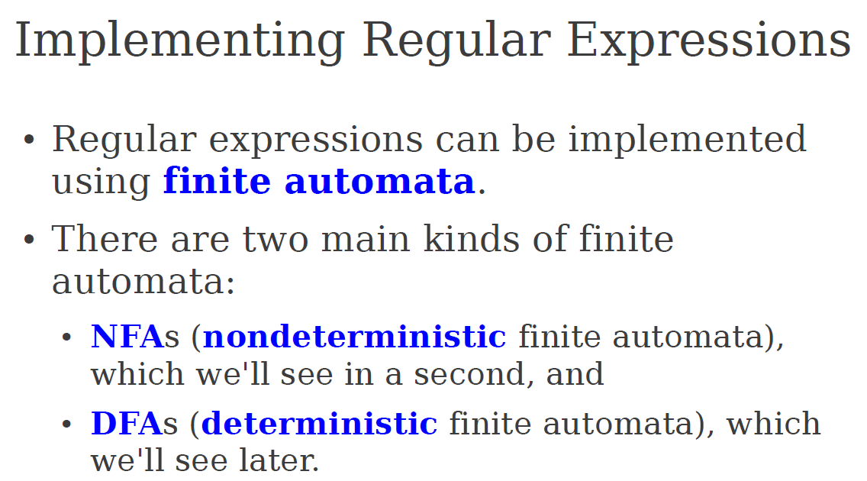

Slide 25
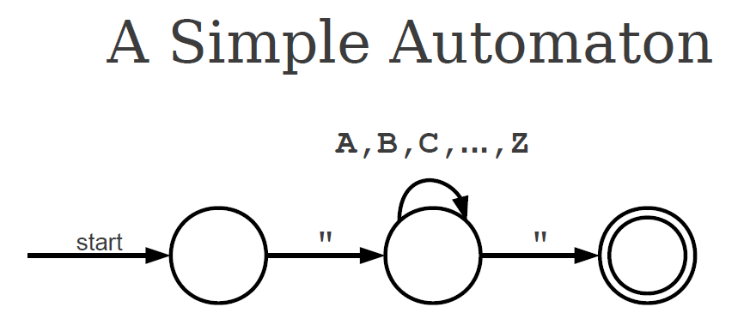

Slide 26
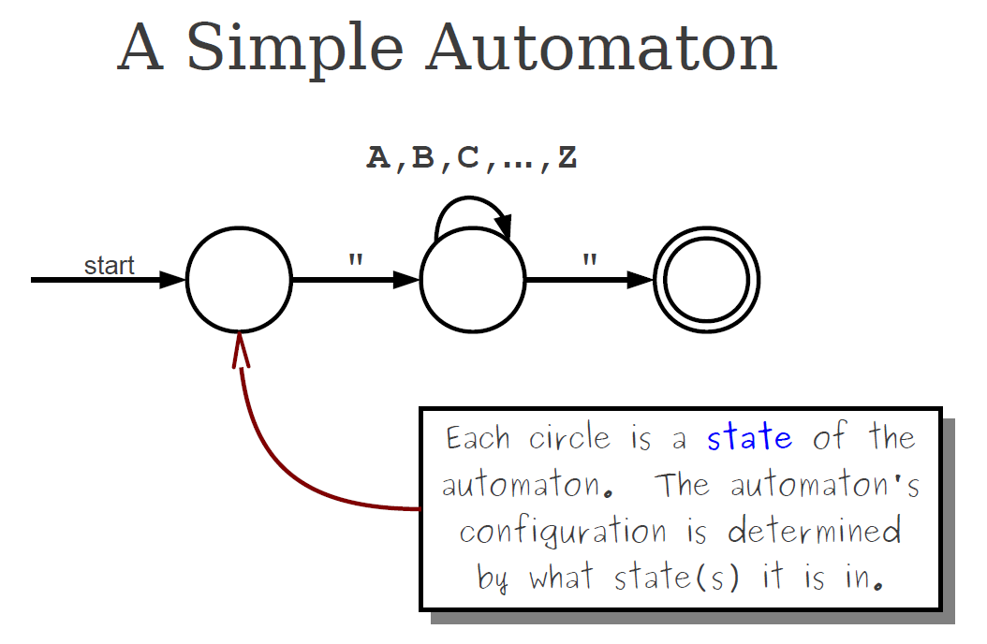

Slide 27
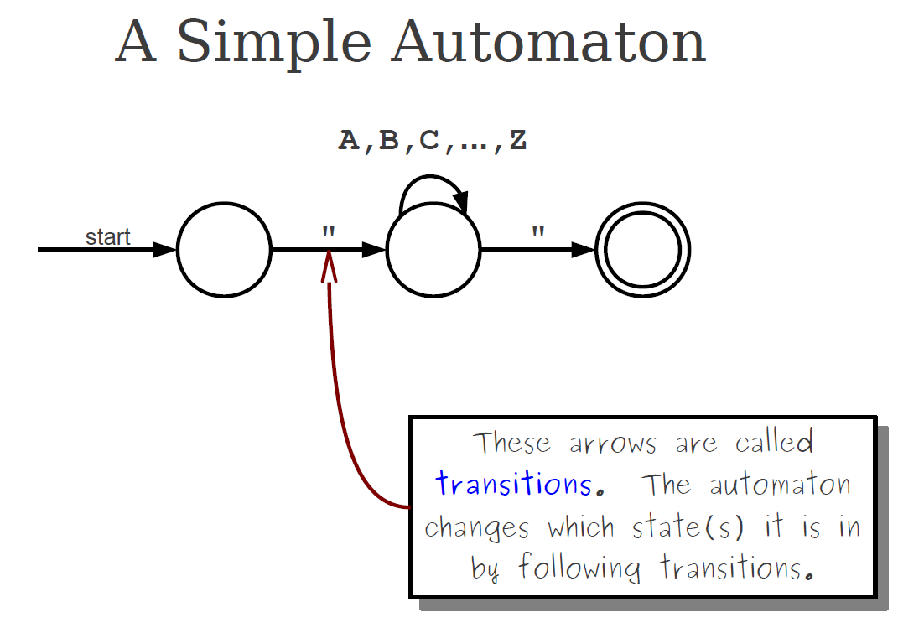

Slide 28
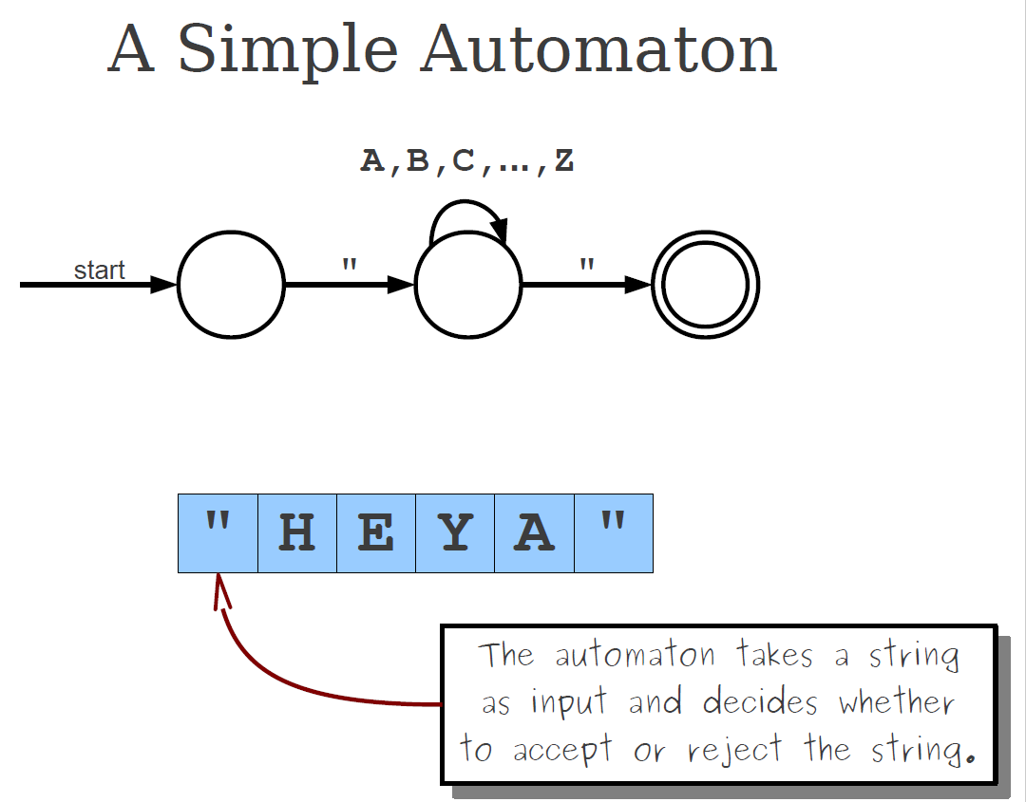

Slide 29
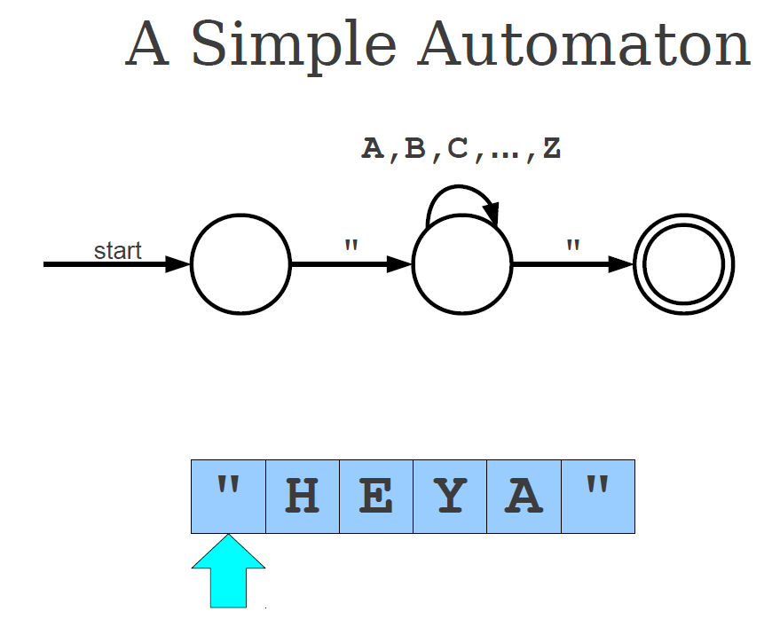

Slide 30
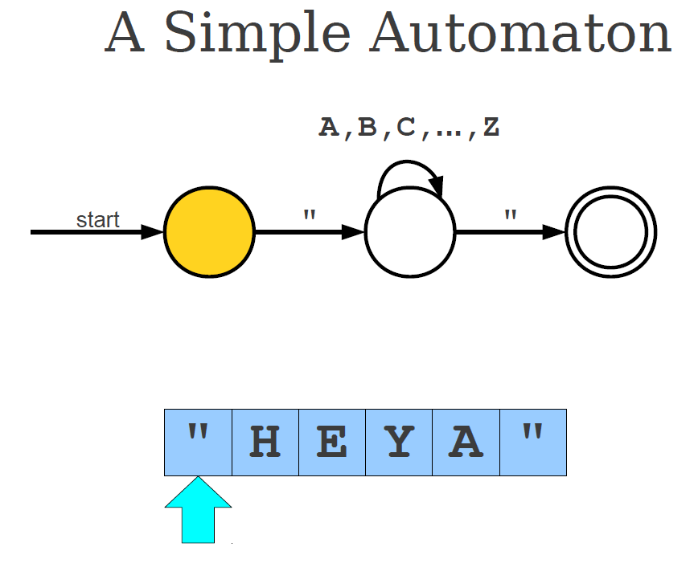

Slide 31
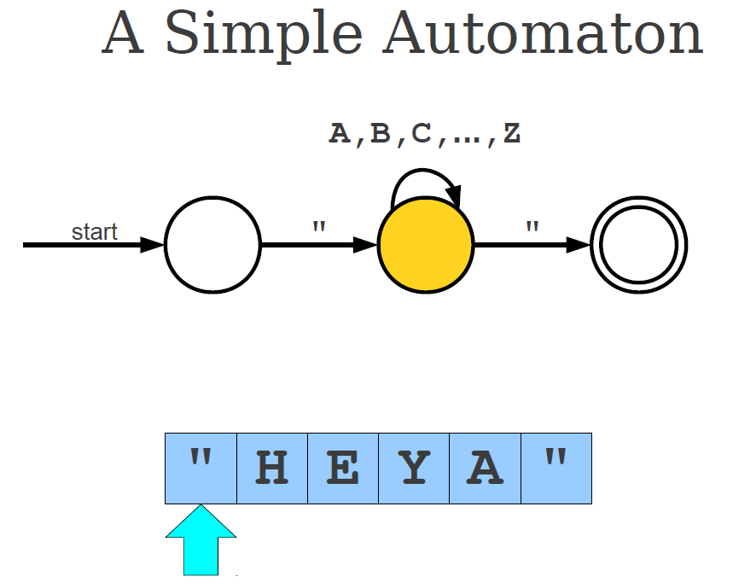

Slide 32
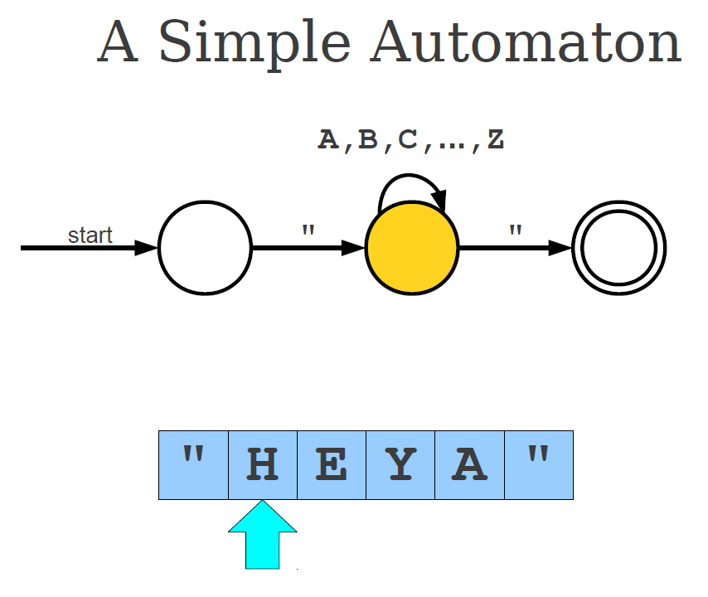

Slide 33
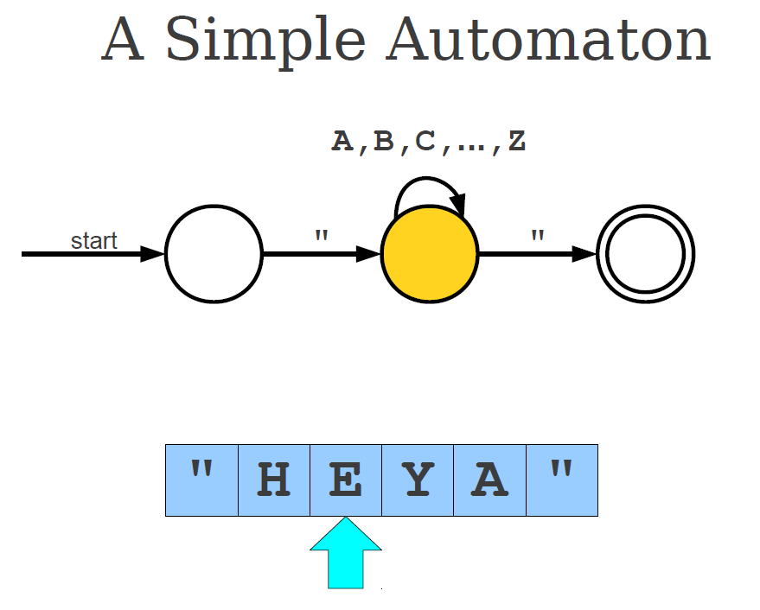

Slide 34
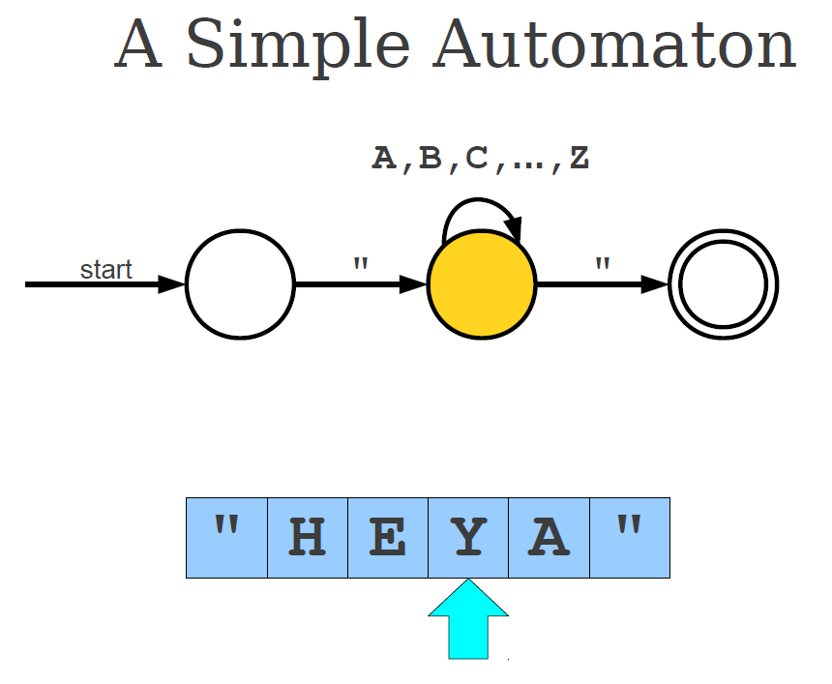

Slide 35
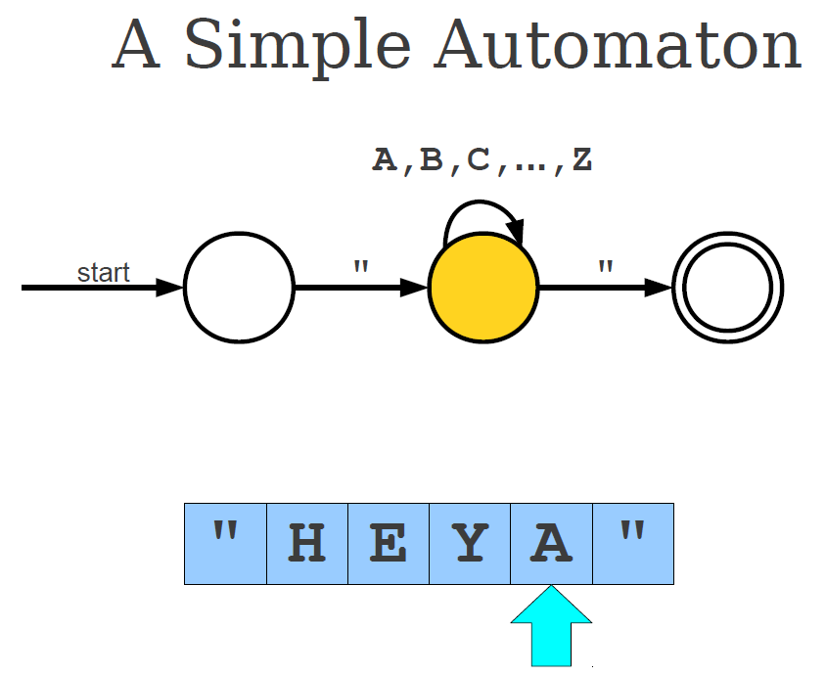

Slide 36
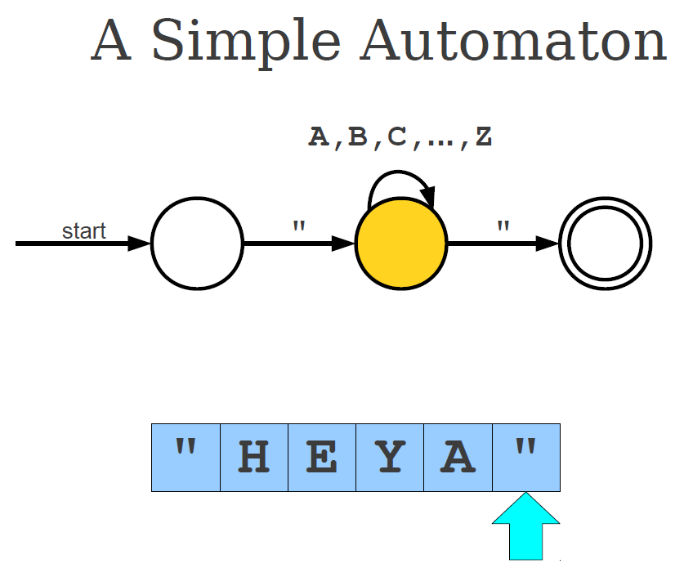

Slide 37
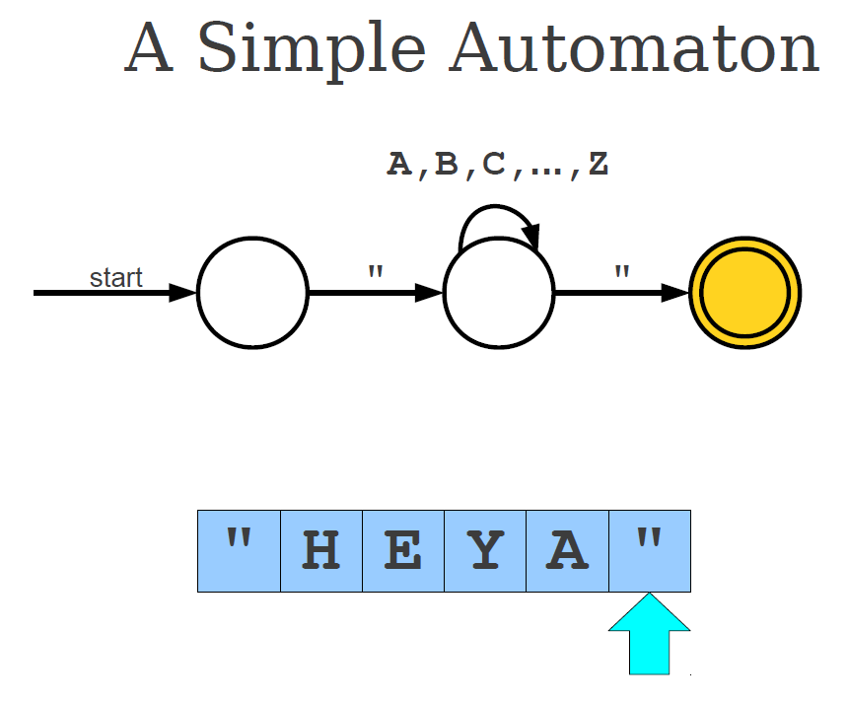

Slide 38
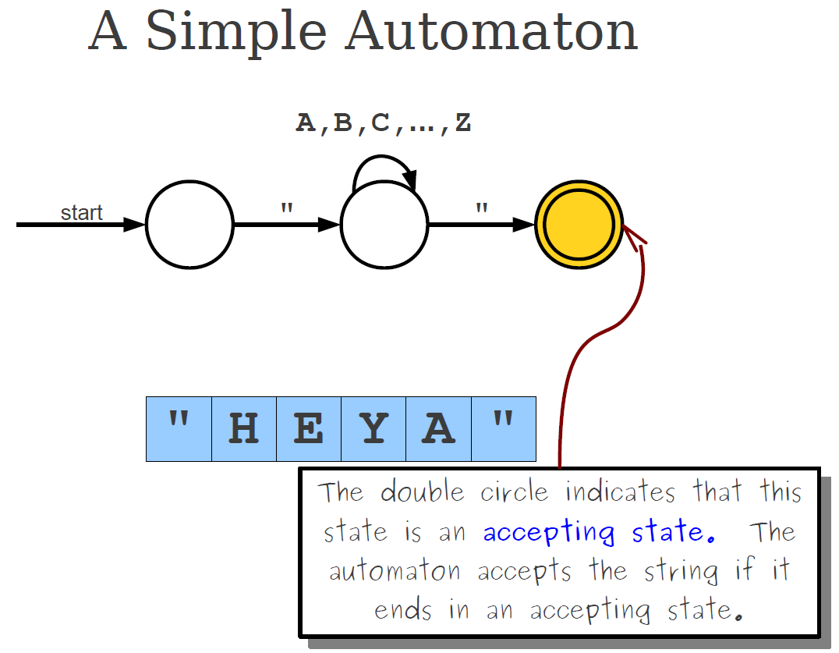

Slide 39
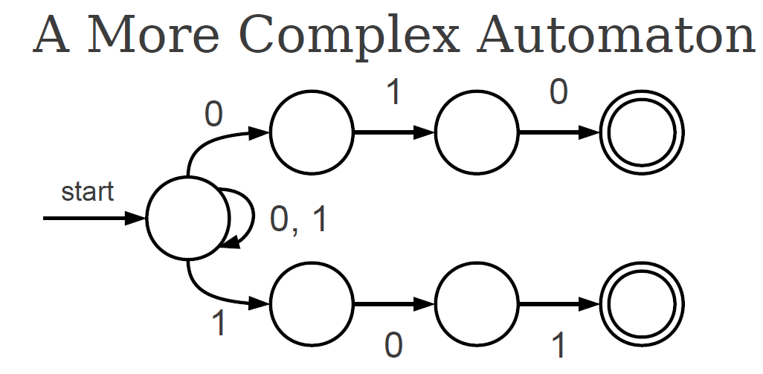

Slide 40
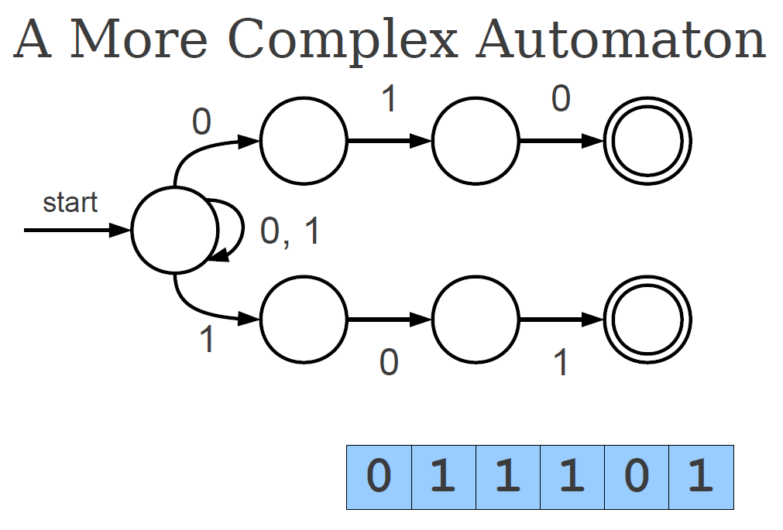

Slide 41
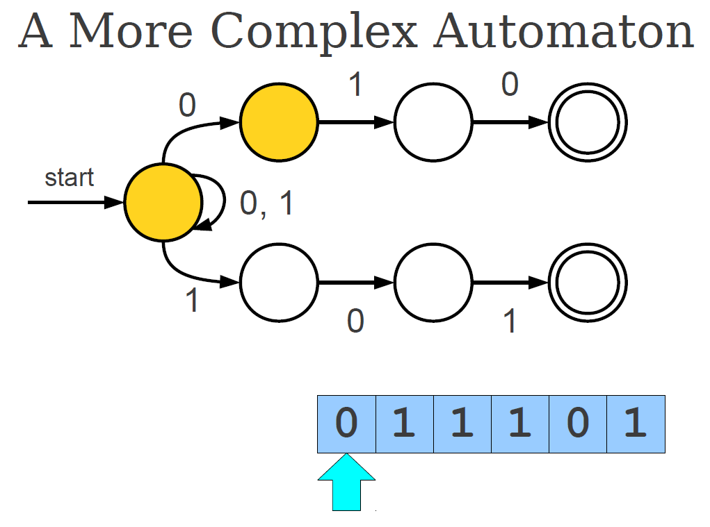

Slide 42
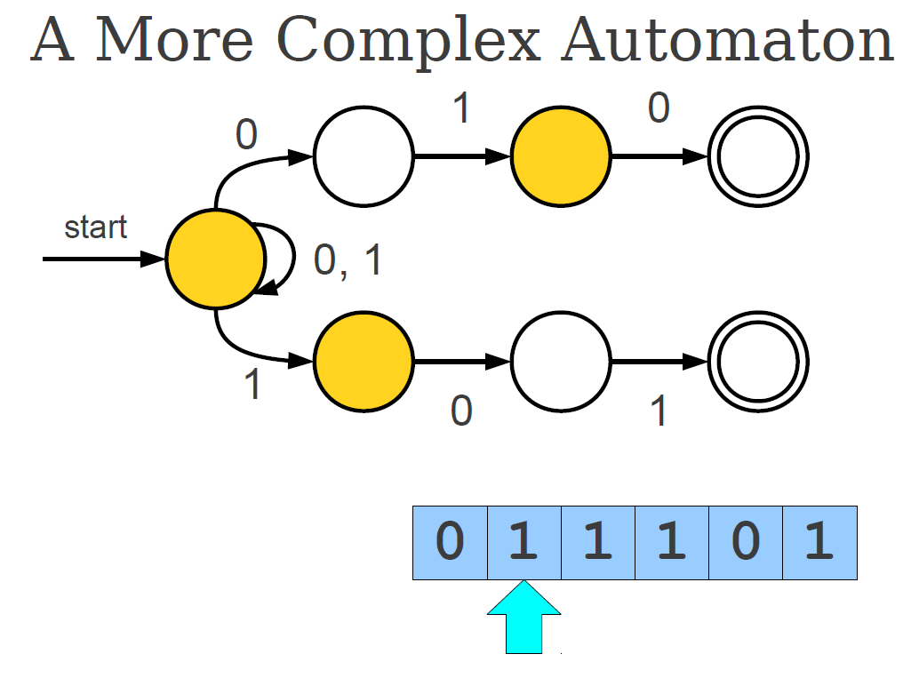

Slide 43
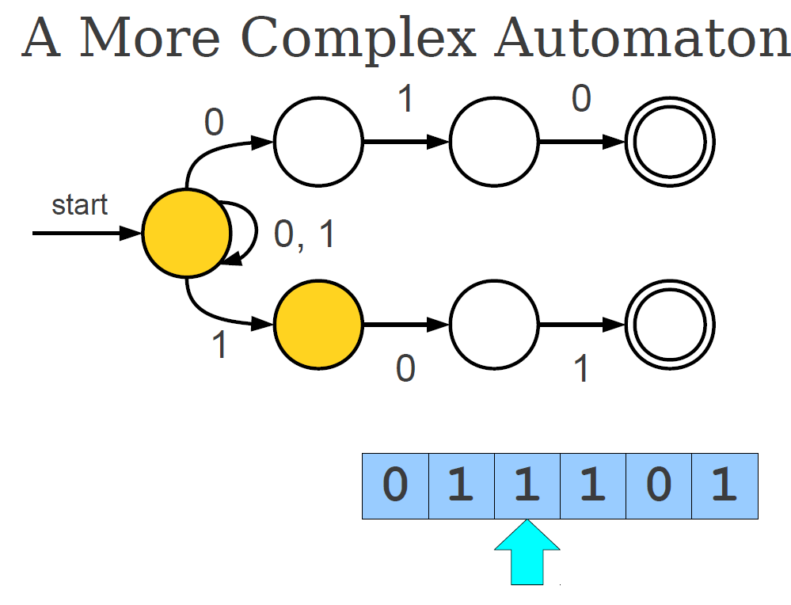

Slide 44
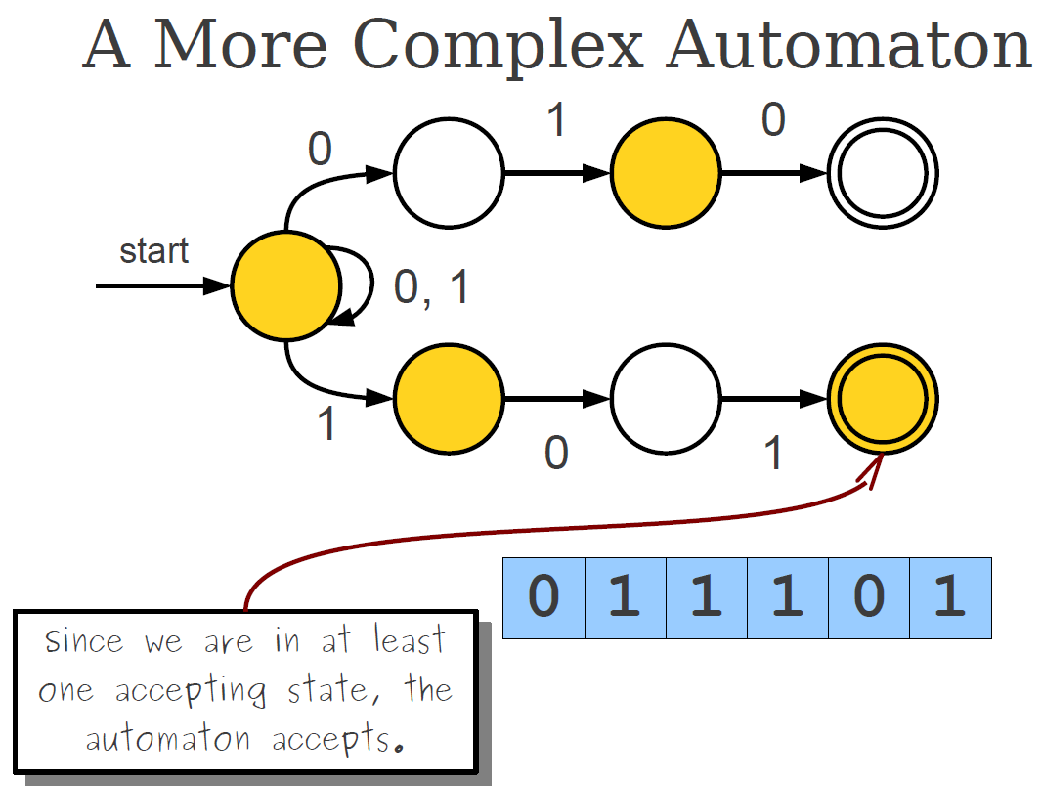

Slide 45
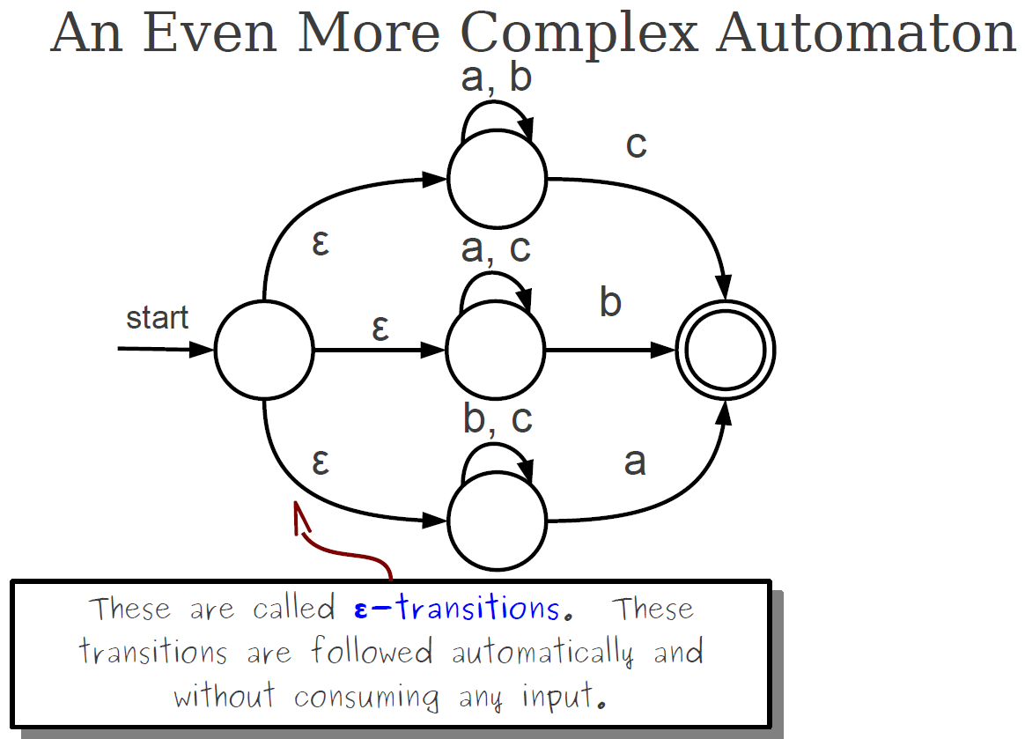

Slide 46
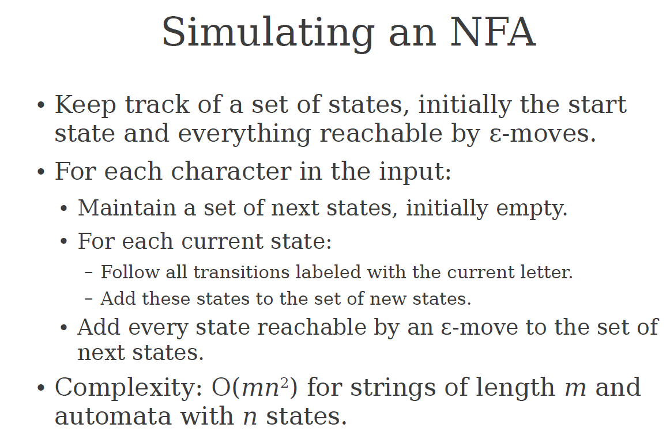

Slide 47
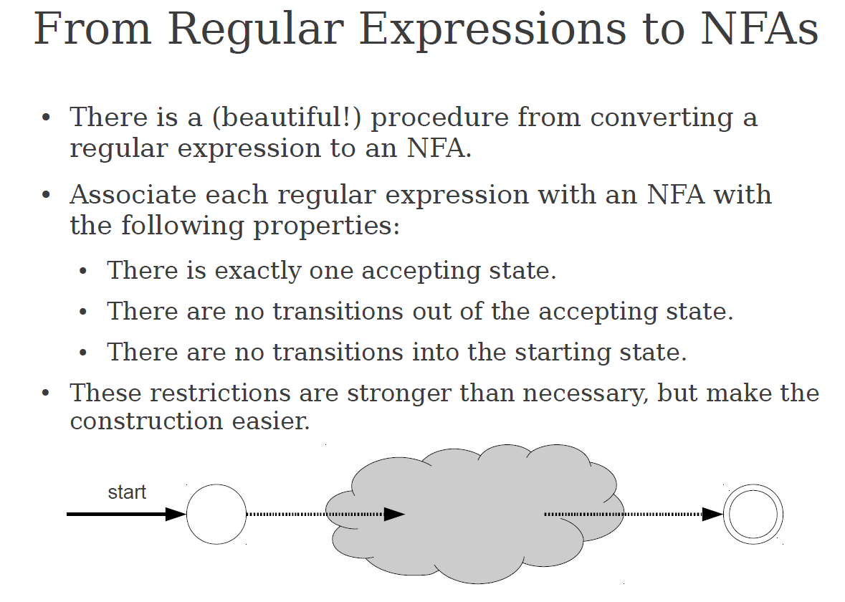

Slide 48
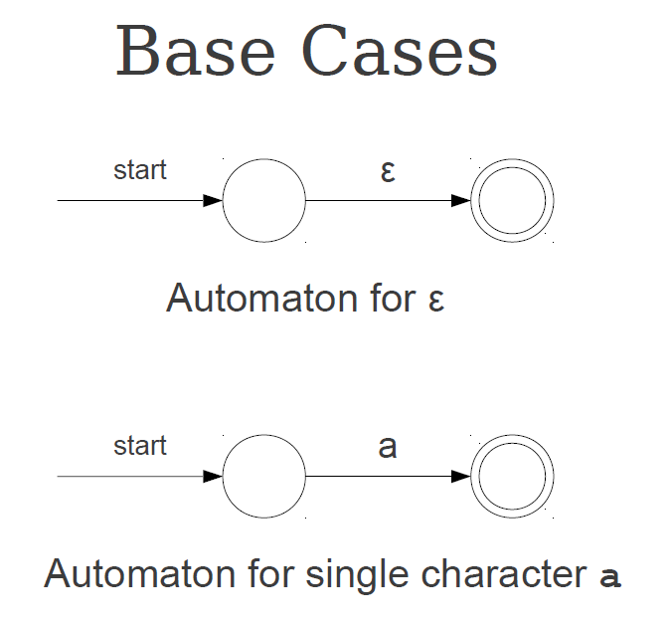

Slide 49
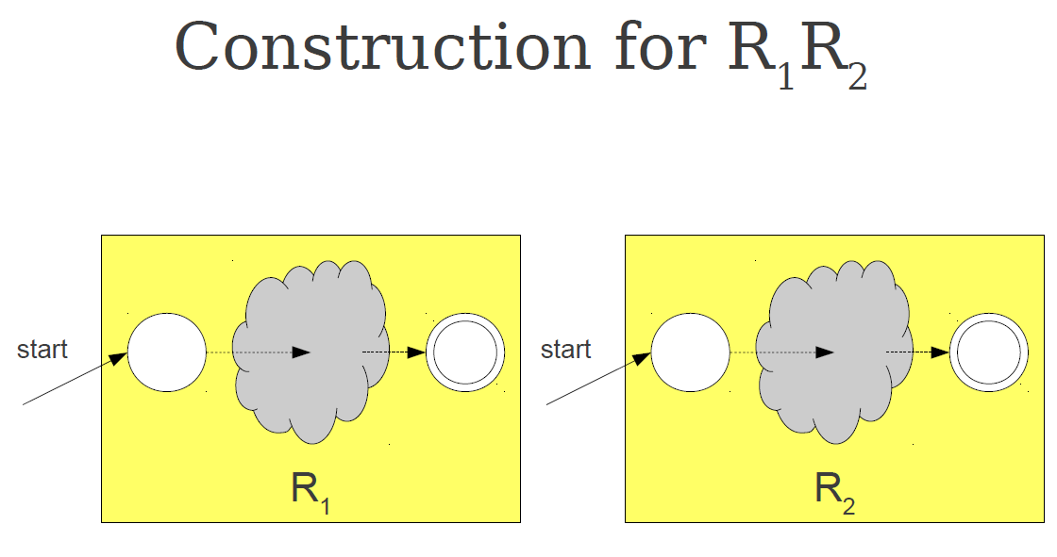

Slide 50
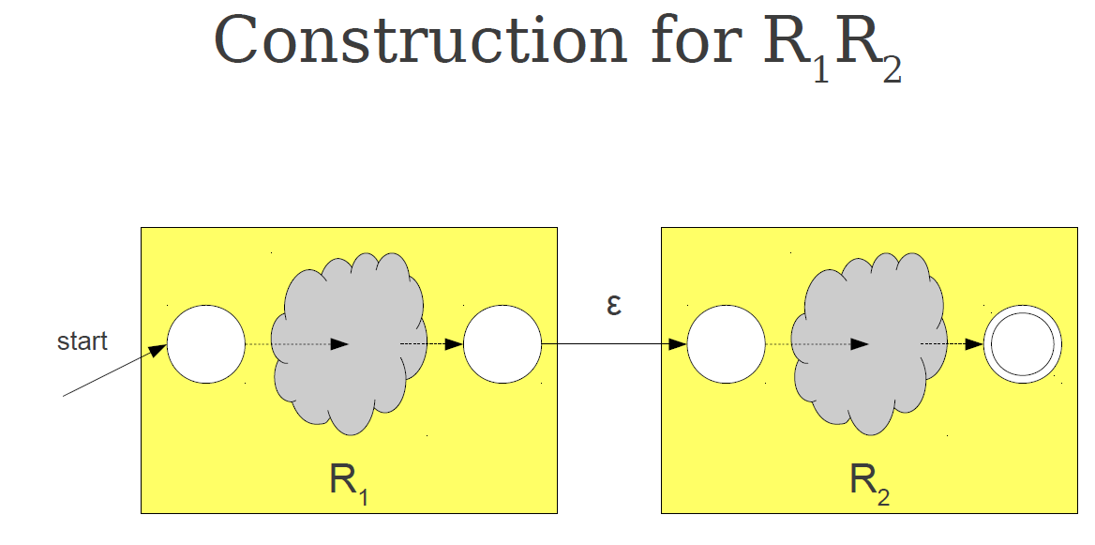

Slide 51
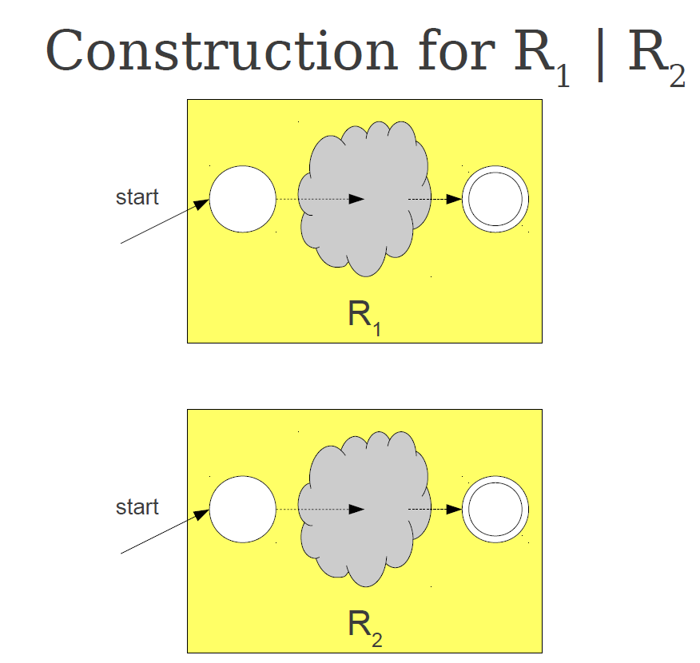

Slide 52
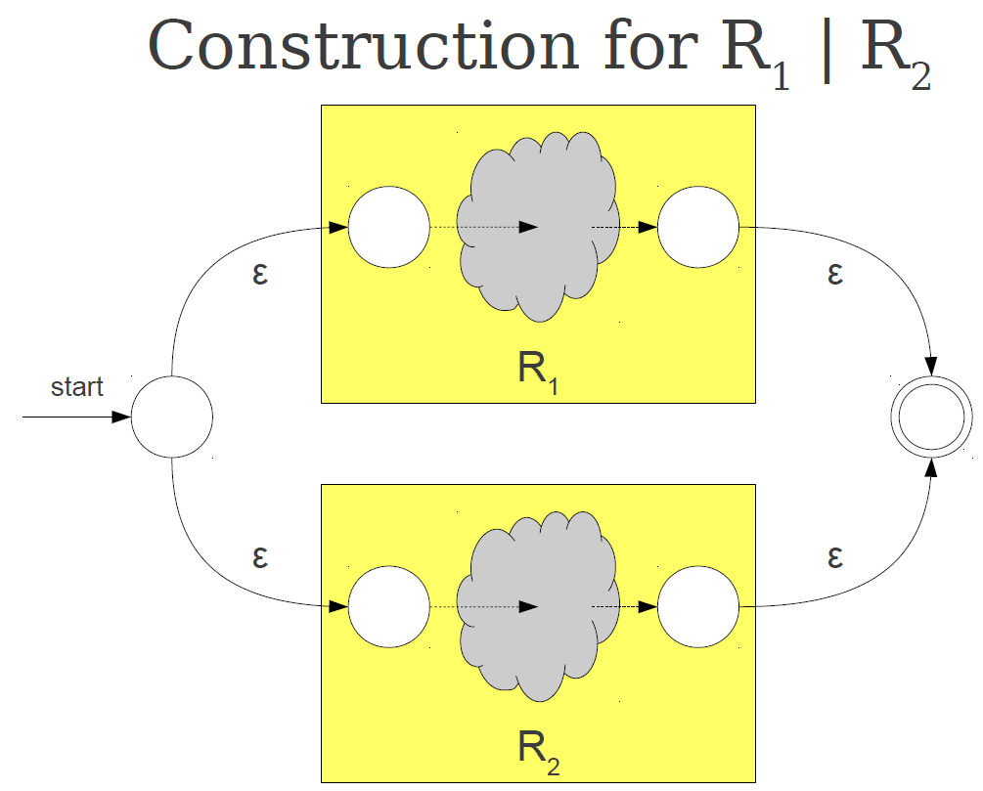

Slide 53
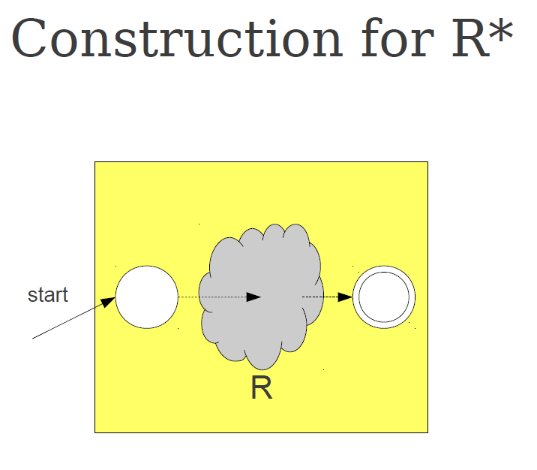

Slide 54
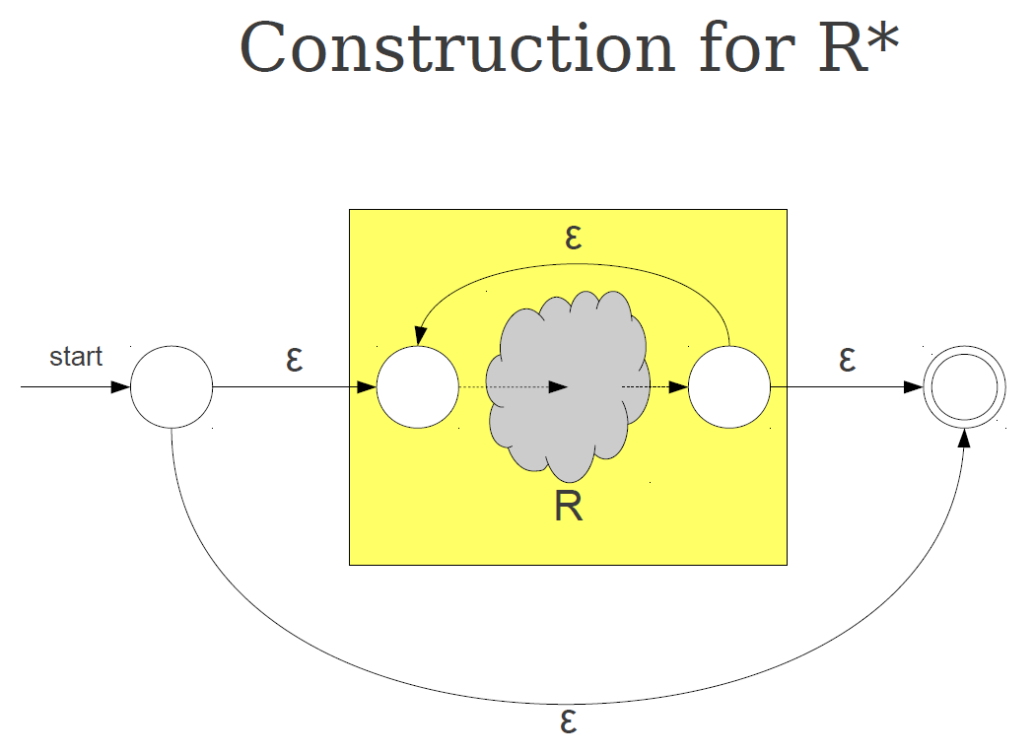

Slide 55
Problem with a Naive State Diagram
Programming languages usually allow many possible characters:
  Letters(A-Z, a-z)
  Digits (0-9)
  Operators (+,-,=,etc)
  Punctuation symbols (!, ?, :, ;, etc)
If every state had a transition for each possible character, the number of transitions would become very large.
As a result, the state diagram would be:
  Very complex
  Difficult to design
  Hard to maintain

Slide 56
Motivation for Simplification
Since naive state diagrams are too large, lexical analyzer design typically uses simplification techniques, such as:
  Character classes (grouping similar characters together)
  Shared transitions for multiple characters
  Table-driven implementations
These techniques allow the state diagram to remain compact and manageable.
Example: suppose the lexical analyzer must recognize identifiers and an identifier can start with any letter (a-z,A-Z).
  Start -> a, start ->b, ... Start -> Z.
  Instead, simplify this by defining a character class: LETTER= {A-Z, a-z}
  Now the diagram becomes Start -> LETTER

Slide 57
Character Classes for Integer Literals and Identifiers
When recognizing identifiers, all uppercase and lowercase letters play the same role. Example identifiers:
  Sum
  Value
  Total
  X1
  Counter
When recognizing integer literals, all digits behave in the same way. Instead of creating transitions for each digit (0-9), we define a digit class. Example:
  DIGIT = {0-9}
Using character classes:
  Reduces the number of transitions in the state diagram
  Makes the lexical analyzer simpler and easier to design
  Improves readability and Maintainability of the scanner design

Slide 58
In many programming languages, reserved words and identifiers have the same lexical pattern:
  if
  while
  return
  sum
  value
  count
From the perpevtive of the lexical analyzer, these are all strings of letters(ans possibly digits)
Because they follow the same pattern, the lexical analyzer can recognize them using the same part of the state diagram
This avoids crating separate states or transitions for every Reserved word, which would make the state diagram unnecessarily large

Slide 59
Convenient utility subprograms:
  In many lexical analyzer implementations, several utility subprograms are used to simplify the scanning process.
  These helper functions manage reading characters, building lexemes, and identifying tokens.
  getChar: reads the next character from the input source program.
  It performs two main tasks:
    Stores the character in a variable such as nextChar.
    Determines the Character class of the input characters.
  Example characters classes:
    LETTER -> A-Z, a-z
    DIGIT -> 0-9
    UNKNOWN -> operators or punctuation
  The result is stored in a variable such as charClass.
  This classification helps the lexical analyzer decide how to process the character.

Slide 60
  addChar: adds the current character (nextChar) to the lexeme being constructed.
  The lexeme is usually stored in a character array or string, often called lexeme.
  Example, if the program contains «total», addChar builds the lexeme step by step:
    t -> to -> tot -> tota -> total
    This continues until the lexical analyzer determines that the lexeme is complete.
  Lookup: this function checks whether the Lexeme stored in lexeme corresponds to a reserved word or special symbol.
  Lexeme
    if
    while
    +
  Returned Token
    IF
    WHILE
    ADD_OP
  If the lexeme is not a reserved word, it may be classified as a general identifier token (IDENT) token.

Slide 61
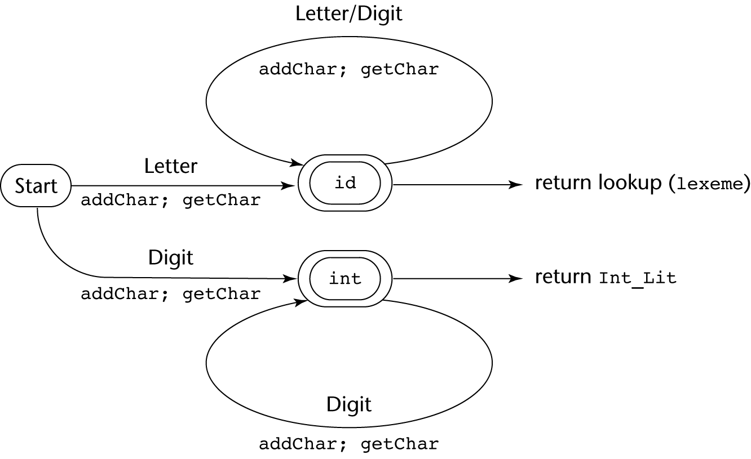
State Diagram

Slide 62
The Parsing Problem
Given an input program, the parser (syntax analyzer) has two main objectives:
  Checks whether the sequence of tokens follows the grammar rules of the programming language. (The first objective)
    If the program violates the grammar rules, the parser must:
      Detect the syntax error
      Produce a clear diagnostic error message
  Produce the parse tree, or at least a trace of the parse tree, for the program. (The second objective)

Slide 63
Example syntax error:
  X =+ 5
  Error message example:
    Syntax error: unexpected operator + in assignment expression
  After detecting an error, the parser should recover quickly and continue analyzing the rest of the program
  This allows the compiler to report multiple errors in a single compilation, instead of stopping at the first error.

Slide 64
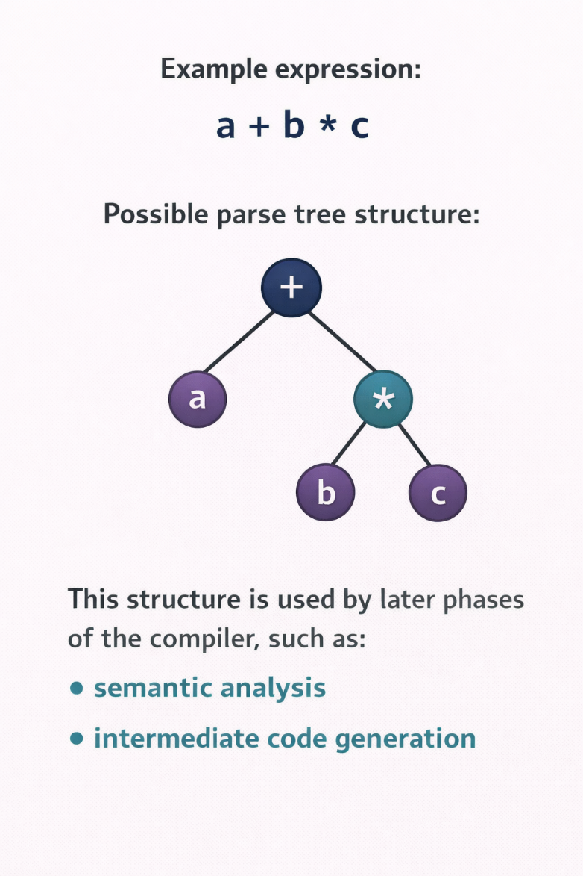
Construct the Parse Tree (Second objective):
  If the program is syntactically correct, the parser builds a parse tree (or produces information needed to construct it).
  A parse tree represents the hierarchical structure of the program according to the grammar rules.

Slide 65
Parsers can generally be divided into two main categories, depending on how they construct the parse tree:
  Top down parsers– construct the parse tree starting from the root and expanding toward the leaves.
  The process follows a leftmost derivation, meaning that the parser repeatedly expands the leftmost nonterminal in the grammar.
  In this approach:
    The parser predicts which grammar rule to apply
    It attempts to match the input tokens with the expected structure.
  The parse tree is built in preorder traversal (root first, then its children)
  Common top-down parsing techniques:
    Recursive-descent parsing
    LL parsers (L: left-to-right scan of input, L: leftmost derivation)

Slide 66
Bottom up parsers – construct the parse tree starting from the leaves (tokens) and working toward the root.
Instead of predicting grammar rules, they combine tokens and smaller structures into larger constructs.
This process corresponds to reverse of a rightmost derivation.
Example:
    Tokens
    ↓
    Combine tokens into phrases
    ↓
    Build larger structures
    ↓
    Reach the start symbol (root)
Common bottom-up parsing techniques:
  LR parsers
  Shift-reduce parsers

Slide 67
Most practical parsers look ahead only one token in the input stream to make parsing decisions
This approach is efficient and sufficient for most programming language grammars.
Example:
  Current token -> decide next parsing action
This design helps parsers remain efficient and practical for compiler implementation

Slide 68
Top-down Parsers
A top-down parser builds the parse tree beginning from root
At each step, the parser considers a sentential form:
  xAα
  x: a string of terminal symbols that have already been processed
  A: the leftmost nonterminal that must be expanded
  α : the remaining part of the string
The parser must select the correct grammar rule for A to produce the next step in the leftmost derivation.

Slide 69
Top-down Parsers
Parsing decision:
  The key challenge is deciding which grammar rule to apply for the nonterminal A.
  Top-down parsers usually make this decision by examining the next token of input, often called the lookahead token.
  Example:
    Current sentential form: xAα
    Next input token: t
    The parser chooses the rule for A whose right-hand side can generate t as its first symbol.

Slide 70
Common Top-down Parsing Algorithms
Two widely used approaches implement top-down parsing:
  Recursive-descent parsing
    Implement directly as a set of recursive functions, one for each nonterminal
    Each function corresponds to a grammar rule
    The parser calls these functions to expand nonterminals
    Example:
      Expr()
        Term()
        Factor()

Slide 71
Common Top-down Parsing Algorithms
  LL Parsers (Table-driven parsers)
    Use a parsing table instead of explicit recursive code
    The table determines which grammar rule to apply, based on:
      The current nonterminal
      The next input token
    The name LL means:
      L -> scan input from left to right
      L-> construct a leftmost derivation
    Example grammar:
      A -> aB
      A -> bC
      A -> c
    Suppose the parser sees:
      Current form: xAα
      Next token: b
    The parser chooses:
      A -> bC , since that rule begins with b.

Slide 72
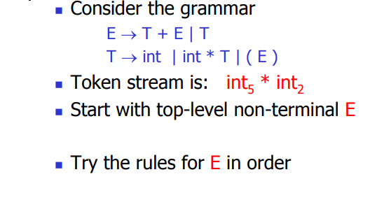
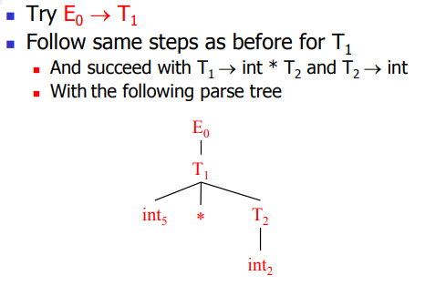
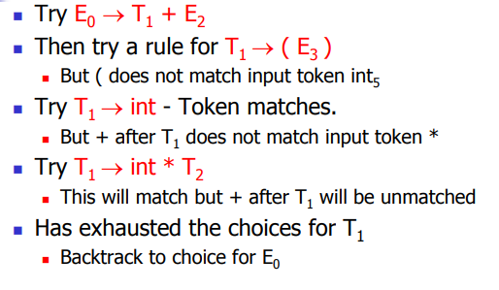
Example: Recursive Descent Parsing
2
1

Slide 73
Example: Recursive-Descent
Let's consider the following grammar:
0 | Goal | → | Expr
1 | Expr | → | Expr + Term
2 |  | | | Expr - Term
3 |  | | | Term
4 | Term | → | Term * Factor
5 |  | | | Term / Factor
6 |  | | | Factor
7 | Factor | → | ( Expr )
8 |  | | | number
9 |  | | | id
And the input x – 2 * y

Slide 74
Example
Let’s try x – 2 * y :
Goal
Rule | Sentential Form | Input
— | Goal | ↑x - 2 * y
0 | Expr | ↑x - 2 * y
1 | Expr +Term | ↑x - 2 * y
3 | Term +Term | ↑x - 2 * y
6 | Factor +Term | ↑x - 2 * y
9 | <id,x> +Term | ↑x - 2 * y
→ | <id,x> +Term | x ↑- 2 * y
Expr
Expr
+
Term
Term
Fact.
<id,x>
This worked well, except that “–” doesn’t match “+”
The parser must backtrack to here
↑ is the position in the input buffer

Slide 75
Example
Continuing with x – 2 * y :
Goal
Rule | Sentential Form | Input
— | Goal | ↑x - 2 * y
0 | Expr | ↑x - 2 * y
2 | Expr -Term | ↑x - 2 * y
3 | Term -Term | ↑x - 2 * y
6 | Factor -Term | ↑x - 2 * y
9 | <id,x> - Term | ↑x - 2 * y
→ | <id,x> -Term | x ↑- 2 * y
→ | <id,x> -Term | x - ↑2 * y
Expr
Expr
–
Term
Term
Fact.
<id,x>
Now, “-” and “-” match
Now we can expand Term to match “2”
Now, we need to expand Term - the last NT on the fringe

Slide 76
Example
Trying to match the “2” in x – 2 * y :
Goal
Rule | Sentential Form | Input
→ | <id,x> - Term | x - ↑2 * y
6 | <id,x> - Factor | x - ↑2 * y
8 | <id,x> - <num,2> | x - ↑2 * y
→ | <id,x> - <num,2> | x - 2 ↑* y
Expr
Expr
-
Term
Term
Fact.
Fact.
<num,2>
Where are we?
“2” matches “2”
We have more input, but no NTs left to expand
The expansion terminated too soon
Need to backtrack
<id,x>

Slide 77
Example
Trying again with “2” in x – 2 * y :
Goal
Rule | Sentential Form | Input
→ | <id,x> - Term | x - ↑2 * y
4 | <id,x> - Term * Factor | x - ↑2 * y
6 | <id,x> - Factor * Factor | x - ↑2 * y
8 | <id,x> - <num,2> * Factor | x - ↑2 * y
→ | <id,x> - <num,2> * Factor | x - 2 ↑* y
→ | <id,x> - <num,2> * Factor | x - 2 * ↑y
9 | <id,x> - <num,2> * <id,y> | x - 2 * ↑y
→ | <id,x> - <num,2> * <id,y> | x - 2 * y↑
Expr
Expr
–
Term
Term
Term
*
Fact.
Fact.
Fact.
<id,y>
<id,x>
<num,2>
The Point:
The parser must make the right choice when it expands a NT. Wrong choices lead to wasted effort.
This time, we matched & consumed all the input
Success!

Slide 78
Another possible parse
Other choices for expansion are possible
This expansion doesn’t terminate
Wrong choice of expansion leads to non-termination
Non-termination is a bad property for a parser to have
Parser must make the right choice
Rule | Sentential Form | Input
— | Goal | ↑x - 2 * y
0 | Expr | ↑x - 2 * y
1 | Expr +Term | ↑x - 2 * y
1 | Expr + Term +Term | ↑x - 2 * y
1 | Expr + Term +Term + Term | ↑x - 2 * y
1 | And so on …. | ↑x - 2 * y
Consumes no input!

Slide 79
Left Recursion
Top-down parsers cannot handle left-recursive grammars
Formally,
  A grammar is left recursive if ∃ A ∈ NT such that
  ∃ a derivation A ⇒⁺ Aα, for some string α ∈ (NT ∪ T )⁺
The expression grammar we worked on is left recursive.
This can lead to non-termination in a top-down parser
In a top-down parser, any recursion must be right recursion
We would like to convert the left recursion to right recursion
Non-termination is always a bad property in a compiler

Slide 80
Eliminating Left Recursion
The new grammar defines the same language as the old grammar, using only right recursion.
Added a reference to the empty string
To remove left recursion, we can transform the grammar
Consider a grammar fragment of the form
  Fee → Fee α
  | β
where neither α nor β start with Fee
We can rewrite this fragment as
  Fee → β Fie
  Fie → α Fie
  | ε
where Fie is a new non-terminal

Slide 81
Eliminating Left Recursion
The expression grammar contains two cases of left recursion
Applying the transformation yields
These fragments use only right recursion. Right recursion often means right associativity. In this case, the grammar does not display any particular associative bias.
Expr | → | Expr + Term
 | | | Expr - Term
 | | | Term
Term | → | Term * Factor
 | | | Term * Factor
 | | | Factor
Expr | → | Term Expr’
Expr’ | → | + Term Expr’
 | | | - Term Expr’
 | | | ε
Term | → | Factor Term’
Term’ | → | * Factor Term’
 | | | / Factor Term’
 | | | ε

Slide 82
Eliminating Left Recursion
Substituting them back into the grammar yields
0 | Goal | → | Expr
1 | Expr | → | Term Expr’
2 | Expr’ | → | + Term Expr’
3 |  | | | - Term Expr’
4 |  | | | ε
5 | Term | → | Factor Term’
6 | Term’ | → | * Factor Term’
7 |  | | | / Factor Term’
8 |  | | | ε
9 | Factor | → | ( Expr )
10 |  | | | number
11 |  | | | id
  The naïve transformation yields a right recursive grammar, which changes the implicit associativity

Slide 83
Eliminating Left Recursion
The general algorithm:
  arrange the NTs into some order A₁, A₂, …, A_{n}
  for i ← 1 to n
  for s ← 1 to i – 1
    replace each production A_{i} → A_{s}γ with A_{i} → δ₁γ ⏐δ₂γ⏐…⏐δ_{k}γ,
    where A_{s} → δ₁⏐δ₂⏐…⏐δ_{k} are all the current productions for A_{s}
  eliminate any immediate left recursion on A_{i}
  using the direct transformation
This assumes that the initial grammar has no cycles (A_{i} ⇒⁺ A_{i} ),
and no epsilon productions
Must start with 1 to ensure that A₁ → A₁ β is transformed
Notes:
The restriction against a cycle in the grammar exists only because the case of
A => A must be handled carefully.
The diagonalization will eventually reduce it to the following form
A => A b
If b is not present, the grammar is not useful (in that it doesn’t terminate)
If b is present and another right hand side for A exists, then the standard transformation will fix it. [It requires special case checking in the algorithm to handle it, but the basic idea is sound.]

Slide 84
Eliminating Left Recursion
How does this algorithm work?
1. Impose arbitrary order on the non-terminals
2. Outer loop cycles through NT in order
3. Inner loop ensures that a production expanding A_{i} has no non-terminal A_{s} in its rhs, for s < i
4. Last step in outer loop converts any direct recursion on A_{i} to right recursion using the transformation showed earlier
5. New non-terminals are added at the end of the order & have no left recursion
At the start of the i^{th} outer loop iteration
  For all k < i, no production that expands A_{k} contains a non-terminal
  A_{s} in its rhs, for s < k

Slide 85
Predictive Parsing
Basic idea
Given A → α | β, the parser should be able to choose between α & β
FIRST sets
  For some rhs α∈G, define FIRST(α) as the set of tokens that appear as the first symbol in some string that derives from α
  That is, x ∈ FIRST(α) iff α ⇒* x γ, for some γ
The LL(1) Property
If A → α and A → β both appear in the grammar, we would like
FIRST(α) ∩ FIRST(β) = ∅
This would allow the parser to make a correct choice with a lookahead of exactly one symbol !

Slide 86
Predictive Parsing
What about ε-productions?
They complicate the definition of LL(1)
If A → α and A → β and ε ∈ FIRST(α), then we need to ensure that FIRST(β) is disjoint from FOLLOW(A), too, where
FOLLOW(A) = the set of terminal symbols that can immediately follow A in a sentential form
Define FIRST⁺(A→α) as
FIRST(α) ∪ FOLLOW(A), if ε ∈ FIRST(α)
FIRST(α), otherwise
Then, a grammar is LL(1) iff A → α and A → β implies
FIRST⁺(A→α) ∩ FIRST⁺(A→β) = ∅

Slide 87
Bottom-up Parsers
A bottom-up parser constructs the parse tree starting from the leaves (input tokens) and gradually works upward toward the root.
Instead of predicting grammar rules, the parser recognizes smaller parts of the input and combines them into larger structures
This process corresponds to the reverse of a rightmost derivation in the grammar.

Slide 88
At any step, the parser examines a right sentential form, represented as α
The parser must determine which substring of α corresponds to the right-hand side (RHS) of a grammar rule
Once the correct substring is found, the parser reduces it to the corresponding LHS of the rule.
This process is called reduction.

Slide 89
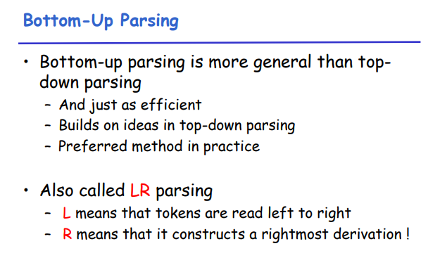

Slide 90
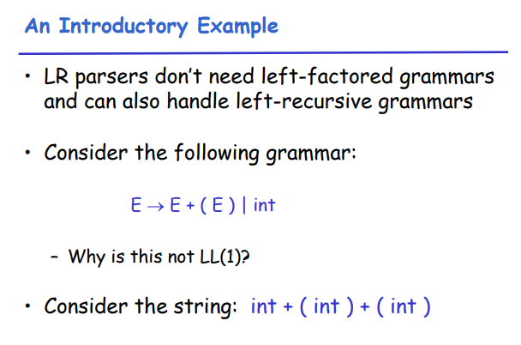

Slide 91
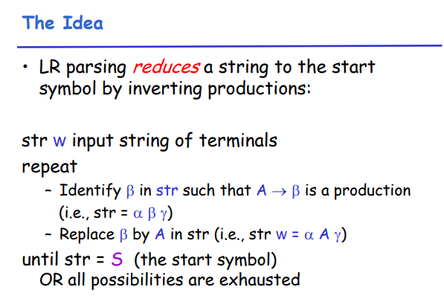

Slide 92


Slide 93


Slide 94


Slide 95


Slide 96


Slide 97

An LR parser traces a rightmost derivation in reverse

Slide 98


Slide 99


Slide 100


Slide 101


Slide 102


Slide 103


Slide 104


Slide 105


Slide 106


Slide 107


Slide 108


Slide 109


Slide 110


Slide 111


Slide 112


Slide 113


Slide 114


Slide 115
Summary
Syntax analysis is a common part of language implementation
A lexical analyzer is a pattern matcher that isolates small-scale parts of a program
  Detects syntax errors
  Produces a parse tree
A recursive-descent parser is an LL parser
Parsing problem for bottom-up parsers: find the substring of current sentential form
The LR family of shift-reduce parsers is the most common bottom-up parsing approach

