Slide 1
CHAPTER 8
STATEMENT-LEVEL CONTROL STRUCTURES
2025-2026 SPRING

Slide 2
Chapter 8 Topics
Introduction
Selection Statements
Iterative Statements
Unconditional Branching
Guarded Commands
Conclusions

Slide 3
Levels of Control Flow
Within expressions (Chapter 7)
Among program units (Chapter 9)
Among program statements (this chapter)

Slide 4
Control Statements: Evolution
FORTRAN control statements were based directly on IBM 704 hardware
Much research and argument in the 1960s about the issue
  One important result: It was proven that all algorithms represented by flowcharts can be coded with only two-way selection and pretest logical loops
A pretest logical loop (or entry-controlled loop) evaluates a boolean condition before executing the loop body. If the condition is false initially, the code block is skipped entirely, ensuring the loop runs zero or more times. Common examples include while and for loops.

Slide 5
Control Structure
A control structure is a control statement and the statements whose execution it controls
Design question
  Should a control structure have multiple entries?
A multiple-entry control structure is a programming construct that allows execution to jump into the middle of a code block or module from different locations, rather than always starting at the designated beginning.
While modern high-level programming largely relies on single-entry, single-exit (SESE) structures to ensure code readability and reliability, multiple entries were historically common in lower-level or older languages

Slide 6
Selection Statements
A selection statement provides the means of choosing between two or more paths of execution
Two general categories:
  Two-way selectors
  Multiple-way selectors

Slide 7
Two-Way Selection Statements
General form:
if control_expression
then clause
else clause
Design Issues:
  What is the form and type of the control expression?
  How are the then and else clauses specified?
  How should the meaning of nested selectors be specified?

Slide 8
The Control Expression
If the then reserved word or some other syntactic marker is not used to introduce the then clause, the control expression is placed in parentheses
In C89, C99, Python, and C++, the control expression can be arithmetic
int x = 5;
// The expression (x - 5) evaluates to 0, which is false.
if (x - 5) {
// This code will not run }
In most other languages, the control expression must be Boolean

Slide 9
Clause Form
In many contemporary languages, the then and else clauses can be single statements or compound statements
In Perl, all clauses must be delimited by braces (they must be compound)
In Python and Ruby, clauses are statement sequences
Python uses indentation to define clauses
if x > y :
x = y
print(" x was greater than y")

Slide 10
Nesting Selectors
Java example
  if (sum == 0)
if (count == 0)
result = 0;
else result = 1;
Which if gets the else?
Java's static semantics rule: else matches with the nearest previous if

Slide 11
Nesting Selectors (continued)
To force an alternative semantics, compound statements may be used:
if (sum == 0) {
if (count == 0)
result = 0;
}
else result = 1;
The above solution is used in C, C++, and C#

Slide 12
Nesting Selectors (continued)
Statement sequences as clauses: Ruby
if sum == 0 then
if count == 0 then
result = 0
else
result = 1
end
end

Slide 13
Nesting Selectors (continued)
Python
if sum == 0 :
if count == 0 :
result = 0
else :
result = 1

Slide 14
Selector Expressions
In ML, F#, and Lisp, the selector is an expression; in F#:
let y =
if x > 0 then x
else 2 * x
  - If the if expression returns a value, there must be an else clause (if the condition is false, there is no value to return). The types of the values returned by then and else clauses must be the same.

Slide 15
Multiple-Way Selection Statements
Allow the selection of one of any number of statements or statement groups
Design Issues:
  What is the form and type of the control expression?
  How are the selectable segments specified?
  Is execution flow through the structure restricted to include just a single selectable segment?
  How are case values specified?
  What is done about unrepresented expression values?

Slide 16
Multiple-Way Selection: Examples
C, C++, Java, and JavaScript
switch (expression) {
case const_expr₁: stmt₁;
…
case const_expr_{n}: stmt_{n};
[default: stmt_{n+1}]
}

Slide 17
Multiple-Way Selection: Examples
Design choices for C’s switch statement
  Control expression can be only an integer type
  Selectable segments can be statement sequences, blocks, or compound statements
  Any number of segments can be executed in one execution of the construct (there is no implicit branch at the end of selectable segments)
  default clause is for unrepresented values (if there is no default, the whole statement does nothing)

Slide 18
Multiple-Way Selection: Examples
C#
  Differs from C in that it has a static semantics rule that disallows the implicit execution of more than one segment
  Each selectable segment must end with an unconditional branch (goto or break)
  Also, in C# the control expression and the case constants can be strings

Slide 19
Multiple-Way Selection: Examples
Ruby has two forms of case
leap = case
when year % 400 == 0 then true
when year % 100 == 0 then false
else year % 4 == 0
end

Slide 20
Other case examples for Ruby
Example A:
case car
when 'toyota', 'lexus', 'honda'
puts 'Japanese brand'
when 'ford', 'gm', 'tesla'
puts 'American brand'
else
puts 'Unknown brand' end
Example B:
case score
when 90..100
puts "A"
when 80, 85, 88
puts "B (specific high B)" else
puts "Other"
end

Slide 21
Implementing Multiple Selectors
Approaches:
  Multiple conditional branches
  Store case values in a table and use a linear search of the table
  When there are more than ten cases, a hash table of case values can be used
  If the number of cases is small and more than half of the whole range of case values are represented, an array whose indices are the case values and whose values are the case labels can be used

Slide 22
Multiple-Way Selection Using if
Multiple Selectors can appear as direct extensions to two-way selectors, using else-if clauses, for example in Python:
  if count < 10 :
  bag1 = True
  elif count < 100 :
  bag2 = True
  elif count < 1000 :
  bag3 = True

Slide 23
Multiple-Way Selection Using if
The Python example can be written as a Ruby case
case
when count < 10 then bag1 = true
when count < 100 then bag2 = true
when count < 1000 then bag3 = true
end

Slide 24
Scheme’s Multiple Selector
General form of a call to COND:
(COND
(predicate₁ expression₁)
…
(predicate_{n} expression_{n})
[(ELSE expression_{n+1})]
)
  The ELSE clause is optional; ELSE is a synonym for true
  Each predicate-expression pair is a parameter
  - Semantics: The value of the evaluation of COND is the value of the expression associated with the first predicate expression that is true

Slide 25
Iterative Statements
The repeated execution of a statement or compound statement is accomplished either by iteration or recursion
General design issues for iteration control statements:
  1. How is iteration controlled?
  2. Where is the control mechanism in the loop?

Slide 26
Counter-Controlled Loops
A counting iterative statement has a loop variable, and a means of specifying the initial and terminal, and stepsize values
Design Issues:
  What are the type and scope of the loop variable?
  Should it be legal for the loop variable or loop parameters to be changed in the loop body, and if so, does the change affect loop control?
  Should the loop parameters be evaluated only once, or once for every iteration?

Slide 27
Counter-Controlled Loops: Examples
C-based languages
  for ([expr_1] ; [expr_2] ; [expr_3]) statement
- The expressions can be whole statements, or even statement sequences, with the statements separated by commas
  The value of a multiple-statement expression is the value of the last statement in the expression
  If the second expression is absent, it is an infinite loop
Design choices:
  There is no explicit loop variable
  Everything can be changed in the loop
  The first expression is evaluated once, but the other two
  are evaluated with each iteration
  - It is legal to branch into the body of a for loop in C using a goto` statement. You can goto a label located inside af or` loop's body from outside that block.

Slide 28
Counter-Controlled Loops: Examples
C++ differs from C in two ways:
  The control expression can also be Boolean
  The initial expression can include variable definitions (scope is from the definition to the end of the loop body)
Java and C#
  Differs from C++ in that the control expression must be Boolean

Slide 29
Counter-Controlled Loops: Examples
Python
  for loop_variable in object:
  - loop body
  The object is often a range, which is either a list of values in brackets ([2, 4, 6]), or a call to the range function (range(5), which returns 0, 1, 2, 3, 4)
  The loop variable takes on the values specified in the given range, one for each iteration

Slide 30
Counter-Controlled Loops: F# Examples
1. // Looping over a list.
let list1 = [ 1; 5; 100; 450; 788 ]
for i in list1 do
printfn "%d" i
2.
let seq1 = seq { for i in 1 .. 10 -> (i, i*i) }
for (a, asqr) in seq1 do
printfn "%d squared is %d" a asqr
3.
for i in 1 .. 10 do
printf "%d " i
printfn ""

Slide 31
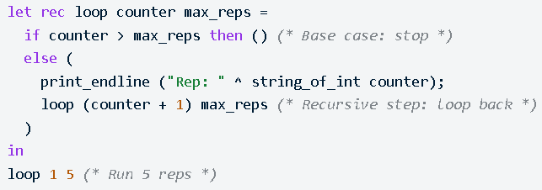
Counter-Controlled Loops: Examples .n OCaml
In OCaml, let rec defines a recursive function that can call itself, acting as a loop, often replacing traditional for loops. Recursive loops typically include an accumulator or state that is passed back into the next iteration ("loopBack") until a base case ends the repetition.

Slide 32
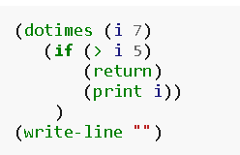
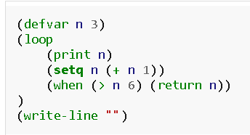
Counter-Controlled Loops: Examples in Lisp
1. 2.

Slide 33
Logically-Controlled Loops
Repetition control is based on a Boolean expression
Design issues:
  Pretest or posttest?
  Should the logically controlled loop be a special case of the counting loop statement or a separate statement?

Slide 34
Logically-Controlled Loops: Examples
C and C++ have both pretest and posttest forms, in which the control expression can be arithmetic:
while (control_expr) do
loop body loop body
while (control_expr)
- In both C and C++ it is legal to branch into the body
of a logically-controlled loop
Java is like C and C++, except the control expression must be Boolean (and the body can only be entered at the beginning -- Java has no goto )

Slide 35
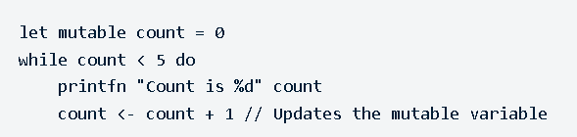
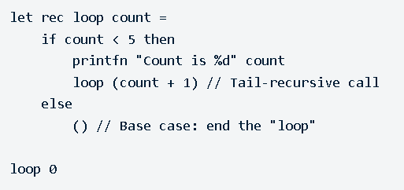
Logically-Controlled Loops: Examples in F#
A.
B.

Slide 36
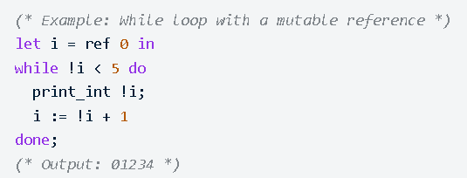
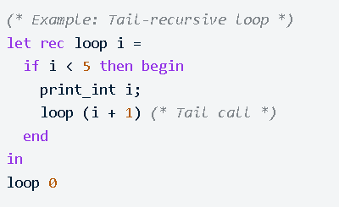
Logically-Controlled Loops: Examples in OCaml
A.
B.

Slide 37
User-Located Loop Control Mechanisms
Sometimes it is convenient for the programmers to decide a location for loop control (other than top or bottom of the loop)
Simple design for single loops (e.g., break)
Design issues for nested loops
  Should the conditional be part of the exit?
  Should control be transferable out of more than one loop?

Slide 38
User-Located Loop Control Mechanisms
C , C++, Python, Ruby, and C# have unconditional unlabeled exits (break)
Java and Perl have unconditional labeled exits (break in Java, last in Perl)
C, C++, and Python have an unlabeled control statement, continue, that skips the remainder of the current iteration, but does not exit the loop
Java and Perl have labeled versions of continue

Slide 39
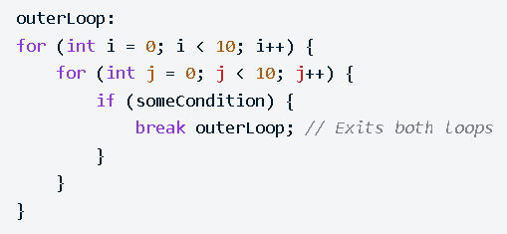
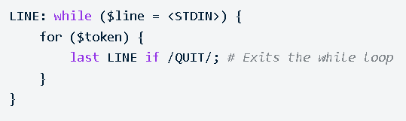
Java:
Perl uses the last keyword (which is equivalent to break in other languages) combined with a label to exit a specific loop block.

Slide 40
Iteration Based on Data Structures
The number of elements in a data structure controls loop iteration
Control mechanism is a call to an iterator function that returns the next element in some chosen order, if there is one; else loop is terminated
C's for can be used to build a user-defined iterator:
for (p=root; p!=NULL; traverse(p)){
...
}

Slide 41
Iteration Based on Data Structures (continued)
PHP
- current points at one element of the array
- next moves current to the next element
- reset moves current to the first element
Java 5.0 (uses for, although it is called foreach)
For arrays and any other class that implements the Iterable interface, e.g., ArrayList
  for (String myElement : myList) { … }

Slide 42
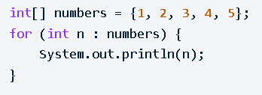
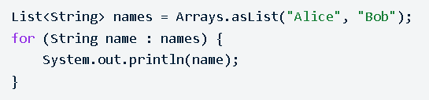
Introduced in Java 5 (JDK 1.5), the enhanced for loop (commonly known as "for-each") provides a cleaner, more readable syntax for iterating through arrays and collections. While termed "for-each," it uses the keyword for, eliminating the need for manual indexing, counters, or iterators to access elements

Slide 43
Iteration Based on Data Structures (continued)
C# and F# (and the other .NET languages) have
generic library classes, like Java 5.0 (for arrays,
lists, stacks, and queues). Can iterate over
these with the foreach statement. User-defined
collections can implement the IEnumerator
interface and also use foreach.
List<String> names = new List<String>();
names.Add("Bob");
names.Add("Carol");
names.Add("Ted");
foreach (String name in names)
Console.WriteLine ("Name: {0}", name);

Slide 44
Iteration Based on Data Structures (continued)
Ruby blocks are sequences of code, delimited by either braces or do and end
  Blocks can be used with methods to create iterators
  Predefined iterator methods (times, each, upto):
3.times {puts ″Hey!″}
list.each {|value| puts value}
(list is an array; value is a block parameter)
1.upto(5) {|x| print x, ″ ″}
  Iterators are implemented with blocks, which can also be defined by applications

Slide 45
Iteration Based on Data Structures (continued)
Ruby blocks are attached methods calls; they can have parameters (in vertical bars); they are executed when the method executes a yield statement
def fibonacci(last)
first, second = 1, 1
while first <= last
yield first
first, second = second, first + second
end
end
puts "Fibonacci numbers less than 100 are:"
fibonacci(100) {|num| print num, " "}
puts
  - Ruby has a for statement, but Ruby converts them to upto method calls

Slide 46
Unconditional Branching
Transfers execution control to a specified place in the program
Represented one of the most heated debates in 1960’s and 1970’s
Major concern: Readability
Some languages do not support goto statement (e.g., Java)
C# offers goto statement (can be used in switch statements)
Loop exit statements are restricted and somewhat camouflaged goto’s

Slide 47
Guarded Commands
Designed by Dijkstra
Purpose: to support a new programming methodology that supported verification (correctness) during development
Basis for two linguistic mechanisms for concurrent programming (in CSP)
Basic Idea: if the order of evaluation is not important, the program should not specify one

Slide 48
Guarded commands are a fundamental programming construct introduced by Edsger Dijkstra in 1975 to support nondeterminism and facilitate the formal verification of programs. They are the core building blocks of the Guarded Command Language (GCL), designed to make program development and mathematical proofs of correctness go hand-in-hand.
A guarded command consists of a guard (a boolean expression B) and a command (a statement S), typically written as: B→S. The statement (S) is only eligible for execution if its guard (B) is true.

Slide 49
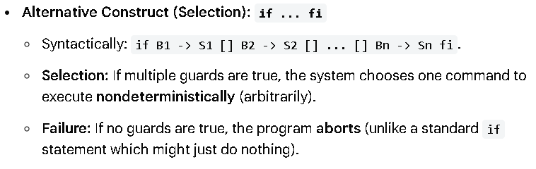
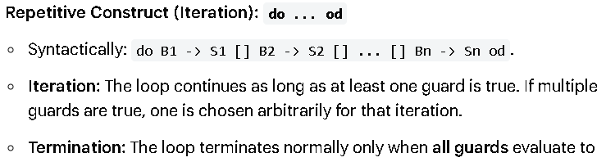
False.

Slide 50
Selection Guarded Command
Form
  if <Boolean expr> -> <statement>
  [] <Boolean expr> -> <statement>
  ...
  [] <Boolean expr> -> <statement>
  fi
Semantics: when construct is reached,
  Evaluate all Boolean expressions
  If more than one are true, choose one non-deterministically
  If none are true, it is a runtime error

Slide 51
Loop Guarded Command
Form
  do <Boolean> -> <statement>
  [] <Boolean> -> <statement>
  ...
  [] <Boolean> -> <statement>
  od
Semantics: for each iteration
  Evaluate all Boolean expressions
  If more than one are true, choose one non-deterministically; then start loop again
  If none are true, exit loop

Slide 52
Guarded Commands: Rationale
Connection between control statements and program verification is intimate
Verification is impossible with goto statements
Verification is possible with only selection and logical pretest loops
Verification is relatively simple with only guarded commands

Slide 53
Conclusions
Variety of statement-level structures
Choice of control statements beyond selection and logical pretest loops is a trade-off between language size and writability
Functional and logic programming languages use quite different control structures

